Slide 1
Korean4 class week4
Yery Kim

Slide 2
Index
Review
Conversation
Today’s Words
Counters + ‘몇’

Slide 3
PPT PRESENTATION Enjoy your stylish business and campus life with BIZCAM
Exercise 1.
Change the following verb or adjective into the short form negation using the negative 안.
Then translate the sentence.
Example: 텔레비전을 (보다) [tellebijeoneul boda]
⇒ 텔레비전을 안 봐요. [tellebijeoneul an bwayo]
“(I) do not watch TV”
김치를 (사다) [gimchireul sada]
(2) 저녁을 (먹다) [jeonyeogeul meokda]
(3) 방이 (크다) [bangi keuda]
김치를 안 사요. [gimchireul an sayo] “(I) do not buy kimchi”
저녁을 안 먹어요. [jeonyeogeul an meogeoyo] “(I) do not eat dinner”
방이 안 커요. [bangi an keoyo] “Room is not big”

Slide 4
PPT PRESENTATION Enjoy your stylish business and campus life with BIZCAM
Exercise 2. Change the following verb or adjective into the short form negation using the negative 못.
Then translate the sentence.
Example: 공포 영화를 (보다) [gongpo yeonghwareul boda]
⇒ 공포 영화를 못 봐요. [gongpo yeonghwareul mot bwayo]
“(I) cannot see a horror movie”
도서관에서 책을 (빌리다) [doseogwaneseo chaegeul billida]
(2) 아버지한테 (전화하다) [abeojihante jeonhwahada]
(3) 문을 (열다) [muneul yeolda]
도서관에서 책을 못 빌려요. [doseogwaneseo chaegeul mon billyeoyo]
“(I) cannot borrow book in the library”
아버지한테 못 전화해요. [abeojihante mon jeonhwahaeyo]
“(I) cannot call to my father”
문을 못 열어요. [muneul mon yeoreoyo] “(I) cannot open the door”

Slide 5
PPT PRESENTATION Enjoy your stylish business and campus life with BIZCAM
Exercise 3. Answer the following questions with the long form negation.
Example: 햄버거 먹어요? [haembeogeo meogeoyo]
“(Do you) eat hamburgers?”
⇒ 아니오, 먹지 않아요. [anio, meokji anayo]
“No, (I) do not eat (it)”
한국어를 배워요? [hangugeoreul baewoyo] “(Do you) learn Korean?
(2) 시험이 어려워요? [siheomi eoryeowoyo] “Is the test difficult?”
(3) 피곤해요? [pigonhaeyo] “(Are you) tired?”
아니오, 배우지 않아요. [anio, baeuji anayo] “No, (I) do not learn (it)”
아니오, 어렵지 않아요. [anio, eoryeopji anayo] “No, (It) is not difficult”
아니오, 피곤하지 않아요. [anio, pigonhaji anayo] “No, (I) am not tired”

Slide 6
PPT PRESENTATION Enjoy your stylish business and campus life with BIZCAM
◼ Vocabulary
건너다 [geonneoda] v. cross/ go over
아버지 [abeoji] n. father
내일 [naeil] n. tomorrow
늦게 [neutge] adv. lately
도서관 [doseogwan] n. library
마시다 [masida] v. drink
만나다 [mannada] v. meet
말하다 [malhada] v. speak
바쁘다 [bappeuda] adj. to be busy
버리다 [beorida] v. throw away
병원 [byeongwon] n. hospital
보내다 [bonaeda] v. send
부르다 [bureuda] v. call out/ sing
비싸다 [bissada] adj. to be expensive
빌리다 [billida] v. borrow
사다 [sada] v. buy
쉬다 [swida] v. rest
식당 [sikdang] n. cafeteria
신다 [sinda] v. wear (shoes)
쓰다 [sseuda] v. use/ write
쓰레기 [sseuregi] n. garbage
씻다 [ssitda] v. wash
팔다 [palda] v. sell
타다 [tada] v. ride

Slide 7
PPT PRESENTATION Enjoy your stylish business and campus life with BIZCAM
◼ Conversation
선우[sunwoo]:
안녕하세요. 처음 뵙겠습니다. [annyeonghaseyo. cheoeum boepgetseumnida.]
Hello. Nice to meet you.
은서[eunseo]:
안녕하세요. 커피 드실래요? [annyeonghaseyo. keopi deusillaeyo?]
Hello. Do you want some coffee?
선우[sunwoo]:
아니오, 저는 커피를 안 마셔요. 차 한 잔 주시겠어요?
[anio, jeoneun keopireul an masyeoyo. cha han jan jusigesseoyo?]
No, I don’t drink the coffee. Can you give me a cup of tea?

Slide 8
PPT PRESENTATION Enjoy your stylish business and campus life with BIZCAM
은서[eunseo]:
네, 여기요. 혹시 저번에 제안한 건 생각해보셨나요?
[ne, yeogiyo. hoksi jeobeone jeanhan geon saenggakaebosyeonnayo?]
Yes, here it is. Have you thought about what I suggested last time?
선우[sunwoo]:
네. 근데 아무래도 저는 못 할 것 같아요. 요즘에 다른 일들로 너무 바빠서요.
[ne. geunde amuraedo jeoneun mot hal geot gatayo. yojeume dareun ildeullo neomu bappaseoyo.]
Yes. But I think I cannot do it. I’m so busy with other things these days.
은서[eunseo]:
아, 그렇군요. 알겠습니다. [a, geureokunyo. algetseumnida.]
Oh, I got it. Okay.

Slide 9
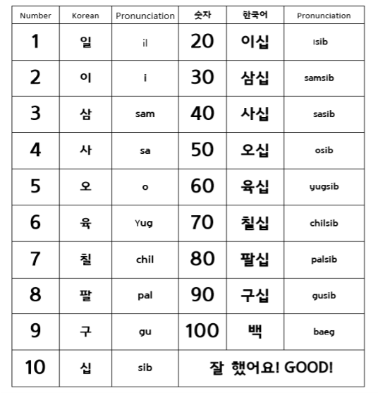
PPT PRESENTATION Enjoy your stylish business and campus life with BIZCAM
Chinese number
0 : 영 [yeong] / 공 [gong]
22
78
141
300
이십이 [i-sib-i]
칠십팔 [chil-sib-pal]
백사십일 [baek-sa-sib-il]
삼백 [sam-baek]

Slide 10
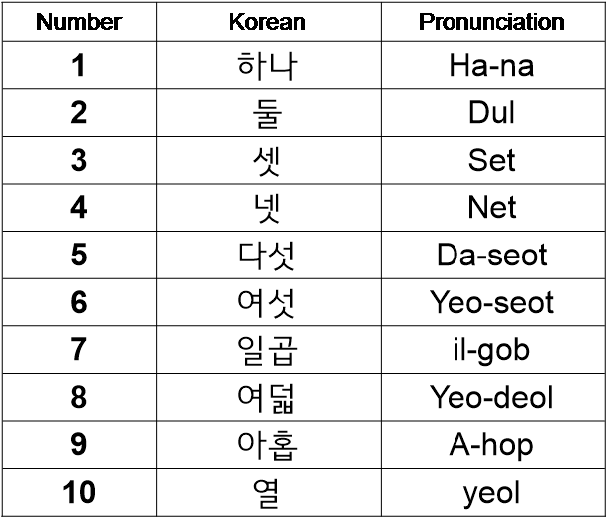
PPT PRESENTATION Enjoy your stylish business and campus life with BIZCAM
2. Korean number
Number | Korean | Pronunciation
0 | 영 | Yeong
20 | 스물 | Seu-mul
30 | 서른 | Seo-reun
40 | 마흔 | Ma-heun
50 | 쉰 | shin
60 | 예순 | Ye-sun
70 | 일흔 | il-heun
80 | 여든 | Yeo-deun
90 | 아흔 | A-heun

Slide 11
PPT PRESENTATION Enjoy your stylish business and campus life with BIZCAM
Chinese number
Counting number
Date : day (일 [il]) , month (월 [wol]) , year (년[nyeon])
  ex) 4th : 사일[sa-il], 12nd : 십이일[sib-i-il]
Phone number
  ex) 010-6372-0819 / 776-079-455
2. Korean number
Counting number
Counting age
Counting materials (paper, piece, things, etc)
-Time

Slide 12
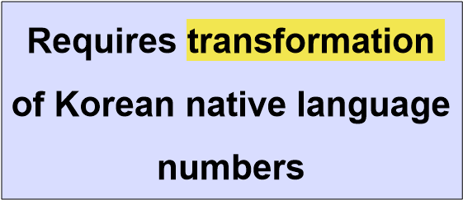
PPT PRESENTATION Enjoy your stylish business and campus life with BIZCAM
살 [sal] : age
개 [gae] : things
장 [jang] : sheet
조각 [jo-gak] : piece
Number

Slide 13
PPT PRESENTATION Enjoy your stylish business and campus life with BIZCAM
2. Korean number
Number | Korean | Pronunciation
1 | 한 | Han
2 | 두 | Du
3 | 세 | Se
4 | 네 | Ne
5 | 다섯 | Da-seot
6 | 여섯 | Yeo-seot
7 | 일곱 | il-gob
8 | 여덟 | Yeo-deol
9 | 아홉 | A-hop
10 | 열 | yeol
Number | Korean | Pronunciation
0 | 영 | Yeong
20 | 스무 | Seu-mu
30 | 서른 | Seo-reun
40 | 마흔 | Ma-heun
50 | 쉰 | shin
60 | 예순 | Ye-sun
70 | 일흔 | il-heun
80 | 여든 | Yeo-deun
90 | 아흔 | A-heun

Slide 14
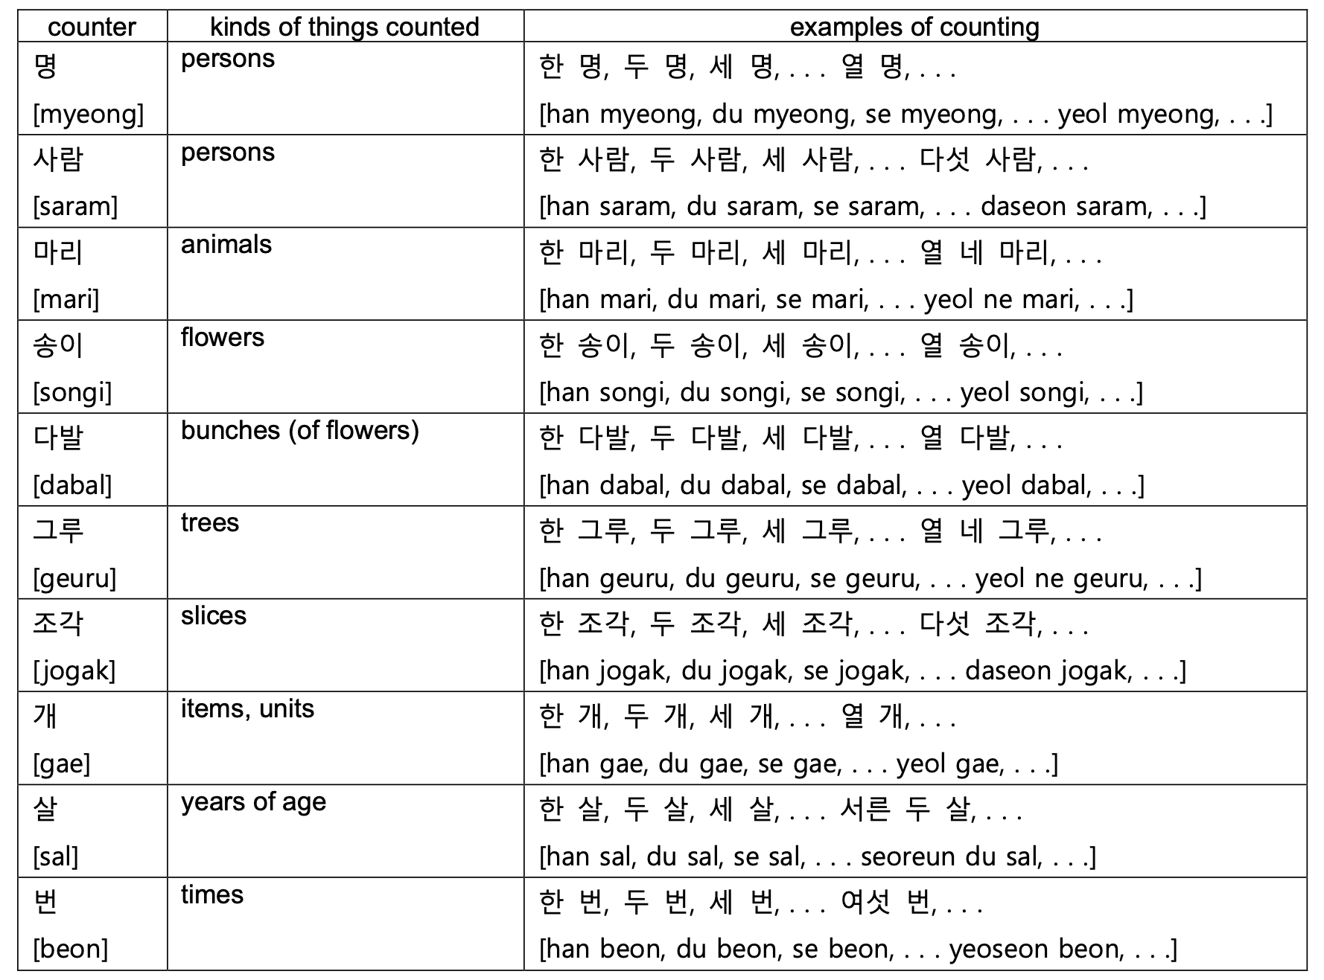
PPT PRESENTATION Enjoy your stylish business and campus life with BIZCAM

Slide 15
PPT PRESENTATION Enjoy your stylish business and campus life with BIZCAM
1 years old : 한 살 [han-sal]
2 years old : 두 살 [du-sal]
3 years old : 세 살 [se-sal]
4 years old : 네 살 [ne-sal]
20 years old : 스무 살 [seu-mu-sal]
Q. How old are you? 너 몇 살이야? [neo myeot-sal-i-ya?]
A. I’m 22 years old. 나는 스물 두살이야. [na-neun seu-mul-du-sal-i-ya.]

Slide 16
PPT PRESENTATION Enjoy your stylish business and campus life with BIZCAM
1 thing : 한 개 [han-gae]
2 things : 두 개 [du-gae]
3 things : 세 개 [se-gae]
4 things : 네 개 [ne-gae]
20 things : 스무 개 [seu-mu-gae]
Two apples please : 사과 두 개 주세요. [sa-gwa du-gae ju-se-yo.]
How much is four chocolates? : 초콜릿 네 개 얼마예요? [cho-kol-lit ne-gae eol-ma-ye-yo?]

Slide 17
PPT PRESENTATION Enjoy your stylish business and campus life with BIZCAM
1 sheet of paper : 한 장 [han-jang]
2 sheets of paper : 두 장 [du-jang]
3 sheets of paper : 세 장 [se-jang]
4 sheets of paper : 네 장 [ne-jang]
20 sheets of paper : 스무 장 [seu-mu-jang]
I have to write a report for today's assignment.
: 오늘 과제로 보고서 한 장 써야해.
[o-neul gwa-je-ro bo-go-seo han-jang sseo-ya-hae.]

Slide 18
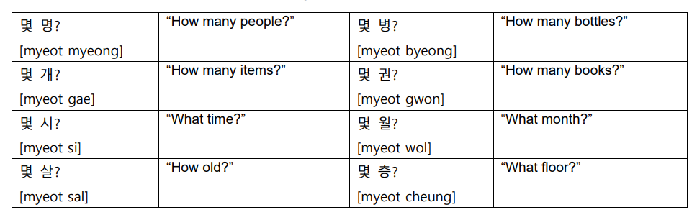
Question word [몇]
◼ Question word [몇]
Korean has a question word 몇[myeot] “how many.”
The word cannot be used on its own but must precede a counter.
For example, a specific question expression such as “how many people” would be 몇 명[myeot myeong], “how many months” would be 몇 달[myeot dal] and so on.

Slide 19
Time
Koreans use native Korean numbers for
시[si] “o’clock”
분[bun] “minutes”
초[Cho] “seconds”
For A.M
오전[ojeon] “before noon”
아침[achim] “morning”
For P.M
오후[ohu] “afternoon,”
저녁[jeonyeok] “evening,”
밤[bam] “night”
To say half past, you can either say
1) “삼십 분[samsip bun]”
2)반[ban], meaning “a half”

Slide 20
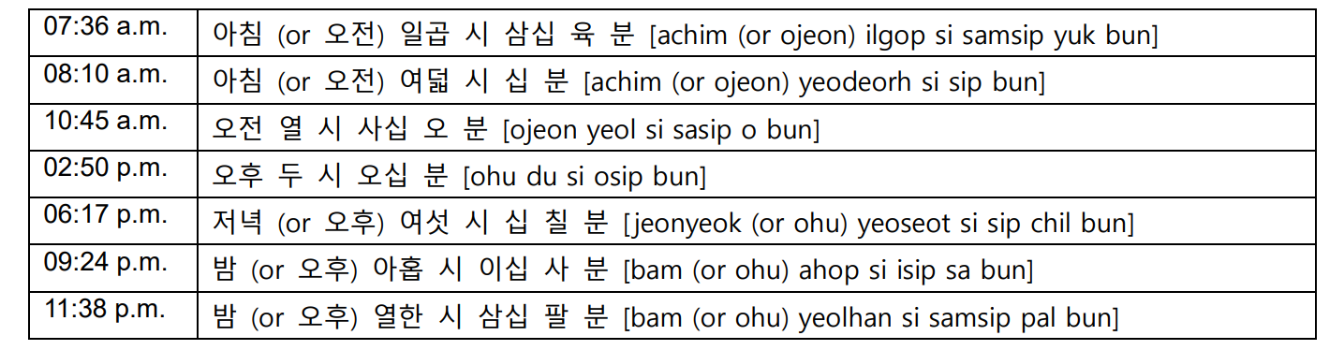
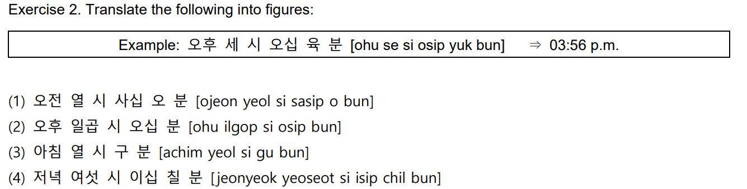
Time- Let’s practice
10 : 45 a.m
7: 50 p.m
10 : 09 a.m
6 :27 p.m

Slide 21
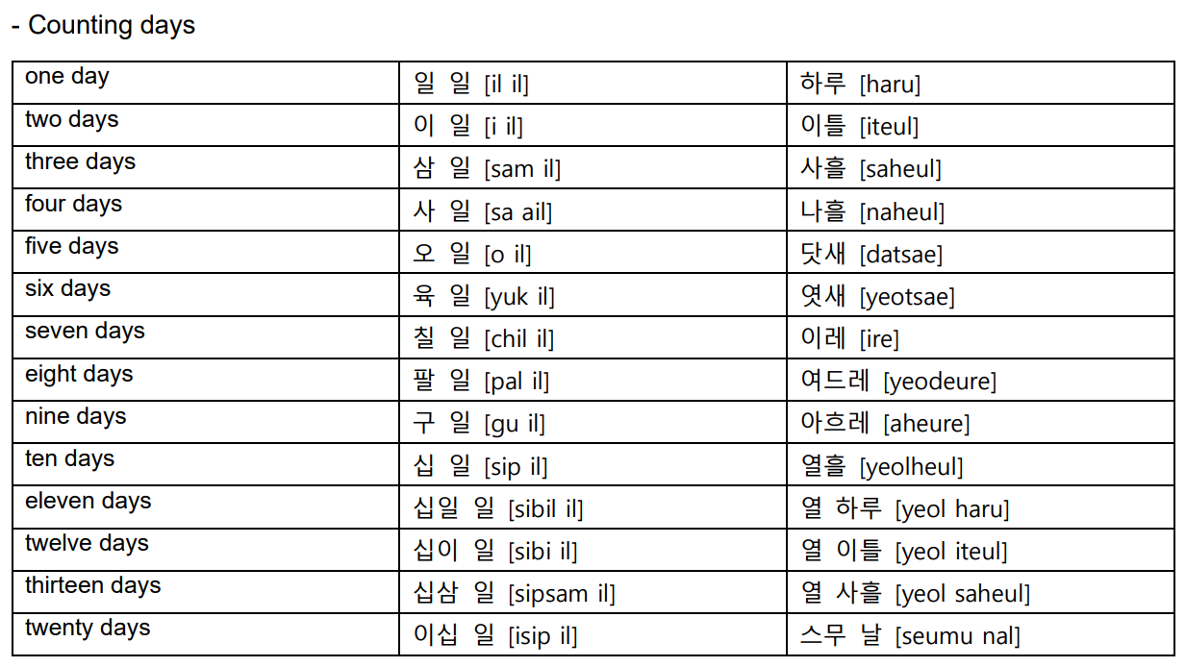
Counting days

Slide 22
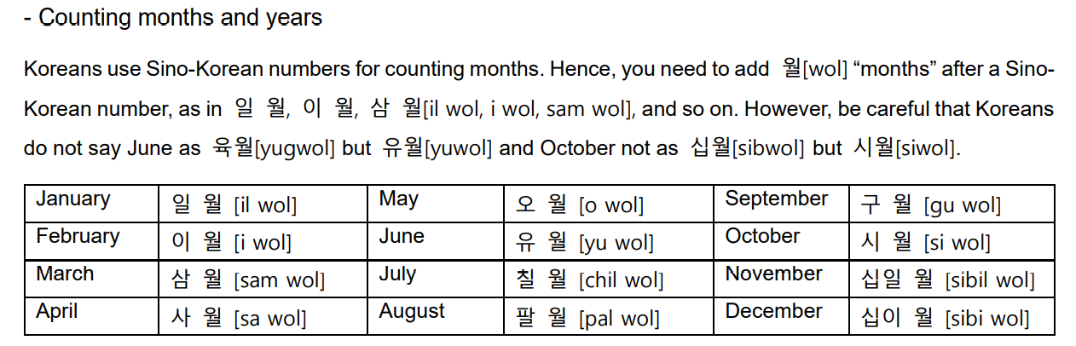
Counting months and years

Slide 23
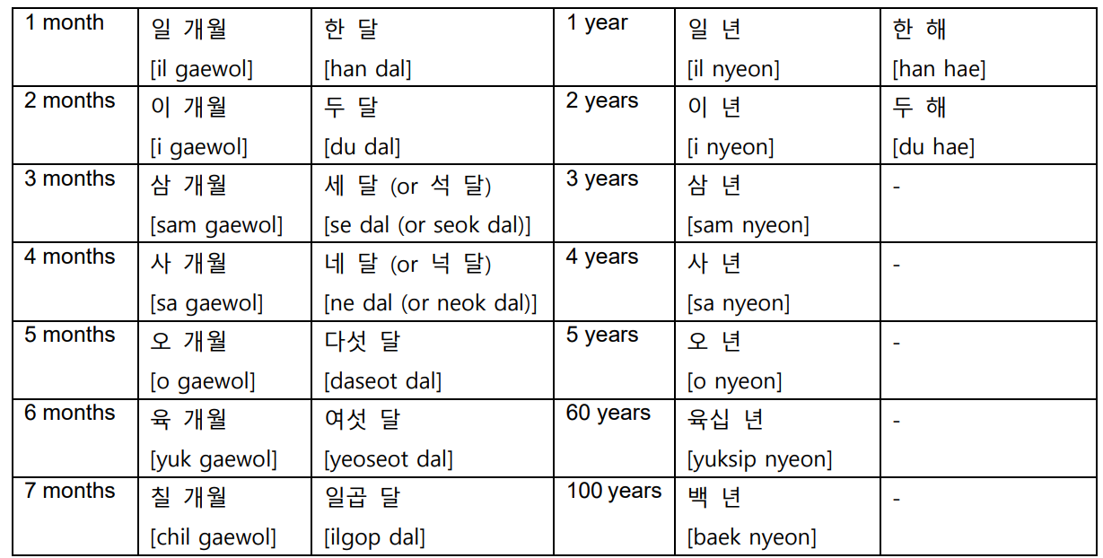
Counting months and years
When counting with Chinese numbers, you add 개월[gaewol] after the number
When counting with native Korean numbers, you add 달[dal] after the number
For years, Koreans normally use Chinese numbers with 년[nyeon] “year,”
They use native Korean numbers for years only for small numbers, such as 한 해[han hae] and 두 해[du hae]

Slide 24
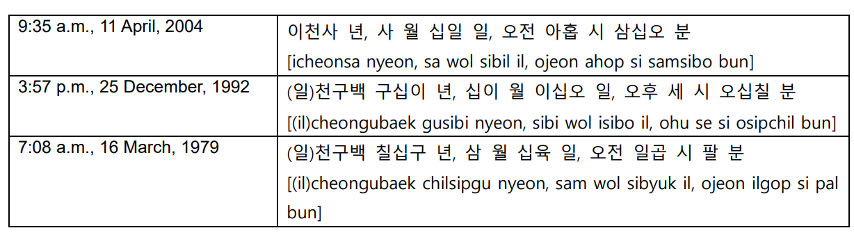

Order of Korean number
Koreans give dates starting from the largest unit to the smallest
This is the opposite of the English expression
Ex) “2:19 p.m., 18 May, 1970”
“(일)천구백 칠십년 오월 십팔일,오후 두 시 십구 분”
[(il)cheongubaek chilsimnyeon owol sipparil, ohu du si sip gu bun]

Slide 25
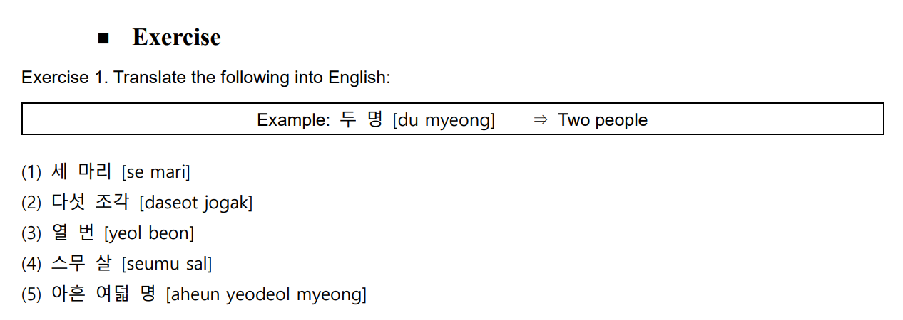
Practice
Three animals
Five slices (pieces)
Ten times
Twenty years of age
Ninety eight people

Slide 26
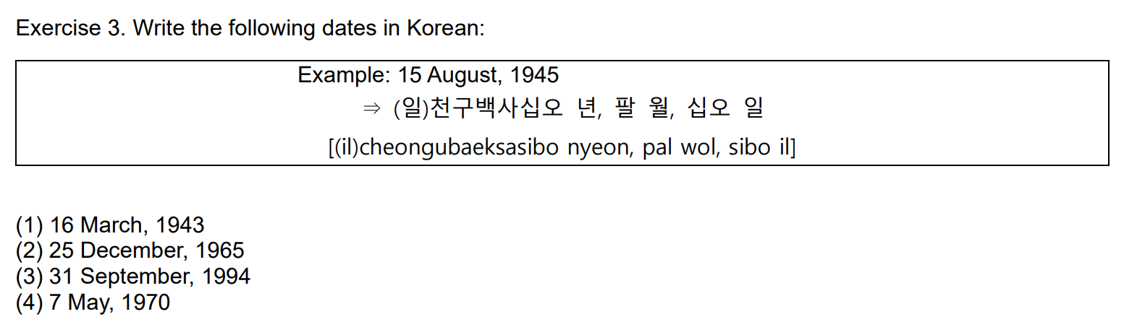
Practice
(일)천구백사십삼 년, 삼 월, 십육 일
(일)천구백육십오 년, 십이 월, 이십오 일
(일)천구백구십사 년, 구 월, 삼십일 일
(일)천구백칠십 년, 오 월, 칠 일

Slide 27
Conversation
선우:
언니, 교수님 언제 만나기로 했어? [eonni, gyosunim eonje mannagiro haesseo]
Sister, when did you decide to meet the professor?
은서:
다음주 월요일. 왜? [daeumju woryoil. wae]
Next Monday. Why?
선우:
곧 혜주 생일이잖아. 6월 1일이 혜주 생일이야.
[got hyeju saengirijana. 6wol 1iri hyeju saengiriya.]
Hyeju’s birthday is coming. June 1st is Hyeju’s birthday.
은서:
그렇구나. 그럼 6월에 다같이 여행 가는 거 어때?
[geureokuna. geureom 6wore dagachi yeohaeng ganeun geo eottae]
I got it. Then how about going a trip together in June?

Slide 28
Conversation
선우:
좋지. 우리 크로아티아 가자! 6월 3일에 떠나는 거 어때?
[jochi. uri keuroatia gaja! 6wol 3ire tteonaneun geo eottae]
Good. Let’s go Croatia! How about leaving on June 3rd?
은서 :
좋아. 애들이랑 다같이 얘기해보자.
[joa. aedeurirang dagachi yaegihaeboja.]
Okay. Let’s talk all together.

Slide 29
Learning Sentences
1. 몇 시에 만날까요? [myeot sie mannalkkayo]
What time shall we meet?
2. 6시 45분이에요. [6si 45bunieyo]
It’s quarter to seven.
3. 오늘이 무슨 요일이죠? [oneuri museun yoirijyo]
What day is it today?
4. 생일이 언제십니까? [saengiri eonjesimnikka]
When is your birthday?
5. 다음 모임은 7월 15일 화요일입니다. [daeum moimeun 7wol 15il hwayoirimnida.]
The next meeting will be on Tuesday, July 15th.
6. 우리 휴가가 언제 시작이지? [uri hyugaga eonje sijagiji]
What date does our vacation start?

Slide 30
Learning Sentences
7. 매월 둘째, 넷째 월요일에 피아노 레슨이 있습니다.
[maewol duljjae, netjjae woryoire piano reseuni itseumnida.]
I have piano lessons on the 2nd and the 4th Mondays of each month.
8. 언제 서울에 도착했습니까? [eonje seoure dochakaetseumnikka]
When did you arrive in Seoul?
9. 가장 편한 시간은 언제세요? [gajang pyeonhan siganeun eonjeseyo]
When is the most convenient time for you?
10. 벌써 6시가 넘었어요. [beolsseo 6siga neomeosseoyo]
It’s already after six.

Slide 31
Thank you

