Slide 1
British and American Drama After 1945
28 March 2022 dr. Tomáš Kačer (kacer@phil.muni.cz)
Introduction
Post-war American drama
1956 and all that in Great Britain
“Solitaire” playwrights
Playwrights of emancipation
In-yer-face and other later developments

Slide 2
Introduction
Influences of pre-WWII drama
USA
_{Broadway}
_{Eugene O’Neill}
_{Great Britain}
_{Bernard Shaw}
The well-made play tradition (Coward, Rattigan)

Slide 3
Definitions (genres, styles)
Theatre of the Absurd: theatre that presents the world as unknowable, random and unpredictable.
Community Theatre: often performed in places where people gather to socialise, dealing with local and community issues using local people as actors.
Poetic Drama: plays written in verse form.
Documentary theatre: a drama involving actual documentary and verbatim materials (such as transcripts of historical speeches).
Smart, John: Twentieth Century British Drama, Cambridge: CUP, 2001.

Slide 4
Post-war American drama
Arthur Miller
Tennessee Williams
Edward Albee

Slide 5
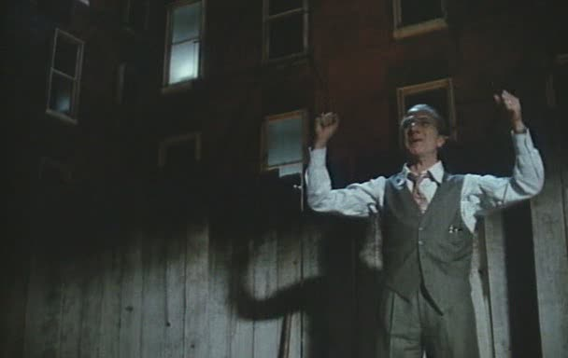
A. Miller 1915-2005
The moral imperative
1949: All My Sons
1949: Death of a Salesman
1953: The Crucible
Notes:
AMS: Joe Keller; DoS: Willy Loman (Biff + Happy); Cru: 1693, Abigail Williams, John Proctor

Slide 6
CHARLEY: Nobody dast blame this man. You don’t understand: Willy was a salesman. And for a salesman, there is no rock bottom to the life. He don’t put a bolt to a nut, he don’t tell you the law or give you medicine. He’s a man way out there in the blue, riding on a smile and a shoeshine. And when they start not smiling back—that’s an earthquake. And then you get yourself a couple of spots on your hat, and you’re finished. Nobody dast blame this man. A salesman is got to dream, boy. It comes with the territory.
BIFF: Charley, the man didn’t know who he was.
HAPPY […]: All right, boy. I’m gonna show you and everybody else that Willy Loman did not die in vain. He had a good dream. It’s the only dream you can have—to come out number-one man. He fought it out here, and this is where I’m gonna win it for him
(Miller: Death of a Salesman, Requiem)

Slide 7
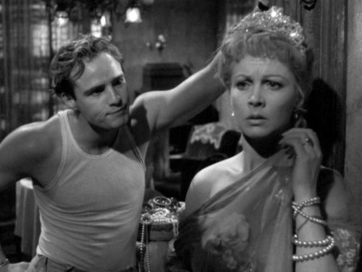
T. Williams 1911-1983
the intimate South
1944: The Glass Menagerie
1947: A Streetcar Named Desire
1955: Cat on a Hot Tin Roof
Notes:
GM: Wingfield: Tom, Laura, Amanda (mother); SND: Blance duBois; Stanley+Stella Kowalski; Cat: Margaret, Brick, Big Daddy

Slide 8
[…] The apartment faces an alley and is entered by a fire-escape, a structure whose name is a touch of accidental poetic truth, for all of these huge buildings are always burning with the slow and implacable fires of human desperation. The fire-escape is included in the set - that is, the landing of it and steps descending from it.
The scene is memory and is therefore non-realistic. Memory takes a lot of poetic licence. It omits some details; others are exaggerated, according to the emotional value of the articles it touches, for memory is seated predominantly in the heart. The interior is therefore rather dim and poetic. […]
TOM: Yes, I have tricks in my pocket, I have things up my sleeve. But I am the opposite of a stage magician. He gives you illusion that has the appearance of truth. I give you truth in the pleasant disguise of illusion.
To begin with, I turn back time. I reverse it to that quaint period, the thirties, when the huge middle class of America was matriculating in a school for the blind. Their eyes had failed them or they had failed their eyes, and so they were having their fingers pressed forcibly down on the fiery Braille alphabet of a dissolving economy. […] The play is memory.
Being a memory play, it is dimly lighted, it is sentimental, it is not realistic. […]
I am the narrator of the play, and also a character in it. The other characters are my mother Amanda, my sister Laura and a gentleman caller who appears in the final scenes.
(Williams: The Glass Menagerie, opening lines)

Slide 9
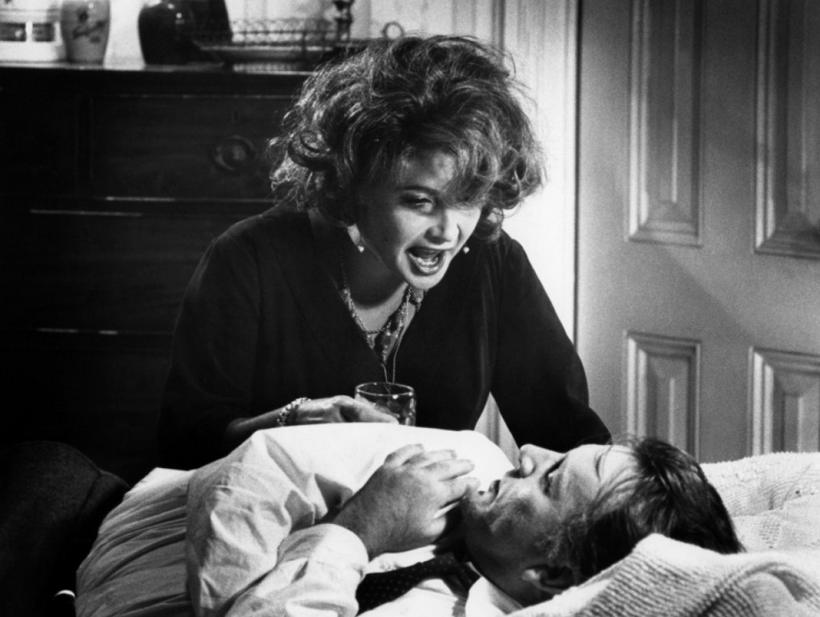
E. Albee 1928-
American Absurdist drama
1958: The Zoo Story
1962: Who’s Afraid of Virginia Woolf?
2002: The Goat, or Who Is Sylvia?
Notes:
Zoo: Peter and Jerry; VW: Martha+George (Taylor, Burton), Nick+Honey; Goat: Martin, Stevie (wife), Billy (son)

Slide 10
STEVIE Tell me! Tell me!
MARTIN Her name is Sylvia!
STEVIE Sylvia? Who is Sylvia?
MARTIN She’s a goat; Sylvia is a goat! (Acting manner dropped; normal tone now; serious, flat) She’s a goat.
STEVIE (Long pause; she stares, finally smiles. She giggles, chortles, moves toward the hall; normal tone) You’re too much! (Exits)
MARTIN I am? (Shrugs; to himself) You try to tell them; you try to be honest. What do they do? They laugh at you. […]
(Albee – The Goat; or, Who Is Sylvia? Scene 1.)

Slide 11
Great Britain: 1956 and after
Foreign influences
Bertolt Brecht, Samuel Beckett
The Royal Court Theatre
John Osborne: Look Back in Anger (1956)
kitchen-sink realism
social themes
1963: National Theatre opens
1968: abolition of censorship
Notes:
Jimmy Porter, Alison; George Devine – the right to fail

Slide 12
JIMMY: Have you ever seen her brother? Brother Nigel? The straight-backed, chinless wonder from Sandhurst? I only met him once myself. He asked me to step outside when I told his mother she was evil minded.
CLIFF: And did you?
JIMMY: Certainly not. He's a big chap. Well, you've never heard so many well-bred commonplaces come from beneath the same bowler hat. The Platitude from Outer Space—that's brother Nigel. He'll end up in the Cabinet one day, make no mistake. But somewhere at the back of that mind is the vague knowledge that he and his pals have been plundering and fooling everybody for generations. (Going upstage, and turning.) […] Besides, he's a patriot and an Englishman, and he doesn't like the idea that he may have been selling out his countryman all these years, so what does he do? The only thing he can do—seek sanctuary in his own stupidity. […] Don't you worry, he'll make it. And, what's more, he'll do it better than anybody else!
There is no sound, only the plod of Alison's iron. Her eyes are fixed on what she is doing. Cliff stares at the floor. His cheerfulness has deserted him for the moment. Jimmy is rather shakily triumphant. […]
(conversationally) Yes, that’s the little woman’s family. You know Mummy and Daddy, of course. And don’t let the Marquess of Queensbury manner fool you. They’ll kick you in the groin while you’re handing your hat to the maid.
(Osborne: Look Back in Anger, act 1)

Slide 13
“Solitaire” playwrights (GB)
Harold Pinter
Tom Stoppard
Michael Frayn
Martin Crimp

Slide 14
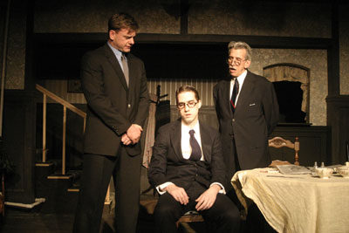
H. Pinter 1930-2008
Theatre of the absurd (Pinter’s comedy of menace)
1957: The Birthday Party
memory plays
1978: Betrayal
political plays
1996: Ashes to Ashes
Notes:
BP: Stanley – Goldberg, McCann; Betrayal; A2A – Rebecca remembering the Holocaust

Slide 15
In an essay on Kafka, Ionesco defined his understanding of the term as follows: ‘Absurd is that which is devoid of purpose.… Cut off from his religious, metaphysical, and transcendental roots, man is lost; all his actions become senseless, absurd, useless.’
This sense of metaphysical anguish at the absurdity of the human condition is, broadly speaking, the theme of the plays of Beckett, Adamov, Ionesco, Genet, and the other writers discussed in this book. But it is not merely the subject-matter that defines what is here called the Theatre of the Absurd. […]
The Theatre of the Absurd strives to express its sense of the senselessness of the human condition and the inadequacy of the rational approach by the open abandonment of rational devices and discursive thought.
(Esslin, The Theatre of the Absurd, 22-23)

Slide 16
[The two characters sit at opposite sides of a kitchen table in a house that seems to belong to their dead employer. Beth, in her late 40s, never looks at Duff. Neither appears to hear the other’s voice.]
DUFF: … I thought you would come into my arms and kiss me, even .. Offer yourself to me. I would have had you in fron of the dog, like a man, in the hall, on the stone, banging the gong, mind you don’t get the scissors up your arse, or the thimble, don’t worry, I’ll throw them for the dog to chase, the thimble will keep the dog happy, he‘ll play with it with his paws, you‘ll plead with me like a woman, I’ll bang the gong on the floor, if the sound is too flat, lacks resonance, I’ll hang it back on its hoko, bang you against it swiging, gonging, waking the place up, calling them all for diner, lunch is up, bring out the bacon, bang your lovely head, mind the dog doesn’t swallow the thimble, slam – (silence)
BETH: He lay above me and looked down at me. He supported my shoulder. (pause) So tender his touch on my nceck. So softly his kiss on my cheek. (pause) My hand on his rib. (pause) So sweetly the sand over me. Tiny the sand on my skin. (pause) So silent the sky in my eyes. Gently the sound of the tide. (pause) Oh my true love I said.
(Pinter: Landscape (1968): closing lines)

Slide 17
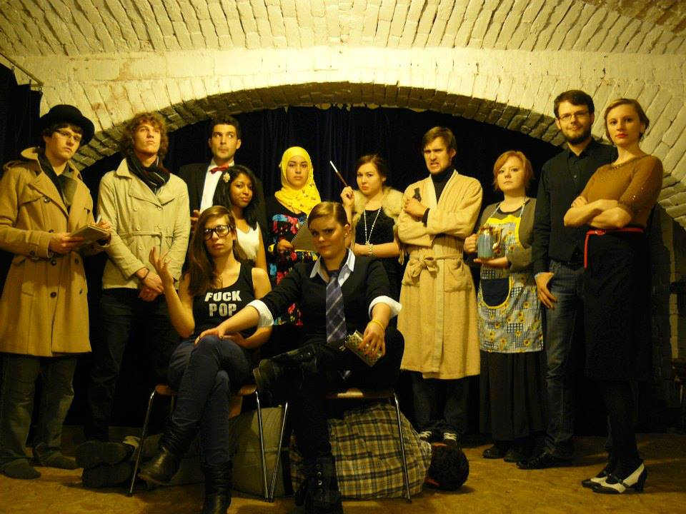
T. Stoppard 1937-
Absurdity, comedy … and politics
1966: Rosencrantz and Guildenstern Are Dead
1968: The Real Inspector Hound
1972: Jumpers
1993: Arcadia
2002: The Coast of Utopia
2006: Rock’n’Roll
2015: The Hard Problem
2020: Leopoldstadt

Slide 18
ROSENCRANTZ: Heads. Heads. Heads. Heads. Heads.
GUILDENSTERN: There is an art to the building up of suspense.
ROS: Heads. […]
GUIL: A weaker man might be moved to re-examine his faith, if in nothing else at least in the law of probability.
ROS: Heads.
GUIL (musing) : The law of probability, it has been oddly asserted, is something to do with the proposition that if six monkeys (he has surprised himself) ... if six monkeys were .. . ROS: Game? GUIL: Were they? ROS: Are you? GUIL (understanding): Game. (Flips a coin.) The law of averages, if I have got this right, means that if six monkeys were thrown up in the air for long enough they would land on their tails about as often as they would land on their ---
ROS: Heads.
Tom Stoppard: Rosencrantz and Guildenstern Are Dead (opening scene)

Slide 19
THOMASINA: When you stir your rice pudding, Septimus, the spoonful of jam spreads itself round making red trails like the picture of a meteor in my astronomical atlas. But if you stir backward, the jam will not come together again. Indeed, the pudding does not notice and continues to turn pink just as before. Do you think this is odd?
SEPTIMUS: No.
THOMASINA: well, I do. You cannot stir things apart.
SEPTIMUS: No more you can, time must needs run backward, and since it will not, we must stir our way onward mixing as we go, disorder out of disorder into disorder until pink is complete, unchanging and unchangeable, and we are done with it forever. This is known as free will or self-determination.
Tom Stoppard: Arcadia 1.1

Slide 20
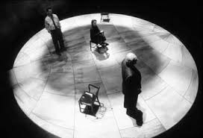
M. Frayn 1933-
reinventing the farce
1977: Alphabetical Order
1982: Noises Off
historical plays
1998: Copenhagen
2003: Democracy
Notes:
Dem – Willy Brandt‘s West Germany (1970s)

Slide 21
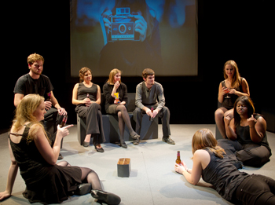
M. Crimp 1956-
theatre language revisions
1993: The Treatment
1997: Attempts on Her Life
2005: Fewer Emergencies

Slide 22
It’s quite clear that her mind’s / made up.
It’s not a cry for help. It’s very important to extablish that, wouldn’t you agree, from the outset. It’s very important to establish that no one could’ve helped / her at that point.
No one could’ve helped her – not her Mum – not her Dad – and certainly none of her so-called / friends.
She wouldn’t’ve / wanted help.
Help is the last thing she would’ve wanted.
(silence – in the silence):
She enjoys spending lots of time with guests,
And gets a feeling of great satisfaction
When everyone is haveing a good time.
She says there are lots of hugs at the station
When it’s time to go home, with holidaymakers
waving and calling out
See you next time, from the train window
(Laughter all through next passage):
Some of the strange things she says…
Some of the strange things she says to her Mum and Dad as a child…
(Crimp: Attempts on her Life, scenario 6)

Slide 23
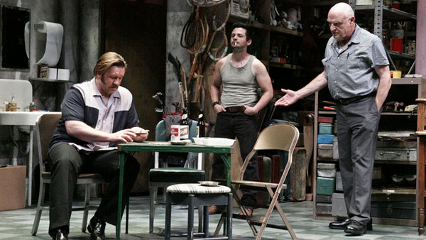
USA
D. Mamet 1947-
dialogue as fiction
1975: Sexual Perversity in Chicago
1977: American Buffalo
1984: Glengarry Glen Ross
Notes:
Danny and Bernie, Joan and Deborah; AmB: Danny, Teach, Bobby; GGR – real estate

Slide 24
Playwrights of emancipation
USA:
African American playwrights
Lorraine Hansberry
August Wilson
GLBT, Feminist playwrights
Tony Kushner
V (Eve Ensler)

Slide 25
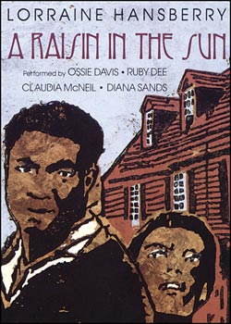
L. Hansberry 1930-1965
1959: A Raisin in the Sun

Slide 26
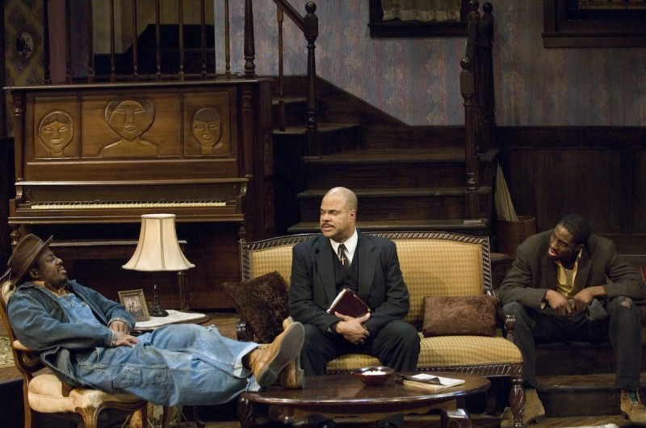
A. Wilson 1945-2005
A chronicler of African Americans in Pittsburgh
The Twentieth Century Cycle
The Piano Lesson
Fences
Notes:
Piano the Charles household; Fences: Troy Maxson – son Cory

Slide 27
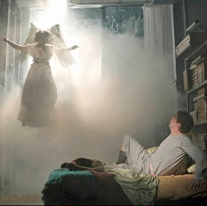
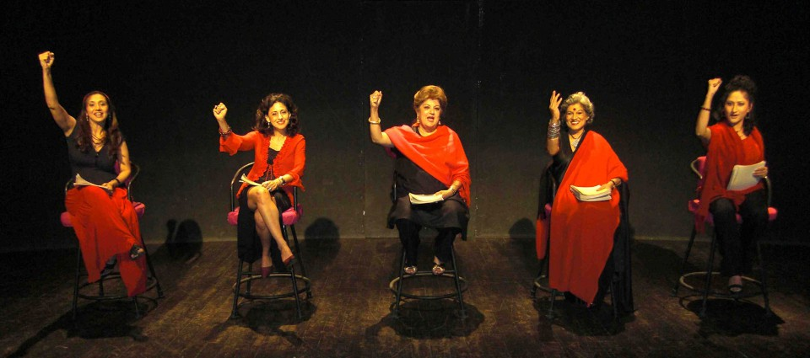
Tony Kushner 1956-
1993: Angels in America
V (Eve Ensler) 1953-
1996: The Vagina Monologues

Slide 28
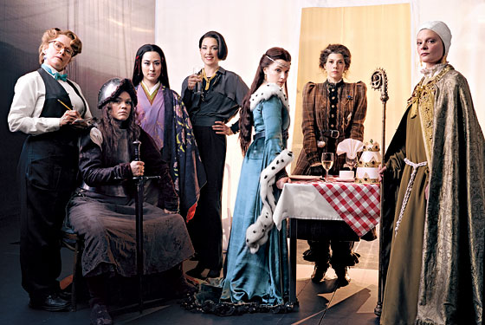
Playwrights of emancipation
GB:
feminist authors
Pam Gems 1925-2011
1977: Queen Christina, 1978: Piaf
Caryl Churchill 1938-
1982: Top Girls

Slide 29
NIJO. There was nothing in my life, nothing, without the Emperor’s favour. The Empress had always been my enemy, Marlene, she said I had no right to wear three-layered gowns. / But I was the adopted daughter of my grandfather the Prime Minister. I had been publicly granted permission to wear thin silk.
JOAN. There was nothing in my life except my studies. I was obsessed with pursuit of the truth. I taught at the Greek School in Rome, which St Augustine had made famous. I was poor, I worked hard. I spoke apparently brilliantly, I was still very young, I was a stranger; suddenly I was quite famous, I was everyone’s favourite. Huge crowds came to hear me. The day after they made me cardinal I fell ill and lay two weeks without speaking, full of terror and regret. / But then I got up
MARLENE. Yes, success is very …
JOAN. Determined to go on. I was seized again / with a desperate longing for the absolute.
ISABELLA. Yes, yes, to go on. I sat in Tobermory among Hennie’s flowers and sewed a complete outfit in Jaeger flannel. / I was fifty-six years old.
NIJO. Out of favour but I didn’t die. I left on foot, nobody saw me go. For the next twenty years I walked through Japan.
GRET. Walking is good.
The WAITRESS enters.
JOAN. Pope Leo died and I was chosen. All right then. I would be Pope. I would know God. I would know everything.
ISABELLA. I determined to leave my grief behind and set off for Tibet.
MARLENE. Magnificent all of you. We need some more wine, please, two bottles I think, Griselda isn’t even here yet, and I want to drink a toast to you all.
(Churchill: Top Girls, Act 1)

Slide 30
In-yer-face and other developments
Aesthetics of intensity
Anthony Neilson 1967-
1991: Normal: The Düsseldorf Ripper
Mark Ravenhill 1966-
1996: Shopping and Fucking
Sarah Kane 1971-1999
1995: Blasted
2000 (sic): 4.48 Psychosis

Slide 31
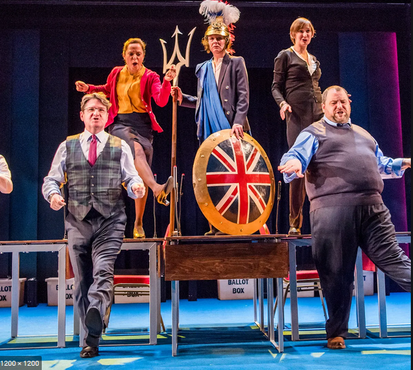
Verbatim drama
- Talking to Terrorists (2005) – Robin Soans
- My Country: A Work in Progress (2017) – Carol Ann Duffy and Rufus Norris

Slide 32
Thank you!
Time for Q & A

