Slide 1
ARTS023 Chinese
doc. Wei-lun Lu, Ph.D.
Department of Chinese Studies

Slide 2
Overview of Chinese language
1. Section of THE CHINESE TIME: Please find out (through Google Translate) how to express "last week" and "next week" in Chinese. Also find out (also through Google Translate) what the individual components mean.
2. Section of THE CHINESE TIME: Find out the definition of "grammatical tense" online.
3. Section of TONE: Find out the definition of "lexical tone".
4. Section of PLURICENTRICITY: Find out where Standard Chinese is spoken.

Slide 3
Overview: linguistic facts
Thailand | 9,392,792 (2012)^{[2]}
Indonesia | 8,010,720 (2011)^{[1]}
Malaysia | 6,712,200 (2021)^{[3]}
United States | 5,143,982 (2018)^{[4]}
Singapore | 2,675,521 (2020)^{[5]}
Myanmar | 1,725,794 (2011)^{[1]}
Canada | 1,715,770 (2021)^{[6]}
Australia | 1,390,639 (2021)^{[7]}
Philippines | 1,350,000 (2013)^{[8]}
South Korea | 1,070,566 (2018)^{[9]}
Sinitic (Sino-Tibetan language family)
Chinese and Mandarin?
Mandarin being a form of Chinese (a standard variety).
Mandarin spoken as an official language in:
  China (incl. Hong Kong, Macau); Beijing
  Singapore; Singaporean
  Taiwan; Taiwanese
https://www.youtube.com/watch?v=eJj5BWB1ai0
Also used in various parts of the world (lg of the diaspora).

Slide 4
Dialects
Proportions of first-language speakers^{[24]}
Mandarin (65.7%)
Min (6.2%)
Wu (6.1%)
Yue (5.6%)
Jin (5.2%)
Gan (3.9%)
Hakka (3.5%)
Xiang (3.0%)
Huizhou (0.3%)
Pinghua, others (0.6%)

Slide 5

Grammar
Chinese as an analytic language (very little inflection).
Inflection: word formation through modification of word form (tense, case, person, number, gender, etc.)
Show class notes https://docs.google.com/document/d/1kl9gM8OL1EKaOuWquGqoCp64iwtAegzPXh6VgR-_1qw/edit?usp=sharing
Vague language…

Slide 6
The Chinese TIME
Grammatical: (lack of) tense marking
Cultural: metaphorical understanding of TIME

Slide 7
How would you communicate without tense?
In-class Task 1: Try to write a short passage (3-4 sentences) of what you did yesterday/last week/last month, without using tense.
In-class Task 2: Try to communicate indirectness (which is a tense-related phenomenon) without using tense. Can you come up with a way?

Slide 8
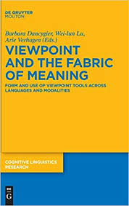
Time, tense and narrative viewpoint
Dancygier, Barbara, Wei-lun Lu and Arie Verhagen (eds.). 2016. Viewpoint and the Fabric of Meaning: Form and Use of Viewpoint Tools across Languages and Modalities. Berlin: De Gruyter.
Lu, Wei-lun. 2019. Time, tense and viewpoint shift across languages: A Multiple-Parallel-Text approach to “tense shifting” in a tenseless language. Cognitive Linguistics 30.2: 377-397.

Slide 9
Case 1: Tense and Narrative Viewpoint
Tense in narratives extensively studied in SAE languages.
Past as narrator’s and (historical) present as character’s consciousness (Fleischman 1990; Fludernik 2012).

Slide 10


STR in a glimpse
“From now on I will do the job myself!”
N: “Wei-lun: ‘From now on I will do the job myself!’”
  Narrator: distant, less involved in narration; little trace of narrator in narration.
  Direct discourse.
N: “Wei-lun shouted that from then on, he would do the job himself.”
  Narrator: distant, less involved in narration; little trace of narrator in narration.
  Indirect discourse.
N: “Wei-lun shouts that from now on, he will do the job himself.”
  Narrator: proximal (even embedded), more involved in narration.
  Free indirect discourse (FID).
Tense marking as an important tool in STR.

Slide 11
Comparing STR (FID) across languages
STR (FID) research done in single languages (using monolingual texts).
No way to compare FID across lgs with methodologically controlled commensurability.
Use of Multiple Parallel Texts (Multi-ParT; Knotková & Lu, 2020; Lu & Verhagen, 2016; Lu et. al, 2018; Lu, 2019; Lu, 2020; Lu et. al, 2020).
Useful for studying how multiple users of target lg (TL) render an ideational content with a stylistic effect from source lg (SL).
One text in SL and its multiple renditions in TL.
Stability and variation of user choices within TL (in producing same content, same effect).

Slide 12
Research issue
Tense shifting (past/present) being a hallmark of FID (among other lexico-grammatical cues).
TIME being an important dimension in the encoding of narrative distance.
Chinese being a language without systematic tense marking.
Question: Does Chinese operate on narrative distance using TIME?

Slide 13
Hypothesis 1
If Chinese cares as much about TIME as English does in managing narrative vpt, in passages where the English switches between tenses, we see elements that invoke TIME in the Chinese corresponding passage.
In cases where multiple translations exist, the phenomenon should be consistent.
Chinese has a productive aspectual system, where the perfective aspect is reported to play a role of expressing past events (Lin 2012; Liu 2014).
If we are able to identify constructions that invoke TIME in Chinese, PFV should be an important part of it.
I went to school yesterday.
我昨天去了學校。
Hypothesis 2

Slide 14
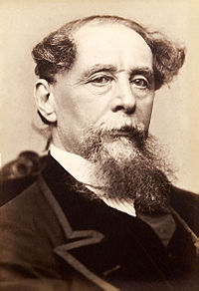
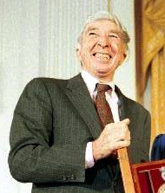
Material choice
Published Commercial Translations.
  Great Expectations (ST) and its 9 Ch translations.
  David Copperfield (ST) and its 5 Ch translations.
  “A&P” (ST) and its 2 Ch translations.
Random choice of 1 passage from each ST.

Slide 15
Results
Out of the 16 Chinese passages (2 + 9 + 5), only 1/16 uses a temporal adverbial construction.
Only 2/16 passages have PFV, but where the English passage involves the present tense.
Chinese does not care about TIME in managing narrative vpt.
The perfective aspect not used for managing vpt, at least not the way past tense is used in English.

Slide 16
Sample FID feature (in SL): tense shifting
From Chapter 9 of David Copperfield by Charles Dickens and its 9 published Chinese renditions.
(1) If the funeral had been yesterday, I could not recollect it better. The very air of the best parlour, when I went in at the door, the bright condition of the fire, the shining of the wine in the decanters, the patterns of the glasses and plates, the faint sweet smell of cake, the odour of Miss Murdstone’s dress, and our black clothes. Mr. Chillip is in the room, and comes to speak to me.

Slide 17
Renditions in TL: Reduplications
Out of the 9 renditions, 9 use reduplication.
Reduplication has a function of intensifying the perceptual content (Liu 2012; Melloni and Basciano 2018), which creates narrator involvement.
In addition to simple full reduplications (AA), other types of reduplications are identified:
  AABB (e.g. 清清楚楚)
  ABAC (e.g. 各式各样 and 有声有色)

Slide 18
Sample FID passage (2)
From Chapter 56 of Great Expectations and its 5 published Chinese renditions.
(2) The whole scene starts out again in the vivid colours of the moment, down to the drops of April rain on the windows of the court, glittering in the rays of April sun. Penned in the dock, as I again stood outside it at the corner with his hand in mine, were the two-and-thirty men and women; some defiant, some stricken with terror, some sobbing and weeping, some covering their faces, some staring gloomily about. There had been shrieks from among the women convicts, but they had been stilled, a hush had succeeded.

Slide 19
Perceptual deixis in TL
A perceptual deictic element consistently found in all translations: 在我（的）眼前; 5 out of 5.
Puts the narrator onstage (as an OoC); high degree of narrator involvement.

Slide 20
Summary
Multi-ParT helps identify variation of vpt strategies across lgs:
  Overall absence of TIME adverbials and of PFV in Ch.
  Ch: Reduplication (AA, AABB, ABAC)
  Ch: Perceptual deixis 在我（的）眼前
  En: tense shifting
Multi-ParT turns up the stability across the users
  Reduplication 9/9
  Perceptual deixis 5/5

Slide 21
Implications for cross-linguistic FID research
FID: varying degrees of narrator involvement in discourse
Varying degrees of subjectivity in the construal of the narrator (SoC)
Achieved via diff linguistic means in diff lgs (EN: tense; CN: reduplication)
Tense marking as obligatory; reduplication as optional
Vpt per sentence; less obvious demarcation of vpt
Switching/mixing of vpts; unspecified/context-dependent vpt
Language-specific vpt arrangement and perspectivization of the same(!) narrated content.

Slide 22
Case 2: Biblical texts
RI: How does the conventionalized toolkit of CN allow its various users to render an FID effect in narration?
Multiple published translations of the Bible.
5 versions used:
  Chinese Union Version 和合本, Revised Chinese Union Version 修訂和合本, Chinese Contemporary Bible 當代譯本, Chinese Standard Bible 中文標準譯本, Chinese New Version 中文聖經新譯本.
Passage chosen: 路加福音 Luke 19:1-10 (Yamazaki 2006, in Journal of Biblical Literature 125:1).

Slide 23
Finding 1: [V] – [V] reduplication
Character’s vpt:
  他 要 看看 耶穌 是 怎樣 的 人… (RCUV)
  Tā yào kàn-kàn yēsū shì zěnyang de rén
  He MOD see-RED Jesus LK how LK man
Compare:
  他要看耶穌是怎樣的人… (constructed from RCUV)
  他 要 看 耶穌 是 怎樣 的 人… (RCUV)
  Tā yào kàn yēsū shì zěnyang de rén
  He MOD see Jesus LK how LK man
Verbal reduplication as a tentative aspectual construction, expressing ‘briefly or a bit’. Pragmatically, it introduces Zaccheus’s mental state (of uncertainty).
Elaborated in the Greek and English versions as an infinitive (e.g. wanted to see/was trying to see) in irrealis mood.
5/5 versions.

Slide 24
Finding 2: AABB reduplication (from AB)
Character’s vpt:
  他 就 急忙 下來， 歡歡喜喜 地 接待 耶穌。(RCUV)
  Tā jiù jímáng xià-lái huān-huān-xǐ-xǐ di jiēdài yēsū
  He PRT hurried come down happy-RED LK receive Jesus
Compare:
  他 就 急忙 下來， 歡喜 地 接待 耶穌。(constructed from RCUV)
  Tā jiù jímáng xià-lái huān-xǐ di jiēdài yēsū
  He PRT hurried come down happy LK receive Jesus
Intensifying the emotion of the character.
In other lgs as an adverbial (joyfully or gladly).
5/5 versions.
撒該連忙爬下來，興高采烈地帶耶穌回家。(CCB)
N1-V1-N2-V2, where N1-V1 and N2-V2 are synonymous.

Slide 25
Summary
Multi-ParT helps identify stylistic strategies (character-based vpt) in CN:
  CN: Reduplication
    VV: uncertainty (irrealis)
    AABB: (intensification of character emotion)
Multi-ParT turns up the stability across users (influential versions).
  VV: 5/5 (100%)
  AABB: 5/5 (100%)

Slide 26
The tenseless nature of Chinese
Consequence (class fill in):
  Viewpoint representation as vague
  Reduplication as an alternative strategy.

Slide 27
Metaphorical understanding of TIME in CH
Phrases
Last week
This week
Next week

Slide 28
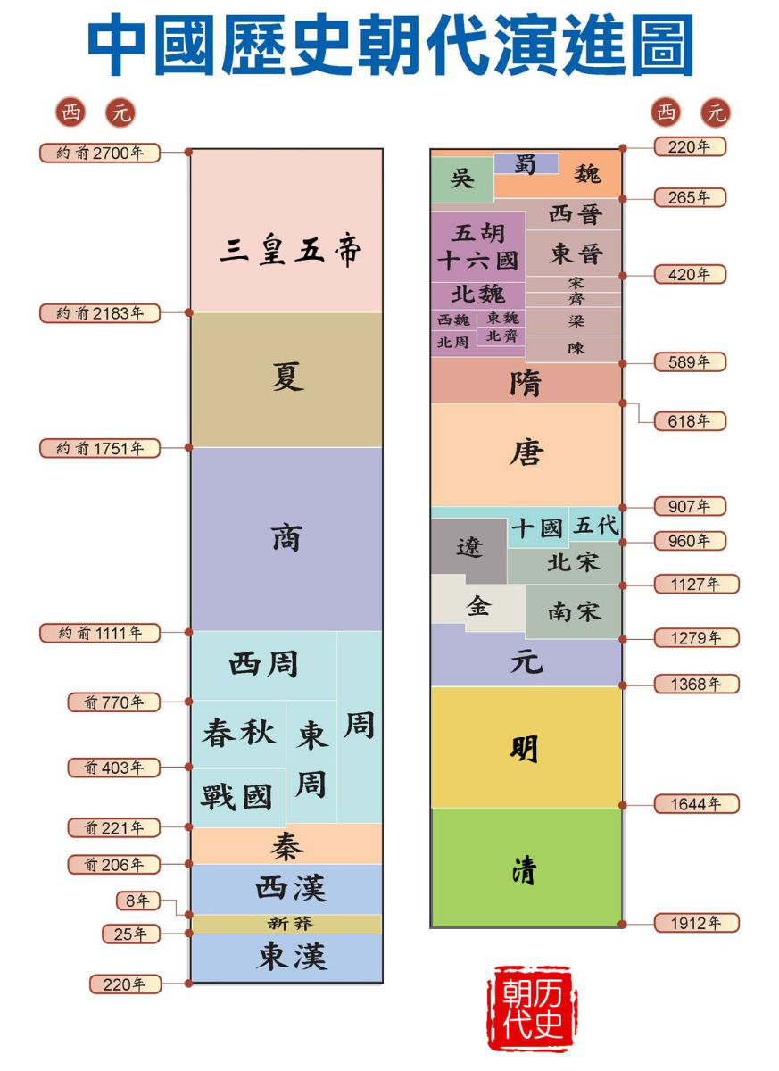
Understanding TIME using UP-DOWN
English: last month, next month
Chinese:
上個月 shàng-ge-yuè ‘up-CL-month’,
下個月 xià-ge-yuè ‘down-CL-month’,
Czech: minulý měsíc(?)
English: first half of the year, second half of the year
Chinese:
上半年 shàng-bàn-nián ‘up-half-year’,
下半年 xià-bàn-nián ‘down-half-year’
Czech: první polovina roku(?)

Slide 29
On reasoning about TIME
Fish race experiment (Boroditsky 2001):
Task: Below you will see a picture and a statement. Based on the picture, please decide whether the statement is true.

Slide 30
You will see a picture and a statement. Raise your left hand if the statement is true. Raise your right hand if the statement is false. Be as fast as you can.

Slide 31
You will see a picture and a statement. Raise your left hand if the statement is true. Raise your right hand if the statement is false. Be as fast as you can.

Slide 32
Mandarin-English bilinguals
Mandarin Chinese as L1, English as L2.
Strong vertical bias for CN-EN bilinguals who started English late.
Learning EN gives those CN speakers a “horizontal bias”.
Learning a different language does make one reason about TIME differently.
Lera Boroditsky’s TED talk (recommended!)

Slide 33
Summary of Chinese TIME
Tenseless
  Analytic
  Grammatical consequence
Up-down temporal orientation
Metaphorical (SPACE > TIME)

Slide 34
Next week
3. Section of TONE: Find out the definition of "lexical tone".
4. Section of PLURICENTRICITY: Find out where Standard Chinese is spoken.

Slide 35
Tonal language
What is a lexical tone?
Tone is the use of pitch in language to distinguish lexical or meaning – that is, to distinguish words.
(East) Asian tonal languages: Chinese, Vietnamese, Thai, among others.
4 lexical tones in Chinese (marked by diacritics over vowel):
High tone (mā)
Rising tone (má)
Dipping/low tone (mǎ)
Falling tone (mà)

Slide 36
Tonal tongue twister
Tongue twister with tonal variation:
https://www.instagram.com/reel/CoJJz5VA6kt/?igshid=YmMyMTA2M2Y%3D
Māma qí mǎ
Mom ride horse
Mǎ màn
Horse slow
Māma mà mǎ
Mom scold horse
“”

Slide 37
Mandarin Chinese spoken and script used
Standard Chinese spoken as an official language in:
- China (incl. Hong Kong, Macau)
- Singapore
- Taiwan
Used by the United Nations as one of the official languages.
The simplified version.

Slide 38
Writing system
Evolution:
Traditional version used till end of WWII.
In 1950s, 1960s, the Chinese communist gov. started simplification process, resulted in the current system.
- Used also in Singapore and Malaysia.
Traditional version has remained:
- Taiwan
- Hong Kong
- Macau

Slide 39
Varieties of Chinese used in Western countries
United States | Chinese American, American-born Chinese | 5,025,817 | 1.5% | 2017^{[157]}
Canada | Chinese Canadian, Canadian-born Chinese | 1,769,195 | 5.1% | 2016^{[158][159]}
France | Chinese French | 600,000 | 1% | 2018^{[143]}
United Kingdom | British Chinese | 433,150 | <1% | 2011
Russia | Chinese people in Russia | 28,943 | <1% | 2010^{[144]}
Italy | Chinese people in Italy | 288,923 | <1% | 2020^{[145]}
Spain | Chinese people in Spain | 197,390 | <1% | 2020^{[146]}
Germany | Chinese people in Germany | 145,610 | <1% | 2020^{[147]}
Netherlands | Chinese people in the Netherlands | 94,000 | <1% | 2018^{[citation needed]}
Cantonese (+ trad. script) for earlier arrivals (1984, 1989)
Standard Chinese (+ simp. script) for later arrivals

Slide 40
Manners of simplification (selected)
Omitting entire components:
廠 → 厂; 廣 → 广; 飛 → 飞; 習 → 习; 滅 → 灭; etc.
Further morphing a character after omitting some components:
婦 → 妇; 麗 → 丽; 歸 → 归; etc.
Preserving the basic outline or shape of the original character:
繼 → 继; 龜 → 龟; 齒 → 齿; 奪 → 夺; etc.

Slide 41


More examples: Chinese Numbers
8
八
Think of MUSTACHE in terms of EIGHT. Conceptual association motivated by imaginstic similarity (based on the writing system)
10
十
Think of CROSS in terms of TEN. Conceptual association motivated by imaginstic similarity (based on the writing system)
Writing system helps people understand the world!

Slide 42


Language in Cultural Conventions
春
Homophony of 到 dào “arrive” and 倒 dào “reverse”
“Spring arrive”
Homophony of 魚 yú “fish” and 餘 yú “remain”
“Every year we have so much that remain.”
Linguistic basis of cultural convention and reasoning.

Slide 43
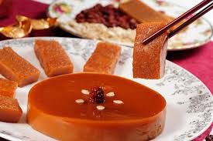
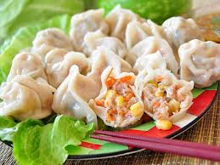
Language in New Year’s Food
Homophony of 糕 gāo “cake” and 高 gāo “high”
“Every year we go up (in career)”
Homophony of “dumplings” and “change of the midnight hours”
Linguistic influence of how people think about food.

Slide 44
Summary (fill in with class)
Chinese as a Tonal language
Variation of Chinese (esp. writing system)
Writing system

Slide 45
Questions? Comments?

Slide 46
Next week
- Please review the basic geographical information about Korea.
- Please watch this video:
https://www.youtube.com/watch?v=2aDPpssj0h0

