Slide 1
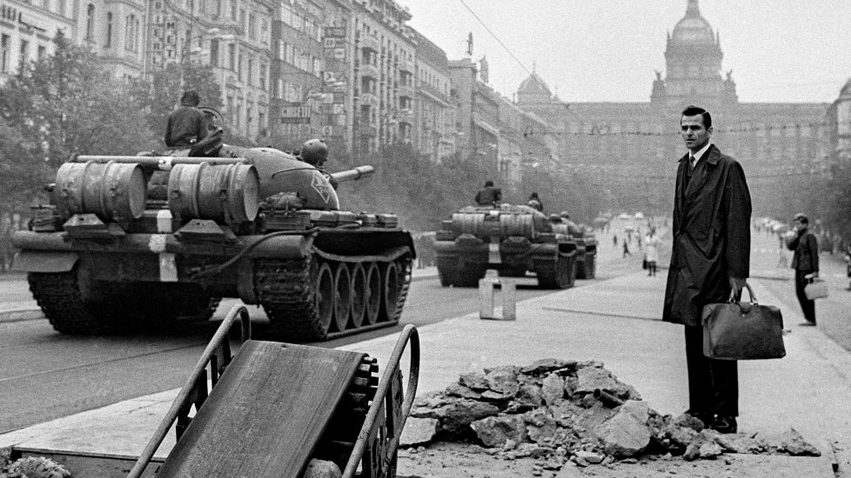
The Golden Sixties
Czechoslovak Theatre, Film and Literature

Slide 2
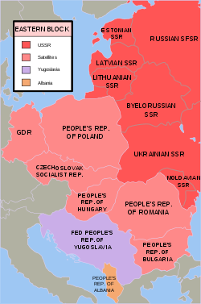
Czechoslovakia became a part of Eastern block
1948: communist coup d'état
Forced collectivization
Political trials and purges​
Trial with Milada Horáková
Trial with Rudolf Slánský
Trials with the members of church and clergy
Since 1956: revision of Stalin‘s cult and thawing

Slide 3
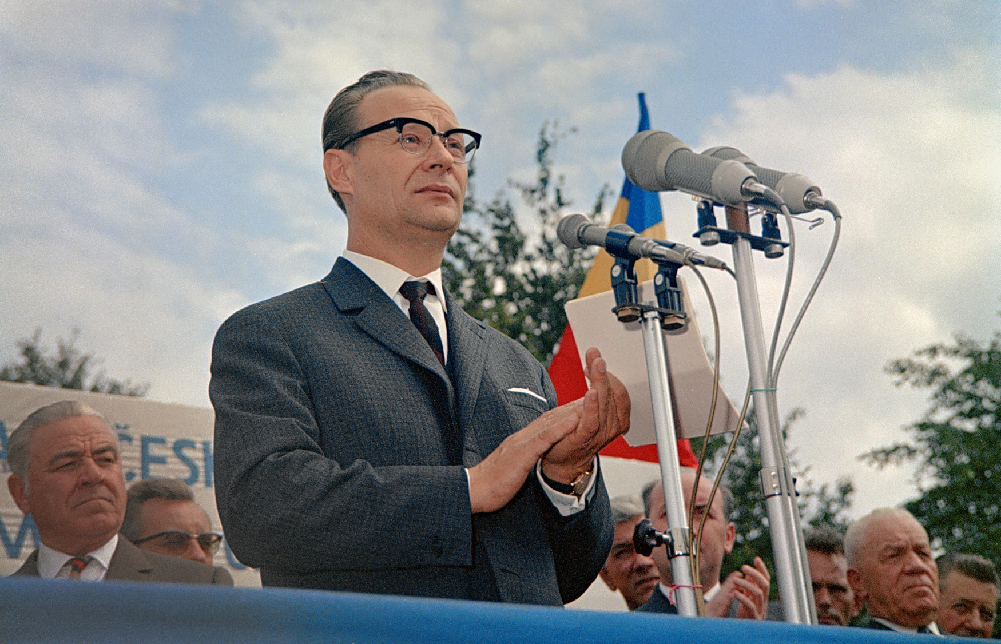
Communist reforms – socialism with „human face“​
More liberal and open atmosphere​
Rise of liberal theatres​ - i.e. opening the repertoire
Rise of different types of literature​, influx of Western literature
Rise of film production
The Prague spring of 1968
democratic reforms​

Slide 4
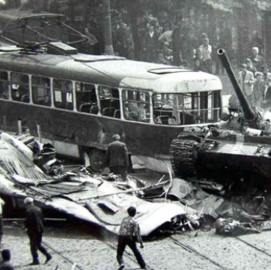
https://www.youtube.com/watch?v=LLrXCW-bS7Y
Night of August 20/21: Soviet invasion of Czechoslovakia

Slide 5
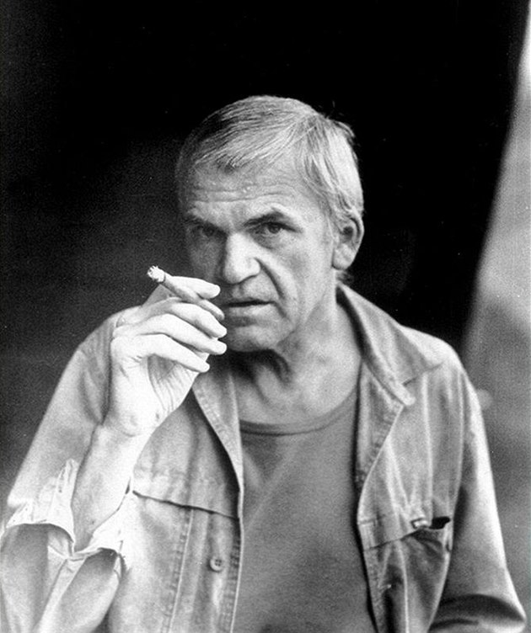
Czech Literature
Milan Kundera
known for his innovative and experimental approach to fiction
emphasized the use of language as a tool for exploring human consciousness and experience
prominent figure in the intellectual and cultural life of Czechoslovakia during the 1960s
his writing was closely associated with the political and cultural changes taking place in the country
The Joke (Žert), 1967
political satire set in communist Czechoslovakia, which explores themes of individual freedom and the dangers of conformism
following the Soviet invasion of Czechoslovakia in 1968, Kundera became disillusioned with the communist regime and eventually left the country for France

Slide 6
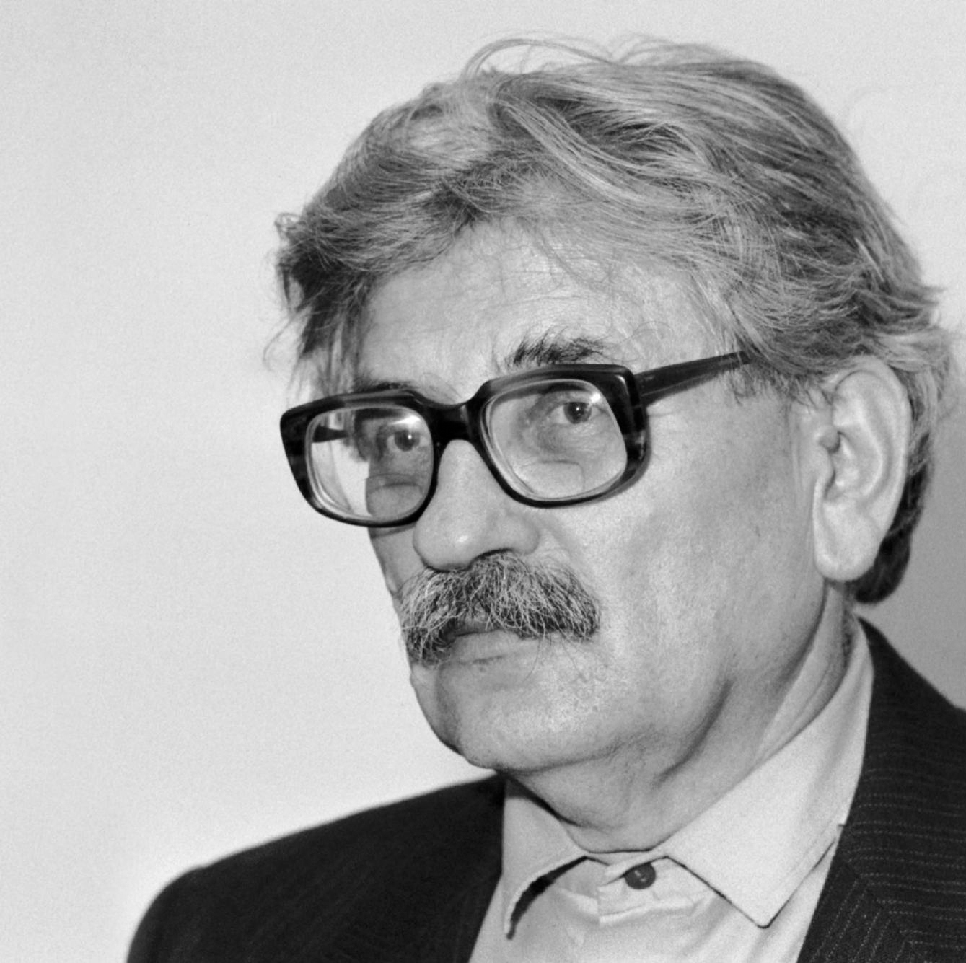
Ludvík Vaculík
Czech writer and political dissident who gained prominence in the 1960s
leading figure in the Prague Spring
prolific writer, publishing a number of essays and short stories that explored the human condition and criticized the Soviet-backed government
essay The Two Thousand Words (Dva tisíce slov) which was published in 1968 and called for an open discussion about the country's political and social problems

Slide 7
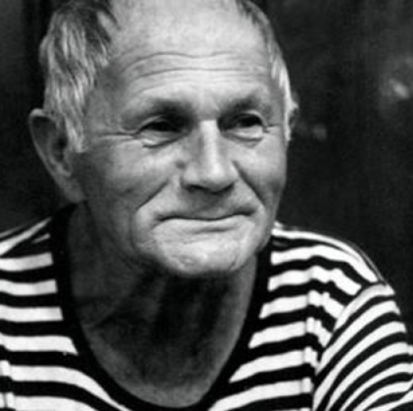
Bohumil Hrabal
best known for his playful and experimental writing style, which often blended humor, nostalgia, and surrealism
Closely Watched Trains (Ostře sledované vlaky) (1965), were set during World War II and the post-war period in Czechoslovakia, and explored the lives of ordinary people in a rapidly changing society
Hrabal's writing was known for its vivid characters and unique perspective
often used humor and irony to comment on social and political issues

Slide 8
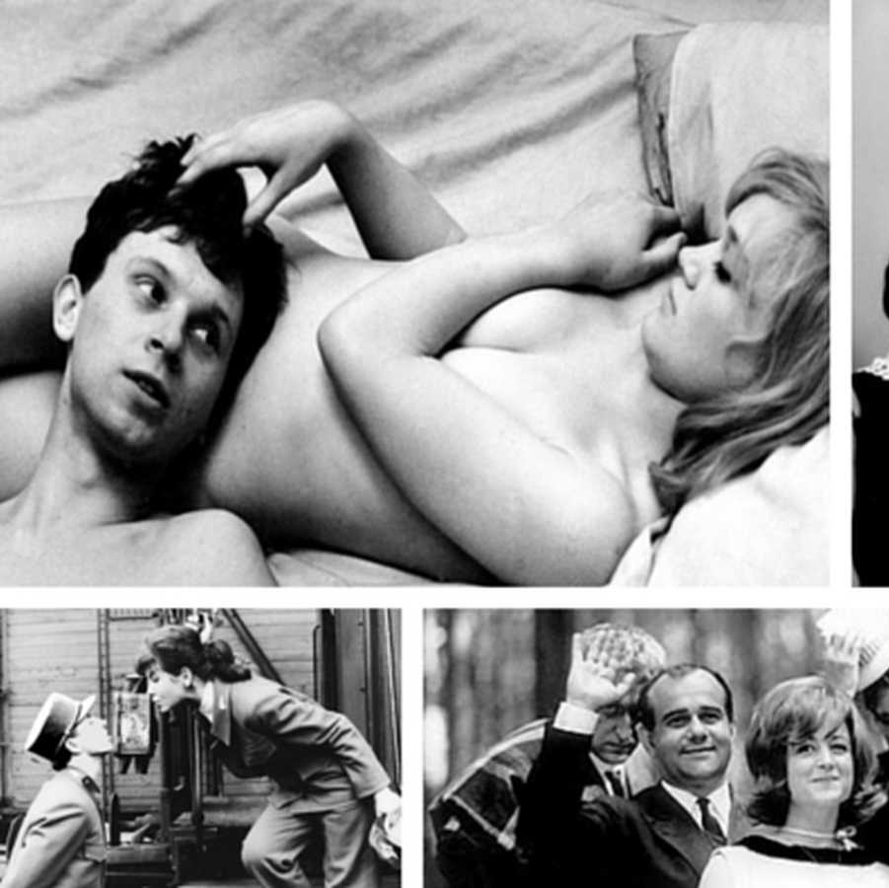
Czech New Wave
film movement that emerged in the 1960s
experimentation with form, narrative structure, and visual style
closely associated with the political and cultural changes taking place in the country
often focused on the lives of ordinary people and used humor and satire to comment on social and political issues
innovative camera work, use of non-professional actors, and incorporation of documentary elements into fictional narratives
came to an end with the Soviet invasion of Czechoslovakia in 1968
many of the filmmakers associated with the movement were banned or exiled from the country

Slide 9
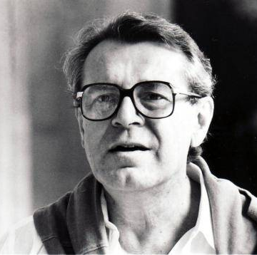
Miloš Forman
Czech-American film director, screenwriter, and actor
best known for his films One Flew Over the Cuckoo's Nest (1975) and Amadeus (1984), both of which won multiple Academy Awards
prominent member of the Czech New Wave movement
Loves of a Blonde (Lásky jedné plavovlásky), 1965
The Firemen's Ball (Hoří, má panenko), 1967
biting social commentary, dark humor, and experimental style
following the Soviet invasion, Forman emigrated to the United States
https://www.youtube.com/watch?v=TbnuGUwxBzw

Slide 10
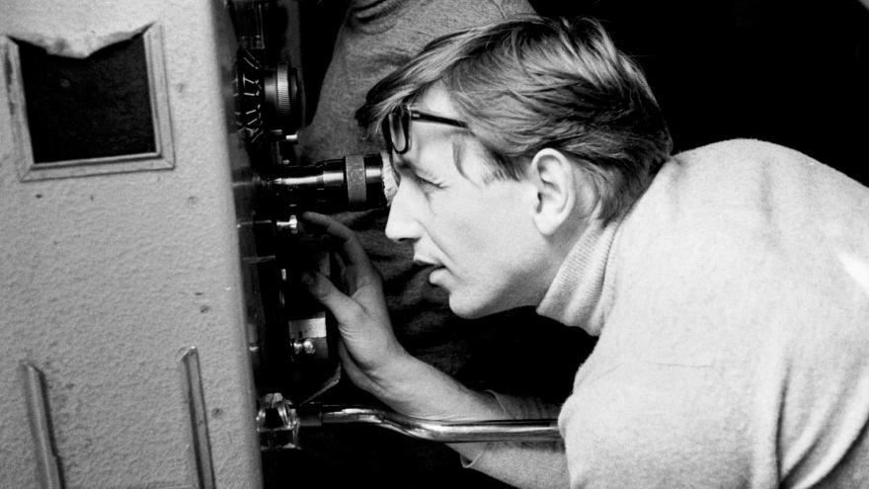
Jiří Menzel
best known for his film Closely Watched Trains (1966), which won the Academy Award for Best Foreign Language Film
he gained a reputation for his idiosyncratic style and his ability to blend comedy and tragedy in his films
portraying the lives of ordinary people in Czechoslovakia, compassionate and humorous portraits
https://www.youtube.com/watch?v=0f52Ar52jdE

Slide 11
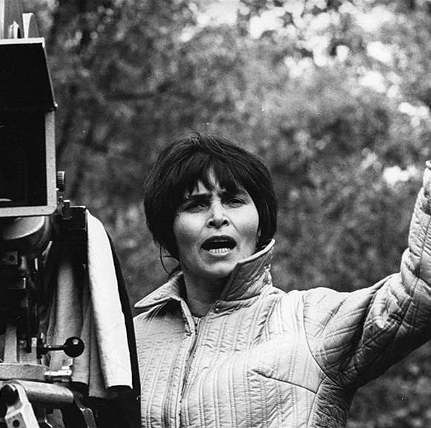
Věra Chytilová
Daisies (Sedmikrásky) 1966: considered a masterpiece of avant-garde cinema
colorful and anarchic satire about two young women who decide to reject societal norms and live according to their own whims
https://www.youtube.com/watch?v=OBabnmxJ6bE
use of surrealism, fragmentation, and nonlinear storytelling
explored themes of gender, sexuality, and political dissent

Slide 12
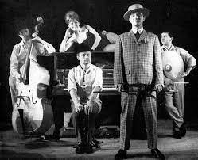
Semafor Theatre
founded in Prague in 1959 by the songwriter and composer Jiří Suchý and the actor and writer Jiří Šlitr
cultural phenomenon and a center of the Czechoslovakian cultural scene in the 1960s
unique blend of music, comedy, and social commentary
many of its productions satirized the socialist government of Czechoslovakia, and the theatre became a haven for young artists and intellectuals who were critical of the regime
musical Hop Side Story (1964)

