Slide 1
Canon Wars
The Values and Objects of Art History
2 March 2023

Slide 2
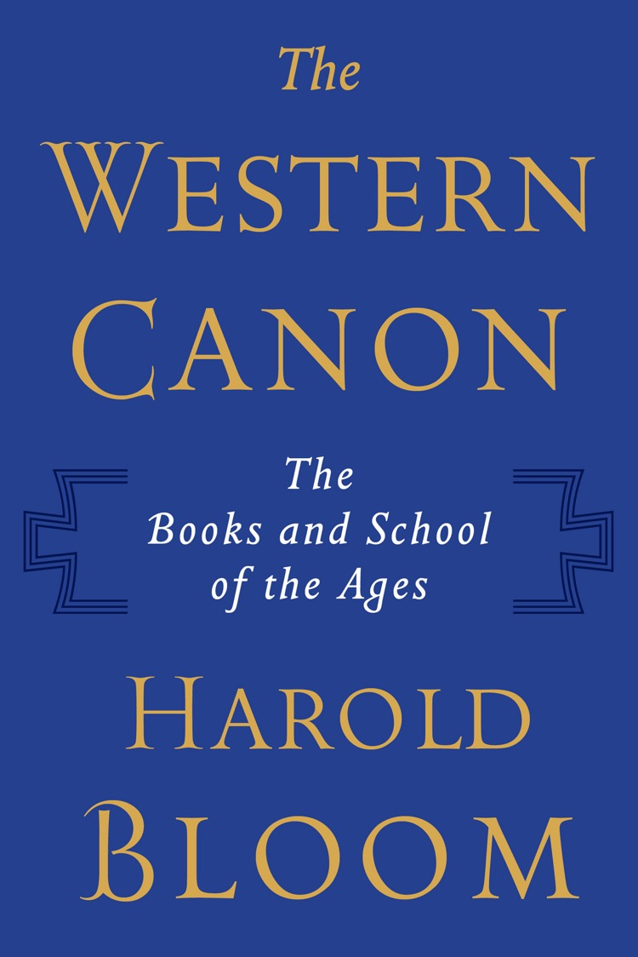
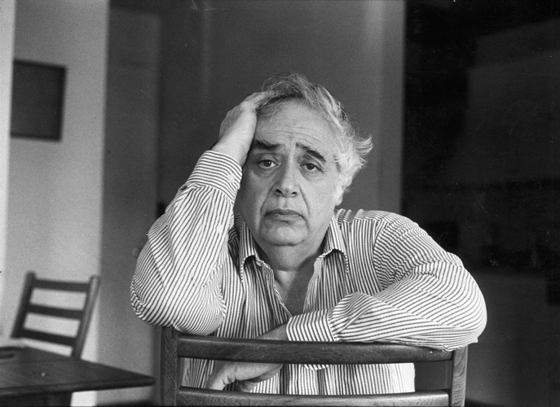
Harold Bloom
The Western Canon (New York, 1994) p. 527

Slide 4
What is a canon?

Slide 5
Bloom’s aims:
To provide a basic framework of great works of art and literature as a means of setting shared universal standards
To affirm the intrinsic aesthetic value of great works of art and literature (note the criticism of scholars who see works of art and canons as the product of ‘race, class, gender and national interests.’
To affirm the self-evident nature of artistic and literary value
Bloom, The Western Canon, p. 521.

Slide 6
What is a Canon?
From the Greek term κανών / kanon = straight rod, rule or standard
‘ … an obligatory syllabus of knowledge to be learned by heart and to be referred to as authoritative in critical discussions and situations’ (Jan Assmann, p. 121)
Legitimating power of a canon
    Best and normative
    Most representative and significant
    Must be studied as exemplary
  Creating of the notion of the ‘classic’ text / work of art
    Jan Assmann, ‘Tradition, Writing and Canonisation’ p. 121

Slide 7
The Canon:
‘The term [canon] is also used to refer to a model in the sense of a guideline, a set of rules, or a schedule or list of dates serving as reference points.’
Hubert Locher, ‘The Idea of the Canon’ in Rampley et al, eds,
Art History and Visual Studies in Europe (Leiden, 2012) 31
‘The canon is emblematic not merely of authority but of the authoritative weight of the past. Infused by tradition, the canon often shapes norms and so becomes the vehicle for shared culture. In its more prominent manifestations, the canon does merely inspire culture. Rather, it comes to command where attention is directed.’
Anita Silvers, ‘The Canon in Aesthetics’ in Oxford Art Online (2013)

Slide 8
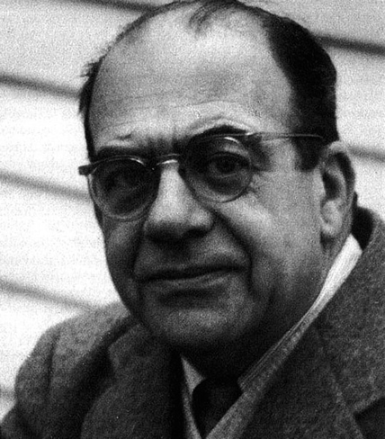
The Weight of the Past …
‘The humanist, then, rejects authority, but he respects tradition. Not only does he respect it, he looks upon it as something real and objective which has to be studied and, if necessary, reinstated: nos vetera instauramus, nova non prodimus [we conserve the old, we do not bring forth the new] as Erasmus puts it.’
Erwin Panofsky, ‘The History of Art as a Humanistic Discipline’ in Eric Fernie, ed, Art History and its Methods (London, 1995) 85.
Erwin Panofsky (1892-1968)

Slide 9
‘Canon formation is concerned with the formation and confirmation of individual and group identity. The individual finds her- or himself addressed and represented in the canon. Its function is to give orientation, which can only be achieved if the reference system is relatively stable.’
Locher, ‘The Idea of the Canon’ 33.

Slide 10
A canon is …
‘A canon constitutes a nexus between the identity of the ego and collective identity. It represents the society as a whole and at the same time a system of values and interpretations, to which the single person avows and to which he or she builds his or her identity as a member of the society.’
Jan Assmann, Das kulturelle Gedächtnis (Munich, 2007) p. 127

Slide 11
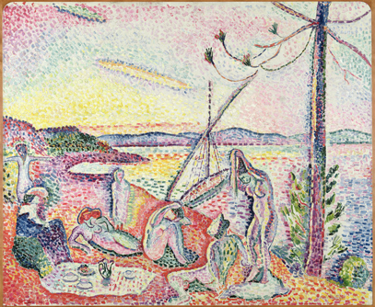
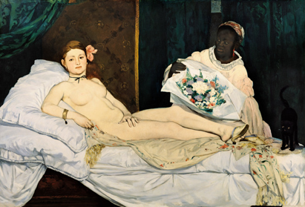
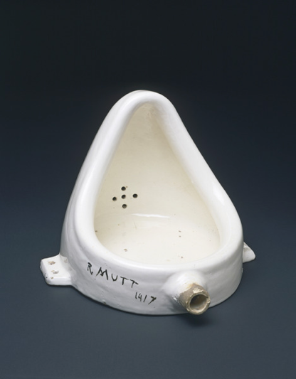
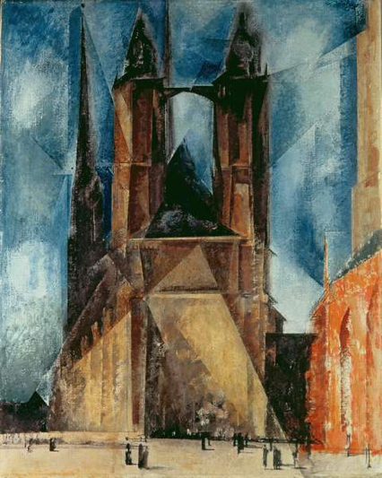
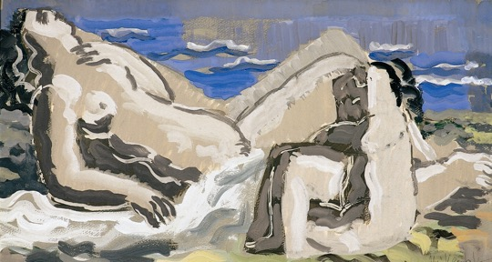
‘Status as a classic is not an either/or matter, but a matter of degree. At any given time, the canon is represented by a series of concentric circles. At the center are texts with the highest degree of canonicity, while at the periphery are those whose classical status is most tenuous. This means that historical changes in the canon are not simply matter of inclusion and exclusion, but also matters of location between the center and the periphery.’
Merold Westphal, ‘The canon as flexible , normative fact,’ The Monist, 76 (1993) p. 436

Slide 12
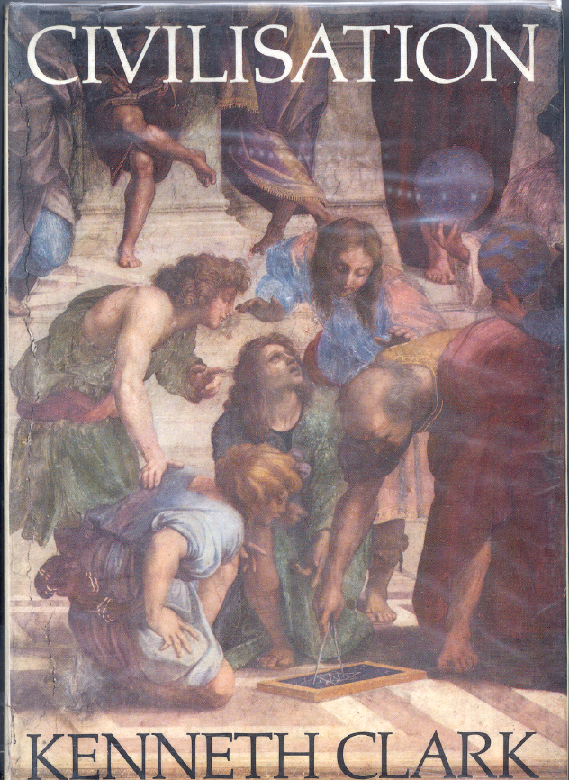
Kenneth Clark Civilisation (London, 1969). This was a hugely popular television series broadcast in 1970.
‘This series has been filled with great works of genius, in architecture, sculpture and painting, in philosophy, poetry and music, in science and engineering. There they are; you can't dismiss them. And they are only a fraction of what western man has achieved in the last thousand years, often after setbacks and deviations at least as destructive as those of our own time. Western civilisation has been a series of rebirths. Surely this should give us confidence in ourselves.’
Civilisation p. 347.

Slide 13
Assmann identifies different processes of canonization:
Primary canonization: the creation of cultural norms and general cultural literacy, ideas of timeless validity, mouvance (Paul Zumthor)
Secondary canonization: the fixing of canonical texts and norms
‘Secondary canonisation means the combination of strict fixation of surface structure typical of sacred texts and complete semantic transparency typical of cultural texts … Cultural texts that undergo the process of secondary canonisation must not be changed, they must be understood’ (Assmann, p. 124)

Slide 14
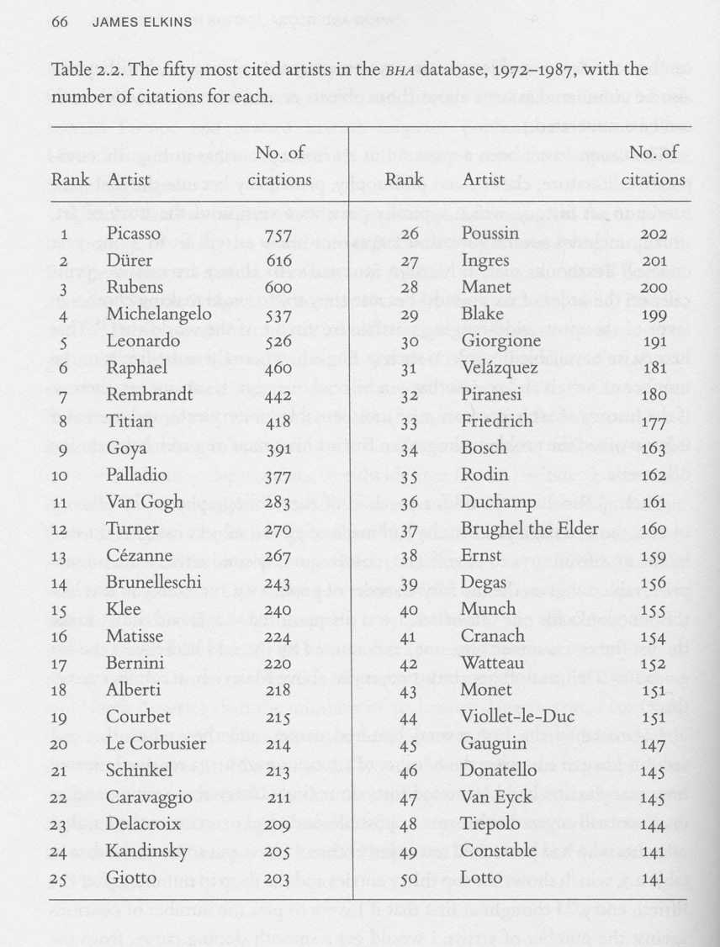
Source: James Elkins, ‘Canon and Globalization in Art History’ in A Brzyski, ed., Partisan Canons (Durham, Duke University Press, 2007) p. 66

Slide 15
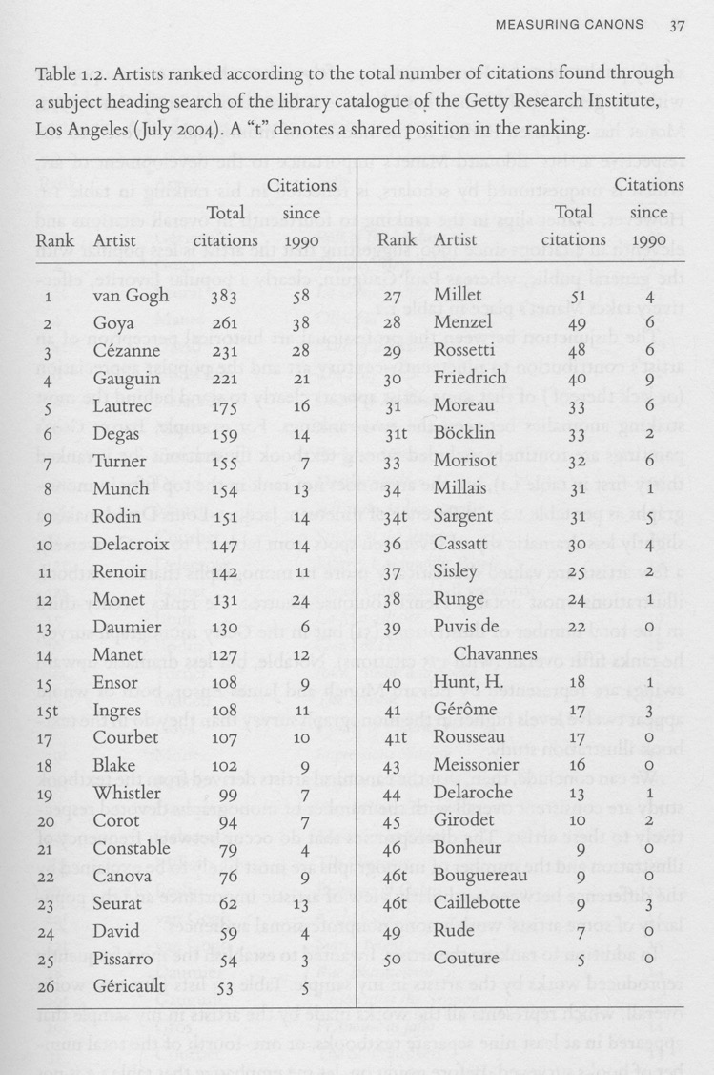
Source: Robert Jensen, ‘Measuring Canons’ in A Brzyski, ed., Partisan Canons (Durham, Duke University Press, 2007) p. 37

Slide 16
Critiquing the canon

Slide 17
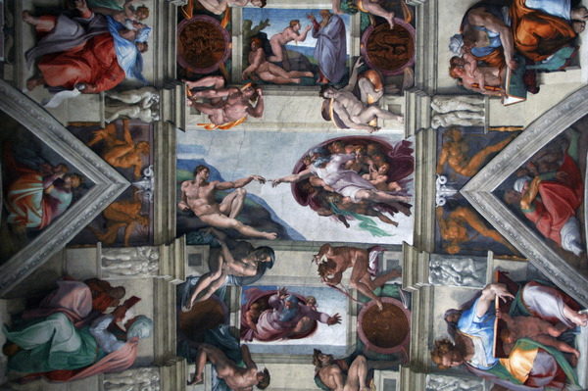
Michelangelo – The Creation of Adam,
from the Sistine Chapel Ceiling (1512)

Slide 18
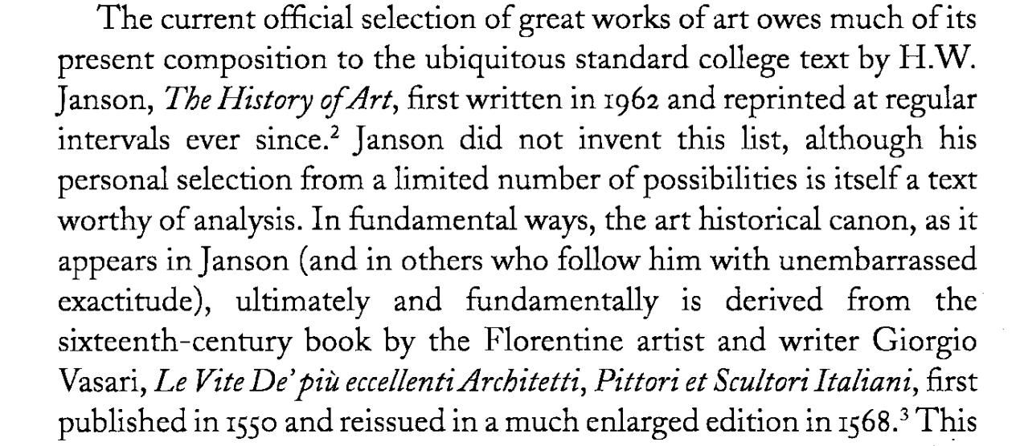
Nanette Salomon, ‘The Art Historical Canon: Sins of Omission,’ in Donald Preziosi, ed., The Art of Art History (Oxford, 1998) p. 344.

Slide 19
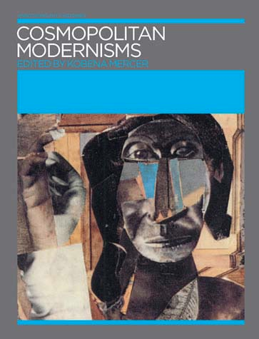

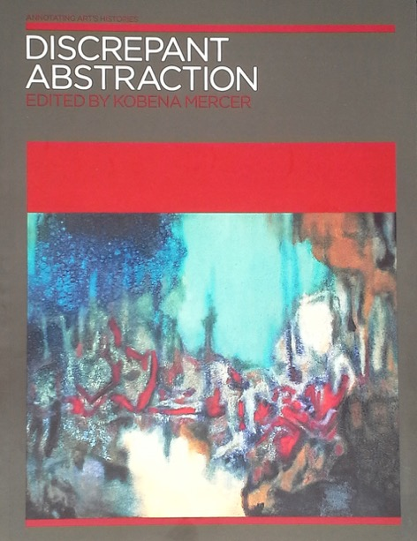
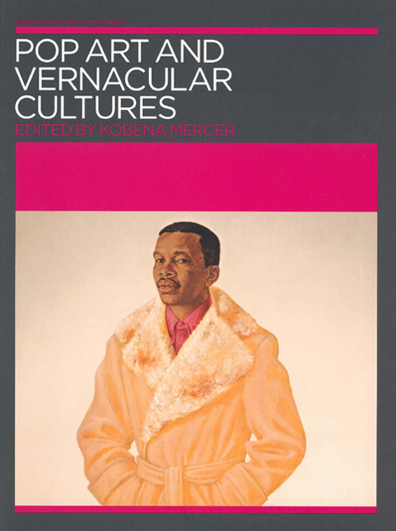
Kobena Mercer, Annotating Art’s Histories (2005-2008)

Slide 20
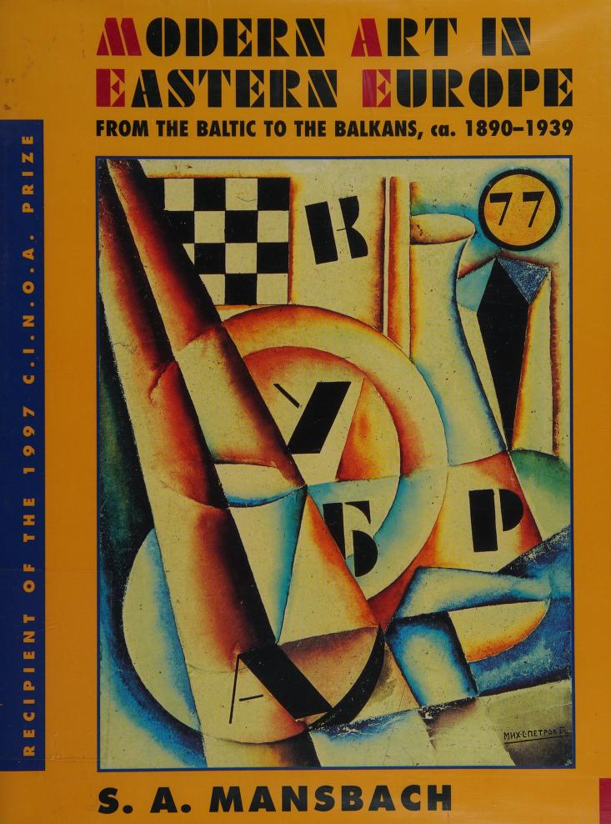
Steven Mansbach, Modern Art in Eastern Europe (Cambridge, 1999)

Slide 21
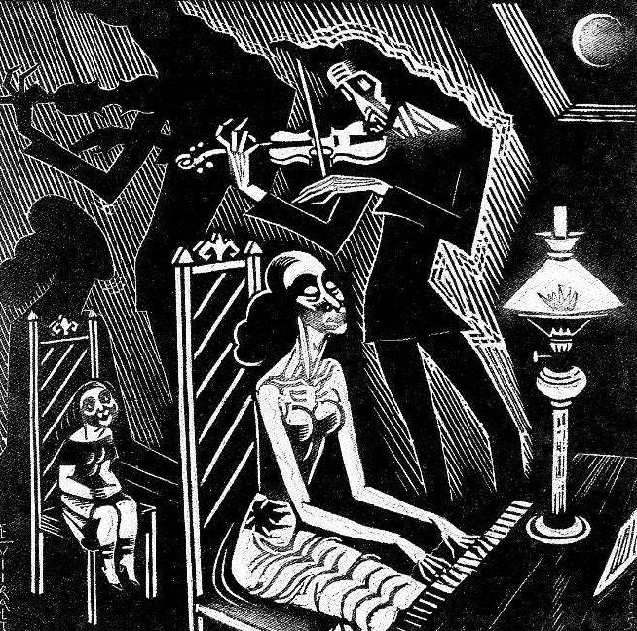
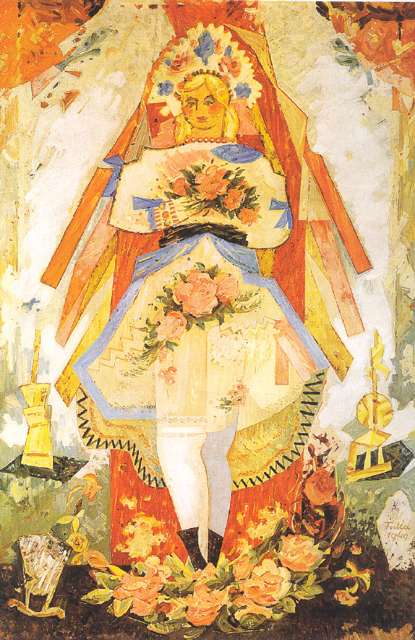
L: Eduard Wiiralt, Music (1925)
R: Ludovít Fulla, Slovak Bride (1949)

Slide 22
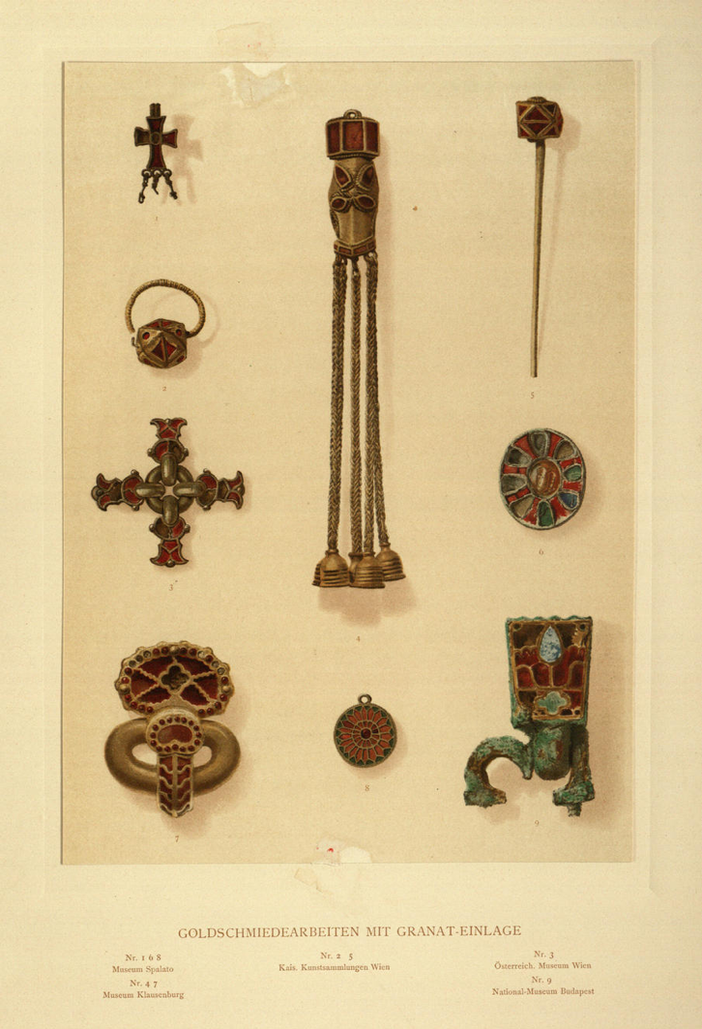
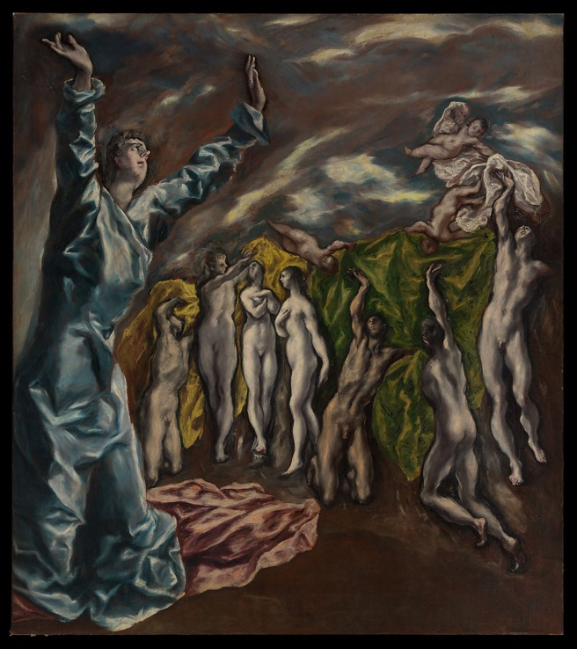
L: Plate of gold jewellery from Alois Riegl, Late Roman Art Industry (1901)
R: El Greco, The Vision of St. John (1608-14). See Max Dvořák, Art History as the History of Spirit (1924)

Slide 23
‘The history and sociology of art have completely fulfilled their purely empirical task when they have made plain the material, technical, social and psychological conditions of the new style. In so doing they do not “evaluate” the Gothic style in relation, say, to the Romanesque or Renaissance style … Rather, the interest of the works of art and their aesthetically relevant individual properties … is something given from outside… it is given by the aesthetic value of the work of art, which cannot be established by the empirical disciplines.’
Max Weber, ‘The Meaning of Ethical Neutrality in Sociology and Economics’ (1917) in Weber The Methodology of Social Sciences (Atlantic Highlands, 2011) 30

Slide 24
The Fact / Value Dichotomy
‘An empirical science cannot tell anyone what he should do - but rather what he can do — and under certain circumstances — what he wishes to do. It is true that in our sciences, personal value-judgments have tended to influence scientific arguments without being explicitly admitted.
[ … ]
... we regard as objectively valuable those innermost elements of the "personality," those highest and most ultimate value-judgments which determine our conduct and give meaning and significance, to our life … Only on the assumption of
belief in the validity of values is the attempt to espouse value-judgments
meaningful. However, to judge the validity of such values is a matter of faith.’
Max Weber, ‘ “Objectivity in Social Science”.’ pp. 54-55.

Slide 25
Hence:
If canonization is based on a faith in the validity of certain values, what are those values?
Two examples:
‘texts are classics because we find in them an inexhaustible (or at least not yet exhausted) source of meaning. They speak to us, they address claims to us, they put us in question.’
(Westphal, ‘The canon as flexible, normative, fact,’ p. 439)
‘The enigma of Shakespeare is his universalism: Kurosawa’s film versions of Macbeth and King Lear are thoroughly Kurosawa and thoroughly Shakespeare … The miracle of Shakespeare’s universalism is that … the great characters and plays accept being embedded in history and in society while refusing every mode of reduction.’
(Bloom, The Western Canon, p. 524)

Slide 26
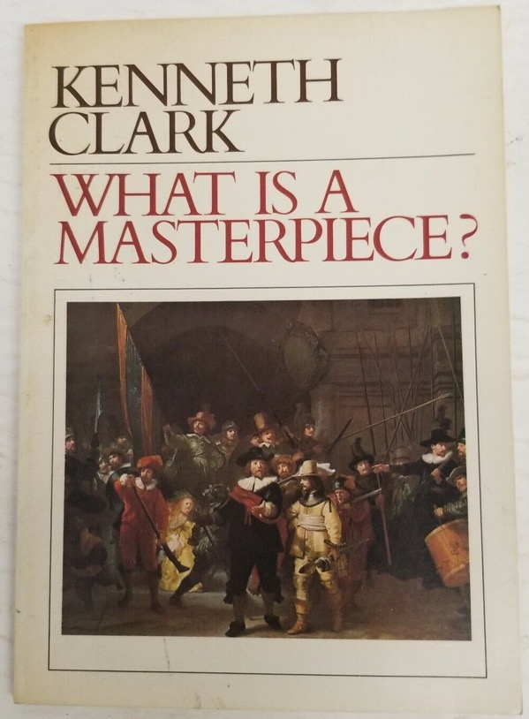
However:
Are these values valid? Where does the belief in the value of inexhaustible meaning come from? How is it justified?
When Bloom et al. talk about universal values as the grounds of the canon, who are they speaking for? Do Shakespeare / Michelangelo etc speak universal values?
‘Although many meanings cluster around the word masterpiece it is above all the work of an artist of genius who has been absorbed by the spirit of the time in a way that his made his individual experiences universal.’
Kenneth Clark, ‘What is a Masterpiece?’ Portfolio (1980) p. 53

Slide 27
And:
What about the value placed on originality, for example?
And can a canon reflect the values of ‘society as a whole’ (Assmann)?
And if canons aid ‘the formation and confirmation of individual and group identity’ (Locher) are groups / cultures / societies comprised of single, coherent sets of values?

Slide 28
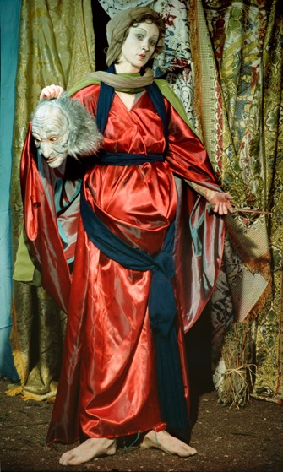
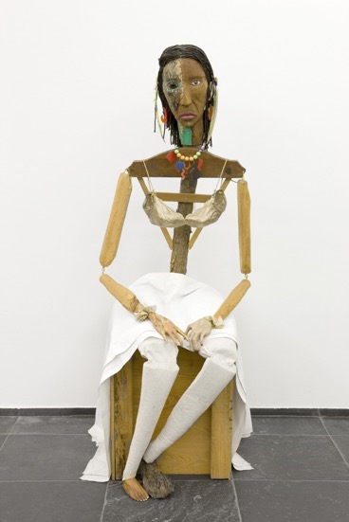
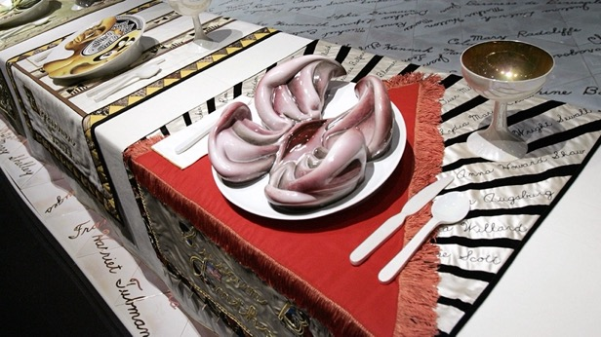
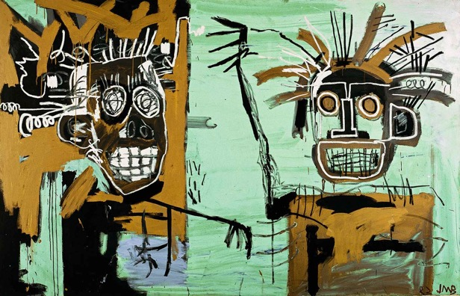
Perhaps it is no accident that it was in the USA that the idea of the canon was first challenged …..
Clockwise from left:
Cindy Sherman, Jimmie Durham, Robert Judy Chicago, Jean-Michel Basquiat

Slide 29
Harold Bloom, The Western Canon (New York, 1994) p. 527

Slide 30
The logic of the canon

Slide 31
So, if the character of the canon is to be criticized because:
…. it is not as universal as its proponents believe
… is it based on a set of values that are a matter of fait
… its values involve exclusions ....
Is the solution merely to expand it to be less exclusive / more inclusive ?

Slide 32
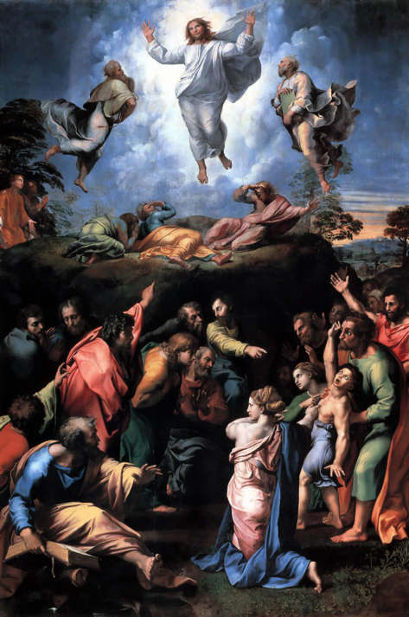
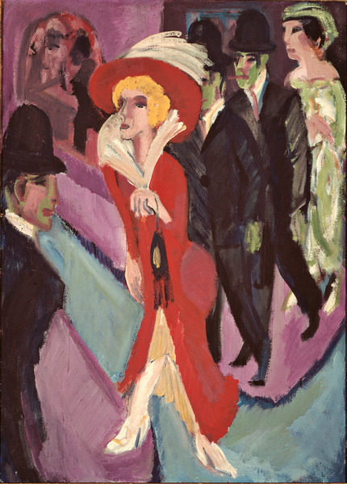
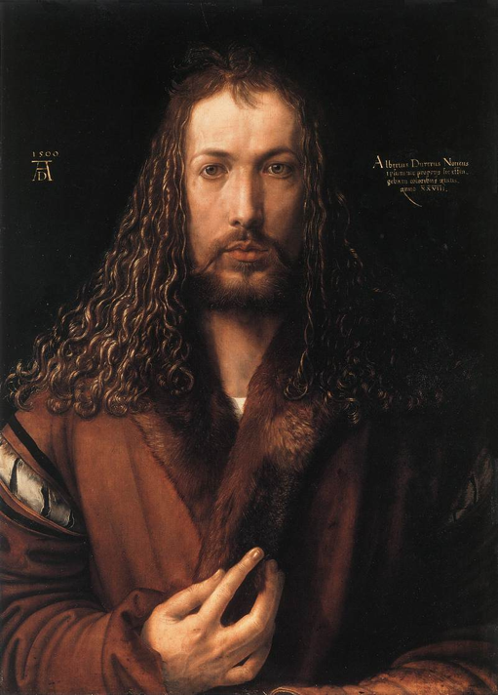
Raphael
Transfiguration (1516-20)
Ernst Ludwig Kirchner
Berlin Street Scene (1914)
Albrecht Dürer,
Self Portrait (1500)

Slide 33
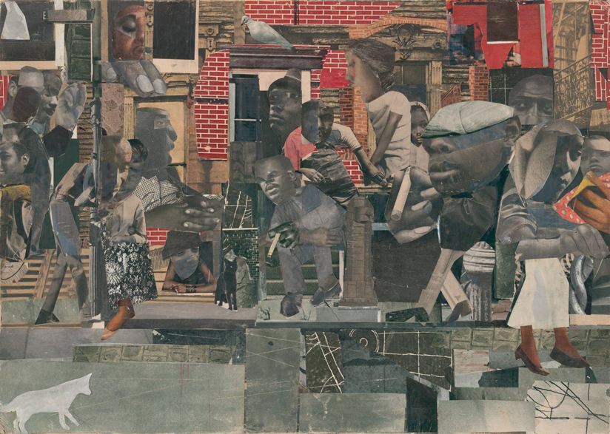
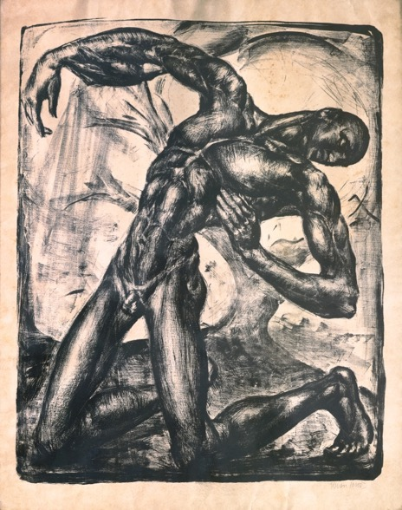
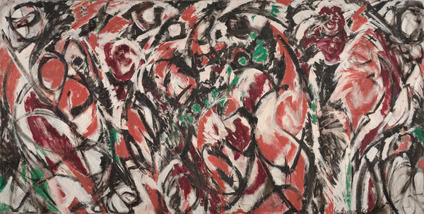
L: Romare Bearden, The Dove (1964)
UR: Jenő Krón, The Wounded (1919-20)
LR: Lee Krasner – Celebration (1960)

Slide 34
Answer …. Not necessarily, if we take Griselda Pollock’s criticisms seriously
Pollock, Differencing the Canon (London, 1999) p. 9

Slide 35
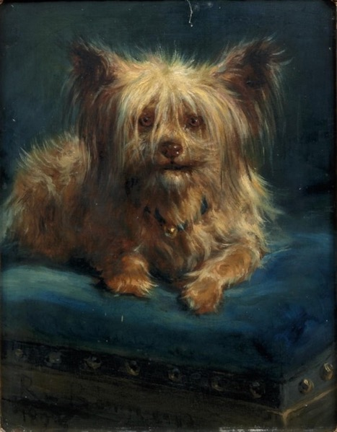
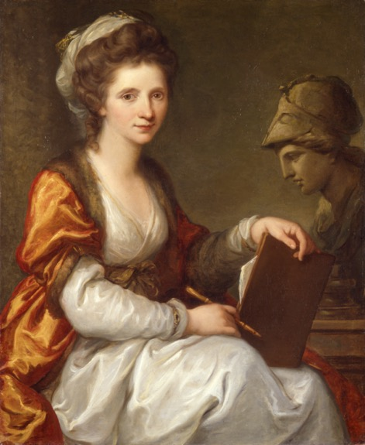
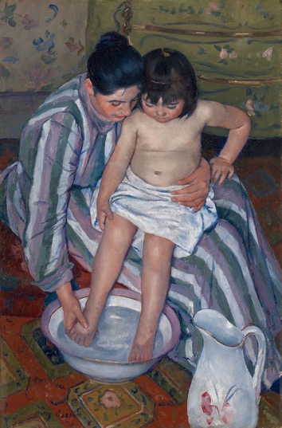
Pollock, Differencing the Canon (London, 1999) p. 9

Slide 36
Pollock, Differencing the Canon (London, 1999) pp. 12 and 13

Slide 37
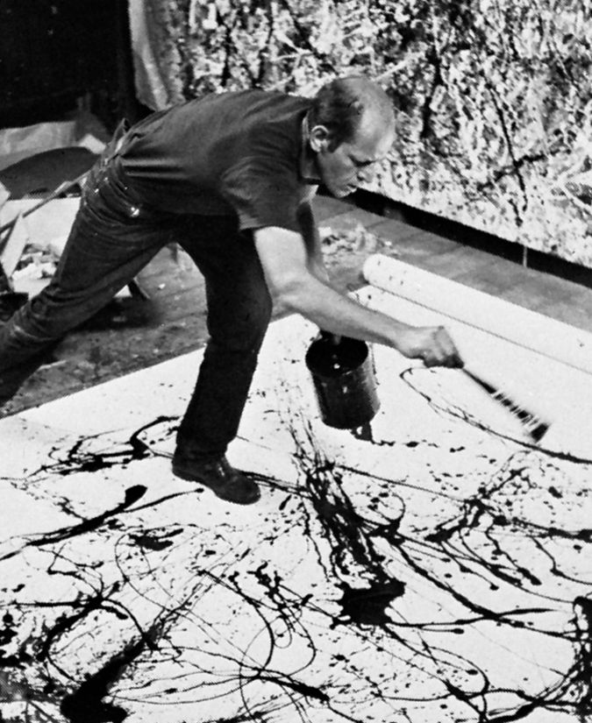
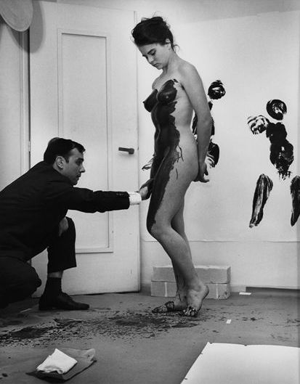
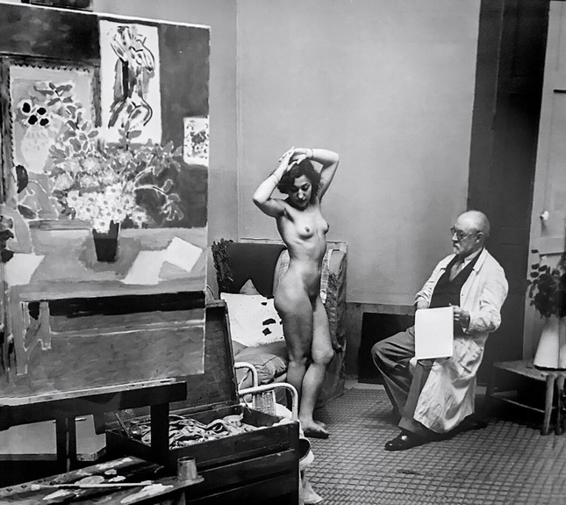

Slide 38
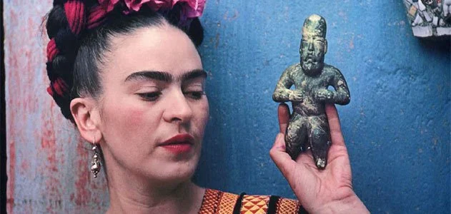
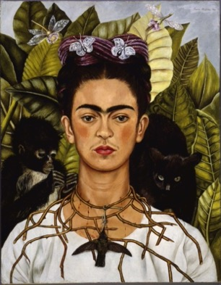
Pollock, Differencing the Canon (London, 1999) p. 14

Slide 39
But what happened if we abolished the canon I ?
Is the proposal: (a) to abolish a particular kind of canon based on mythic ideas of the artist or the masterpiece, or (b) to abolish the idea of canonicity (i.e. the idea of certain works having a normative status, or of there being a hierarchy amongst works of art)
Ad (a): this seems to be the most straightforward, but ….
Is it possible to privilege certain artists and artworks above other without being vulnerable to the criticism that they are still mythification?
What would it look like to privilege certain artworks in a non-hierarchical way?
Radical art historians may challenge the canon, but they mostly replace it with another canon of works / artists selected for other reasons

Slide 40
But what happened if we abolished the canon II ?
Is the proposal: (a) to abolish a particular kind of canon based on mythic ideas of the artist or the masterpiece, or (b) to abolish the idea of canonicity (i.e. the idea of certain works having a normative status, or of there being a hierarchy amongst works of art)
Ad (b): if we have no norms or frame of reference, if we abolish hierarchy, how do you decide what is worth studying?
Is it possible to study works of art without having an opinion as to whether they are worth studying?
Is a value-free history of art possible?

Slide 41
But what happened if we abolished the canon III ?
If we have no norms or shared frame of reference, what stops the selection of artworks being arbitrary and random?
If the canon serves to shape a shared frame of reference or ‘cultural literacy’ (Assmann) on what basis can debates and scrutiny of claims take place if there is no common knowledge ?
So can the idea of the canon be defended - even if not Bloom’s vision of the canon?

Slide 42
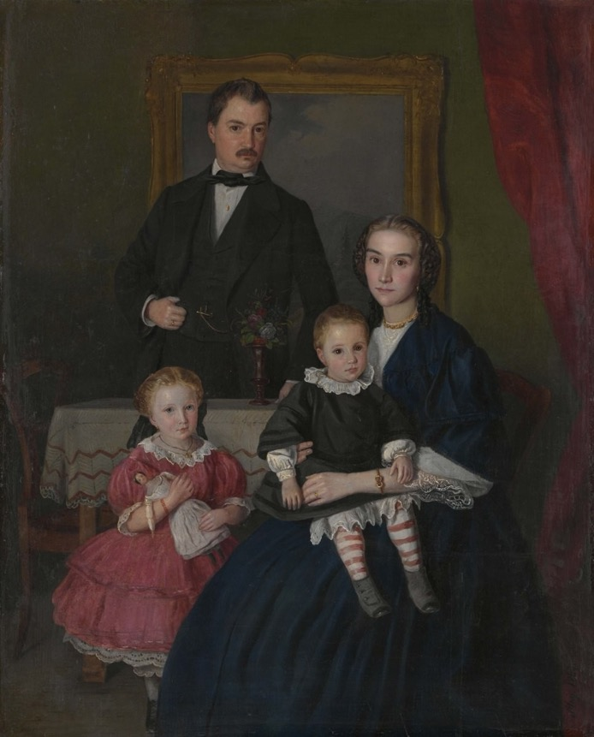
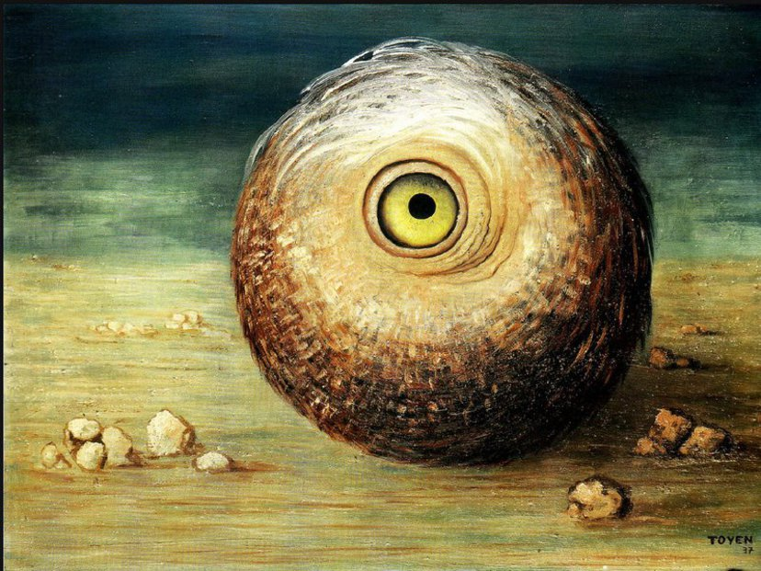
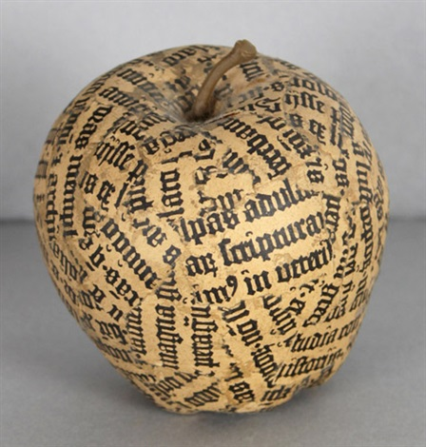
L: Josef Mánes, Family Portrait (1859)
UR: Toyen, Object Phantom (1937)
LR: Jiří Kolář, Apple (1965-70)

