Slide 1
Concepts of iconology: From Visual Lexicon to Social Memory
13 April 2023

Slide 2
Table of contents from Robert Nelson & Richard Schiff, Critical Terms for Art History ( 1996)

Slide 3
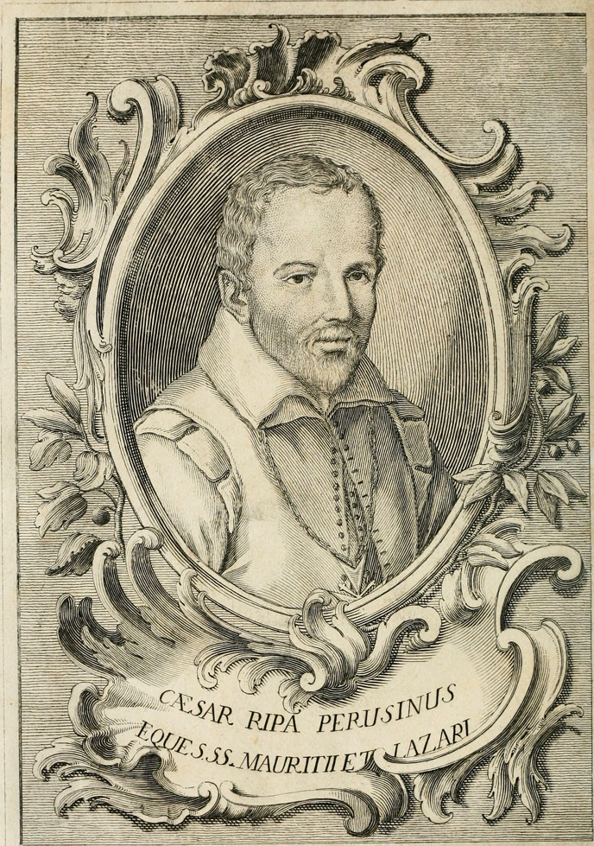
Cesare Ripa
Iconologia overo Descrittione dell’imagini universali cavate dall’antichità et da altri luoghi (1593)

Slide 4
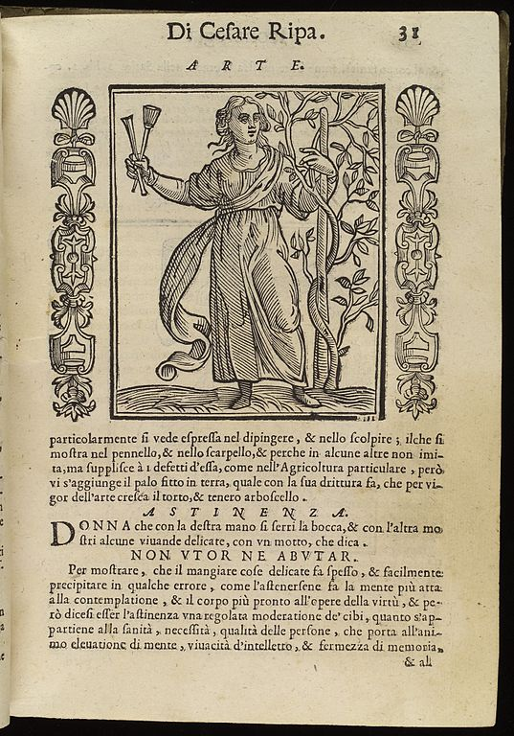
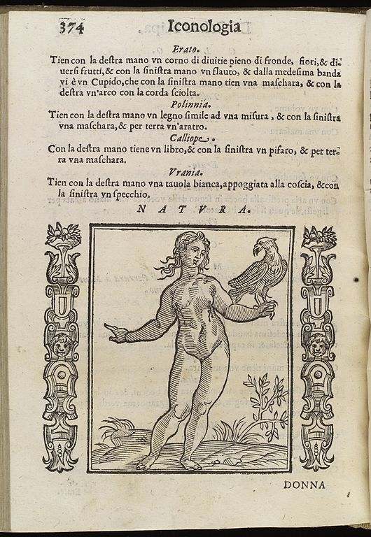

Slide 5
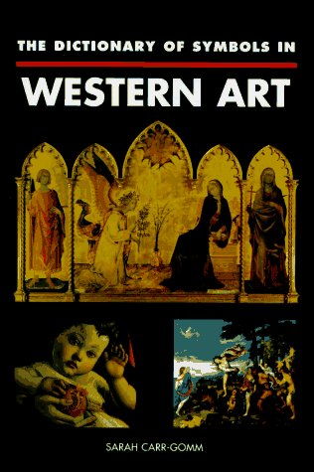
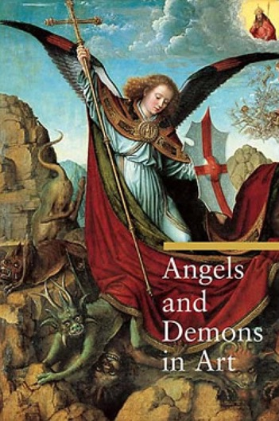
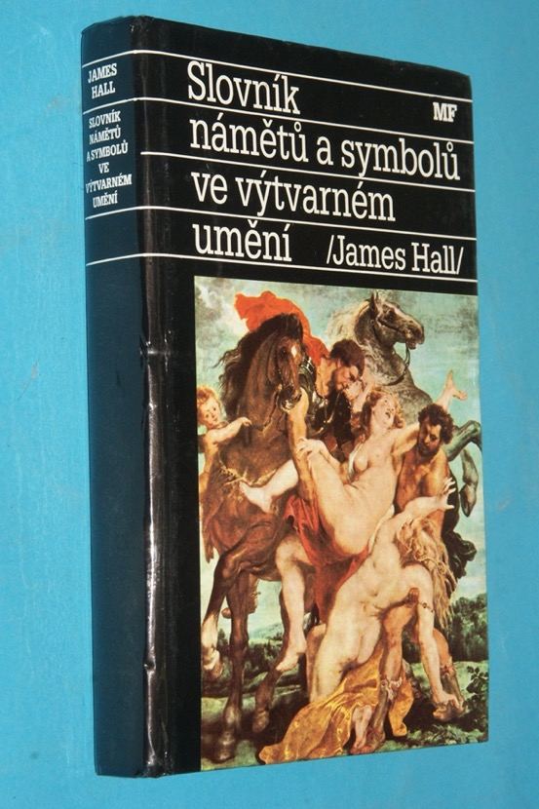
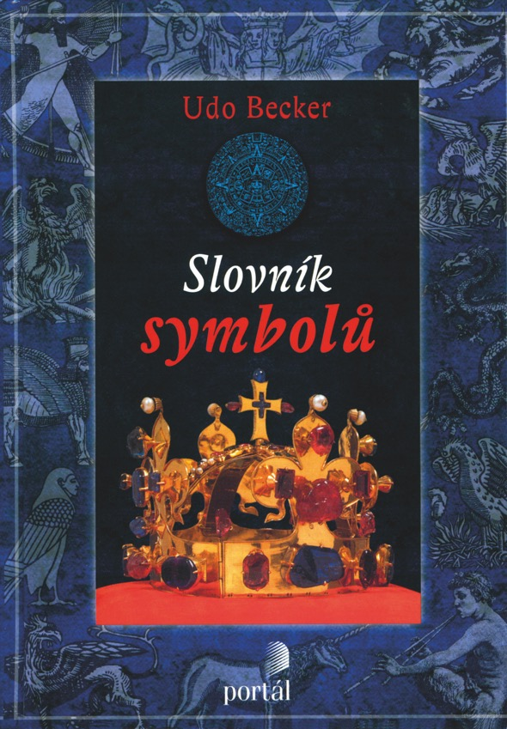
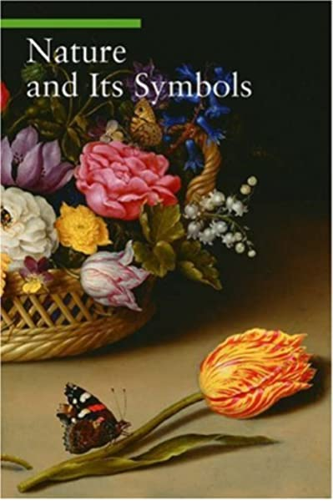
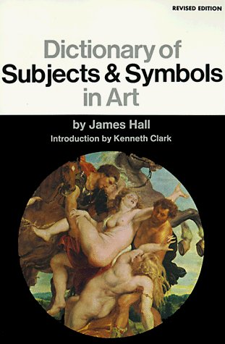

Slide 6
Iconology as Visual Lexicon
Emile Mâle (1862-1954)

Slide 7
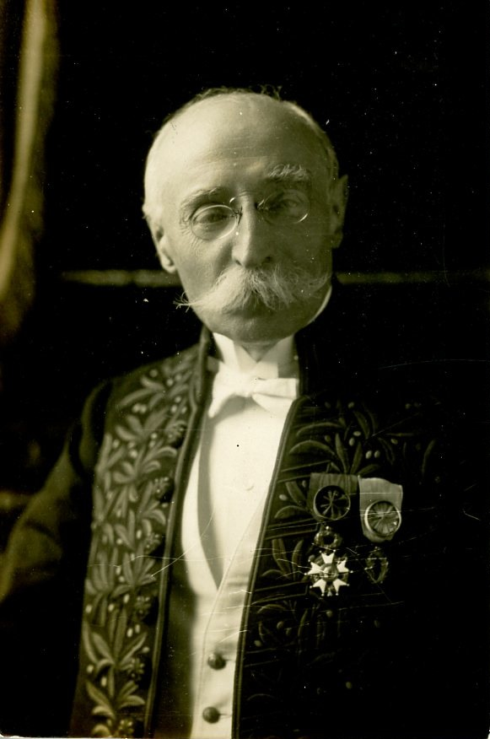
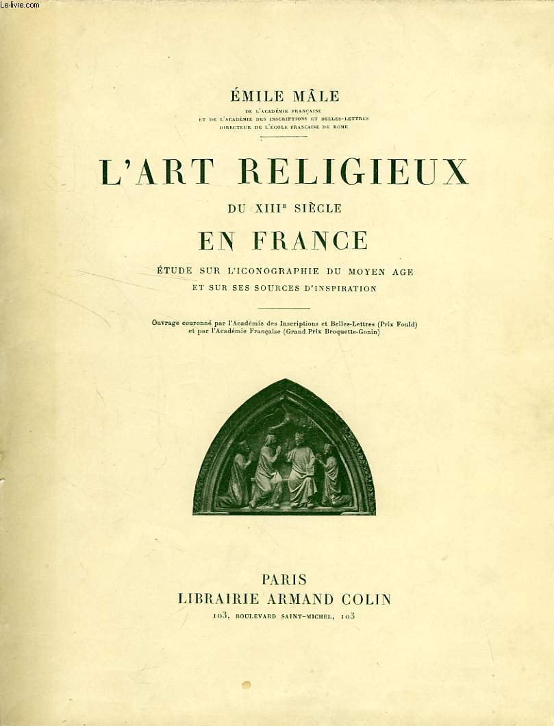
Emile Mâle (1862-1954
L'Art religieux du XIIIe siècle en France (1899). Translated into English as The Gothic Idol.
L'Art religieux de la fin du Moyen Âge en France (1908)

Slide 8
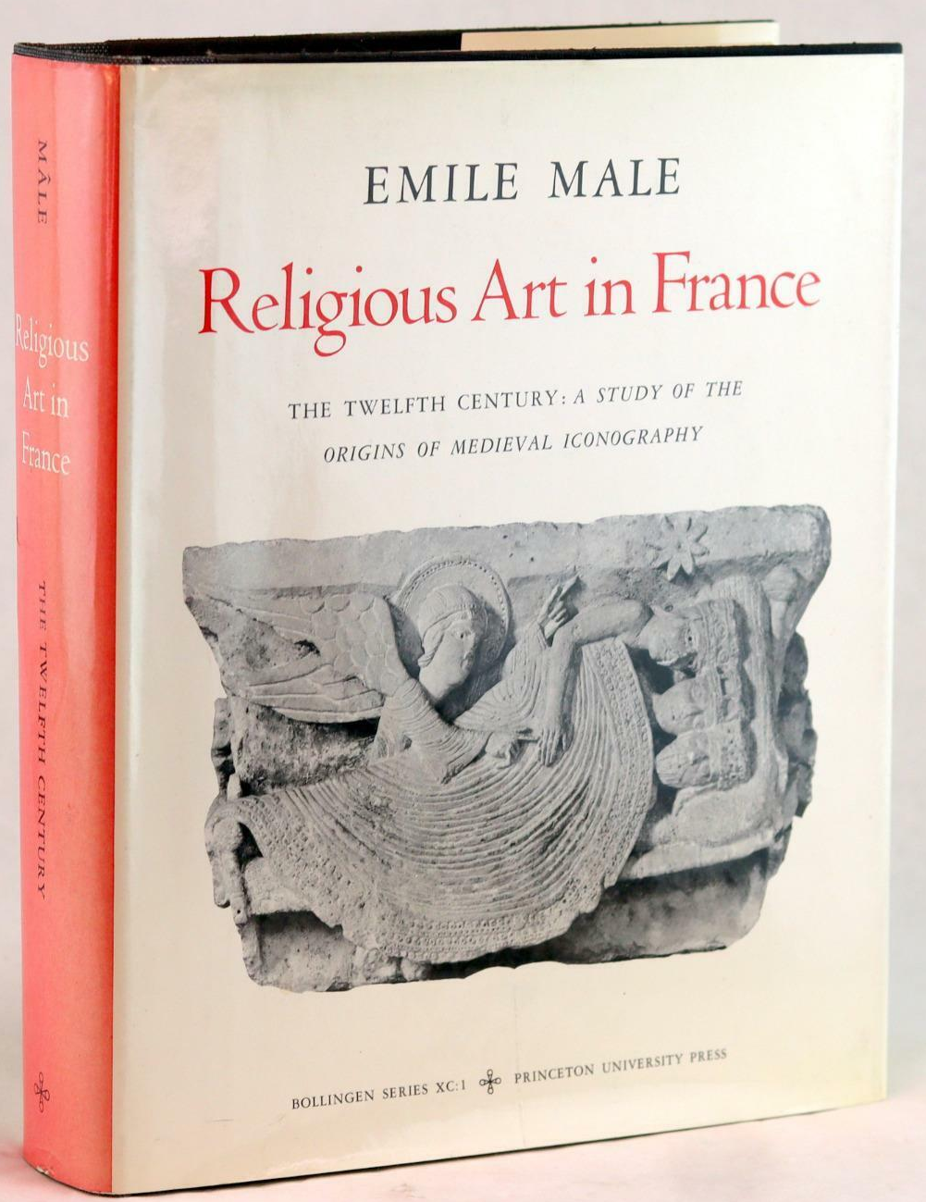
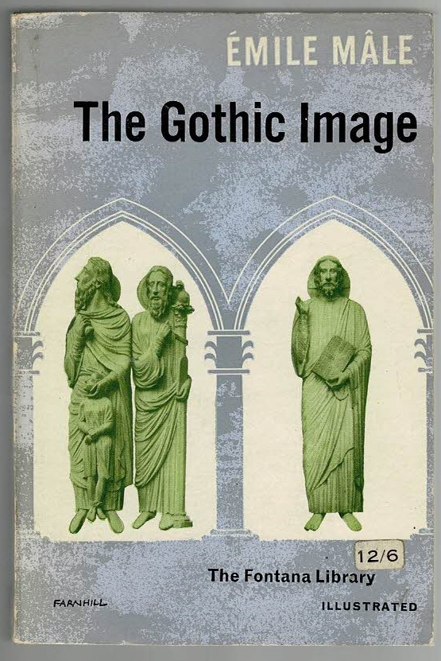

Slide 9
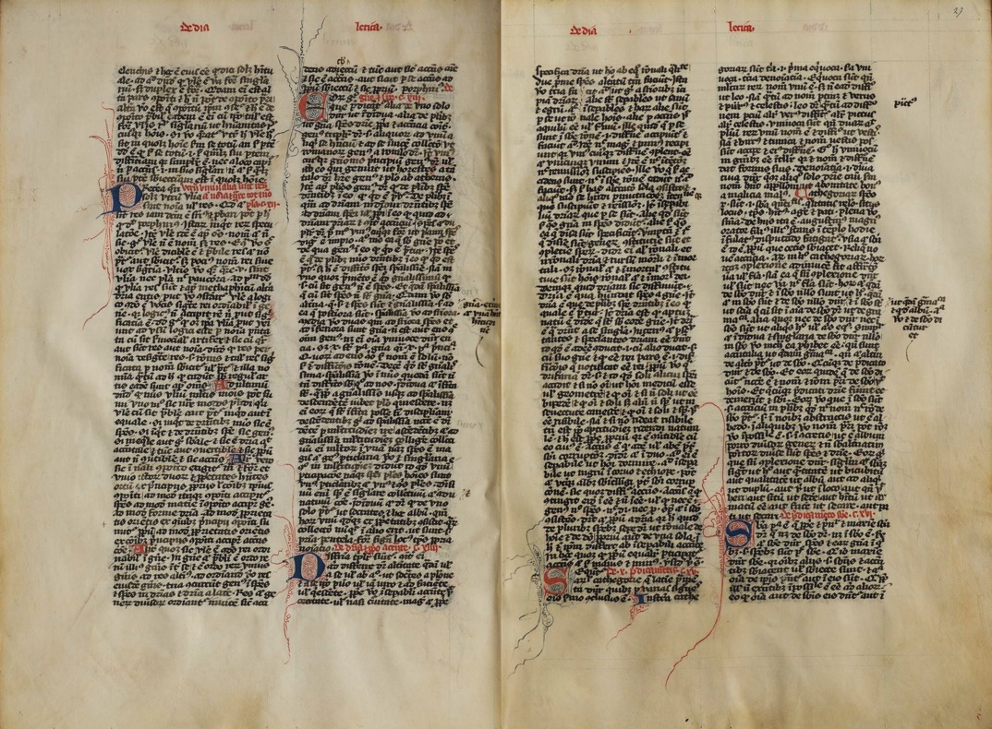
‘If we impose our categories on mediaeval thought, we run every risk of error, and for that reason we borrow our method of exposition from the Middle Age itself. The four books of Vincent of Beauvais's Mirror furnish us with the framework for the four divisions of our study of thirteenth century art.’
Mâle, The Gothic Idol, p. 23
Vincent of Beauvais, Speculum maius (1235-64)
Manuscript from the 14th century

Slide 10
‘The third characteristic of mediaeval art lies in this, that it is a symbolic code. From the days of the catacombs Christian art has spoken in figures, showing men one thing and inviting them to see in it the figure of another. The artist, as the doctors might have put it, must imitate God who under the letter of Scripture hid profound meaning, and who willed that nature too should hold lessons for man.
In mediaeval art there are then intentions, a knowledge of which is necessary to any real understanding of the subject. When for example in scenes of the Last Judgment we see the Wise and Foolish Virgins to the right and left hand of Christ, we should thereby understand that they
symbolise the elect and the lost.’
Mâle, The Gothic Idol, p. 15

Slide 11
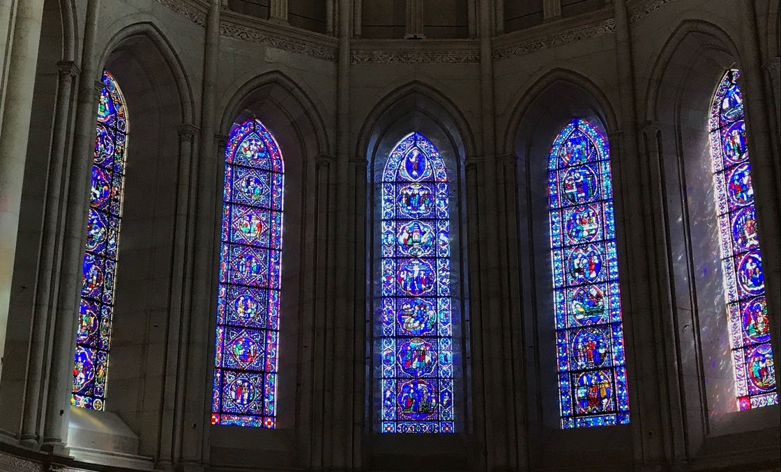
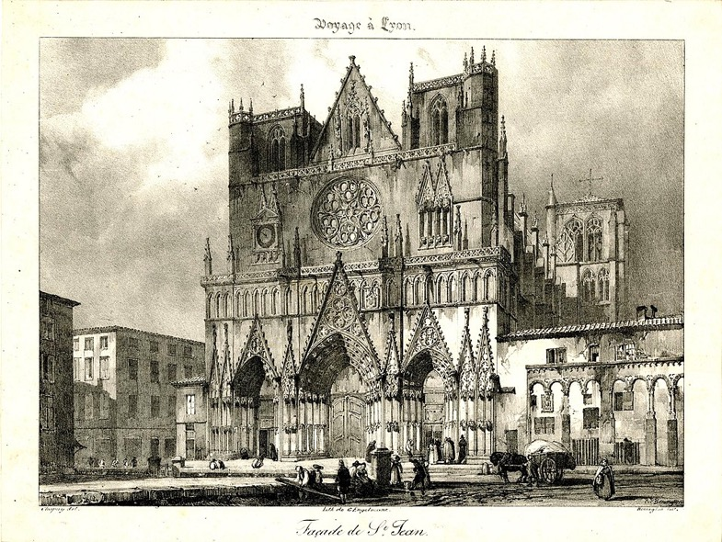
‘The whole world is a symbol. The sun, the stars, the seasons, day and night, all speak in solemn accents. Of what were the Middle Ages thinking in the wintertime when the days were shortening sadly and the darkness seemed to be triumphing for ever over the light ? They thought of the long centuries of twilight that preceded the coming of Christ, and they understood that in the divine drama both light and darkness have their place.’
The Gothic Idol, p. 31

Slide 12
Iconology and Symbolic Forms
Erwin Panofsky (1892-1968)

Slide 13
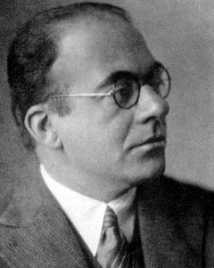
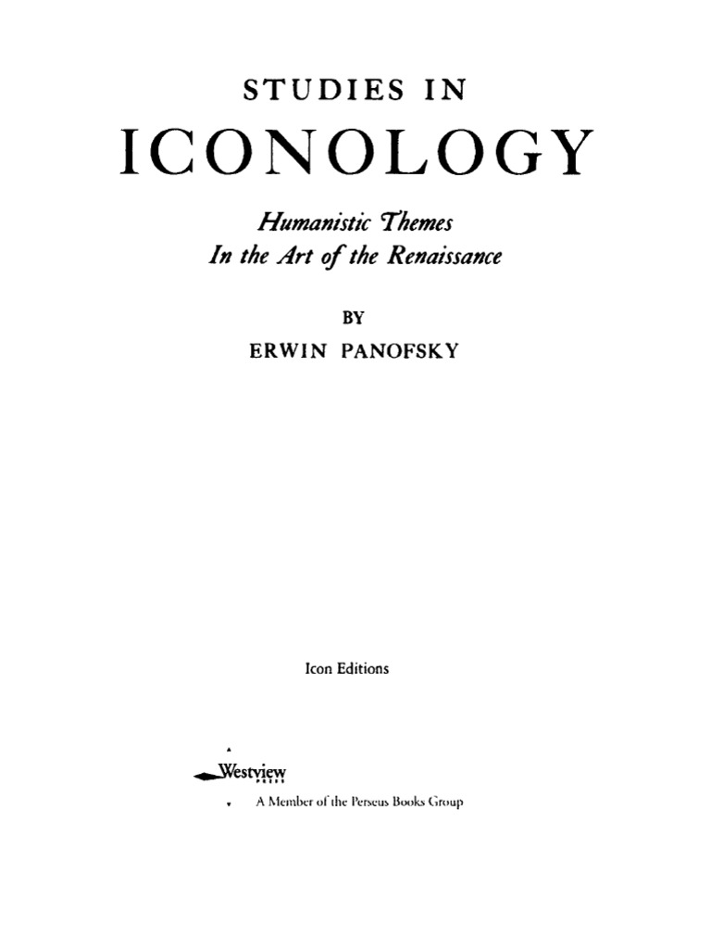
Erwin Panofsky (1892-1968)
Studies in Iconology, first published in 1939

Slide 14
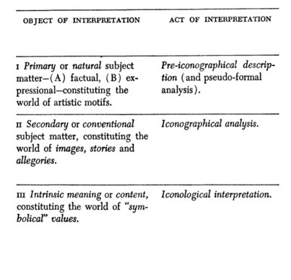
Erwin Panofsky, Studies in Iconology (Oxford, 1939) p. 14

Slide 15
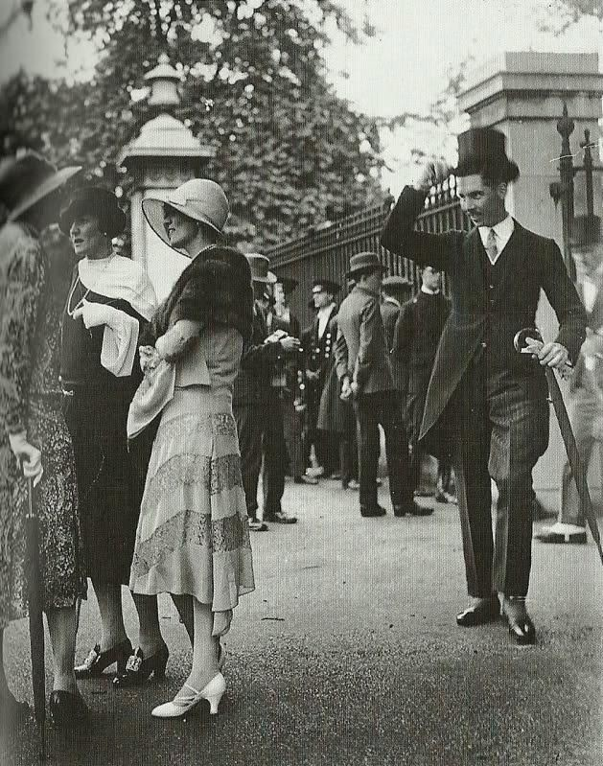
Studies in Iconology (New York, 1962) p. 3

Slide 16
Studies in Iconology (New York, 1962) p. 4

Slide 17
Studies in Iconology (New York, 1962) pp. 4-5

Slide 18
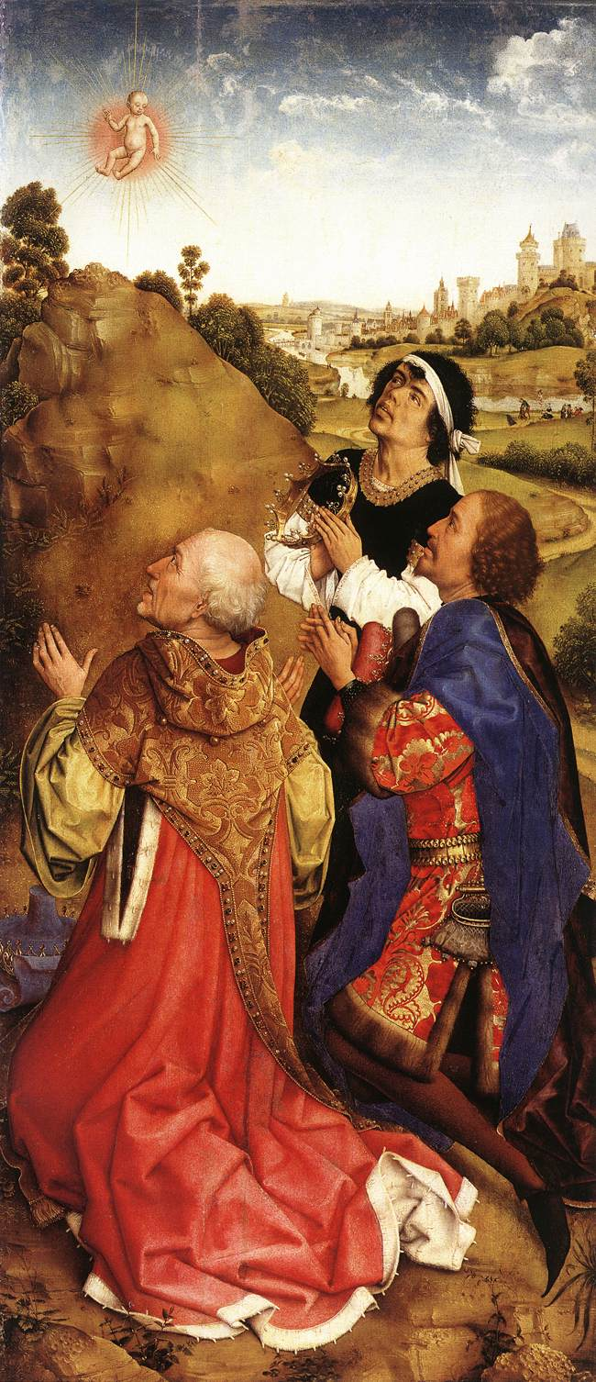
Erwin Panofsky, Studies in Iconology (Oxford, 1939) p. 11
Rogier van der Weyden
Adoration of the Magi, the right wing from the Bladelin Altarpiece, ca. 1450

Slide 19
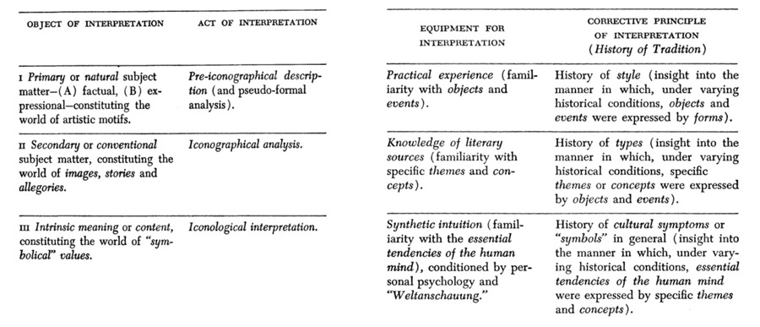
Erwin Panofsky, Studies in Iconology (Oxford, 1939) p. 14

Slide 20
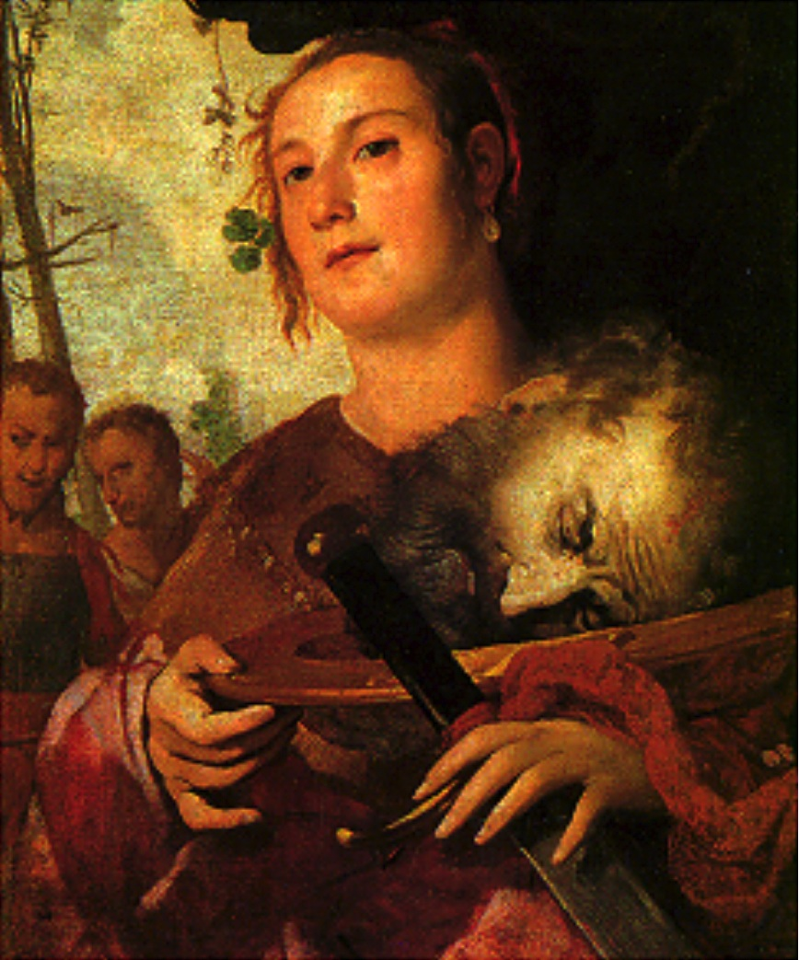
Francesco Maffei
Judith or Salome? (1650-60)

Slide 21
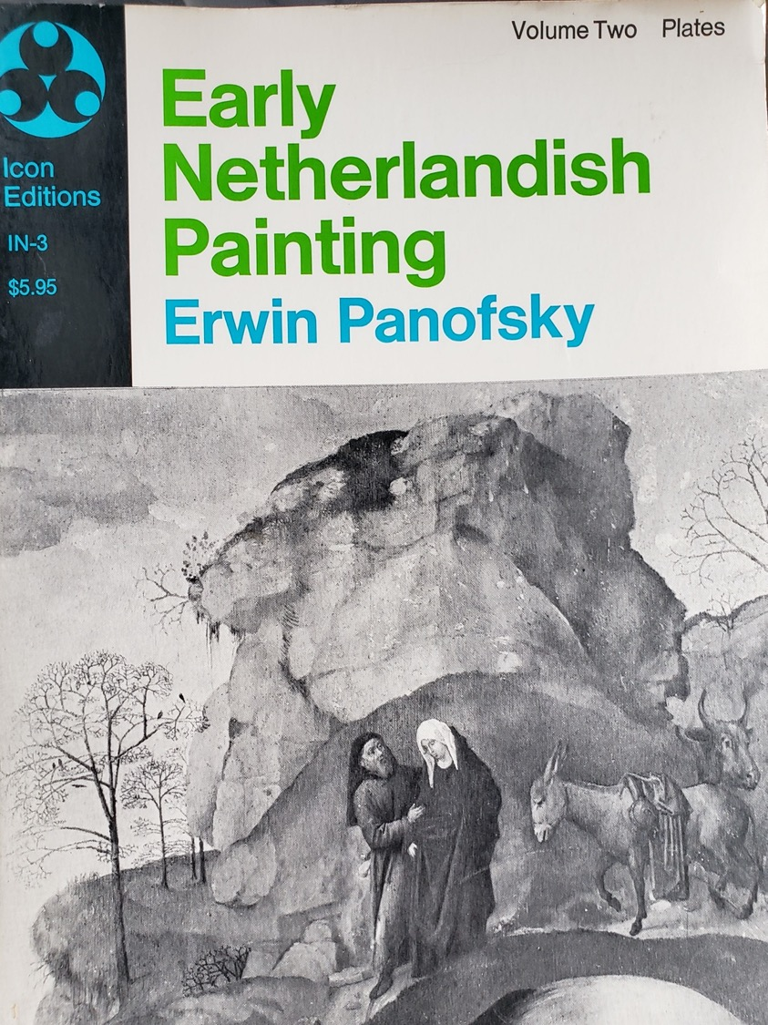
Erwin Panofsky
Early Netherlandish Painting (New York, 1953)

Slide 22
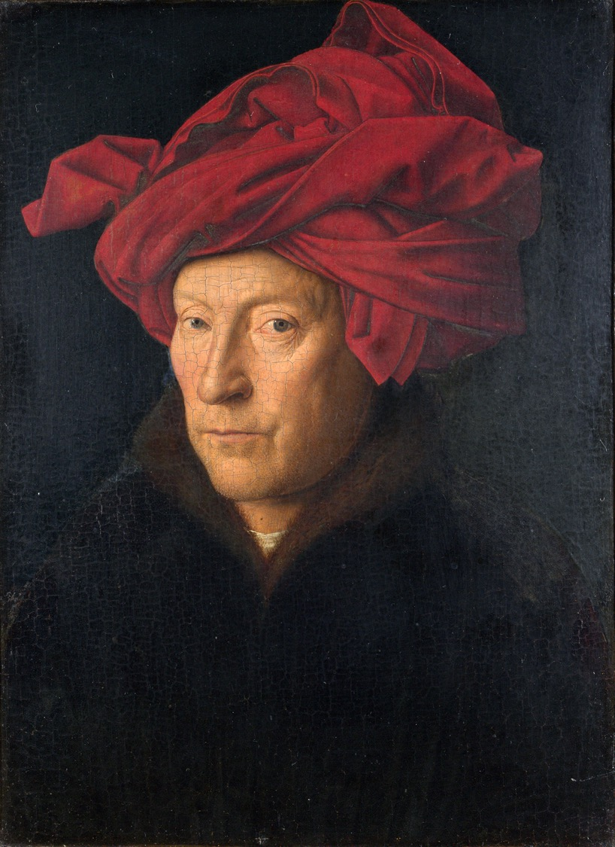
Jan van Eyck
Man with a Turban (possible self-portrait) (1433)

Slide 23
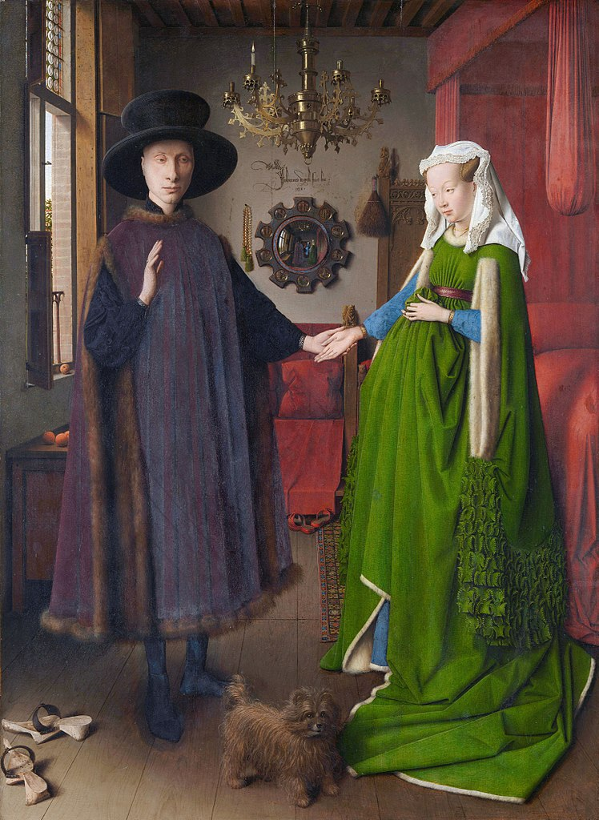
Jan van Eyck
The Arnolfini Betrothal (1434)

Slide 24
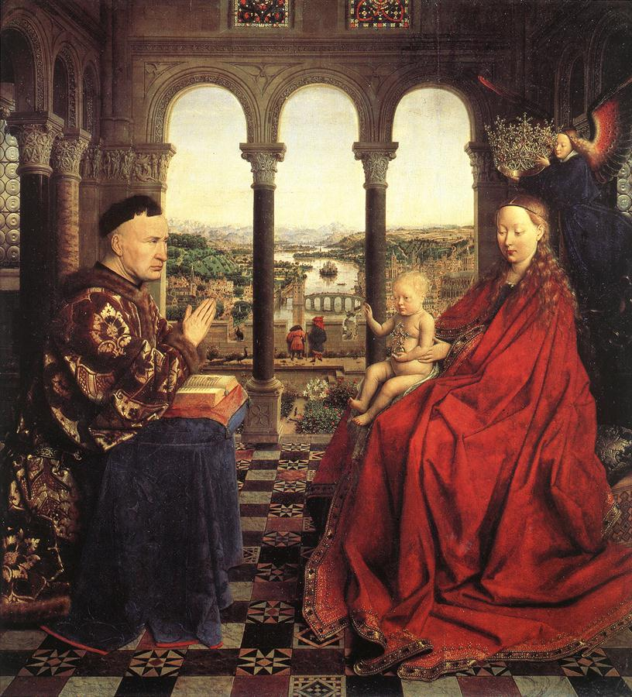
|Jan van Eyck
Madonna of Chancellor Rolin (1435)

Slide 25
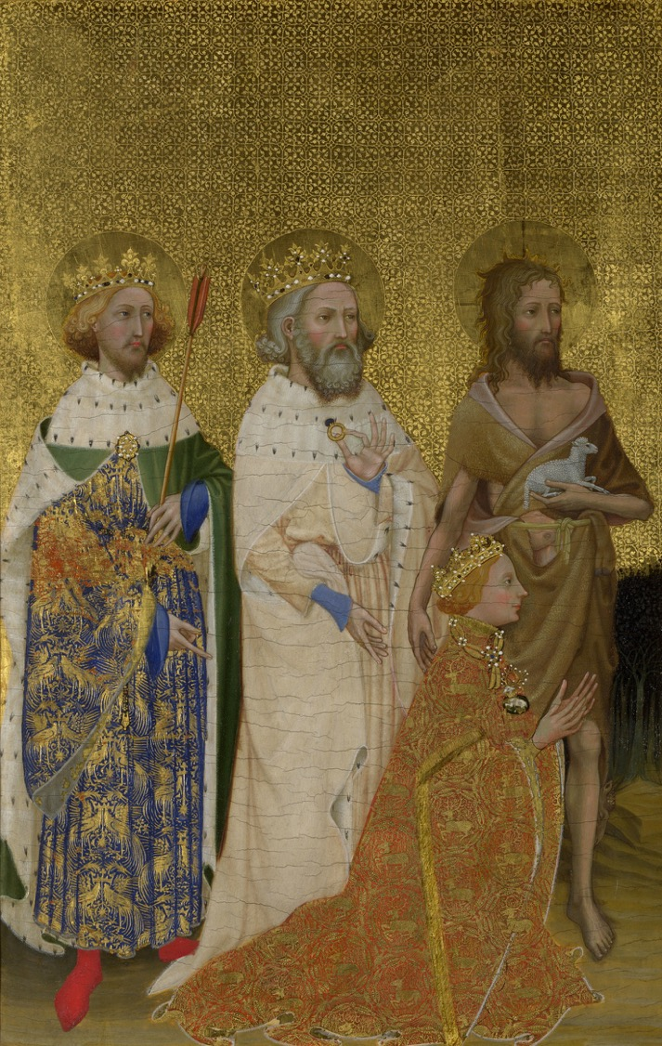
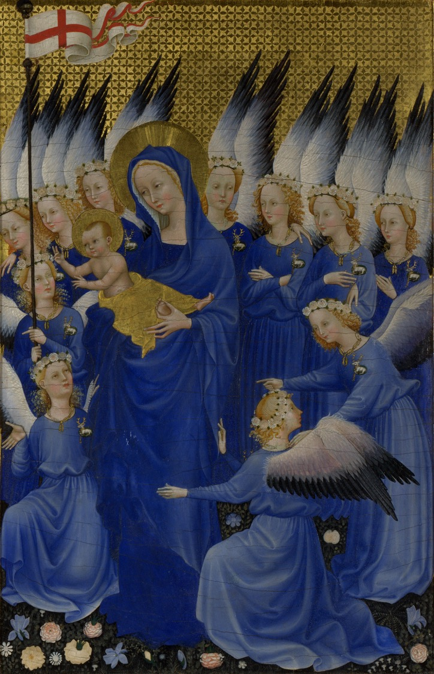
Anon, The Wilton Diptych (ca. 1395-99)

Slide 26
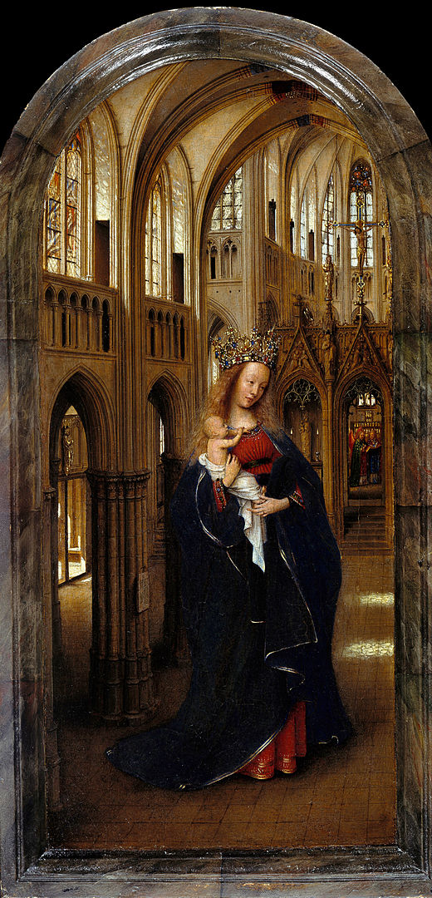
Jan van Eyck
The Madonna in the Church (ca. 1438-40)
Gemäldegalerie, Berlin

Slide 27
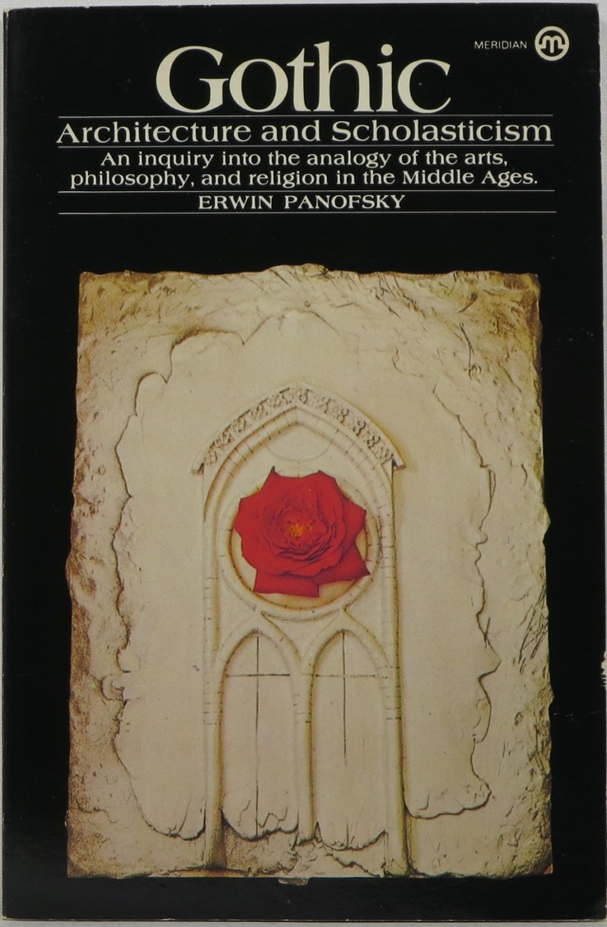
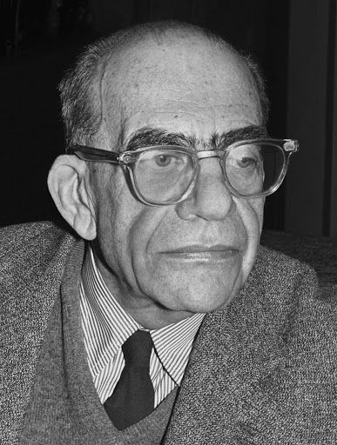
Erwin Panofsky (1892-1968)
Gothic Architecture and Scholasticism (1951)

Slide 28
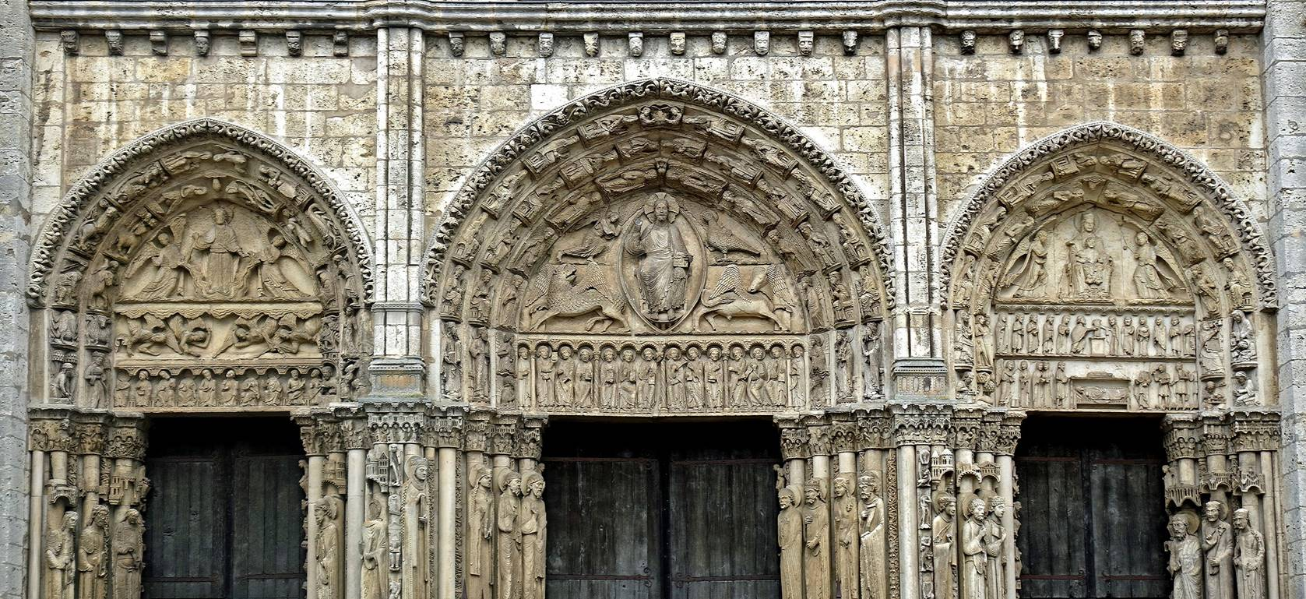
‘It has justly been remarked that the gentle animation that distinguishes the Early Gothic figures in the west facade of Chartres from their Romanesque predecessors reflects the renewal of an interest in psychology which had been dormant for several centuries; but this psychology was still based upon the Biblical—and Augustinian—dichotomy between the “breath of life'' and the “dust of the ground”.’
Panofsky, Gothic Architecture and Scholasticism, p. 6-7

Slide 29
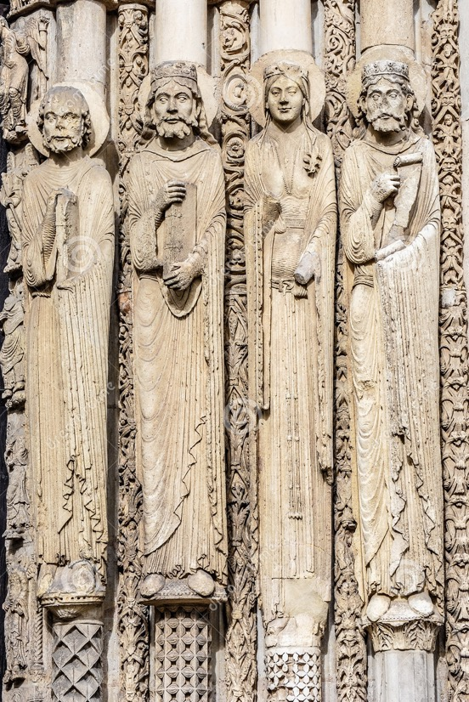
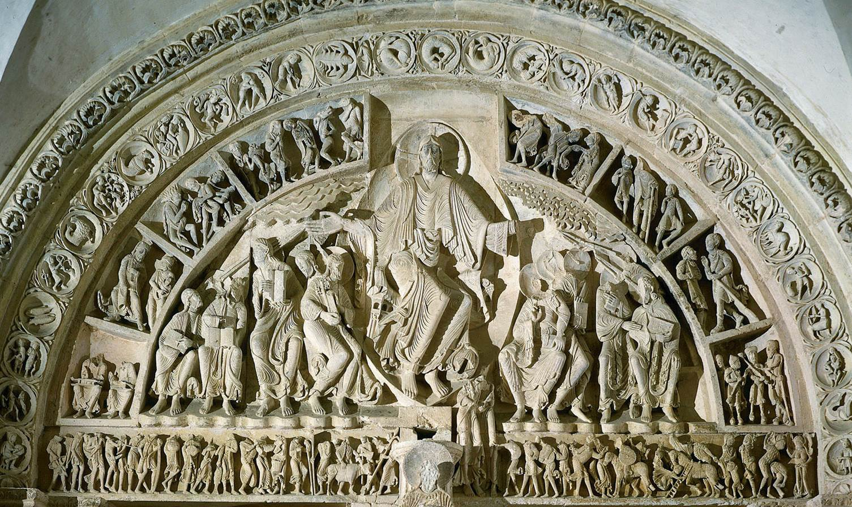
L: Sculptures of the Prophets from the West Front Royal Portal of Chartres Cathedral (mid-12th century CE)
R: Tympanum sculptures of Vézelay Abbey (ca. 1120-30)

Slide 30
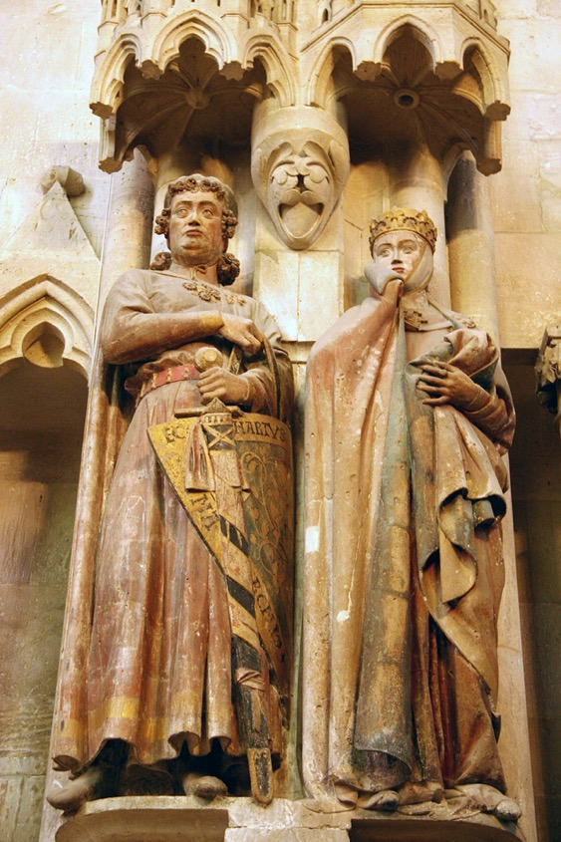
The infinitely more lifelike —though not, as yet, portrait-like — High Gothic statues of Reims and Amiens, Strassburg and Naumburg and the natural — though not, as yet, naturalistic — fauna and flora of High Gothic ornament proclaim the victory of Aristotelianism. The human soul, though recognized as immortal, was now held to be the organizing and unifying principle of the body itself rather than a substance independent thereof. A plant was thought to exist as a plant and not as the copy of the idea of a plant.’
Panofsky, Gothic Architecture and Scholasticism, p. 6-7
Margrave Ekkehard II and Uta, Naumburg Cathedral (mid-13th century)

Slide 31
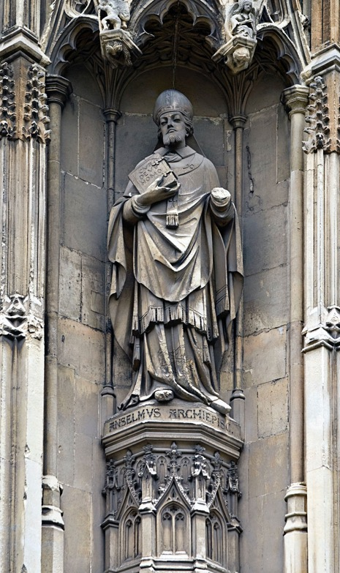
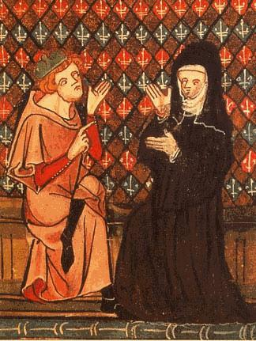
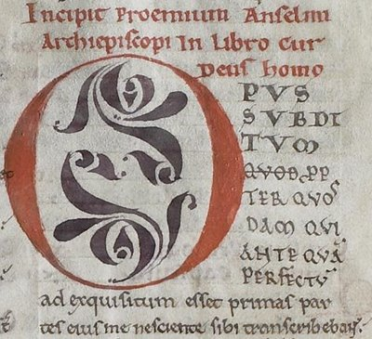
‘ …. we can observe, it seems to me, a connection between Gothic art and Scholasticism which is more concrete than a mere “parallelism" and yet more general than those individual (and very important) “influences" which are inevitably exerted on painters, sculptors, or architects by erudite advisers. In contrast to a mere parallelism, the connection which I have in mind is a genuine cause-and-effect relation; It comes about by the spreading of what may be called, for want of a better term, a mental habit …’
Panofsky, Gothic Architecture and Scholasticism p. 20
L: Portrait of St. Anselm of Canterbury, (1033-1109) Canterbury Cathedral (late 12th century CE)
R: Pierre Abelard (1079-1142) and Héloise d’Argenteuil (ca. 1100-1163/64)
L: The beginning of St. Anselm, Cur Deus Homo (1094-98)

Slide 32
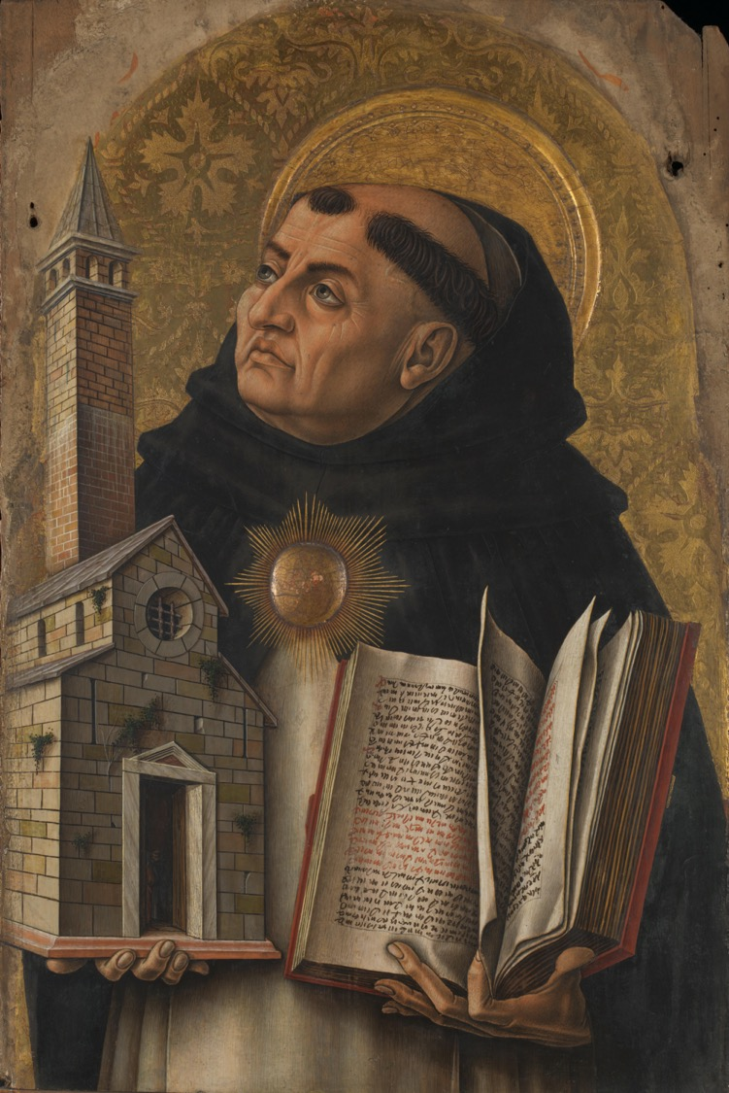
‘ “Sacred doctrine"' says Thomas Aquinas, “makes use of human reason, not to prove faith but to make clear (manifestare) whatever else is set forth in this doctrine.” … We take it for granted that major works of scholarship, especially systems of philosophy and doctoral theses, are organized according to a scheme of division and subdivision, condensable into a table of contents or synopsis, where all parts denoted by numbers or letters of the same class are on the same logical level … However, this kind of systematic articulation was quite unknown until the advent of Scholasticism.’
Panofsky, Gothic Architecture and Scholasticism p. 29 and 32
Carlo Crivelli, Portrait of Thomas Aquinas (1225-74) (1476)

Slide 33
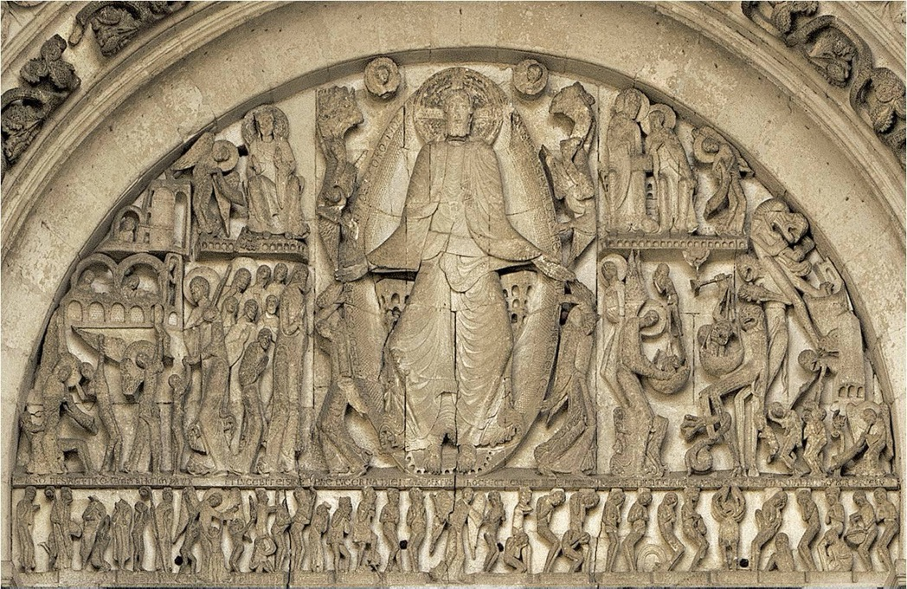
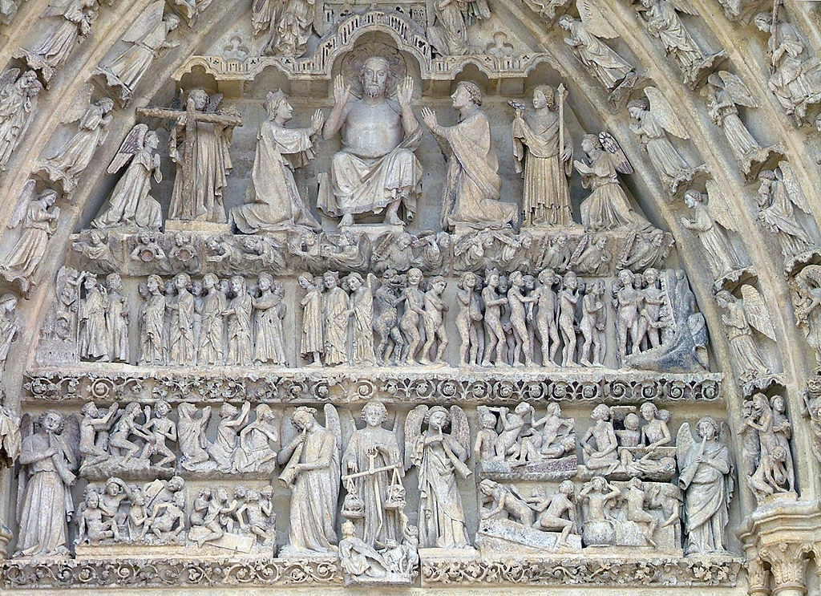
L: Autun Cathedral, Last Judgement West Portal (ca. 1130)
R: Amiens Cathedral, Last Judgement West Portal (120-1236)

Slide 34
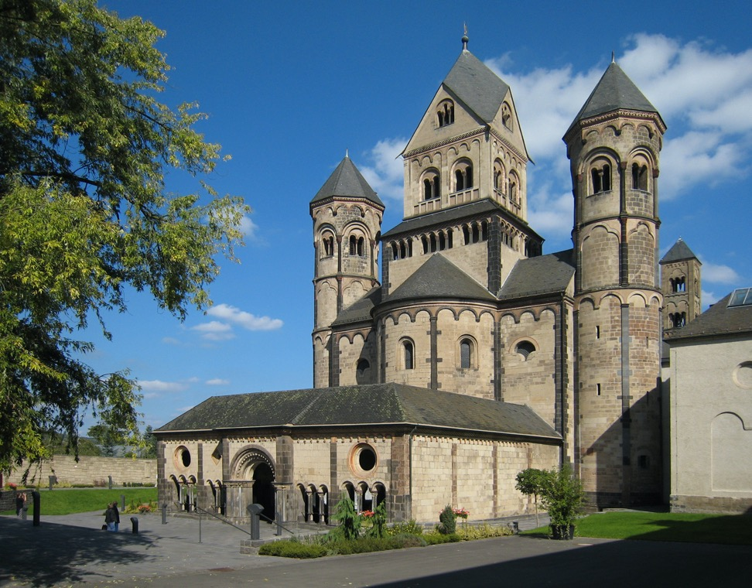
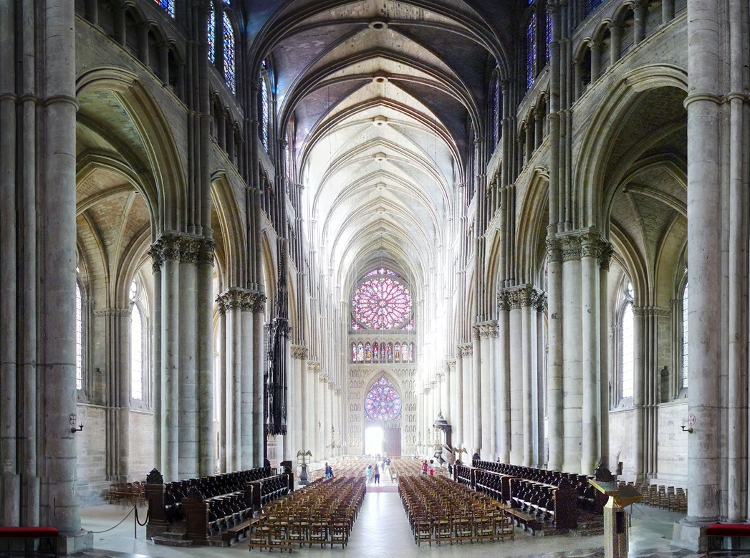
Reims Abbey (1211-1345)
Maria Laach Abbey (1158)

Slide 35
Criticisms of Iconography

Slide 36
Panofsky’s idea of intrinsic meaning was never clearly articulated – but it seemed to be about unconscious meanings and symbolic values of a culture
However …. this was eclipsed by the social history of art in which such unconscious meanings are reinterpreted as ideology. But this means that iconology is perhaps blind to the political meanings of symbols
Iconology easily degenerated into a mere cataloguing of symbols and images – and forcing them into pre-existing categories. It seems reluctant to accept ambiguity and contradiction. It treated artworks as puzzles to be ‘solved’

Slide 37
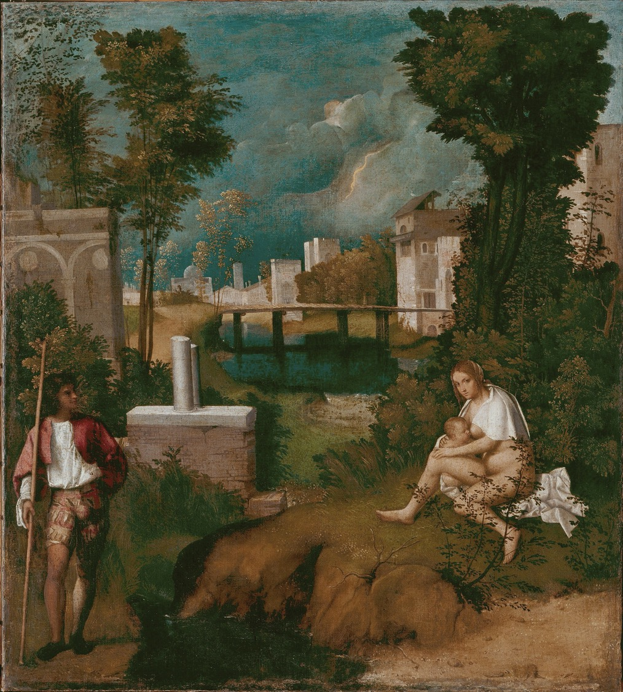
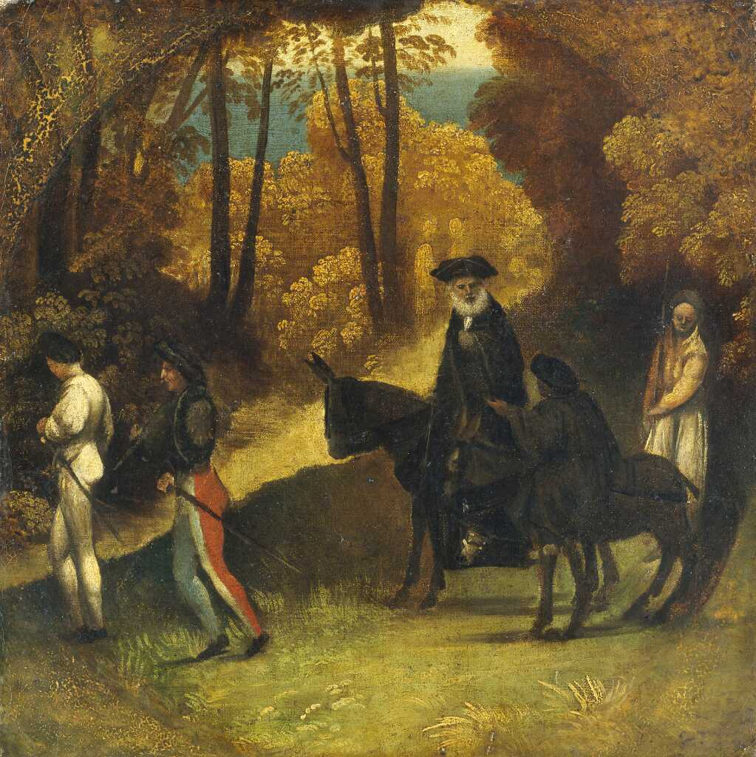
Dosso Dossi, Travellers in a Wood (1520)
Giorgione, The Tempest (1508)

Slide 38
‘ … along with a complex allusive logic of learned reference, assumed so widely in recent studies, other developments must be emphasized: there are pictures with no subject at all (Dosso); there are those with ordinary surface subjects in which it is really correct, and not merely obscurantist, to reject symbolic depths (sleeping Child theme, Tempest); and there are also those which have capricious subjects determined by an artist's personal stress (Flagellation, Ficino theme). All these have been alleged by the "romantic" historians perhaps for the wrong reason that they disliked the "inartistic" exactitude of iconology, and perhaps muddling them together and applying them without justification. Yet if these intuitions are examined, it would seem equally wrong, and perhaps equally the result of cultural pressures, to apply too far the idea of cultural precision.’
Creighton Gilbert, ‘On Subject and Not-subject in Italian Renaissance Pictures,’ Art Bulletin, Sep., 1952, Vol. 34, No. 3 (Sep., 1952) p. 216

Slide 39
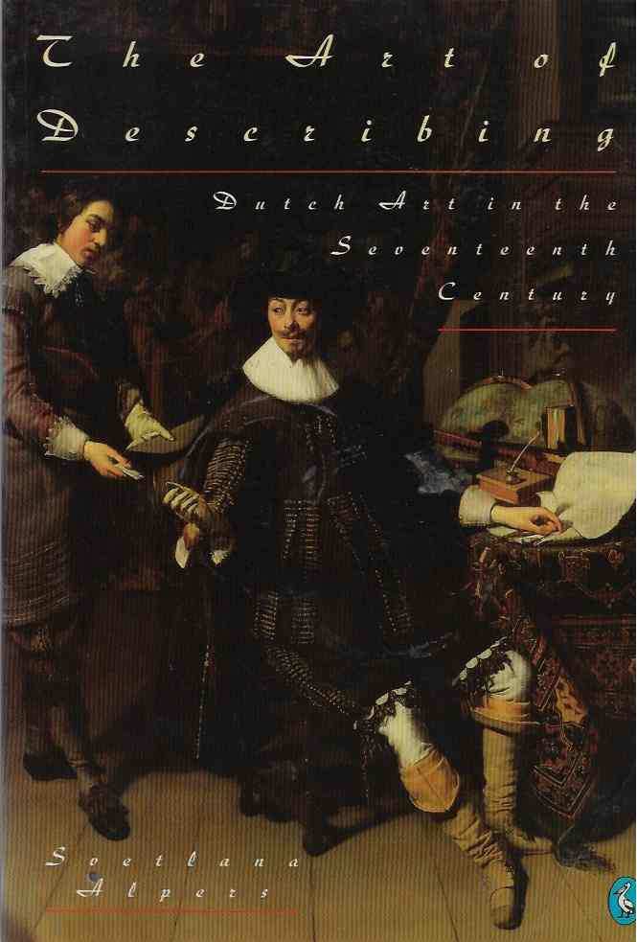
Svetlana Alpers, The Art of Describing (Chicago, 1983) p. xix

Slide 40
Alpers, The Art of Describing, p. xx and p. xx1

Slide 41
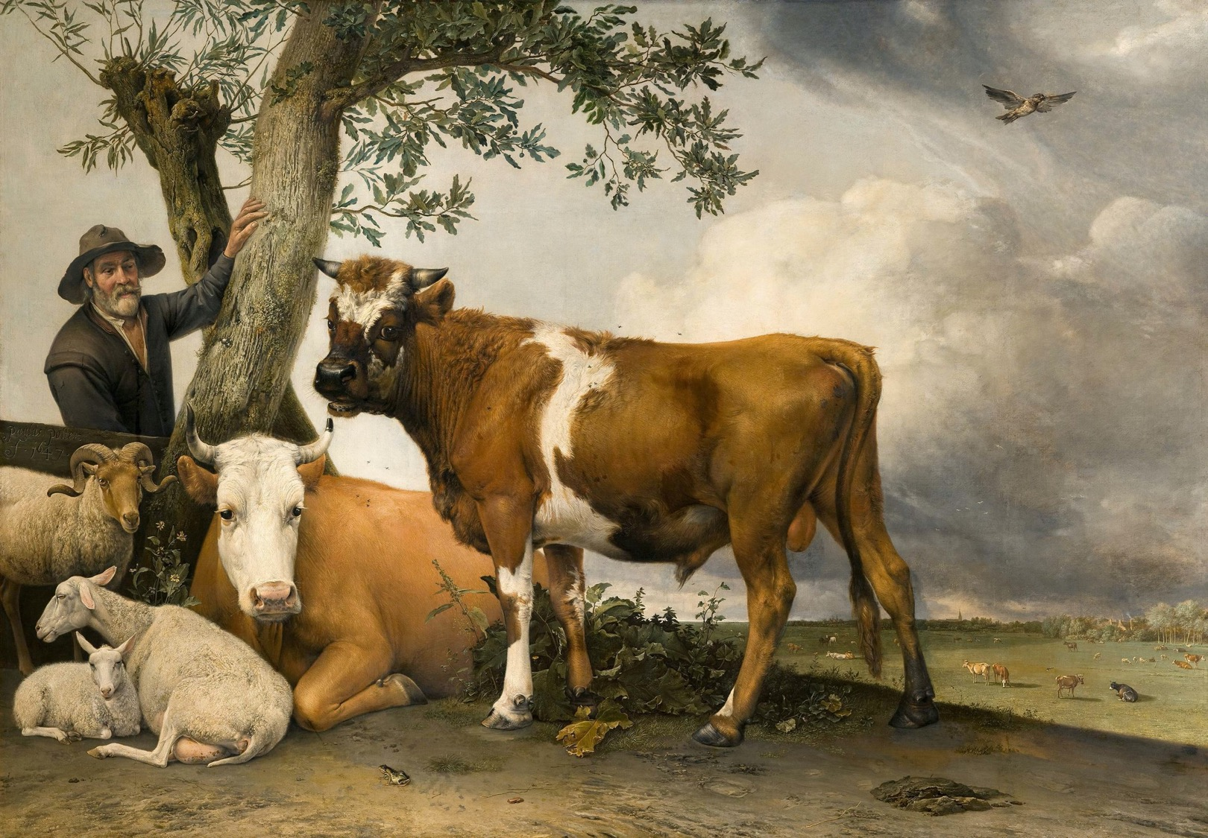
Paulus Potter, Young Bull (1647)

Slide 42
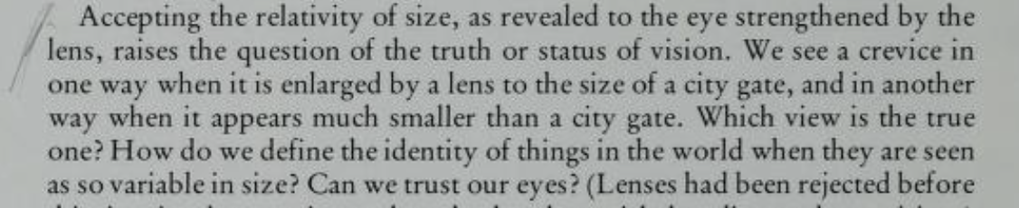
Alpers, The Art of Describing, p. 22

Slide 43
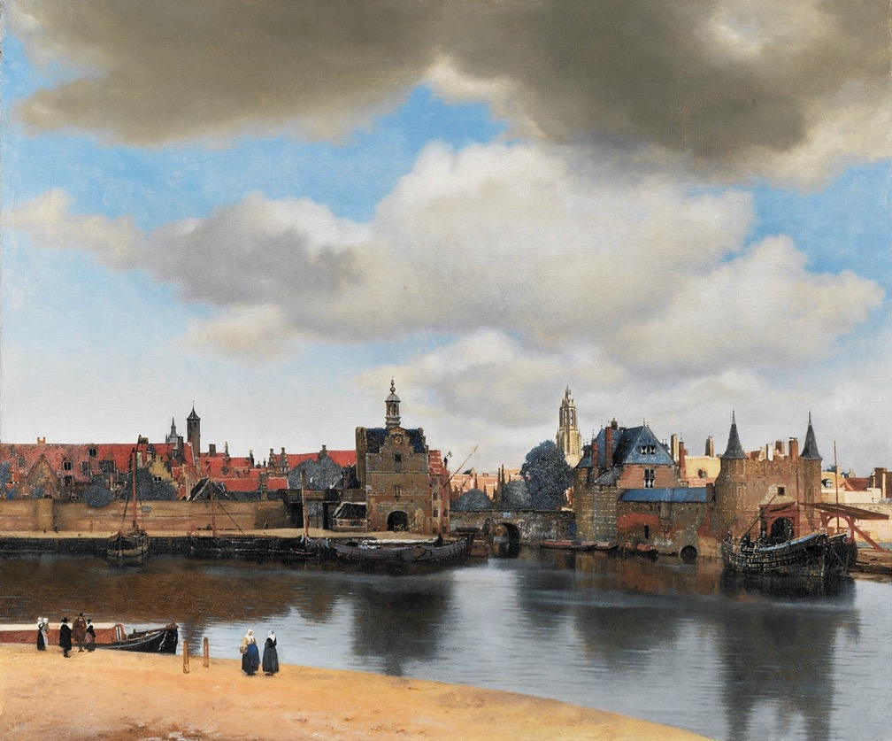

L: Jan Vermeer, View of Delft (1660-1661)
R: Jan Vermeer, The Art of Painting (1666-68)

Slide 44
Iconology as Social Memory
Aby Warburg (1866-1929)

Slide 45

Aby Warburg (1866-1929)

Slide 46




Slide 47


It is possible to trace., step by step, how the artists and their advisors recognised the antique as a model that demanded an intensification of outward movement, and how they turned to antique sources whenever accessory forms – those of garments and of hair – were to be represented in motion.
It may be adduced that this evidence has its value for psychological aesthetics in that it enables us to observe, within a milieu of working artists, an emerging sense of the aesthetic act of “empathy” as a determinant of style.’
Warburg, ‘Sandro Botticelli’s Birth of Venus and Primavera’ in The Renewal of Pagan Antiquity p. 89

Slide 48

‘In the late 15th century the antique as a source of poised and measured beauty – the hallmark of its influence as we have known it since Winckelmann – still counted for comparatively little. The figures of ancient myth appeared … as figures full of life and colour, in the festival pageants through which pagan joie de vivre had kept its foothold in popular culture.’
Warburg, ‘Sandro Botticelli’ (1898) in The Renewal of Pagan Antiquity, p. 161

Slide 49






Slide 50


Slide 51


Laocoon, 1st century BCE
Friedrich Nietzsche (1873)
Source: Bridgeman

Slide 52


Albrecht Dürer
Death of Orpheus (1494)

Slide 53

‘I am by no means ashamed of being a Jew. On the contrary, I attempt to show to others that representatives of my kind are well suited to using their talents in order to fit in as useful members into the development of culture and the state.’
Aby Warburg, Letter to his mother, 26 January 1887
Aby Warburg on military service in Karlsruhe (1892-1893)

Slide 54

Legend of the Jew calling the Devil from a Vessel of Blood, from
Pierre Boaistuau, Histoires Prodigieuses (Paris, 1560)

Slide 55


L : Lucio Tosani - Medallion of the legend of Simonino di Trento (Palazzo Salvadori, Trento, 1515)
R: The legend of Simon of Trent, from Hartmann Schedel, Weltchronik (1493)

Slide 56


‘Death of Orpheus: Return of the eternally unchanging beast, genus: homo sapiens’ (Warburg)
L: The Pogrom in Białystok, 1906
R: Members of the Jewish workers’ Bund, with colleagues murdered in the 1905 pogrom.

