Slide 1
Horizontal Art History
13 April 2023

Slide 2
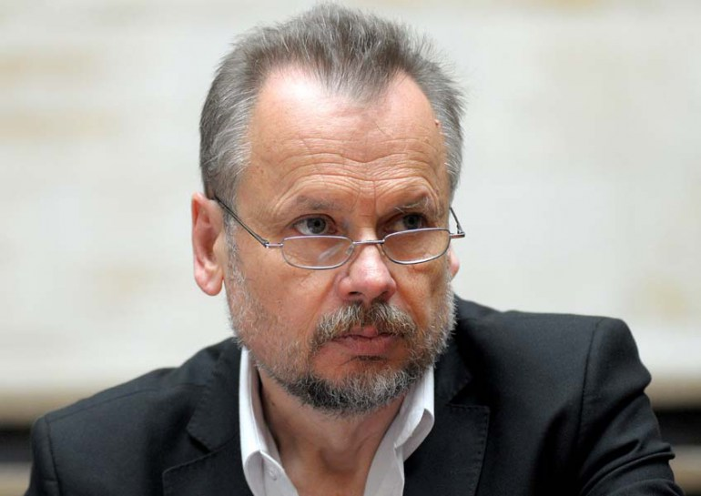
Piotr Piotrowski (1952-2015)

Slide 3
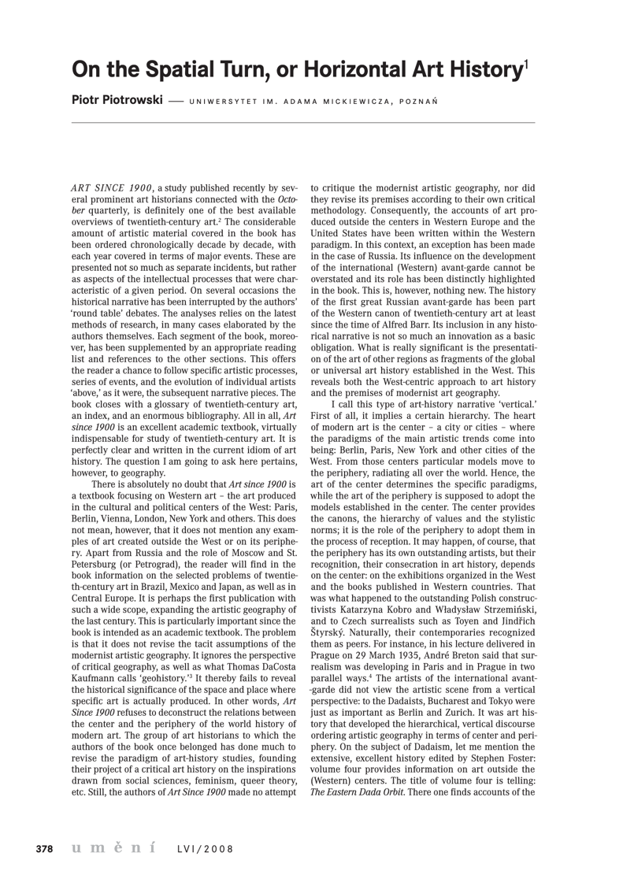

Slide 4
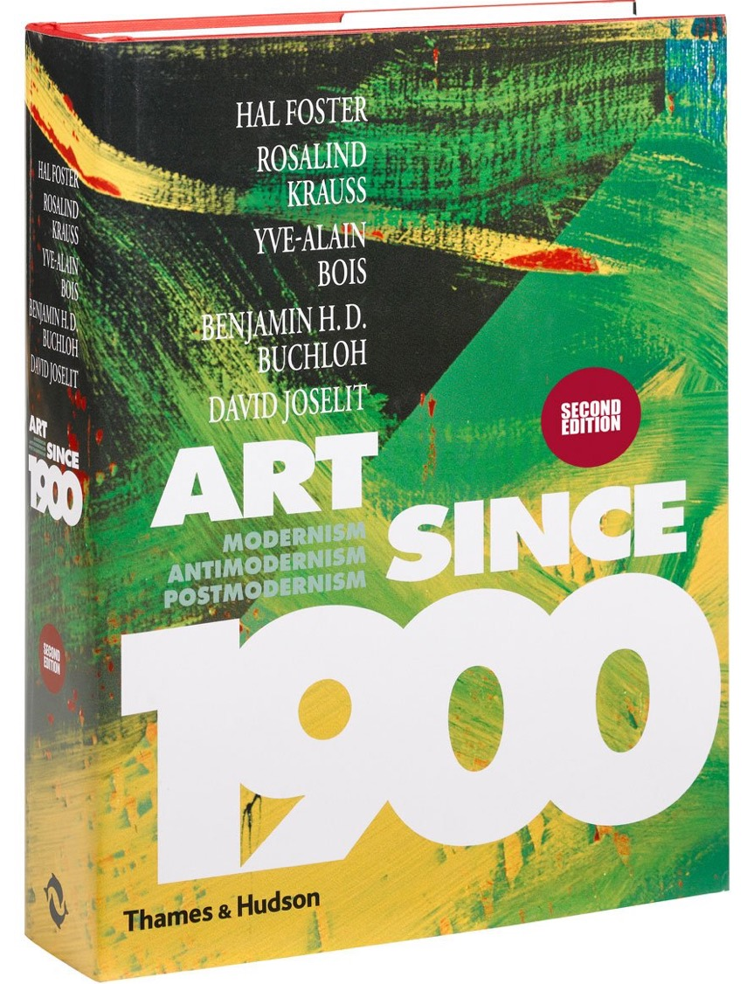

Slide 5
Centres and Peripheries

Slide 6
‘The history of European art has been largely the history of a number of centres, from each of which a style has spread out. For a time, whether short or long, this style dominates the art of the period, turning in effect into an international style, while remaining metropolitan at the centre and becoming more and more provincial as it reaches the periphery. A style docs not develop spontaneously over a large area . It is the creation of a centre, a single unit that provides the impulse. The centre may be small, like fifteenth century Florence, or large, like Paris before the war, but it has the self-confidence and coherence of a metropolis.’
Sir Kenneth Clark, Provincialism (London, 1962) p. 3

Slide 7
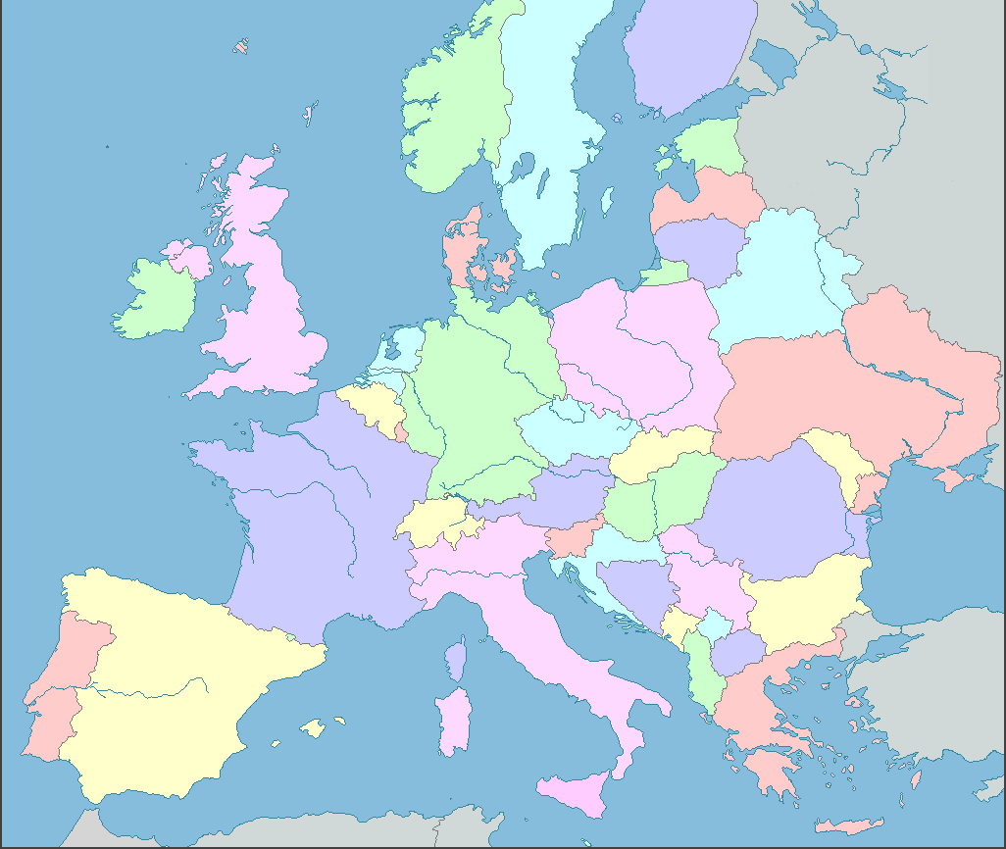
Main Art Centres in Europe, 1400 – 1900
According to standard accounts of art history
e.g.
Fauré, Histoire de l’art (1921)
Henri Focillon, Art of the West (1938)
Gombrich, Story of Art (1950)
Germain Bazin, A Concise History of Art (1958)
Amsterdam
London
Berlin
Bruges/ Ghent
Munich
Paris
Vienna
Venice
Milan
Florence
Madrid
Rome

Slide 8
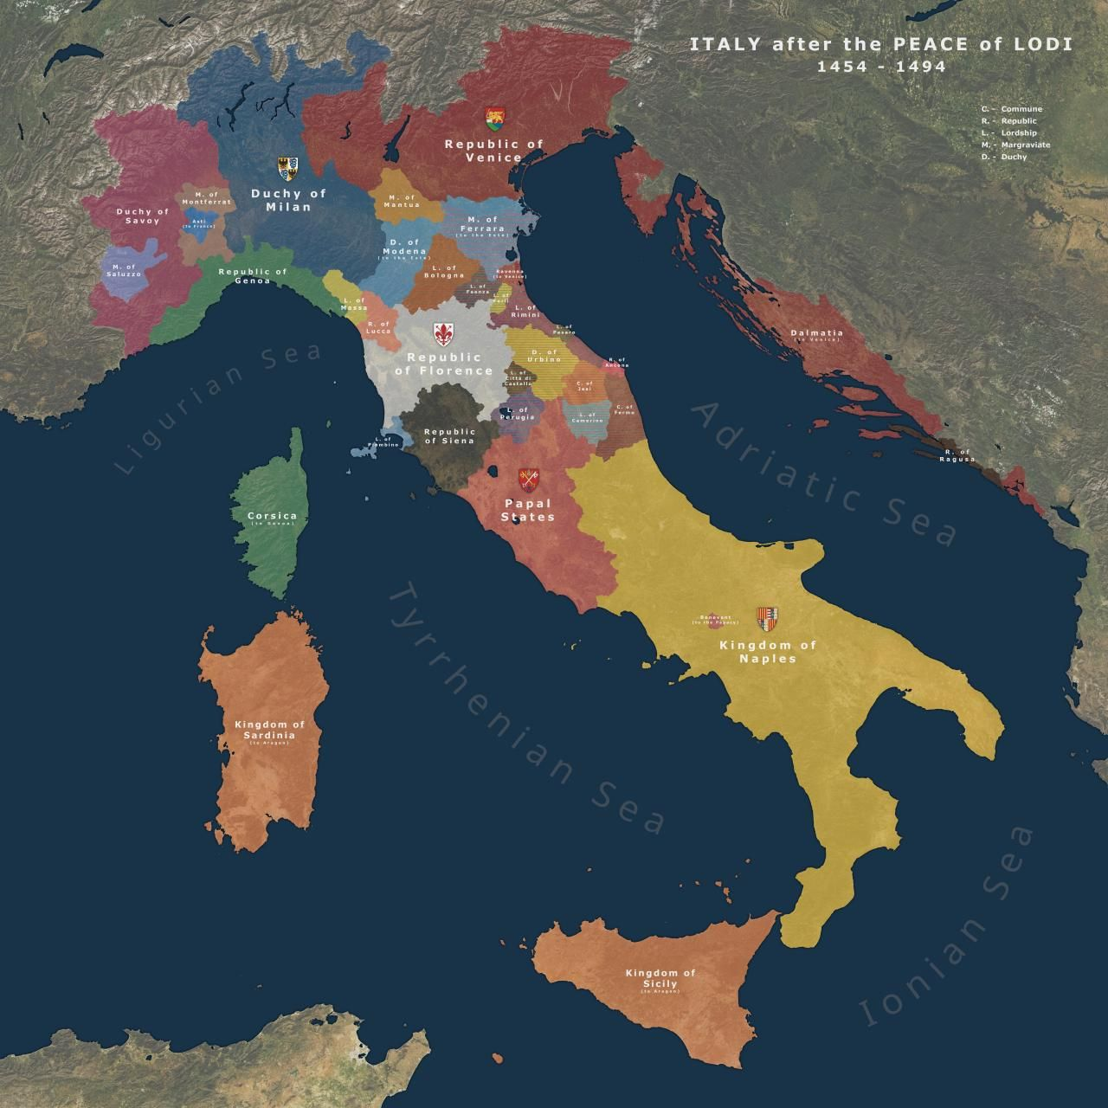
Renaissance Italy
The major centres:
Florence
Rome
Venice
Naples
Milan
Giotto (Florence)
Donatello (Florence)
Botticelli (Florence)
Masaccio (Florence)
Raphael (Rome)
Leonardo (Milan)
Bramante (Milan / Rome)
Michelangelo (Florence / Rome)
Bellini (Venice)
Titian (Venice)
Vasari (Florence)

Slide 9
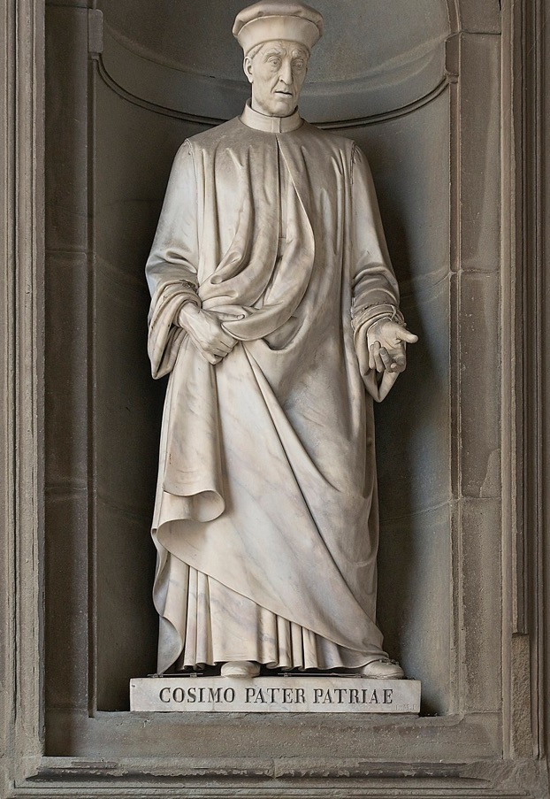
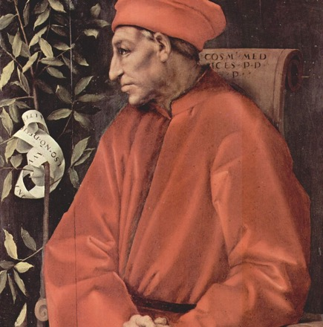
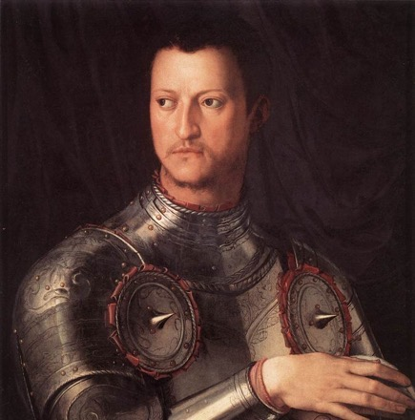
Defining Centres
‘One could indeed define the artistic center as a place characterized by the presence of a large number of artists and important groups of patrons who, moved by various motivations – be it their family or self pride, their wish for hegemony, or their quest for eternal salvation – are ready to invest part of their wealth in works of art. This latter point implies evidently that the center must be a place where considerable surplus wealth flows in, which can be directed toward artistic production.’
Enrico Castelnuovo and Carlo Ginzburg, ‘Symbolic Domination and Artistic Geography in Italian Art History, ‘ Art in Translation 1.1 (2009) p. 9.’

Slide 10
The ‘centres’ of European modernism, 1870 – 1939 Paris Berlin Moscow Vienna (until 1918) Munich Rome / Milan London | The ‘peripheries’ of European modernism: Prague Budapest Warsaw Madrid Bucharest Helsinki Vienna (after 1918) Glasgow
 | The peripheries of the peripheries: Bratislava Košice Athens Salzburg Edinburgh Szentendre

Slide 11
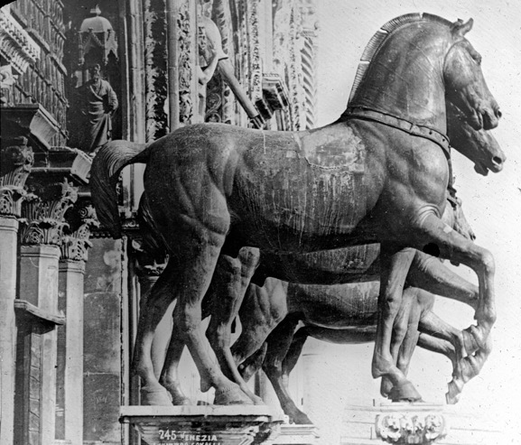
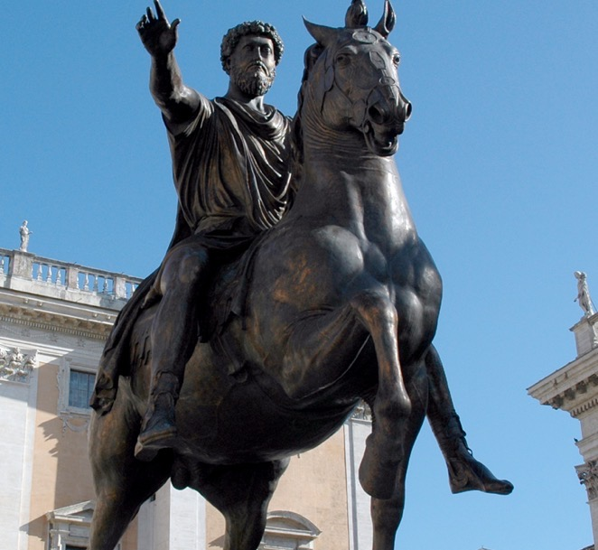
Symbolic Domination ….
‘ … the forced adoption of stylistic and iconographical models from the center; the elaboration by the latter of differentiated style codes, some aimed at the center, and the others at the periphery; the pillaging of the symbolic goods of subjected lands; the exodus of the best talents from the periphery toward the center, and the drift toward the latter of works carrying a high symbolic potential.’
Castelnuovo and Carlo Ginzburg, ‘Symbolic Domination and Artistic Geography,’ p. 26

Slide 12
The ‘Master – Slave’ Dialectic
(from Georg Hegel, The Phenomenology of Spirit (1807)
Stages of development of consciousness:
Desire, where consciousness is directed at things other than itself
Master-slave, where consciousness is directed at another conscious being
Universal self-conscious, where a conscious being recognizes itself in another, equal consciousness.

Slide 13
The Myth of the ‘Master – Slave’ Dialectic
At first, a conscious being tries to treat another conscious being like an object that it can achieve mastery over
A struggle arises between two conscious beings and eventually the winner demands recognition and subordinates the other
For Hegel, this is a failed relationship, since recognition of mastery is achieved through compulsion
For Hegel, true self-consciousness arises only through free and mutual recognition of two conscious being

Slide 14
Significance of the Myth of the ‘Master – Slave’ Dialectic
A model for understanding social relations (they are always based on conflict and demand for recognition, e.g. Marx’s notion of class struggle)
A model for understanding racial and colonial relations (e.g. Franz Fanon, Black Skin, White Masks [1967] argues that due to colonial oppression, white colonizers are not fully self-aware)
A model for understanding centre-periphery relations in art history (Piotrowski argues that the centre does not know itself due to its refusal of recognition of the ‘periphery’)

Slide 15
Symbolic Domination
Hungarian Fauvism

Slide 16
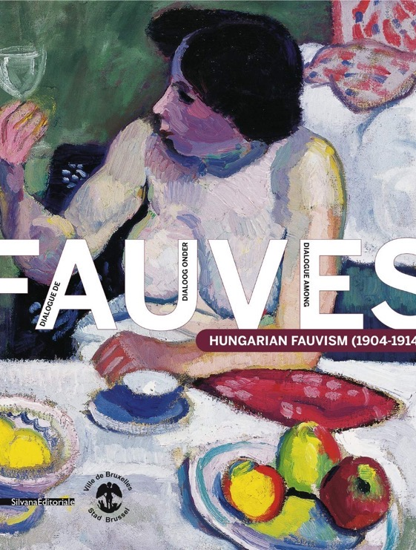
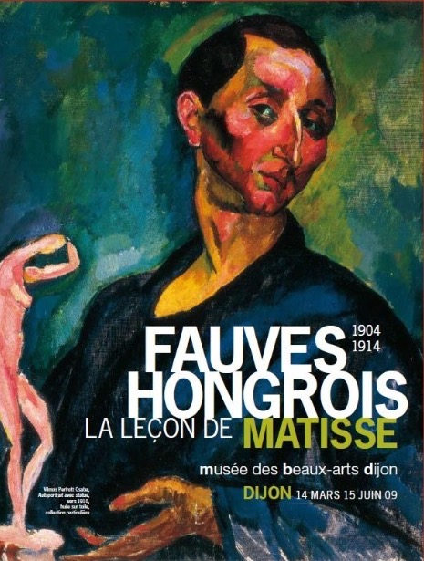
Exhibitions at Museum of Fine Art, Dijon (2009)
City Hall of Brussels (2010-11)

Slide 17
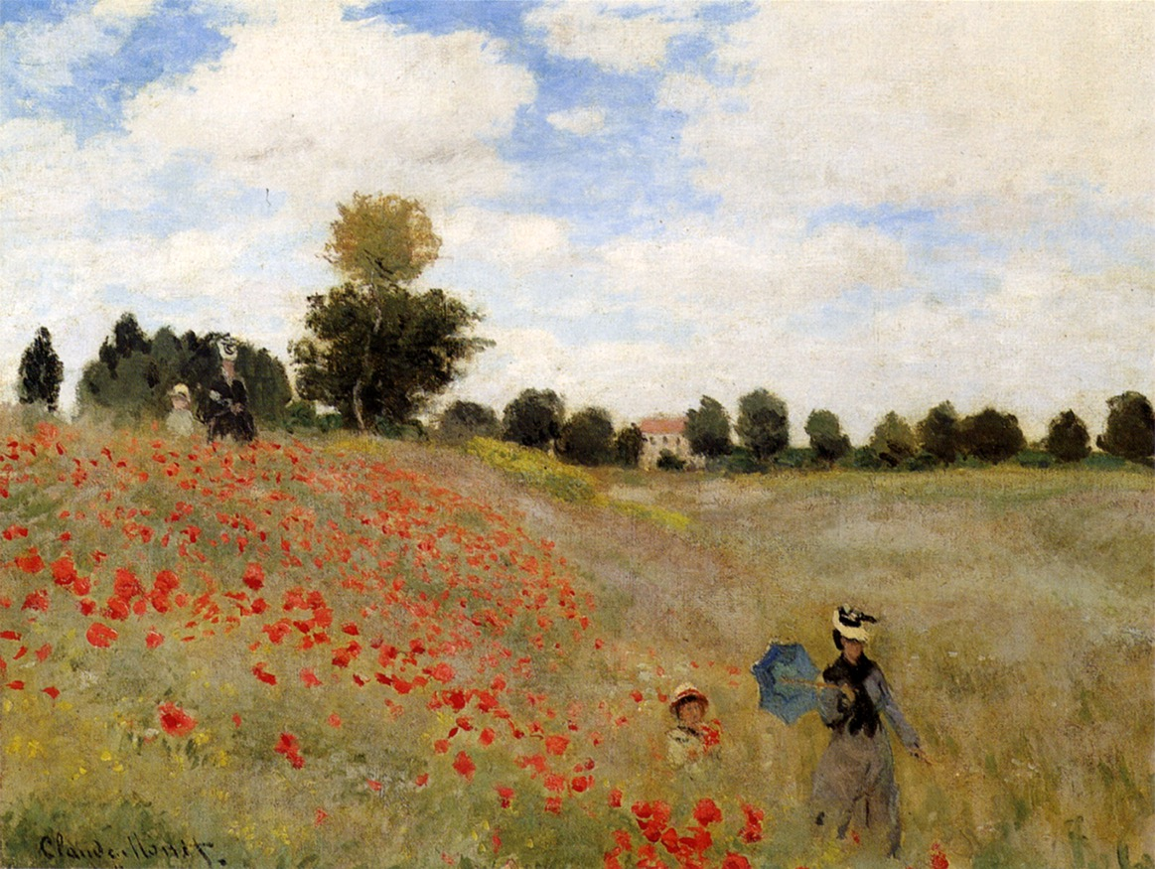
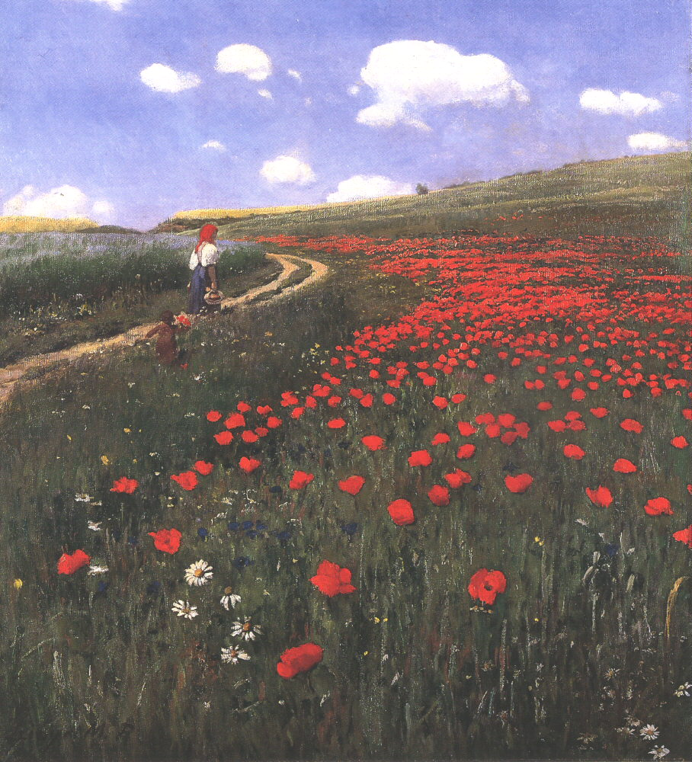
L: Claude Monet, Poppies at Argenteuil (1873)
R: Pál Szinyei Merse, Poppies in the Field (1902)

Slide 18
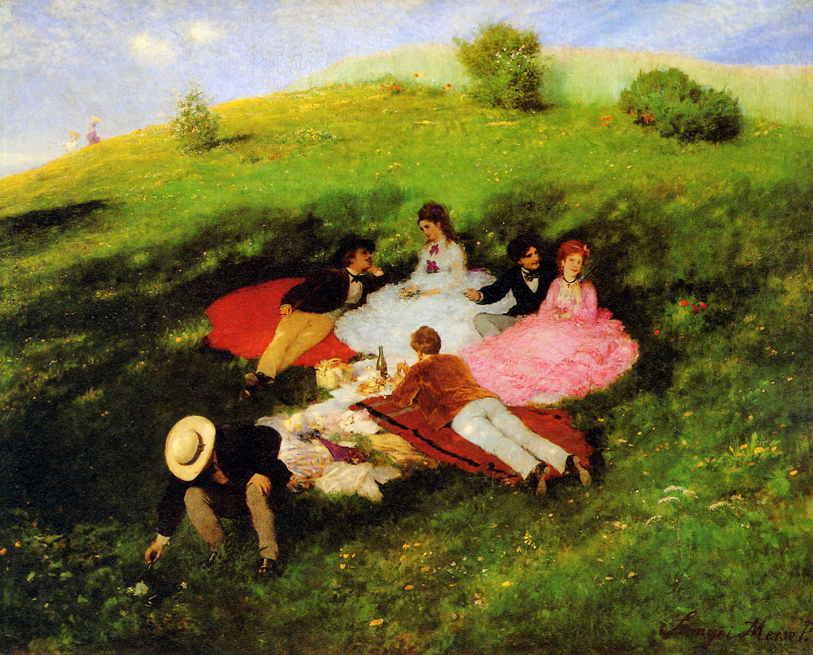
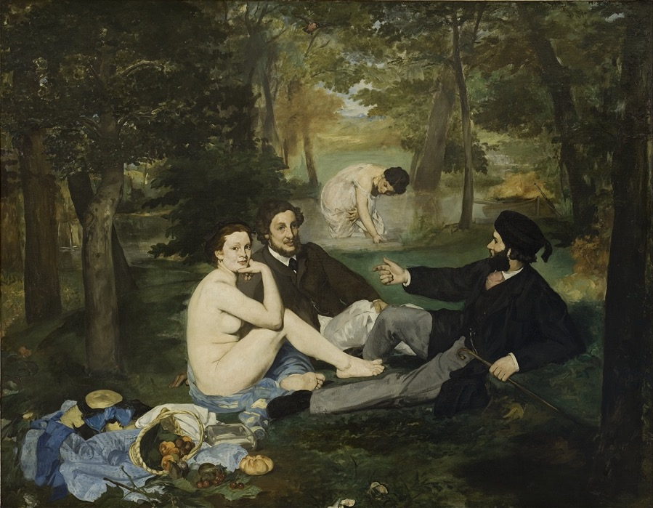
L: Pál Szinyei Merse, Luncheon in May (1873)
R: Edouard Manet, Déjeuner sur l’herbe (1863)

Slide 19
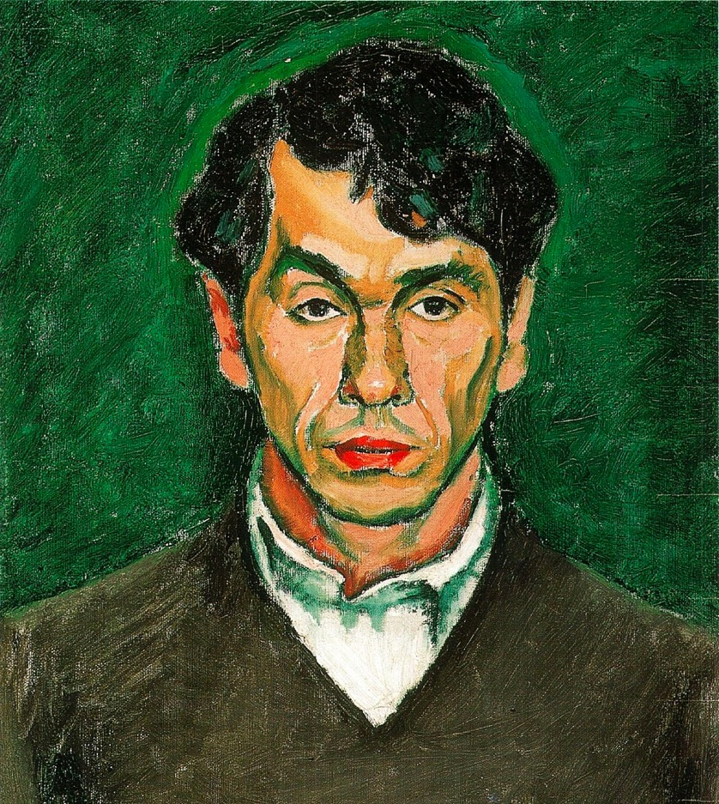
Attendance at Académie Julian (1901-7) in Paris by young Hungarian artists, such as:
Dezső Czigány
Béla Czóbel
Csaba Vilmos Perlrott
Róbert Berény
Some also study at the Académie Matisse (1908)
Exhibit in Paris at the Salon d’automne and the Salon des indépendants.
Frequent visitors at the Salon of Gertrude Stein in Paris
Dezső Czigány, Self Portrait (1909)

Slide 20
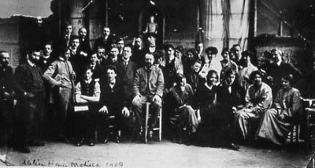
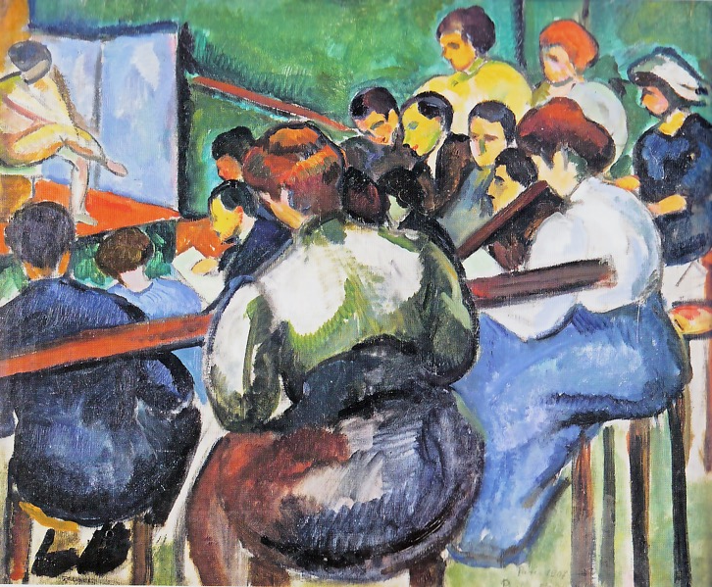
Académie Matisse
1907 – 1911
Hungarian students included:
Géza Bornemisza
Vilmos Perlrott-Csaba
Vilmos Perlrott-Csaba
School of Painters (1907)

Slide 21
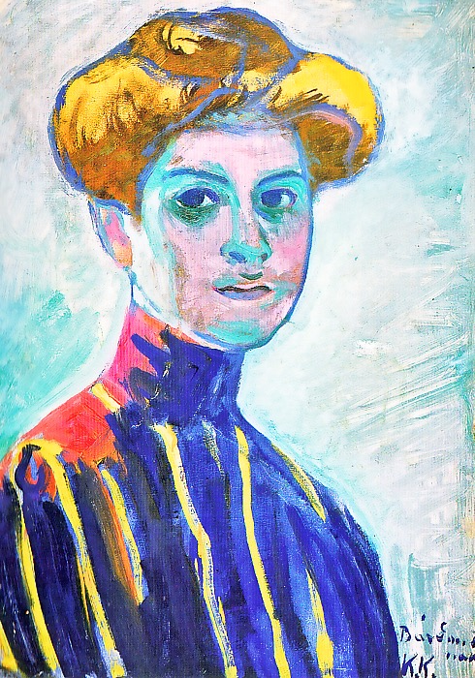
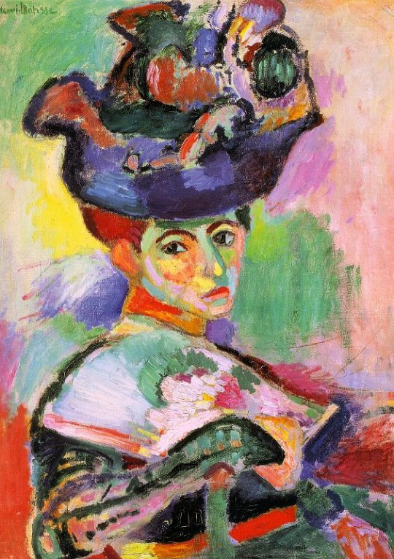
Henri Matisse
Women with Hat (1905)
Károly Kernstock – Portrait of a Young Girl (1909)
Desző Cigány – Actress with Yellow Hat (1907)

Slide 22
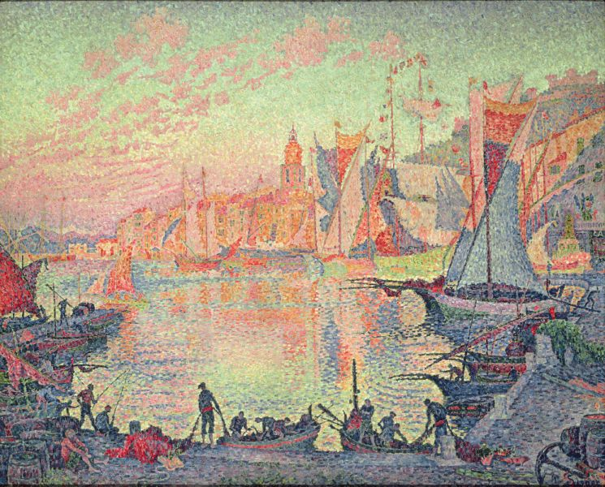
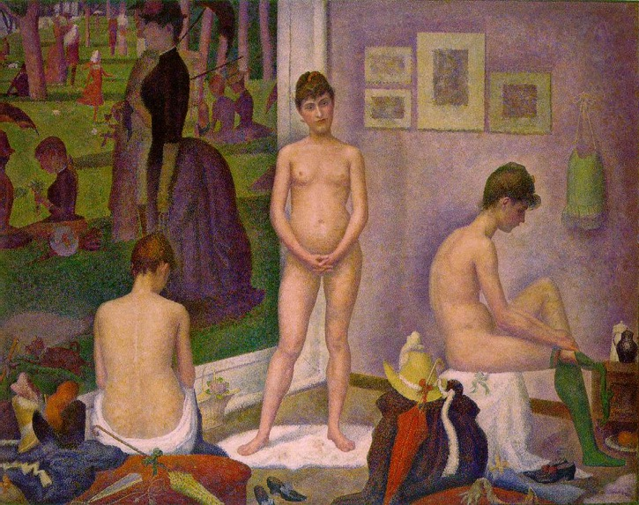
L: Paul Signac
The Port of Saint Tropez (1901)
R: Georges Seurat
Les Poseuses (1888)

Slide 23
Béla Czóbel – Street in Paris (1905)

Slide 24
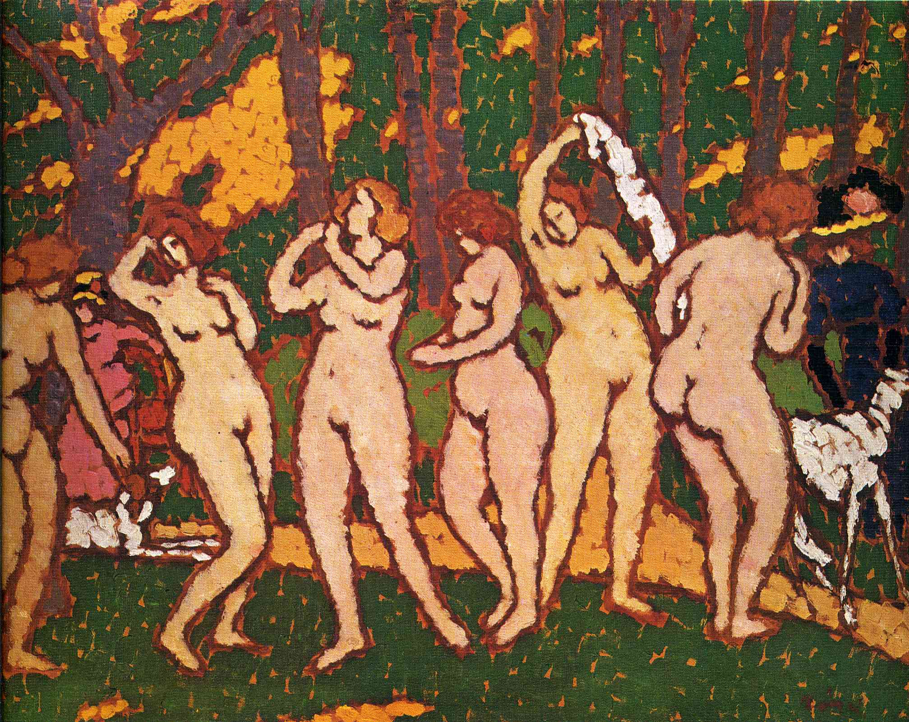
József Rippl-Ronai – Park with Nudes (1910)

Slide 25
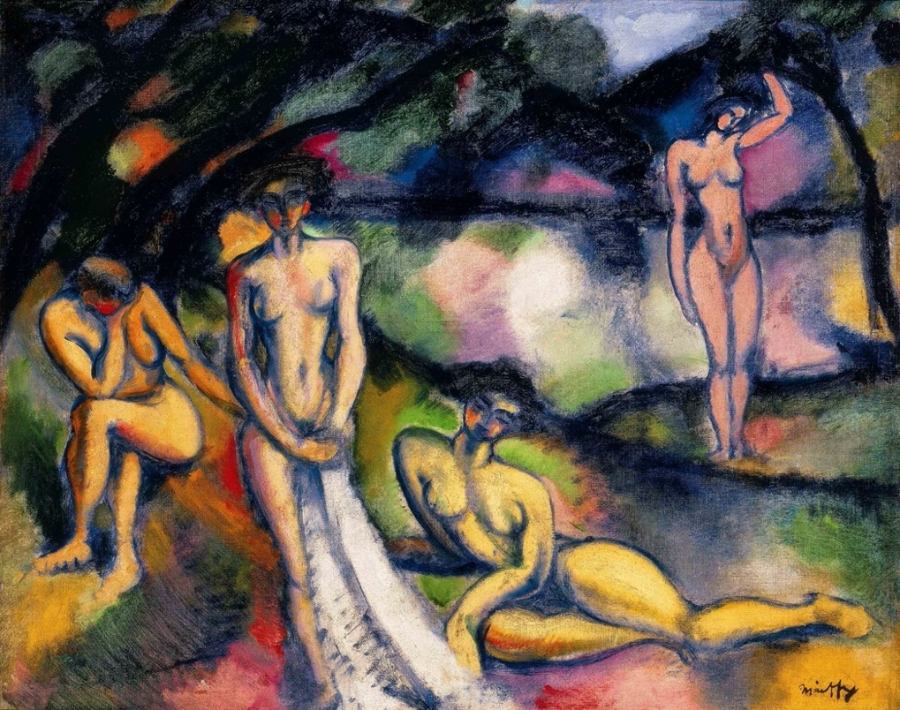
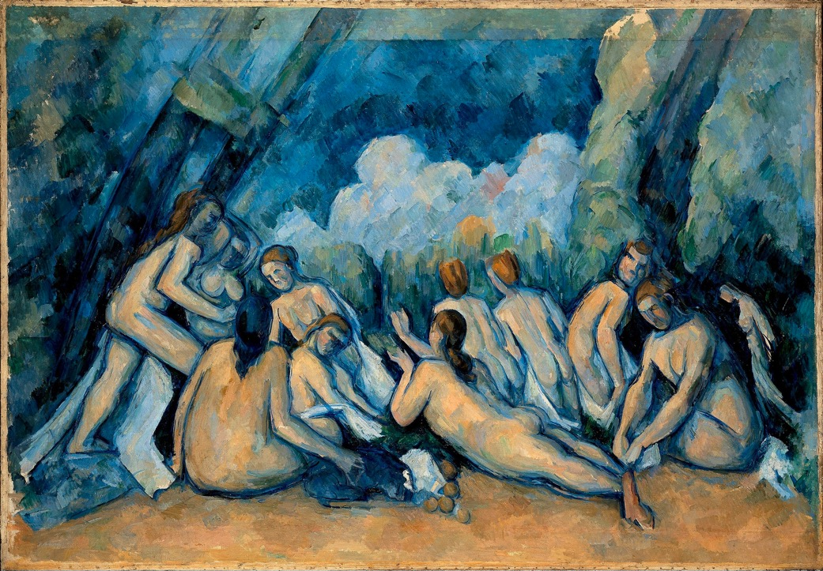
Paul Cézanne, Les Grandes Baigneuses (1894-1905)
Ödön Márffy
Composition with Nudes (1909)

Slide 26
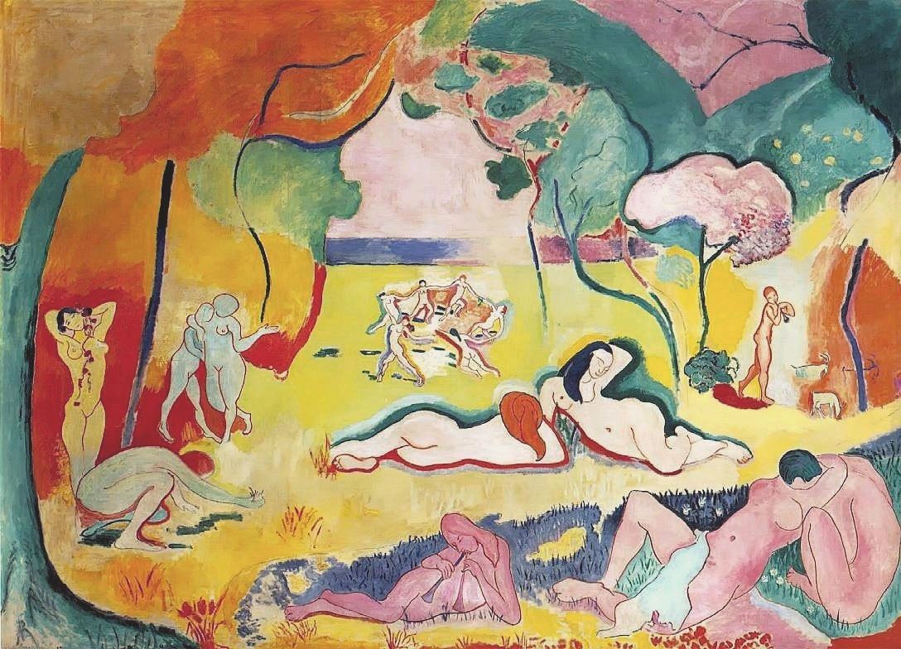
Vilmos Perlrott-Csaba, Nudes in the Open Air (Eden) (1909)
Henri Matisse, Bonheur de vivre (1905)

Slide 27
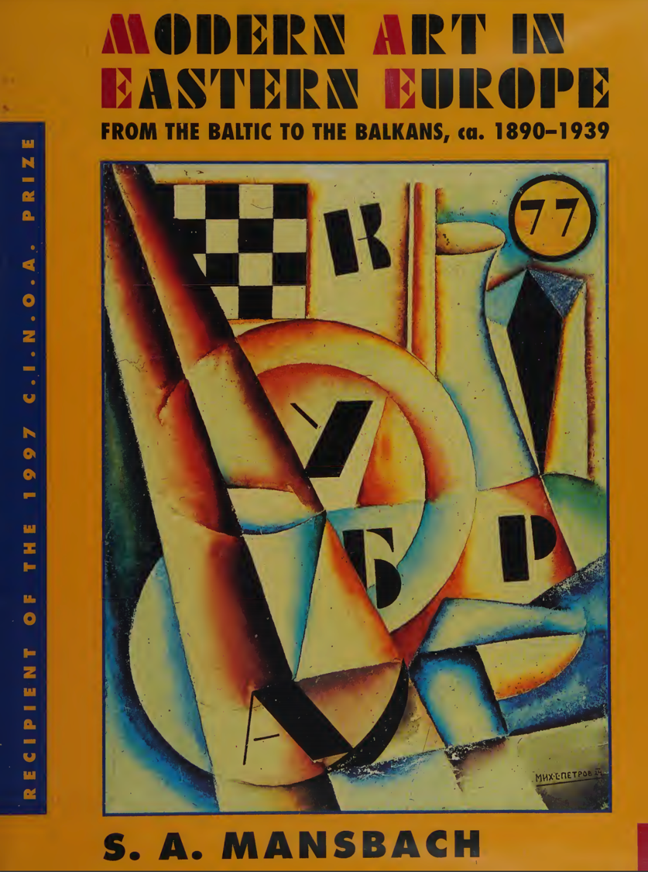

Slide 28
Symbolic Domination
Czech Cubism

Slide 29
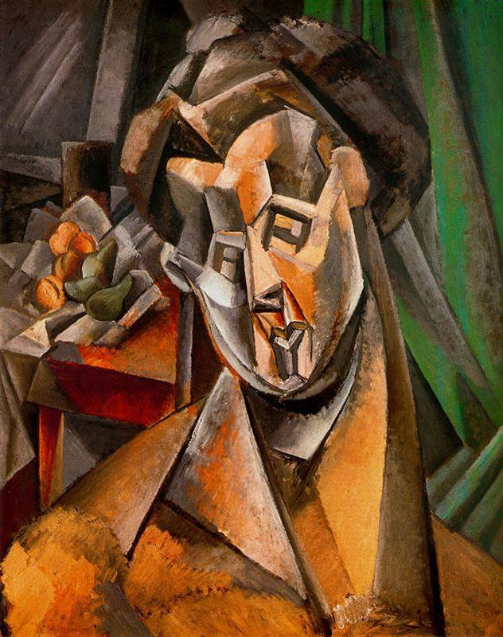
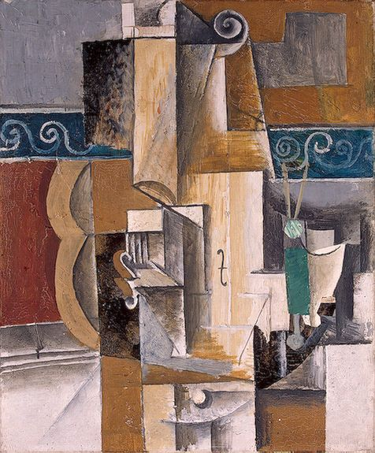
L: Pablo Picasso, Guitar and Violin (1912)
R: Picasso, Woman and Pears (Fernande) (1909)

Slide 30
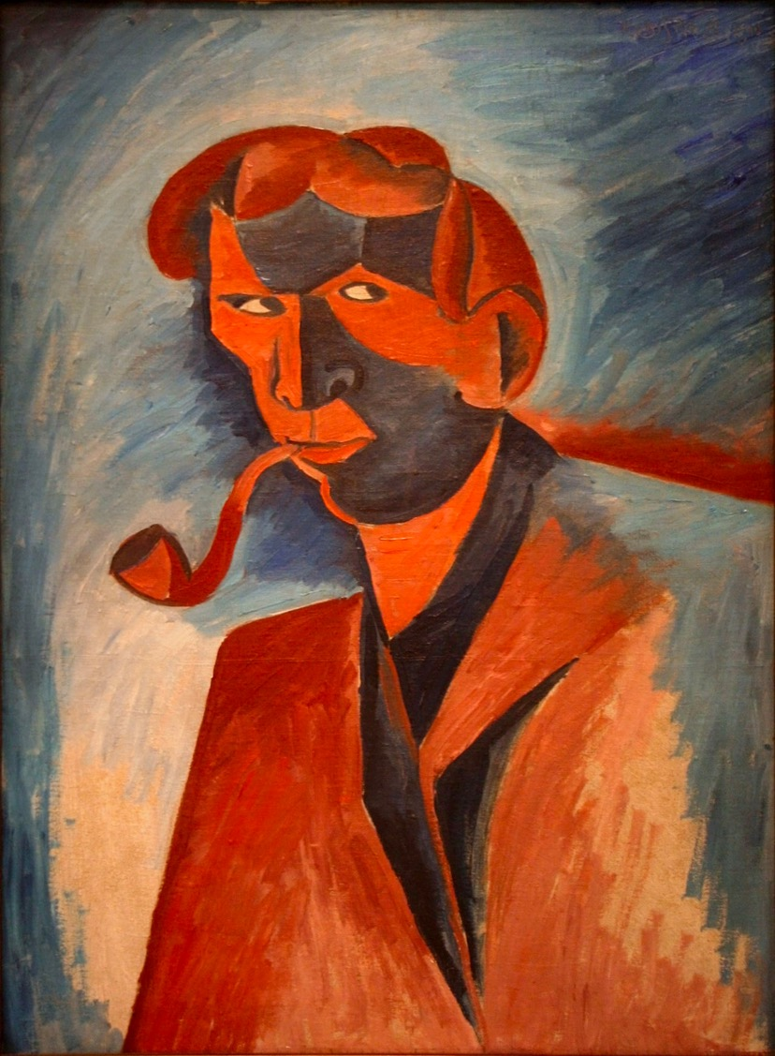
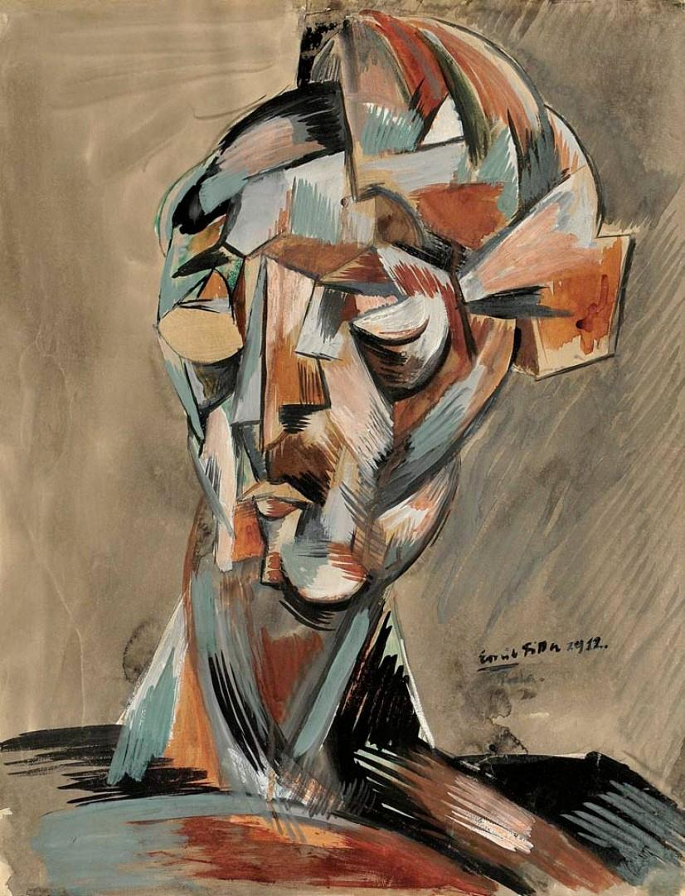
Emil Filla, Head (1912)
Bohumil Kubišta, Smoker (Self-Portrait) (1910)

Slide 31
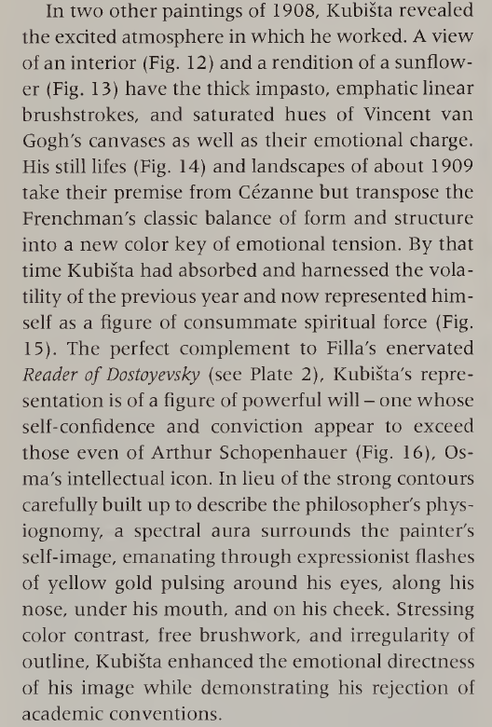

Slide 32
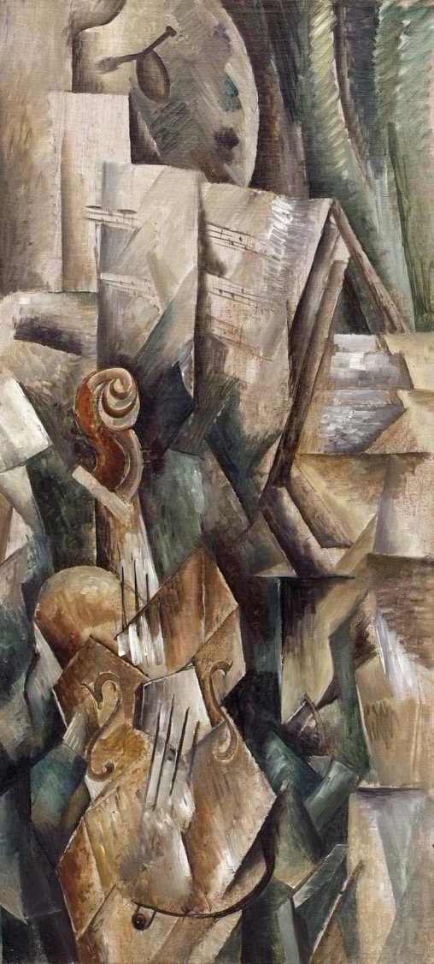
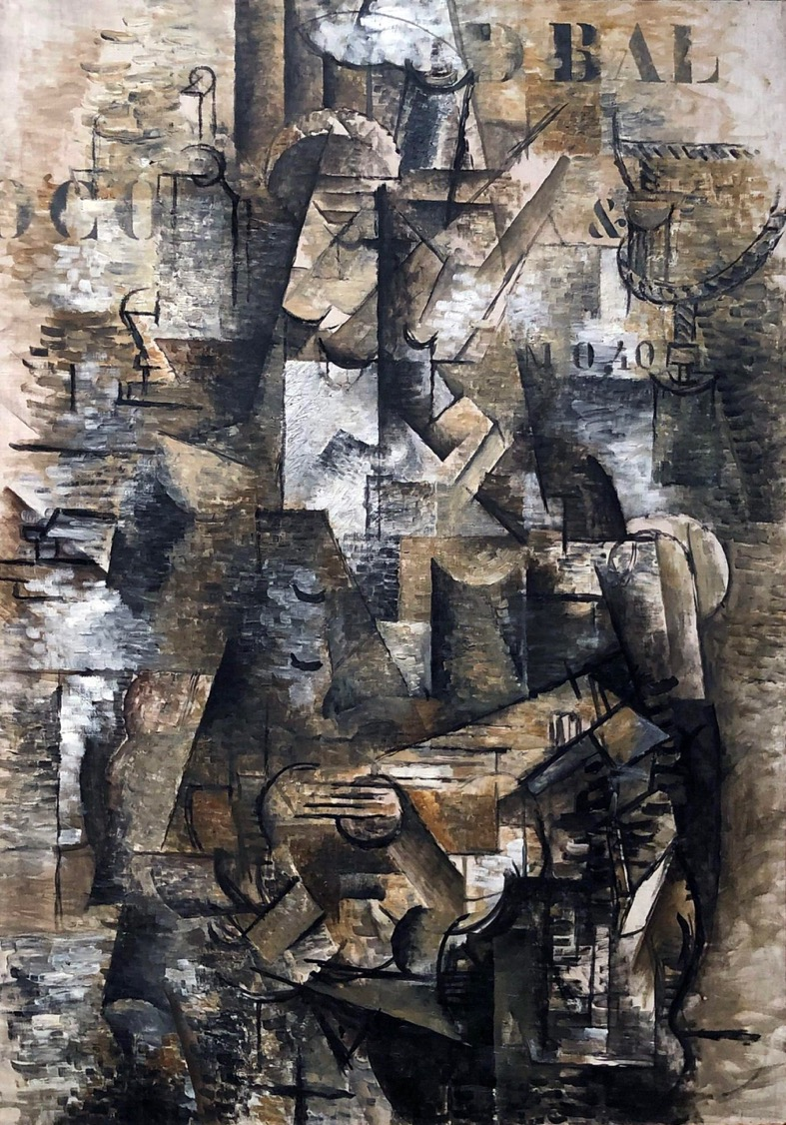
Georges Braque
L: Violin and Palette (1909)
R: The Portuguese Woman (1911)

Slide 33
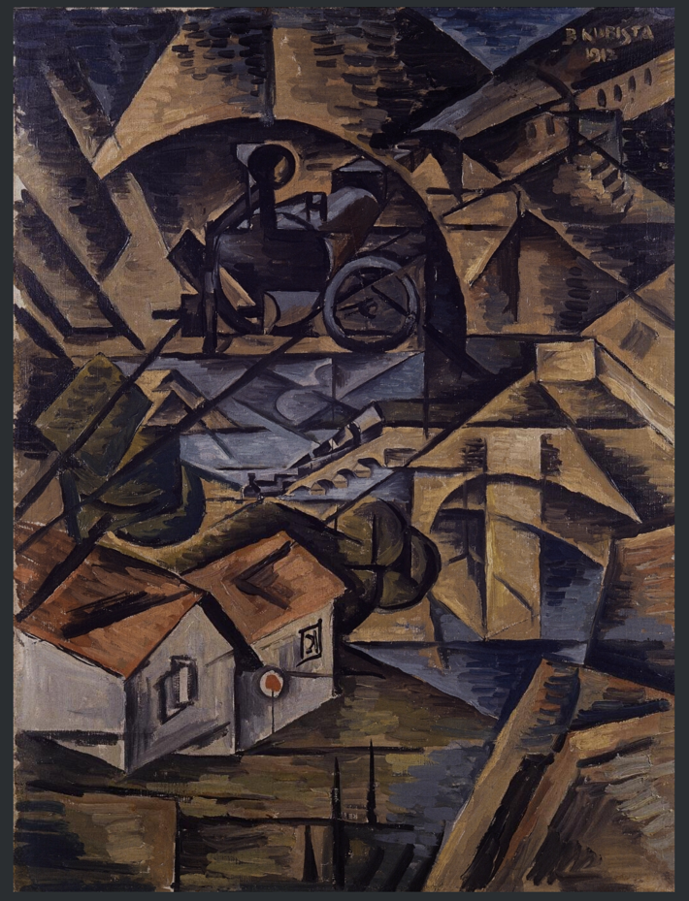
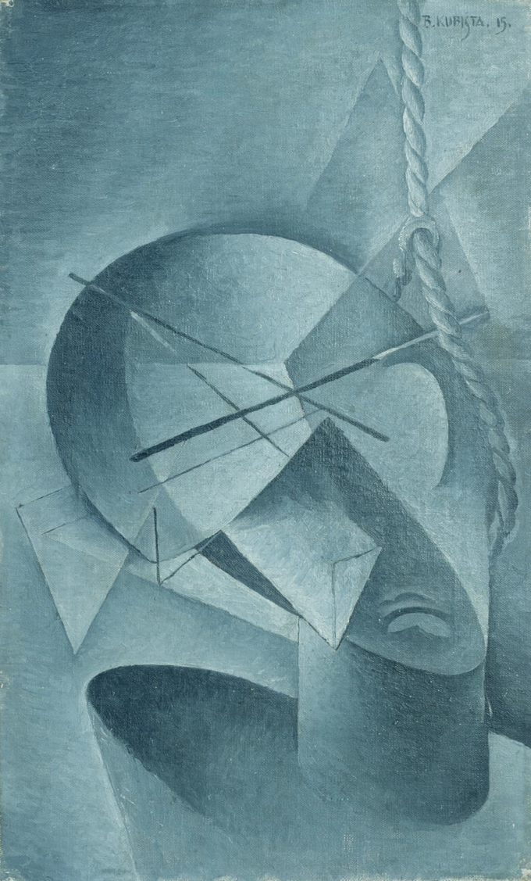
L: Bohumil Kubišta, Train in the Tunnel (1913)
R: Kubišta, The Hanged Man (1915)

Slide 34
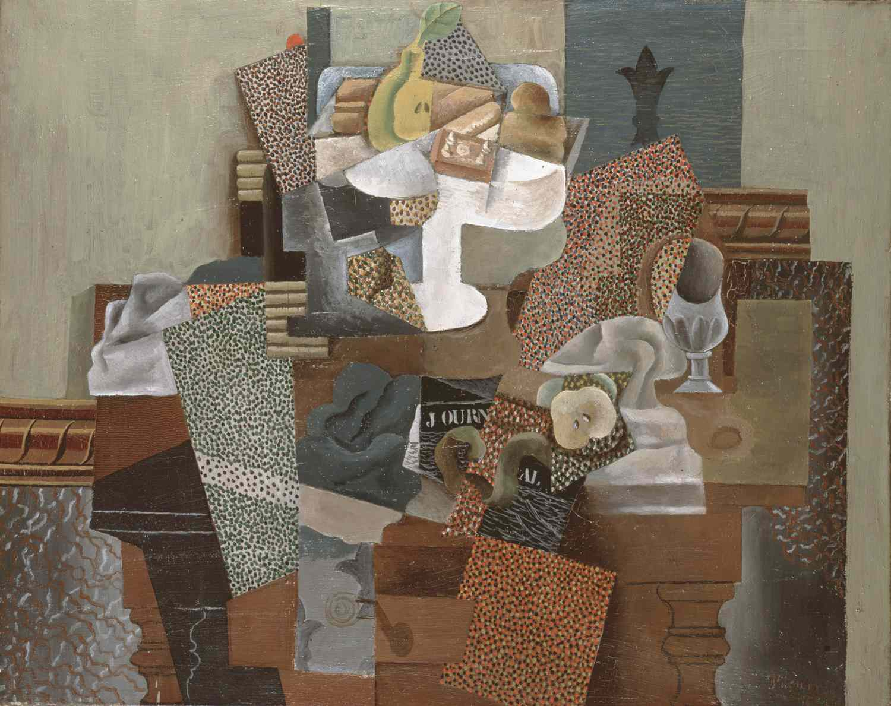
Picasso
Still Life with Compôte and Glass (1914)

Slide 35
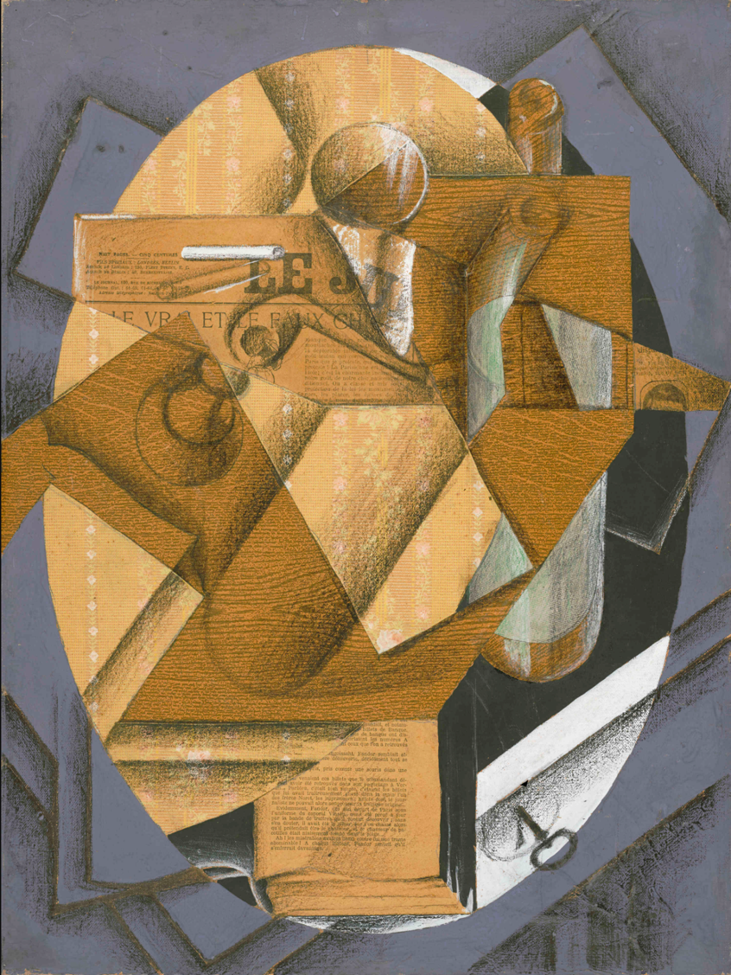
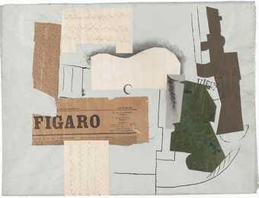
L: Juan Gris – The Table (1914)
R: Picasso – Bottle of Vieux Marc, Glass, Guitar and Newspaper (1913)

Slide 36
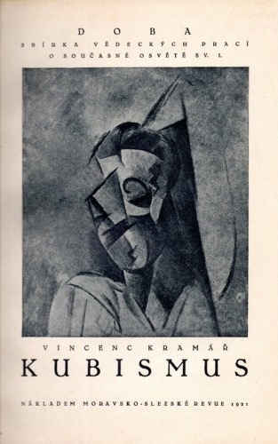
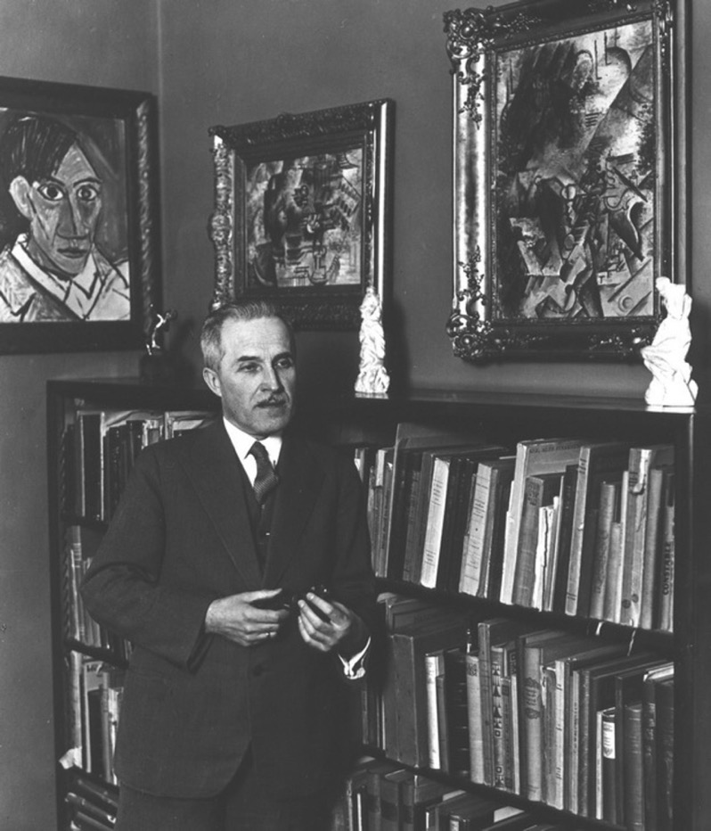
Vincenc Kramář, Cubism (Brno, 1921)
Vincenc Kramář (1877-1960)

Slide 37
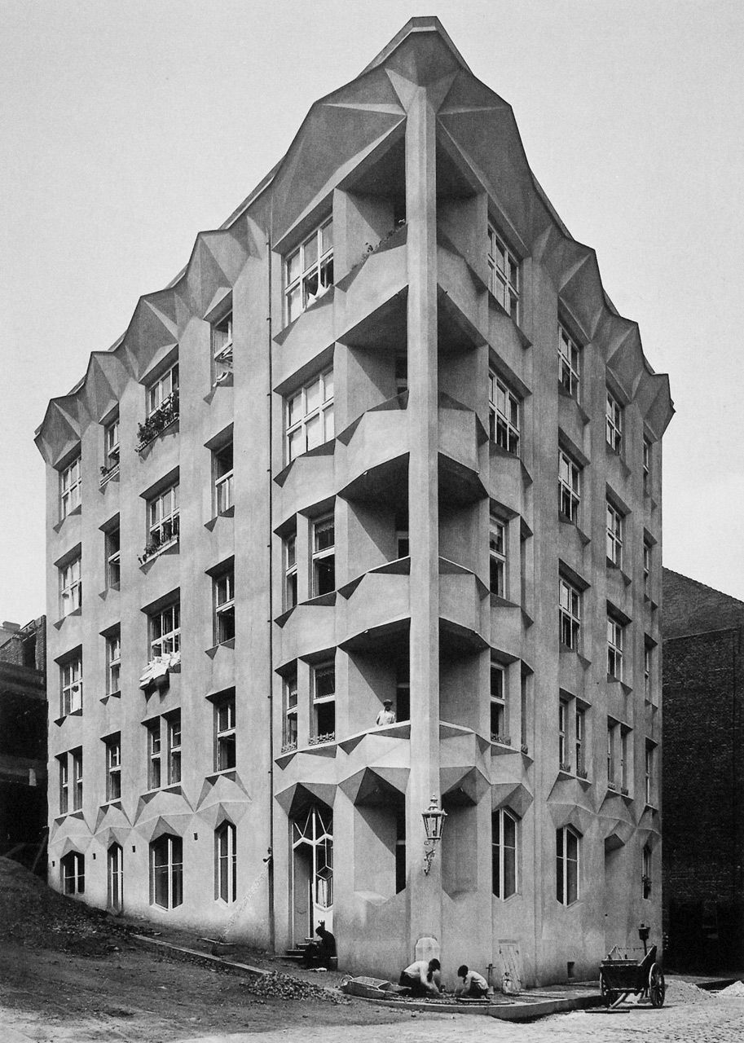
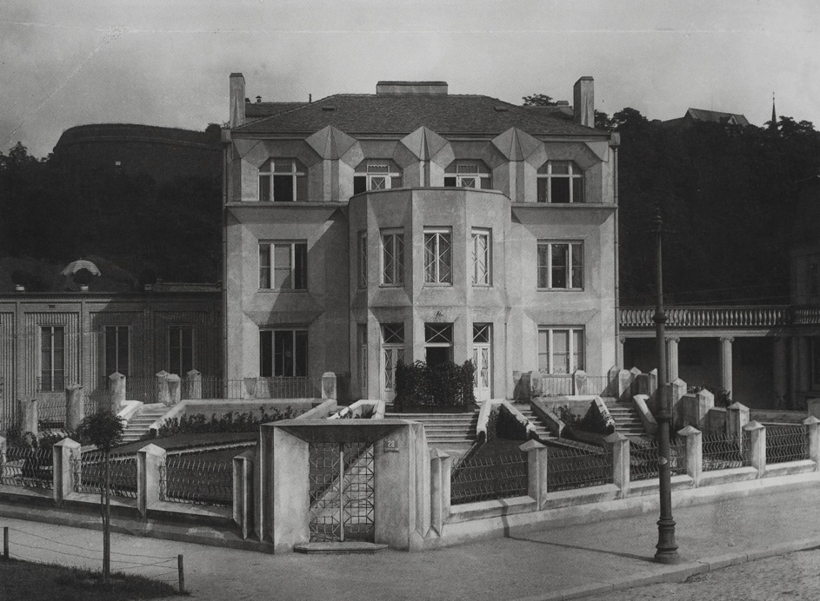
Josef Chochol
Apartment block, Vyšehrad, Prague (1914)
Josef Chochol, Vila Kovařovicova, Prague (1912-13)

Slide 38
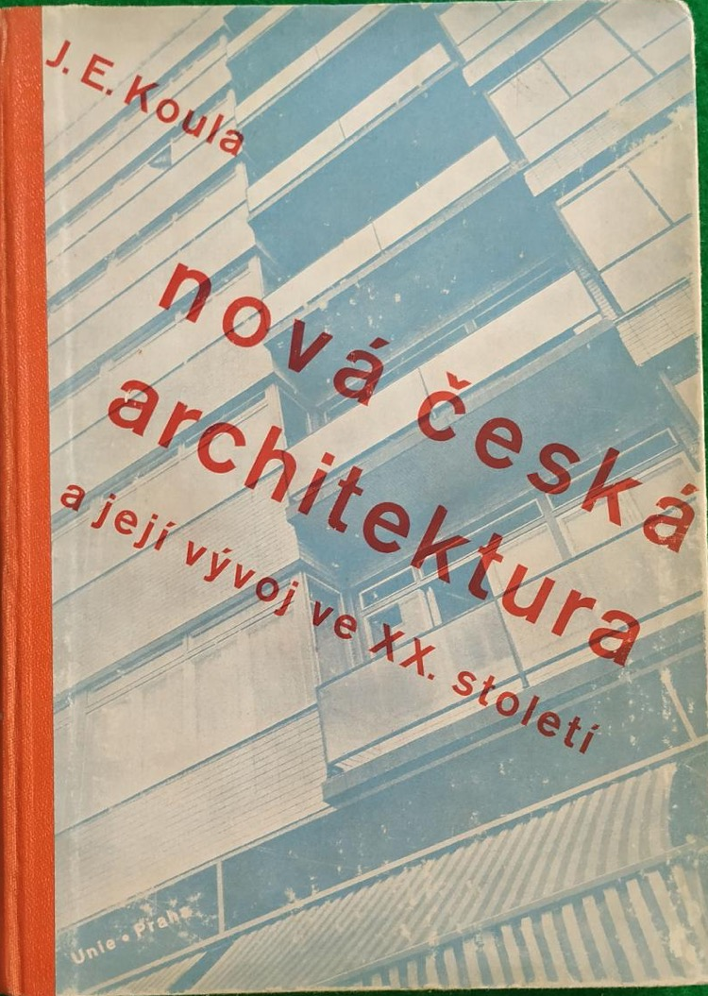
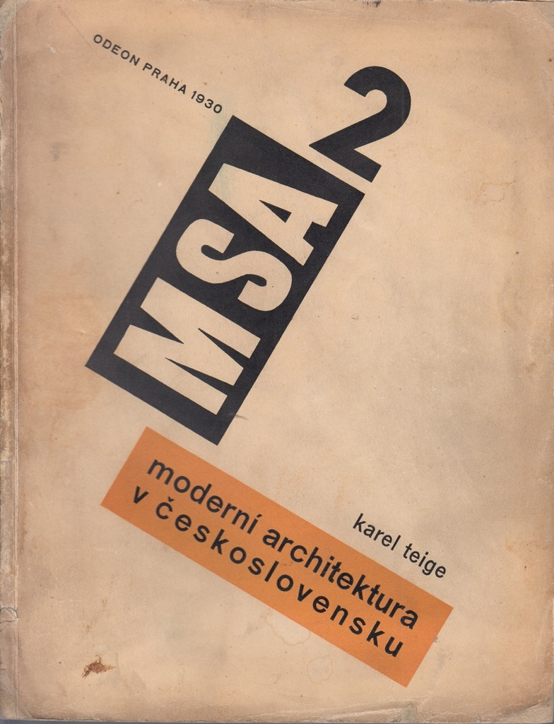
Jan Koula, Modern Czech Architecture and its Development in the 20th Century (Prague, 1940)
Karel Teige, Modern Architecture in Czechoslovakia (Prague, 1930)

Slide 39
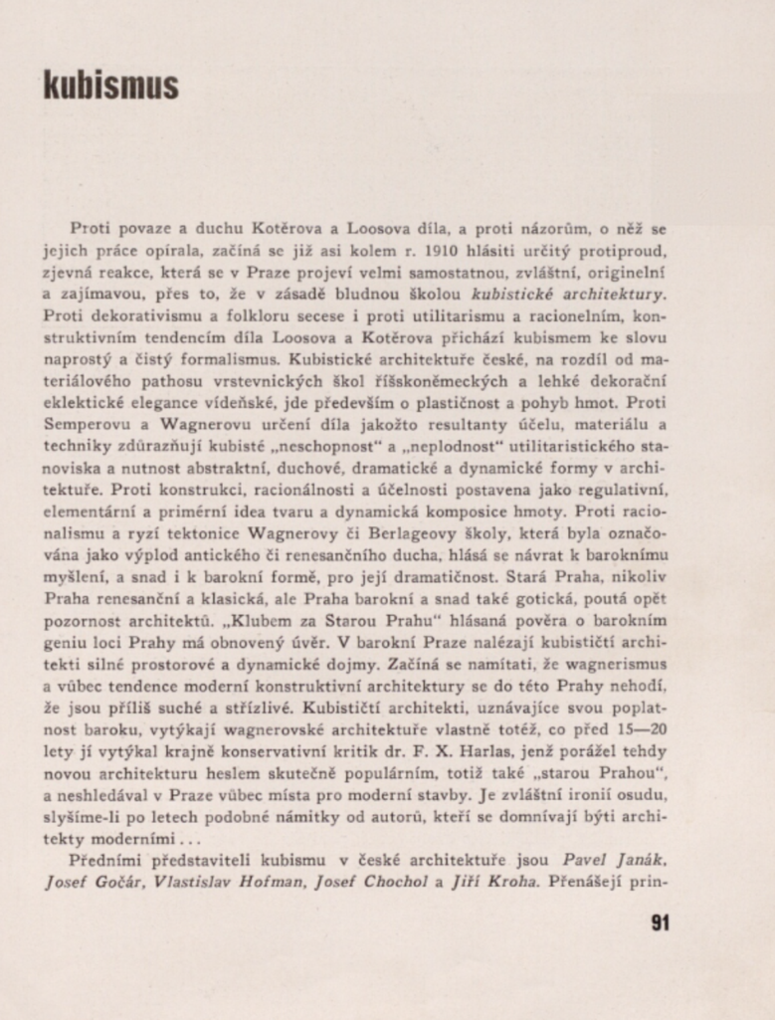
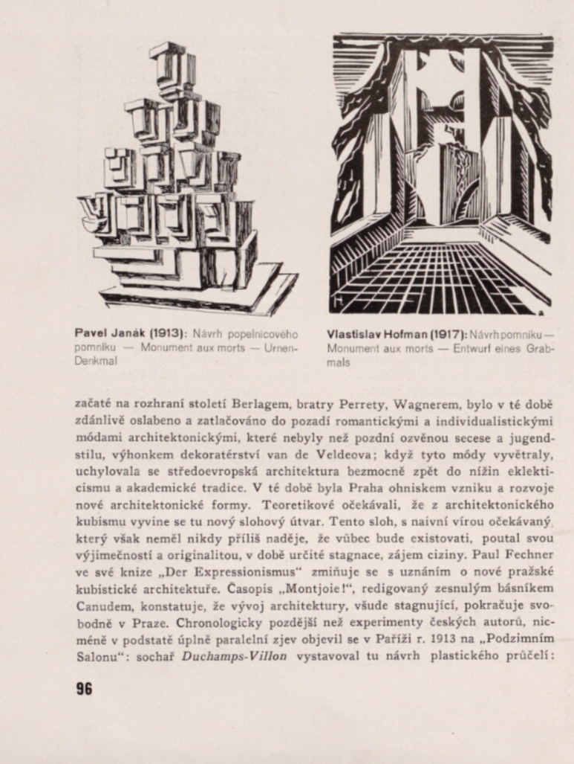

Slide 40
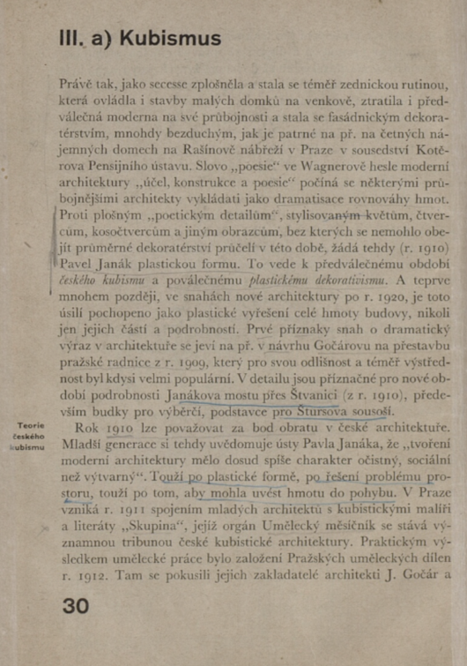
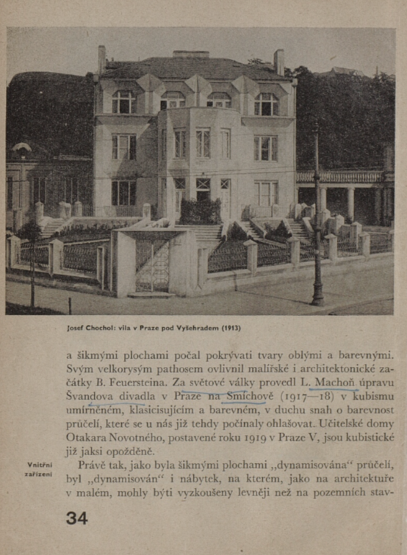

Slide 41
‘Only the institutional entanglement of the creative work of the four architects with the activities of the artists involved in the Prague Skupina speaks in favour of using the term ‘Cubism’ in connection with Czech architecture from the period after 1912.
… it has a paradoxical consequence: it devalues the originality and conceptual depth of Czech ‘modern art’ and reduces it merely to being a marginal articulation of the convergence of the Prague periphery and the Parisian centre.’
Jindřich Vybíral, Český kubismus na trhu symbolických statků in Michal Novotný , ed., Kubismus v české architektuře. Sto let poté
(Prague, 2013) p. 18 and 19
Zdeněk Kratochvíl, Le plus grand cirque cubist, Umělecký měsíčník (1914)

Slide 42
Horizontal Art History

Slide 44
Piotrowski, ‘Towards a Horizontal Art History’ p. 54

Slide 45
Some principles:
Approach the ‘center’ from the viewpoint of the periphery ‘the marginal observer sees that the center is cracked’
Critique the ‘canon’ and ‘style’: both of these are not as uniform as the ‘center’ imagines
‘A canon is always an effect of an analytical and historical construction’ (p. 55)
Dismantle the opposition between ‘universal’ (i.e. French / German / US) modernism and ‘national / local’ (i.e. Czech / Polish / Hungarian / Slovak) modernism
Relativize the center – ‘French’ modernism is also a ‘local’ modernism
‘Transnational’ art history - ‘negotiating values and concepts along other lines than the opposition of the national versus the international’ (p. 58)

Slide 46
Alfred Barr
Cubism and Abstract Art (New York, 1936)

Slide 48
IRWIN, Eastern European Art Map

