Slide 1
Canon of Czech modernism
Margarita Khakhanova, Denisa Kadlčíková
Notes:
Good afternoon everyone and welcome to our presentation. As you can see on the screen, our topic today is Canon of Czech modernism.

Slide 2
Is it possible to talk of a canon of Czech modernism?
Literature
What are the values underpinning it?
Is anything significant missing?
How and why the canon has been constructed?
Notes:
Our presentation is going to be divided into 5 parts.
First we are going to answer the question if it is even possible to talk about a canon of Czech modernism.
Second, we are going to introduce some bibliography.
And after that we are going to talk about three main questions which are - what are the values underpinning the concept of canon - if there‘s anything significant missing in it and how and why the canon has been constructed?

Slide 3
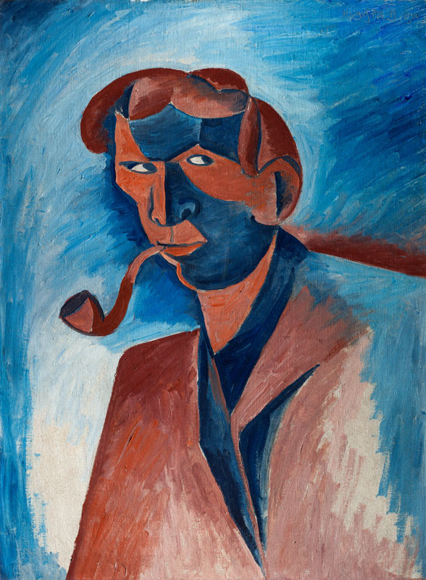
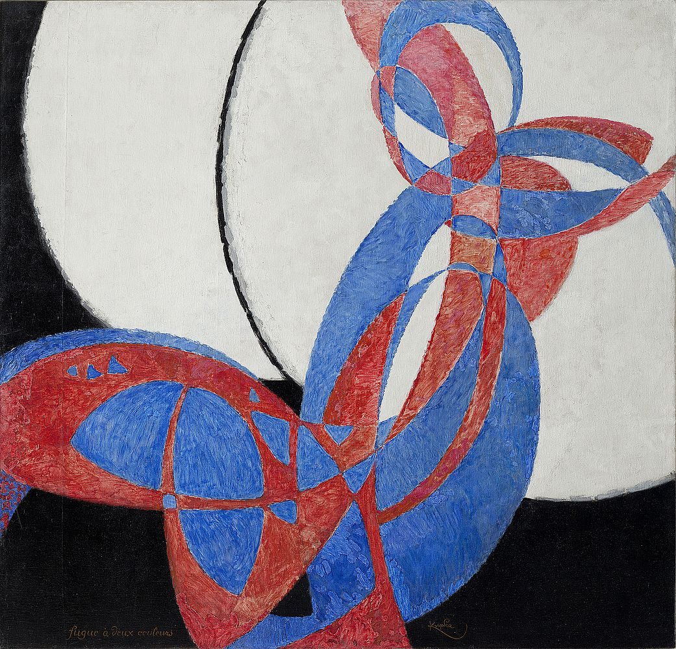
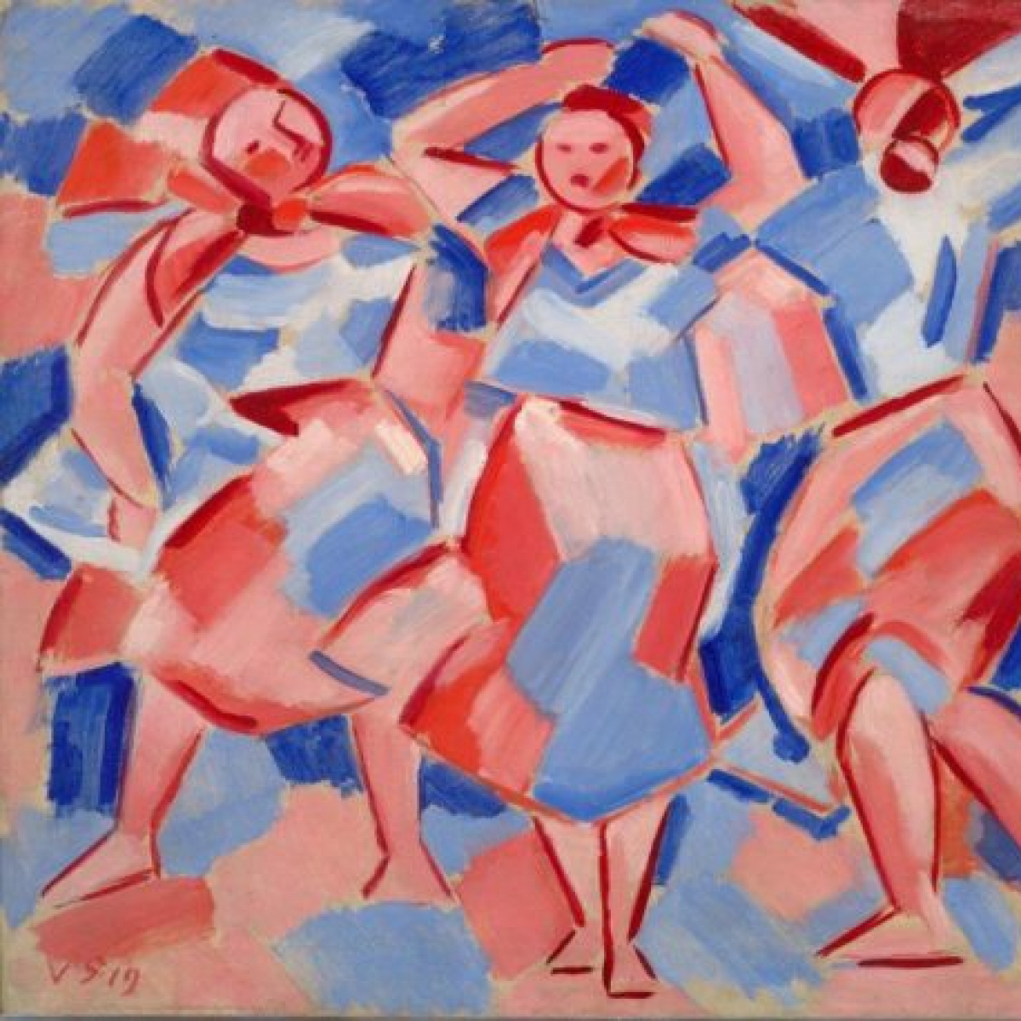
Is it possible to talk of a canon of Czech modernism?
František Kupka, Amorfa. dvoubarevná fuga,
1912
Václav Špála, Pradleny, 1918
Bohumil Kubišta, Kuřák, 1910
Notes:
So – It is even possible to talk about canon of czech modrnism? When we studied the bibliography we noticed some same formulae (formjulí) in the table of contents of the individual books which are leading us to thinking that some kind of canon has been constructed in the history.

Slide 4
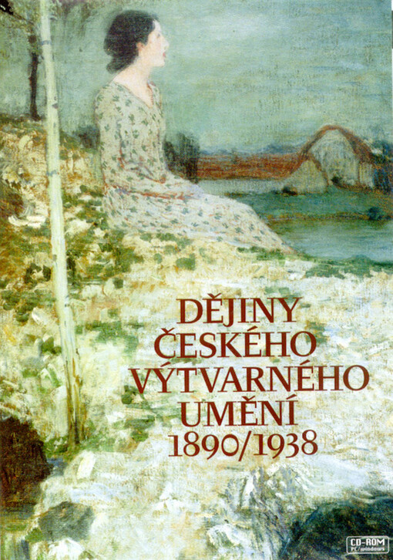
Literature
Alena Adlerová, ed. Dějiny českého umění IV: 1890-1938 (Prague, 1998)
Notes:
Now I would like to briefly introduce the table of contents of the individual books we studied. First, we have a book written by Alena Adlerová which is focused on the history of Czech art from 1890-1938. This book contains a pretty strong narrative starting with secession and ending with the sculpture of the twenties and thirties. Main attention is given to avant-garde currents such as the group Osma, Tvrdošíjní, and also Czech cubistic architecture.

Slide 5
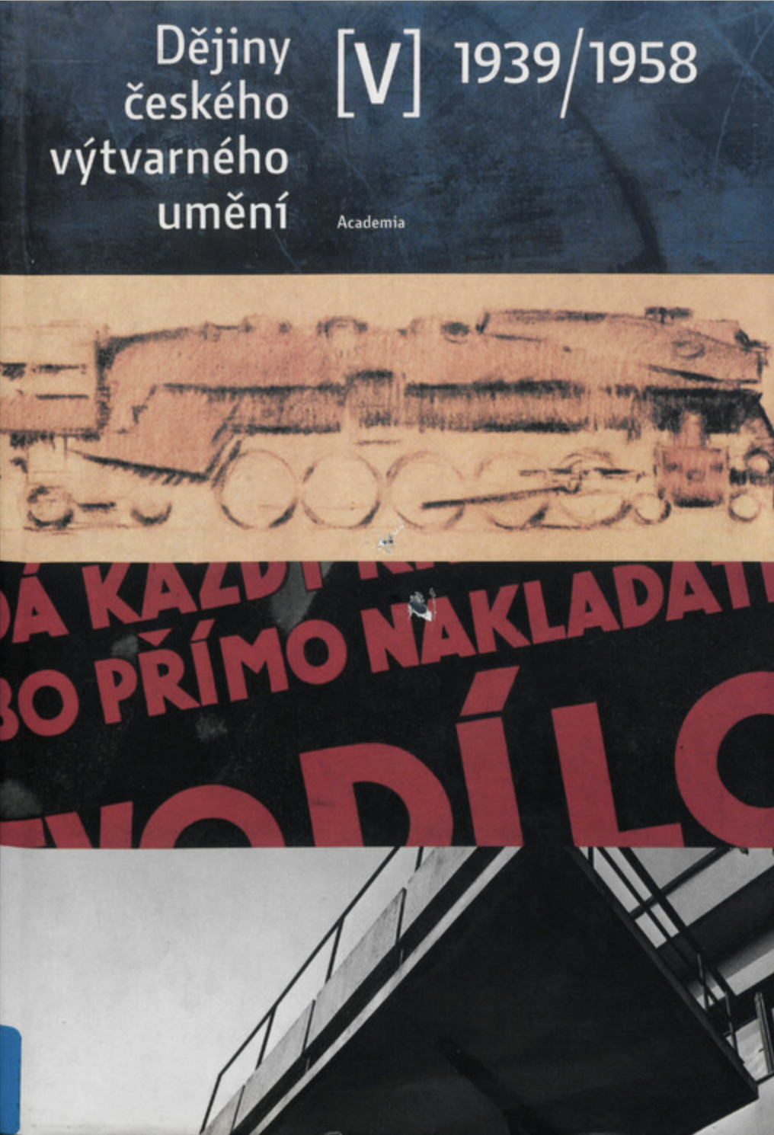
Literature
Rostislav Švácha, ed., Dějiny českého umění V: 1939-1958 (Prague, 2005)
Notes:
Second book we went trough is written by Rostislav Švácha and it is a continuation of the previous book. This one is studying Czech art history from 1939-1958. Švácha does also follow the narrative line starting with post-war painting and important points for him are czech expressionism and surrealism, but he also writes for example about official art in the fifties.

Slide 6
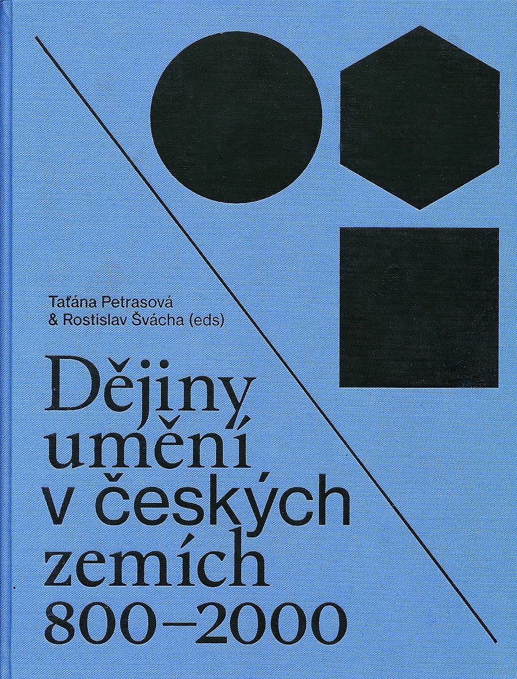
Literature
Taťána Petrasová and Rostislav Švácha, eds, Art of the Czech Lands, 800-2000 (Prague, 2017)
Notes:
The third book we got our hands on is a collection made by many authors who studied Art of the Czech Lands from 800-2000. We were surprised that it didn‘t pay as much attention to the narrative as the previous two books but still the basic idea is developed around Czech avant-garde. We were also taken by surprise that this book contains a chapter about German artists who are often forgotten.

Slide 7
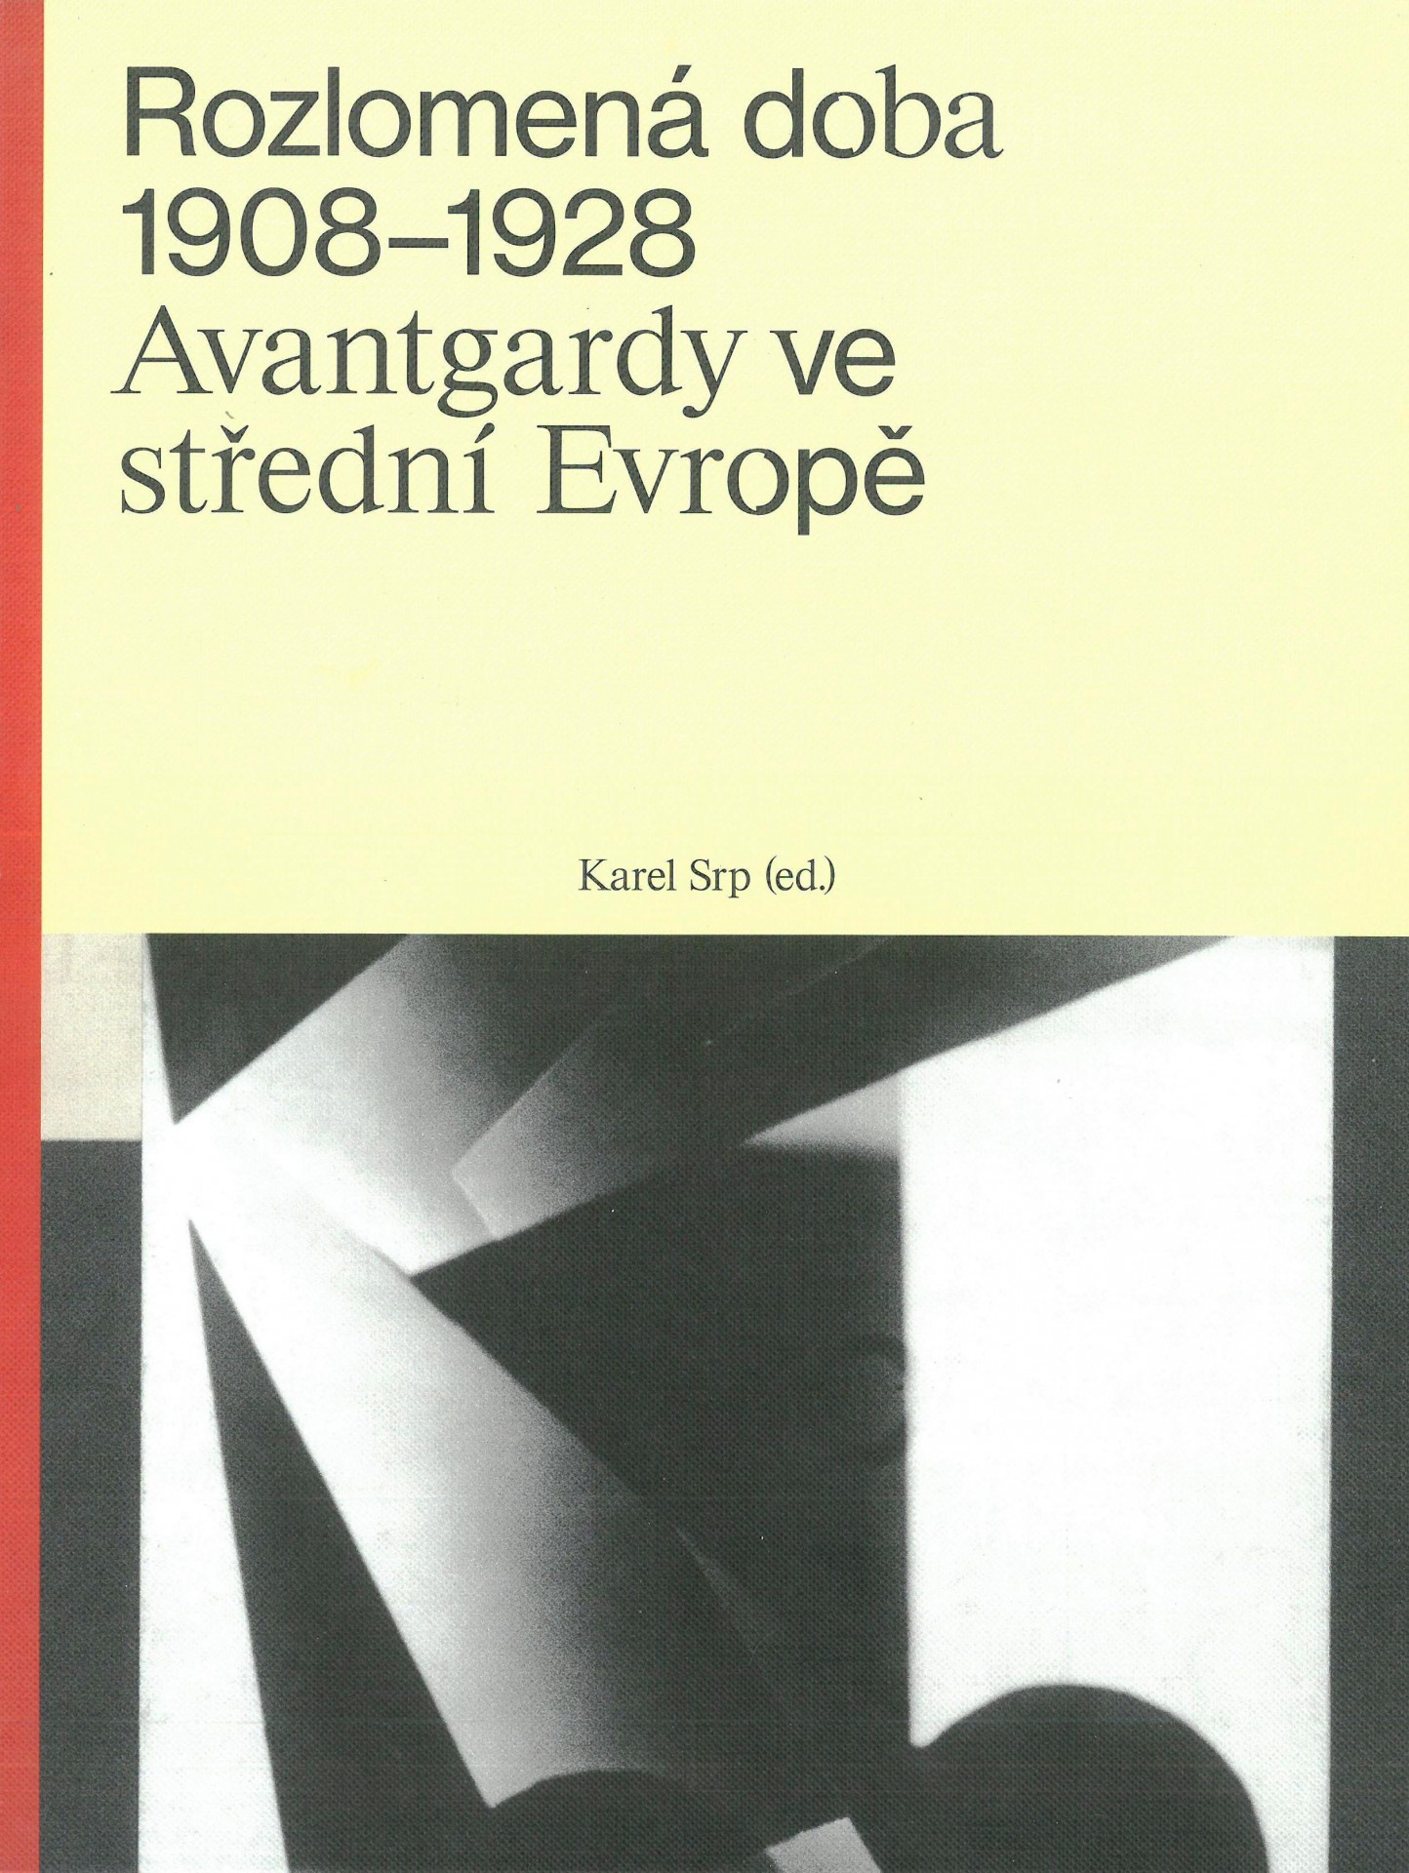
Literature
Karel Srp, Rozlomená doba 1908-1928: avantgardy ve střední Evropě (Olomouc, 2018)
Notes:
The next book relevant to this topic is Rozlomená doba by Karel Srp which can be translated as Years of disarray (disréj). This book focuses on the turning point of twenty years in the history of modern and avant-garde art in Central Europe and in twelve chapters there are examples of work starting with Expressionism in 1908 and ending with Abstraction in 1928.

Slide 8
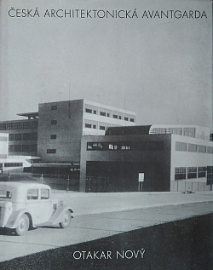
Literature
Otakar Nový, Česká architektonická avantgarda (Prague, 1998)
Notes:
And the last book I would like to briefly introduce is Czech architectural avant-garde by Otakar Nový. In this book, he focuses his attention on artists, projects, and buildings of interwar functionalism. (fankšlism)

Slide 9
What are the values underpinning it?
The linear concept of time
Positivistic approach
Emphasis on the non-traditional art
Notes:
So now we can try to answer the questions which lied in the basis of our presentation.
as we can see all reviewed books have similar structure. The authors choose some, not a very large passage of time, which they analyze in detail.
As values that connects all diskussed books, we can emphasized the linear concept of time and positivistic approach to the art history, which we discussed last time.
The emphasis on the non-traditional art
While the traditional art is just slightly mentioned.

Slide 10
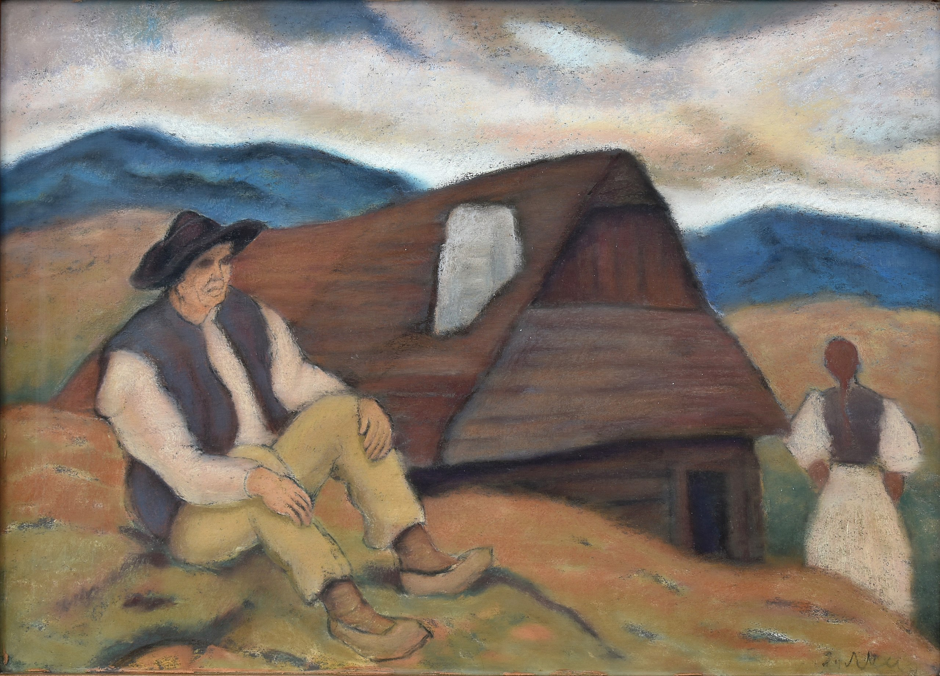
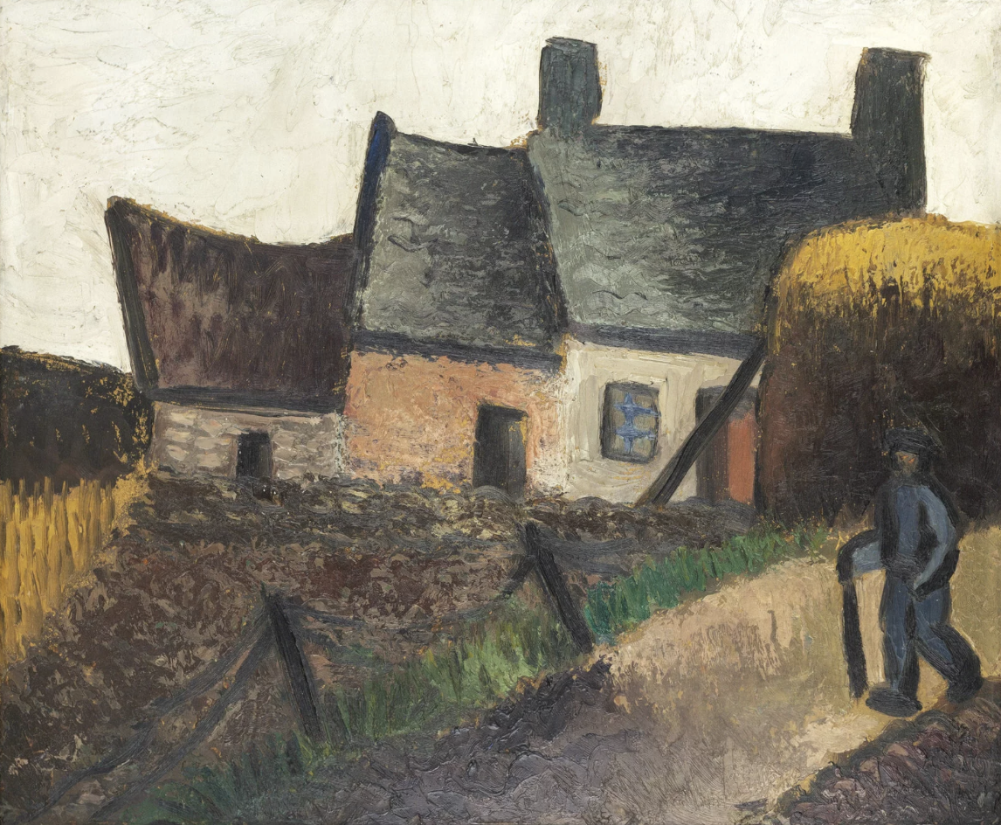
Is anything significant missing?
Janko Alexy, Púchovčan
Věra Jičínská, Motiv z Bretaně, 1929
Notes:
When we talk about the Czech canon of modernism, we noticed that it doesn‘t contain few very significant, to our opinion, elements
Firstly, when we are speaking about national art it is always very hard to define the nation itself from other nations. In some cases it is easier, like for example in France and French art, in some cases it is harder. Situation of the czech national art belongs to the more complicated cases. When we are speaking about the czech art in the end of 19th century, it is hard not to speak also about German and Austrian painters. Later, in the 20th century, It would be wrong to separate Czech and Slovak art.
However, in the canon of czech modernism we would rarely encounter with the artist of not a czech nationality. We can connect this fenomenon with the desire to establish strong national narrativ, but the question is, if it is right.
Second significant element which is missing is woman artists in the story of czech modern art. There is no book which is fully devoted to the feminist art and to the role of women in the czech art scene. For example, in the book D.V.U, which was disscused previously, only 3 women has been mentioned, and moreover, their value for the czech art was denied.

Slide 11
How and why the canon has been constructed?
National narattive
Idependence
The effort to rank among the artistic centers of Europe
Notes:
In the category of why the canon has been constructed, we want to point out three possible reasons why this might be so. The first two have a lot in common – in the Czech canon of modernism we can see a strong national narattive containg mainly czech male artists.
We think that this strong patriotism is also connected with some desire for independence which is visible in the canon and linked to Czech history.
And somethig what we also noticed is the effort to rank among the artistic centers of Europe which we talked about previously.

