Slide 1
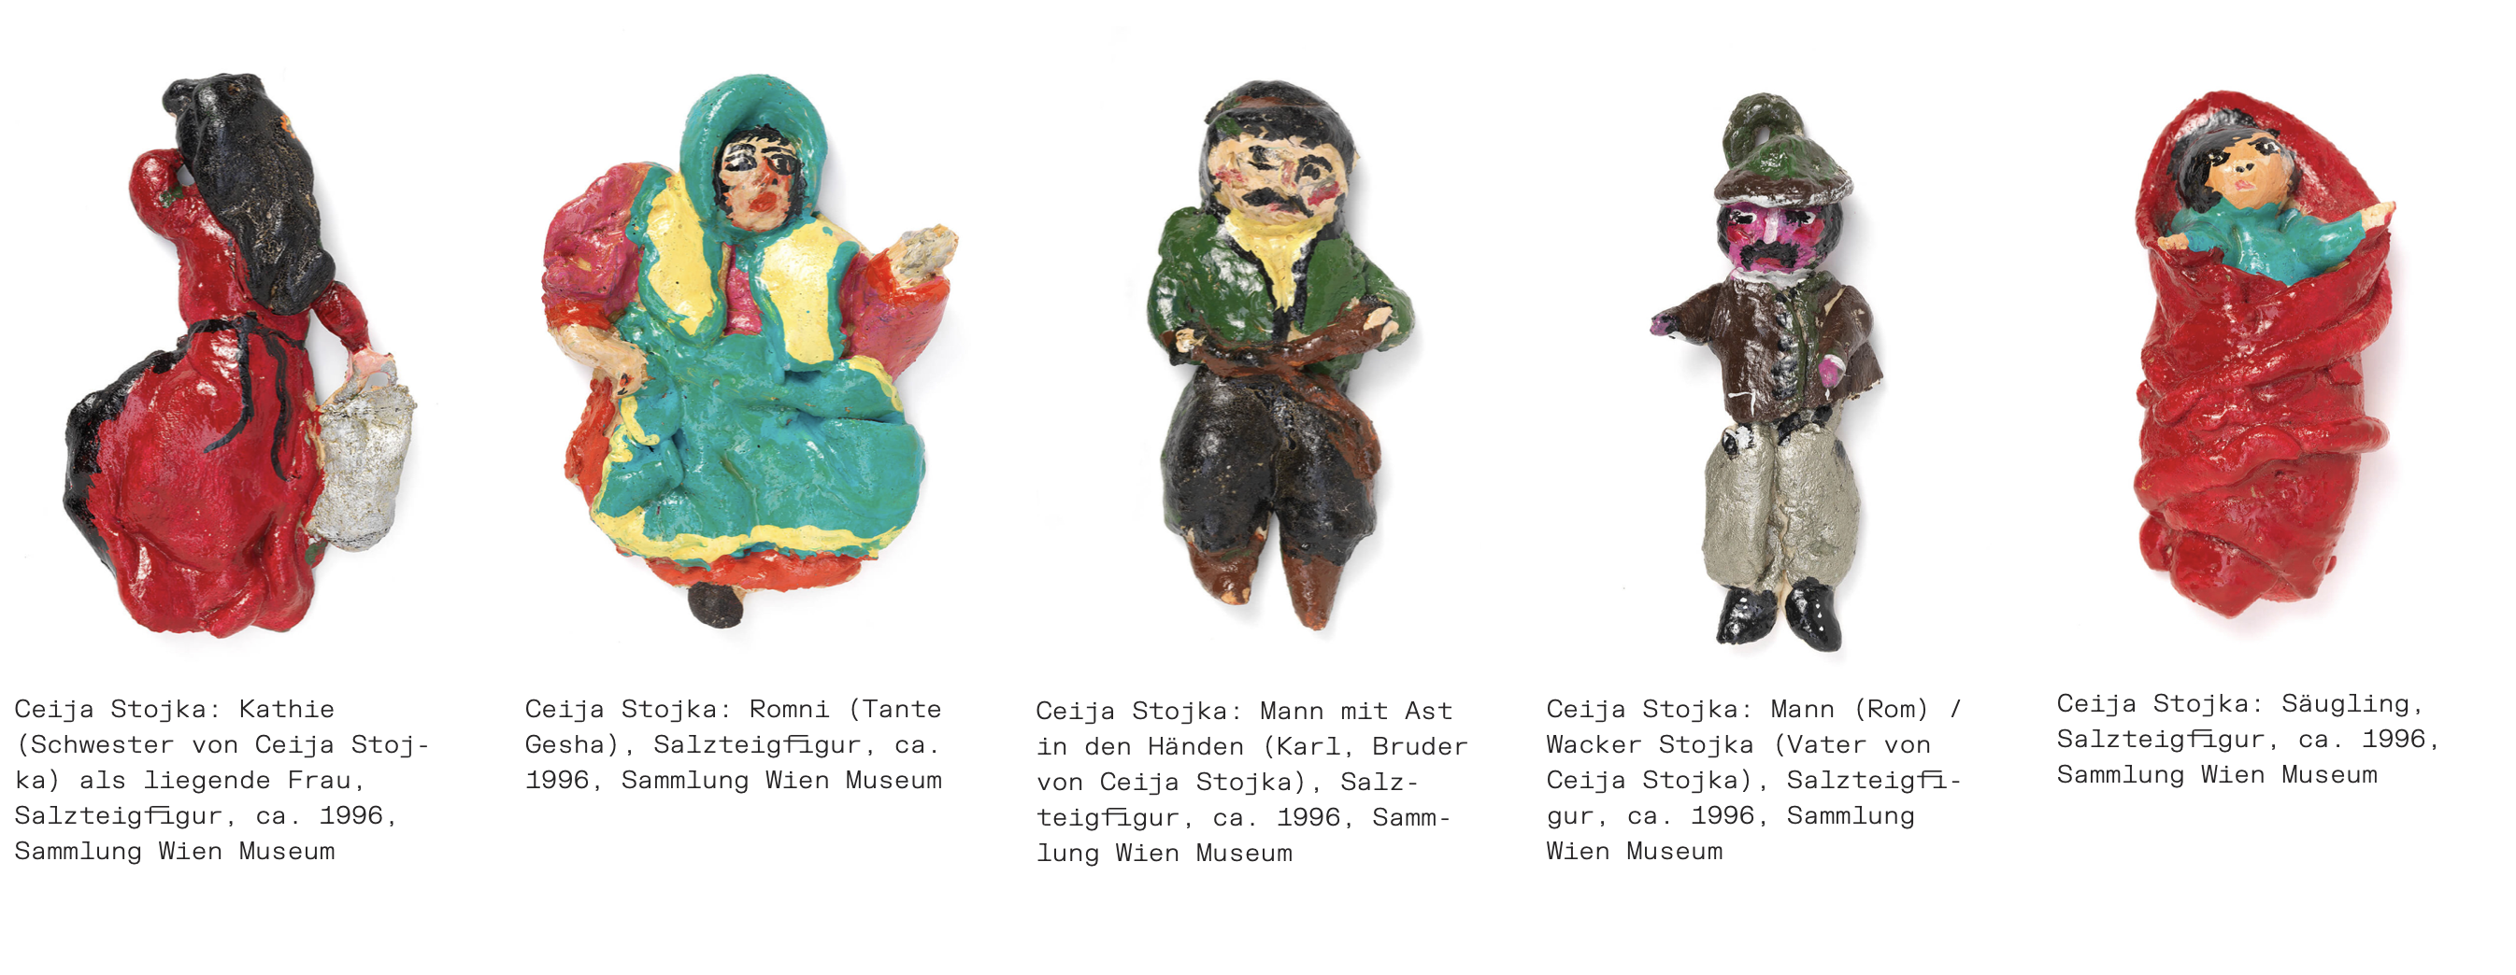
Documents of Persecution
30 March 2023
Memory cultures and the Romani Holocaust

Slide 2
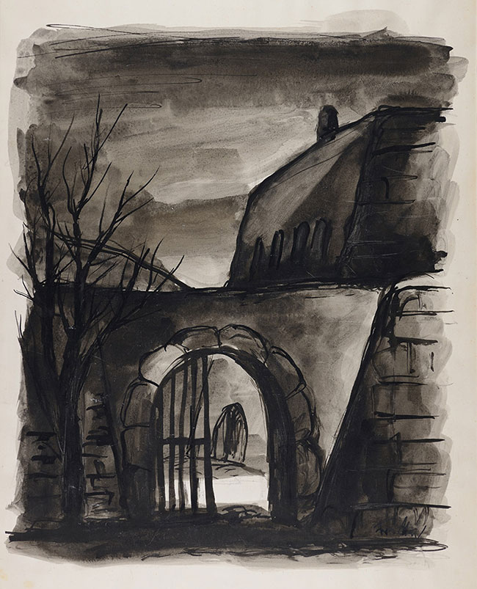
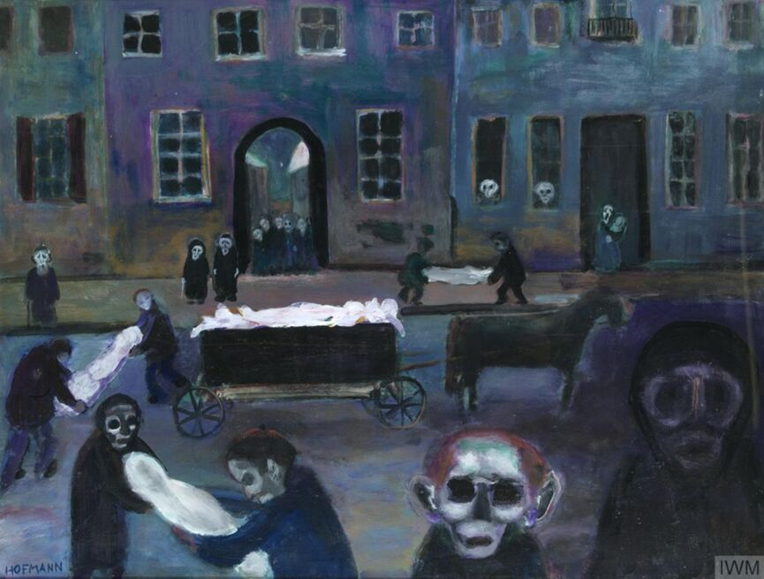
Bedřich Fritta (Friedrich Taussig) (1906–1944) Rear Entrance, Theresienstadt Ghetto, 1941–1944
Edith Birkin (1927–2018), The Death Cart - Lodz Ghetto, 1980, IWM London

Slide 3
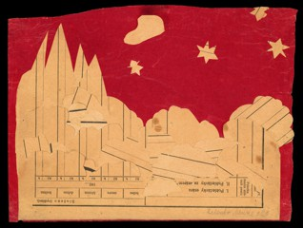
t was really I think the worst time of the war. Although we were free and liberated, it was the very worst time because we realised, or I realised that nobody was going to come back, and that life is never going to be the same, and what I hoped for would happen after the war is never going to happen. The hope was gone.
"Edith Birkin". British Library. Archived from the original on 1 March 2023. Retrieved 28 January 2018.
Helena Mändlová (1930–44), Undated (1943), Paper collage of old printed forms, 20.5 x 27 cm, Signed on the verso UL: Helene Mändl N72, Jahrgang 1930, XV. Stunde / and LR: Helenka Mändl 28 B. Provenance: created during the drawing classes in the Terezín Ghetto organized between 1943 and 1944 by the painter and teacher Friedl Dicker-Brandeis (1898–1944); in the Jewish Museum in Prague’s collection since 1945. Acc. No. JMP 121.586

Slide 4
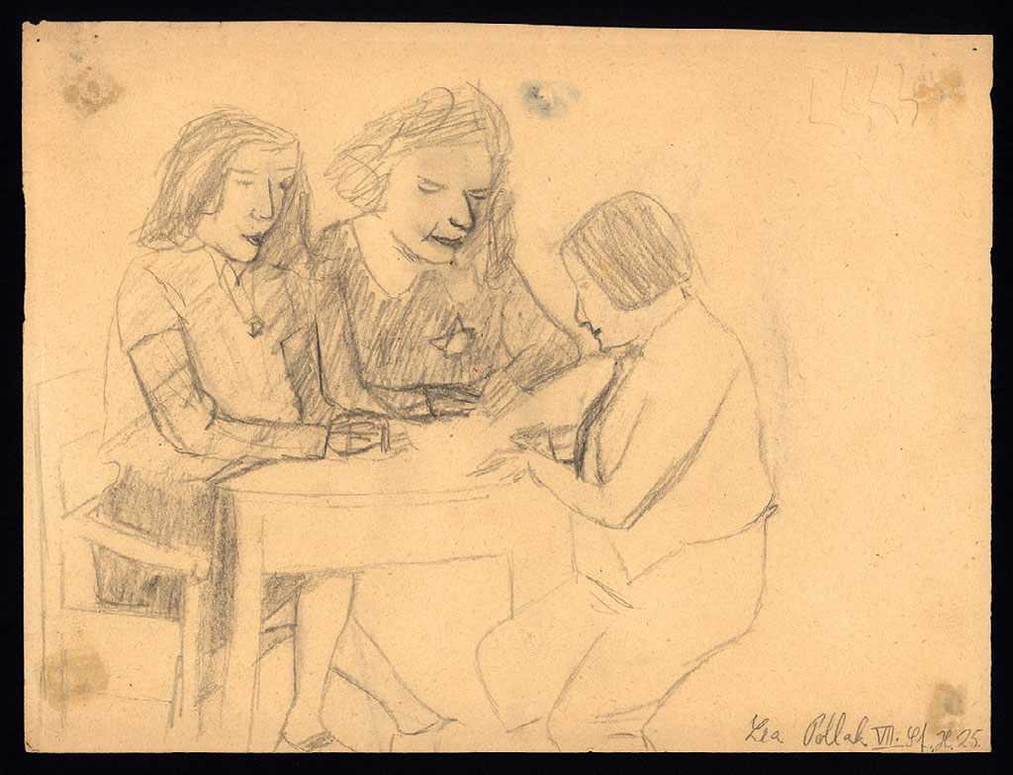
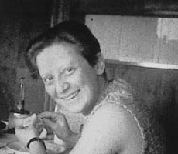
Friedl Dicker-Brandeis (1898–1944
"Sometimes I felt like she was a doctor. She herself was a medicine. Until today I cannot understand the mystery of her freedom. It flew into us from her like a current."
Edna Amit
Lea Lenka Pollak (1930-1944): Class in a Dorm, graphite pencil on paper, 217 x 278 mm, Ghetto Theresienstadt / Terezín (1943-1944) • Collection of the Jewish Museum in Prague, #130.957

Slide 5
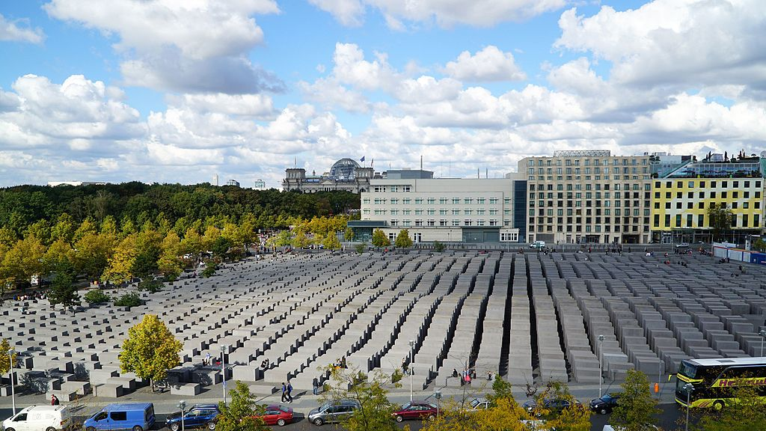
Peter Eisenman and Buro Happold. Memorial to the Murdered Jews of Europe, Berlin, 2003–2004

Slide 6

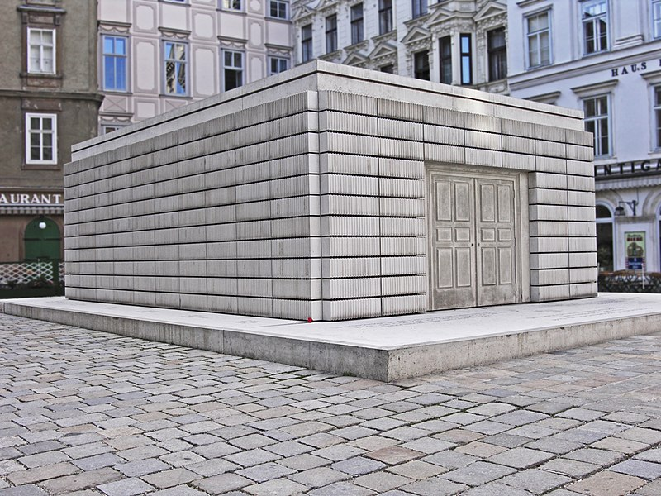
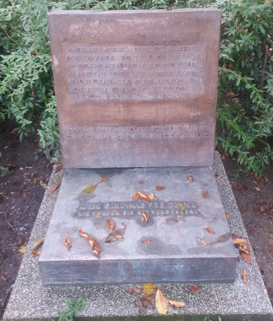
“Stumbling Blocks”
Memorial for murdered Roma, Sinta and Lovara, Barankaplatz, Vienna, 1999
Rachel Whiteread, The Judenplatz Holocaust Memorial, Vienna, 2000

Slide 7
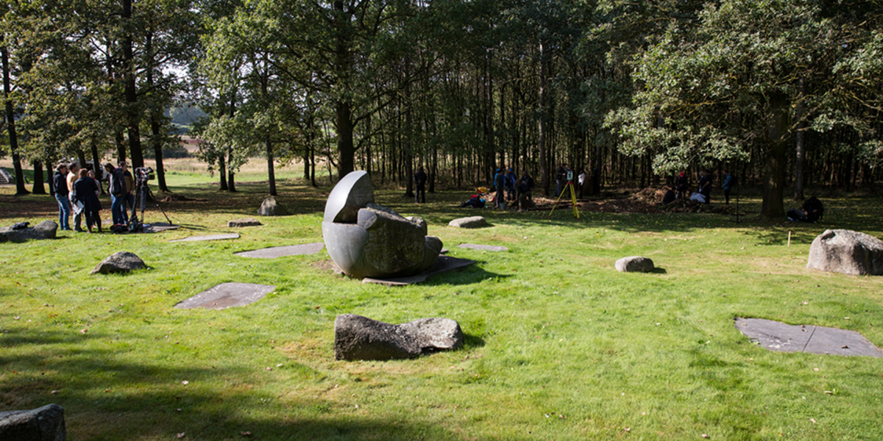
Lety u Písku. The Memorial to the holocaust of the Roma and Sinti in Bohemia.

Slide 8
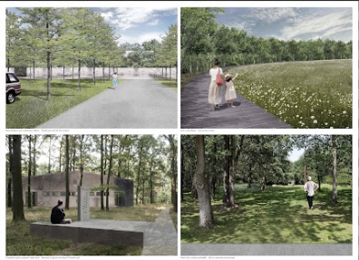
https://www.newmemoriallety.com/proposals/1st-place/
The main element of our composition is the forest. Forest. Its inner space. Its edge. Open space created by the edge of the forest. Forest as a community. Here, the most general metaphor for the Roma community. The absence of the forest as a metaphor for the absence of those who did not survive Roma holocaust. Memorial : The first goal of our project is to anchor the commemoration of those who suffered in this concentration camp. Education : Our second goal is to tell this story of horrors and bring it before the eyes of the society. Community : The third goal is to create a space of encounter: coming together as an opportunity to maintain or start friendships, to share our lives.
Ateliér Terra Florida v. o. s., Jan Sulzer, Lucie VogelováAteliér Světlík, Jan Světlík, Vojtěch Šedý, Filip Šefl

Slide 9
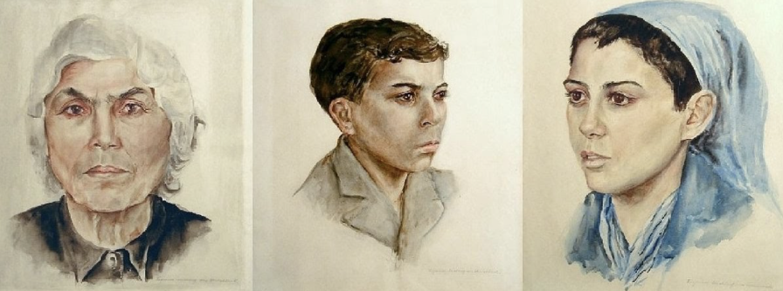
Whose memory is it?
Celine
Dina Gottliebová-Babbitt (1923–2009), Portraits of inmates from the Roma camp
Auschwitz-Birkenau State Museum Collections

Slide 10
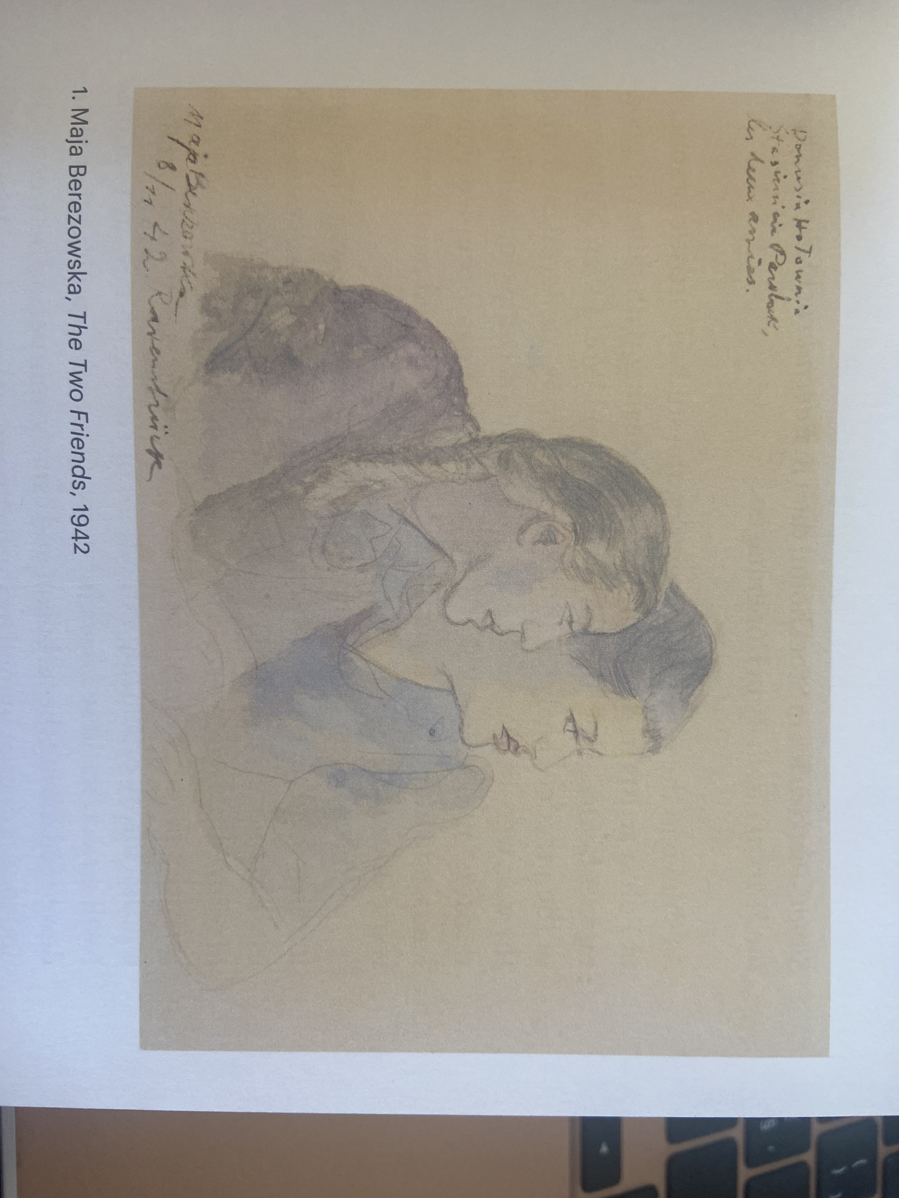
Art as resistance
“When we sat around the table, I hid a piece of paper on my lap and made quick drawings, scenes full of joy, cheerful and loving, which then went from hand to hand, giving the tormented women a moment of forgetfulness, evoking laughter and hope. I drew their portraits. Often those sheets endured better than young bodies that fire turned to ashes.”
Maja Berezowska, Piorkem przrz stulencia (Warsaw, 1985).
Maja Berezowska, The two Friends, 1942
Agata Pietrasik, Art in a Disrupted World. Poland 1939–1949, Warsaw 2021.

Slide 11
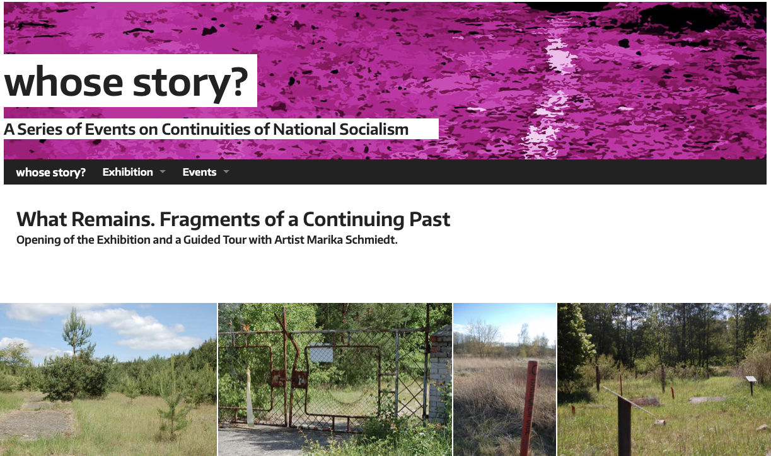
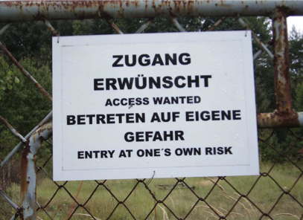
Asavei, M. A. (2020). “Call the witness”: Romani Holocaust related art in Austria and Marika Schmiedt’s will to memory. Memory Studies, 13(1), 107–123.
The Right to Memory
Artistic memory as confrontation in counter-public spheres
National unification and victimhood – different forms of memory
Memory work and participatory artistic practice
Exhibition catalogue, 2015: http://www.uckermark -projekt.org/sites/default/files/veranstaltungen/files/ausstellung_uckermark_12.pdf

Slide 12
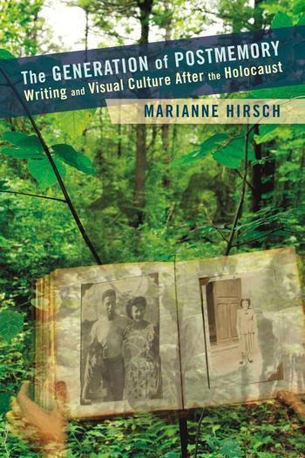
Marianne Hirsch – POSTMEMORY
‘“Postmemory” describes the relationship that the “generation after” bears to the personal, collective, and cultural trauma of those who came before — to experiences they “remember” only by means of the stories, images, and behaviors among which they grew up. But these experiences were transmitted to them so deeply and affectively as to seem to constitute memories in their own right. As I see it, the connection to the past that I define as postmemory is mediated not by recall but by imaginative investment, projection, and creation. To grow up with overwhelming inherited memories, to be dominated by narratives that preceded one´s birth or one´s consciousness, is to risk having one´s own life stories displaced, even evacuated, by our ancestors. It is to be shaped, however indirectly, by traumatic fragments of events that still defy narrative reconstruction and exceed comprehension. These events happened in the past, but their effects continue into the present.’
An interview with Marianne Hirsch, https://cup.columbia.edu/author-interviews/hirsch-generation-postmemory
Marianne Hirsch, The Generation of Postmemory, New York, 2012

Slide 13
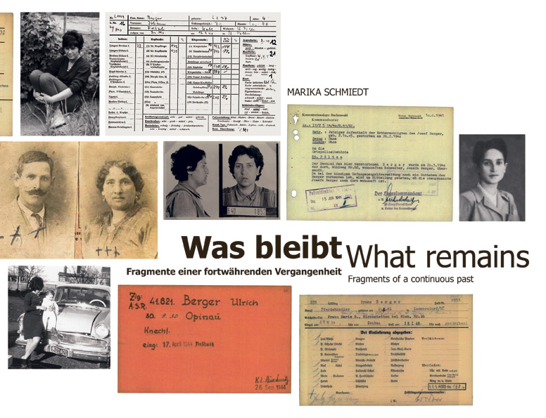
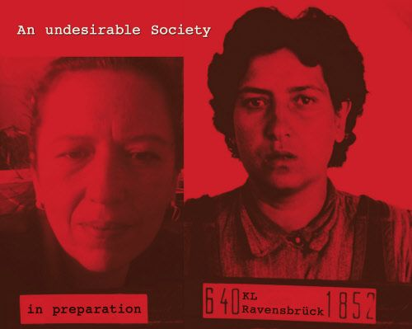
Marika Schmidt (*1966)
Marika Schmiedt, What remains, 2014
An undesirable Society, 2001

Slide 14
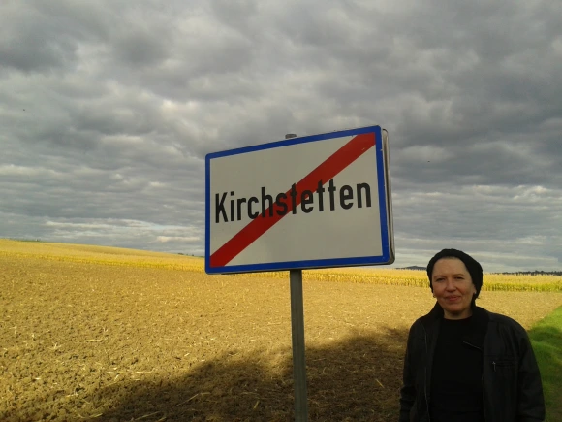
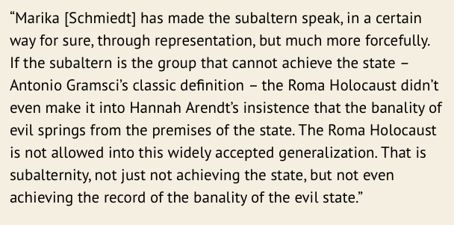
Marika Schmiedt (*1966)
Futschikato—The Missing Roma and Sinti
from Kirchstetten and the “The Weinheber Case”
Quote by Gayatri Chakravorty Spivak,
https://marikaschmiedt.com/2015/08/06/regarding-marika-schmiedts-request-for-permission-of-showing-her-art-installation-in-kirchstetten/
https://marikaschmiedt.com/futschikato-die-verschwundenen-roma-und-sinti-aus-kirchstetten-und-der-fall-weinheber/

Slide 15
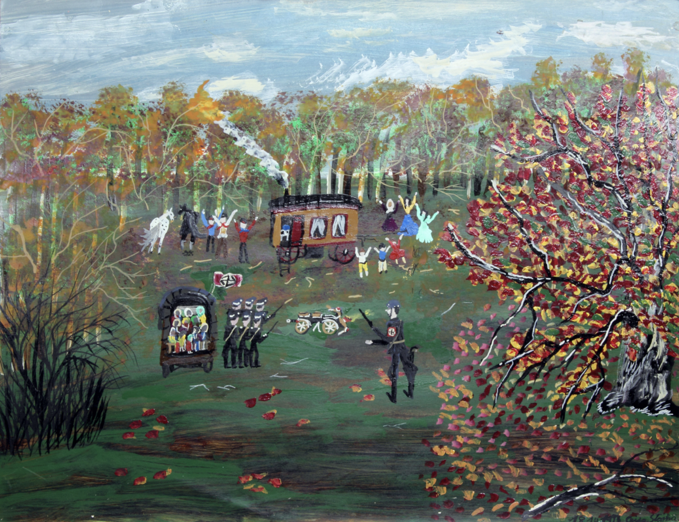
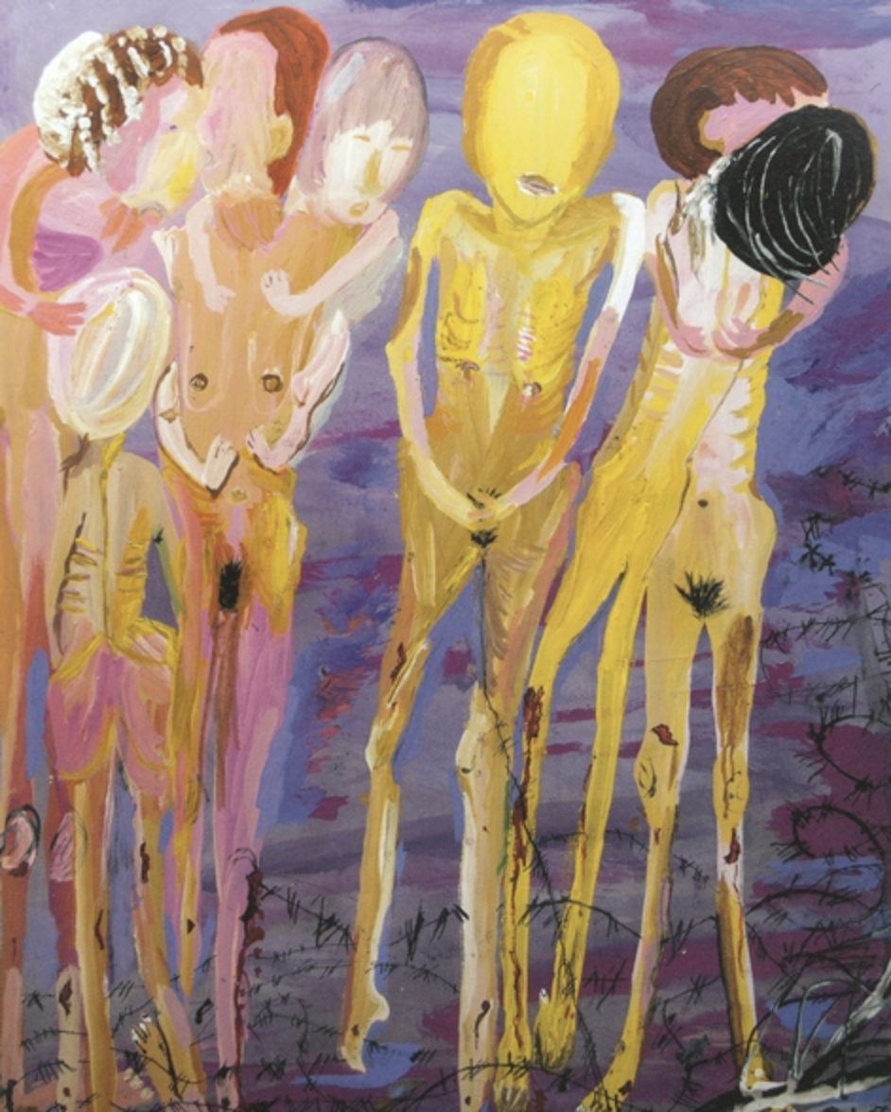
Ceija Stojka. This Has Happened, (Museo Reina Sofía, 22 November 2019 – 23 March 2020)
Ceija Stojka, Sans titre, 1993, acrylic on board, Courtesy Hojda et Nuna Stojka, © Ceija Stojka, © ADAGP, 2017
Ceija Stojka, image from: https://volksgruppen.orf.at/v2/roma/stories/2904664/

Slide 16
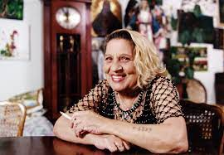
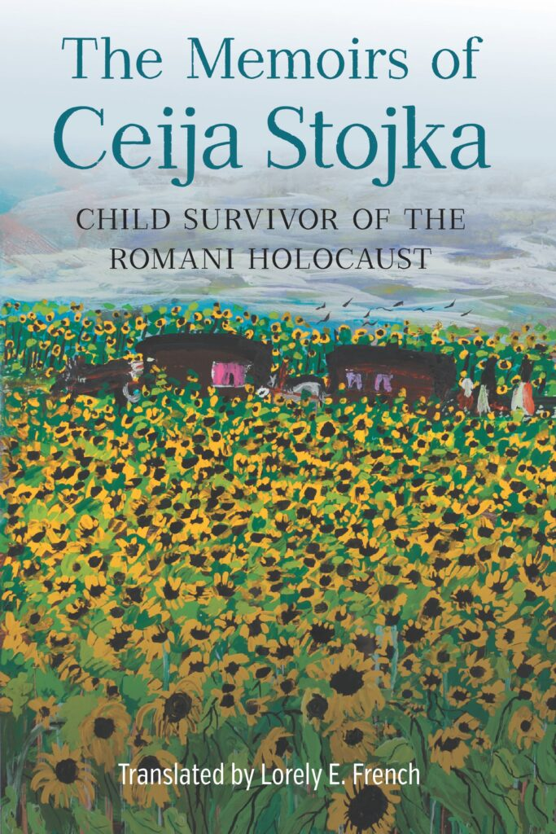
“The dead fly off in a rustling of wings. They rush out, they
shake themselves. I can feel them. They sing, and the sky’s
full of birds. It’s only their bodies that are lying there. They’ve
left their bodies […] we’re carrying them along with our own lives.”
Ceija Stojka, Je rêve que je vis? Libérée de Bergen-Belsen
Ceija Stojka (1933–2013)
The Memoirs of Ceija Stojka, Child Survivor of the Romani Holocaust, 2022 (Engl. Translation)

Slide 17
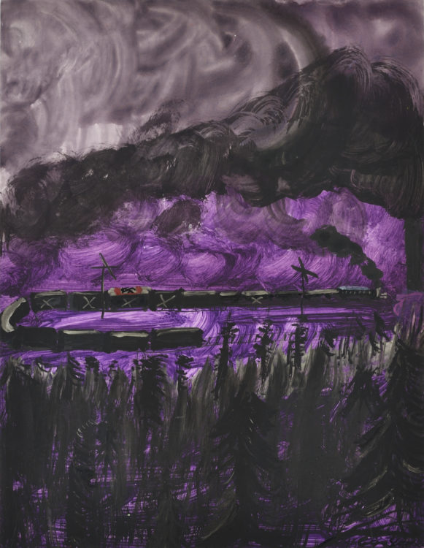
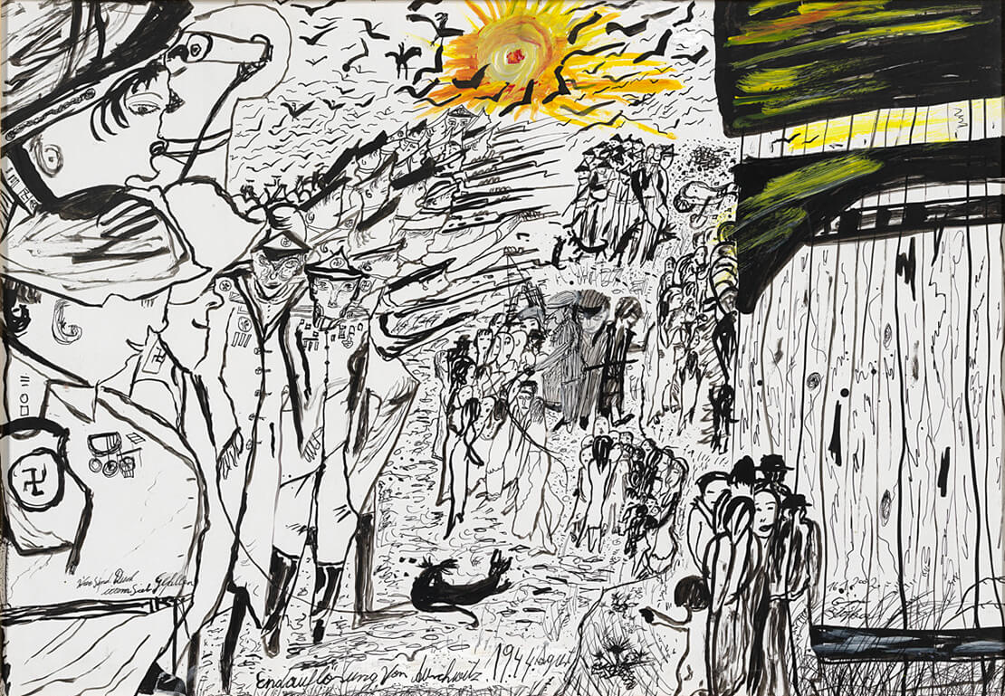
“If the world does not change now … if it does not build
peace-so that my great grandchildren have a chance to live in this world, then I cannot explain why I survived Auschwitz, Bergen-Belsen, and Ravensbrück” (Stojka quoted in Keen, 2015: 80)
Ceija Stojka: „Endauflösung von Auschwitz“, Gouache auf Karton, 2011, Sammlung Wien Museum
The “dark works”
Ceija Stojka, Personne n’avait vu cela…ref 828, 1995, © Ceija Stojka, ADAGP, Paris. © Photo: Rebecca Fanuele.

Slide 18
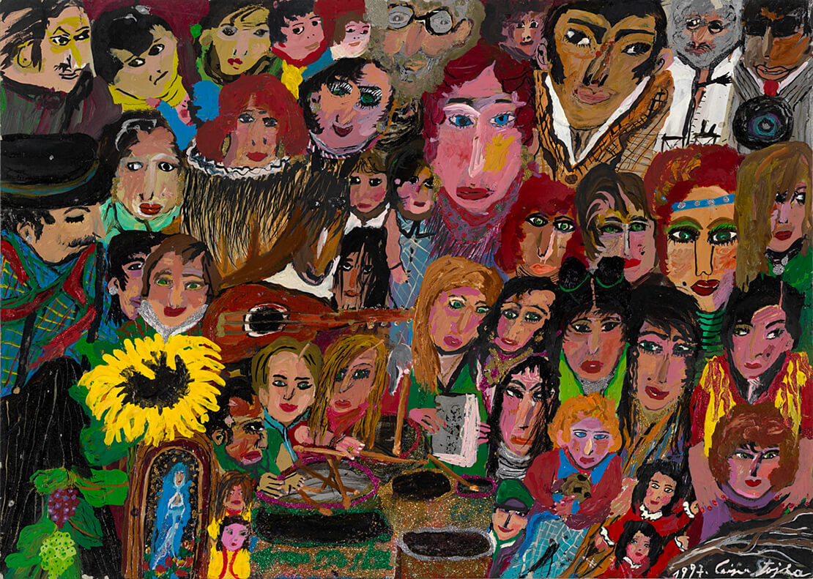
The “light works”
Ceija Stojka: „Der Rest der Stojkas“, Öl auf Karton, 1997, Sammlung Wien Museum

