Slide 1
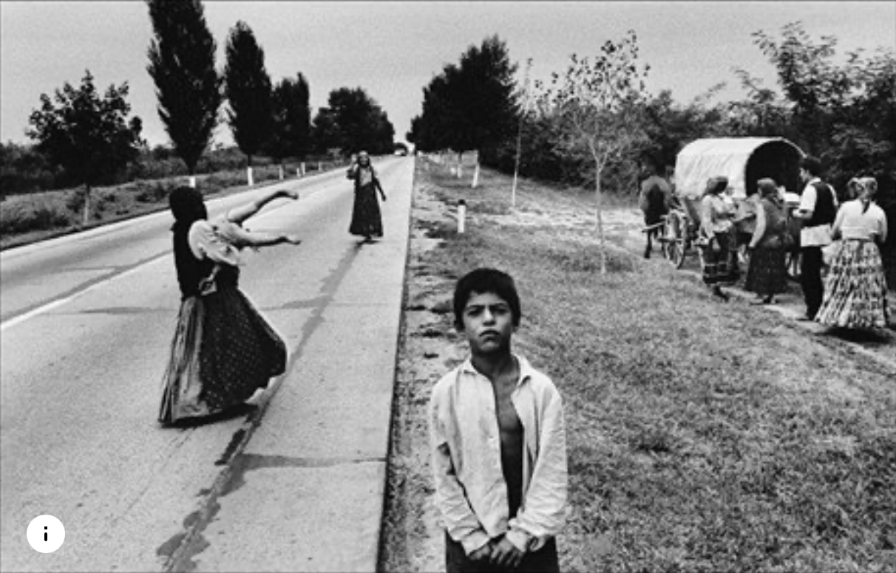
The struggle for control of Romani identity: Emancipation after 1945
20 April 2023

Slide 2
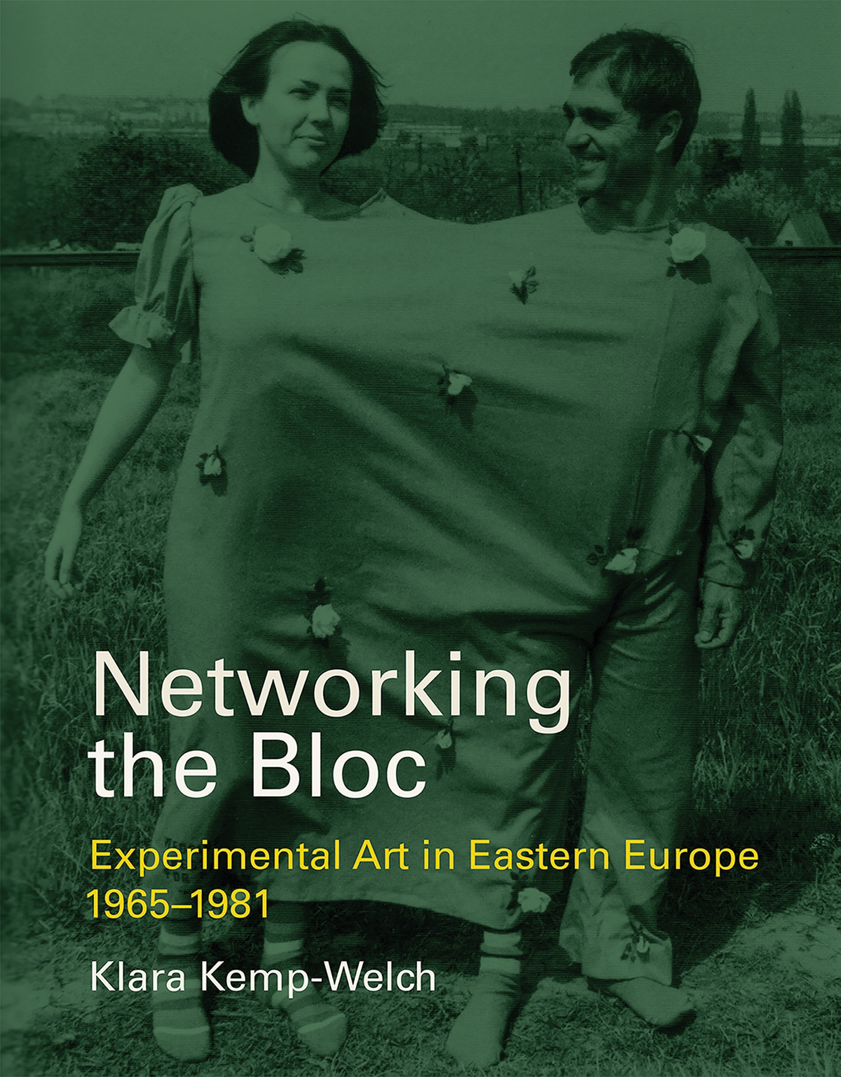
Klara Kemp-Welch, Networking the Bloc, 2019

Slide 3
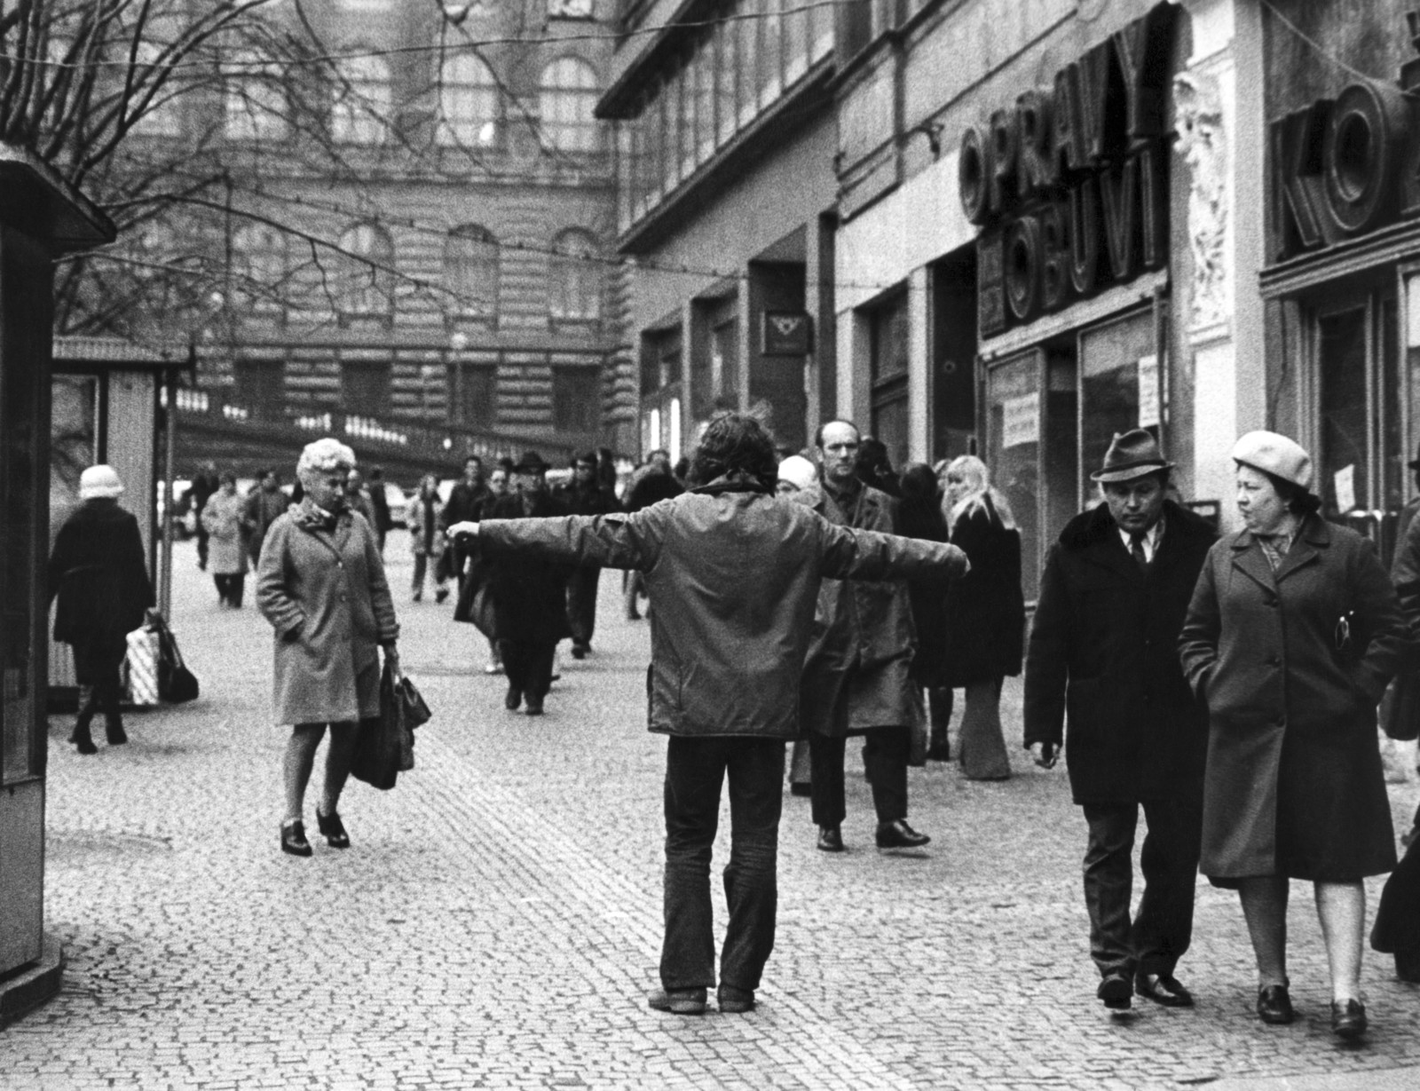
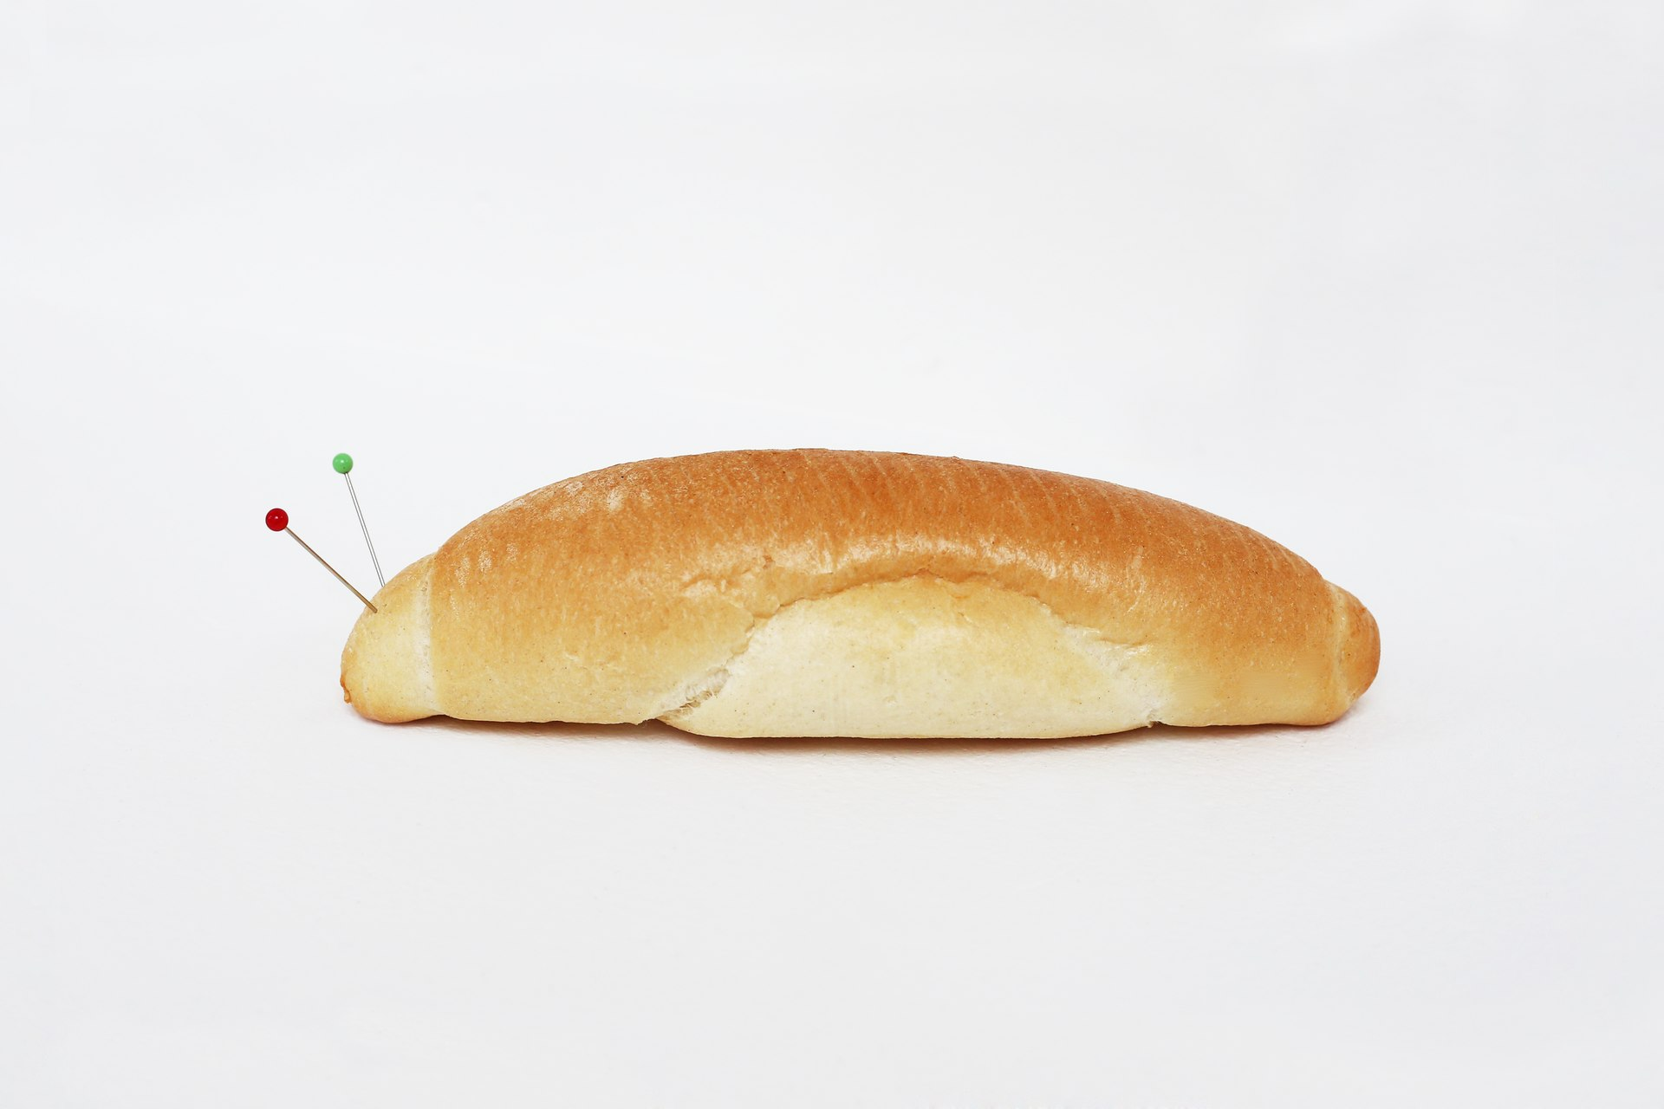
Jiří Kovanda (*1953)
Jiří Kovanda, Slimák, 1989 / 2020, rohlík, špendlíky, rozměry variabilní
Jiří Kovanda, November 19th, 1976.

Slide 4
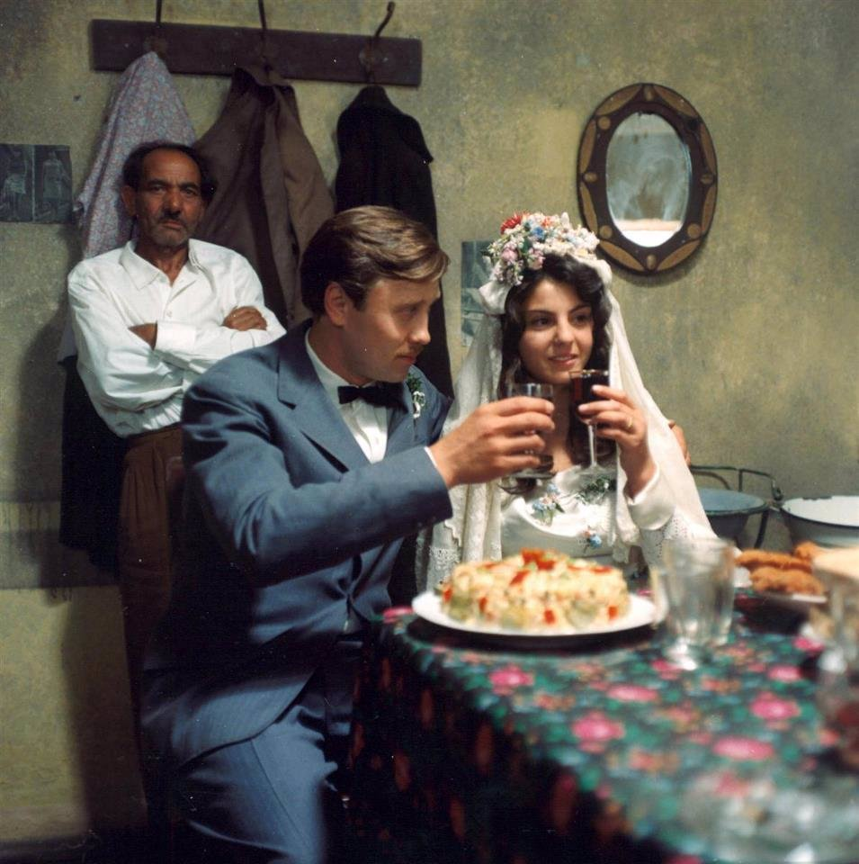
Jiří Menzel, Skřivánci na niti (Larkson a String, 1969)
- Based on Bohumil Hrabal’s “Inzerát na dům, ve kterém už nechci bydlet” (1965)

Slide 5
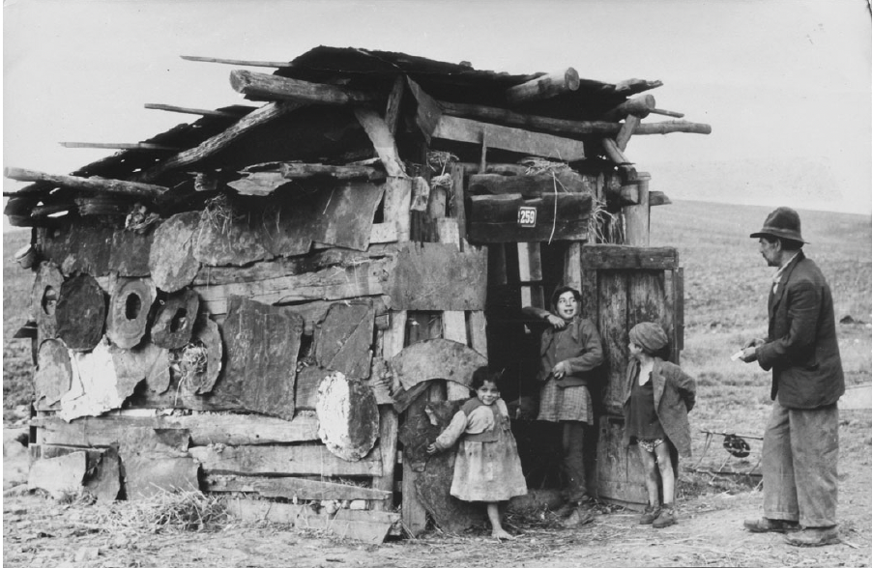
Eva Davidová (1932–2018)
ethnologist, folklorist, art historian, but above all co-founder of Czech Romani studies and photographer
Roma in Kendice, eastern Slovakia, 1960. Photographer: Eva Davidová. From the Gypsy Lore Society Collections, University of Liverpool Special Collections and Archives.

Slide 6
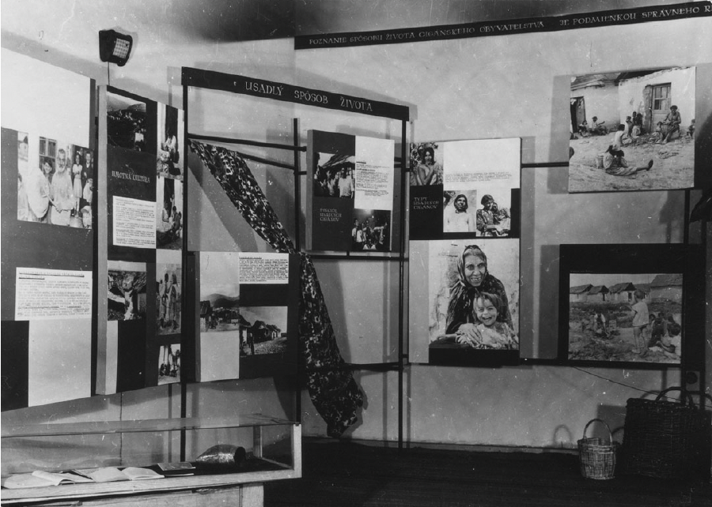
Exhibition of photographs by Eva Davidová entitled Gypsies yesterday, today and tomorrow, Košice, Czechoslovakia, 1962.
Photographer: Eva Davidová. From the Gypsy Lore Society Collections, University of Liverpool Special Collections and Archives.

Slide 7
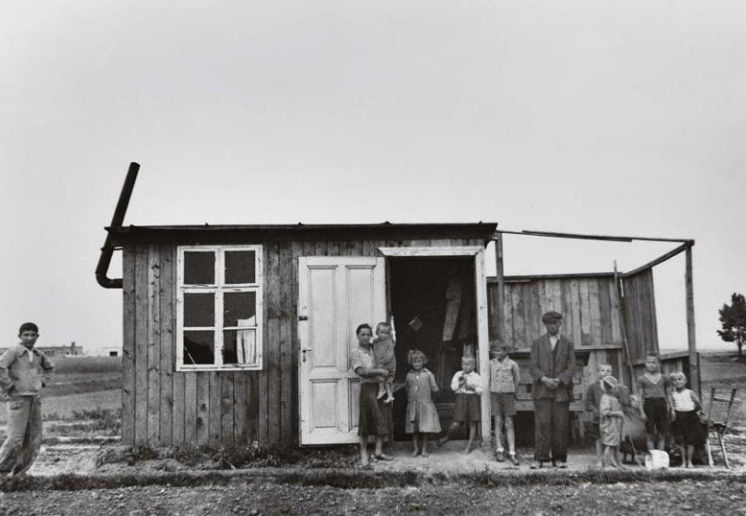
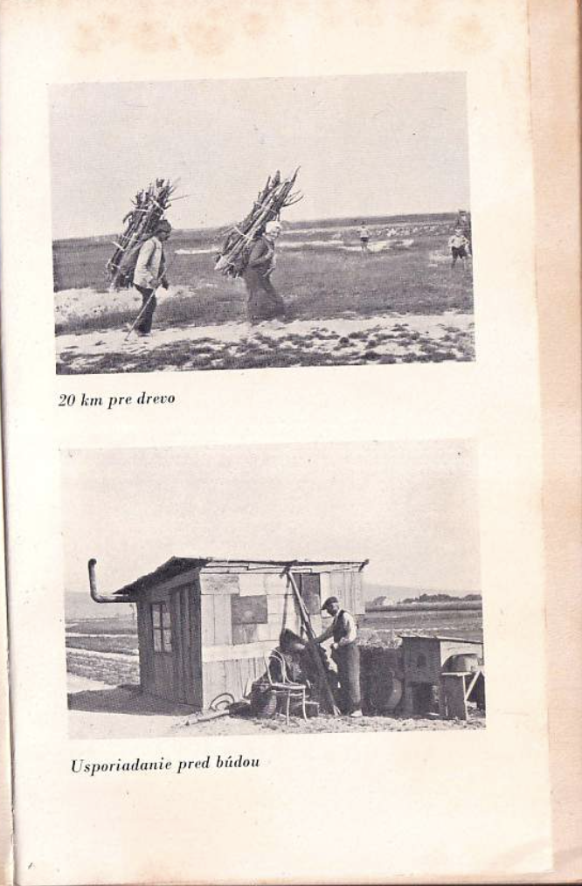
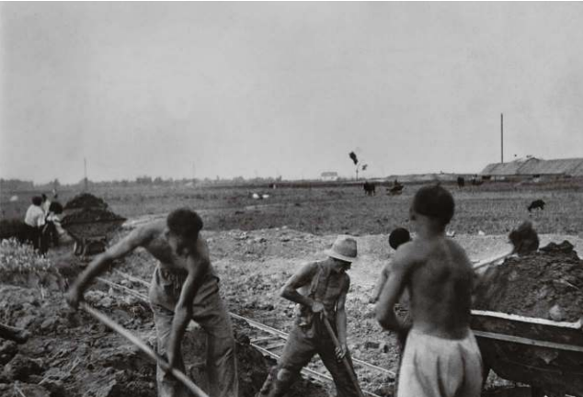
Valie of the series
Iľja Jozef Marko, Dornkappel – a suburb of three languages, 1938

Slide 8
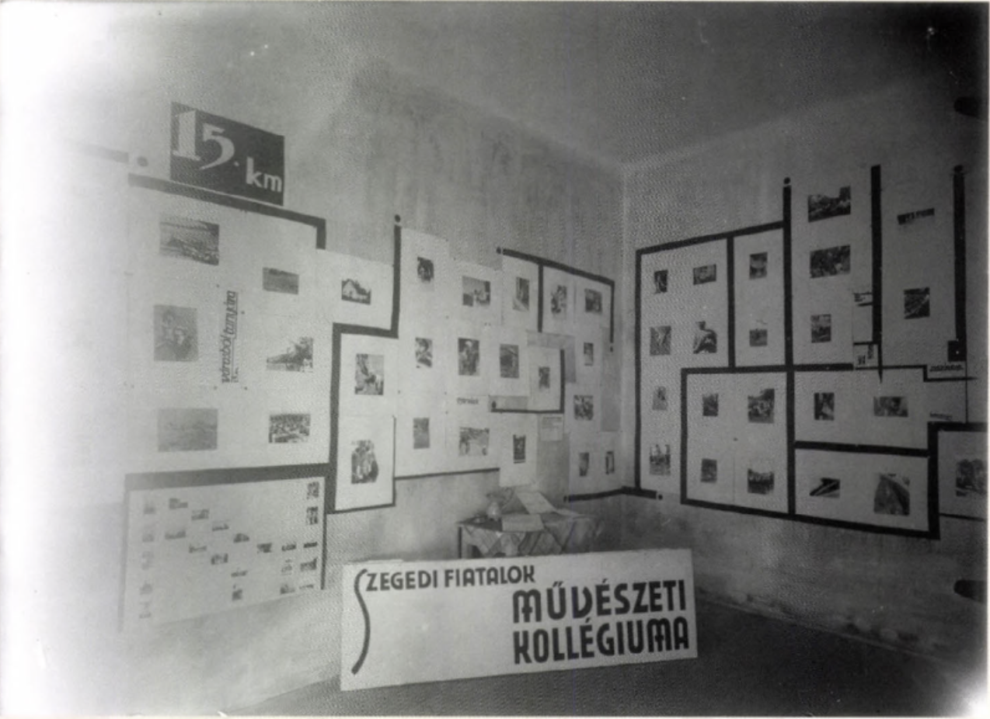
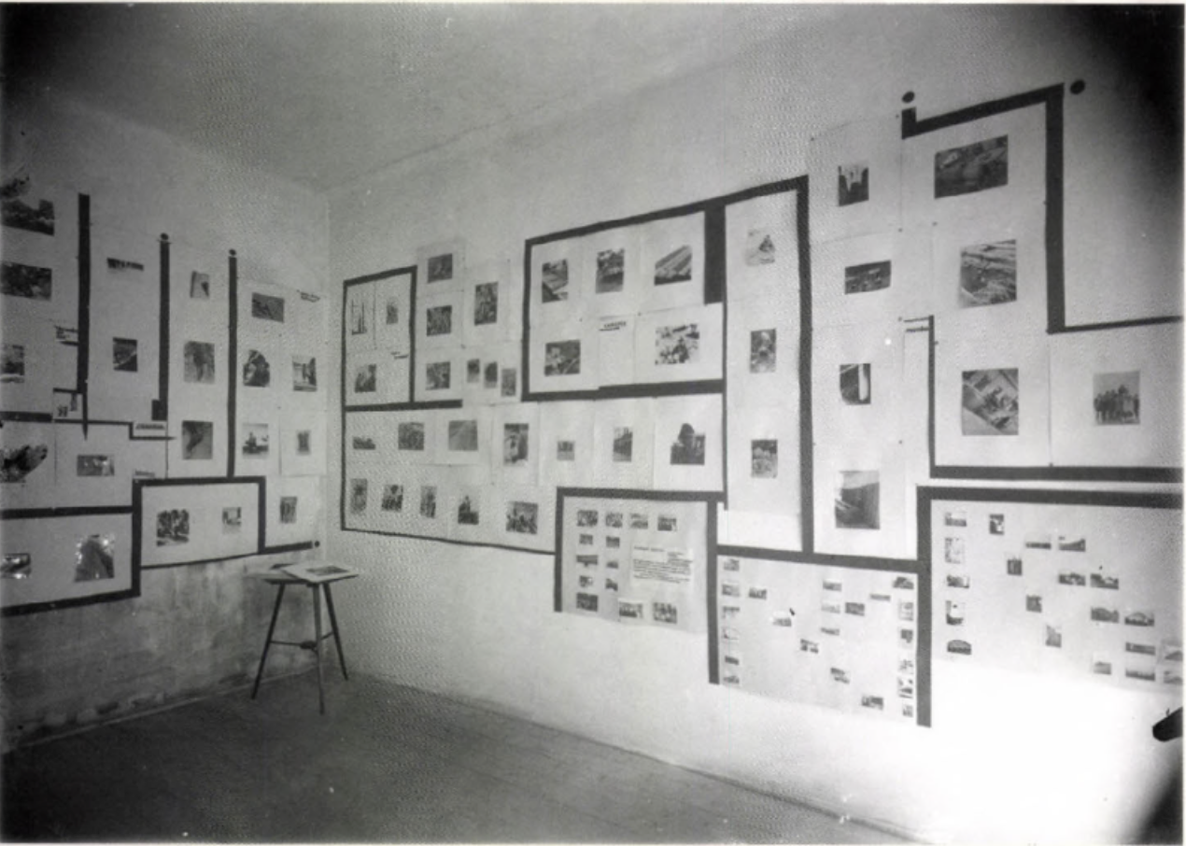
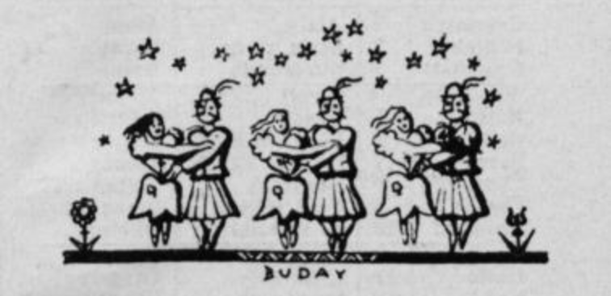
Judit Kárász, Fifteen kilometres from Town to Homestead , 1933 (Exhibition view)
György Buday, Illustration for a folk poem, 1930s

Slide 9
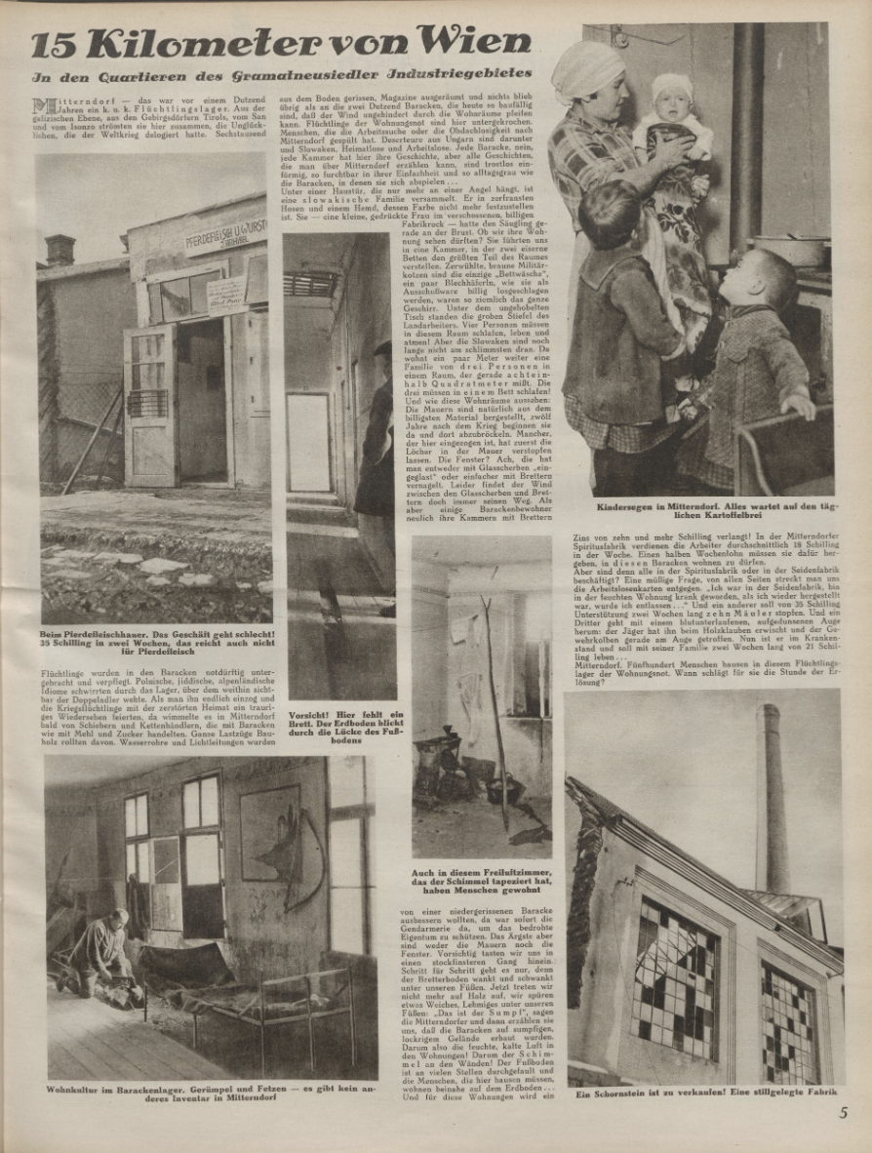
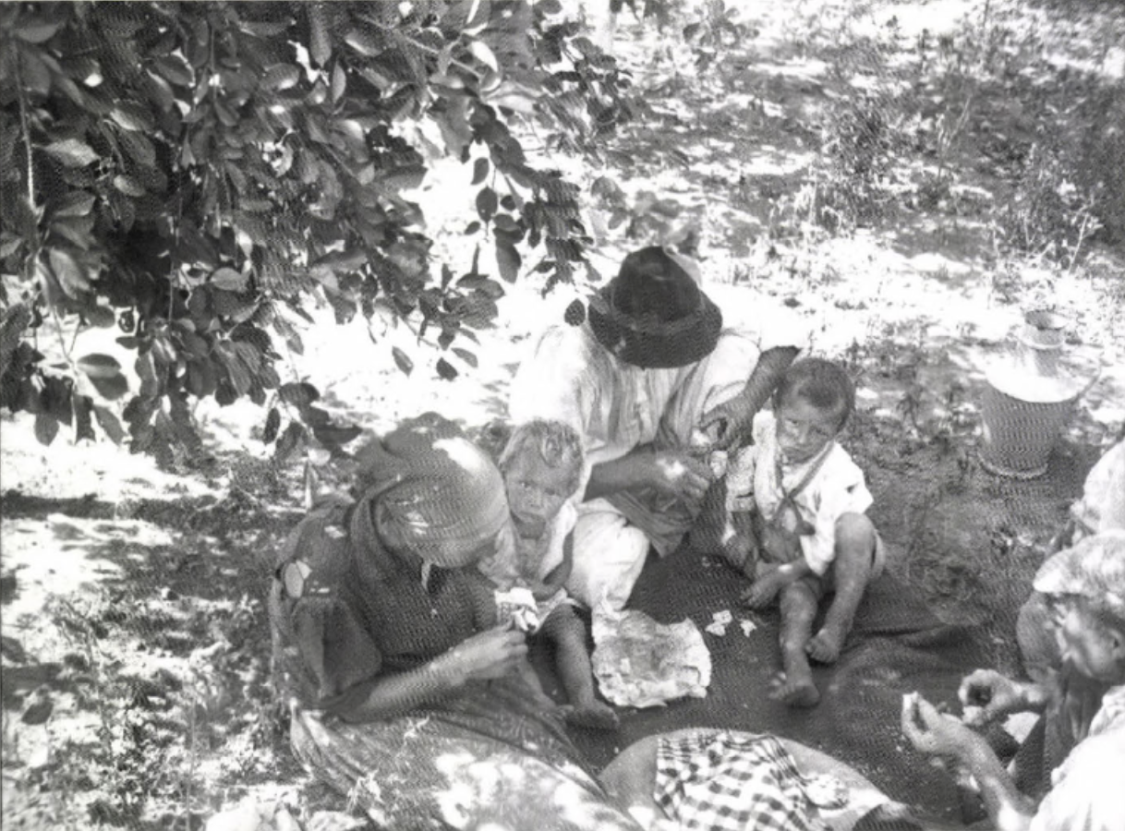
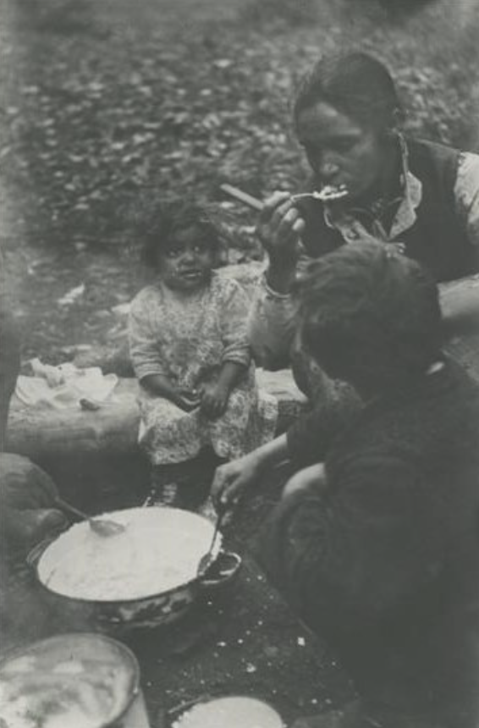
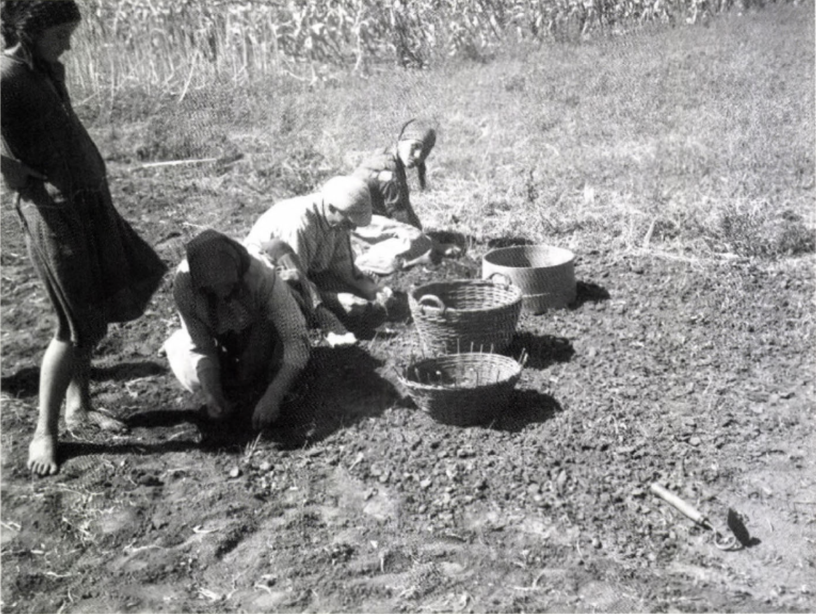
Judit Kárász, Lunch in the Shade, Makó, 1930s
Irena Blühová, Breakfast in the Forest, 1930s
“15km from Vienna”, Der Kuckuck, 9 March 1930
Judit Kárász, Onion Field, Makó, 1930s

Slide 10
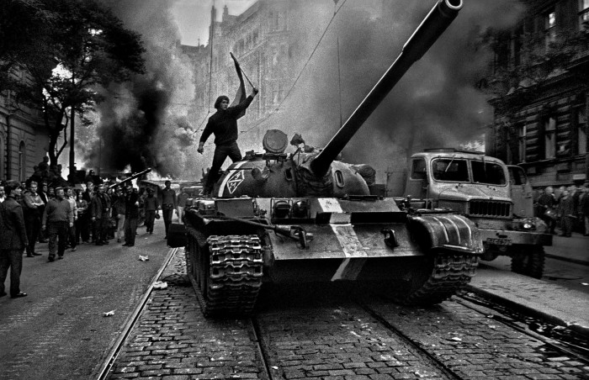
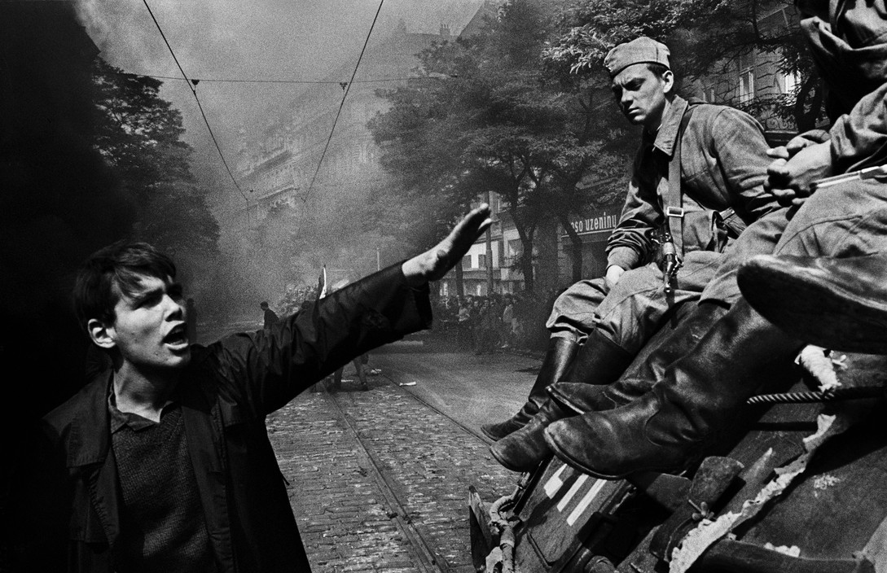
Josef Koudelka (*1938)
"The maximum, that is what has always interested me"
P. P. (Prague Photographer)
https://www.magnumphotos.com/photographer/josef-koudelka/

Slide 11
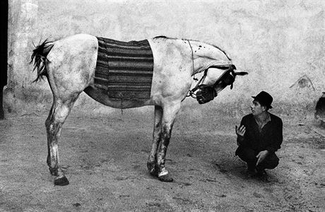
Gypsies, 1975
When I came across gypsies, I found that there was something about me. Photographer and critic Jiří Jeníček, who somehow discovered me, used to tell me: "Kudeláčka, the photographer makes the subject and the subject makes the photographer.
Zdroj: https://www.lidovky.cz/orientace/kultura/josef-koudelka-mit-vsechno-ostre.A110805_170321_ln_kultura_wok
Magnum Photos

Slide 12
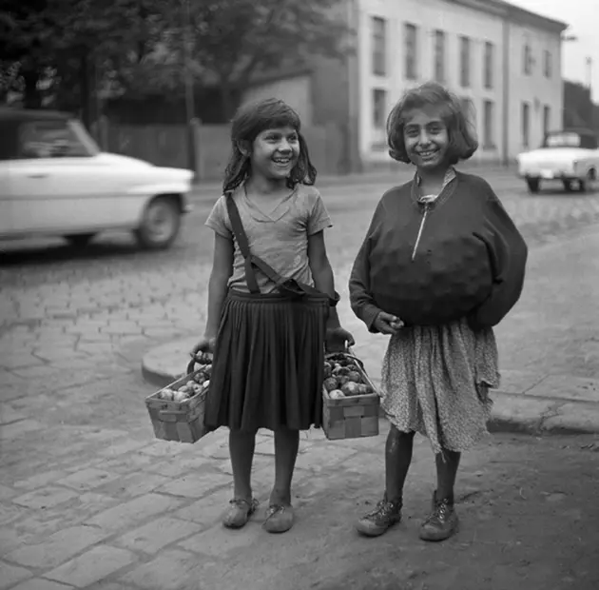
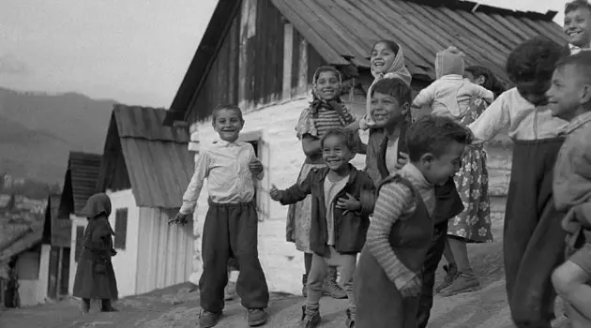
Photographs 1956-1988
A photography of social relations

Slide 13
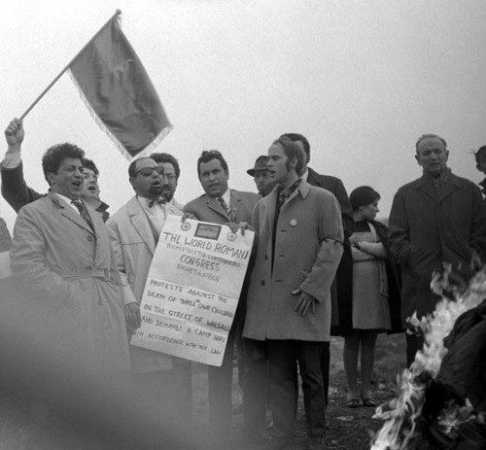
The First World Romani Congress, 1971.
London.

Slide 14
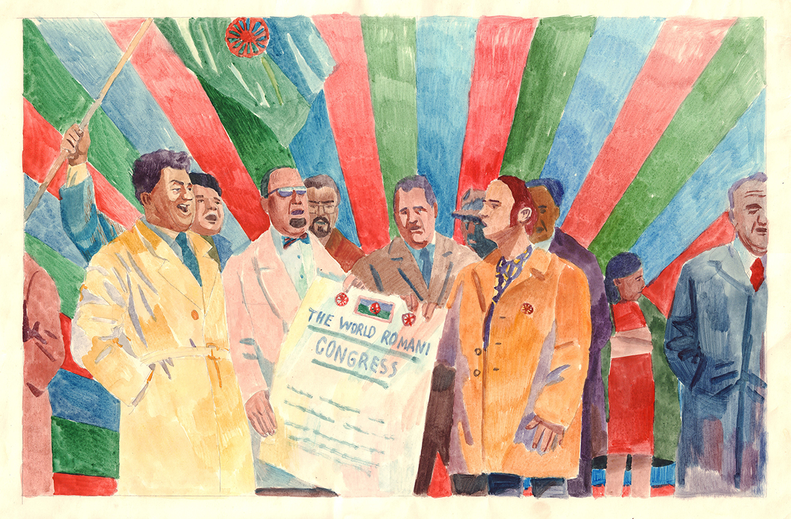
Rozana Kuburovič, The First World Romani Congress, 1971.

Slide 15
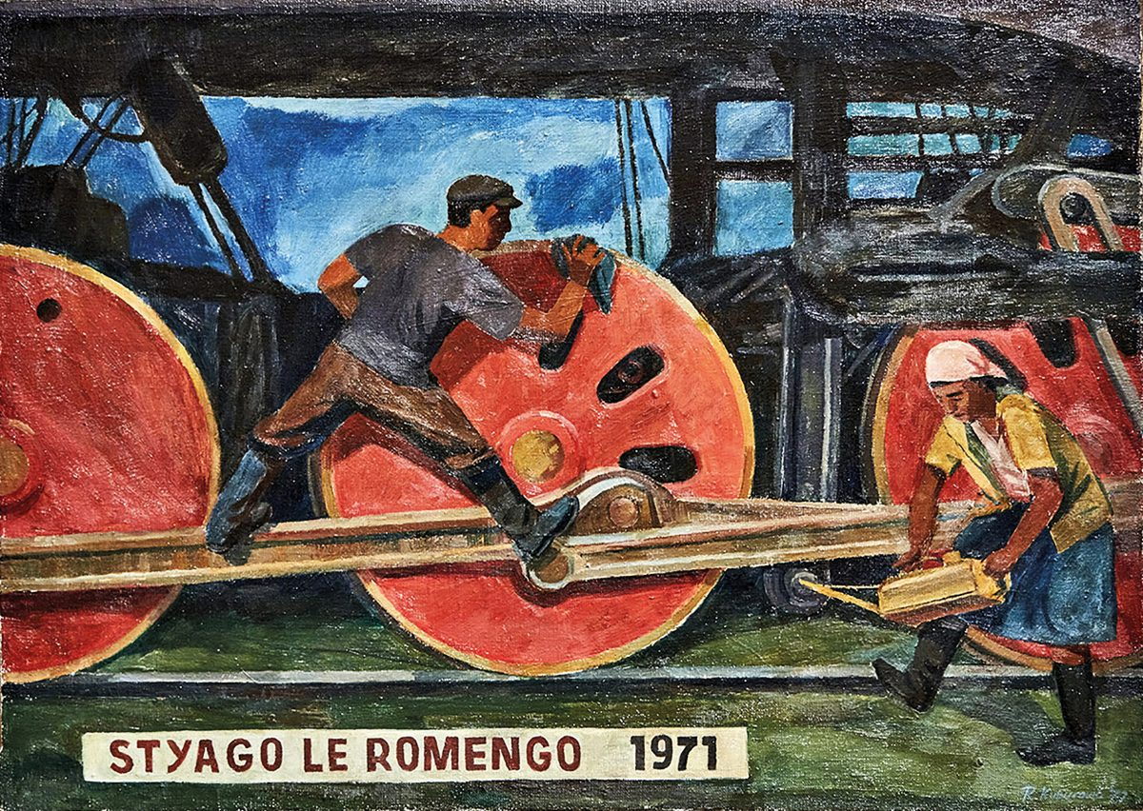
Rozana Kuburovič: Rom*nja-Flag, 1971. Private collection.

Slide 16
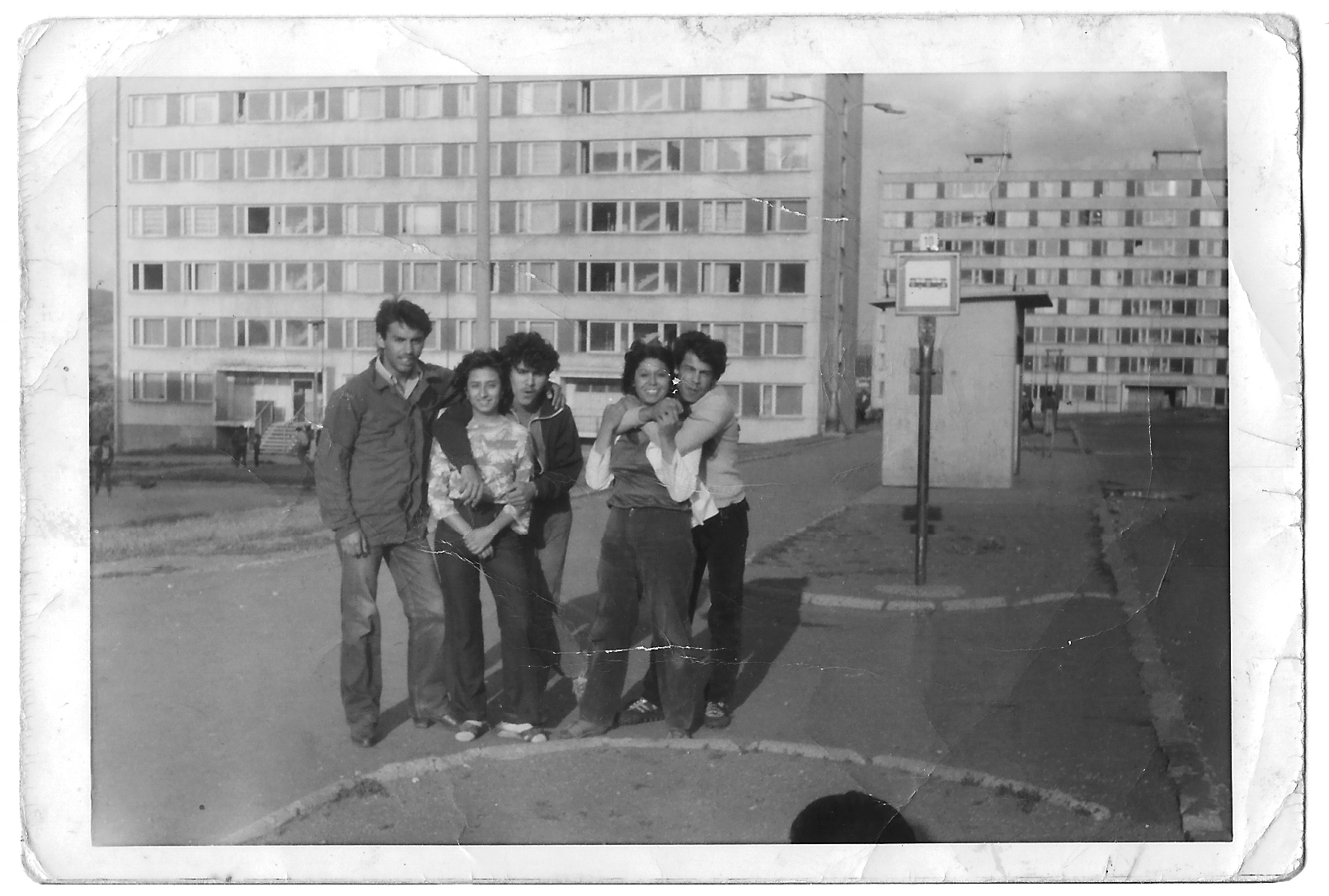
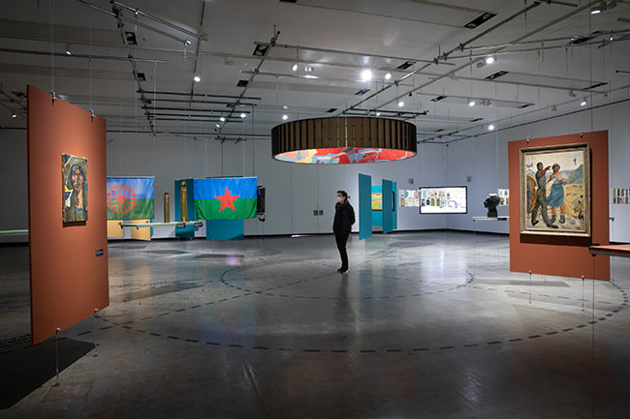
Averklub Collective, Manuš Means Human, Kunsthalle Wien, 2021
Exhibition view, 2021
Chanov-Estate 1980s, archive Helena Nistorová

Slide 17
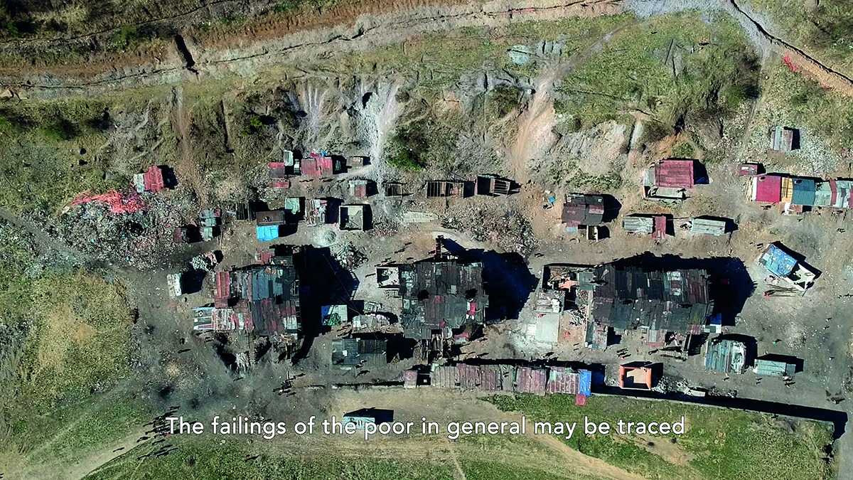
Averklub Collective, Social Murder (still), 2021.

Slide 18

Vincent Danihel, Manuš Means Human (Manuš znamená člověk), 1986
Merging socialist past (Danihel) and the present
Averklub Collective: “the desire for a dignified life common to all ordinary folk who are prevented from participating in decisions regarding their own fates”.
Importance of symbols for affirmation
Flag of the Roma people

Slide 19
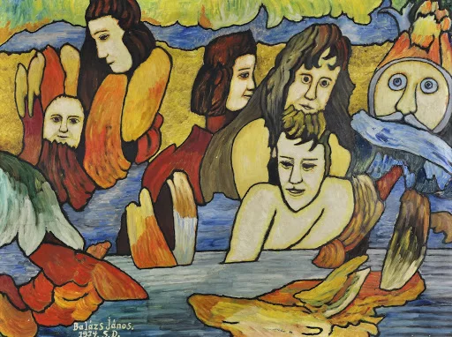
The naïve art movement
bright colors, “child-like perspective”, idiosyncratic scale
simple, easily-understandable and often idealized scenes of everyday life
naïve artist - often self-taught - uniquely literal, yet extremely personal and coherent, vision of what the world was, is or should be
timeless and optimistic depiction of an ancient story or Biblical tale, an ordinary occurrence or current event, a special ceremony or daily activity
Janos Balasz, Untitled, 1959, Kalman Maklary Fine Arts, Budapest, Hungary.

Slide 20
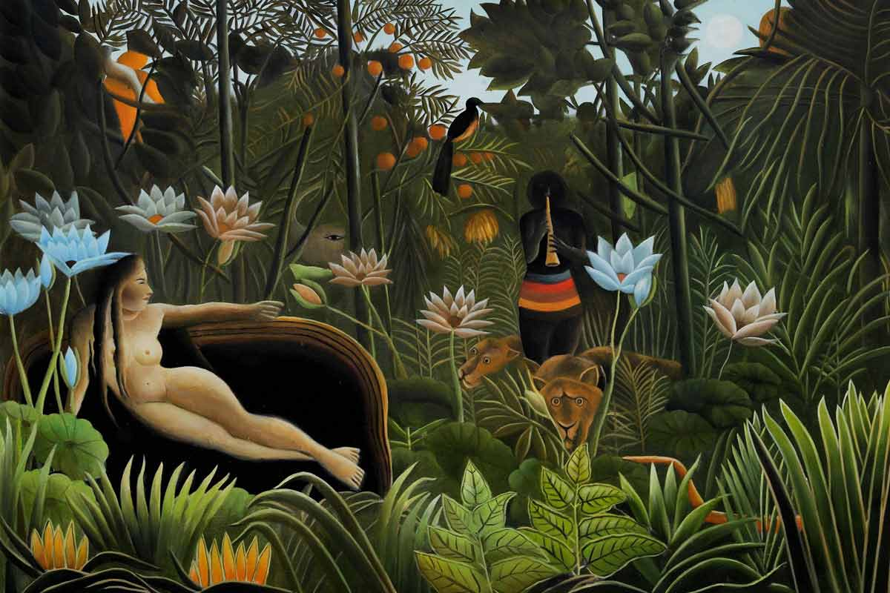
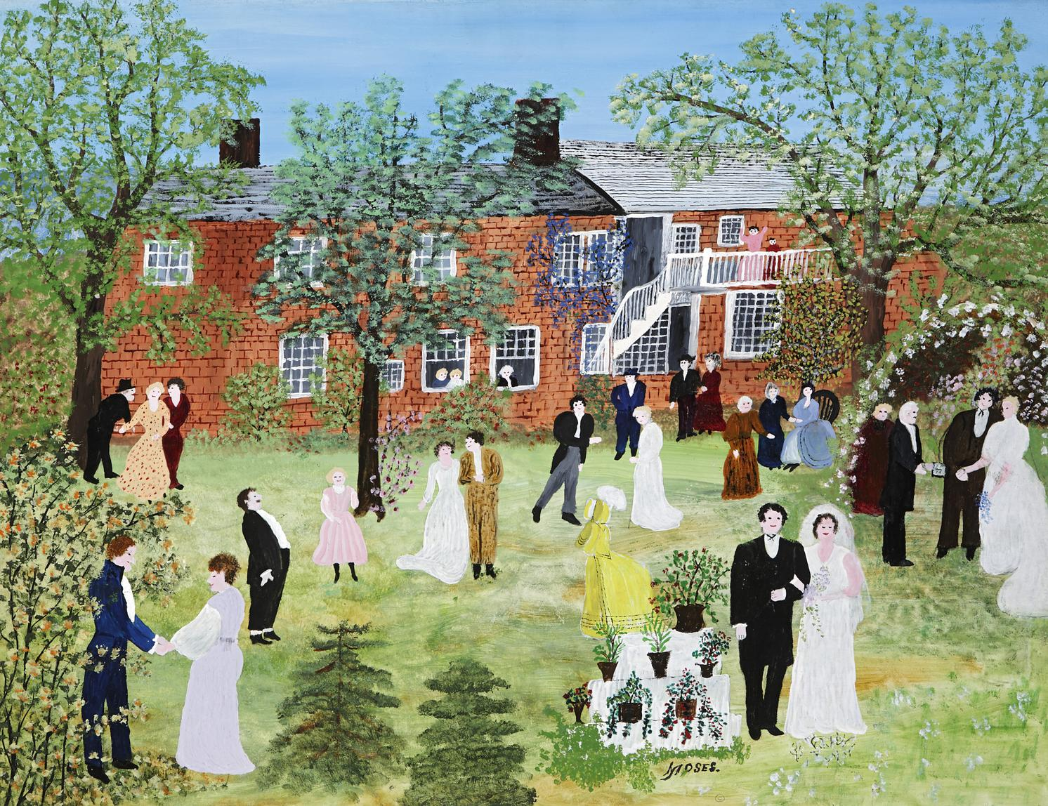
Henri Rousseau, The Dream, 1910
Anna Mary Robertson “Grandma” Moses’ ‘A Country Wedding’ (1951)

Slide 21
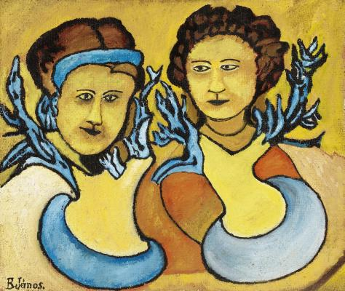
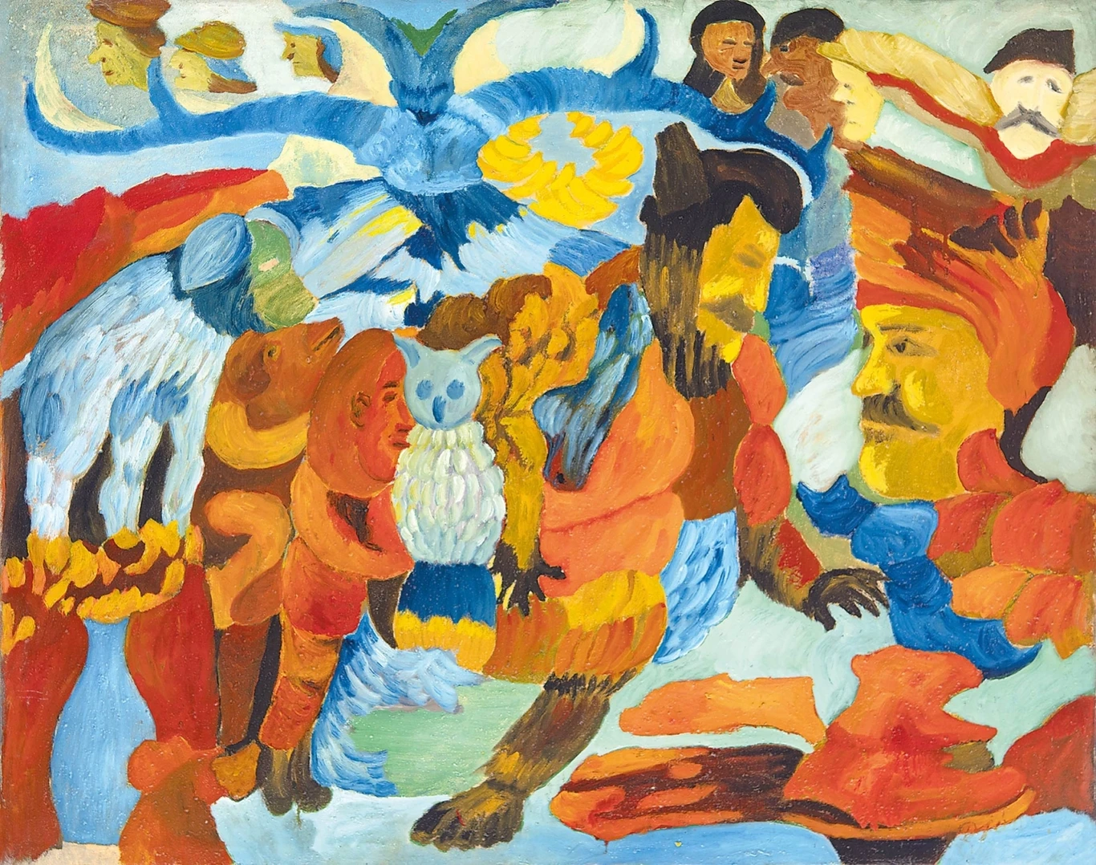
Janos Balasz (1905–1977)
Women, 1968
Dream

Slide 22
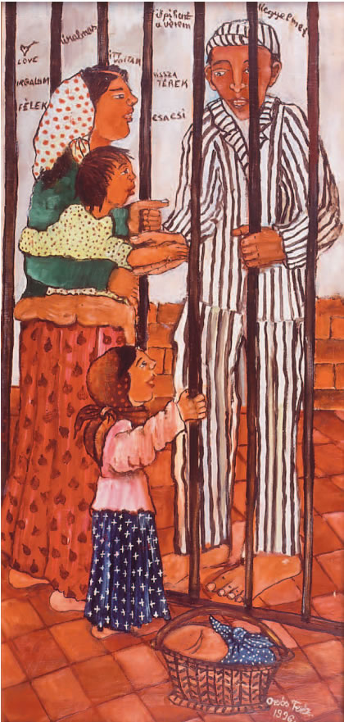
Teréz Orsós (1956–2021)
- Teaching art classes from 1972 onwards
1979 first national (Hungarian) exhibition of Self-taught Artists
Exhibition in Hungary, Austria, Czechoslovakia, Switzerland, China and the US
‘These paintings are with red colours. That’s the colour of love. If I do not use red, love-colour, it doesn’t mean that there is no love in me. I do have plenty of it. I feel that love almost bursts out of me. But my inner mood, my slightly sad life can be seen in this picture, where the brown dominates. At that time I didn’t feel anything, no love and I felt I wanted to be alone. This one with the prison is a fantasy painting. ‘Cause I’ve never been to prison, thanks God. The prison means that you are closed away from something, probably the world around you. Sadly, I could say I do not have any private life.’
Börtönben / In prison

Slide 23
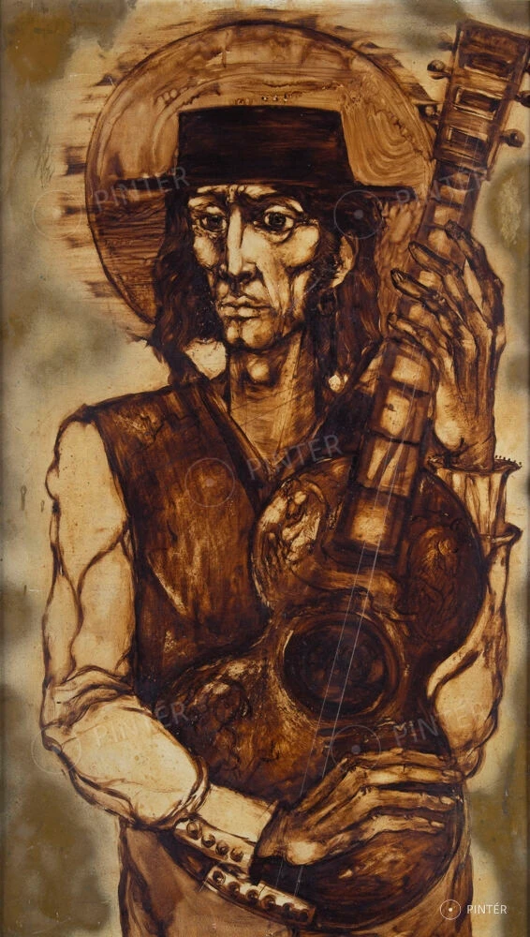
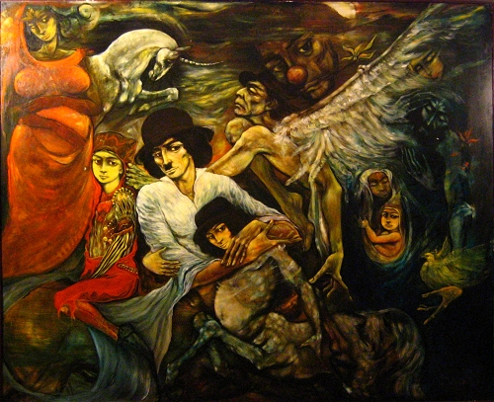
István Szentandrássy (1957–2020)
Lindri Dream
Gypsy Musician

Slide 24
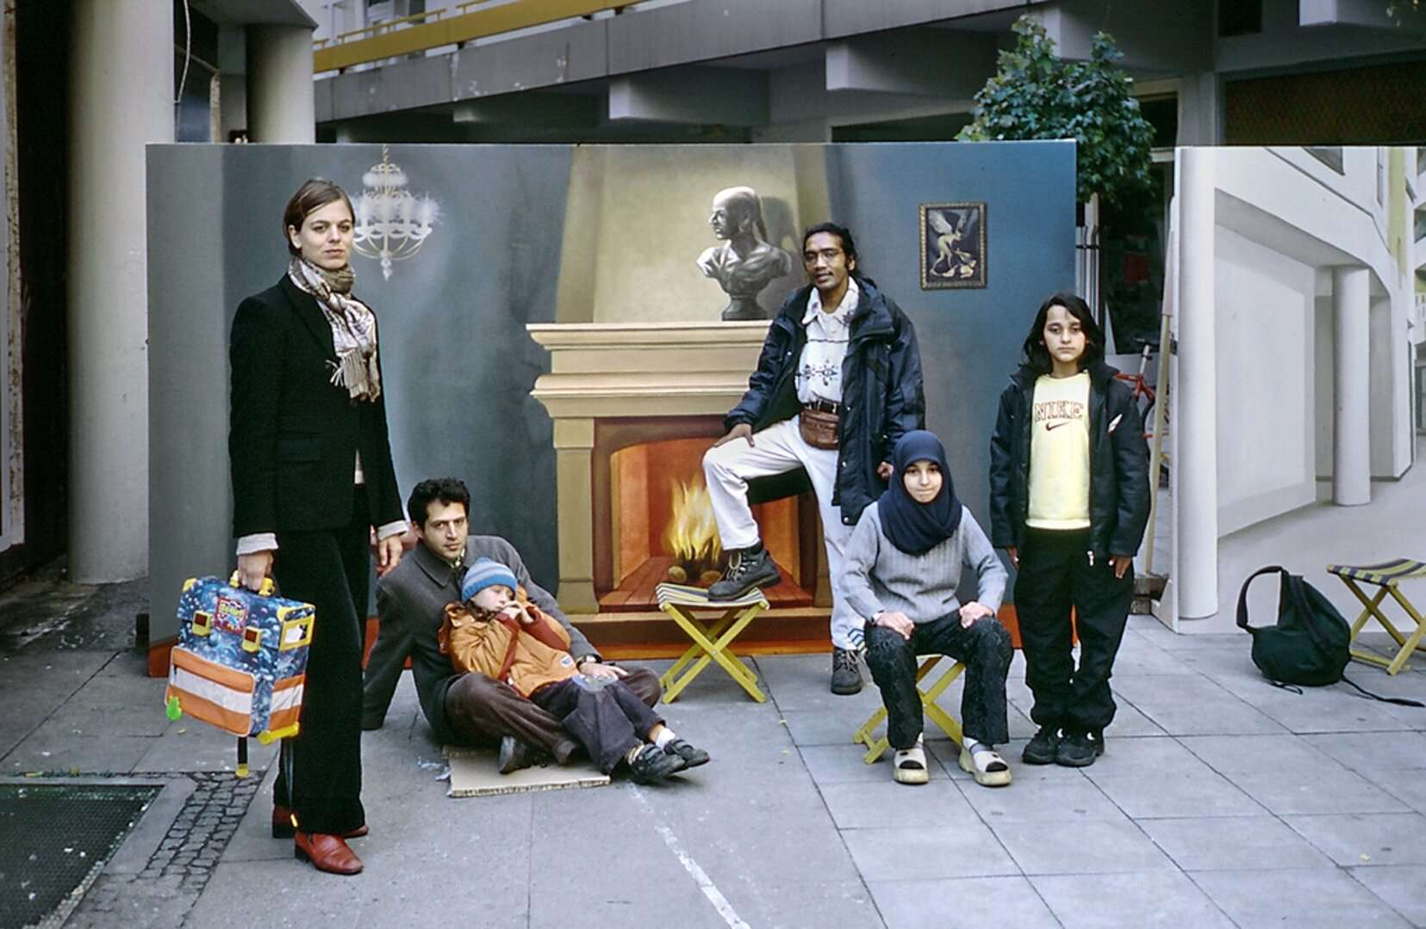
Nihad Nino Pušija (*1965)
‘I was able to achieve a successful disruption of the canon of visual representation of Roma with the selection of Nihad Nino Pušija’s photographic works. I invited him to the exhibition with a small collection of non-typical “gypsy” photographs. My aim was simply not to repeat the images expected from the “ethno-industry” in order to point out a very important aspect: In order to legitimize themselves as artists, Romani artists do not have to create “gypsy-typical” works. I go even further: the versatility of the photographic motifs in Pušija’s work (see also the catalogue text by Dr. Sibylle Badstübner-Gröger) refers much more “honestly” to the complexity of ethnicized determinations of identity or to national affiliations and simultaneous hybridities - in Pušija’s case to ex-Yugoslavian and German culture - than is the case in “conventional” illustrations of Roma.’
André Raatzsch
https://www.romarchive.eu/en/collection/50x-fotografien-ohne-antiziganismus/
http://www.fotofabrika.de/

