Slide 1
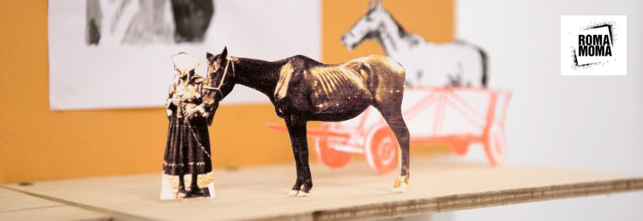
Decades of inclusion? Roma artists and contemporary art
Oto Hudec: Invisible Museum, project, 2017
27 April 2023

Slide 2
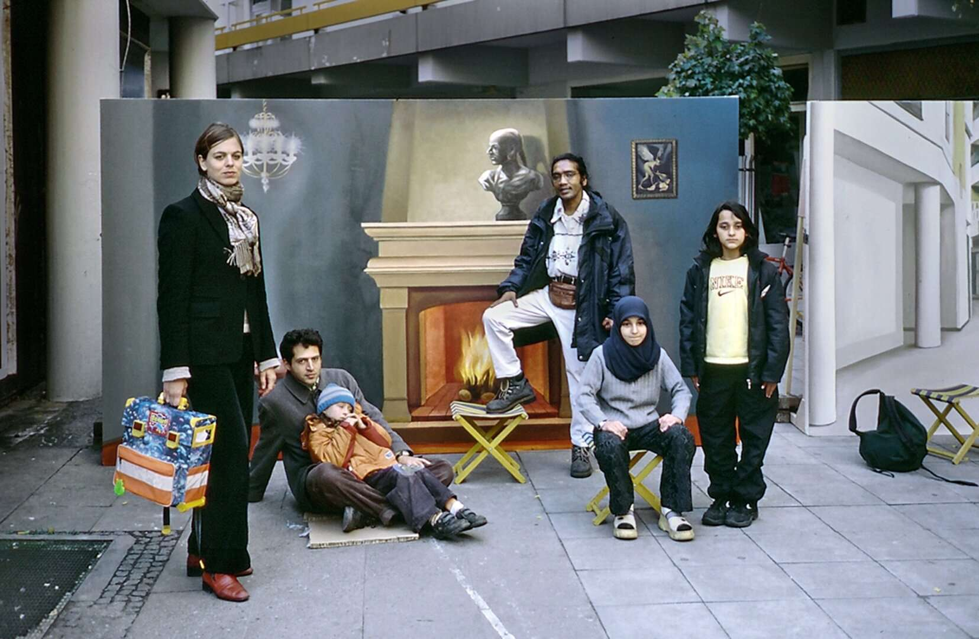
Nihad Nino Pušija (*1965)
‘I was able to achieve a successful disruption of the canon of visual representation of Roma with the selection of Nihad Nino Pušija’s photographic works. I invited him to the exhibition with a small collection of non-typical “gypsy” photographs. My aim was simply not to repeat the images expected from the “ethno-industry” in order to point out a very important aspect: In order to legitimize themselves as artists, Romani artists do not have to create “gypsy-typical” works. I go even further: the versatility of the photographic motifs in Pušija’s work (see also the catalogue text by Dr. Sibylle Badstübner-Gröger) refers much more “honestly” to the complexity of ethnicized determinations of identity or to national affiliations and simultaneous hybridities - in Pušija’s case to ex-Yugoslavian and German culture - than is the case in “conventional” illustrations of Roma.’
André Raatzsch
https://www.romarchive.eu/en/collection/50x-fotografien-ohne-antiziganismus/
http://www.fotofabrika.de/

Slide 3
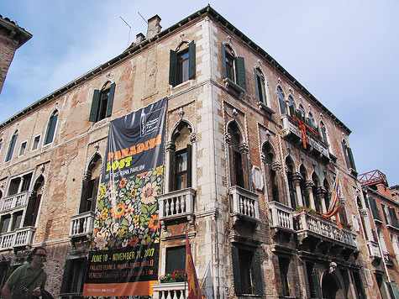
52nd Venice Biennale (2007): "Think with the Senses, Feel with the Mind: Art in the Present Tense"
Roma pavilion – transnational representation; ethnic collective
Tunali, T. (2011). The politics of "Roma inclusion" at the 52nd venice art biennale. Studia Politica: Romanian Political Science Review, 11(4), 701-711.
Is art history lagging behind processes of inclusion? – first Romani Group exhibition in 1979 (Budapest)
Inclusion as “the consequence of a sudden and spontaneous humanitarian interest. They are the continuation of a complex set of political, economic, and discursive relations marked by the collapse of State Socialism and EU expansion which helped to institutionalize ”Western” human rights discourses to frame ”Eastern” ethnic conflicts and tensions in the process of the ongoing ”liberalization” and ”democratization” of the CEE countries”
Tunali, T. (2011). The politics of "Roma inclusion”, 702–703.

Slide 4
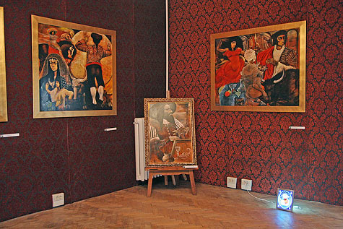
Did the Roma Pavilion in the 52nd Venice Biennial aim for negotiating the Roma’s ”particular political vocabulary” in need to be visible to Romany populations around Europe to build an alternative political solidarity?
Or was this exhibition part of the institutional creativity aimed at the socio-political integration of the former communist Europe into the global economic circuits?
Tunali, T. (2011). The politics of "Roma inclusion”, 703.

Slide 5
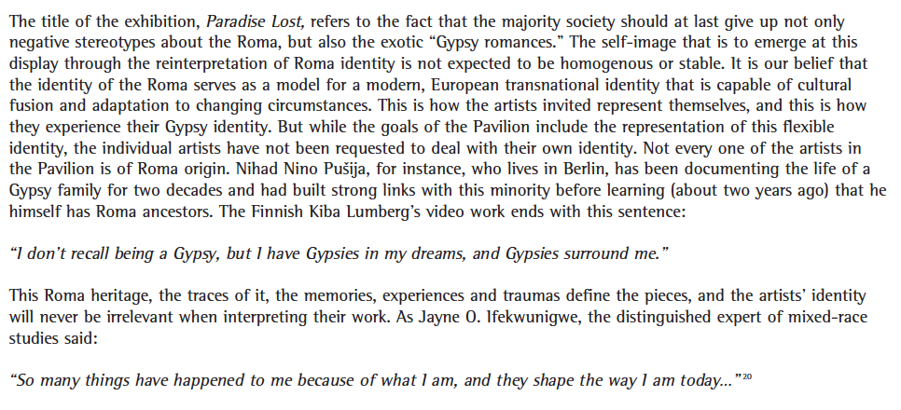
Identity and artistic expression

Slide 6
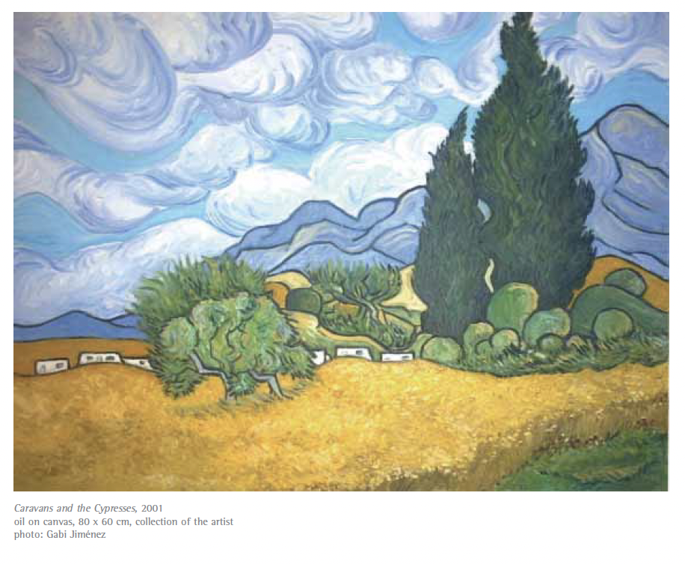
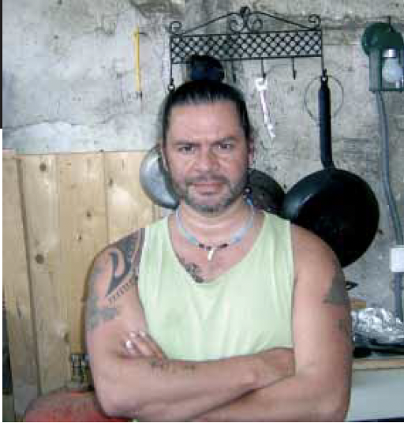
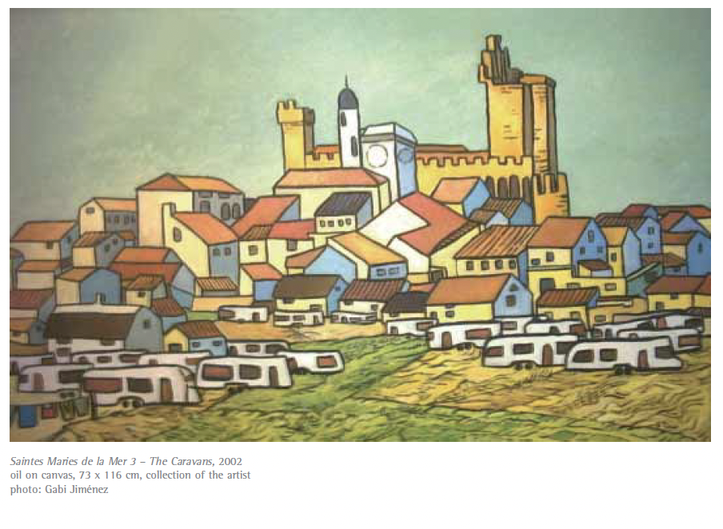
Gabi JIMÉNEZ

Slide 7
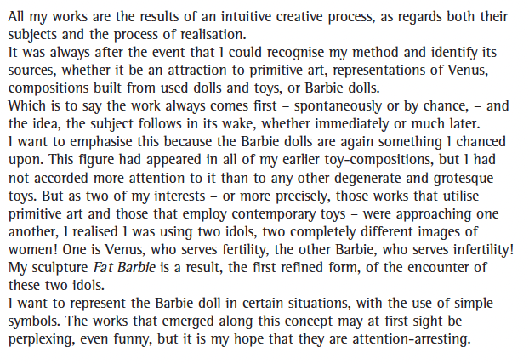
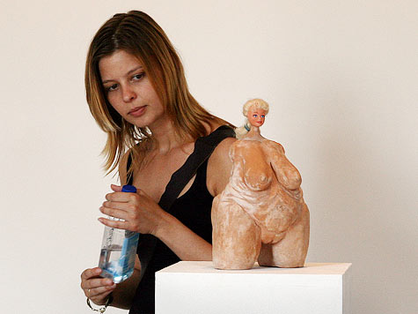
András KÁLLAI
András Kállai, Fat Barbie. 2006, Terracotta, plastic, 28 x 13 x 14 cm, http://universes-in-universe.de/car/venezia/eng/2007/tour/roma/img-19.htm

Slide 8
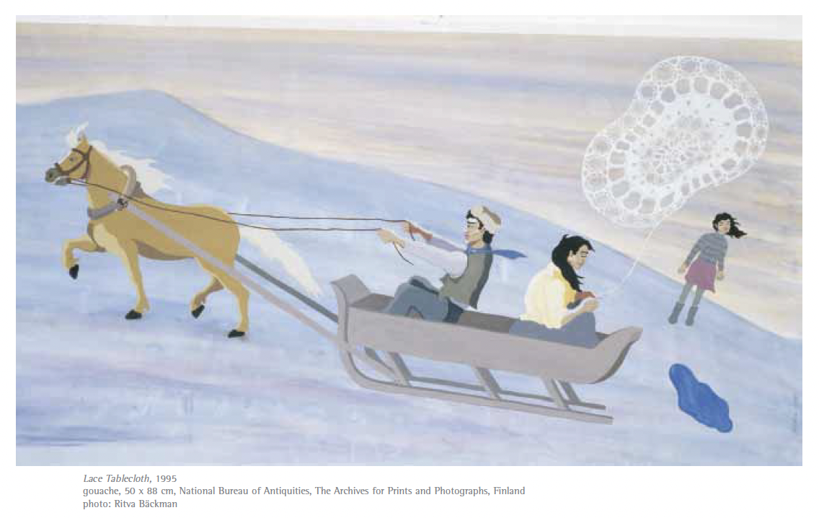
Kiba LUMBERG

Slide 9
Roma identity politics in the EU has not been employed to unveil the reasons of increasing social inequality; instead it has been applied to define Roma as a distinct community, which, in turn, has triggered traditional prejudices on them.
Tunali, T. (2011). The politics of "Roma inclusion”, 705.
”Are we creating an ethnicising, socially motivated ’special case’, sponsored by philanthropy, in the hybrid environment of the art establishment?”
Gottfried WAGNER, ”The Roma Pavilion in Venice: A Bold Beginning”, in Exhibition Catalogue: Paradise Lost, Open Society Foundations, Budapest, 2007, p. 36.

Slide 10
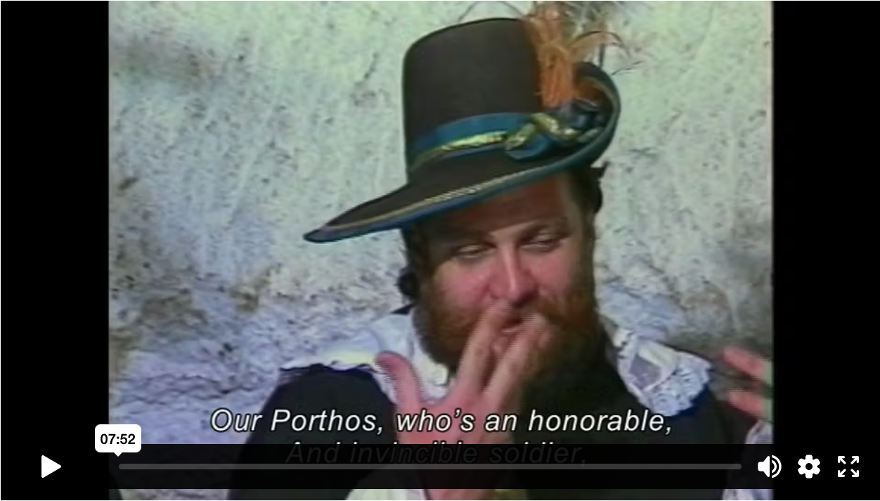
Vanda Zsoldos, Stációk (Stations), 1988
‘…and in order to become a Roma painter, the existence of the Roma bricklayer should be acknowledged. This is a massive and difficult question … and I would like to be a Hungarian painter … The time will come but I will not get the final immigration license from my colleagues for another year or two … I am going to present a significant piece of art at the World Fair and this work of art … will not be made by Tamás Péli the Roma painter but Tamás Péli, a painter with a European mind and soul, that of the image designer who is concerned with the future of this country and his community’.
Tamás Péli (b. Budapest 1948, d. Budapest 1994),
https://www.romarchive.eu/en/collection/staciok-portrefilm-peli-tamas-festomuveszrol/

Slide 11
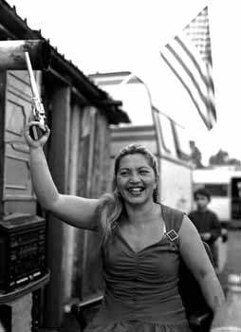
“WE ARE WHAT WE ARE” ASPECTS OF ROMA LIFE IN CONTEMPORARY ART @ MINORITEN GALLERY, GRAZ (2004)
(shown in trnava in the following year)
Matei Bejenaru (RO)
Michaela Bruckmüller (A)
Pavlina Fichta Cierna (SK)
Cosmin Gradinaru (RO)
Iosif Kiraly / Mariana Celac / Marius Marcu-Lapadat (RO)
Monika Kovacova (SK)
Aydan Murtezaoglu (TR)
Terez Orsos (HU)
Nihad Nino Pusija (D/BiH)
Gyöngyi Raczne Kalanyos (HU)
Mario Rizzi (I), Erzen Shkololli (KOS)
Mladen Stilinovic (HR)
Ceija Stojka (A)
Chad Evans Wyatt (USA/CZ)
Dusan Zahoransky (CZ/SK)
Nihad Nino Pusija, photo from the series "Ramadan Armani"

Slide 12
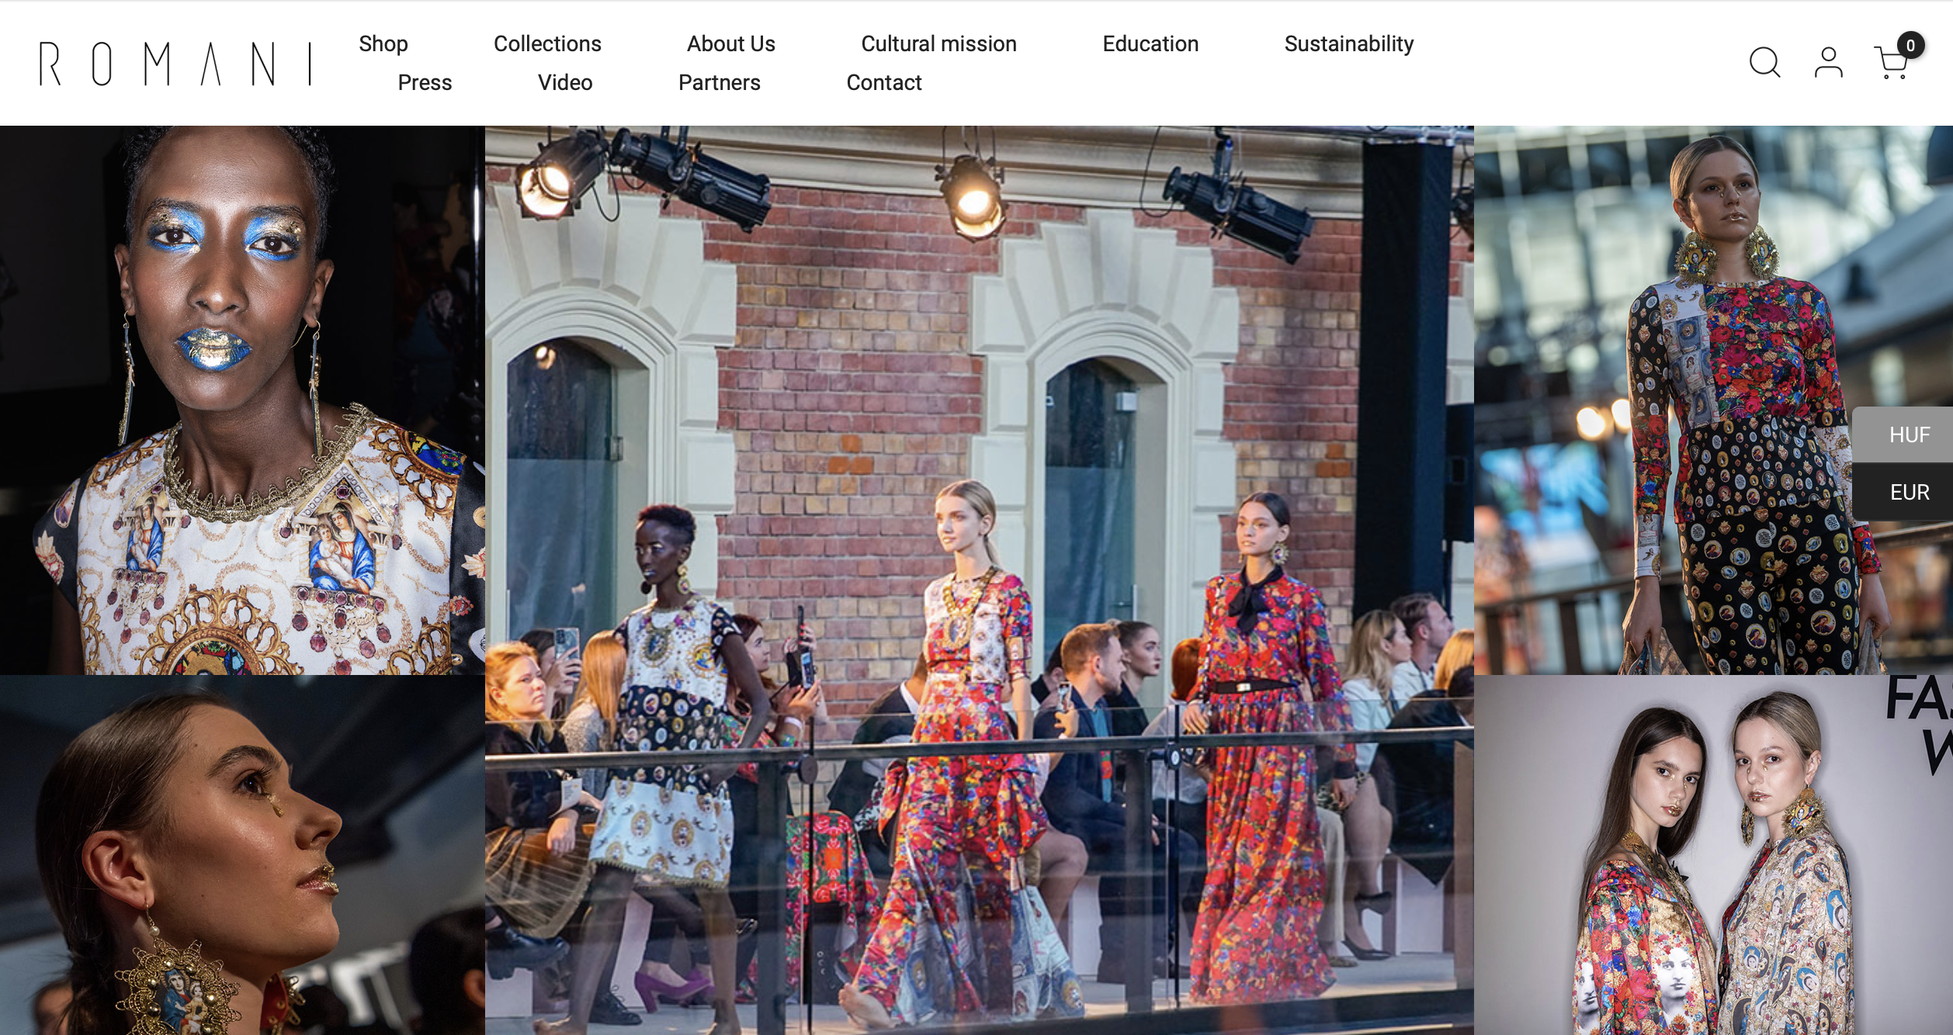
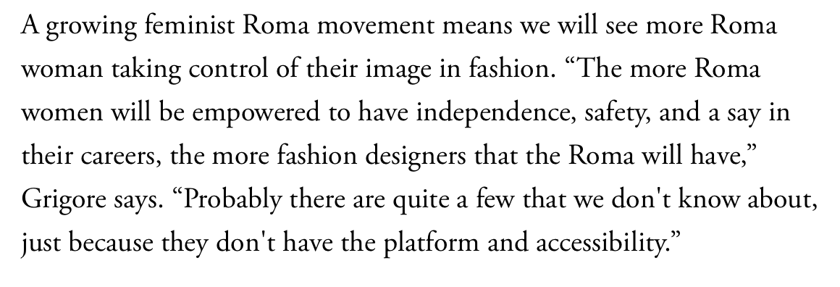
Kitsch and the decorative as a style
https://www.vogue.com/article/roma-activism-fashion
Helena & Erika Varga, https://romani.hu/en/

Slide 13
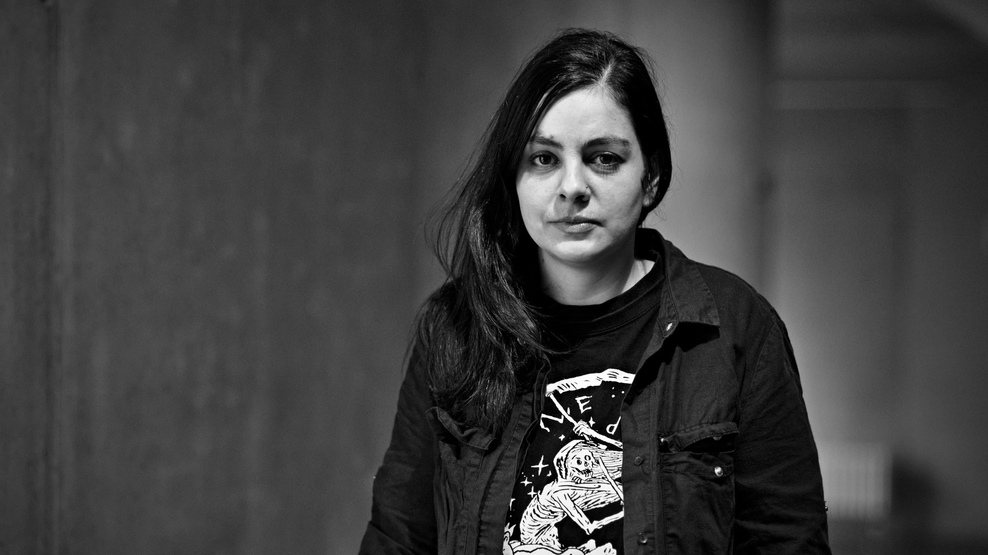
LACKA – Ladislava Gažiová
https://www.artlist.cz/en/lacka-ladislava-gaziova-618-video/

Slide 14
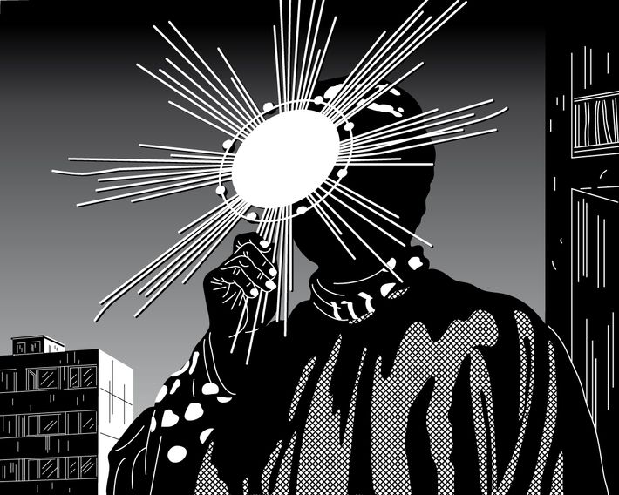
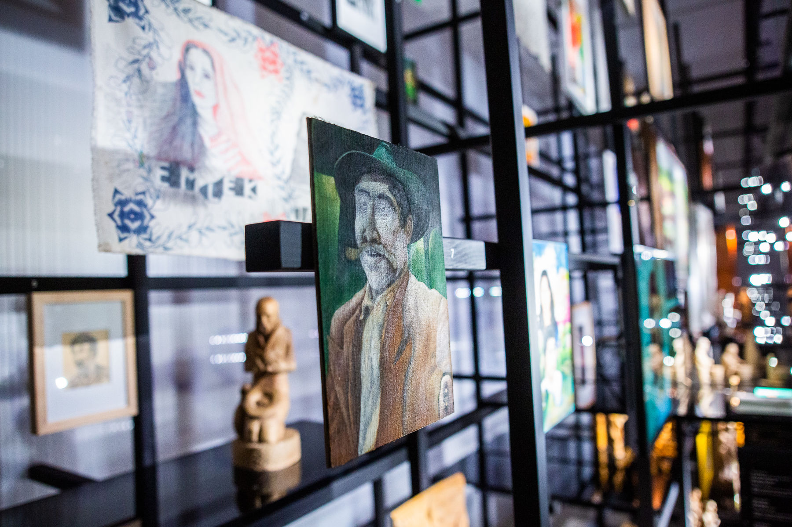
O kosmos hino kalo/The Universe is Black, 2017, Moravian Gallery in Brno,
Phundrado drom / The Open Road, Ethnographic Museum, Prague, 3. 6. 2022 – 31. 5. 2024
Ladislava Gažiová,
https://www.artmap.cz/artist/ladislava-gaziova/
https://www.nm.cz/en/program/exhibitions/phundrado-drom-the-open-road#gallery-9

Slide 15
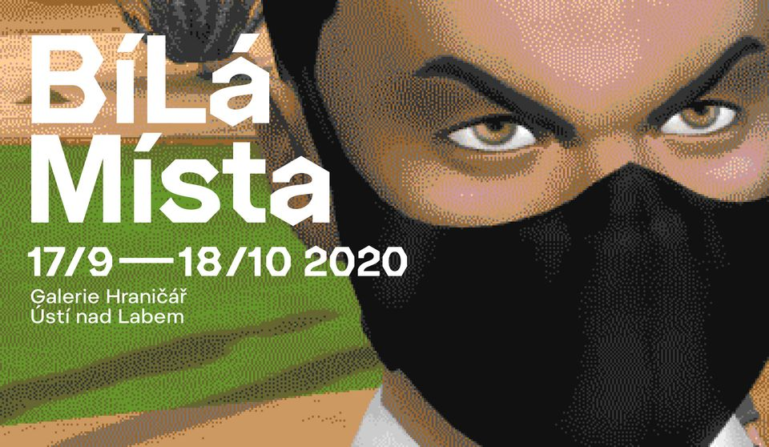
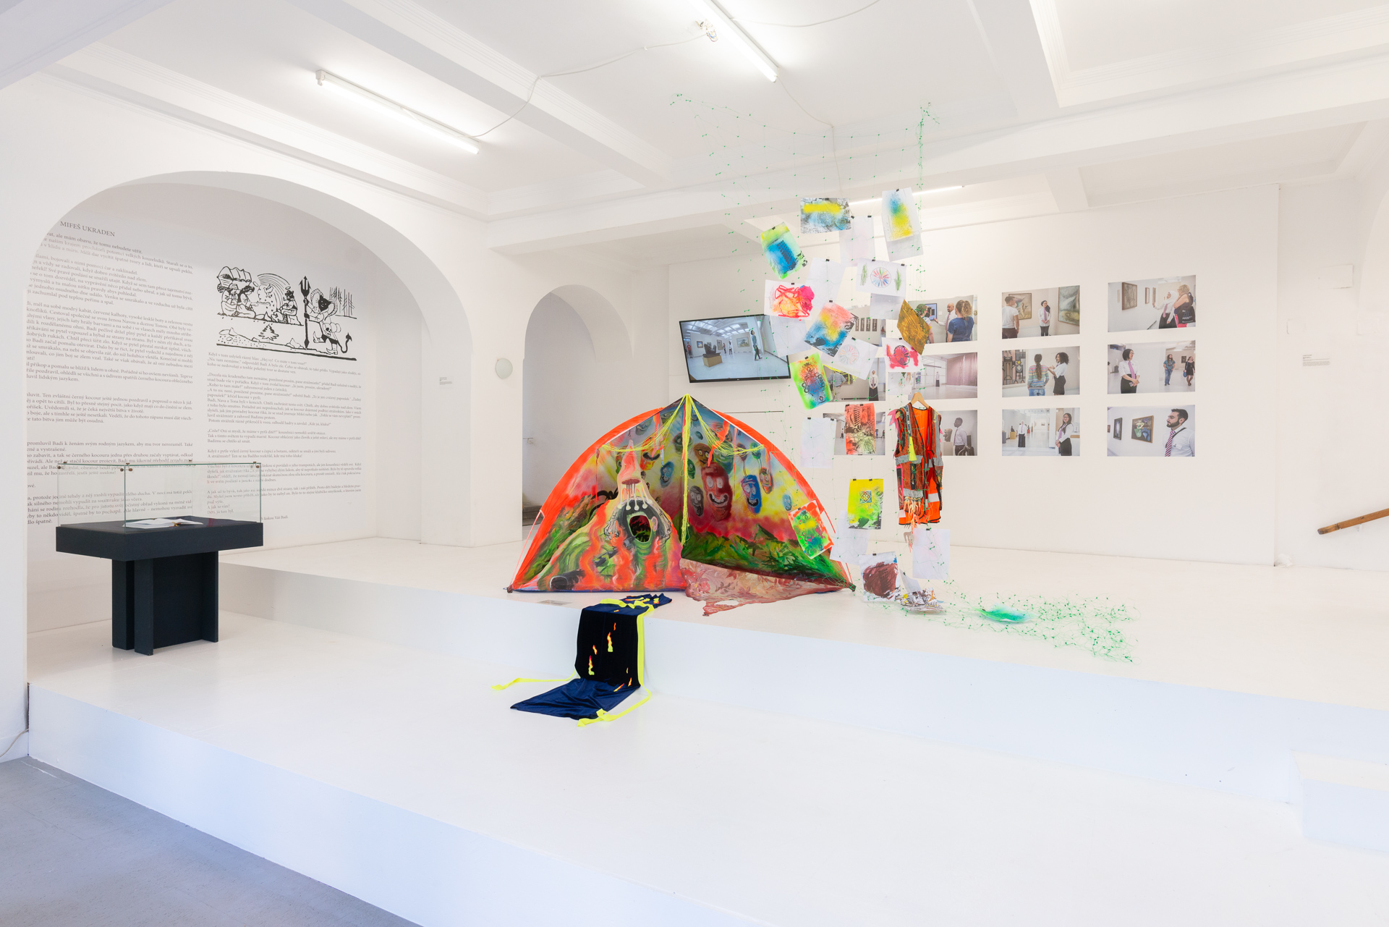
BíLá Místa, Hranicář Gallery, Ustí nad Labem (2020)
https://artalk.cz/2020/10/05/roma-lives-matter-v-hranicari/?fbclid=IwAR2zbG0yCtwDxh874ZrCspWpNciDXDcyPXIozFszM1hilHljIcTH42TT3Dw

Slide 16
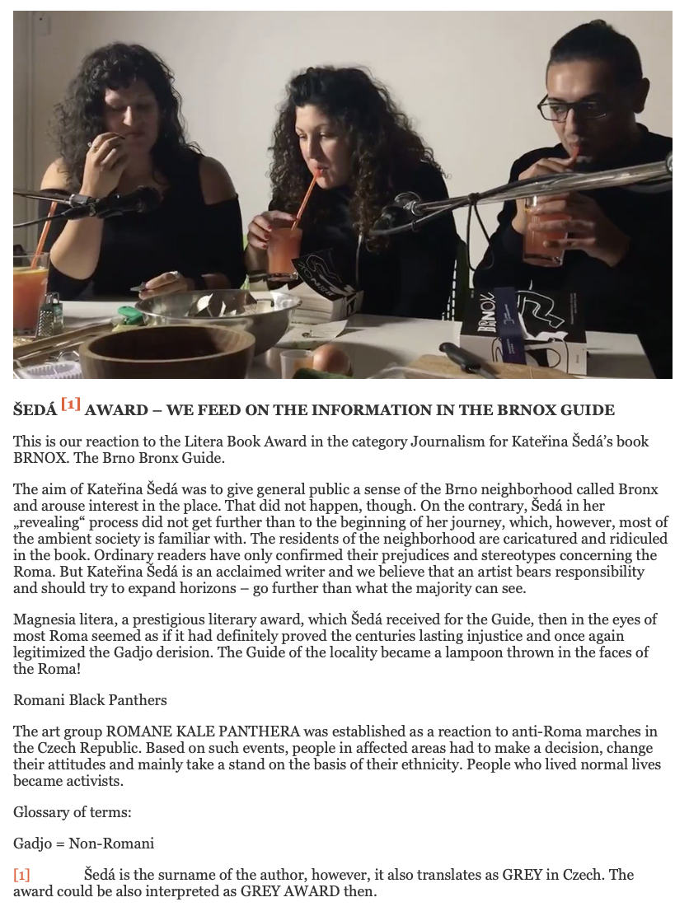
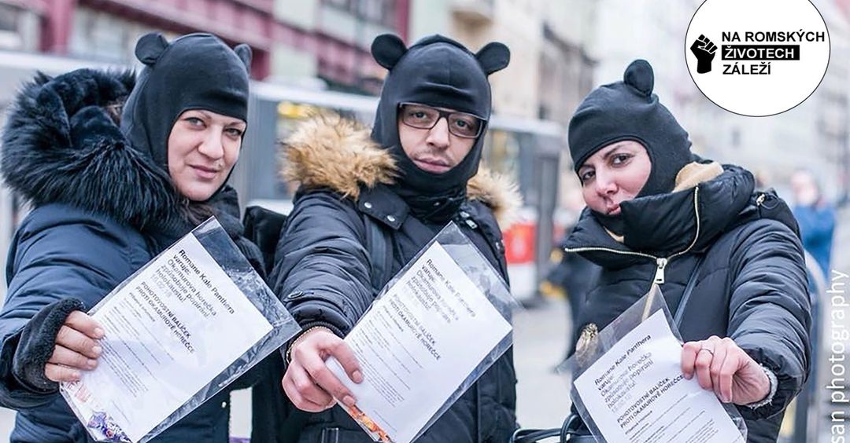
Romane Kale Panthera / Roma Black Panthers
http://www.tamaramoyzes.info/?p=1420

Slide 17
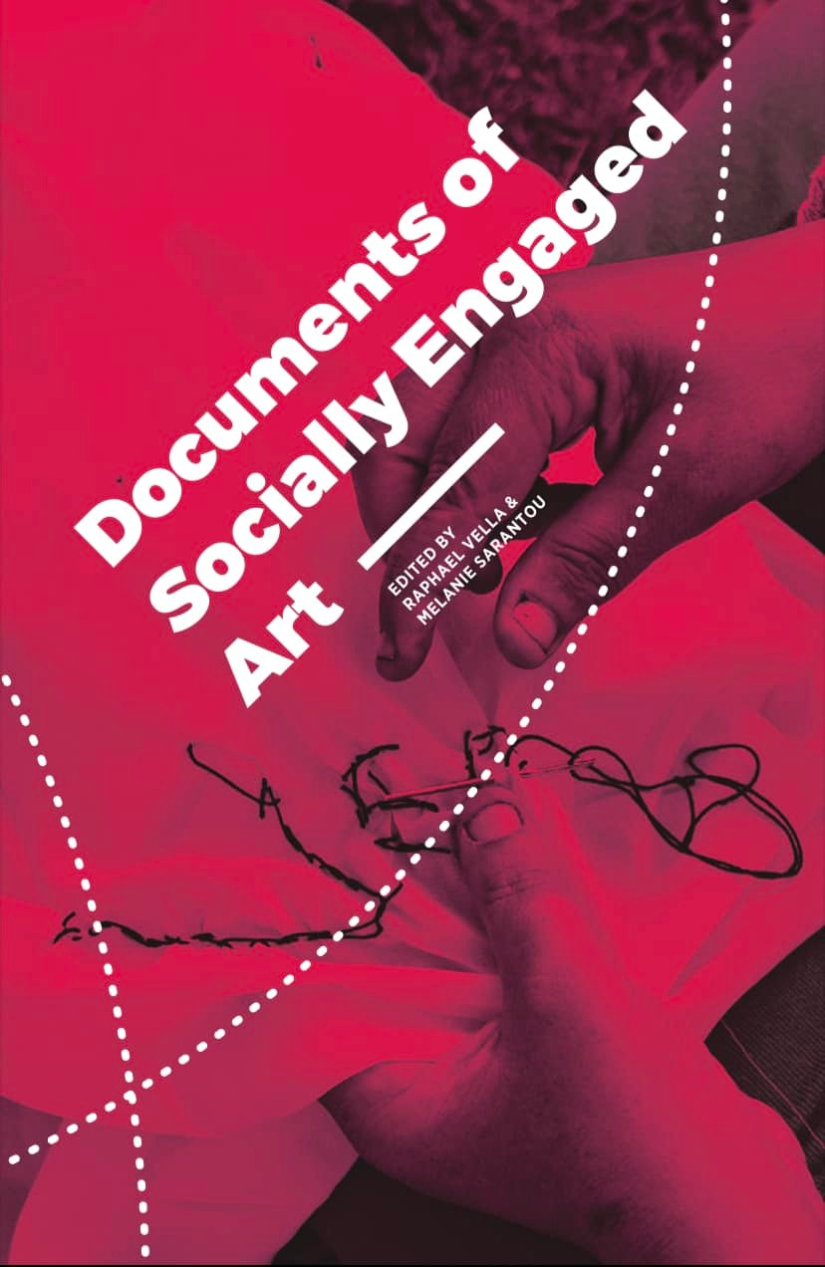
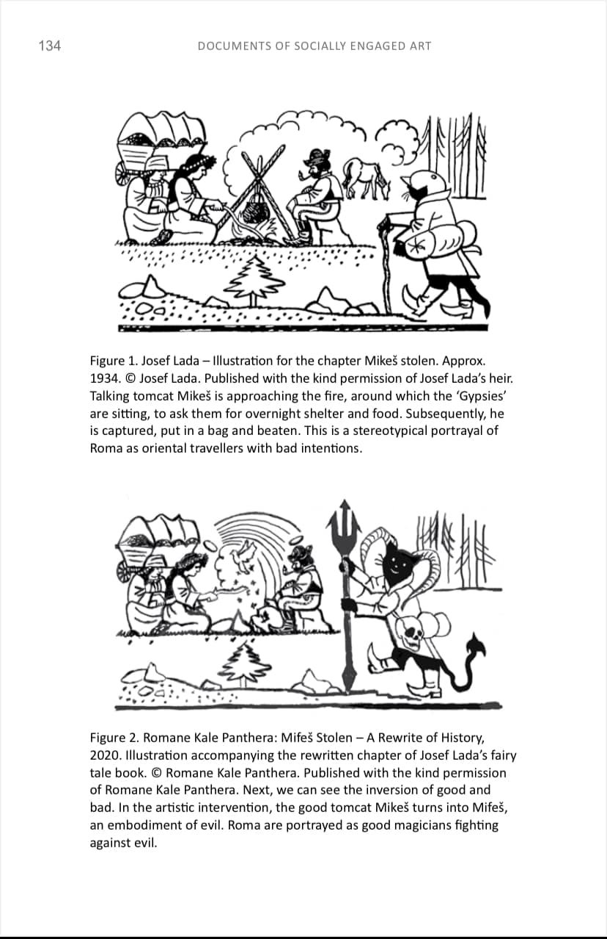
Raphael Vella & Melanie Sarantou, Documents of Socially Engaged Art, InSEA (2021)

Slide 18
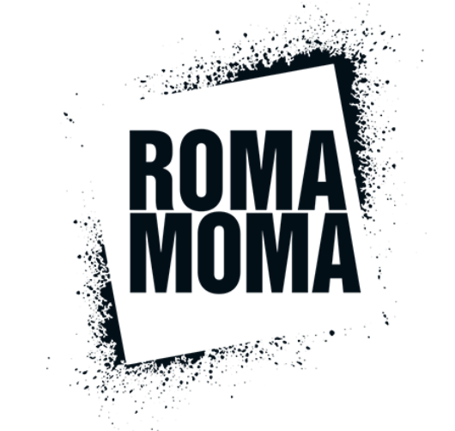
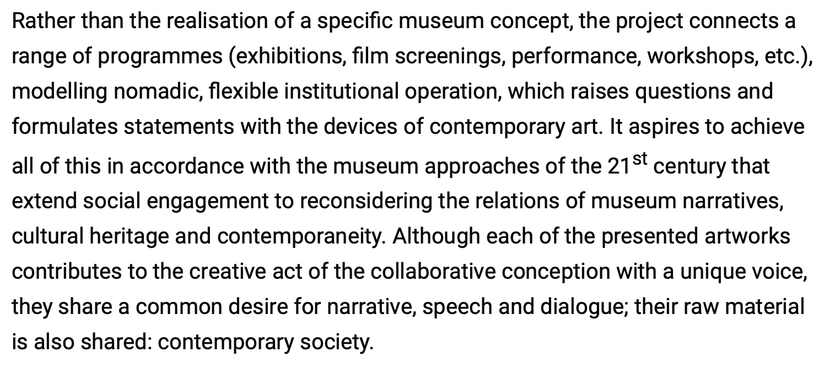
https://eriac.org/category/romamoma/

Slide 19
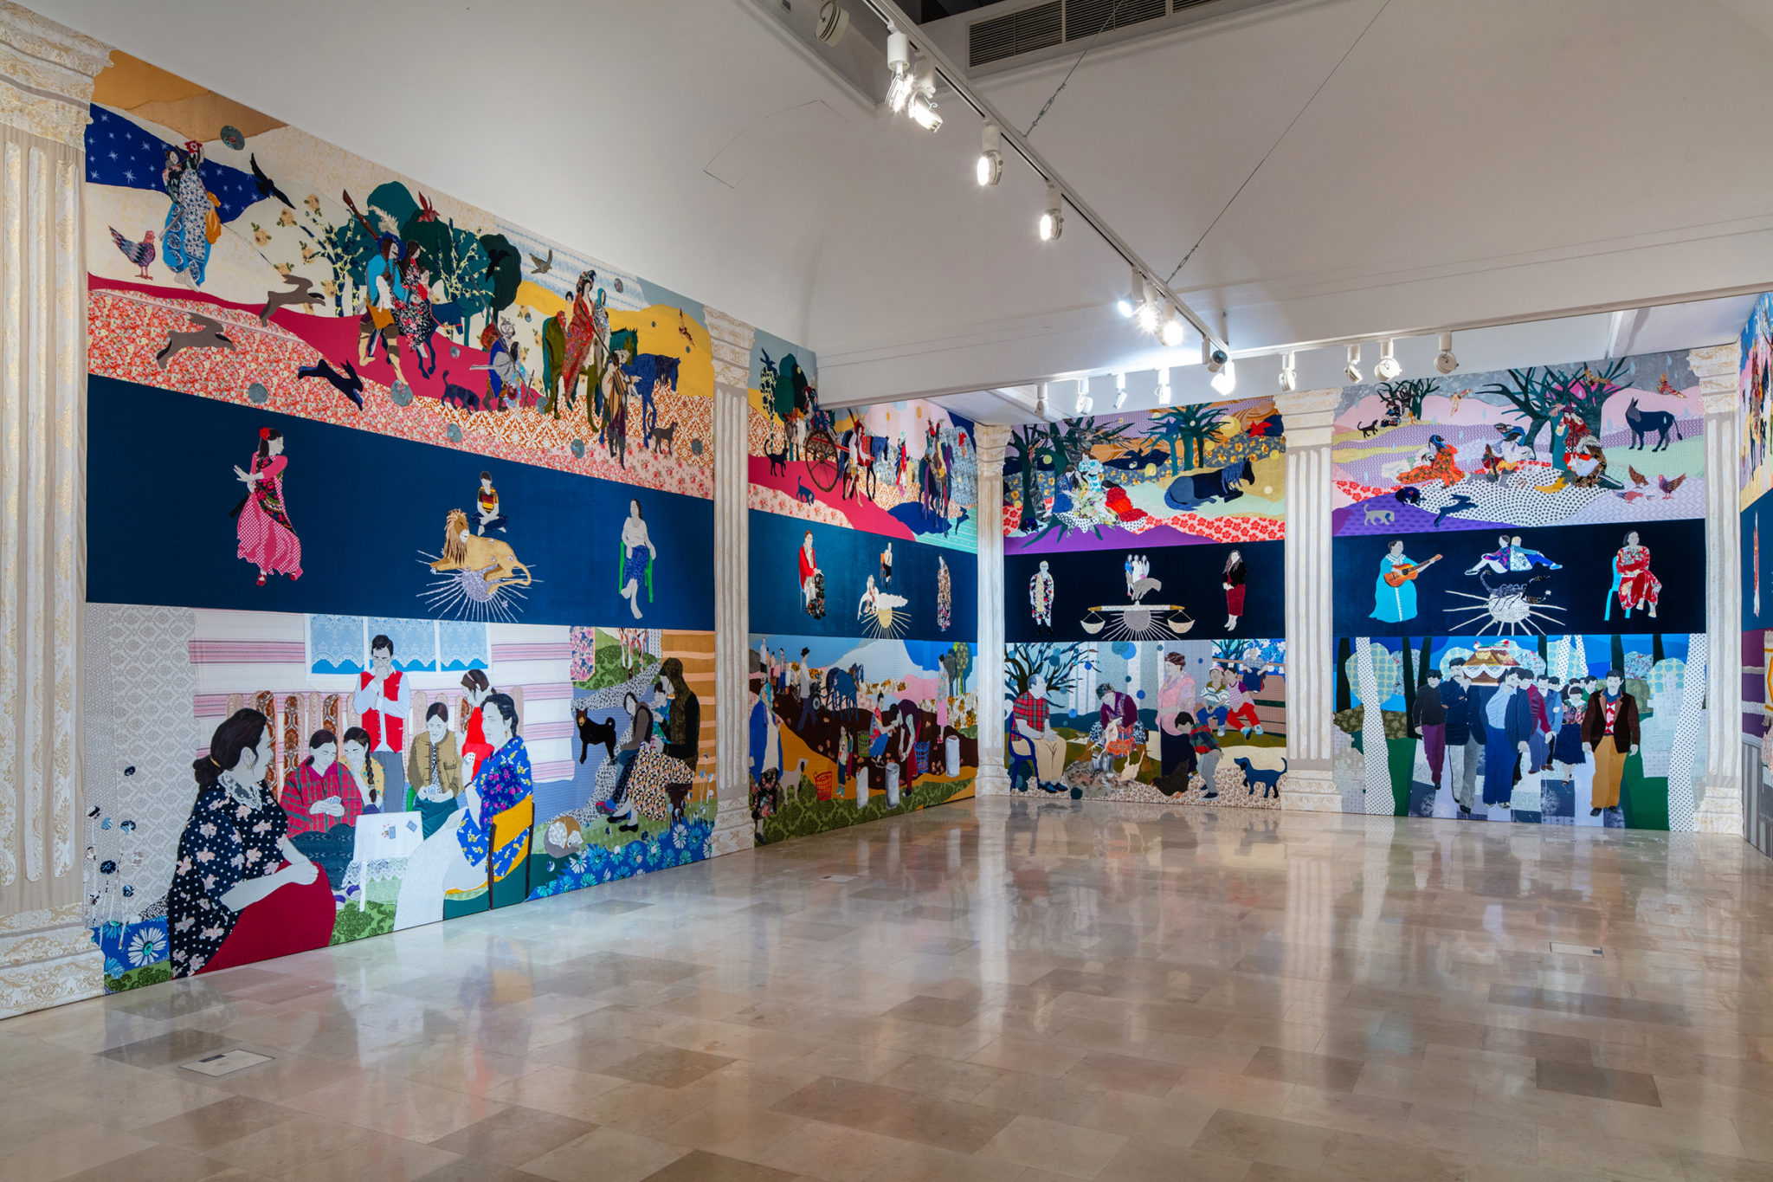
Małgorzata Mirga-Tas (*1978)
Małgorzata Mirga-Tas, Re-enchanting the World, exhibition view, Polish Pavilion at the 2022 Venice. Biennale. Image courtesy Zachęta National Gallery of Art. Photo: Daniel Rumiancew.

