Slide 1
ISKM09 Introductory Session February 17
Martina Šindelářová Skupeňová

Slide 2
Course description
weekly face-to-face / online seminars
continuous tasks (essay, poster+discussion, report)
interactive syllabus

Slide 3
Introduction
You - reflection and self-assessment
English - tasks and needs analysis
Information /Librarianship - topics, materials
Science - skills

Slide 4
You and languages
?

Slide 5
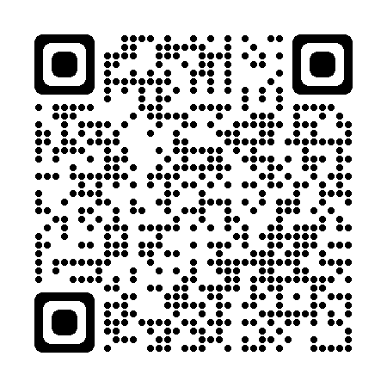
You and languages
https://padlet.com/marta_skupka/ISKM09

Slide 6
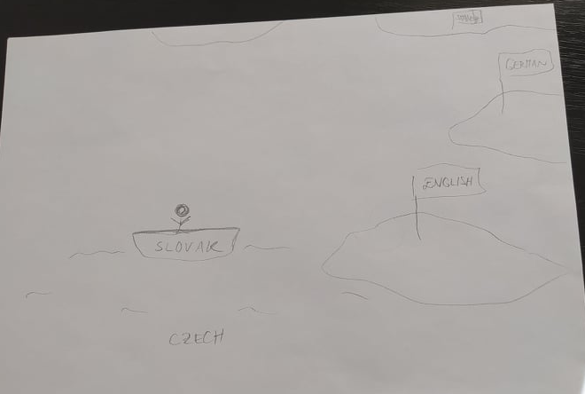
My students and languages

Slide 7
You and English
In small groups, identify:
at least 2 very specific things you share about English
(not “we have been learning English”, but rather “when we were staying with a host family in England we experienced terrible misunderstanding about food”)
at least 2 specific issues related to English that you have different approaches to / opinions about / perspectives on

Slide 8
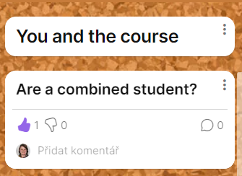
You and the course
https://padlet.com/marta_skupka/ISKM09

Slide 9
Defining tasks
In groups, define each task in terms of:
features (adjectives)
skills (nouns, can do statements)
steps (verbs)
Group 1 (5) - poster presentation
Group 2 (6) - discussion
Group 3 (7) - essay
Group 4 (8) - report

Slide 10
Poster presentation
5 minute input - prepared, informed, clear
good balance of text / visuals
clear structure

Slide 11
Discussion
asking questions, asking for clarification, offering comments
responding to questions and comments
turn-taking, politeness

Slide 12
Essay
source based + referencing
argumentative, response to the source/s
well-structured, coherent, sign-posting
500-600 words, wide range of grammar and vocabulary

Slide 13
Report
informative, concise
clarity and logical structure
facts x opinions

Slide 14
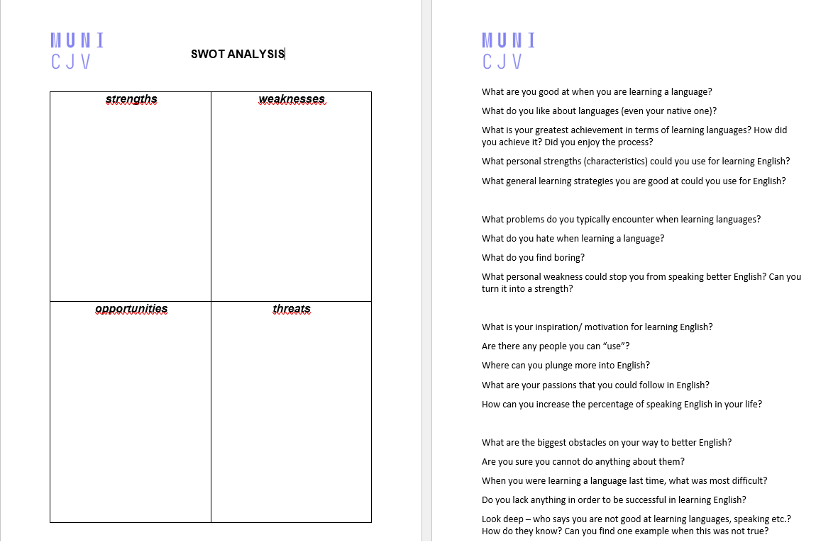
SWOT analysis
Thinking about the tasks, conduct this analysis:
What are you already good at?
What do you need to pay more attention to?
What is an opportunity to prepare or practice for you?
Can you see some threads?

Slide 15
swOt analysis

Slide 16
Topics, materials
In groups, discuss the following samples and consider:
genre / text type
author´s voice and style
text organisation / structure
vocabulary and register
grammar used / difficulty
usefulness as sources for this course

Slide 17
Sample 1
On August 16, 1968, I was handed a book written by a certain Abbe Vallet, Le Manuscrit de Dom Adson de Melk, traduit en francais d’apres l’edition de Dom J. Mabillon (Aux Presses de l’Abbaye de la Source, Paris, 1842). Supplemented by historical information that was actually quite scant, the book claimed to reproduce faithfully a fourteenth-century manuscript that, in its turn, had been found in the monastery of Melk by the great eighteenth-century man of learning, to whom we owe so much information about the history of the Benedictine order. The scholarly discovery (I mean mine, the third in chronological order) entertained me while I was in Prague, waiting for a dear friend. Six days later Soviet troops invaded that unhappy city. I managed, not without adventure, to reach the Austrian border at Linz, and from there I journeyed to Vienna, where I met my beloved, and together we sailed up the Danube.
In a state of intellectual excitement, I read with fascination the terrible story of Adso of Melk, and I allowed myself to be so absorbed by it that, almost in a single burst of energy, I completed a translation, using some of those large notebooks from the Papeterie Joseph …

Slide 18
Sample 2
Machlup (1983) makes the useful point that “information is acquired by being told, whereas knowledge can be acquired by thinking” (p. 644). Through our inner experience of thought, we can form new knowledge without taking in new information from the external environment. Information implies transfer, says Machlup, while knowledge is a state (“knowing”). Knowledge and information are therefore not usually the same, except that “information in the sense of that which is being told may be the same” (p. 644). Hayes (1993) makes a somewhat different point when he says that “knowledge is internal; it cannot be received but must be internally created” (p.5). Savolainen (2009a) discusses similar issues in distinguishing between knowing and acting in practice.
Other authors sometimes raise the issue of truth, discussed earlier, in the knowledge-information distinction back to the truth issue discussed earlier, Raber (2003, p.8) notes that: “The relationship between knowledge and truth is especially problematic,” while Frické (2009) points out that data can be flawed and thus untrue. Yet Dretske (1981, p.45) makes no distinction between the two in regards to a truth requirement: “information is that is capable of yielding knowledge, and since knowledge requires truth, information requires it also.”

Slide 19
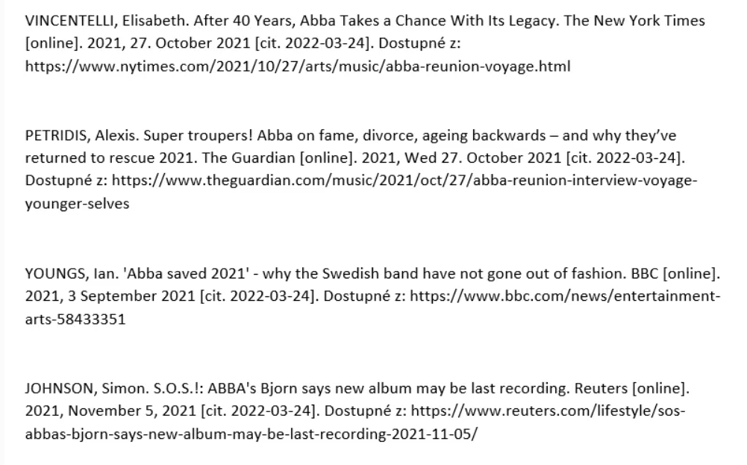
Sample 3

Slide 20
Sample 4
In seeking tales and informations
Against this man, whose honesty the devil
And his disciples only envy at,
Ye blew the fire that burns ye. Now have at ye!

