Slide 1
ISKM09 Session 13 May 12
Martina Šindelářová Skupeňová

Slide 2
Outline
in/formal writing
informative genres
reporting

Slide 3
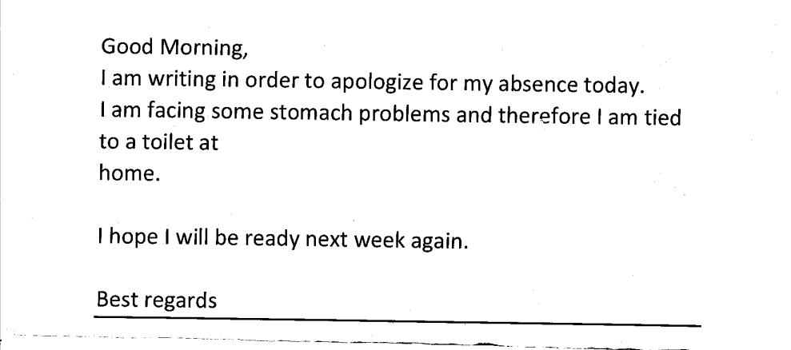
In/formal email

Slide 4
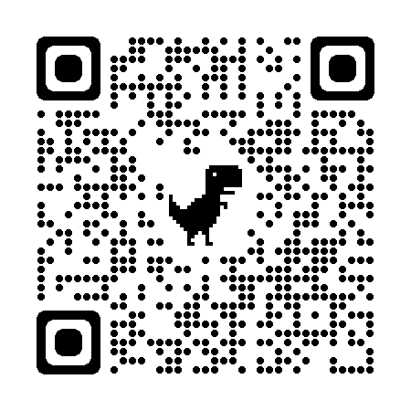
Re-writing - group project
https://padlet.com/marta_skupka/ISKM09

Slide 5
Text 1
Subject: Catching Up
Hey Pete,
How have you been? It's been a while since we caught up. What have you been up to lately? I've been keeping busy with work, but I recently took a trip to the Venice and it was really amazing.
Remember that book you recommended to me? I finally got around to reading it and loved it! Thanks for the recommendation. Don´t you have another tip for me on what to read in English?
We should plan a get-together soon. Maybe we can grab dinner or go to that new art exhibit you were talking about. Let me know what you think.
Take care,
Bob

Slide 6
Text 2
Hi I´m writing about the assignment you gave me last week about European Union. You said it had to be handed in at the end of this week but I want to ask if I could have a few extra days as I´m feeling pretty ill at the moment and my doctor says I should rest. You can call me if you want. My number is 779 700 070. Thanks a lot Petr Novák

Slide 7
Informative texts - definition
meeting minutes
course requirements
project report
presentation abstract
event flyers
class syllabi
application guidelines
job description
autobiography
news article

Slide 8
Which text?
Taking down ………………………………… may feel mundane or critical, depending on what’s on the agenda, but it’s always important that your writing is clear and accurate. However you feel about your role as transcriber, recording effective ………………………… is a long-term essential for any organization with meetings.
In this article, we’ll discuss how to write …………………………. like a pro so everyone involved clearly understands what took place during the …………………. just by reading the ………………... Here are some tips and templates to make writing …………………… a breeze.

Slide 9
8 basic elements of meeting minutes:
…
……..
……..
……
…..
…..
…..
…..

Slide 10
Minutes example
The meeting started at 11:00 am and was attended by John Smith, Jane Doe, and Robert Brown. The meeting minutes were kept by James Taylor.
After an overview of how the project is going so far and what we hope to accomplish in the next week, we discussed how best to divide up our tasks for this upcoming week. For the first day, we decided to work on task A and B.
We also reached a consensus that we would finish up our discussion about how best to handle issue C at next week's meeting instead of trying to solve it now.

Slide 11
Course report - a bit more than minutes
One lecture was taught by a student, that is on Masaryk university within Erasmus. In the beginning it was surprising for me and all the lecture went very well. This teacher had an accent that I don’t hear so often, but I truly liked it. In this lesson, we listened to Winston Churchill's speech and sometimes I had a problem to understand some words, but it was soothing to hear from the teacher, that even native speakers have a problem to understand sometimes.

Slide 12
Course report - a bit more than minutes
This semester was (still is) very intense for me. I wish I had this seminar sooner, because every semester there is more and more studying to do. This seminar took me quite a bit of time, mainly due to the continuous tasks that we always had to submit by the end of the week. So, I didn't catch up sometimes because I had a bunch of other tasks in other subjects.
At this point I am waiting to present my presentation, to fine-tune the abstract with the essay. I think I should be ready for all of it, because I done a drafts and presented our group presentation.

Slide 13
Course report - a bit more than minutes
WHAT to include?
COURSE ACTIVITIES
in class
final tasks (poster, essay)
…
…
HOW to comment?
. …..
….

