Slide 1
ISKM09
Session 2
February 24
Martina Šindelářová Skupeňová

Slide 2

Outline
reading academic texts
introductions
cohesion
vocabulary
The concept of genre in information studies (wiley.com)
Educational Informatics: An Emerging Research Agenda (sagepub.com)

Slide 3
Text 1 + Task 1: key term/s
Humans and human societies have always organized and transmitted knowledge, meaning, and human experience by means of particular modes of communication. Oral cultures and societies preserve their knowledge using songs, stories, genealogies, poetry, hymns, and so on.Literate cultures preserve their knowledge using, among other things,lists, e-mail, recipes, newspapers, novels, maps, journals, books, diaries,textbooks, letters, and Weblogs. Such forms of communication are an inherent part of the organization of any culture because they structure and sustain society’s institutionalized means and modes of communication. The concept that covers this variety of forms of communication and human activity can be termed genre. Most people would probably instinctively associate genre with literary forms, such as the novel, the poem, or the drama, and there is nothing wrong with this. However, we also recognize that there are a number of communication forms pertaining to nonfictional prose and used in a variety of human activities.Genres of nonfictional prose cover the relationship between forms of communication, human activity and social organization, and how activities are typified by means of genre. Genre is thus broader than literary works. It follows that in order to understand genre we will have to look at more than mere text types. This chapter deals with genres of nonfictional prose. Although research in library and information studies (LIS)is not limited to nonfictional prose and its use in various professional or everyday life contexts, many classical LIS studies of, for instance, information use, are indeed studies of the use of nonfictional prose, in particular, scholarly literature. However, these studies seldom address textual form.

Slide 4
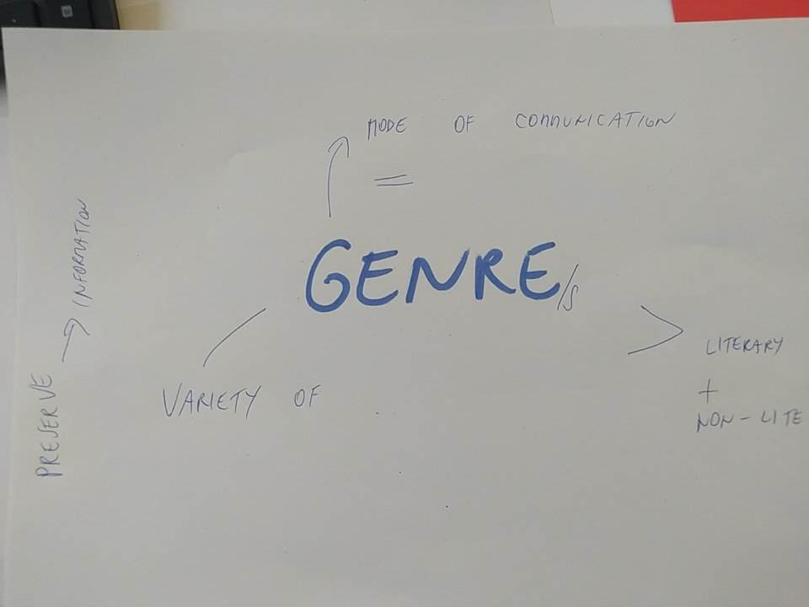

Slide 5
Task 2
Predict what comes next and write down the following sentence.

Slide 6
Purpose statement
What is it?
Does it include / refer to topic?
What kind of verbs are used?
How does it relate to conclusion?

Slide 7
Purpose statement
What is it?
Explanation of the text´s aim, focus and perspective (a bit of methodology sometimes too).
Does it include / refer to topic?
Yes, the topic introduced (but more needs to be explained, e.g. author´s take on the topic).
What kind of verbs are used? Good examples are ANALYSE, COMPARE, INVESTIGATE, CONTRAST, INTERPRET, DISCUSS, ILLUSTRATE (not just PRESENT, INTRODUCE).
How does it relate to conclusion? Closely, the purpose statement promises what is going to be concluded. E.g. the aim is to compare - it can be concluded that XZ is much more … than DYV.

Slide 8
Purpose statement x topic ?
Abstract
This paper discusses educational informatics as a research field and provides an overview of the scope of work in this, and closely related, areas by members of the Department of Information Studies at the University of Sheffield. Current work in Sheffield focuses on the use of information and communications technologies (ICTs) in universities and schools, seeking to understand the effects of using ICTs in educational practice on learners, teachers and learning support staff. It also seeks to develop practical knowledge of relevance to the design and facilitation of ICT-enabled learning environments. The paper highlights the interdisciplinary nature of this research, and discusses theoretical frameworks and methodological approaches that are being used by Sheffield researchers. It concludes by suggesting that library and information science has a distinctive contribution to make to the study of ICT-enabled learning, and that there is a need for further discussion within the literature of this emergent field of inquiry.

Slide 9
Purpose statement x topic ?
Abstract
This paper discusses educational informatics as a research field and provides an overview of the scope of work in this, and closely related, areas by members of the Department of Information Studies at the University of Sheffield. Current work in Sheffield focuses on the use of information and communications technologies (ICTs) in universities and schools, seeking to understand the effects of using ICTs in educational practice on learners, teachers and learning support staff. It also seeks to develop practical knowledge of relevance to the design and facilitation of ICT-enabled learning environments. The paper highlights the interdisciplinary nature of this research, and discusses theoretical frameworks and methodological approaches that are being used by Sheffield researchers. It concludes by suggesting that library and information science has a distinctive contribution to make to the study of ICT-enabled learning, and that there is a need for further discussion within the literature of this emergent field of inquiry.

Slide 10
Purpose statement?
1. Introduction
Over the last decade, the impact of information and communication technologies (ICTs) on educational and training policy and provision in all sectors has been considerable – some might say, revolutionary. Governmental and intergovernmental agendas, combined with institutional and commercial interests, point the way towards continued, rapid diffusion of ICT-based resources and processes into all areas of educational practice in the developed world. Within this context, it seems safe to predict that ICTs are set to play an increasingly significant role in the experience of both formal and informal learning at all levels. A growing body of multidisciplinary research seeks to explore the implications of this development from a variety of stakeholder and research perspectives. One such perspective is that of library and information science (LIS). In this paper, we introduce educational informatics as a research field and provide an overview of the scope of work in this, and closely related, areas by members of the Department of Information Studies(DIS) at the University of Sheffield (see also http://dis.shef.ac.uk/eirg/). The paper aims to reflect the way in which we conceptualize this field of inquiry, and to highlight elements of an evolving research agenda forLIS in this field.

Slide 11
Text 2 + task 3: identify purpose statement and outline
The purpose of this chapter is to critically review, discuss, and analyze the concept of genre within LIS. This results in the following chapter structure. First, a discussion of the LIS context and its relation to genre is provided. Emphasis is on the significance of genre for LIS, why should want to know (more) about it, and what exactly it is about genre that is important for LIS to know. This is followed by an overview of genre and genre-related research in LIS and its implications for LIS research and discourse. I examine the ways genre theory has been employed in LIS research and related fields. Third, a review of genre theory research is provided in order to show what scholarly traditions inform modern genre theory and its concepts. Fourth, I outline basic concepts from genre theory in order to demonstrate their usefulness inLIS research. The concluding section points to the need for further genre-oriented perspectives in LIS research.

Slide 12
Task 4
Find examples of:
passive voice
author´s voice
cohesive tools
linking words

Slide 13
Text 4
The purpose of this chapter is to critically review, discuss, and analyze the concept of genre within LIS. This results in the following chapter structure. First, a discussion of the LIS context and its relation to genre is provided. Emphasis is on the significance of genre for LIS, why should want to know (more) about it, and what exactly it is about genre that is important for LIS to know. This is followed by an overview of genre and genre-related research in LIS and its implications for LIS research and discourse. I examine the ways genre theory has been employed in LIS research and related fields. Third, a review of genre theory research is provided in order to show what scholarly traditions inform modern genre theory and its concepts. Fourth, I outline basic concepts from genre theory in order to demonstrate their usefulness in LIS research. The concluding section points to the need for further genre-oriented perspectives in LIS research.

Slide 14
Task 5
Rewrite the excerpt in a creative way, you can:
introduce your own essay /thesis
present a famous book / study
summarize a film / series
describe a cooking recipe / process

Slide 15
Text 3 - cohesion
It would tell us what kinds of genres various people and institutions in different communicative contexts prefer. A genre view of these communicative activities would provide a means to examine systematically document production and use and the organization of document production and use.
Thus,using genre as an analytical concept in LIS would help us understand how professional, cultural, and social communication is carried out. It would also enable understanding of how genres organize activity, texts,knowledge, and people.
This implies that we should view information systems not as ends in themselves but rather as means to an end. We should focus on what information systems do, as tools to be used in goal-directed activity.Such a view may have been present in LIS but formulated in other ways. However, what has been missing is the genre perspective.
For the sake of the argument, assume that LIS is the study of how and with what means professional, scholarly, cultural, and social knowledge as materialized in documents (print or electronic) is communicated in society and what function libraries and other similar knowledge organizing institutions or activities have, or are supposed to have, in these communication processes.1
Moreover, a genre perspective would not only focus on the people and the production and use of various documents,but also stress typical activities in which people are discursively engaged. From a genre point of view, then, document production and use are looked upon not as ends in themselves but in terms of how documents help people do their work (cf. Bazerman, 2004, p. 319).
If LIS, by means of theoretical and empirical studies, can gain a more thorough understanding of situated and typified document production and use,then we may also be able to have a more informed understanding of the ways in which information systems help, or fail to help, people do their work.
As LIS is interested in how knowledge in documents and other artifacts is organized, genre theory is a productive perspective. Studying genres would reveal how they and human activity are important organizing factors of communication and knowledge.
Professional, scholarly, cultural, and social communication as manifested in documents comprises a diversity of genres: work orders, newsletters, recipes, bibliographies,articles in literary-cultural journals, surveys, chronicles, technical reports, governmental reports, scholarly articles, book reviews, and soon.
Such a view may have been present in LIS but formulated in other ways. However, what has been missing is the genre perspective.

Slide 16
Text 3 - cohesion
It would tell us what kinds of genres various people and institutions in different communicative contexts prefer. A genre view of these communicative activities would provide a means to examine systematically document production and use and the organization of document production and use.
Thus,using genre as an analytical concept in LIS would help us understand how professional, cultural, and social communication is carried out. It would also enable understanding of how genres organize activity, texts,knowledge, and people.
This implies that we should view information systems not as ends in themselves but rather as means to an end. We should focus on what information systems do, as tools to be used in goal-directed activity.
For the sake of the argument, assume that LIS is the study of how and with what means professional, scholarly, cultural, and social knowledge as materialized in documents (print or electronic) is communicated in society and what function libraries and other similar knowledge organizing institutions or activities have, or are supposed to have, in these communication processes.1
Moreover, a genre perspective would not only focus on the people and the production and use of various documents,but also stress typical activities in which people are discursively engaged. From a genre point of view, then, document production and use are looked upon not as ends in themselves but in terms of how documents help people do their work (cf. Bazerman, 2004, p. 319).
If LIS, by means of theoretical and empirical studies, can gain a more thorough understanding of situated and typified document production and use,then we may also be able to have a more informed understanding of the ways in which information systems help, or fail to help, people do their work.
As LIS is interested in how knowledge in documents and other artifacts is organized, genre theory is a productive perspective. Studying genres would reveal how they and human activity are important organizing factors of communication and knowledge.
Professional, scholarly, cultural, and social communication as manifested in documents comprises a diversity of genres: work orders, newsletters, recipes, bibliographies,articles in literary-cultural journals, surveys, chronicles, technical reports, governmental reports, scholarly articles, book reviews, and so on.
Such a view may have been present in LIS but formulated in other ways. However, what has been missing is the genre perspective.

Slide 17
Text 3 - cohesion
For the sake of the argument, assume that LIS is the study of how and with what means professional, scholarly, cultural, and social knowledge as materialized in documents (print or electronic) is communicated in society and what function libraries and other similar knowledge organizing institutions or activities have, or are supposed to have, in these communication processes.1
Professional, scholarly, cultural, and social communication as manifested in documents comprises a diversity of genres: work orders, newsletters, recipes, bibliographies,articles in literary-cultural journals, surveys, chronicles, technical reports, governmental reports, scholarly articles, book reviews, and soon.
As LIS is interested in how knowledge in documents and other artifacts is organized, genre theory is a productive perspective. Studying genres would reveal how they and human activity are important organizing factors of communication and knowledge.
It would tell us what kinds of genres various people and institutions in different communicative contexts prefer. A genre view of these communicative activities would provide a means to examine systematically document production and use and the organization of document production and use.
Thus,using genre as an analytical concept in LIS would help us understand how professional, cultural, and social communication is carried out. It would also enable understanding of how genres organize activity, texts,knowledge, and people.
Moreover, a genre perspective would not only focus on the people and the production and use of various documents,but also stress typical activities in which people are discursively engaged. From a genre point of view, then, document production and use are looked upon not as ends in themselves but in terms of how documents help people do their work (cf. Bazerman, 2004, p. 319).
If LIS, by means of theoretical and empirical studies, can gain a more thorough understanding of situated and typified document production and use,then we may also be able to have a more informed understanding of the ways in which information systems help, or fail to help, people do their work.
This implies that we should view information systems not as ends in themselves but rather as means to an end. We should focus on what information systems do, as tools to be used in goal-directed activity.
Such a view may have been present in LIS but formulated in other ways. However, what has been missing is the genre perspective.

Slide 18
Text 4 - vocabulary
A concept from social theory, which has ______________ genre theory, is structuration(Giddens, 1984). With structuration, Giddens takes up an old problem in social theory, that of the relationship between social structure and human agency. Giddens’s argument is that structure and agency do not present / represent a dichotomy, but rather both produce and reproduce each other, a duality of structure in Giddens’s terms. Humans live in a socially structured world but, at the same time, humans with all their social and cultural resources /sources and activities shape socially structured society. Structuration has informed genre theory through the writings of, in particular, Yates and Orlikowski (1992) and Orlikowski and Yates (1994). Miller (1994) also discusses structuration theory as a ______________of her own notion of genre. The argument is that the use of genres simultaneously constitutes and reproduces / produces social structures.Miller (1994, p. 71) proposes that genres represent a specific, and important, constituent of society, a major aspect of its communicative structure, one of the structures of power that institutions ______________. Genre we can understand specifically as that aspect of situated communication that is capable / able of reproduction...Understanding genre in the light of structuration theory explicitly locates genre within social theory and ______________ genre beyond a contextualized / decontextualized view of how to use and understand particular forms of text. Another approach to genre, similar to structuration theory, is activity theory (e.g., Bazerman, 1997, 2004; Russell, 1997; Winsor, 1999). This approach has its historic / historical roots in the cultural-historical school in psychology, which originated in the 1930s in the Soviet Union with Vygotsky, Luria, and later Leont’ev (see Wilson’s chapter in the ______________ volume). Activity theory ______________ the relationship between human activity and modes of cognition. It considers social and cultural forms as objective conditions of possibilities for both cognition and human activity. Human activity is understood as______________ and object-oriented. To this end humans make usage / use of particular tools, such as texts. Activity theory stresses that humans shape and are shaped by social structures by means of their production and use of tools in an active dialectical process. These structures are considered relatively objective insofar as they constitute the social and material circumstances with and within which humans act.

Slide 19
Text 4 - vocabulary
A concept from social theory, which has informed genre theory, is structuration(Giddens, 1984). With structuration, Giddens takes up an old problem in social theory, that of the relationship between social structure and human agency. Giddens’s argument is that structure and agency do not present / represent a dichotomy, but rather both produce and reproduce each other, a duality of structure in Giddens’s terms. Humans live in a socially structured world but, at the same time, humans with all their social and cultural resources and activities shape socially structured society. Structuration has informed genre theory through the writings of, in particular, Yates and Orlikowski (1992) and Orlikowski and Yates (1994). Miller (1994) also discusses structuration theory as a continuation of her own notion of genre. The argument is that the use of genres simultaneously constitutes and reproduces social structures.Miller (1994, p. 71) proposes that genres representa specific, and important, constituent of society, a major aspect of its communicative structure, one of the structures of power that institutions wield. Genre we can understand specifically as that aspect of situated communication that is capable of reproduction...Understanding genre in the light of structuration theory explicitly locates genre within social theory and elevates genre beyond a decontextualized view of how to use and understand particular forms of text. Another approach to genre, similar to structuration theory, is activity theory(e.g., Bazerman, 1997, 2004; Russell, 1997; Winsor, 1999). This approach has its historical roots in the cultural-historical school in psychology, which originated in the 1930s in the Soviet Union with Vygotsky, Luria, and later Leont’ev (see Wilson’s chapter in the present volume). Activity theory explicates the relationship between human activity and modes of cognition. It considers social and cultural forms as objective conditions of possibilities for both cognition and human activity. Human activity is understood as intentional and object-oriented. To this end humans make use of particular tools, such as texts. Activity theory stresses that humans shape and are shaped by social structures by means of their production and use of tools in an active dialectical process. These structures are considered relatively objective insofar as they constitute the social and material circumstances with and within which humans act.

Slide 20
Sample 4 (last week) - genre?
In seeking tales and informations
Against this man, whose honesty the devil
And his disciples only envy at,
Ye blew the fire that burns ye. Now have at ye!

