Slide 1
ISKM09 Session 7 March 31
Martina Šindelářová Skupeňová

Slide 2
Outline
your drafts
planning poster sessions
designing a poster - text and visuals
presenting a poster - language and voice

Slide 3
SUMMARY (original text - verbs?) / RESPONSE (student´s perspective - adjectives?)
I read this article I found online about the topic INFORMATION NEED. Even though it wasn’t unnecessary long, the author chose very good words to educate people about this topic and it was really easy to get. He used some quality examples. This article is posted on some forum named AGROPEDIA and it was posted under a nickname Pankaj Ojha@BHU, who apparently writes blogs about interesting topics quite often.
I think that the first sentence is very descriptive and tells the reader briefly what is this article about. I’ll shorten the original sentence to: “INFROMATION NEED = desire to locate and obtain information to satisfy a need.” What helped me understand this topic even better was this part in the article, with reference to Robert Taylor’s theory about information need having four levels. It’s hard to put it in the few words, so I strongly advice to read it, if you are interested.
In my opinion, this topic touches every one of us. Either consciously or unconsciously, everyone needs information. As it is written further in the article, there are multiple reasons why we seek information, hence, we have different usage for them. My last point is that information flow is constant and we may receive some even if we don’t seek them at the time. It is only up to us what we decide to do with them.

Slide 4
SUMMARY (original text - verbs?) / RESPONSE (student´s perspective - adjectives?)
I read this article I found online about the topic INFORMATION NEED. Even though it wasn’t unnecessary long, the author chose very good words to educate people about this topic and it was really easy to get. He used some quality examples. This article is posted on some forum named AGROPEDIA and it was posted under a nickname Pankaj Ojha@BHU, who apparently writes blogs about interesting topics quite often.
I think that the first sentence is very descriptive and tells the reader briefly what is this article about. I’ll shorten the original sentence to: “INFROMATION NEED = desire to locate and obtain information to satisfy a need.” What helped me understand this topic even better was this part in the article, with reference to Robert Taylor’s theory about information need having four levels. It’s hard to put it in the few words, so I strongly advice to read it, if you are interested.
In my opinion, this topic touches every one of us. Either consciously or unconsciously, everyone needs information. As it is written further in the article, there are multiple reasons why we seek information, hence, we have different usage for them. My last point is that information flow is constant and we may receive some even if we don’t seek them at the time. It is only up to us what we decide to do with them.

Slide 5
SPECIFIC (clear) / GENERAL (vague)
I read this article I found online about the topic INFORMATION NEED. Even though it wasn’t unnecessary long, the author chose very good words to educate people about this topic and it was really easy to get. He used some quality examples. This article is posted on some forum named AGROPEDIA and it was posted under a nickname Pankaj Ojha@BHU, who apparently writes blogs about interesting topics quite often.
I think that the first sentence is very descriptive and tells the reader briefly what is this article about. I’ll shorten the original sentence to: “INFROMATION NEED = desire to locate and obtain information to satisfy a need.” What helped me understand this topic even better was this part in the article, with reference to Robert Taylor’s theory about information need having four levels. It’s hard to put it in the few words, so I strongly advice to read it, if you are interested.
In my opinion, this topic touches every one of us. Either consciously or unconsciously, everyone needs information. As it is written further in the article, there are multiple reasons why we seek information, hence, we have different usage for them. My last point is that information flow is constant and we may receive some even if we don’t seek them at the time. It is only up to us what we decide to do with them.

Slide 6
SPECIFIC (clear) / GENERAL (vague)
I read this article I found online about the topic INFORMATION NEED. Even though it wasn’t unnecessary long, the author chose very good words to educate people about this topic and it was really easy to get. He used some quality examples. This article is posted on some forum named AGROPEDIA and it was posted under a nickname Pankaj Ojha@BHU, who apparently writes blogs about interesting topics quite often.
I think that the first sentence is very descriptive and tells the reader briefly what is this article about. I’ll shorten the original sentence to: “INFROMATION NEED = desire to locate and obtain information to satisfy a need.” What helped me understand this topic even better was this part in the article, with reference to Robert Taylor’s theory about information need having four levels. It’s hard to put it in the few words, so I strongly advice to read it, if you are interested.
In my opinion, this topic touches every one of us. Either consciously or unconsciously, everyone needs information. As it is written further in the article, there are multiple reasons why we seek information, hence, we have different usage for them. My last point is that information flow is constant and we may receive some even if we don’t seek them at the time. It is only up to us what we decide to do with them.

Slide 7
SUMMARY (original text) / RESPONSE (student´s perspective)
My essay is going to deal with position of information giver in information behavior models.
Main source for my work is the article “Absence of Information-Giver in Information Behavior Models” by Ali Hossein Ghasemi[1], which examines the role of information-giver in information behavior models and proposes a new model that incorporates this concept.
The author argues that most existing models focus on information-seeker and information-source but neglect the human factor of information-giver who can influence the quality and quantity of information exchange.
The author reviews several models of information behavior and identifies their stance to the information-giver position.
Ghasemi argues for a greater focus on information-givers and their impact on information behavior. He suggests that this could lead to a better understanding of how people seek, use, and share information.
In my opinion, it is important to highlight that even if Ghasemi is right in an idea of absence of information giver in information behavior models, not every field of study requires this approach (and Ghasemi is aware of this).
On the other hand, this perspective can open other doors and provide different view on information behavior – which can help us to understand our minds a little bit more.

Slide 8
SUMMARY (original text) / RESPONSE (student´s perspective)
My essay is going to deal with position of information giver in information behavior models.
Main source for my work is the article “Absence of Information-Giver in Information Behavior Models” by Ali Hossein Ghasemi[1], which examines the role of information-giver in information behavior models and proposes a new model that incorporates this concept.
The author argues that most existing models focus on information-seeker and information-source but neglect the human factor of information-giver who can influence the quality and quantity of information exchange.
The author reviews several models of information behavior and identifies their stance to the information-giver position.
Ghasemi argues for a greater focus on information-givers and their impact on information behavior. He suggests that this could lead to a better understanding of how people seek, use, and share information.
In my opinion, it is important to highlight that even if Ghasemi is right in an idea of absence of information giver in information behavior models, not every field of study requires this approach (and Ghasemi is aware of this).
On the other hand, this perspective can open other doors and provide different view on information behavior – which can help us to understand our minds a little bit more.

Slide 9
Sample text 1
The value of an arts degree depends on a variety of factors, including the individual's goals and aspirations, the quality of the program and the institution offering the degree, and the current job market.
In terms of personal growth and development, an arts degree can provide students with a broad range of skills and knowledge that can be valuable in many different areas of life, including critical thinking, creativity, communication, and cultural awareness.
However, in terms of career prospects, the value of an arts degree may be more limited compared to degrees in fields such as science, technology, engineering, and mathematics (STEM) or business. Depending on the specific career path, an arts degree may not provide a direct pathway to a high-paying job, and graduates may need to supplement their degree with additional skills and training.
Ultimately, the decision of whether an arts degree is worth the tuition depends on the individual's personal circumstances and goals. It is important to carefully consider the potential benefits and drawbacks of pursuing an arts degree, as well as the cost and quality of the program, before making a decision.
Is an arts degree worth the tuition fees? - five-minute video debate | Opinion | The Guardian

Slide 10
Sample text 2
Whether or not an arts degree is worth the tuition depends on several factors, including your personal goals, career aspirations, and financial situation.
An arts degree can provide you with a broad range of skills, such as critical thinking, communication, creativity, and problem-solving, which are highly valued by employers in many industries. Additionally, pursuing an arts degree can be a rewarding and intellectually stimulating experience that allows you to explore your interests and passions.
However, it is important to consider the potential financial implications of pursuing an arts degree. Tuition fees for arts programs can be high, and the job market for graduates in some fields may be competitive or have limited earning potential. Therefore, it is important to research potential career paths and salaries in your desired field to ensure that the financial investment in your education will be worthwhile.
Ultimately, whether or not an arts degree is worth the tuition will depend on your individual circumstances and goals. It is important to carefully consider your options, do your research, and weigh the potential benefits and costs before making a decision.
Is an arts degree worth the tuition fees? - five-minute video debate | Opinion | The Guardian

Slide 11
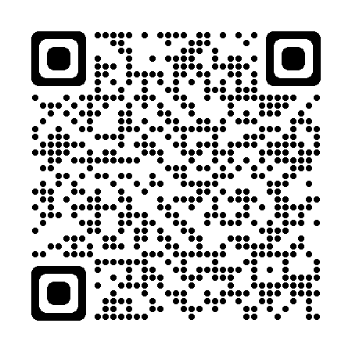
Planning poster sessions
April 7
May 5
Exam period: May 26, June 2, June 16
https://is.muni.cz/tudle/fnec

Slide 12
Designing posters

Slide 14
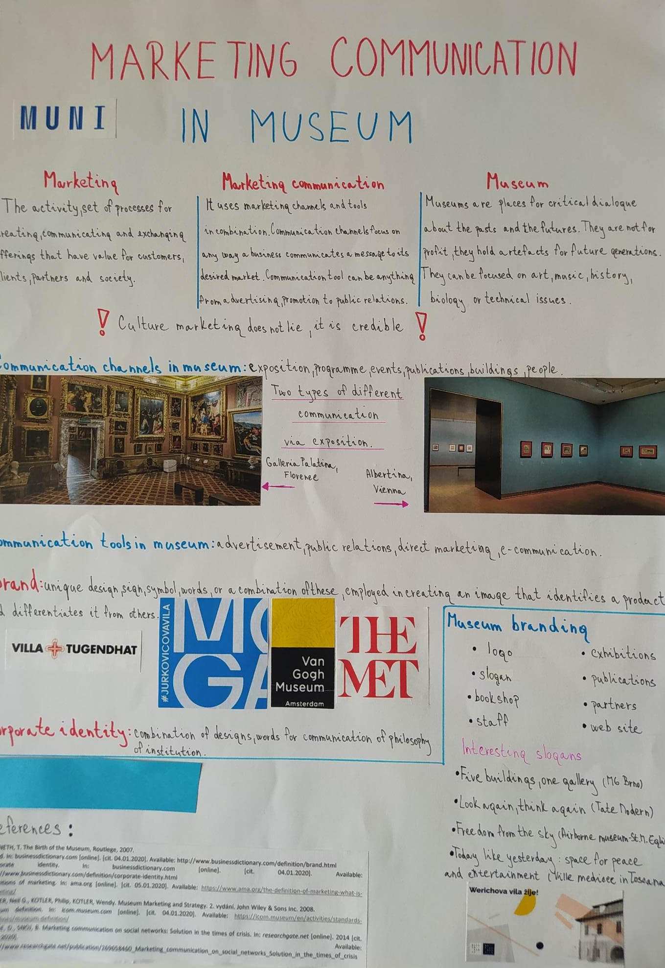
Group/s A
Poster´s layout - structure - clarity

Slide 15
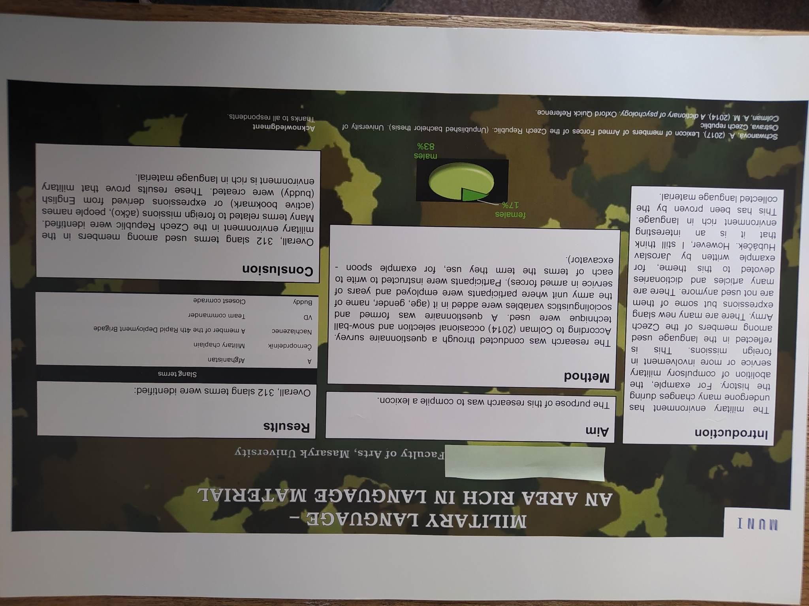
Group/s B
Text / visuals balance

Slide 16
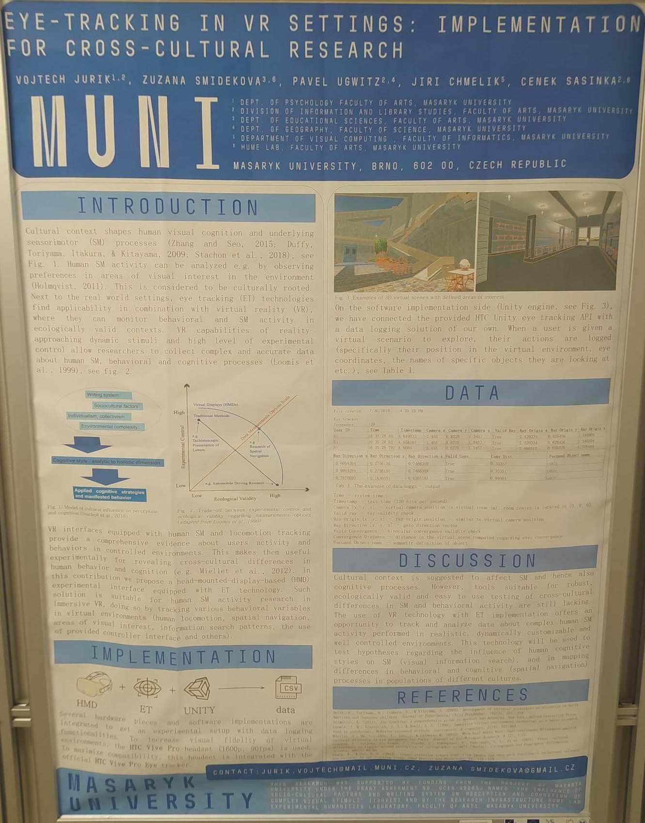
Group/s C
Form and formality

Slide 17
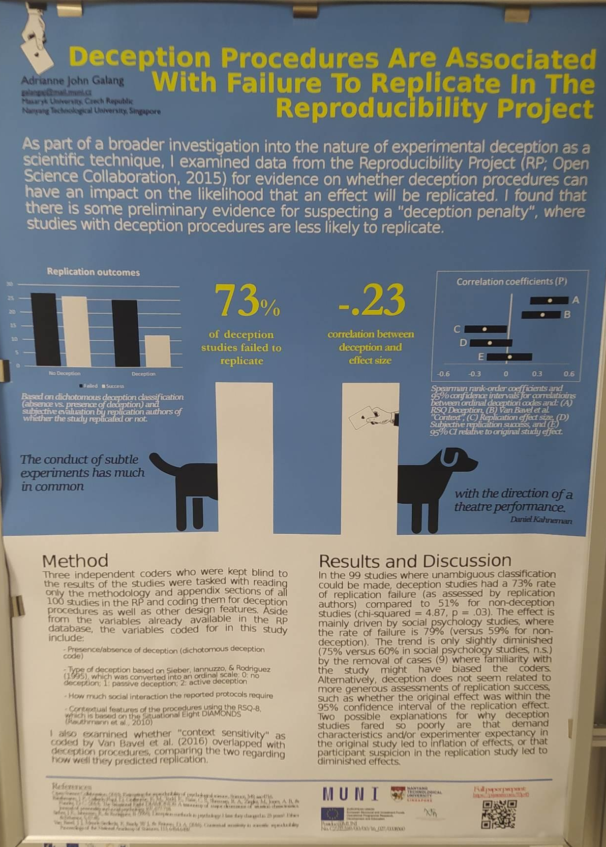
Group/s D
Author and audience

Slide 18
Presenting a poster - language
on the picture
you know
because I like it
there is a graph
guys

Slide 19
Presenting a poster
In my talk, I would like to ……………………. that an art degree is worth the tuition fees.

Slide 20
Presenting a poster
2. As this graph ………………………………, the number of students enrolling in the programme has ………………………….

Slide 21
Presenting a poster
3. Let me now …………………..to the following section which is going to …………………. more detailed insight into the problem.

Slide 22
Presenting a poster
4. The data collected in the Czech republic was ……………….

Slide 23
Presenting a poster
5. The following ……………….. illustrates that the situation has not really ……………….

Slide 24
Presenting a poster
6. If you have …………………………, I am more than ready to ……………………….

Slide 25
Presenting a poster
7. I would like to …………………….. by ……….that the strongest argument for arts degrees having a value in contemporary world seems to be the variety of careers that arts graduates succeed in.

