Slide 1
Cantonese II
Lesson 2 – food again

Slide 2
Conversation Practice
Waiter/Waitress: 你想食乜嘢? (what do you want to eat?)
nei5 soeng5 sik6 mat1 je5?
Client: 我要一個 XX 同YY◦ (I want one piece of XX and YY.)
ngo5 jiu3 jat1 go3 XX tung4 YY.
Waiter/Waitress: 你想飲乜嘢? (What do you want to drink?)
nei5 soeng5 jam2 mat1 je5?
Client: 我要一杯 ZZ◦ (I want one cup of ZZ)
ngo5 jiu3 jat1 bui1 ZZ.
Waiter/Waitress: 要凍定係熱? (Want cold or hot?)
jiu3 dung3 ding6 hai6 jit6?
Client: 要凍嘅◦ (want cold’s)
jiu3 dung3 ge3
Waiter/Waitress: 想要多糖定少糖? (want more sugar or less sugar?)
soeng5 jiu3 do1 tong4 ding6 siu2 tong4?
Client: 少糖˒唔該◦ (less sugar please)
siu2 tong4, m4 goi1
Waiter/Waitress: 請等一等◦ (please wait one wait)
ceng2 dang2 jat1 dang2

Slide 4
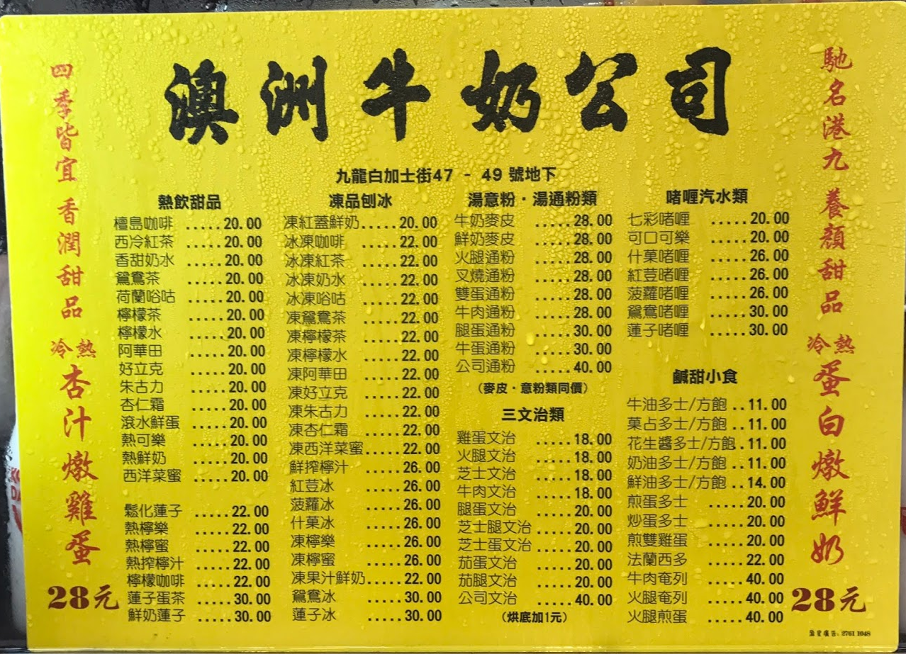
蛋 (egg) daang2
多士 (toast) do1 si2
通粉 (macaroni) tung1 fan2
啫喱 (jelly) ze1 lei2
叉燒 (barbecued pork) caa1 siu1
火腿 (ham) fo2 teoi2
文治 (sandwich) man4 zi6

Slide 6
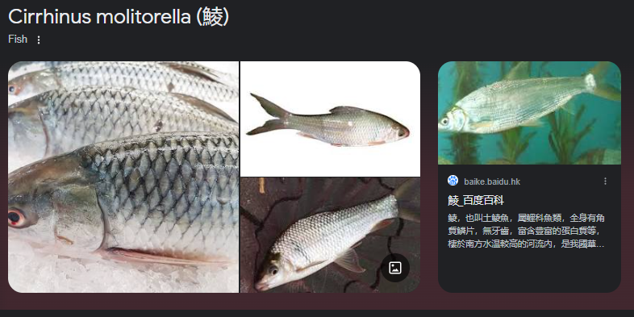
Vocabs
Protein
牛肉 ngau4 juk6 beef meat
雞肉 gai1 juk6 chicken meat
羊肉 joeng4 juk6 lamb meat
豬肉 zyu1 juk6 pork meat
豆腐 dau6 fu6 tofu
魚 jyu1 fish
魷魚 jau4 jyu2 squid
吞拿魚 tan1 naa4 jyu2 tuna fish
墨魚 mak6 jyu4 cuttlefish
鱈魚 syut3 jyu2 cod fish
鯪魚 leng4 jyu2 dace fish
鱸魚 lou4 jyu2 sea bass, perch
三文魚 saam1 man4 jyu2 salmon
蝦 haa1 shrimp/prawn
蛋 daan6 egg

Slide 7
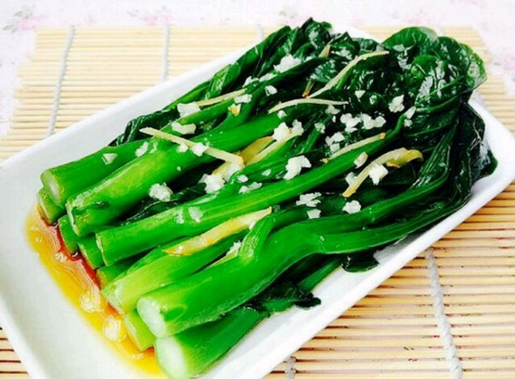
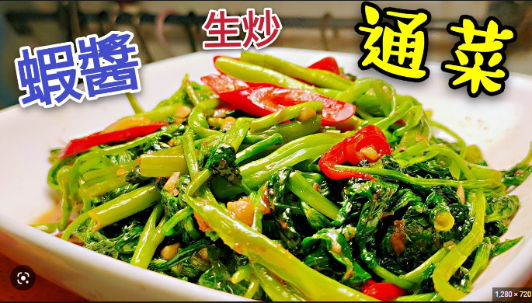
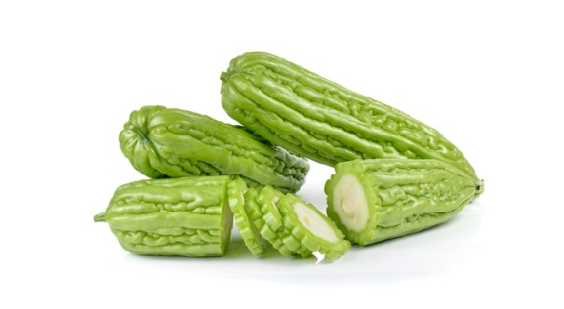
Vocabs
蔬菜 So1 Coi3 Vegetable
菜心 coi3 sam1 choy sum
白菜 baak6 coi3 bok choy
通菜 tung1 coi3 water spinach
芥蘭 gaai3 laan2 broccoli
椰菜花 je4 coi3 faa1 cauliflower
蘿蔔 lo4 baak6 carrot
番茄 faan1 ke2 tomato
薯仔 syu4 zai2 potato
椰菜 Je4 Coi3 Cabbage
青瓜 Ceng1 Gwaa1 Cucumber
蘑菇 Mo4 Gu1 Mushroom
生菜 Saang1 Coi3 Lettuce
粟米 suk1 mai5 corn
菜心 coi3 sam1
通菜 tung1 coi3
涼瓜/苦瓜 loeng4 gwaa1/fu2 gwaa1
矮瓜 aai2 gwaa1 eggplant
翠玉瓜 ceoi3 juk6 gwaa1 zucchini
菠菜 bo1 coi3 spinach/Chinese spinach
豆 dau6*2 beans, peas
涼瓜/苦瓜 loeng4 gwaa1/fu2 gwaa1 bitter melon/ gourd

Slide 8
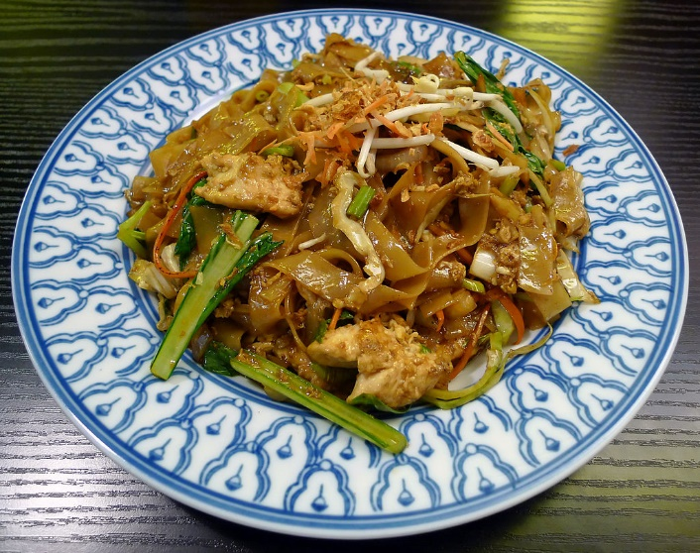
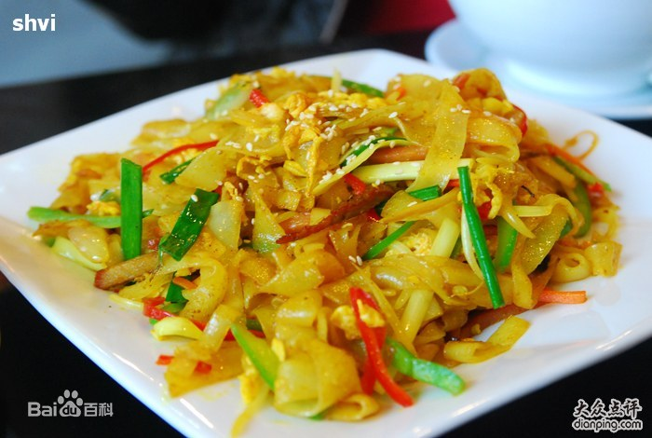
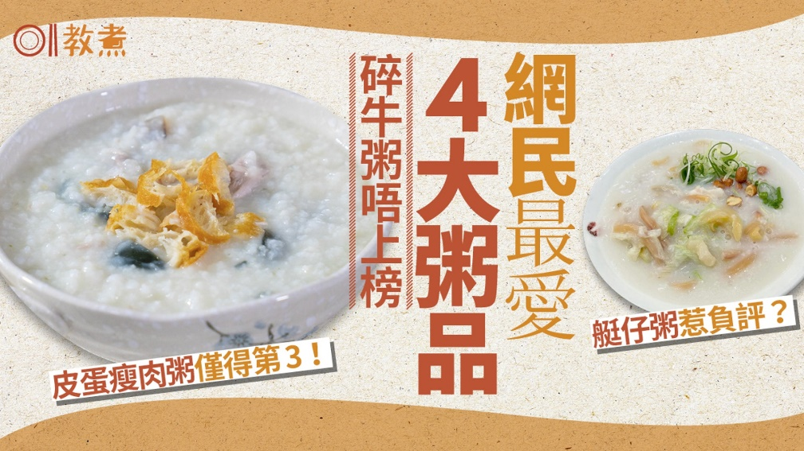
Vocabs
Carbohydrate (side dish in European cuisine)
飯 faan6 rice
意粉 ji3 fan2 spaghetti
薯菜 syu4 coi3 potatos as “side dish”
薯條 syu4 tiu2 French fry, fried potato
河粉 ho4 fan2 broad rice noodles (“pho”), single word“河” on menu
貴刁 gwai3 diu1 rice noodles
米粉 mai5 fan2 rice noodles
米線 mai5 sin3 thin rich noodles
粥 zuk1 rice porridge
麵 min6 noodle
麵包 min6 baau1 bread
餃 gaau2 stuffed dumpling
河粉
貴刁
粥

Slide 9
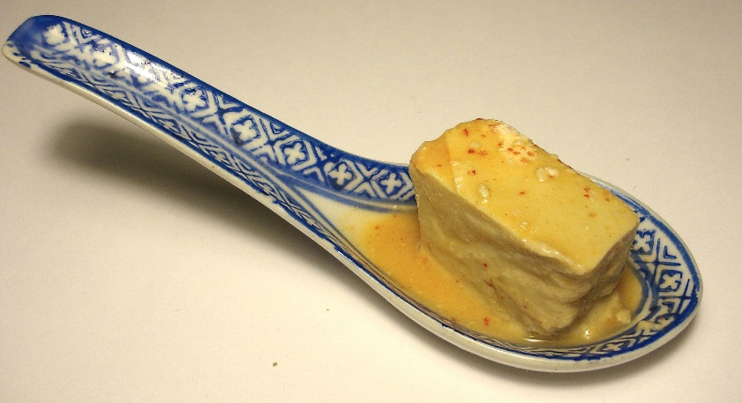
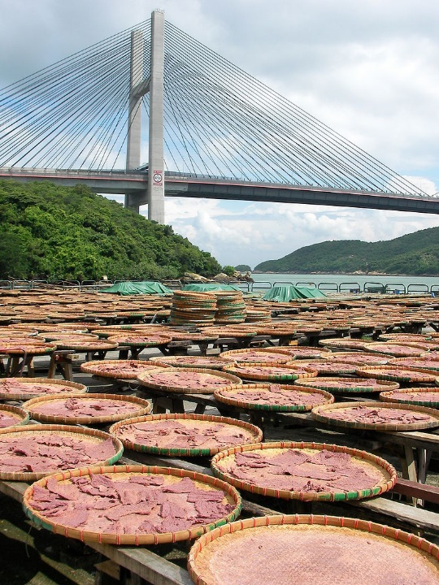
Vocabs
Seasoning
洋葱 Joeng4 Cung1 onion
蒜 syun3 garlic
蒜茸 syun3 jung4 crushed garlic
辣椒 laat6 ziu1 chili, pepper
姜/薑 goeng1 ginger
薑葱 goeng1 cung1 ginger and green onion
蝦醬 haa1 zoeng3 shrimp paste
腐乳 fu6 jyu5 fermented bean curd
豉油 si6 jau4 soya sauce
蠔油 hou4 jau4 oyster sauce
忌廉汁 gei6 lim1 zap1 cream sauce
黑椒 haak1 ziu1 black pepper “sauce”
腐乳 fu6 jyu5
蝦醬 haa1 zoeng3

Slide 10
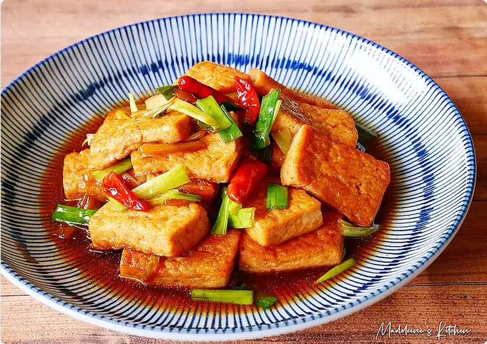
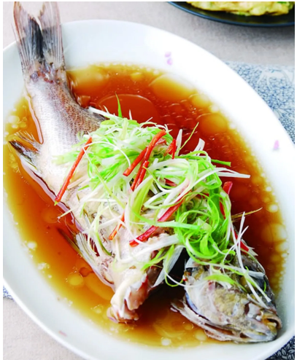
Vocabs
Ways of cooking
煮 zyu2 cook
煎 zin1 pan fry
炒 caau2 stir fry
乾炒 gon1 caau2 “dry-fried” (stir fry but don’t add sauce)
炸 zaa3 deep dry in oil
燒 siu1 barbecue
紅燒 hung4 siu1 braised in soya sauce
蒸 zing1 steam
清蒸 cing1 zing1 steamed in clear soup (usually without soy sauce)
炆 man1 simmer, cook over slow fire
烹 paang1 cook in water, boil
煲 bou1 boil
白灼 baak6 coek3 blanching, cooking with clean broth
紅燒豆腐
Hung4 siu1 dau6 fu6
清蒸魚
Cing zing1 jyu1

Slide 11
Create the dish names
Vegetable dish name = Seasoning + way of cooking + vegetable
Eg: 蒜茸炒白菜 crushed garlic stir-fry bak choy
syun3 jung4 caau2 baak6 coi3
Meat dish name = Seasoning + way of cooking + meat
Eg: 薑葱炒牛肉 ginger and green onion stir-fry beef
goeng1 cung1 caau2 ngau4 juk6
Both vegetable and meat together = seasoning + way of cooking + vegetable + meat
Eg: 蠔油炆蘿蔔羊肉 oyster sauce simmer with carrot and lamb
hou4 jau4 man1 lo4 baak6 joeng4 juk6

Slide 12
Conversation Practice (off-menu vegetable dishes)
Waiter/Waitress: 你想食乜菜? (what vegetable do you want to eat?)
nei5 soeng5 sik6 mat1 coi3?
Client: 你有乜嘢菜? (What vegetable do you have?)
nei5 jau5 mat1 je5 coi3?
Waiter/Waitress: 我哋有菜心˴菠菜˴芥蘭˴通菜◦你想食咩? (we have choy sum, boy choy, water spinach, broccoli. What do you want to eat?)
ngo5 dei6 jau5 coi3 sam1 ˴bo1 coi3˴gaai3 laan2˴tung1 coi3 ◦ nei5 soeng5 sik6 me1?
Client:菜心˒唔該◦ (choy sum, thank you)
coi3 sam1, m4 goi1
Waiter/Waitress: 你想點煮? (how do you want it to be cooked?)
nei5 soeng5 dim2 zyu2?
Client: 可唔可以炸? (can you deep dry it?)
ho2 m4 ho2 ji5 zaa3?
Waiter/Waitress: 唔好意思◦我哋唔炸菜心◦ (sorry we don’t deep dry choy sum.)
m4 hou2 ji3 si1. ngo5 dei6 m4 coi3 sam1.
Client: 有冇蒜茸炒菜心? (do you have minced garlic stir-fry choy sum?)
jau5 mou5 syun3 jung4 caau2 coi3 sam1?
Waiter/Waitress: 有◦要一個? (yes. One portion?)
jau5. jiu5 jat1 go3?
Client: 係◦一個◦ (yes. One portion?)
hai6. jat1 go.
If he/she is rude:
𨳒你! 依家係咪玩嘢呀?
(Fuck you! Are you now fooling around?)
Diu2 nei5! Ji1 gaa1 hai6 mai2 waan2 je5 aa3?
Then you say “sorry sorry”
alternative
你有冇推介? (do you have recommendation?)
Nei5 jau5 mou5 teoi1 gaai3?

Slide 13
“expert level” in food ordering,走 zau2 (without)
走蔥 zau2 cung1 “run away (green) onion”, without onion
走甜 zau2 tim4 “run away sweet”, without sugar
走冰 zau2 bing1 “run away ice”
Examples:
汽水走冰 soft drink without ice cubes
Hei3 seoi2 zau2 bing1
雲吞麵走蔥 wonton noodle without spring onions
wan4 tan1 min6 zau2 cung1
凍檸茶走甜 iced lemon tea without sugar
dung3 ning4 caa4 zau2 tim4
唔該, 一個漢堡包走牛肉 走芝士 走番茄
Excuse me, one hamburger without beef, without cheese, without tomato
M4 goi1, jat1 go3 hon3 bou2 baau1 zau2 ngau3 juk6, zau2 zi1 si2, zau2 faan1 ke2

Slide 14
Conversation Practice (wonton noodle restaurant)
Waiter/Waitress: 你想食乜? (what do you want to eat?)
nei5 soeng5 sik6 mat1?
Client: 唔該˒一個雲吞麵˒走蔥◦ (excuse me. One wonton noodle. Without green onion)
m4 goi1, jat1 go3 wan4 tan1 min6, zau2 cung1.
Waiter/Waitress: 想飲咩? (what do you want to drink?)
Soeng5 jam2 me1?
Client: 一杯凍豆漿走甜◦ (one cup of cold soy milk without sweet)
jat1 bui1 dung3 dau6 zoeng1 zau2 tim4
Waiter/Waitress: 豆漿冇得走甜㗎◦ (soy milk isn’t possible without sweetness “gaa”)
Dau6 zoeng1 mou5 dak1 zau2 tim4 gaa4.
Client: 咁我要甜啦◦ (in this case, I want sweet la.)
Gam3 ngo5 jiu5 tim4 laa1.
Waiter/Waitress: 一個雲吞麵走蔥˒一杯凍豆漿◦係咪咁多? (one wonton noodle, one cup of cold soy milk. Is that all?)
Jat1 go3 wan4 tan1 min6 zau2 cung1, jat1 bui1 dung3 dau6 zoeng1. hai6 mai6 gam3 do1?
Client: 係◦就係甘多˒唔該◦ (yes. That’s all. Thank you)
Hai6. zau6 hai6 gam3 do1. m4 goi1.

Slide 15
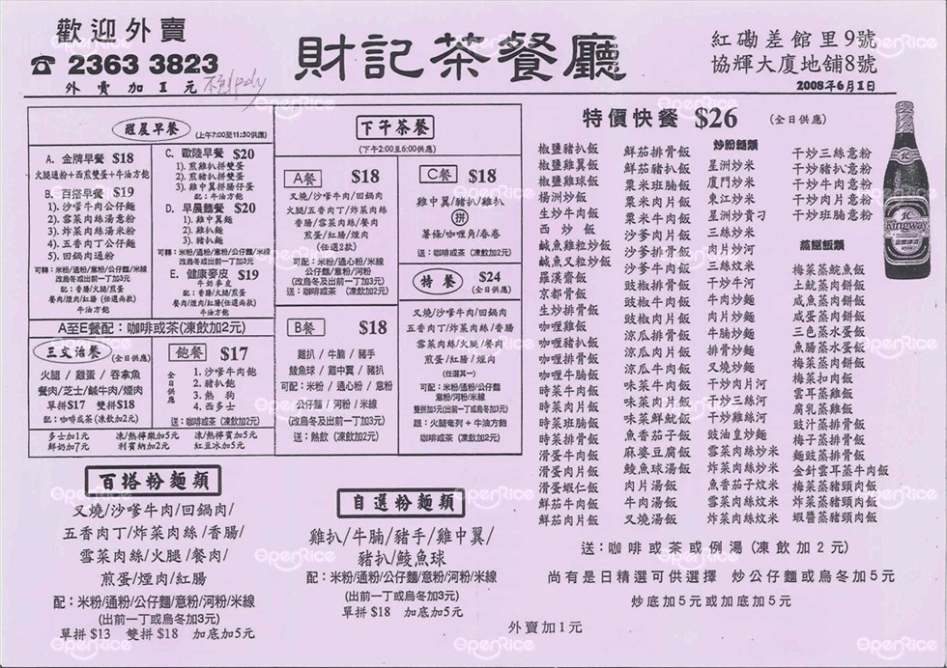
意粉 (spaghetti) ji3 fan2 飯 (rice) faan6 滑蛋 (silky egg) waat6 daan6*2 咖喱 (curry) gaa3 lei1 鮮茄 (fresh tomato) sin1 ke4*2 公仔麵 (instant noodle) gung1 zai2 min6 湯 (soup) tong1 炒麵 (fried noodles) caau2 min6 炒飯 (fried rice) caau2 faan6 炒河 (fried rice flat noodle) caau2 ho2 炒米 (fried rice vermicelli) caau2 mai5 乾炒/干炒 (“dry fried”, stir-fry, don’t add sauce) gon1 caau2

Slide 16
