Slide 1
Cantonese II
Lesson 4 – Transportation

Slide 2
Tone check
diu 鵰diu1 𨳒diu2 吊diu3 diu4 diu5 調diu6
Hai 閪hai1 喺hai2 hai3 兮hai4 匸hai5 係hai6
liu 撩liu1 料liu2 liu3 聊liu4 瞭liu5 廖liu6
kai 溪kai1 啟kai2 契kai3 kai4 kai5 kai6
cyun 川cyun1 喘cyun2 寸cyun3 全cyun4 cyun5 cyun6
fan 婚fan1 粉fan2 瞓fan3 焚fan4 奮fan5 分fan6
Haa 蝦haa1 吓haa2 嚇haak3 (or 8) 霞haa4 吓haa5 夏haa6
Ziu 蕉ziu1 沼ziu2 照ziu3 ziu4 ziu5 趙ziu6
Soeng 箱soeng1 想soeng2 相soeng3 償soeng4 上soeng5 尚soeng6
吓haa2 haa5 haa1

Slide 3
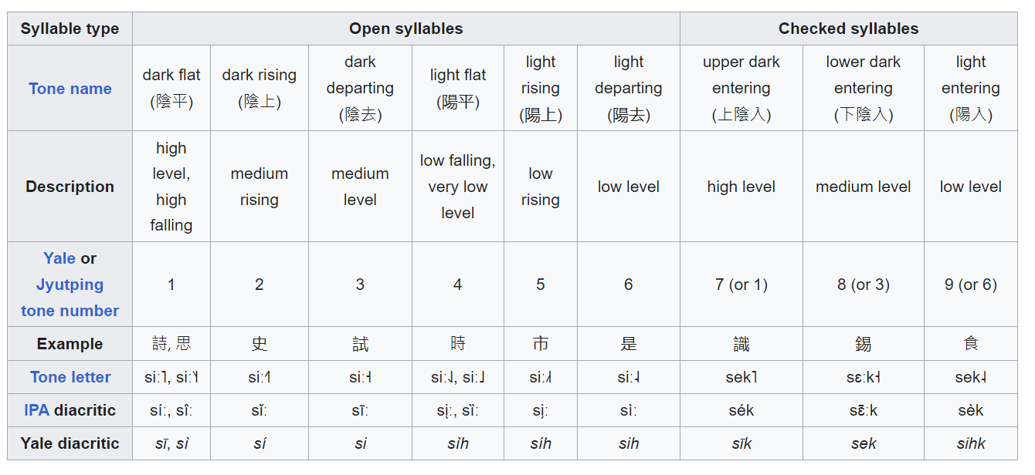
7th, 8th, 9th tone?
https://en.wikipedia.org/wiki/Cantonese_phonology

Slide 6
元朗 jyun4 long5
大學 daai6 hok6
上水 soeng6 seoi2
沙田 saa1 tin4
機場 gei1 coeng4
香港 hoeng1 gong2
九龍塘 gau2 lung4 tong4
旺角 wong6 gok3
油麻地 jau4 maa4 dei2
尖沙咀 zim1 saa1 zeoi2
荃灣 cyun4 waan1
中環 zung1 waan4
灣仔waan1 zai2
銅鑼灣 tung4 lo4 waan1
堅尼地城 gin1 nei4 dei6 sing4
金鐘 Gam1 zung1
柴灣 Caai4 waan1

Slide 7
Conversation Practice – number
Tourist: 我想去中環,搭幾多號小巴呀?
(I want to go to Central, get on what number minibus aa?)
Ngo5 soeng2 heoi3 zung1 waan4, daap3 gei2 do1 hou6 siu2 baa1 aa3?
Local: 搭八號啦!
(get on number 8 la!)
Daap3 baat3 hou6 laa1!
Instruction: Randomly choose which city to go. Randomly choose number of minibus to respond.
Underline words are for exchangeable options

Slide 8
Conversation Practice – Name the city and count how many stations to go
Tourist: 我喺美孚(where you are)˒我想去旺角 (destination)◦ 我應該搭幾多個站?
(I am at Mei Foo, I want go Mong Kok. I should take how many stops?)
Ngo5 hai2 mei5 fu1. ngo5 soeng2 heoi3 wong6 gok3. Ngo5 jing1 goi1 daap3 gei2 do1 go3 zaam6?
Local: 你應該搭五個站◦
(you should take 5 “pieces” of stops)
Nei5 jing1 goi1 daap3 ng5 go3 zaam6.
Instruction: you would go through the metro map and count how many stops.
Underline words are for exchangeable options

Slide 9
Conversation Practice – which vehicle?
Your friend: 你搭乜嘢車嚟㗎?
(You took on what car come gaa?)
Nei3 daap3 mat1 je5 ce1 lei4 gaa3?
You: 我搭___嚟呢度嘅◦
(I took _____come here ge)
Ngo5 daap3 _____lei4 ni1 dou6 ge3.
Underline words are for exchangeable options
㗎 gaa2 gaa3 gaa4 - final particle for making a strong assertion

Slide 10
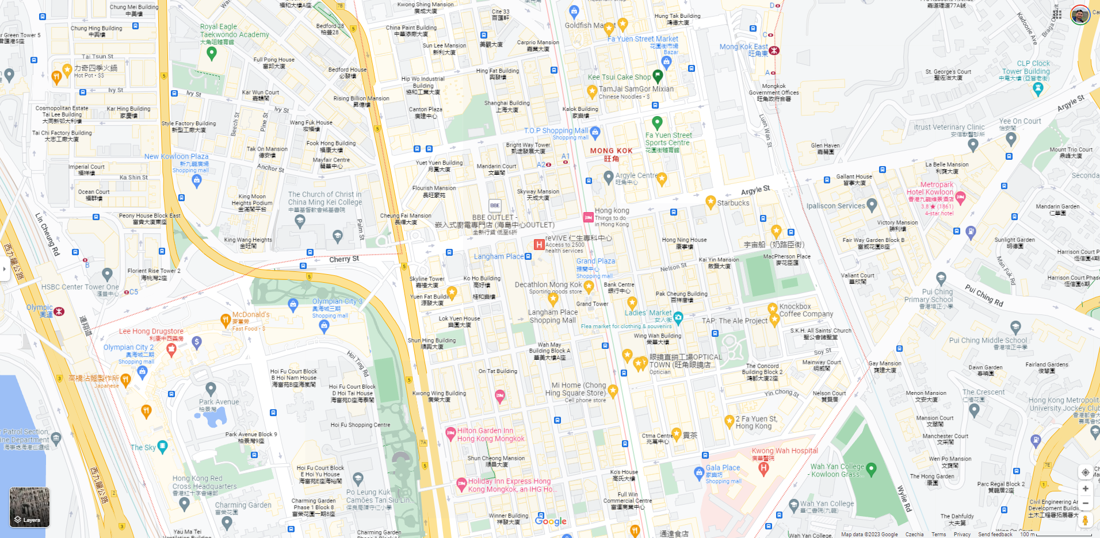
Search “Mong Kok” on Google Map

Slide 11
Conversation Practice - Taxi
Taxi: 你想去邊度? (you want go where?)
Nei5 soeng2 heoi3 bin1 dou6?
Passenger: 司機大哥, 唔該, 我想去 旺角◦
(driver big brother, excuse me, I want go Mong Kok.)
Si1 gei1 daai6 go1, m4 goi1, ngo5 soeng2 heoi3 wong6 gok3.
Taxi: 你想去 旺角 邊度? (you want go Mong Kok where?)
Nei5 soeng2 heoi3 wong6 gok3 bin1 dou6?
Passenger: 信和呀◦唔該◦ (Sino Centre aa. Excuse me)
seon3 wo2 aa3. m4 hoi1
Taxi: 好嘅! (good ge)
Hou2 ge3
Part 1 (just go to a city)
Part 2 (exactly where?)

Slide 12
gei1 coeng4 faai3 sin3
海綠色 hoi2 luk6 sik1
green
橙色 caang2 sik1
orange
Dung1 cung1 sin3
Dik6 si6 nei4 sin3
粉紅色 fan2 hung4 sik1
pink
泥黃色 nai4 wong4 sik1
Mud yellow
Hing1 tit3
Dung1 tit3 sin3
淺藍色 cin2 laam4 sik1
Light blue
Dung1 tit3 sin3
深藍色 sam1 laam4 sik1
Dark blue
Gun1 tong4 sin3
綠色 luk6 sik1
green
naam4 gong2 dou2 sin3
青綠色 ceng1 luk6 sik1 cyan, lime green
Zoeng1 gwan1 ou3 sin3
紫色 zi2 sik1
purple
Cyun4 waan 1 sin3
紅色 hung4 sik1
red
Tyun3 maa5 sin3
啡色 fe1 sik1
brown

Slide 13
Conversation Practice
咁 gam3 – “so”, -”ly”.
Tourist: Excuse me. Do you speak English?
Local: 唔好意思◦我唔識講英文◦ (Excuse me. I don’t speak English.)
m4 hou2 ji3 si1/3. ngo5 m4 sik1 gong2 jing1 man4*2/4.
Tourist: 我想問點樣去中環? (I want to ask, how go to Central?)
ngo5 soeng2 man6 dim2 joeng2 heoi3 zung1 waan4?
Local: 呢度係旺角◦你可以坐 紅色 (荃灣線) 往中環方向 坐五個站◦咁就去到中環啦◦
(here is Mong Kok. You can take red (Tsuen Wan line) to Central direction, sit for 5 stations. so, you already arrive Central laa.)
ni1 dou6 hai6. nei5 ho2 ji5 co5 hung4 sik1 cyun4 waan1 cin3 wong5 zung1 waan4 fong1 hoeng3 co5 ng5 go3 zaam6. Gam3 zau6 heoi3 dou3 zung1 waan4 laa3.
Tourist: 好◦ 唔該晒◦ (good. Thank you completely.)
Hou2. M4 goi1 saai3.
Instruction: 1. choose where you want to go. 2. which stop you are.
3. choose which color of metro line 4. which direction of metro line 5. how many stops to go.

