Slide 1
Cantonese II
Lesson 5 – Activities

Slide 2
Tone check
diu 鵰diu1 𨳒diu2 吊diu3 diu4 diu5 調diu6
Hai 閪hai1 喺hai2 hai3 兮hai4 匸hai5 係hai6
Ngo ngo1 鵝ngo2 ngo3 蛾ngo4 我ngo5 餓ngo6
Nei 匿nei1/nik1 洱nei5*2 nei3 妮nei4 你nei5 餌nei6
Heoi 虛heoi1 許heoi2 去heoi3 heoi4 heoi5 heoi6
Jing 英jing1 影jing2 應jing1 or 3 型jing4 jing5 認jing6
Dou 都dou1 島dou2 妒dou3 dou4 dou5 道dou6
Co 初co1 楚co2 挫co3 鋤co4 坐co5 co6
Coi 啋coi1 彩coi2 菜coi3 財coi4 coi5 coi6
Ce 車ce1 扯ce2 斜ce3 邪ce4 ce5 ce6
呢 ni1 ne1 nei1 nei4 - final particle; [粵] this

Slide 3
Question phrases
verb
食乜嘢? Sik6 mat1/mi1/me1 je5? (eat what things?)
做乜嘢? Zou6 mat1 je5? (do what things?)
聽乜嘢? Teng1 mat1 je5? (hear what things?)
睇乜嘢? Tai2 me1 je5? (see what things?)
去邊度? Heoi3 bin1 dou6? (go where?)
邊個? Bin1 go3? (who?)
點解? Dim2 gaai2 (how explain? → why?)
點樣? Dim2 jeong2? (how?)
幾時? Gei2 si4? (how time → when?)
幾多? Gei2 do1? (how many?)

Slide 4
"outstanding five in Cantonese" (廣東話一門五傑)
Diu2 屌 or 𨳒 (fuck)
Gau1 鳩 or 𨳊 (small penis)
Lan2 撚 or 𨶙 (penis)
Cat6 柒 or 𨳍 (penis)
Hai1 閪 (cunt)
Similar usage: gau1 ~ lan2 ~ cat6 ~hai1
As i. a particle to boost the tone, ii. a negation

Slide 5
Question phrases with the “goodies”
食乜X嘢? Sik6 mat1/mi1/me1 je5? (eat what X things?)
做乜X嘢? Zou6 me1 je5? (do what X things?)
聽乜X嘢? Teng1 me1 je5? (hear what X things?)
睇乜X嘢? Tai2 me1 je5? (see what X things?)
去邊X度? Heoi3 bin1 dou6? (go X where?)
邊X個? Bin1 go3? (who X?)
點X解? Dim2 gaai2 (how explain? → why X?)
點X樣? Dim2 jeong2? (how X?)
幾X時? Gei2 si4? (how time → when X?)
幾X多? Gei2 do1? (how many X?)
X = Gau1 鳩 or 𨳊 (small penis)
Lan2 撚 or 𨶙 (penis)
Cat6 柒 or 𨳍 (penis)
Hai1 閪 (cunt)

Slide 6
Common words in place names
中心 zung1 sam1 (centre, shopping centre)
街 gaai1 (street)
道 dou6 (road)
廣場 gwong2 coeng4 (plaza, square)
大廈 daai6 haa6 (building)

Slide 7
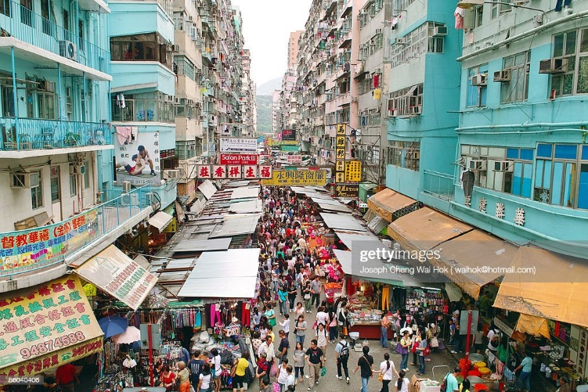
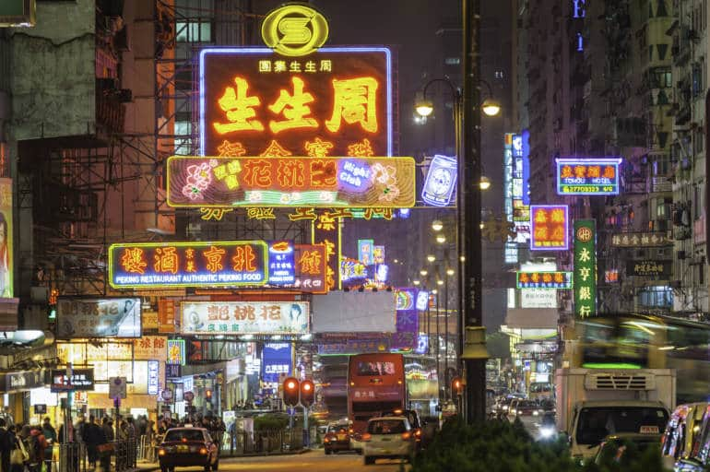
旺角 wong6 gok3
旺角中心 wong6 gok3 zung1 sam1 (Mong Kok Centre), 旺中wong6 zung1
銀行中心 ngan4 hong3 zung1 sam1 (Bank Centre)
旺角電腦中心 wong6 gok3 din6 nou5 zung1 sam1 (Mong Kok Computer Centre), 旺電 wong6 din6
信和(中心) seon3 wo2 zung1 sam1 (Sino Centre)
兆萬(中心) siu6 maan6 zung1 sam1 (CTMA Centre)
花園街 faa1 jyun4 gaai1 (Fa Yuen Street)
彌敦道 nei4 deon1 dou6 (Nathan Road)

Slide 8
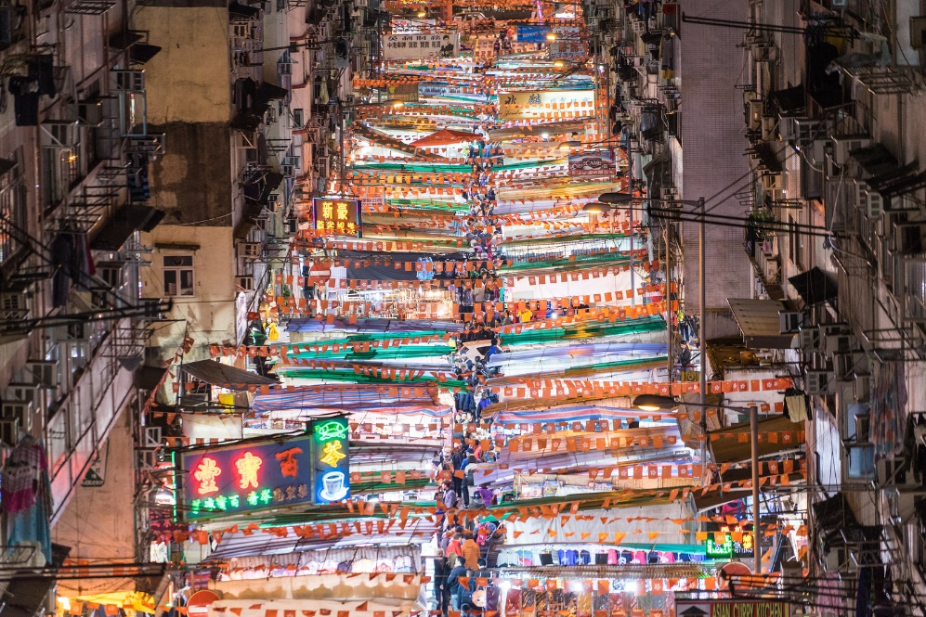
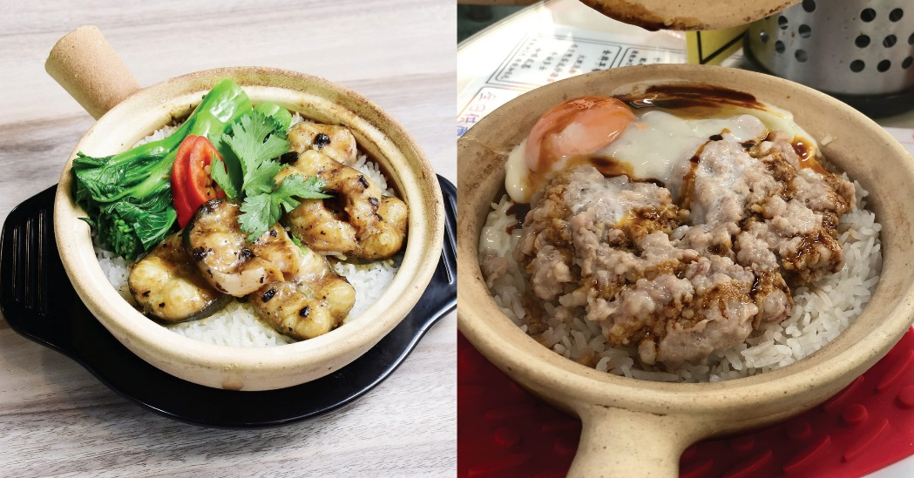
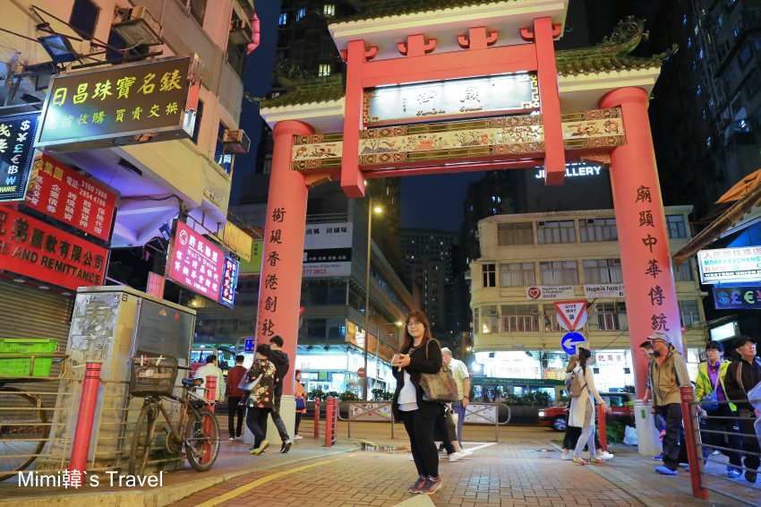
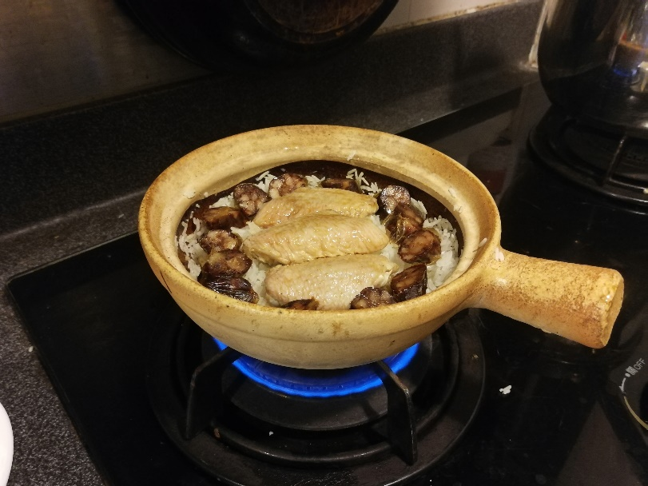
油麻地 jau4 maa4 dei2
廟街 miu6 gaai1 (temple street)
→
食煲仔飯 sik6 bou1 zai2 faan6 (eat claypot rice)

Slide 9
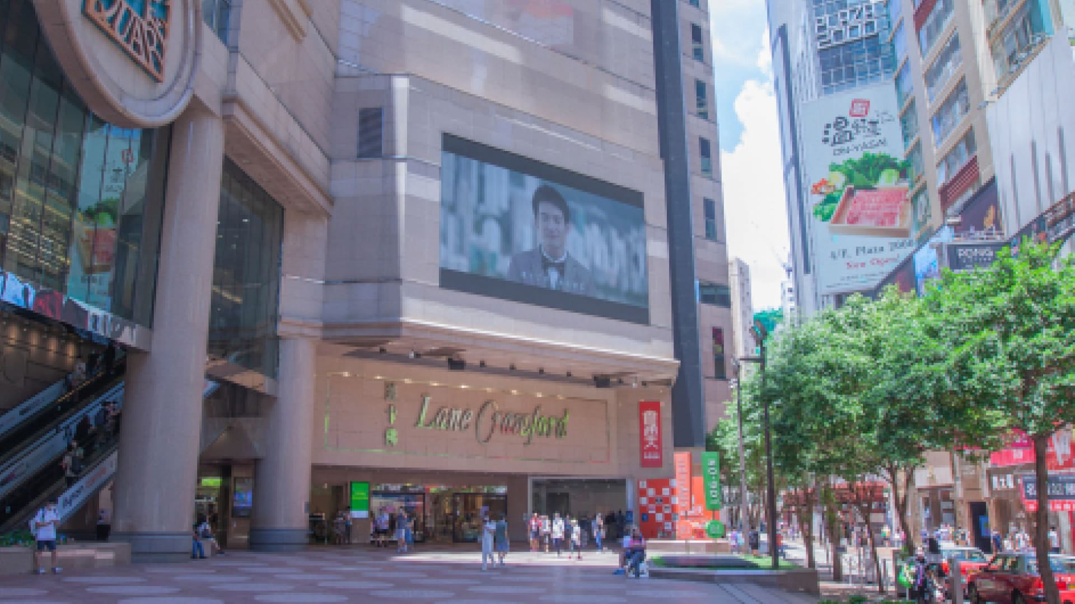
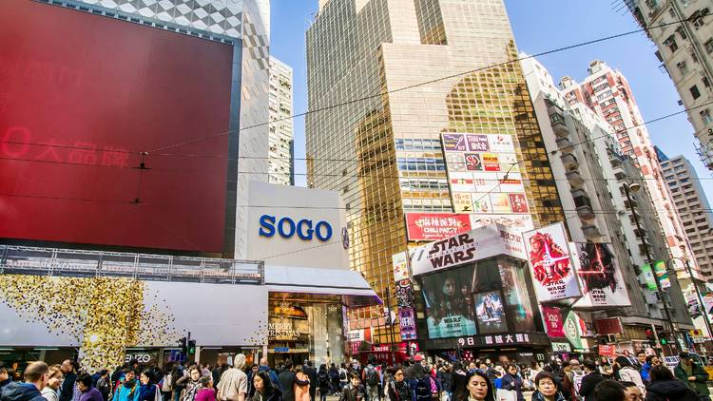
銅鑼灣 tung4 lo4 waan1/*4
時代廣場 si4 doi6 gwong2 coeng4 (Times Square)
崇光百貨 sung4 gwong1 baak3 fo3 (sogo department store) → SO GO

Slide 10
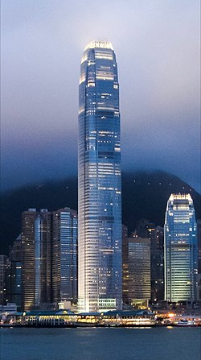
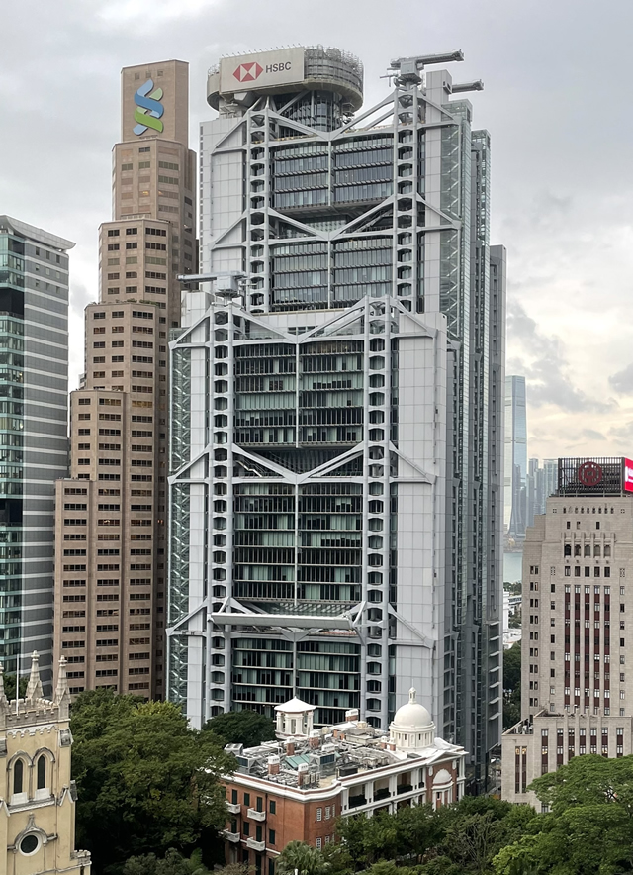
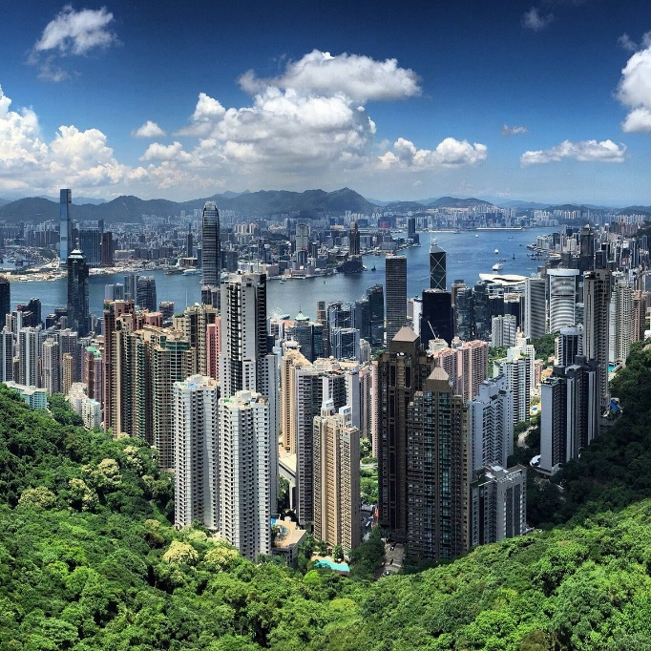
中環 zung1 waan4
中環碼頭 zung1 waan4 maa5 tau4 (Central Ferry Pier)
交易廣場 gaau1 jik6 gwong2 coeng4 (Exchange Square)
國際金融中心 gwok3 zai3 gam1 jung4 zung1 sam1 (IFC Mall)
置地廣場 zi3 dei6 gwong2 coeng4 (Landmark)
滙豐總行大廈 wui6 fung1 zung2 hong2 daai6 haa6 (HSBC bank headquarter)
中銀大廈 zung1 ngan2 (daai6 haa6) (Bank of China Tower)
山頂 saan1 deng2 (Victoria Peak)
蘭桂坊 laan4 gwai3 fong1 (Lan Kwai Fong LKF) → 飲酒, 去clubbing, 去party

Slide 11
Conversation Practice - Taxi
Taxi: 你想去邊度? (you want go where?)
Nei5 soeng2 heoi3 bin1 dou6?
Passenger: 司機大哥, 唔該, 我想去 旺角◦
(driver big brother, excuse me, I want go Mong Kok.)
Si1 gei1 daai6 go1, m4 goi1, ngo5 soeng2 heoi3 wong6 gok3.
Taxi: 你想去 旺角 邊度? (you want go Mong Kok where?)
Nei5 soeng2 heoi3 wong6 gok3 bin1 dou6?
Passenger: 信和呀◦唔該◦ (Sino Centre aa. Excuse me)
seon3 wo2 aa3. m4 hoi1
Taxi: 好嘅! (good ge)
Hou2 ge3
Underline words are for exchangeable options
Part 1 (just go to a city)
Part 2 (exactly where?)

Slide 12
Activities
行街 haang4 gaai1 (“walk on street”, meaning: shopping)
買嘢 maai5 je5 (buy things, meaning: shopping)
唱K coeng3 kei1 (sing karaoke)
食嘢 sik6 je5 (“eat something”, meaning: go for food)
食飯 sik6 faan6 (“eat rice”, have a meal)
飲嘢 jam2 je5 (“drink something”, meaning: go for a drink)
飲酒 jam2 zau2 (drink alcohol)
見朋友 gin3 pang4 jau5 (“see friends”, meaning: meet friends)
拍拖 paak3 to1 (literally “partner dragging”. Meaning: courting, go out on a date)
睇戲 tai2 hei3 (watch movie)
去party; heoi3 party (go to party)
去clubbing; heoi3 clubbing (go to disco clubs)

Slide 13
Conversation Practice – Which city to go? What do you do?
HK friend: 你一陣去邊度呀? (you later go where aa?)
Nei5 jat1 zan6/2 heoi3 bin1 dou6 aa3?
I: 我一陣去旺角呀◦ (I later go Mong Kok aa)
Ngo5 jat1 zan6/2 heoi3 wong6 gok3.
HK friend: 你去 旺角 有乜做? (you go Mong Kok have what do?)
Nei5 heoi3 wong6 gok3 jau5 mat1 zou6?
I: 我去 旺角 睇戲◦ (I go Mong Kok watch movie)
Ngo5 heoi3 wong6 gok3 tai2 hei3.
Underline words are for exchangeable options
Part 1 (which city?)
Part 2 (do what?)

Slide 14
Types of Cantonese restaurants:
酒樓zau 2 lau4/茶樓caa4 lau4/海鮮酒家 hoi2 sin1 zau2 gaa1 -點心dim2 sam1, 小菜 siu2 coi3
“alcohol building” “tea building” “seafood restaurant”
燒味 siu1 mei6*2, roasted meat
茶餐廳 caa4 caan1 teng1 “diner”
潮州打冷 ciu4 zau1 daa2 laang5*1 “Chiu-Chow style meal”
大排檔 daai6 paai4 dong3, street food stall
打邊爐 daa2 bin1 lou4, hotpot
街邊小食 gaai1 bin1 siu2 sik6 (street food snack), 掃街 sou3 gaai1 “sweep the street”
雲吞麵 wan4 tan1 min6 (wonton noodle)
麵包鋪 min6 baau1 pou3*2 (bread shop, bakery)
糖水鋪 tong4 seoi2 pou3*2 (甜品店 tim4 ban2 dim3) (dessert bistro)

Slide 15
Conversation Practice – Which city to go? What are you going to eat there?
HK friend: 你一陣去邊度呀? (you later go where aa?)
Nei5 jat1 zan6/2 heoi3 bin1 dou6 aa3?
I: 我一陣去油麻地呀◦ (I later go Yau Ma Tei aa)
Ngo5 jat1 zan6/2 heoi3 jau4 maa4 dei2 aa3.
HK friend: 你去油麻地有乜做? (you go Yau Ma Tei have what do?)
Nei5 heoi3 jau4 maa4 dei2 jau5 mat1 zou6?
I: 我去油麻地 食嘢◦ (I go Yau Ma Tei eat things)
Ngo5 heoi3 jau4 maa4 dei2 sik6 je1.
HK friend: 你去食乜嘢? (you go eat what things?)
Nei5 heoi3 sik6 mat1 je1?
I: 我去食大排檔 ◦ (I go eat street food stall.)
Ngo5 heoi3 sik6 daai6 paai4 dong3.
HK friend: 你喺大排檔想食乜嘢? (you want eat what things?)
Nei5 hai2 daai6 paai4 dong3 soeng2 sik6 mat1 je1?
I: 我想食蒜茸炒牛肉菜心◦ (I want eat smashed garlic stir-fry beef and choy sum)
Ngo5 soeng2 sik6 syun3 jung4 caau2 ngau4 juk6 coi3 sam1.
Underline words are for exchangeable options
Which city to go?
Do what?
Eat what type of restaurant?
Eat what dish?

Slide 16
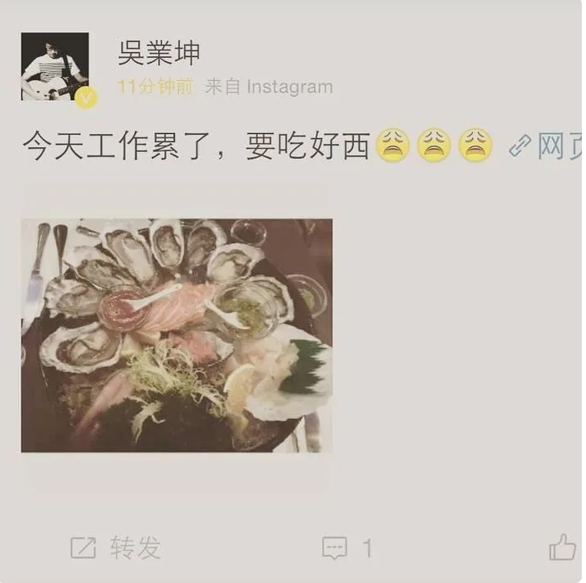

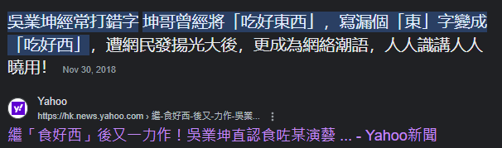
食好西
Originally, he wanted to type
食好東西 (eat good things)
Sik6 hou2 dung1 sai1
Mistakenly:
食好西 (eat good “west”/X)
Sik6 hou2 sai1
西sai1 <-> 閪hai1

