Slide 1
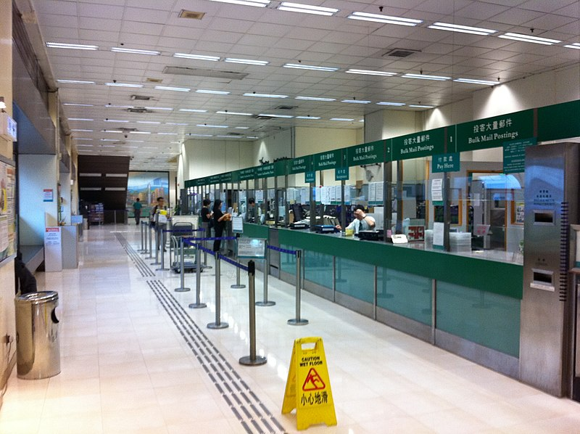
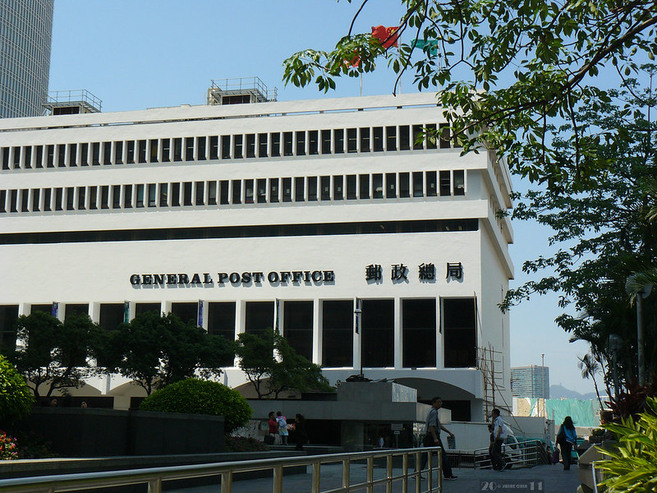
Cantonese II
Lesson 7 – Post Office

Slide 2
Tone check
Si 師si1 屎si2 嗜si3 匙si4 市si5 是si6 識sek7 錫sek8 食sek9
Gei 機gei1 幾gei2 寄gei3 gei4 gei5 技gei6
Gong 江gong1 港gong2 鋼gong3 gong4 gong5 槓gong6
Cin 千cin1 錢cin2 cin3 前cin4 踐cin5 cin6
Man 炆man1 抆man2 𠍁man3 民man4 敏man5 問man6
Gan 跟gan1 緊gan2 艮gan3 gan4 gan5 近gan6
Zung 中zung1 總zung2 眾zung3 zung4 zung5 仲zung6
Hei 希hei1 起hei2 戲hei3 hei4 hei5 hei6
Jau 休jau1 柚jau2 幼jau3 郵jau4 有jau5 右jau6
Maai maai1 maai2 maai3 埋maai4 買maai5 賣maai6
Ho 苛ho1 可ho2 ho3 河ho4 ho5 賀ho6

Slide 3
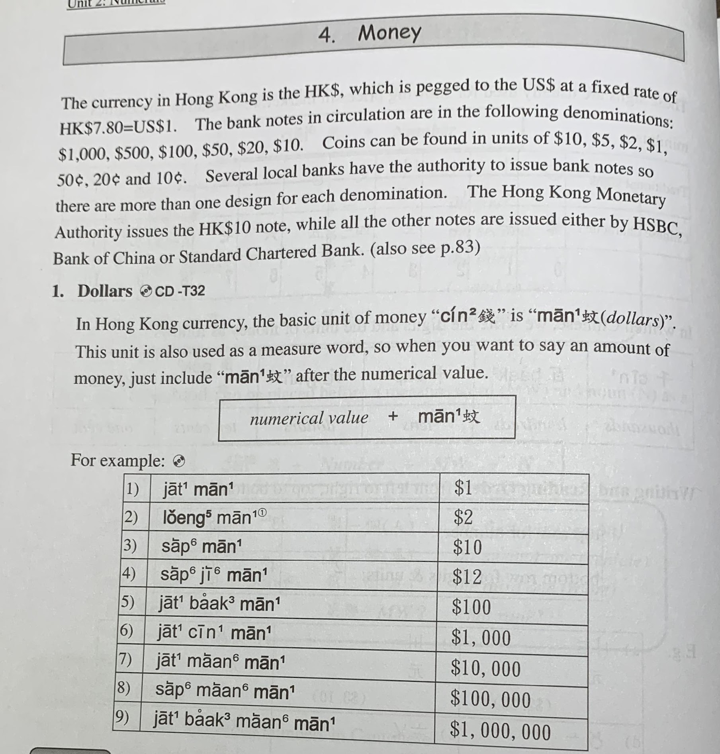

Notes:
Finish here on 12.10.2022

Slide 4
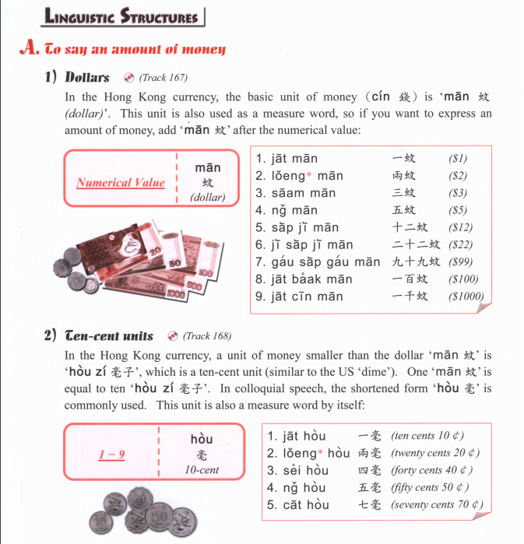
The use of the character 蚊 (mān) originate from the tone change of the currency denomination used in China in imperial times 文 (màn), which was the chief denomination until the introduction of the yuan in the late 19th century.

Slide 5
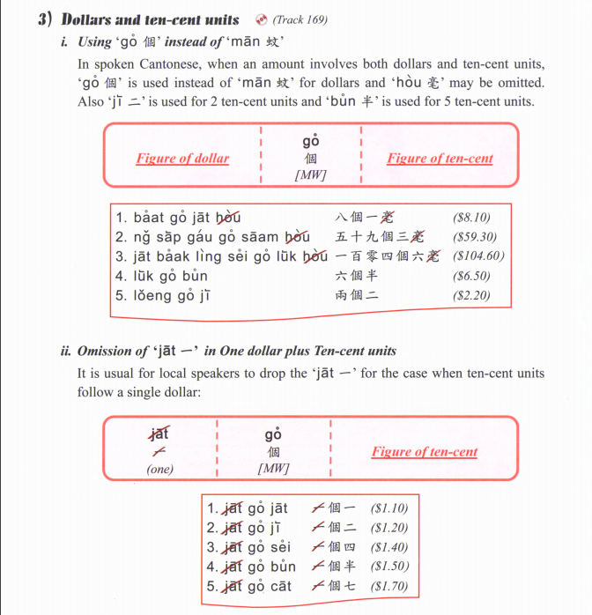

Slide 6
啲 di1
Comparative:
呢個靚啲◦ ni1 go3 leng3 di1. (this one is more beautiful.)
呢個貴啲◦ ni1 go3 gwai3 di1. (this one is more expensive.)
procession:
嗰間餐廳啲嘢好好食㗎！
Go2 gaan1 caan1 teng1 di1 je5 hou2 hou2 sik6 gaa3!
(that restaurant’s thing go go eat gaa! → The food in that restaurant tastes very good.)
A bit, little:
一啲都唔熱嘅！
Jat1 di1 dou1 m4 jit6 ge3!
(a bit not hot ge! → It’s not hot at all!)

Slide 7
最 zeoi3 / 至 zi3
superlatives:
最平 zeoi3 peng4, the cheapest in price
最貴 zeoi3 gwai3, the most expensive
Attributively, with 嘅 ge3
最平嘅機票 zeoi3 peng4 ge3 gei1 piu3, the cheapest flight ticket
Predicates:
咁樣最方便 gam2 joeng2 zeoi3 fong1 bin6, this way is the most convenient.
至 zi3 --- meaning
1. the most, eg: 至平
2. from … to…eg: 二至六 2 to 6

Slide 8
但係 daan6 hai6
But, however
Example:
我琴日睇咗一套戲，但係一啲都唔好睇◦
“I yesterday watched a movie, but little bit not good watch”
I watched a movie yesterday but it wasn’t good at all.
Ngo5 kam4 jat6 tai2 zo2 jat1 tou3 hei3, daan6 hai6 jat1 di1 dou1 m4 hou2 tai2.

Slide 9
Post office glossary
產品類型Type of products:
信 seon3, letter
明信片 ming4 seon3 pin2, postcard
郵包 jau4 baau1, packet
包裹 baau1 gwo2, parcel
快遞 faai3 dai6, express delivery
掛號 gwaa3 hou6, registered
追蹤 zeoi1 zung1, tracking
保險 bou2 him2, insurance
空郵 hung1 jau4, airmail
平郵 ping4 jau4, surface mail (by car/ferry)
目的地 Destination:
捷克 zit6 hak1, Czech Republic
斯洛伐克 si1 lok6 fat6 hak1, Slovakia
台灣 toi4 waan1, Taiwan
中國 內地zung1 gwok3 noi6 dei6, Mainland China
日本 jat6 bun2, Japan
美國 mei5 gwok3, USA
Reference: https://www.hongkongpost.hk/tc/sending_mail/international/index.html

Slide 10
Post office glossary
報關 bou3 gwaan1, declare at customs
快 faai3, fast
慢 maan6, slow
貴 gwai3, expensive
平 peng4, cheap in price
公斤 gung1 gan1, kilogram
克 hak1, gram
長 coeng4, length/long
米 mai5, meter
磅 bong6, to weigh
工作天 gung1 zok3 tin1, working day
送 sung3, deliver
填 tin4, fill up
付款方法 Payment methods:
畀錢 bei2 cin2, pay/give money
八達通 baat3 daat6 tung1, octopus card
現金 jin6 gam1, cash
信用卡 seon3 jung6 kaat1, credit card
碌咭 luk1 kaat1, pay using a credit card
嘟咭 dut1 kaat1, tap a card with a “do” sound
Reference: https://www.hongkongpost.hk/tc/sending_mail/international/index.html

Slide 11
Conversation Practice – Post Office
Officer: 你好◦ 你想寄啲咩? (you good. You want send D what?)
Nei5 hou2. nei5 soeng2 gei3 di1 me1?
Customer: 我想寄呢個包裹去捷克◦ (I want sent this parcel to Czech Republic.)
Ngo5 soeng2 gei3 ni1 go3 baau1 gwo2 heoi3 zit6 hak1.
Officer: 你想點寄? (you want how send? → how do you want to send?)
Nei5 soeng2 dim2 gei3?
Customer: 可以點寄? (can how send? → what are the options?)
Ho2 ji5 dim2 gei3?
Officer: 你可以寄快遞˴空郵或者平郵◦ (you can send express delivery, airmail or surface mail)
Nei5 ho2 ji5 gei3 faai3 dai6, hung1 jau4 waak6 ze2 ping4 jau4.
Underline words are for exchangeable options

Slide 12
Conversation Practice – Post Office
Customer: 有咩分別? (have what difference?)
Jau5 me1 fan1 bit6?
Officer: 你件包裹五公斤◦寄去捷克◦快遞一千三百七十二蚊˒一個工作天送到◦快遞最快但係最貴◦
空郵八百三十一蚊˒大約兩至三個星期送到◦
平郵平啲但係慢啲˒ 三百八十蚊˒兩至三個月送到◦
(your piece of parcel 5 kilograms. Send to Czech Republic. Express delivery $1372, one working day delivered. Express delivery the fastest but is most expensive.
Airmail $831. approximately 2-3 weeks delivered.
Surface mail cheaper but slower, $380. 2-3 months delivered.)
Nei5 gin5 baau1 gwo2 ng5 gung1 gan1. gei3 heoi3 zit6 hak1. faai3 dai6 jat1 cin1 saam1 baak3 cat1 sap6 ji6 man1, jat1 go3 gung1 zok3 tin1 sung3 dou3. faai3 dai6 zeoi3 faai3 daan6 hai6 zeoi3 gwai3.
hung1 jau4 baat3 baak3 saam1 sap6 jat1 man1, daai6 joek3 loeng5 zi3 saam1 go3 sing1 kei4 sung3 dou3.
ping4 jau4 peng4 di1 daan6 hai6 maan6 di1, saam1 baak3 baat3 sap6 man1, loeng5 zi3 saam1 go3 jyut6 sung3 dou3
Customer: 咁樣我寄空郵啦◦ (this way, I send airmail la)
Gam2 joeng2 ngo5 gei3 hung1 jau4 laa3.
Underline words are for exchangeable options

Slide 13
Conversation Practice – Post Office
Officer: 麻煩你填咗呢張報關紙˒用英文填就可以◦ (Trouble you, filled this piece of custom paper. Use English to fill, just ok)
maa4 faan4 nei5 tin4 ni1 zoeng1 bou3 gwaan1 zi2, jung6 jing1 man2 tin4 zau6 ho2 ji5.
Customer: 好嘅◦ (good ge)
Hou2 ge3
Officer: 你想點畀錢? 現金˴嘟八達通定係信用咭? (you want how give money? Cash, “do” octopus card or credit card?)
Nei5 soeng2 dim2 bei2 cin2? jin6 gam1, dut1 baat3 daat6 tung1 ding6 hai6 seon3 jung6 kaat1?
Customer: 信用咭˒唔該◦ (credit card. Please)
seon3 jung6 kaat1, m4 goi1.
Officer: 呢張係托運單˒呢個係追蹤號碼◦ (this piece is airway bill. This one is tracking number.)
Ni1 zoeng1 hai6 tok3 wan6 daan1, ni1 go3 hai6 zeoi1 zung1 hou6 maa5.
Customer: 好嘅◦唔該晒◦拜拜 (good ge. Thank you all. Byebye)
Hou2 ge3. m4 goi1 saai3. baai1 baai3.
Officer: 再見◦ (again see → see you again)
Zoi3 gin3.
Underline words are for exchangeable options

Slide 14
Fun time
你想寄啲咩? →你想寄啲咩𨶙?
你想點寄? → 你想點𨶙寄?
有咩分別? →有咩𨶙分別?
咁樣我寄空郵啦◦ →咁𨶙樣我寄空郵啦◦
麻煩你填咗呢張報關紙 →麻𨶙煩你填𨶙咗呢𨶙張報關紙
唔該晒 →唔𨶙該晒
拜拜 →拜𨶙拜,拜𨳊拜 (898)
再見 →再𨶙見
Keywords: 𨳊,𨶙,𨳍,閪

