Slide 1
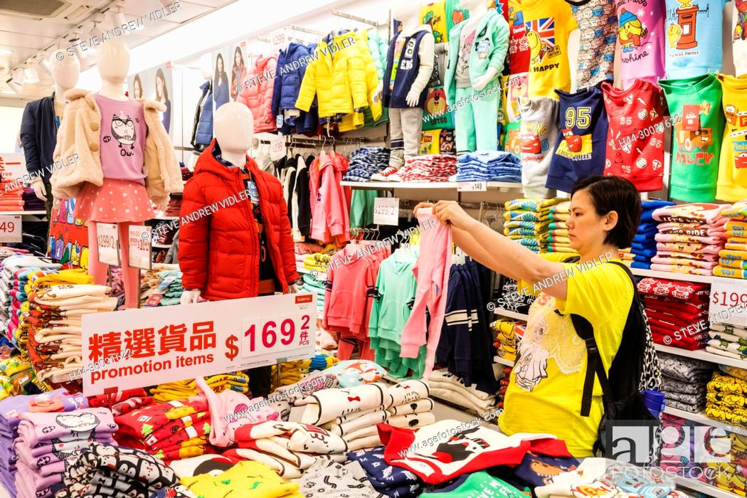
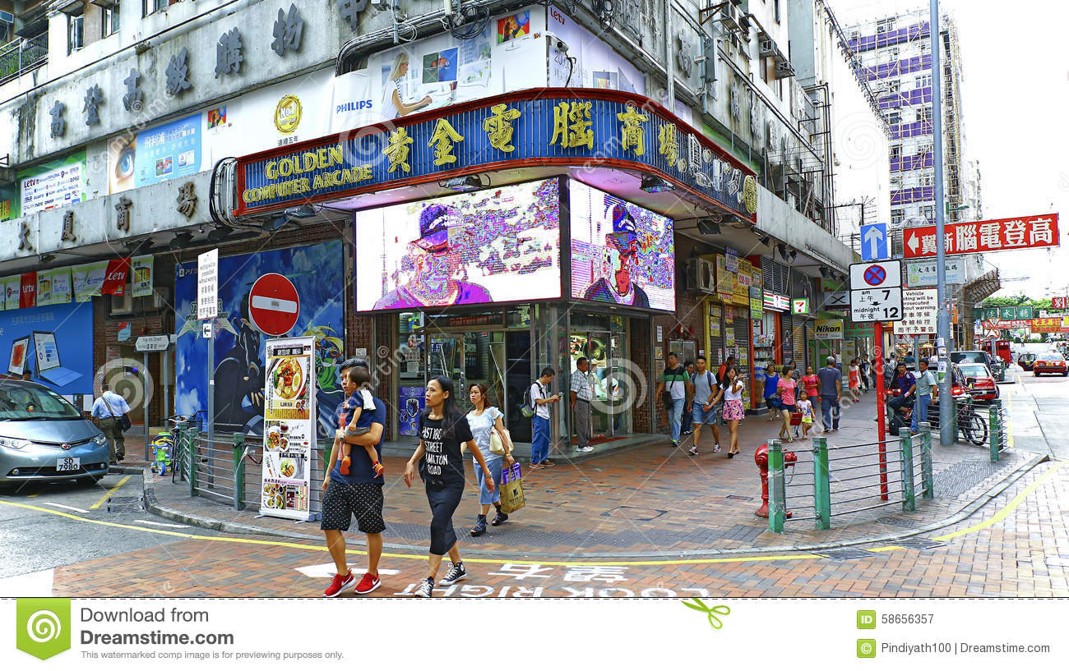
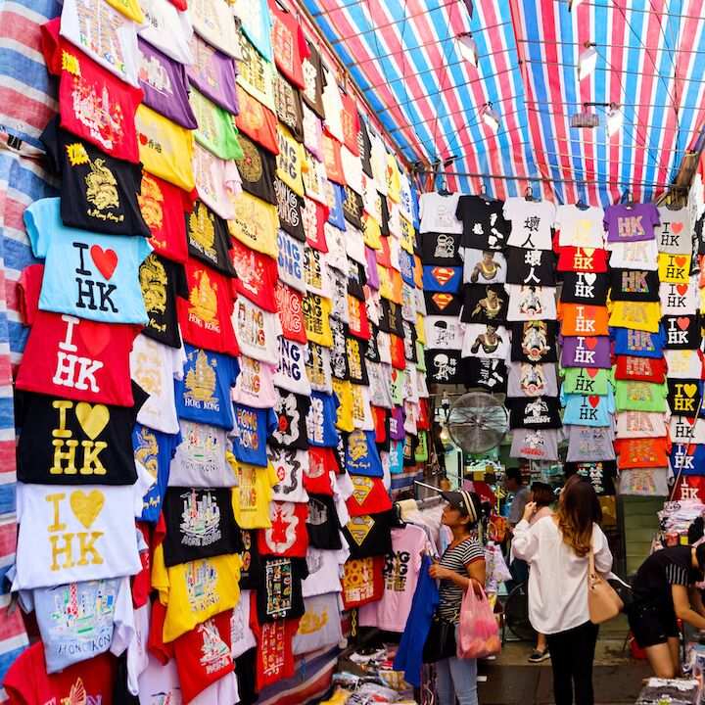
Cantonese II
Lesson 8 – Shop

Slide 2
Tone check
Si 師si1 屎si2 嗜si3 匙si4 市si5 是si6 識sek7 錫sek8 食sek9
Man 炆man1 抆man2 𠍁man3 民man4 敏man5 問man6
Baak 迫baak1 baak2 百baak3 baak4 baak5 白baak6
Piu 飄piu1 piu2 票piu3 嫖piu4 剽piu5 piu6
Fong 方fong1 訪fong2 放fong3 防fong4 fong5 fong6
Zeoi 追zeoi1 咀zeoi2 最zeoi3 zeoi4 zeoi5 聚zeoi6
Gam 今gam1 噉gam2 咁gam3 gam4 gam5 㩒gam6
Tai 梯tai1 睇tai2 剃tai3 提tai4 悌tai5 tai6
Bong 幫bong1 綁bong2 bong3 bong4 bong5 磅bong6

Slide 3
住 zyu6, continuous
1. 住 zyu6 added to a verb describes a continuous activity or state without change. It is associated with particular verbs, such as those denoting stationary situations:
架車阻住個出口◦ The car is blocking the exit
Gaa3 ce1 zo2 zyu6 go3 ceot1 hau2.
2. 諗住 – intend to, 睇住 – “look, see”
我諗住請佢哋食飯◦ I intend to invite/pay them for a meal.
Ngo5 nam2 zyu6 ceng2 keoi5 dei6 sik6 faan6.
你睇住呢兩個細路仔˒唔好畀佢哋打交◦ You keep an eye on these two kids, (and) don’t let them fight.
Nei5 tai2 zyu6 ni1 loeng5 go3 sai3 lou6 zai2, m4 hou2 bei2 keoi5 dei6 daa2 gaau1.

Slide 4
住 zyu6, continuous
3. Can be used to describe an action carried out simultaneously with another
佢望住我笑 (he/she watching me smiled → he/she smiled (while looking) at me.)
Keoi5 mong6 zyu6 ngo5 siu3
佢對住我喊 He cried at (while facing) me
Keoi6 deoi3 zyu6 ngo5 haam3.
你跟住我行 (you) walk after (following) me
Nei5 gan1 zyu6 ngo5 haang4

Slide 5
緊gan2 versus 住 zyu6
Both are progressive “-ing” forms in English.
緊gan2 is for activities involving change or movement, dynamic
住 zyu6 is for static ones
佢著緊件衫 versus 佢著住件衫
He/she is putting on clothes he/she was/is wearing clothes
Keoi6 zoek3 gan2 gin6 saam1 keoi6 zoek3 zyu6 gin6 saam1
佢攞緊啲玩具 versus 佢攞住啲玩具
He/she is fetching the toys he/she is holding the toys
Keoi6 lo2 gan2 di1 wun6 geoi6 keoi6 lo2 zyu6 di1 wun6 geoi6

Slide 6
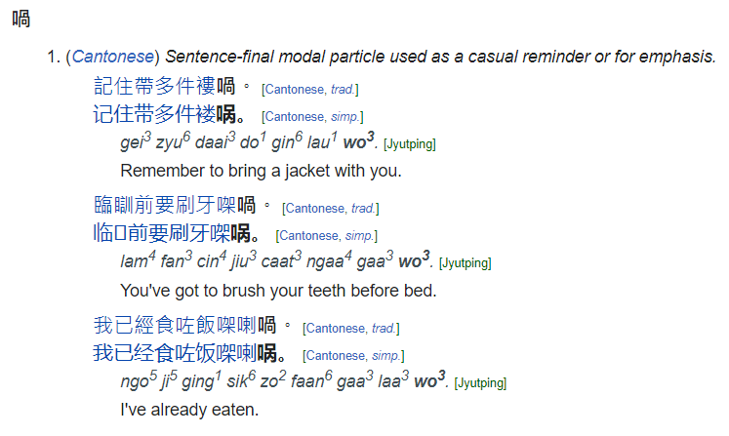
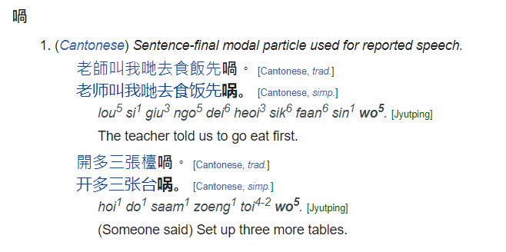
喎wo3 /wo5
wo3
wo5

Slide 7
深水埗 sam1 seoi2 bou2
旺角 wong6 gok3
尖沙咀 zim1 saa1 zeoi2
銅鑼灣 tung4 lo4 waan1

Slide 8
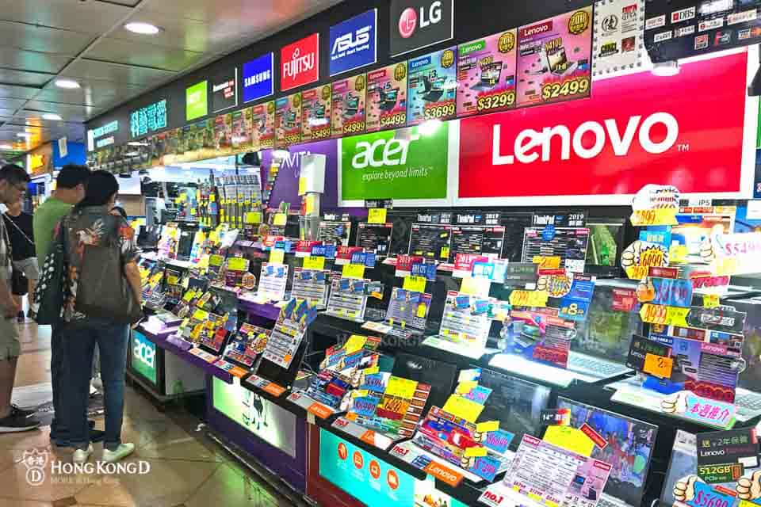
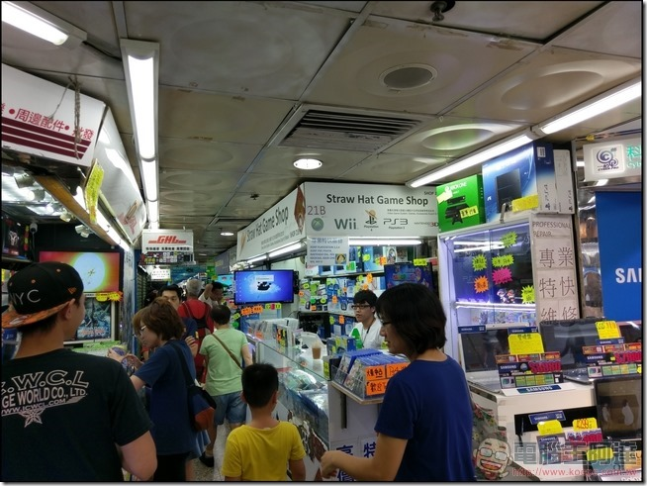
深水埗 sam1 seoi2 bou2
黃金電腦中心 wong4 gam1 din6 nou5 zung1 sam1
Golden Computer Arcade
買電子嘢 maai5 din6 zi2 je5, buy electronics-related things
買電腦嘢 maai5 din6 nou5 je5, buy computer-related things

Slide 9
買乜嘢? Maai5 mat1 je5? Buy what?
衫 saam1 clothes in general
褲 fu3 trousers
鞋 haai4 shoes
電子嘢 din6 zi2 je5 electronics-related things
電腦嘢 din6 nou5 je5 computer-related things
運動嘢 wan6 dung6 je5 sports-related things
餸 sung3 dish of food, grocery
嘢食 je5 sik6 something to eat
嘢飲 je5 jam2 something to drink
文具 man4 geoi6 stationery
書 syu1 book
電話 din6 waa2 phone
電器 din6 hei3 electrical appliance
禮物 lai5 mat6 present/gift

Slide 10
Conversation Practice – what to shop? With a friend
friend: 你想買啲咩?(what do you want to buy?)
Nei5 soeng2 maai5 di1 me2?
I: 我想去買衫◦ (I want go buy clothes)
Ngo5 soeng2 heoi3 maai5 saam1?
Friend: 你會去邊度買? (you will go where buy?)
Nei5 wui5 heoi3 bin1 dou6 maai5?
I: 我諗住去旺角買◦ (I intend go Mongkok buy.)
Ngo5 nam2 zyu6 heoi3 wong6 gok3 maai5.
Underline words are for exchangeable options
諗住 nam2 zyu6 – to plan, intend, estimate

Slide 11
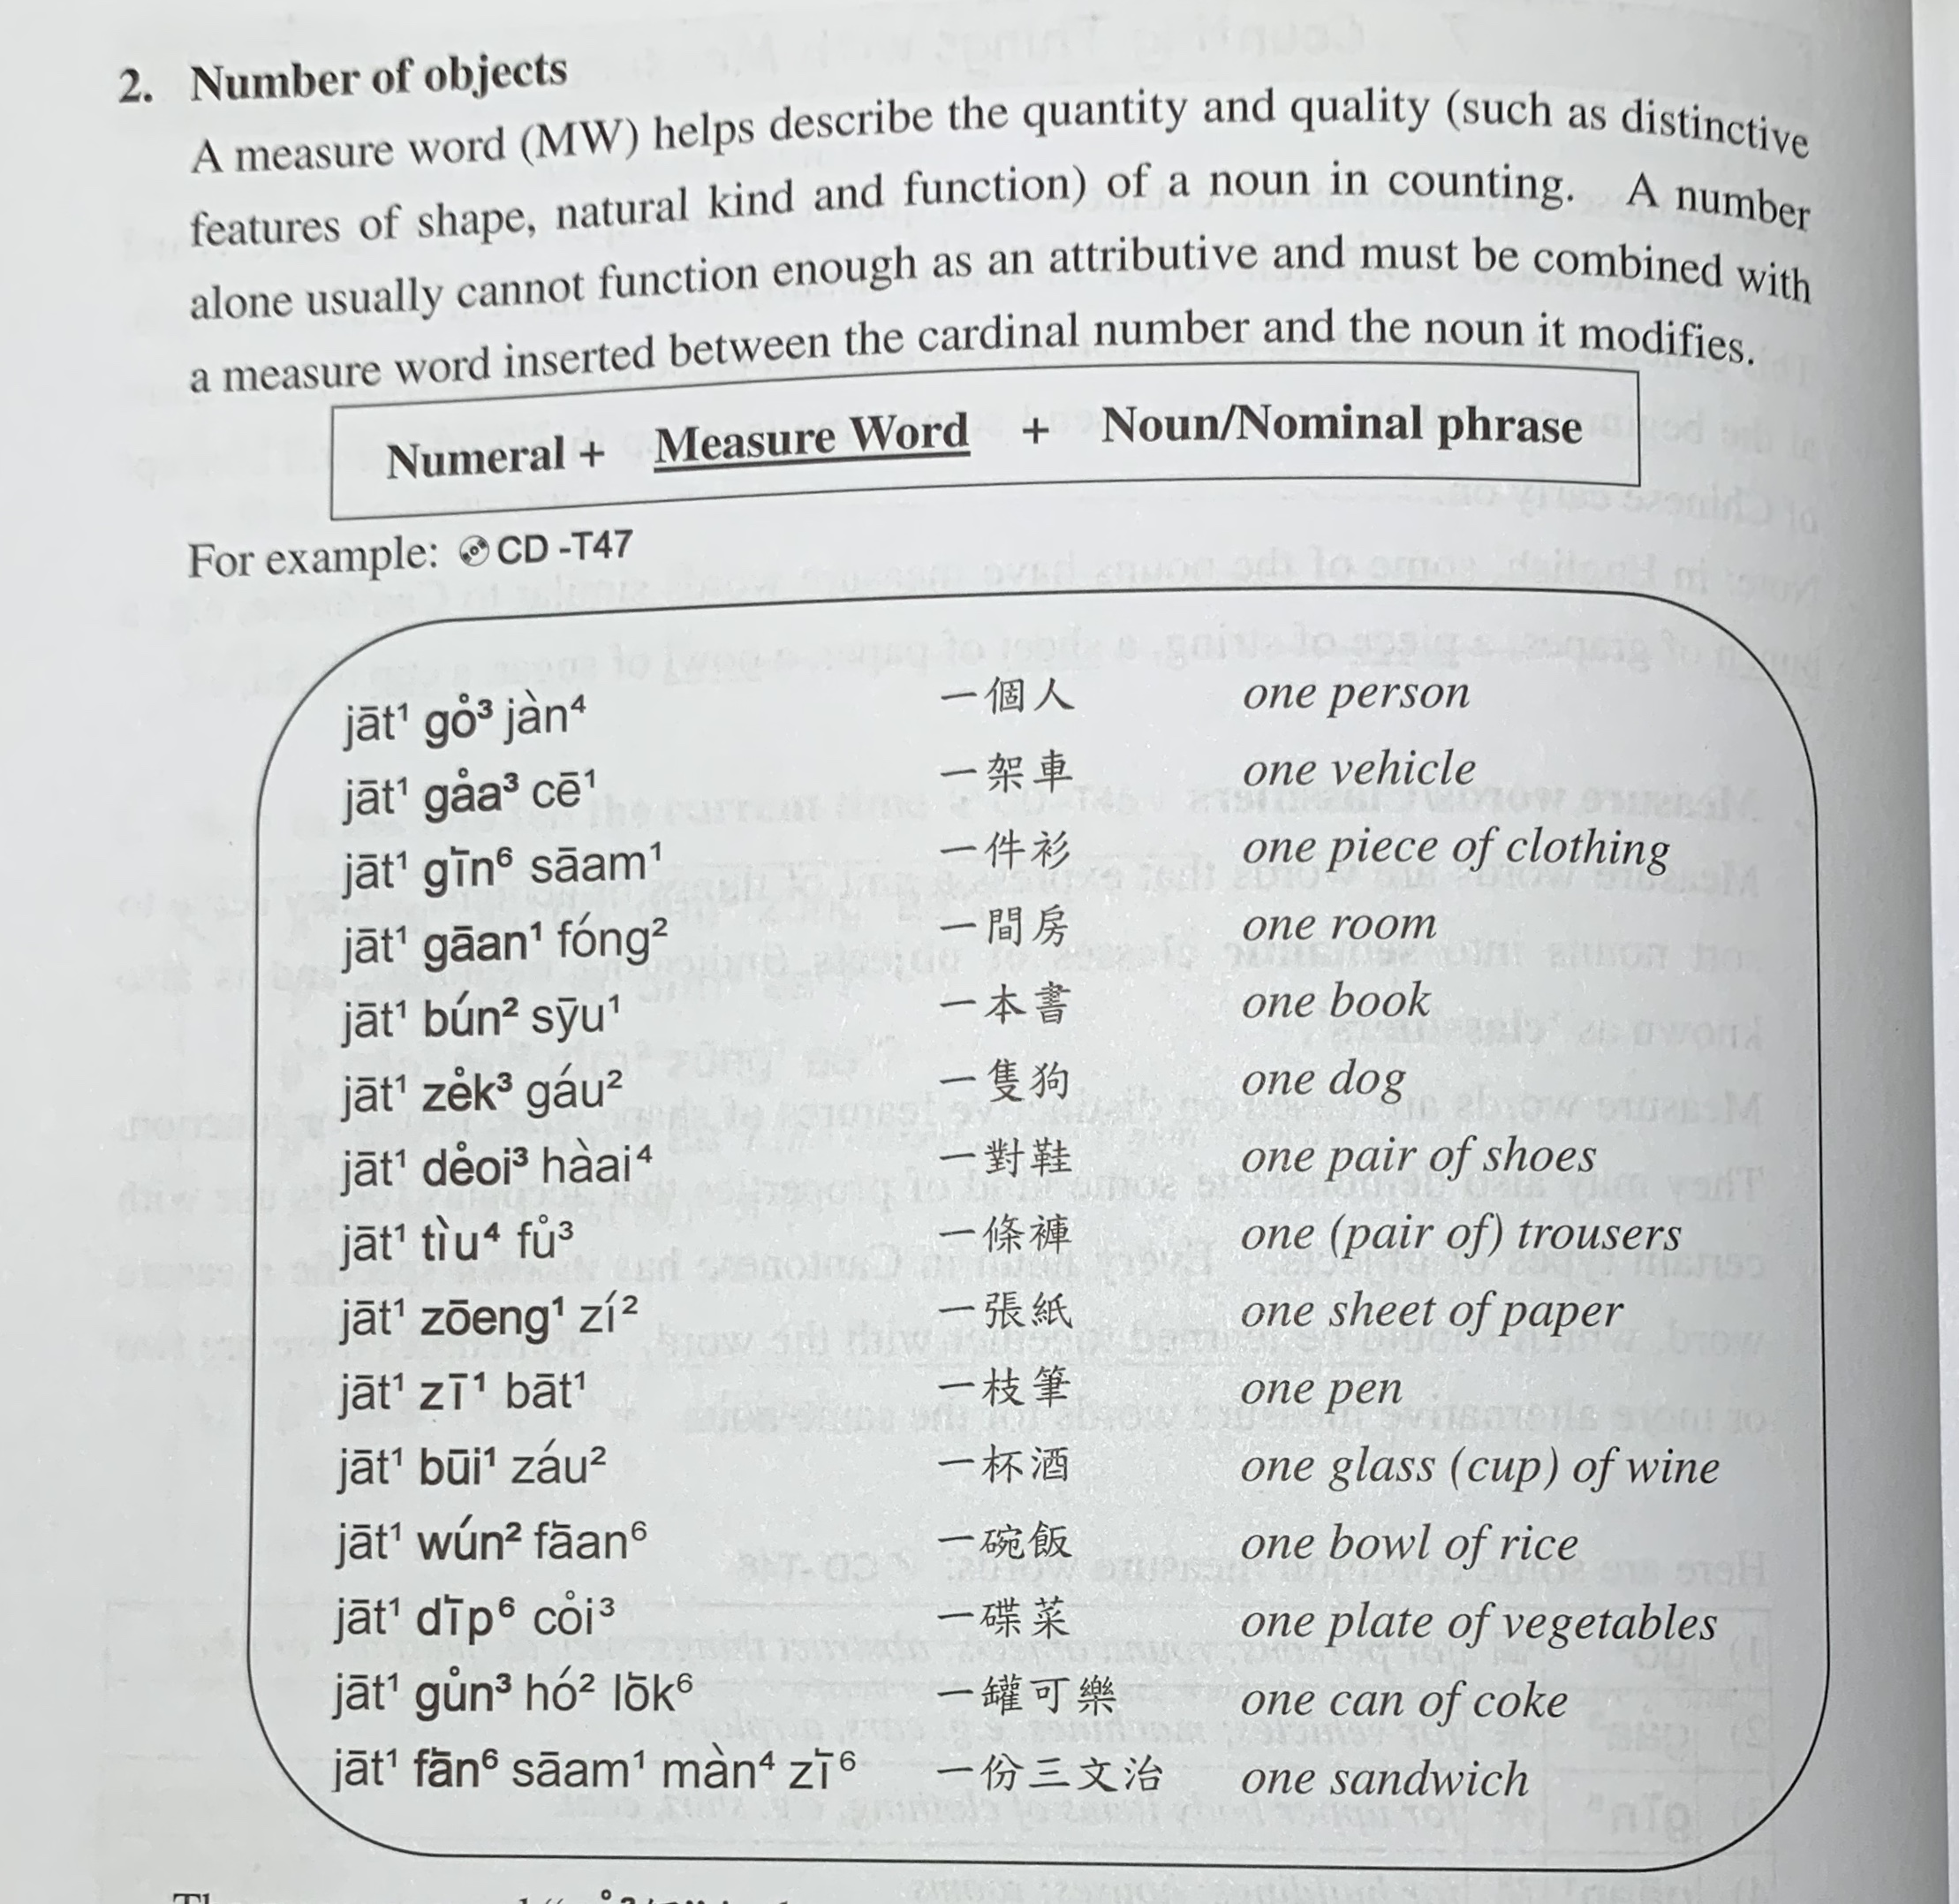

一部電話 one phone
Jat1 bou6 din6 waa2

Slide 12
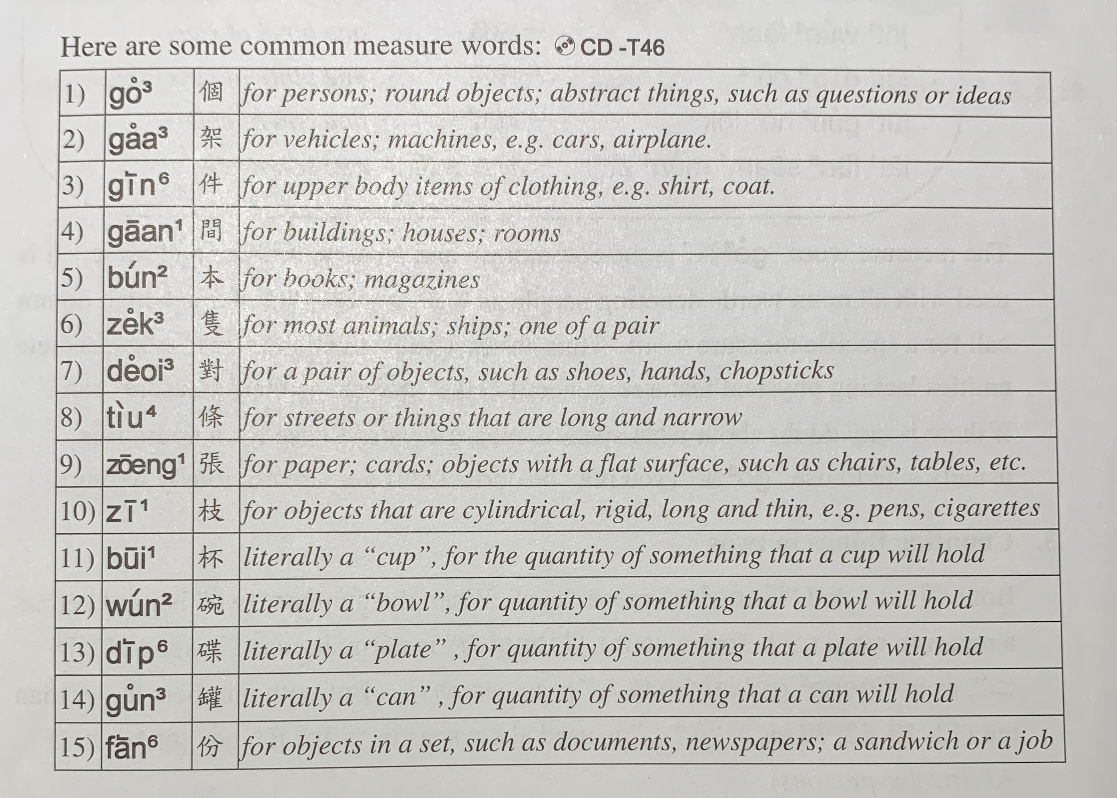

Slide 13
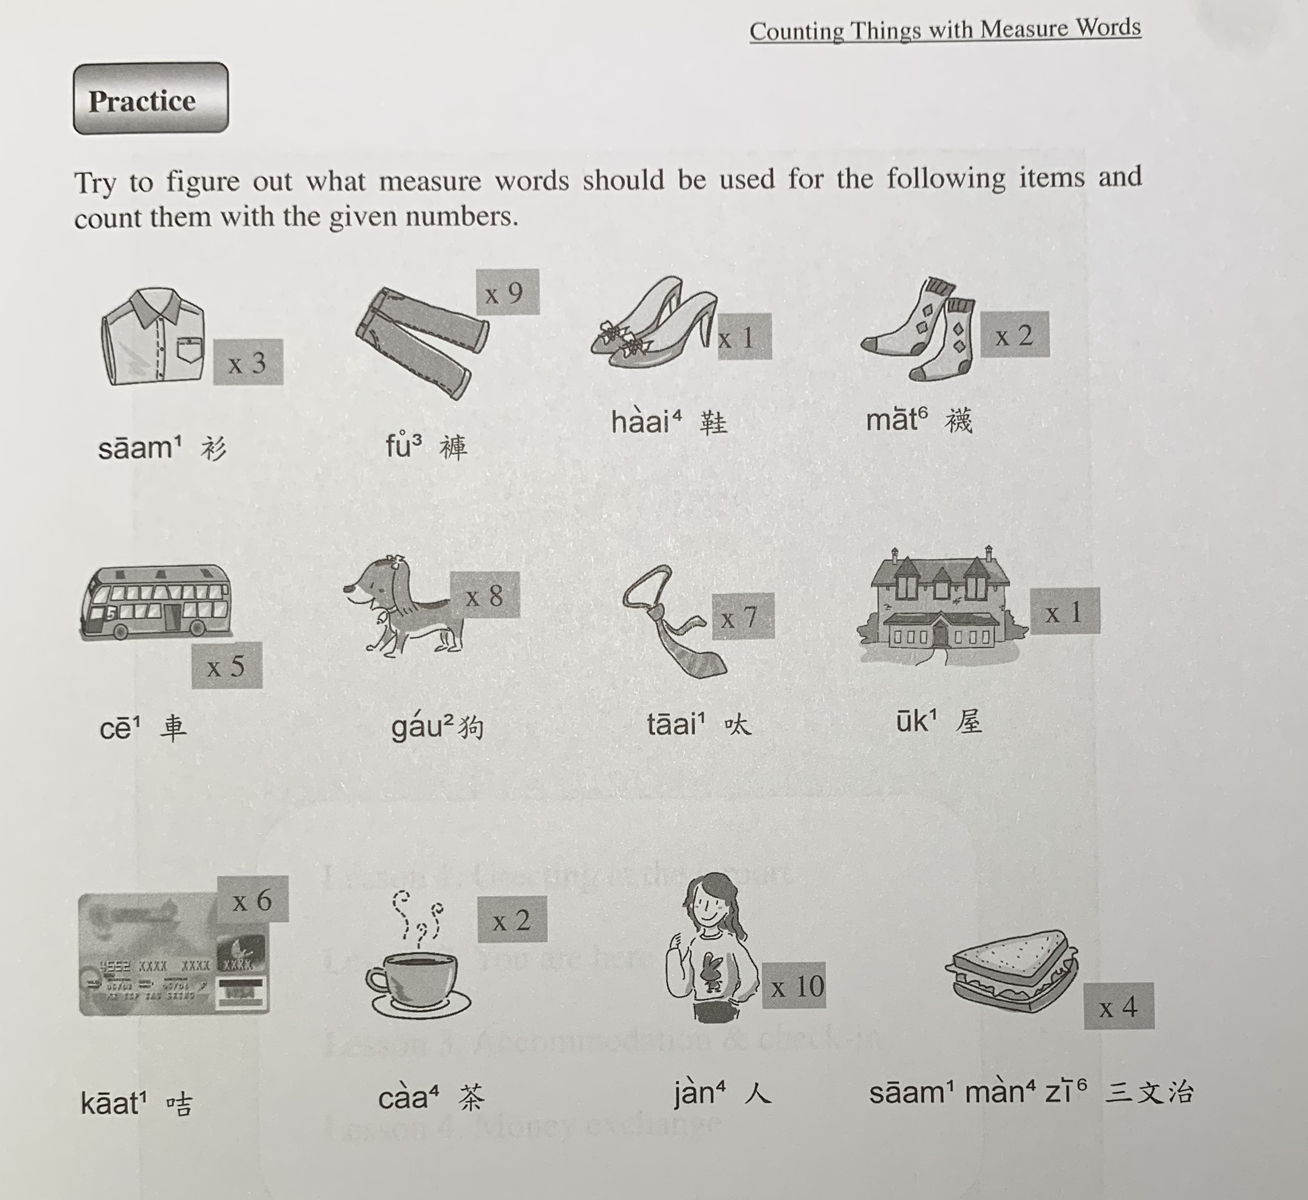

Slide 14
Conversation Practice – In shop bargaining
Shop: (我)有咩可以幫到你? ( (I) have what can help you?)
Jau5 me2 ho2 ji5 bong1 dou2 nei5?
I: 請問呢件嘢幾多錢? (please (I wanna) ask this piece of thing how much money?)
Ceng2 man6 ni1 gin6 je5 gei2 do1 cin2?
Shop: 呢件三千四百八十蚊◦ (This piece $3480)
Ni1 gin6 saam1 cin1 sei3 baak3 baat3 sap6 man1.
I: 有冇得平啲? 隔離舖賣緊三千一百咋◦ 三千得唔得呀? (have or not cheaper? Next door shop is selling $3100 zaa. $3000 can or not?)
Jau5 mou5 dak1 peng4 di1? Gaak3 lei4 pou3 maai6 gan2 saam1 cin1 jat1 baak3 zaa3. Saam1 cin1 dak1 m4 dak1 aa3?
Shop: i. 噉你過隔離舖買囉◦ / ii. 噉我三千五十蚊畀你◦ (in that case, you go next door shop lor. / in that case, I $3050 give you)
Gam2 nei5 gwo3 Gaak3 lei4 pou3 maai5 lo1. / gam2 ngo5 saam1 cin1 ng5 sap6 man1 bei2 nei5.
I: 好啦◦ (good la)
Hou2 laa1
Underline words are for exchangeable options
咋 zaa3 – merely, only
噉 gam2 – such; like this; this way; in that case
囉 lo1 lo4 lo3 - [final particle] showing argumentative mood or making emphasis; expressing a changed condition

Slide 15
More reasons for bargaining
隔離舖賣緊三千一百咋 (Next door shop is selling $3100 zaa)
Gaak3 lei4 pou3 maai6 gan2 saam1 cin1 jat1 baak3 zaa3
呢件係陳列品 (this piece is the display product)
Ni1 gin6 hai6 can4 lit6 ban2
呢件嘢花咗喎 (this piece thing is scratched already)
Ni1 gin6 je5 faa1 zo2 wo3
我唔夠錢 (I don’t have enough money)
Ngo5 m4 gau3 cin2

Slide 16
Gau1 Lan2 Cat6 Hai1
架車阻X住個出口◦
Gaa3 ce1 zo2 X zyu6 go3 ceot1 hau2.
你睇X住呢兩個細路仔˒唔好畀佢哋打交◦
Nei5 tai2 X zyu6 ni1 loeng5 go3 sai3 lou6 zai2, m4 hou2 bei2 keoi5 dei6 daa2 gaau1.
佢望X住我笑 佢對X住我喊
Keoi5 mong6 X zyu6 ngo5 siu3 Keoi6 deoi3 X zyu6 ngo5 haam3.
你跟X住我行 佢著X緊件衫
Nei5 gan1 X zyu6 ngo5 haang4 Keoi6 zoek3 X gan2 gin6 saam1
Keywords: X = 𨳊gau1, 𨶙lan2, 𨳍cat6, 閪hai1

