Slide 1
Cantonese II
Lesson 9 – gossip, adjectives, people

Slide 2
Tone check questions
Si 師si1 屎si2 嗜si3 匙si4 市si5 是si6 識sek7 錫sek8 食sek9
抆man 問man
百baak 白baak
票piu 飄piu
方fong 放fong
最zeoi 聚zeoi
咁gam 㩒gam
提tai 睇tai
鵰diu 𨳒diu
係hai 喺hai 閪hai
上soeng 想soeng
焚fan 奮fan 婚fan 瞓fan 粉fan 分fan
夏haa 霞haa 蝦haa

Slide 3
Tone check answer
Si 師si1 屎si2 嗜si3 匙si4 市si5 是si6 識sek7 錫sek8 食sek9
抆man2 問man6
百baak3 白baak6
票piu3 飄piu1
方fong1 放fong3
最zeoi3 聚zeoi6
咁gam3 㩒gam6
提tai4 睇tai2
鵰diu1 𨳒diu2
係hai6 喺hai2 閪hai1
上soeng6 想soeng2
焚fan4 奮fan5 婚fan1 瞓fan3 粉fan2 分fan1
夏haa6 霞haa4 蝦haa1

Slide 4
Negative Adjectives/Verbs
Negative adjectives to people
人渣 jan4 zaa1; literally: residue of human → scumbag
賤格 zin6 gaak3; despicable
賤人 zin6 jan4; low-life, despicable person
仆街 puk1 gaai1; bastard
唔老實 m4 lou5 sat6; not honest
廢 fai3, good-for-nothing
假 gaa2; untrue
Negative action/verb
呃人 aak1/ngaak1 jan4; cheat people
搞亂檔 gaau2 lyun6 dong3; stir/mess up “the store” (things)
幫唔到手 bong1 m4 dou3 sau2; doesn’t help
做錯 zou6 co3; to make a mistake
講錯嘢 gong2 co3 je5; say wrong things
扮嘢 baan6 je5; behave pretentiously; strike an attitude
成日講錯嘢 seng4 jat6 gong2 co3 je5, always say the wrong things

Slide 5
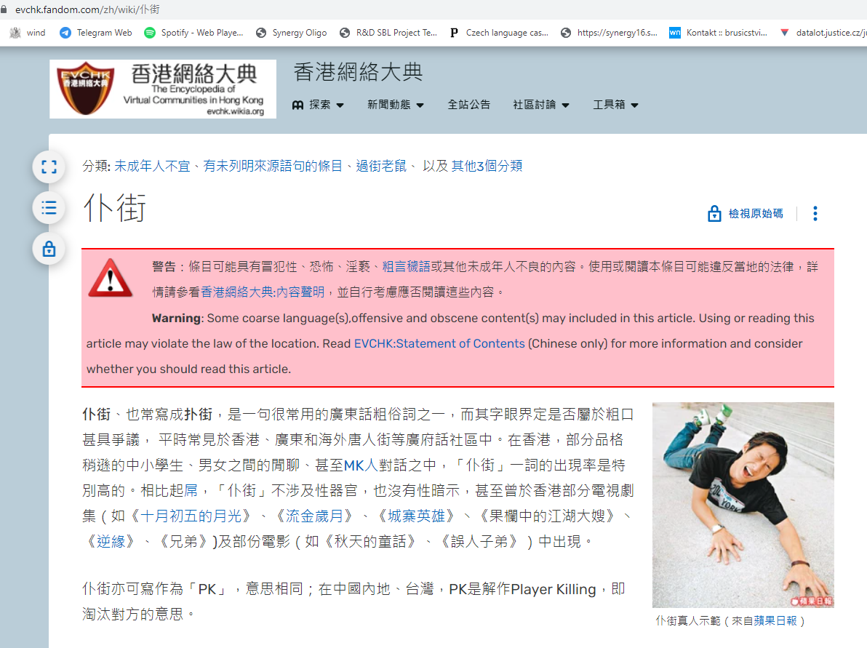
Puk1 gaai1 (epic fail)
https://evchk.fandom.com/zh/wiki/%E4%BB%86%E8%A1%97

Slide 6
咪 mai5
(Verb) don’t; shouldn’t; mustn’t
= 唔好 m4 hou2
Imperative
咪呀! Mai5 aa3! Don’t aa! → Don’t do that
咪啦! Mai5 laa3! Don’t laa! → Don’t do that
咪噉啦! mai5 gam2 laa1! Don’t be like that la!

Slide 7
Negative adj/verb→ Imperative Don’t be
Negative adjectives to people
- 咪噉人渣啦! mai5 gam2 jan4 zaa1 laa1 or 3!
Don’t be a scumbag laa!
- 咪噉賤格啦! mai5 gam2 zin6 gaak3 laa1 or 3!
Don’t be despicable laa!
- 咪噉賤人啦! mai5 gam2 zin6 jan4 laa1 or 3!
Don’t be a despicable person laa!
- 咪噉仆街啦! mai5 gam2 puk1 gaai1 laa1 or 3!
Don’t be a bastard laa!
- 咪噉唔老實啦! mai5 gam2 m4 lou5 sat6 laa1 or 3!
Don’t be dishonest laa!
-咪噉廢啦! mai5 gam2 fai3 laa1 or 3!
Don’t be good-for-nothing laa!
-咪噉假啦! mai5 gam2 gaa2 laa1 or 3!
Don’t be untrue laa!
Negative action/verb
-咪呃人啦! mai5 aak1/ngaak1 laa1 or 3!
Don’t cheat cheat people laa!
-咪搞亂檔啦! mai5 gaau2 lyun6 dong3 laa1 or 3!
Don’t stir/mess up “the store” (things) laa!
-咪幫唔到手啦!咪bong1 m4 dou3 sau2 laa1 or 3!
Don’t doesn’t help laa! (doesn’t work with negation)
-咪做錯啦! mai5 zou6 co3 laa3!;
Don’t make a mistake laa!
-咪講錯嘢啦! mai5 gong2 co3 je5 laa 1 or 3!
Don’t say wrong things laa!
-咪扮嘢啦! mai5 baan6 je5 laa 1 or 3!
Don’t pretend laa!
-咪成日講錯嘢啦! mai5 seng4 jat6 gong2 co3 je5 laa1 or 3!
Don’t always say the wrong things laa!
啦 laa1 - Emphasis, serious warning with a bit violent way.
啦 laa3 - a mild advice, tip, a kind reminder

Slide 8
Negative adj/verb → Imperative +𨶙Lan2
Negative adjectives to people
- 咪𨶙噉人渣啦! Mai5 lan2 gam2 jan4 zaa1 laa 1 or 3!
Don’t fucking be a scumbag laa!
- 咪𨶙噉賤格啦! mai5 lan2 gam2 zin6 gaak3 laa 1 or 3!
Don’t fucking be despicable laa!
- 咪𨶙噉賤人啦! mai5 lan2 gam2 zin6 jan4 laa1 or 3!
Don’t fucking be a despicable person laa!
- 咪𨶙噉仆街啦! mai5 lan2 gam2 puk1 gaai1 laa1 or 3!
Don’t fucking be a bastard laa!
- 咪𨶙噉唔老實啦! mai5 lan2 gam2 m4 lou5 sat6 laa1 or 3!
Don’t fucking be dishonest laa!
-咪𨶙噉廢啦! mai5 lan2 gam2 fai3 laa1 or 3!
Don’t fucking be good-for-nothing laa!
-咪𨶙噉假啦! mai5 lan2 gam2 gaa2 laa1 or 3!
Don’t fucking be untrue laa!
Negative action/verb
-咪𨶙呃人啦! mai5 lan2 aak1/ngaak1 jan4 laa 1 or 3!
Don’t fucking cheat cheat people laa!
-咪𨶙搞亂檔啦! mai5 lan2 gaau2 lyun6 dong3 laa1 or 3!
Don’t fucking stir/mess up “the store” (things) laa!
-咪𨶙幫唔到手啦! mai5 lan2 bong1 m4 dou3 sau2 laa1!
Don’t fucking doesn’t help laa! (doesn’t work with negation)
-咪𨶙做錯啦! mai5 lan2 zou6 co3 laa 1 or 3!;
Don’t fucking make a mistake laa!
-咪𨶙講錯嘢啦! mai5 lan2 gong2 co3 je5 laa 1 or 3!
Don’t fucking say wrong things laa!
-咪𨶙扮嘢啦! mai5 lan2 baan6 je5 laa 1 or 3!
Don’t fucking pretend laa!
-咪𨶙成日講錯嘢啦! mai5 lan2 seng4 jat6 gong2 co3 je5 laa 1 or 3!
Don’t fucking always say the wrong things laa!
啦 laa1 - Emphasis, serious warning with a bit violent way.
啦 laa3 - a mild advice, tip, a kind reminder

Slide 9
Positive Adjectives/Verb
Positive adjectives to people
好人 hou2 jan4; good (kind) person
肯幫人 hang2 bong1 jan4; willing to help
心地好 sam1 dei2 hou2; with good intention/mind/inner-conscience
做到嘢 zou6 dou2 je5; able to achieve
老實 lou5 sat6; honest
啱feel; ngaam1 feel; feels right
啱傾 ngaam1 king1; right talk → interested in the same topic
真心 zan1 sam1; sincere, heartfelt
識講嘢 sik1 gong2 je5; know how to speak
Positive action/verb
幫手 bong1 sau2; help
唔呃人m4 aak1/ngaak1 jan4; not to cheat people
唔搞亂檔 m4 gaau2 lyun6 dong3; not to stir/mess up the store
做啱 zou6 ngaam1; do correctly
圓滑 jyun4 waat6; tactful, smooth

Slide 10
Vocabulary of people
同學 tung4 hok6, classmates/schoolmates
老師 lou5 si1, teachers
大學 daai6 hok6, university
學校 hok6 haau6; school/institutes
同事 tung4 si6; co-worker
媽媽 maa4 maa1; mother
爸爸 baa4 maa1; father
大佬 daai6 lou2; elder brother
細佬 sai3 lou2; younger brother
親戚 can1 cik1; relatives
老細 lou5 sai3; boss/manager/owner
朋友 pang4 jau5; friend(s)
好朋友 hou2 pang4 jau5; good friend(s)
男朋友 naam4 pang4 jau5; boyfriend
女朋友 neoi5 pang4 jau5; girlfriend

Slide 11
Conversation Practice – gossip description of personality
Friend: 你媽媽個人點㗎? (your mother personality how gaa?)
Nei5 maa4 maa1 go3 jan4 dim2 gaa3?
I: 佢平時好好人嘅˒仲好識講嘢◦ (she usually very good kind ge, also very know how to speak)
Keoi5 ping4 si4 hou2 hou2 jan4 ge3, zung6 hou2 sik1 gong2 je5.
Underline words are for exchangeable options
㗎 – gaa2 gaa3 gaa4; final particle for making a strong assertion
仲 – zung6; also

Slide 12
Conversation Practice – gossip negative
Friend: 你最近點呀? (you recently how aa?)
Nei5 zeoi3 gan6 dim2 aa3?
I: 最近一般啦◦ 同朋友出咗問題◦ (recently so so laa. With friend, happened issues)
Zeoi3 gan6 jat1 bun1 laa1. tung4 pang4 jau5 ceot1 zo2 man6 tai4.
Friend: 你朋友做咗啲咩? (your friend did D what? → what did your friend did?)
Nei5 pang4 jau5 zou6 zo2 di1 me1?
I: 佢呃人◦ (he/she cheated)
Keoi5 ngaak1 jan4.
Friend: 佢平時個人點㗎? (he/she normal-time person how gaa? → how is his/her personality normally)
Keoi5 ping4 si4 go3 jan4 dim2 gaa3?
I: 佢平時唔老實◦ (he/she normal-time not honest)
Keoi5 ping4 si4 m4 lou5 sat6.
Friend: 咁我明白嘅◦ 睇開啲啦! (in this case I understand ge. See open D laa)
Gam2 ngo5 ming4 baak6 gee3. Tai2 hoi1 di1 laa1!
Underline words are for exchangeable options
㗎 – gaa2 gaa3 gaa4; final particle for making a strong assertion
嘅 – ge3 ge2; adjective suffix; possessive/final particle
平時 – ping4 si4; literally: normal-time, meaning: usually

Slide 13
Slang – 有咗 jau5 zo2
Literally: had
Meaning: be pregnant
Example:
𨳒!有咗! 仆街啦! (Fuck! Pregnant! Screwed up!)
Diu2! Jau5 zo2! Puk1 gaai1 laa3!

