Slide 1
Cantonese II Lesson 10 – Dream, Life

Slide 2
人生目標/理想 jan4 sang1 muk6 biu1/lei5 soeng2 “life goals/ideal”
結婚 git3 fan1, to marry/marriage
生仔 saang1 zai2, give birth
事業 si6 jip6, career
賺錢 zaan6 cin2, earn money
買樓 maai5 lau2, buy a property
買跑車 maai5 paau2 ce1, buy a sports car
畢業 bat1 jip6, to graduate
追求自由 zeoi1 kau4 zi6 jau4, chase for freedom
周圍去 zau1 wai4 heoi3, go around
學新嘢 hok6 san1 je5, learn new things
發現新事物 faat3 jin6 san1 si6 mat6, discover new things
我想…
ngo5 soeng2…
I want…
我唔想…
Ngo5 m4 soeng2…
I don’t want…

Slide 3
人生目標/理想 jan4 sang1 muk6 biu1/lei5 soeng2 “life goals/ideal”
成為作家 sing1 wai4 zok3 gaa1, become a writer
做有錢人 zou6 jau5 cin2 jan4, be a rich man/woman
玩音樂 waan2 jam1 ngok6, play music
出名 ceot1 meng2, be famous
住喺森林 zyu6 hai2 sam1 lam4, live in forest
逃脫 tou4 tyut3, escape
脫苦 tyut3 fu2, escape from pain/suffer
唔做寫字樓工 m4 zou6 se2 zi6 lau4 gung1, not work for office work
有一個花園 jau5 jat1 go3 faa1 jyun2, have a garden
提早退休 tai4 zou2 teoi3 jau1, early retire
我想…
ngo5 soeng2…
I want…
我唔想…
Ngo5 m4 soeng2…
I don’t want…

Slide 4
Conversation Practice – gossip description of personality
Friend: 你有啲咩人生目標㗎? (You have D what life goals gaa?)
Nei5 jau5 di1 jan4 sang1 muk6 biu1 gaa3?
I: 我想結婚˒生仔˒買樓呀◦ (I want marry, give birth, buy apartment aa.)
Ngo5 soeng2 git3 fan1, saang1 zai2, maai5 lau2 aa3.
Friend: 點解你想結婚˒生仔˒買樓呀? (Why you want marry, give birth, buy apartment aa?)
Dim2 gaai2 nei5 soeng2 git3 fan1, saang1 zai2, maai5 lau2 aa3?
I: 我覺得噉樣開心囉◦ (I feel this way happy lo)
Ngo5 gok3 dak1 gam2 joeng2 hoi1 sam1 lo1.
Underline words are for exchangeable options
呀 aa3, aa4, aa5, aa1
(jyutping) aa3 -- [1] final particle used to soften an abrupt question/statement, act as reminder and make emphasis; [2] pause particle in enumerating items
(jyutping) aa4 -- interrogative particle used to get confirmation or clarify a doubt, show skepticism or surprise
(jyutping) aa5 -- interrogative particle used in rhetorical question
(jyutping) aa1 -- variant of 吖

Slide 5
Passives
Cantonese passives are signaled by a 畀bei2 phrase similar to the English by phrase. The 畀bei2 phrase (畀bei2 + a noun phrase indicating the agent of the action) occurs before the verb:
啲雪糕畀啲細路仔食咗 di1 syut1 gou1 bei2 di1 sai3 lou6 zai2 sik6 zo2
(lit. the ice cream by the children eaten.)
The ice cream was eaten by the children.
本書畀個學生借咗 bun2 syu1 bei2 go3 hok6 saang1 ze3 zo2
The book was borrowed by a student
When the identity of the agent is unknown or left unspecified, the word 人jan4 person or 嘢je5 “thing” is used generically:
我個銀包畀人偷咗 ngo5 go3 ngan4 baau1 bei2 jan6 tau1 zo2
My wallet was stolen (by somebody unspecified).
我畀嘢咬親 ngo5 bei2 je5 ngaau5 can1
I’ve been bitten (by something unspecified).

Slide 6
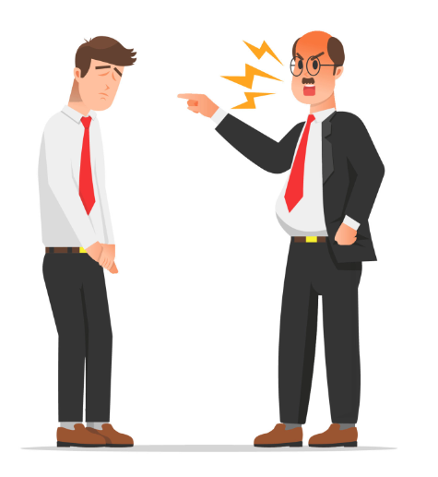
Passives
Friend: 你好嗎?今日點呀?
Nei5 hou2 maa3? gam1 jat6 dim2 aa3?
you good? today how aa?
I: 唉◦我今日又畀老闆𨳒 ◦
Aai1. ngo5 gam1 jat6 jau6 bei2 lou5 baan2 diu2.
Sigh…I today again got fucked by boss

Slide 7
人生哲學 jan4 sang1 zit3 hok6
我覺得最緊要係…
ngo5 gok3 dak1 zeoi3 gan2 jiu3 hai6…
I think that the most important is…
人一世 物一世* jan4 jat1 sai3 mat6 jat1 sai3 man one life, object one life
做人做得開心 zou6 jan4 zou6 dak1 hoi1 sam1 have a happy life
尋找自己 cam4 zaau2 zi6 gei2 find/search myself
夠錢生活就足夠 gau2 cin2 sang1 wut6 zau6 zuk1 gau3 “Enough money to live” is enough
不求富貴 bat1 kau4 fu3 gwai3 not look for rich/wealth
愛與和平 oi3 jyu5 wo4 ping4 love and peace
自由 zi6 jau4 freedom
幫人 bong1 jan4 help people
挑戰自己 tiu1 zin3 zi6 gei2 challenge myself
如水 jyu4 seoi2 be water

Slide 8
人生哲學 jan4 sang1 zit3 hok6
我覺得最緊要係…
ngo5 gok3 dak1 zeoi3 gan2 jiu3 hai6…
I think that the most important is…
平等 ping4 dang2 equality
死得眼閉 sei2 dak1 ngaan5 bai3 die with closed eyes (die with no regrets)
有美好回憶 jau5 mei5 hou2 wui4 jik1 have beautiful good memory
唔信宗教 m4 seon3 zung1 gaau3 not believe in religions
唔好人做我又做 m4 hou2 jan4 zou6 ngo5 jau6 zou6 don’t others do I also do the same (don’t just follow what others do)
唔好畀人指手畫腳 m4 hou2 bei2 jan4 zi2 sau2 waak6 goek3 (lit. not good let others point finger draw feet.) Don’t let others tell you want to do.
唔好做工作狂 m4 hou2 zou6 gung1 zok3 kong4 don’t be a workaholic

Slide 9
挑戰 tiu1 zin3 challenge
要擺脫童年陰影 break away from childhood “shadow” (trauma)
jiu3 Baai2 tyut1 tung4 nin4 jam1 jing2
會畀人批評 wui5 bei2 jan4 pai1 ping4 will be criticised
會畀人罰 wui5 bei2 jan4 fat6 will be punished
要原諒自己 jiu3 jyun4 loeng6 zi6 gei2 need to forgive myself
會失敗 wui5 sat1 baai6, will fail
會餓死 wui5 ngo6 sei6, will starve to death

Slide 10
Conversation Practice – “life idealism/philosophy”
Friend: 你有啲咩人生哲學呢? You have D what life goal ne?
Nei5 jau5 di1 me1 jan4 sang1 zit3 hok6 ne1?
I: 我覺得做人最緊要係開心◦ 唔好做工作狂◦ I think being a person the most important is being happy. Don’t be a workaholic.)
ngo5 gok3 dak1 zou6 jan4 zeoi3 gan2 jiu3 hai6 hoi1 sam1. m4 hou2 zou6 gung1 zok3 kong4.
夠錢生活就足夠◦有美好回億◦死得眼閉◦ enough money to live is enough. Have a beautiful memory. Die with eyes closed.
gau2 cin2 sang1 wut6 zau6 zuk1 gau3. sei2 dak1 ngaan5 bai3
Friend: 你覺得有咩挑戰? you think what challenges (you will come across)?
Nei5 gok3 dak1 jau5 me1 tiu1 zin3?
I: 我覺得可能會餓死◦ I think perhaps will starve to death.
Ngo5 gok3 dak1 ho2 nang4 wui5 ngo6 sei6.
Underline words are for exchangeable options

Slide 11
Movie <<激戰>>
https://www.youtube.com/watch?v=5oFEaoUoM3M
0:55-1:22
我呢廿幾年乜都冇做過呀! I these 20+ years have done nothing aa!
Ngo5 ni1 jaa6 gei2 nin4 mat1 dou1 mou5 zou6 gwo3 aa3!
我唔想到熄燈嗰陣˒我連一件值得記得嘅事都冇呀! I don’t want when “my light” switches off, I don’t even remember one thing.
Ngo5 m4 soeng2 dou3 sik1 dang1 go2 zan6, ngo5 lin4 jat1 gin6 zik6 dak1 gei3 dak1 ge3 si6 dou1 mou5 aa3!
我仲有嘢輸咩? I still can lose?
Ngo5 zung6 jau5 je5 syu1 me1?
唔緊要啦! 贏又好˴輸又好◦啲嘢都返唔到嚟啦◦ not important la! No matter win, or less. Thins won’t come back la
M4 gan2 jiu3 laa3! Jeng4 jau6 hou2˴syu1 jau6 hou2. di1 je5 dou1 faan1 m4 dou2 lei4 laa3.
其實我同阿齊都一樣之嘛◦只係想為自己做返一件事啫◦ in fact, I and Ar Chai also only the same. Only want to do one thing for ourselves
Kei4 sat5 ngo5 tung5 aa3 cai4 dou1 jat1 joeng6 zi1 maa3. zi2 hai6 soeng2 wai4 zi6 gei2 zou6 faan1 jat1 gin6 si6 ze1
之嘛 zi1 maa3 – (model particle) only; that’s all
啫 ze1 - [final particle] merely, only, that's all (used mainly to play down a fact and convey a sense of reassurance)
值得 zik6 dak1 – worthy

Slide 12
Song list
林奕匡 Phil - 高山低谷 (about pushing through the setback in life)
https://youtu.be/VqnpLbr1zJs
RubberBand -發現號 (about discovery of the unknowns)
https://youtu.be/wZD_qQ81l3Q
Mr. - 人一世物一世 (about YOLO)
https://youtu.be/eYKyQn2W2tw
方皓玟 - 你是你本身的傳奇 (you are the legend yourself. kind to summarize some common hardships in hong kong life and encourage audience)
https://youtu.be/tmmliJjsizc
謝安琪 Kay Tse - 山林道 (About fighting challenges and stick to the original initiatives)
https://youtu.be/92umHyOJ8Yg
Beyond - 海闊天空 (about the process and challenges while chasing for freedom, peave and love)
https://youtu.be/Px4VMWBEmuU
LMF - 大懶堂 (one of the legendary rap in Hong Kong. About being lazy. Do nothing.)
https://youtu.be/jECZQPP4azc

Slide 13
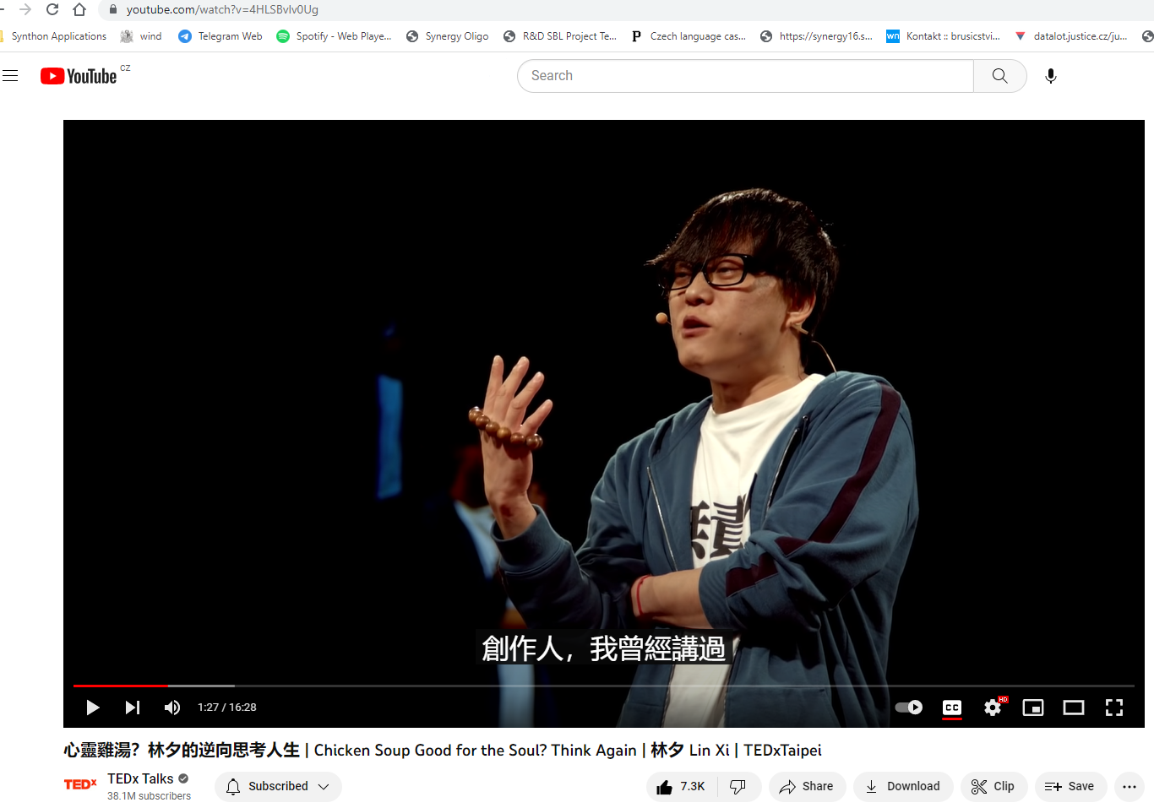
In “mandarin” Chinese,
Talk about how to escape from anxiety in life.
One of the most famous Cantonese pop lyrics writer
https://www.youtube.com/watch?v=4HLSBvlv0Ug
Notes:
Be water bruce lee https://youtu.be/cJMwBwFj5nQ

