Slide 1
Cantonese II
Lesson 11
Review

Slide 2
Question phrases
verb
食乜嘢? Sik6 mat1/mi1/me1 je5? (eat what things?)
做乜嘢? Zou6 mat1 je5? (do what things?)
聽乜嘢? Teng1 mat1 je5? (hear what things?)
睇乜嘢? Tai2 me1 je5? (see what things?)
去邊度? Heoi3 bin1 dou6? (go where?)
邊個? Bin1 go3? (who?)
點解? Dim2 gaai2 (how explain? → why?)
點樣? Dim2 jeong2? (how?)
幾時? Gei2 si4? (how time → when?)
幾多? Gei2 do1? (how many?)

Slide 3
Auxiliary verbs
Negation +唔 m4
會 wui5 will, would →唔會
可以 ho2 ji5 can, may →唔可以
識 sik1 know (how to) →唔識
應該 jing1 goi1 should, ought to →唔應該
需要/要 seoi1 jiu3/jiu3 want, need →唔需要/唔要
想 soeng2 want to →唔想

Slide 4
Combination: auxiliary verb x question phrase
你會食乜嘢? Nei5 wui5 sik6 mat1 je5? (you will eat what thing?)
你會去邊度? Nei5 wui5 heoi3 bin1 dou6? (you will go where?)
我可以食乜嘢? Ngo5 ho2 ji5 sik6 mat1 je5? (I can eat what thing?)
我可以去邊度? Ngo5 ho2 ji5 heoi3 bin1 dou6? (I can go where?)
我可以點樣? ngo5 ho2 ji5 dim2 joeng2? (I can how? -> “what should I do?”)
你可以幾時? Nei5 ho2 ji5 gei2 si4? (you can when?)
你識唔識佢係邊個? Nei5 sik1 m4 sik1 keoi5? (you know or not know he/she is who?)
你識唔識點解? Nei5 sik1 m4 sik1 dim2 gaai2? (you know or not know why?)
你識講乜嘢話? Nei5 sik1 gong2 mat1 je5 waa2? (you know speak what language?)

Slide 5
Combination: auxiliary verb x question phrase
我應該坐乜嘢車? Ngo5 jing1 goi1 co5 mat1 je5 ce1? (I should sit what thing car?)
我應該去邊度? Ngo5 jing1 goi1 heoi3 bin1 dou6? (I should go where?)
我應該點樣? Ngo5 jing1 goi1 dim2 joeng2? (I should how?)
我應該要幾多杯? Ngo5 jing1 goi1 jiu3 gei2 do1 bui1? (I should need how many cups?)
你要一個乜菜? Nei5 jiu3 jat1 go3 mat1 coi3? (you need one piece what “vegetable” dish?)
你要去邊度? Nei5 jiu3 heoi3 bin1 dou6? (you need go where?)
你想點樣? Nei5 soeng2 dim2 joeng2? (you want how?)
你想幾多錢? Nei5 soeng2 gei2 do1 cin2? (you want how much money? -> “how much do you want to pay for this item?”)

Slide 6
Food

Slide 7
Conversation Practice
Waiter/Waitress: 你想食乜嘢? (what do you want to eat?)
nei5 soeng5 sik6 mat1 je5?
Client: 我要一個 XX 同YY◦ (I want one piece of XX and YY.)
ngo5 jiu3 jat1 go3 XX tung4 YY.
Waiter/Waitress: 你想飲乜嘢? (What do you want to drink?)
nei5 soeng5 jam2 mat1 je5?
Client: 我要一杯 ZZ◦ (I want one cup of ZZ)
ngo5 jiu3 jat1 bui1 ZZ.
Waiter/Waitress: 要凍定係熱? (Want cold or hot?)
jiu3 dung3 ding6 hai6 jit6?
Client: 要凍嘅◦ (want cold’s)
jiu3 dung3 ge3
Waiter/Waitress: 想要多糖定少糖? (want more sugar or less sugar?)
soeng5 jiu3 do1 tong4 ding6 siu2 tong4?
Client: 少糖˒唔該◦ (less sugar please)
siu2 tong4, m4 goi1
Waiter/Waitress: 請等一等◦ (please wait one wait)
ceng2 dang2 jat1 dang2

Slide 9
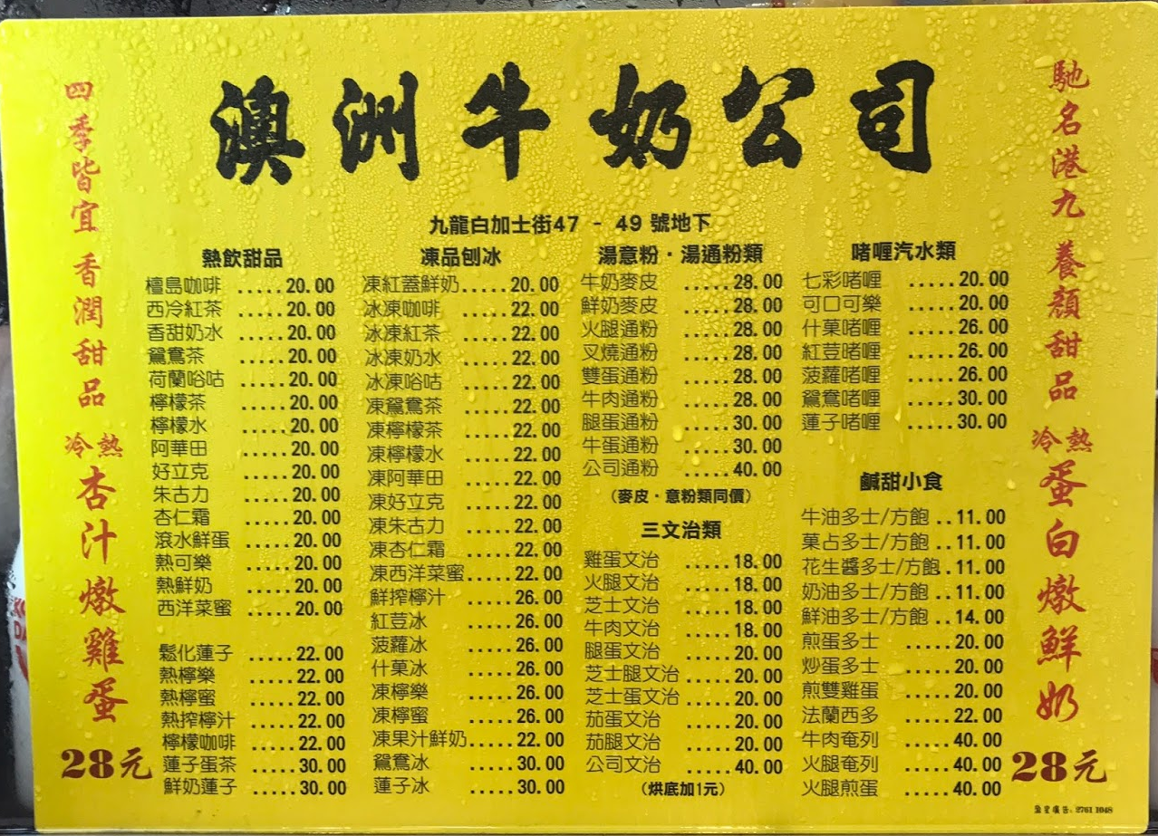
蛋 (egg) daang2
多士 (toast) do1 si2
通粉 (macaroni) tung1 fan2
啫喱 (jelly) ze1 lei2
叉燒 (barbecued pork) caa1 siu1
火腿 (ham) fo2 teoi2
文治 (sandwich) man4 zi6
凍 (cold) dung3
熱 (hot) jit6
檸檬茶 (lemon tea) ning4 mung1 caa4
咖啡 (coffee) gaa3 fe1
多糖 (more sugar) do1 tong4
少糖 (less sugar) siu2 tong4

Slide 10
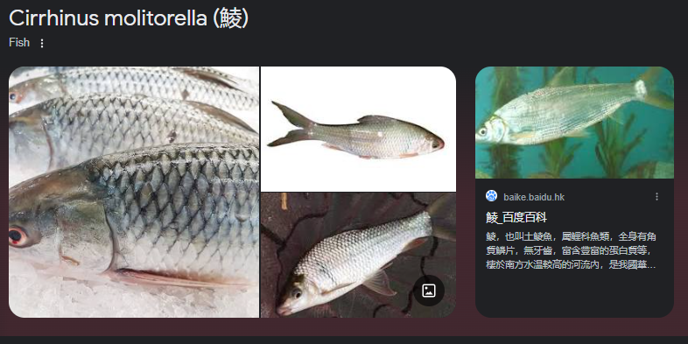
Vocabs
Protein
牛肉 ngau4 juk6 beef meat
雞肉 gai1 juk6 chicken meat
羊肉 joeng4 juk6 lamb meat
豬肉 zyu1 juk6 pork meat
豆腐 dau6 fu6 tofu
魚 jyu1 fish
魷魚 jau4 jyu2 squid
吞拿魚 tan1 naa4 jyu2 tuna fish
墨魚 mak6 jyu4 cuttlefish
鱈魚 syut3 jyu2 cod fish
鯪魚 leng4 jyu2 dace fish
鱸魚 lou4 jyu2 sea bass, perch
三文魚 saam1 man4 jyu2 salmon
蝦 haa1 shrimp/prawn
蛋 daan6 egg

Slide 11
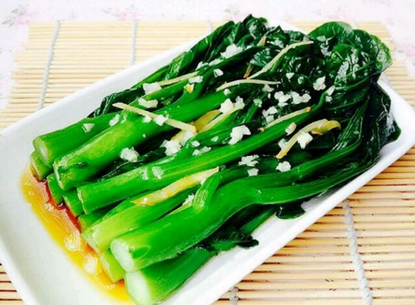
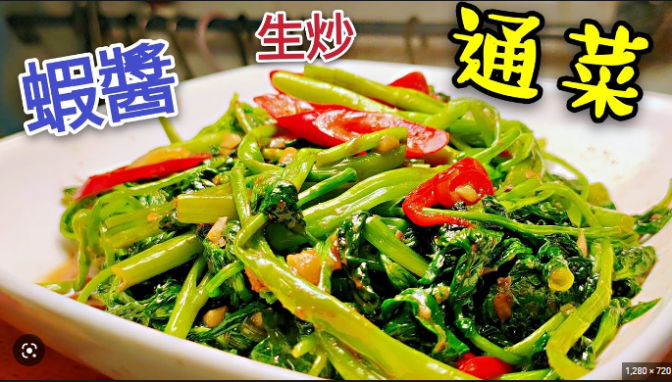
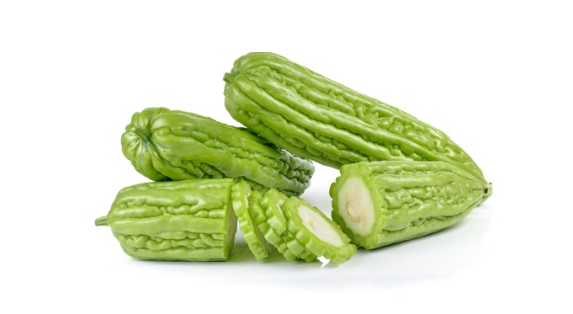
Vocabs
蔬菜 So1 Coi3 Vegetable
菜心 coi3 sam1 choy sum
白菜 baak6 coi3 bok choy
通菜 tung1 coi3 water spinach
芥蘭 gaai3 laan2 broccoli
椰菜花 je4 coi3 faa1 cauliflower
蘿蔔 lo4 baak6 carrot
番茄 faan1 ke2 tomato
薯仔 syu4 zai2 potato
椰菜 Je4 Coi3 Cabbage
青瓜 Ceng1 Gwaa1 Cucumber
蘑菇 Mo4 Gu1 Mushroom
生菜 Saang1 Coi3 Lettuce
粟米 suk1 mai5 corn
菜心 coi3 sam1
通菜 tung1 coi3
涼瓜/苦瓜 loeng4 gwaa1/fu2 gwaa1
矮瓜 aai2 gwaa1 eggplant
翠玉瓜 ceoi3 juk6 gwaa1 zucchini
菠菜 bo1 coi3 spinach/Chinese spinach
豆 dau6*2 beans, peas
涼瓜/苦瓜 loeng4 gwaa1/fu2 gwaa1 bitter melon/ gourd

Slide 12
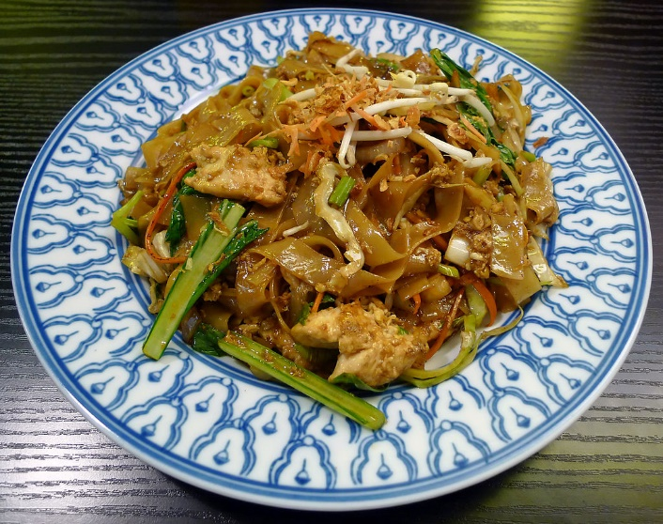
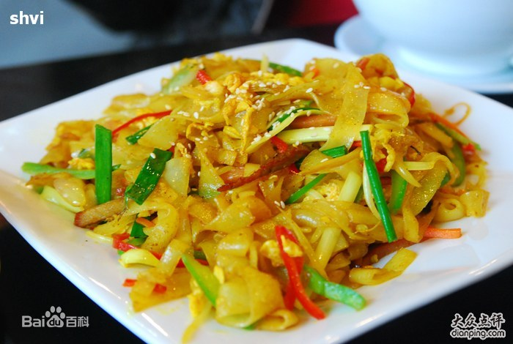
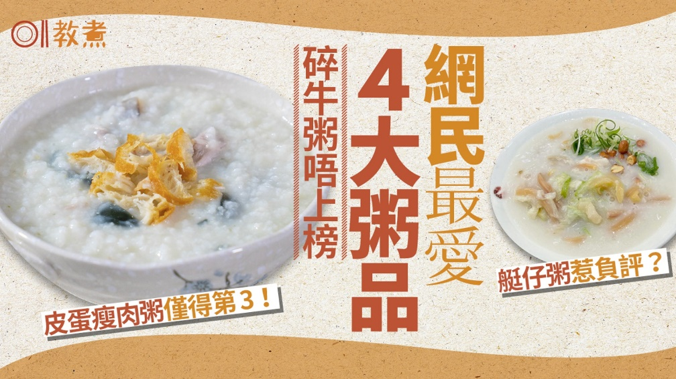
Vocabs
Carbohydrate (side dish in European cuisine)
飯 faan6 rice
意粉 ji3 fan2 spaghetti
薯菜 syu4 coi3 potatos as “side dish”
薯條 syu4 tiu2 French fry, fried potato
河粉 ho4 fan2 broad rice noodles (“pho”), single word“河” on menu
貴刁 gwai3 diu1 rice noodles
米粉 mai5 fan2 rice noodles
米線 mai5 sin3 thin rich noodles
粥 zuk1 rice porridge
麵 min6 noodle
麵包 min6 baau1 bread
餃 gaau2 stuffed dumpling
河粉
貴刁
粥

Slide 13
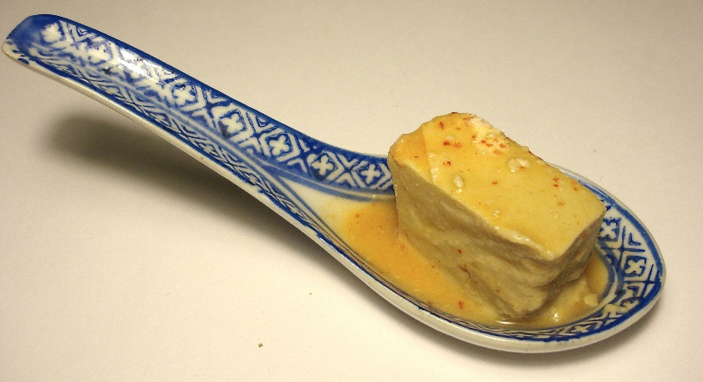
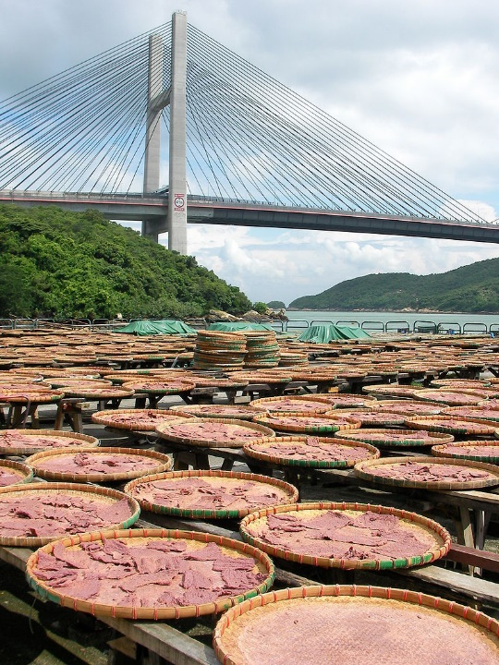
Vocabs
Seasoning
洋葱 Joeng4 Cung1 onion
蒜 syun3 garlic
蒜茸 syun3 jung4 crushed garlic
辣椒 laat6 ziu1 chili, pepper
姜/薑 goeng1 ginger
薑葱 goeng1 cung1 ginger and green onion
蝦醬 haa1 zoeng3 shrimp paste
腐乳 fu6 jyu5 fermented bean curd
豉油 si6 jau4 soya sauce
蠔油 hou4 jau4 oyster sauce
忌廉汁 gei6 lim1 zap1 cream sauce
黑椒 haak1 ziu1 black pepper “sauce”
腐乳 fu6 jyu5
蝦醬 haa1 zoeng3

Slide 14
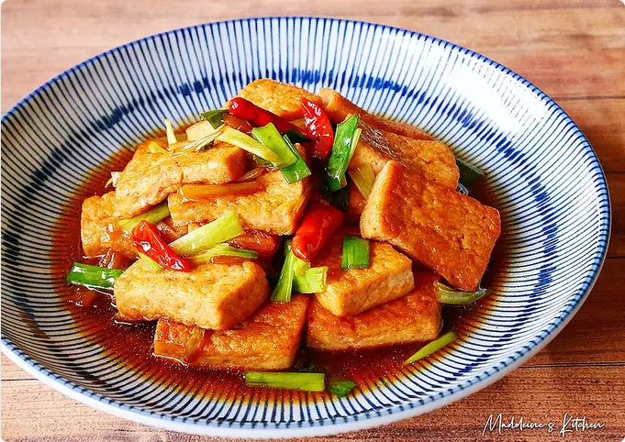
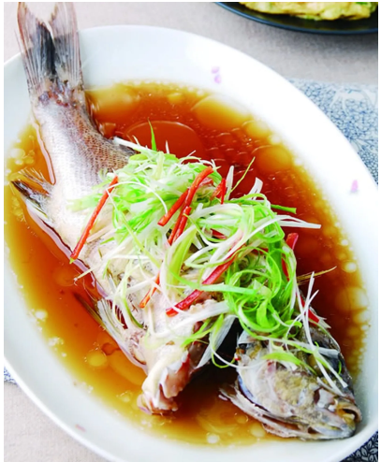
Vocabs
Ways of cooking
煮 zyu2 cook
煎 zin1 pan fry
炒 caau2 stir fry
乾炒 gon1 caau2 “dry-fried” (stir fry but don’t add sauce)
炸 zaa3 deep dry in oil
燒 siu1 barbecue
紅燒 hung4 siu1 braised in soya sauce
蒸 zing1 steam
清蒸 cing1 zing1 steamed in clear soup (usually without soy sauce)
炆 man1 simmer, cook over slow fire
烹 paang1 cook in water, boil
煲 bou1 boil
白灼 baak6 coek3 blanching, cooking with clean broth
紅燒豆腐
Hung4 siu1 dau6 fu6
清蒸魚
Cing zing1 jyu1

Slide 15
Create the dish names
Vegetable dish name = Seasoning + way of cooking + vegetable
Eg: 蒜茸炒白菜 crushed garlic stir-fry bak choy
syun3 jung4 caau2 baak6 coi3
Meat dish name = Seasoning + way of cooking + meat
Eg: 薑葱炒牛肉 ginger and green onion stir-fry beef
goeng1 cung1 caau2 ngau4 juk6
Both vegetable and meat together = seasoning + way of cooking + vegetable + meat
Eg: 蠔油炆蘿蔔羊肉 oyster sauce simmer with carrot and lamb
hou4 jau4 man1 lo4 baak6 joeng4 juk6

Slide 16
Conversation Practice (off-menu vegetable dishes)
Waiter/Waitress: 你想食乜菜? (what vegetable do you want to eat?)
nei5 soeng5 sik6 mat1 coi3?
Client: 你有乜嘢菜? (What vegetable do you have?)
nei5 jau5 mat1 je5 coi3?
Waiter/Waitress: 我哋有菜心˴菠菜˴芥蘭˴通菜◦你想食咩? (we have choy sum, boy choy, water spinach, broccoli. What do you want to eat?)
ngo5 dei6 jau5 coi3 sam1 ˴bo1 coi3˴gaai3 laan2˴tung1 coi3 ◦ nei5 soeng5 sik6 me1?
Client:菜心˒唔該◦ (choy sum, thank you)
coi3 sam1, m4 goi1
Waiter/Waitress: 你想點煮? (how do you want it to be cooked?)
nei5 soeng5 dim2 zyu2?
Client: 可唔可以炸? (can you deep dry it?)
ho2 m4 ho2 ji5 zaa3?
Waiter/Waitress: 唔好意思◦我哋唔炸菜心◦ (sorry we don’t deep dry choy sum.)
m4 hou2 ji3 si1. ngo5 dei6 m4 coi3 sam1.
Client: 有冇蒜茸炒菜心? (do you have minced garlic stir-fry choy sum?)
jau5 mou5 syun3 jung4 caau2 coi3 sam1?
Waiter/Waitress: 有◦要一個? (yes. One portion?)
jau5. jiu5 jat1 go3?
Client: 係◦一個◦ (yes. One portion?)
hai6. jat1 go.
If he/she is rude:
𨳒你! 依家係咪玩嘢呀?
(Fuck you! Are you now fooling around?)
Diu2 nei5! Ji1 gaa1 hai6 mai2 waan2 je5 aa3?
Then you say “sorry sorry”
alternative
你有冇推介? (do you have recommendation?)
Nei5 jau5 mou5 teoi1 gaai3?

Slide 17
Transportation

Slide 18
Conversation Practice – Name the city and count how many stations to go
Tourist: 我喺美孚(where you are)˒我想去旺角 (destination)◦ 我應該搭幾多個站?
(I am at Mei Foo, I want go Mong Kok. I should take how many stops?)
Ngo5 hai2 mei5 fu1. ngo5 soeng2 heoi3 wong6 gok3. Ngo5 jing1 goi1 daap3 gei2 do1 go3 zaam6?
Local: 你應該搭五個站◦
(you should take 5 “pieces” of stops)
Nei5 jing1 goi1 daap3 ng5 go3 zaam6.
Instruction: you would go through the metro map and count how many stops.
Underline words are for exchangeable options

Slide 19
Conversation Practice - Taxi
Taxi: 你想去邊度? (you want go where?)
Nei5 soeng2 heoi3 bin1 dou6?
Passenger: 司機大哥, 唔該, 我想去 旺角◦
(driver big brother, excuse me, I want go Mong Kok.)
Si1 gei1 daai6 go1, m4 goi1, ngo5 soeng2 heoi3 wong6 gok3.
Taxi: 你想去 旺角 邊度? (you want go Mong Kok where?)
Nei5 soeng2 heoi3 wong6 gok3 bin1 dou6?
Passenger: 信和呀◦唔該◦ (Sino Centre aa. Excuse me)
seon3 wo2 aa3. m4 hoi1
Taxi: 好嘅! (good ge)
Hou2 ge3
Part 1 (just go to a city)
Part 2 (exactly where?)

Slide 20
元朗 jyun4 long5
大學 daai6 hok6
上水 soeng6 seoi2
沙田 saa1 tin4
機場 gei1 coeng4
香港 hoeng1 gong2
九龍塘 gau2 lung4 tong4
旺角 wong6 gok3
油麻地 jau4 maa4 dei2
尖沙咀 zim1 saa1 zeoi2
荃灣 cyun4 waan1
中環 zung1 waan4
灣仔waan1 zai2
銅鑼灣 tung4 lo4 waan1
堅尼地城 gin1 nei4 dei6 sing4
金鐘 Gam1 zung1
柴灣 Caai4 waan1

Slide 21
Activities

Slide 22
Activities
行街 haang4 gaai1 (“walk on street”, meaning: shopping)
買嘢 maai5 je5 (buy things, meaning: shopping)
唱K coeng3 kei1 (sing karaoke)
食嘢 sik6 je5 (“eat something”, meaning: go for food)
食飯 sik6 faan6 (“eat rice”, have a meal)
飲嘢 jam2 je5 (“drink something”, meaning: go for a drink)
飲酒 jam2 zau2 (drink alcohol)
見朋友 gin3 pang4 jau5 (“see friends”, meaning: meet friends)
拍拖 paak3 to1 (literally “partner dragging”. Meaning: courting, go out on a date)
睇戲 tai2 hei3 (watch movie)
去party; heoi3 party (go to party)
去clubbing; heoi3 clubbing (go to disco clubs)

Slide 23
Conversation Practice – Which city to go? What do you do?
HK friend: 你一陣去邊度呀? (you later go where aa?)
Nei5 jat1 zan6/2 heoi3 bin1 dou6 aa3?
I: 我一陣去旺角呀◦ (I later go Mong Kok aa)
Ngo5 jat1 zan6/2 heoi3 wong6 gok3.
HK friend: 你去 旺角 有乜做? (you go Mong Kok have what do?)
Nei5 heoi3 wong6 gok3 jau5 mat1 zou6?
I: 我去 旺角 睇戲◦ (I go Mong Kok watch movie)
Ngo5 heoi3 wong6 gok3 tai2 hei3.
Underline words are for exchangeable options
Part 1 (which city?)
Part 2 (do what?)

Slide 24
Shopping

Slide 25
買乜嘢? Maai5 mat1 je5? Buy what?
衫 saam1 clothes in general
褲 fu3 trousers
鞋 haai4 shoes
電子嘢 din6 zi2 je5 electronics-related things
電腦嘢 din6 nou5 je5 computer-related things
運動嘢 wan6 dung6 je5 sports-related things
餸 sung3 dish of food, grocery
嘢食 je5 sik6 something to eat
嘢飲 je5 jam2 something to drink
文具 man4 geoi6 stationery
書 syu1 book
電話 din6 waa2 phone
電器 din6 hei3 electrical appliance
禮物 lai5 mat6 present/gift

Slide 26
Conversation Practice – what to shop? With a friend
friend: 你想買啲咩?(what do you want to buy?)
Nei5 soeng2 maai5 di1 me2?
I: 我想去買衫◦ (I want go buy clothes)
Ngo5 soeng2 heoi3 maai5 saam1?
Friend: 你會去邊度買? (you will go where buy?)
Nei5 wui5 heoi3 bin1 dou6 maai5?
I: 我諗住去旺角買◦ (I intend go Mongkok buy.)
Ngo5 nam2 zyu6 heoi3 wong6 gok3 maai5.
Underline words are for exchangeable options
諗住 nam2 zyu6 – to plan, intend, estimate

Slide 27
Conversation Practice – In shop bargaining
Shop: (我)有咩可以幫到你? ( (I) have what can help you?)
Jau5 me2 ho2 ji5 bong1 dou2 nei5?
I: 請問呢件嘢幾多錢? (please (I wanna) ask this piece of thing how much money?)
Ceng2 man6 ni1 gin6 je5 gei2 do1 cin2?
Shop: 呢件三千四百八十蚊◦ (This piece $3480)
Ni1 gin6 saam1 cin1 sei3 baak3 baat3 sap6 man1.
I: 有冇得平啲? 隔離舖賣緊三千一百咋◦ 三千得唔得呀? (have or not cheaper? Next door shop is selling $3100 zaa. $3000 can or not?)
Jau5 mou5 dak1 peng4 di1? Gaak3 lei4 pou3 maai6 gan2 saam1 cin1 jat1 baak3 zaa3. Saam1 cin1 dak1 m4 dak1 aa3?
Shop: i. 噉你過隔離舖買囉◦ / ii. 噉我三千五十蚊畀你◦ (in that case, you go next door shop lor. / in that case, I $3050 give you)
Gam2 nei5 gwo3 Gaak3 lei4 pou3 maai5 lo1. / gam2 ngo5 saam1 cin1 ng5 sap6 man1 bei2 nei5.
I: 好啦◦ (good la)
Hou2 laa1
Underline words are for exchangeable options
咋 zaa3 – merely, only
噉 gam2 – such; like this; this way; in that case
囉 lo1 lo4 lo3 - [final particle] showing argumentative mood or making emphasis; expressing a changed condition

Slide 28
More reasons for bargaining
隔離舖賣緊三千一百咋 (Next door shop is selling $3100 zaa)
Gaak3 lei4 pou3 maai6 gan2 saam1 cin1 jat1 baak3 zaa3
呢件係陳列品 (this piece is the display product)
Ni1 gin6 hai6 can4 lit6 ban2
呢件嘢花咗喎 (this piece thing is scratched already)
Ni1 gin6 je5 faa1 zo2 wo3
我唔夠錢 (I don’t have enough money)
Ngo5 m4 gau3 cin2

Slide 29
Gossip

Slide 30
Negative Adjectives/Verbs
Negative adjectives to people
人渣 jan4 zaa1; literally: residue of human → scumbag
賤格 zin6 gaak3; despicable
仆街 puk1 gaai1; bastard
唔老實 m4 lou5 sat6; not honest
廢 fai3, good-for-nothing
假 gaa2; untrue
Negative action/verb
呃人 aak1/ngaak1 jan4; cheat people
搞亂檔 gaau2 lyun6 dong3; stir/mess up “the store” (things)
幫唔到手 bong1 m4 dou3 sau2; doesn’t help
做錯嘢 zou6 co3 je5; to make wrong things
講錯嘢 gong2 co3 je5; say wrong things
扮嘢 baan6 je5; behave pretentiously; strike an attitude
成日講錯嘢 seng4 jat6 gong2 co3 je5, always say the wrong things
賤人 (noun) zin6 jan4; low-life, despicable person

Slide 31
Positive Adjectives/Verb
Positive adjectives to people
好人 hou2 jan4; good (kind) person
肯幫人 hang2 bong1 jan4; willing to help
心地好 sam1 dei2 hou2; with good intention/mind/inner-conscience
做到嘢 zou6 dou2 je5; able to achieve
老實 lou5 sat6; honest
啱feel; ngaam1 feel; feels right
啱傾 ngaam1 king1; right talk → interested in the same topic
真心 zan1 sam1; sincere, heartfelt
識講嘢 sik1 gong2 je5; know how to speak
Positive action/verb
幫到手 bong1 dou2 sau2; help
唔呃人m4 aak1/ngaak1 jan4; not to cheat people
唔搞亂檔 m4 gaau2 lyun6 dong3; not to stir/mess up the store
做啱 zou6 ngaam1; do correctly
圓滑 jyun4 waat6; tactful, smooth

Slide 32
Vocabulary of people
同學 tung4 hok6, classmates/schoolmates
老師 lou5 si1, teachers
大學 daai6 hok6, university
學校 hok6 haau6; school/institutes
同事 tung4 si6; co-worker
媽媽 maa4 maa1; mother
爸爸 baa4 maa1; father
大佬 daai6 lou2; elder brother
細佬 sai3 lou2; younger brother
親戚 can1 cik1; relatives
老細 lou5 sai3; boss/manager/owner
朋友 pang4 jau5; friend(s)
好朋友 hou2 pang4 jau5; good friend(s)
男朋友 naam4 pang4 jau5; boyfriend
女朋友 neoi5 pang4 jau5; girlfriend

Slide 33
Conversation Practice – gossip description of personality
Friend: 你媽媽個人點㗎? (your mother personality how gaa?)
Nei5 maa4 maa1 go3 jan4 dim2 gaa3?
I: 佢平時好好人嘅˒仲好識講嘢◦ (she usually very good kind ge, also very know how to speak)
Keoi5 ping4 si4 hou2 hou2 jan4 ge3, zung6 hou2 sik1 gong2 je5.
Underline words are for exchangeable options
㗎 – gaa2 gaa3 gaa4; final particle for making a strong assertion
仲 – zung6; also

Slide 34
Conversation Practice – gossip negative
Friend: 你最近點呀? (you recently how aa?)
Nei5 zeoi3 gan6 dim2 aa3?
I: 最近一般啦◦ 同朋友出咗問題◦ (recently so so laa. With friend, happened issues)
Zeoi3 gan6 jat1 bun1 laa1. tung4 pang4 jau5 ceot1 zo2 man6 tai4.
Friend: 你朋友做咗啲咩? (your friend did D what? → what did your friend did?)
Nei5 pang4 jau5 zou6 zo2 di1 me1?
I: 佢呃人◦ (he/she cheated)
Keoi5 ngaak1 jan4.
Friend: 佢平時個人點㗎? (he/she normal-time person how gaa? → how is his/her personality normally)
Keoi5 ping4 si4 go3 jan4 dim2 gaa3?
I: 佢平時唔老實◦ (he/she normal-time not honest)
Keoi5 ping4 si4 m4 lou5 sat6.
Friend: 咁我明白嘅◦ 睇開啲啦! (in this case I understand ge. See open D laa)
Gam2 ngo5 ming4 baak6 gee3. Tai2 hoi1 di1 laa1!
Underline words are for exchangeable options
㗎 – gaa2 gaa3 gaa4; final particle for making a strong assertion
嘅 – ge3 ge2; adjective suffix; possessive/final particle
平時 – ping4 si4; literally: normal-time, meaning: usually

Slide 35
Life/Dream

Slide 36
人生目標/理想 jan4 sang1 muk6 biu1/lei5 soeng2
“life goals/ideal”
結婚 git3 fan1, to marry/marriage
生仔 saang1 zai2, give birth
事業 si6 jip6, career
賺錢 zaan6 cin2, earn money
買樓 maai5 lau2, buy a property
買跑車 maai5 paau2 ce1, buy a sports car
畢業 bat1 jip6, to graduate
追求自由 zeoi1 kau4 zi6 jau4, chase for freedom
周圍去 zau1 wai4 heoi3, go around
學新嘢 hok6 san1 je5, learn new things
發現新事物 faat3 jin6 san1 si6 mat6, discover new things
我想…
ngo5 soeng2…
I want…
我唔想…
Ngo5 m4 soeng2…
I don’t want…

Slide 37
人生目標/理想 jan4 sang1 muk6 biu1/lei5 soeng2
“life goals/ideal”
成為作家 sing1 wai4 zok3 gaa1, become a writer
做有錢人 zou6 jau5 cin2 jan4, be a rich man/woman
玩音樂 waan2 jam1 ngok6, play music
出名 ceot1 meng2, be famous
住喺森林 zyu6 hai2 sam1 lam4, live in forest
逃脫 tou4 tyut3, escape
脫苦 tyut3 fu2, escape from pain/suffer
唔做寫字樓工 m4 zou6 se2 zi6 lau4 gung1, not work for office work
有一個花園 jau5 jat1 go3 faa1 jyun2, have a garden
提早退休 tai4 zou2 teoi3 jau1, early retire
我想…
ngo5 soeng2…
I want…
我唔想…
Ngo5 m4 soeng2…
I don’t want…

Slide 38
Conversation Practice – gossip description of personality
Friend: 你有啲咩人生目標㗎? (You have D what life goals gaa?)
Nei5 jau5 di1 jan4 sang1 muk6 biu1 gaa3?
I: 我想結婚˒生仔˒買樓呀◦ (I want marry, give birth, buy apartment aa.)
Ngo5 soeng2 git3 fan1, saang1 zai2, maai5 lau2 aa3.
Friend: 點解你想結婚˒生仔˒買樓呀? (Why you want marry, give birth, buy apartment aa?)
Dim2 gaai2 nei5 soeng2 git3 fan1, saang1 zai2, maai5 lau2 aa3?
I: 我覺得噉樣開心囉◦ (I feel this way happy lo)
Ngo5 gok3 dak1 gam2 joeng2 hoi1 sam1 lo1.
Underline words are for exchangeable options
呀 aa3, aa4, aa5, aa1
(jyutping) aa3 -- [1] final particle used to soften an abrupt question/statement, act as reminder and make emphasis; [2] pause particle in enumerating items
(jyutping) aa4 -- interrogative particle used to get confirmation or clarify a doubt, show skepticism or surprise
(jyutping) aa5 -- interrogative particle used in rhetorical question
(jyutping) aa1 -- variant of 吖

Slide 39
人生哲學 jan4 sang1 zit3 hok6
我覺得最緊要係…
ngo5 gok3 dak1 zeoi3 gan2 jiu3 hai6…
I think that the most important is…
人一世 物一世* jan4 jat1 sai3 mat6 jat1 sai3 man one life, object one life
做人做得開心 zou6 jan4 zou6 dak1 hoi1 sam1 have a happy life
尋找自己 cam4 zaau2 zi6 gei2 find/search myself
夠錢生活就足夠 gau2 cin2 sang1 wut6 zau6 zuk1 gau3 “Enough money to live” is enough
不求富貴 bat1 kau4 fu3 gwai3 not look for rich/wealth
愛與和平 oi3 jyu5 wo4 ping4 love and peace
自由 zi6 jau4 freedom
幫人 bong1 jan4 help people
挑戰自己 tiu1 zin3 zi6 gei2 challenge myself
如水 jyu4 seoi2 be water

Slide 40
人生哲學 jan4 sang1 zit3 hok6
我覺得最緊要係…
ngo5 gok3 dak1 zeoi3 gan2 jiu3 hai6…
I think that the most important is…
平等 ping4 dang2 equality
死得眼閉 sei2 dak1 ngaan5 bai3 die with closed eyes (die with no regrets)
有美好回憶 jau5 mei5 hou2 wui4 jik1 have beautiful good memory
唔信宗教 m4 seon3 zung1 gaau3 not believe in religions
唔好人做我又做 m4 hou2 jan4 zou6 ngo5 jau6 zou6 don’t others do I also do the same (don’t just follow what others do)
唔好畀人指手畫腳 m4 hou2 bei2 jan4 zi2 sau2 waak6 goek3 (lit. not good let others point finger draw feet.) Don’t let others tell you want to do.
唔好做工作狂 m4 hou2 zou6 gung1 zok3 kong4 don’t be a workaholic

Slide 41
挑戰 tiu1 zin3 challenge
要擺脫童年陰影 break away from childhood “shadow” (trauma)
jiu3 Baai2 tyut1 tung4 nin4 jam1 jing2
會畀人批評 wui5 bei2 jan4 pai1 ping4 will be criticised
會畀人罰 wui5 bei2 jan4 fat6 will be punished
要原諒自己 jiu3 jyun4 loeng6 zi6 gei2 need to forgive myself
會失敗 wui5 sat1 baai6, will fail
會餓死 wui5 ngo6 sei6, will starve to death

Slide 42
Conversation Practice – “life idealism/philosophy”
Friend: 你有啲咩人生哲學呢? You have D what life goal ne?
Nei5 jau5 di1 me1 jan4 sang1 zit3 hok6 ne1?
I: 我覺得做人最緊要係開心◦ 唔好做工作狂◦ I think being a person the most important is being happy. Don’t be a workaholic.)
ngo5 gok3 dak1 zou6 jan4 zeoi3 gan2 jiu3 hai6 hoi1 sam1. m4 hou2 zou6 gung1 zok3 kong4.
夠錢生活就足夠◦有美好回億◦死得眼閉◦ enough money to live is enough. Have a beautiful memory. Die with eyes closed.
gau2 cin2 sang1 wut6 zau6 zuk1 gau3. sei2 dak1 ngaan5 bai3
Friend: 你覺得有咩挑戰? you think what challenges (you will come across)?
Nei5 gok3 dak1 jau5 me1 tiu1 zin3?
I: 我覺得可能會餓死◦ I think perhaps will starve to death.
Ngo5 gok3 dak1 ho2 nang4 wui5 ngo6 sei6.
Underline words are for exchangeable options

Slide 43
Final word
"Be Water, My Friend.
Empty your mind.
Be formless, shapeless, like water.
You put water into a cup, it becomes the cup.
You put water into a bottle, it becomes the bottle.
You put it into a teapot, it becomes the teapot.
Now water can flow or it can crash.
Be water, my friend.“
Bruce Lee

