Slide 1
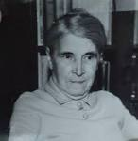
Czech Women Philosophers
XXth-century Czech Philosophy
spring 2023

Slide 2
History of Czech Women Philosophers
Women philosophers?
Czech women philosophers?
Sources (manuscipts, correspondance, library collections etc.)
Multilinguistic corpus (definition of Czech philosophy)
Contextual research
Bibliography
Zdeňka Jastrzembská, Dagmar Pichová, Jan Zouhar. 2021. Czech Women Philosophers and Scientists. Springer.
Zdeňka Jastrzembská, Dagmar Pichová, Jan Zouhar. 2022. Jen mít dosti sil! Ženy v české vědě a filozofii. Host.
Czech Women Philosophers and Scientists. Czech Science Foundation Grant (2017–2019).

Slide 3
History of Women Philosophers
Conversation with M.-E. Waithe
https://www.youtube.com/watch?v=6_fbcv7E-_k&t=494s&ab_channel=HistoryofWomenPhilosophers
Center for the history of women philosophers and scientists (Paderborn university)
https://historyofwomenphilosophers.org/

Slide 4
Božena Komárková (1903-1997)
1903: Born in Tišnov
Studied at Masaryk university (philosophy, history, geography)
Teacher at high schools: Ivančice, Brno
Prisoner during the World War II (1940-1945)
Ph.D. in 1948 (Masaryk university)
Retired since 1952
YCMA, dissident movement, Charter 77, home seminars in Brno
Habilitation at Masaryk university in 1992
Main themes:
History of philosophy, philosophy of history (Christian tradition), human rights

Slide 5
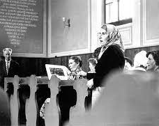
Božena Komárková (1903-1997)
Czechs and Germans in Our Century (1966)

