Slide 1
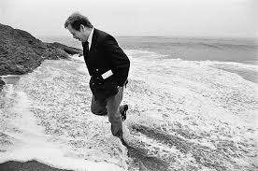
Václav Havel
XXth-century Czech Philosophy
spring 2023

Slide 2
Václav Havel (1936–2011)
October 5, 1936: Václav Havel was born in Prague.
1954: Graduation (evening grammar school).
1954-56: Technical College (Prague).
1960: The Garden Party (play)
1962-66: Drama Studies (DAMU Prague).
1975: Open letter to president Husák.
1977: Charter 77.
1970-80s: Five years in jail.
December 29, 1989: President of Czechoslovakia.
January 26 1993-2003: President of Czech republic.
December 18, 2011: Dies in Hrádeček.

Slide 3
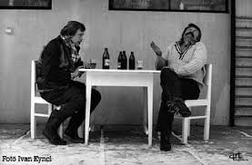
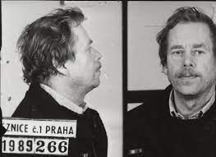
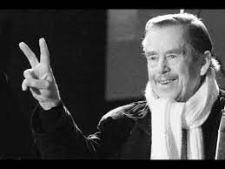
Václav Havel (1936–2011)
family
artist – dissident - politician
Theatre of the absurd
Charter 77
presidency

Slide 4
Václav Havel (1936–2011)
Václav Havel: New Year's Address to the Nation 1990
https://www.youtube.com/watch?v=i3OK650epuo&ab_channel=j0rges
Vaclav Havel under constant surveilance by communist police
https://www.youtube.com/watch?v=ngHldh6UDbs&ab_channel=ShowsOn
Madeleine Albright on Vaclav Havel's 'Massive Moral Authority, Great Courage'
https://www.youtube.com/watch?v=I_SCXfR2wHw&ab_channel=PBSNewsHour
Václav Havel Library
https://www.vaclavhavel.cz/

Slide 5
Václav Havel (1936–2011)
The Power of the Powerless (1978)
What is the power of the powerless?
What is post-totalitarian system?
How is ideology used in a post-totalitarian system?
Describe the greengrocer´s role.

