Slide 1
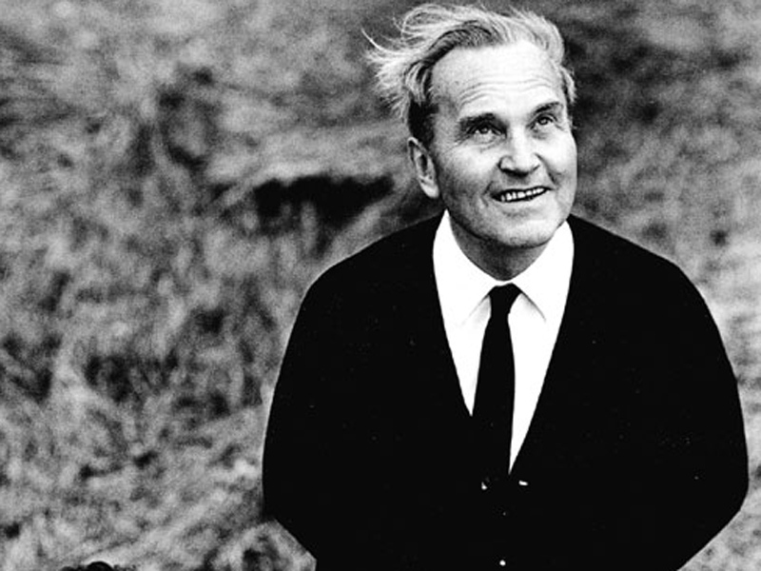
Jan Patočka
XXth-century Czech Philosophy
spring 2023

Slide 2
Jan Patočka (1907–1977)
June 7, 1907: Jan Patočka was born in Turnov.
1925: Starts his studies at Charles University in Prague (romance studies, slavic studies, philosophy).
1928-29: Study at Sorbonne. First meeting with Husserl.
1931: Ph.D. thesis (Notion of evidence and its relevance for noetics).
1933: Study in Freiburg (Husserl and Heidegger), meeting with Fink.
1933-34: Professor at high school (Prague). Founding member of Cercle philosophique de Prague; member of Prague linguistic circle.
1935: Organizes Husserl´s lectures in Prague.
1936: Associate professor (habilitation thesis: Natural world as a philosophical problem).
1945-49: Private associate professor in Prague; transfer to the university in Brno was not possible because of the communist coup d´état in February 1948.
1950-1968: Researcher (Masaryk Institute, Pedagogical Institute, Filozofical Institute)
1968-1972: Full professor at Charles University
1973-1976: Home seminars and lectures. Forbidden publication (only in samizdat).
1977: Charter 77. One of the founders of Charter 77, one of the three first spokesmen (Miloš Hájek and Václav Havel). Dies from heart attack after long interrogations by the State Security Police. (13. 3.)

Slide 3
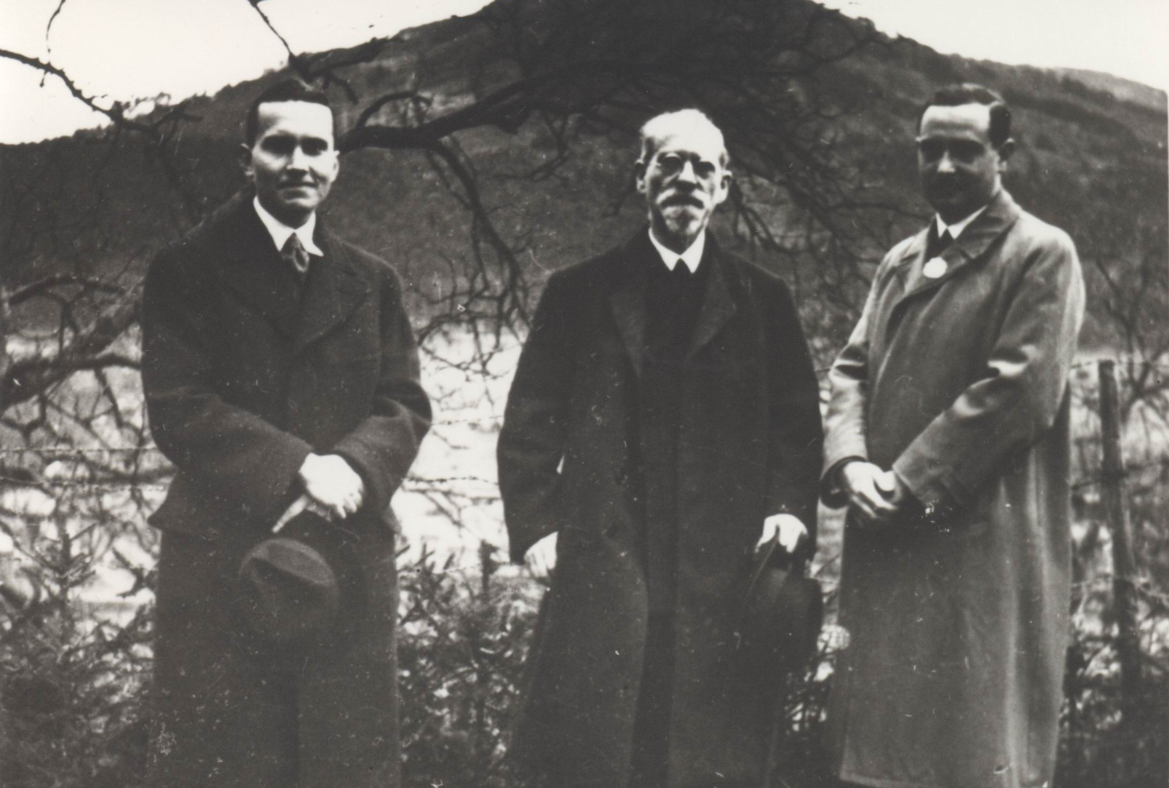
Jan Patočka (1907–1977)
Education
Influence
Phenomenology
Charter 77
Legacy
Jan Patočka, Edmund Husserl, Eugen Fink
©Husserl Archives Leuven 1934

Slide 4
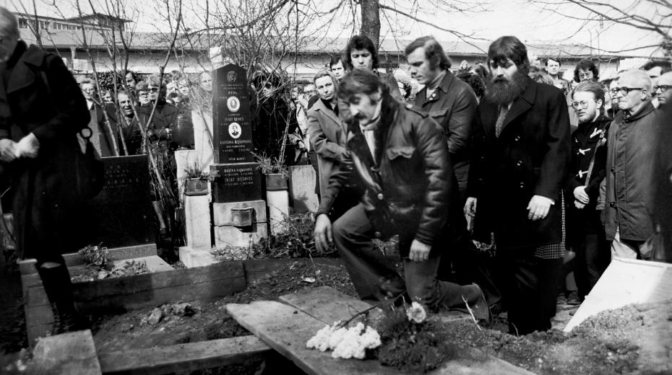
Jan Patočka (1907–1977)
March 7, 1850: Tomas Masaryk was born in Hodonin in Southern Moravia as the son of a coachman and cook.
1865-72: Attended grammar schools in Brno and Vienna.
Education
Influence
Phenomenology
Charter 77
Legacy

Slide 5
Jan Patočka (1907–1977)
Life in Balance, Life in Amplitude (1938)
Difference between life in balance and life in amplitude.
Patočka´s choice/your choice.

Slide 6
Jan Patočka (1907–1977)

Slide 7
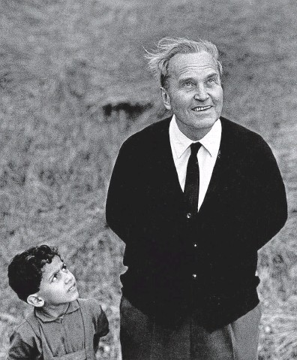
Jan Patočka (1907–1977)

