Slide 1
Belarus
Quiz

Slide 2
Warm up questions - introduction of students in small groups
1. Where are you from and/or what do you study?
2. Why are you interested in Eastern Europe and/or human rights and civil society?

Slide 3
When did the Soviet Union dissolve?
a) 1989
b) 1991
c) 1993

Slide 4
When did the Soviet Union dissolve?
a) 1989
b) 1991
c) 1993

Slide 5
Which are all the countries Belarus borders on?
a) Estonia, Latvia, Lithuania, Poland, Russia, Ukraine
b) Latvia, Lithuania, Poland, Russia, Ukraine
c) Latvia, Lithuania, Moldova, Poland, Russia, Ukraine
d) Latvia, Poland, Russia, Ukraine
https://bit.ly/3I27hdR

Slide 6
Which are all the countries Belarus borders on?
a) Estonia, Latvia, Lithuania, Poland, Russia, Ukraine
b) Latvia, Lithuania, Poland, Russia, Ukraine
c) Latvia, Lithuania, Moldova, Poland, Russia, Ukraine
d) Latvia, Poland, Russia, Ukraine
https://bit.ly/3I27hdR

Slide 7
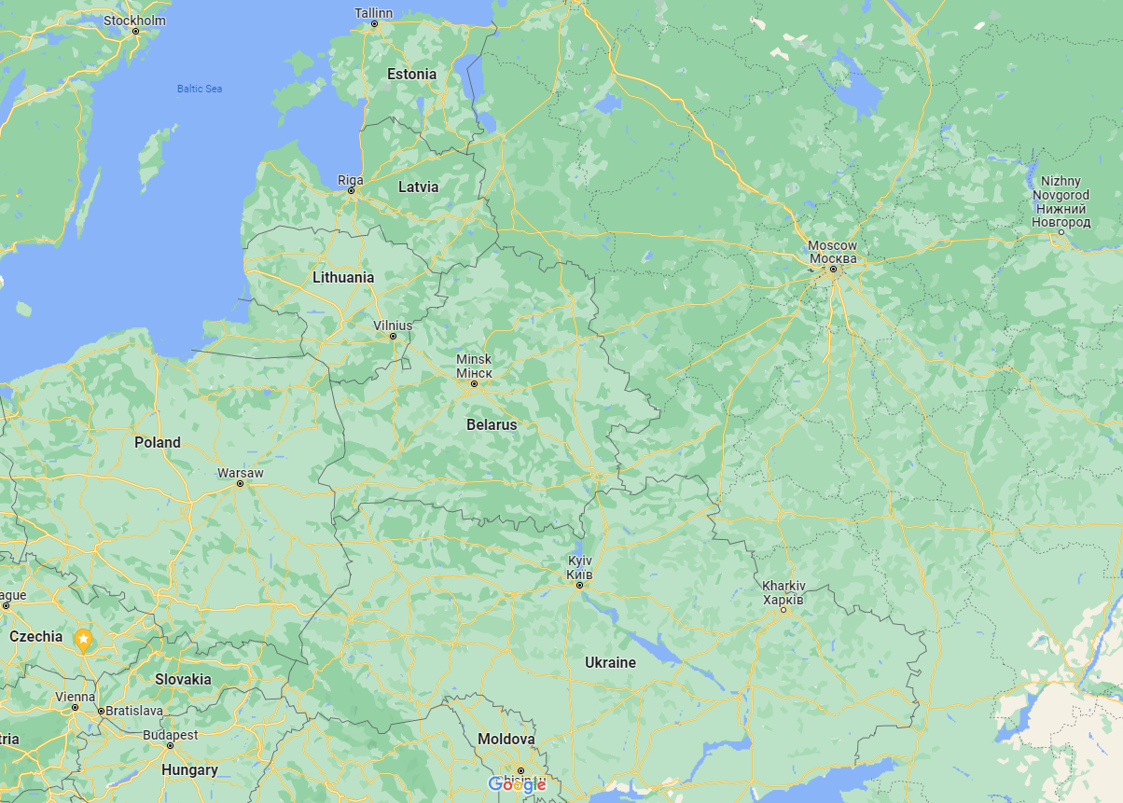

Slide 8
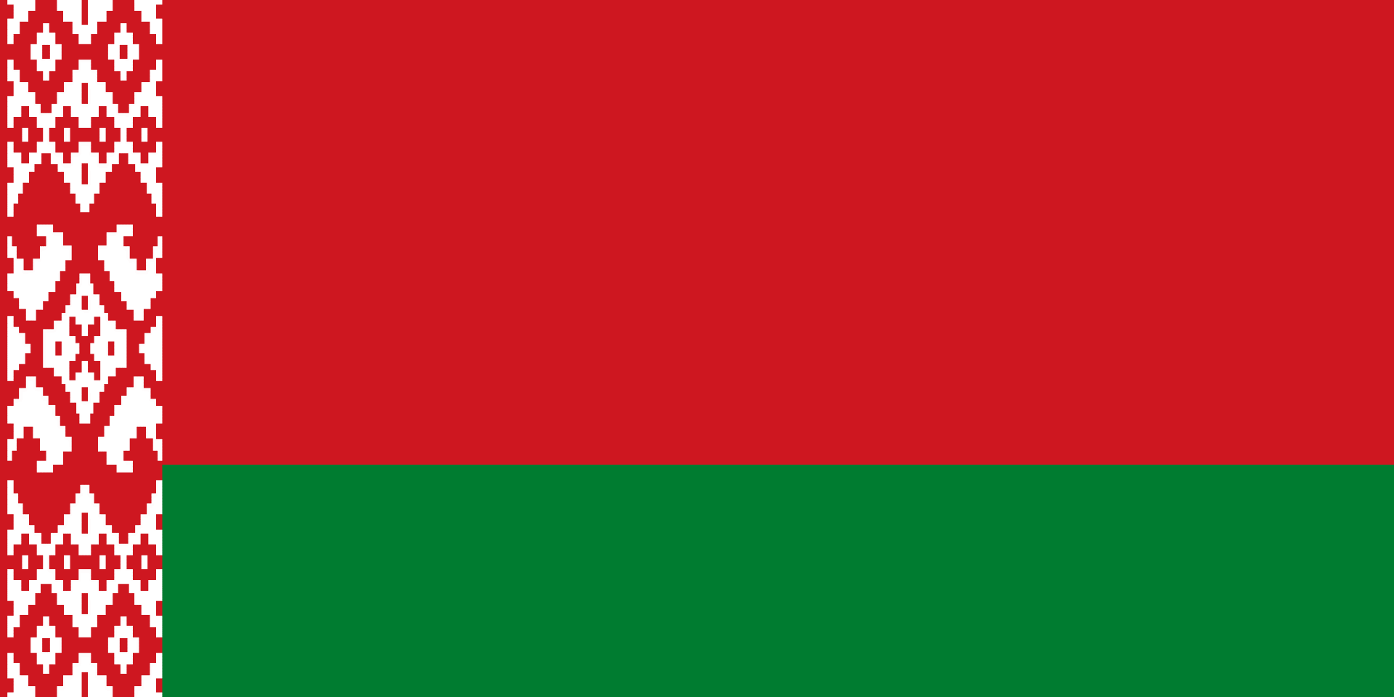
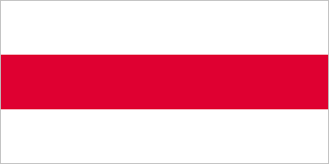
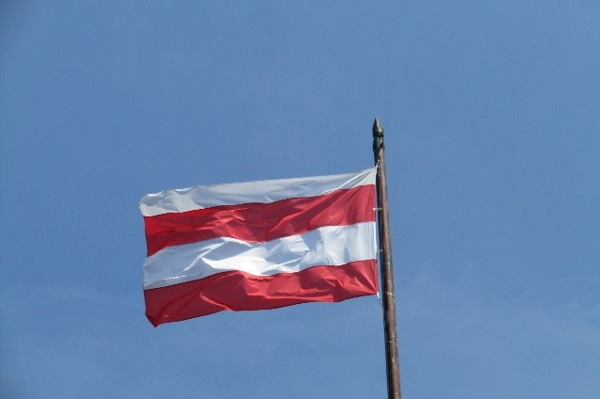
Which is the flag used in the pro-democratic protests in Belarus?
A)
B)
C)

Slide 9
Which is the flag used in the pro-democratic protests in Belarus?
A) official flag of Belarus, similar
to the flag of Soviet Belarus,
used by Lulkashenko
B)
C) flag of Brno

Slide 10
How long has Lukashenka, called the last dictator in Europe, been the president of Belarus?
23 years
28 years
32 years
40 years

Slide 11
How long has Lukashenka, called the last dictator in Europe, been the president of Belarus?
23 years
28 years
32 years
40 years

Slide 12
Most Belarusians speak Russian at home. However, how many Belarusians do you think said in the 2019 census that they normally speak Belarusian at home?
10%
26%
45%

Slide 13
Most Belarusians speak Russian at home. However, how many Belarusians do you think said in the 2019 census that they normally speak Belarusian at home?
10%
26% and rising
45%

Slide 14
1. Brainstorm the words describing Belarus in 2020.
2. And after 2020?

