Slide 1
Ой у лузі червона калина / Oi u luzi chervona kalyna / Oh, the Red Viburnum in the Meadow
A Ukrainian patriotic march first published in 1875. Written in a modern treatment in 1914, in honor and memory of the Sich Riflemen of the First World War, it was later adopted by the Ukrainian People's Army of the Ukrainian War of Independence (1917-1921).
Following the 2014 annexation by Russia of the Ukrainian Crimean peninsula, and then the 2022 Russian invasion of Ukraine, singing "nationalist anthems" such as Chervona Kalyna in Crimea became punishable by fines and imprisonment.
https://www.youtube.com/watch?v=ZztmQsSAqfo

Slide 2
Quiz
Ukraine

Slide 3
Which languages belong to each of the three groups of Slavic languages? (Eastern, Western and Southern)
Polish
Slovenian
Belarusian
Czech
Bosnian/Croatian/Serbian
Ukrainian
Bulgarian
Russian
Slovak
Macedonian

Slide 4
Which languages belong to each of the three groups of Slavic languages?
Eastern: Russian, Ukrainian, and Belarusian
Western: Polish, Czech, and Slovak
Southern: Slovenian, Bosnian/Croatian/Serbian, Macedonian, and Bulgarian

Slide 5
Do you know which of these languages is Belarusian, Ukrainian and Russian?
HELLO, WELCOME TO CLASS TODAY!
Bітаю, cардэчна запрашаем сёння у клас!
Vitayu, sardechna zaprashayem syonnia u klas!
Привет, добро пожаловать сегодня в класс!
Privet, dobro pozhalovat' segodnya v klass!
Привіт, вітаємо сьогодні в класі!
Pryvit, vitayemo sʹohodni v klasi!

Slide 6
Do you know which of these languages is Belarusian, Ukrainian and Russian?
Belarusian:
Bітаю, cардэчна запрашаем сёння у клас! / Vitayu, sardechna zaprashayem sionnia u klas!
Russian
Привет, добро пожаловать сегодня в класс!/ Privet, dobro pozhalovat' segodnya v klass!
Ukrainian
Привіт (Bітаю), вітаємо сьогодні в класі! / Pryvit (Vitayu is also possible, like in Belarusian), vitayemo sʹohodni v klasi!
According to the 2001 census, 67% of the population speak Ukrainian and 30% speak Russian as their first language.

Slide 7
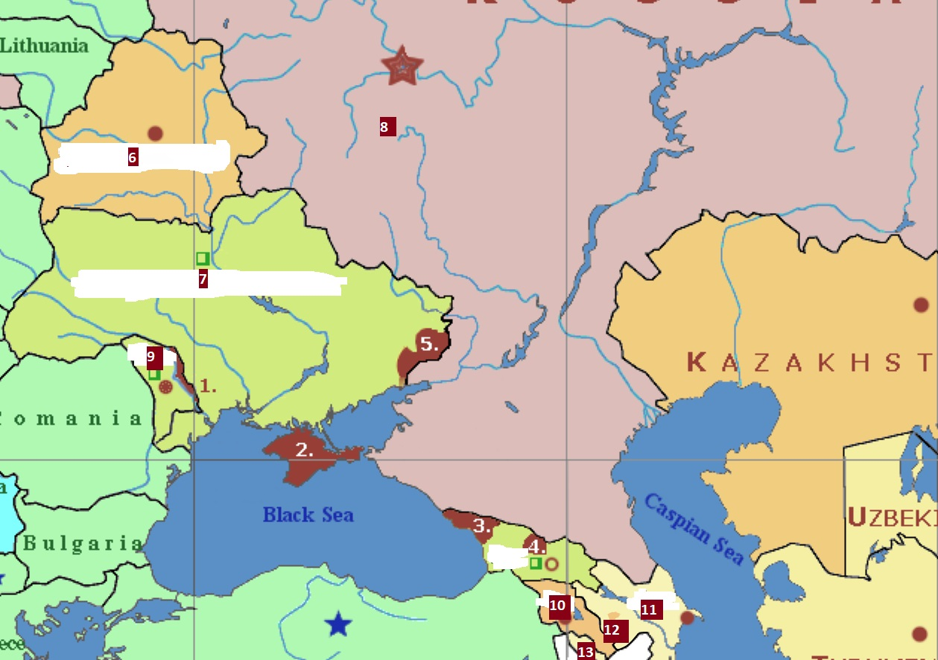
Which numbers in the picture correspond to Crimea and parts of the Donetsk and Luhansk Regions (Ukrainian territories occupied by Russia since 2014)

Slide 8
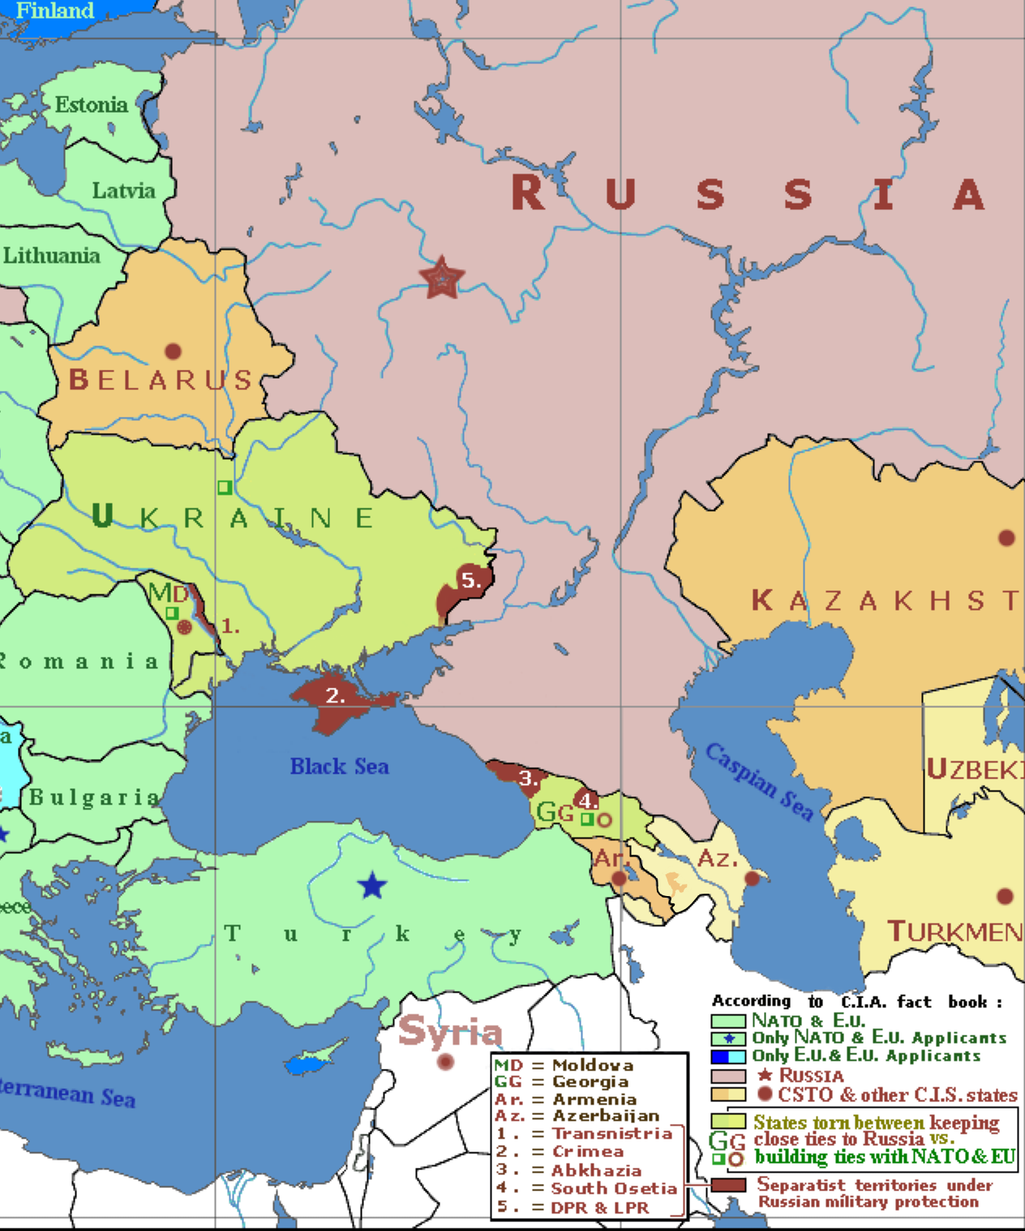
2 Crimea
5 parts of the Donetsk and Luhansk Regions
(Ukrainian territories occupied by Russia since 2014)

Slide 9
How many Ukrainians died between 1932-1933 from Holodomor, the man-made famine in the USSR?
40,000
450,000
3,3-5 mln

Slide 10
How many Ukrainians died between 1932-1933 from Holodomor, the man-made famine?
3,3-5 mln (roughly 13.3% of the population)
As of 2022, the European Union and 22 countries have recognised the Holodomor as a genocide.
A total of 5.5–8.7 million were killed by the famine in the USSR as a whole.

Slide 11
Crimean Tatars are a Turkic ethnic group and nation - an indigenous people of Crimea. What happened to them during these periods?
After Russian annexation at the end of the 18th century
Toward the end of WWII
Nowadays

Slide 12
Crimean Tatars are a Turkic ethnic group and nation - an indigenous people of Crimea. What happened to them at the end of the 18th cent, after 1944 and after 2014?
Crimean Tatars constituted the majority of Crimea's population until the mid-19th century. Russia attempted to purge them through physical violence, intimidation, forced resettlement, and legalized forms of discrimination between 1783 and 1900. Between Russia’s annexation of Crimea in 1783 and 1800, somewhere between 100,000 and 300,000 Crimean Tatars emigrated.
Almost immediately after the Soviet Army retook Crimea from Nazi Germany, in May 1944, the USSR ordered the deportation of all of the Crimean Tatars from Crimea, including the families of Crimean Tatars who had served in the Soviet Army. The deportees were transported in trains and boxcars to Central Asia, primarily to Uzbekistan. The Crimean Tatars lost 18 to 46 percent of their population as a result of the deportations. This was just a part of ethnic cleansing of Muslims in the USSR (see Chechnya, for example).
Today, Crimean Tatars constitute approximately 15% of the population of Crimea. After the annexation of Crimea by the Russian Federation in 2014, Crimean Tatars are reportedly persecuted and discriminated by Russian authorities, including cases of torture, arbitrary detentions, and forced disappearances by Russian security forces and courts. (Human Rights Watch)

Slide 13
What was the reason for the Maidan Revolution / Revolution of Dignity?
Falsified elections in which the tehn Prime Minister Yanukovich claimed he had been elected for president
The wish of young Ukrainians to be closer to the European Union and later the corruption of President Yanukovich and his violence against protesters

Slide 14
What was the reason for the Maidan Revolution / Revolution of Dignity?
Falsified elections were the reason for the Orange Revolution, 2004-2005: the then Prime Minister Yanukovich, favored by the Russian president Putin, claimed he had been elected for president. After reports of election fraud, mass protests swelled and the Supreme Court ruled the election results falsified. In the revote, the pro-democratic candidate, Yushchenko won (his election campaign used orange colours).
Maidan/Revolution of Dignity: In late 2013, mostly young Ukrainians protested after President Yanukovich (elected in 2010) refused to sign the Association Agreement with the EU. He used violence against the protesters, which sparked much larger protests, made up of diverse generations and social groups. The protests also transformed into general protest against the corruption of President Yanukovich, which had robbed ordinary citizens of dignity.

