Slide 1
UNRECOGNIZED TERRITORIES
came into existence in early 1990s
prior to 1990s were part of Soviet Republics

Slide 2
Unrecognized territories
South Caucasus:
Abkhazia (Georgia)
South Ossetia (Georgia)
Nagorno Karabakh (Armenia – Azerbaijan)
Transnistria (Moldova)

Slide 4
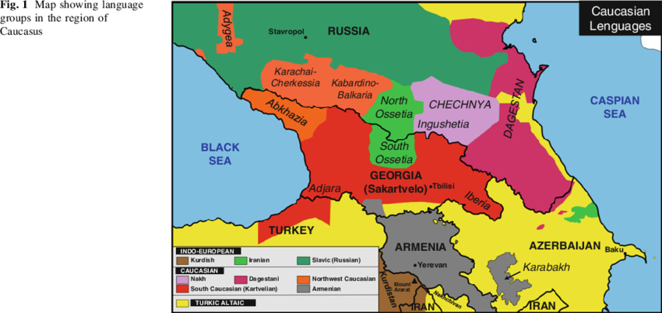

Slide 5
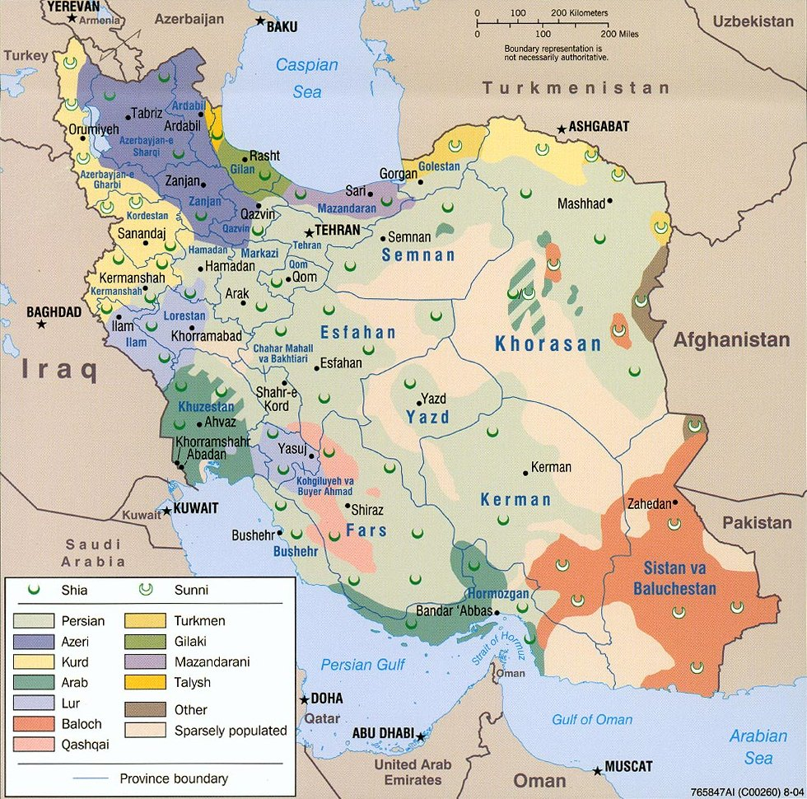

Slide 6
Connect the translation of the sentence „Hello, welcome to the class today!“ with the corresponding language:
Armenian
Azerbaijani
Georgian
Moldovan/Romanian
Salam, bu gün dərsə xoş gəlmisiniz!
გამარჯობა, მოგესალმებით დღეს კლასში! (gamarjoba, mogesalmebit dghes k’lasshi!)
Բարև, բարի գալուստ դասի այսօր: (Barev, bari galust dasi aysor)
Buna ziua, bine ai venit in clasa de astazi!

Slide 7
„Hello, welcome to class today!“
Azerbaijani (Turkish)
Salam, bu gün dərsə xoş gəlmisiniz! (Merhaba, bugün sınıfa hoş geldiniz!)
Georgian
გამარჯობა, მოგესალმებით დღეს კლასში!
gamarjoba, mogesalmebit dghes k’lasshi!
Moldovan/Romanian
Buna ziua, bine ai venit in clasa de astazi!
Armenian
Բարև, բարի գալուստ դասի այսօր:
Barev, bari galust dasi aysor

