Slide 1

Notes:
Hi guys my name is suhyun kim and I will introduce korea online platform

Slide 2
INDEX
1
Relationship between Koreans offline culture and Kakao talk
(Korea's representitive messenger)
2
Introducing useful Korea's online platform
(ex. Coupang, secondhand shop app , delivery app , style commerce platform , night delivery, interior app, etc.)
Main presenter : Suhyun Kim
sub-presenter: Sojung Kim, Minseong Kim
Notes:
So today guys I will talk about Relationship between Koreans offline culture and Kakao talk
and.,I will Introduce Korea's online shopping platform
I think would be really helpful if you guys knew about them and had them that way your life in korea will be fully functional when you arrive.

Slide 3
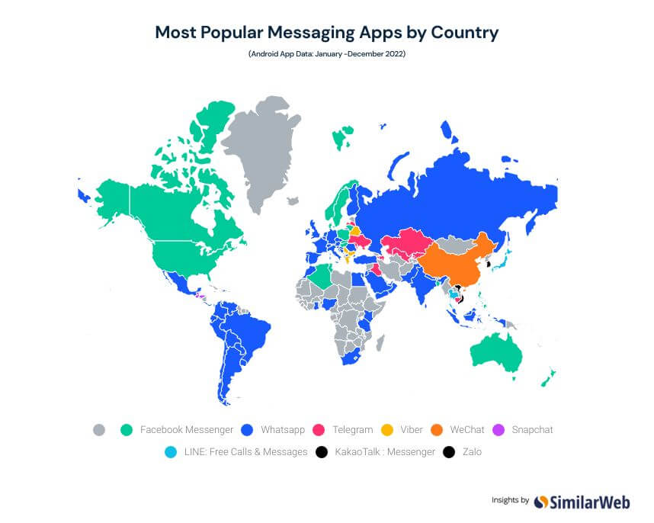
Relationship between Koreans offline culture and Kakao talk
Notes:
This is the map about most popular messaging apps by country. Green is Facebook messenger. We can see green in US and Canada. Blue is whatsapp. We can know that North amarica and euorpe mainly use whatsapp..In korea it’s seems like a black dot. This is a kakako talk.

Slide 4

Korea’s main messenger, Kakao talk
Kakao talk
Notes:
So the first app I want to introduce is called kakaotalk. Does anyone already knows about kakaotalk? Good. i think you have probably heard about kakaotalk even in dramas I guess they’re using that. anyway ,It’s main messenger app in Korea. I use kakaotalk everyday to talk to anyone.

Slide 5
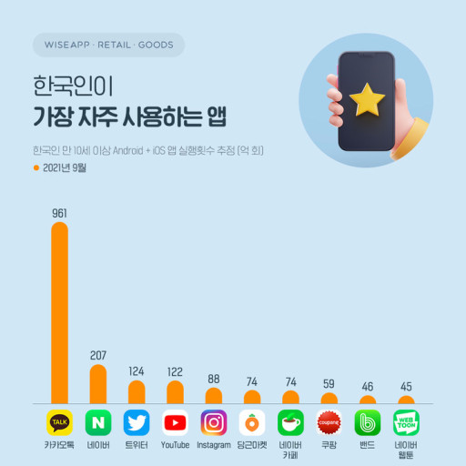
Korea’s main messenger, Kakao talk
The most common chatting app is Kakao talk
Notes:
This is a graph showing the apps that Koreans use most often. The most frequently used app by Koreans is kakao talk. Ninety-five percent of Koreans use KakaoTalk.
If someone is asking you for your line id in a dating scenario like I’m sorry this is just straight facts it’s because they’re cheating on their girlfriend. It’s because they want to keep these things veryvery separate it’s because they have a profile that doesn’t have her on it where their kakakotalk profile is like all pictures of them as a couple.

Slide 6
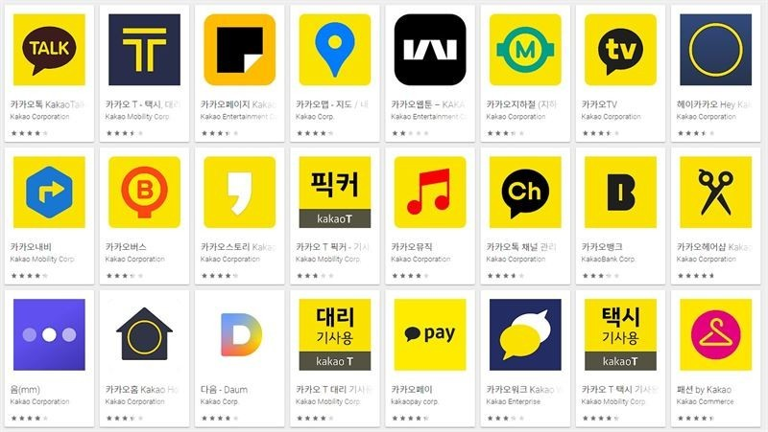
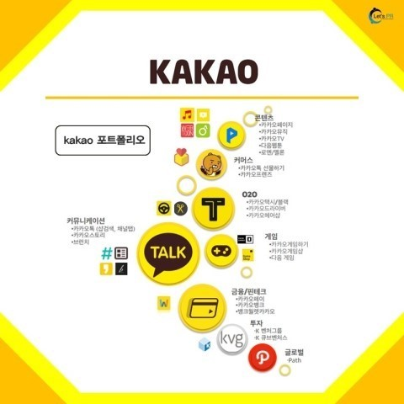
Korea’s main messenger, Kakao talk
They have expanded their business into many areas.
There are Kakao games, Kakao Pay, Kakao Taxi, Kakao Bike,
Kakao Certificate, Kakao Navigation, Kakao Map, Kakao Music, etc.
Notes:
You should download kakaotalk when you visit Korea. Everything is connected to kakaotalk. It is so much more than a messaging app. They have expanded their business into many areas. There are Kakao games, Kakao Pay, Kakao Taxi, Kakao Bike, Kakao Certificate, Kakao Navigation, Kakao Map and Kakao Music and so on

Slide 7
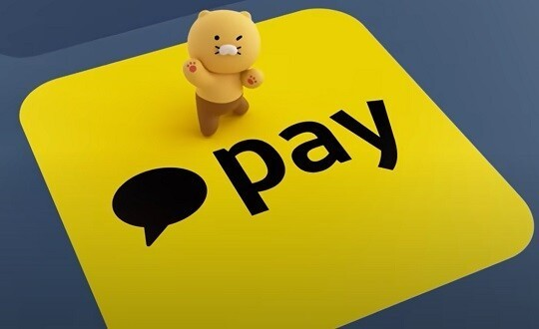
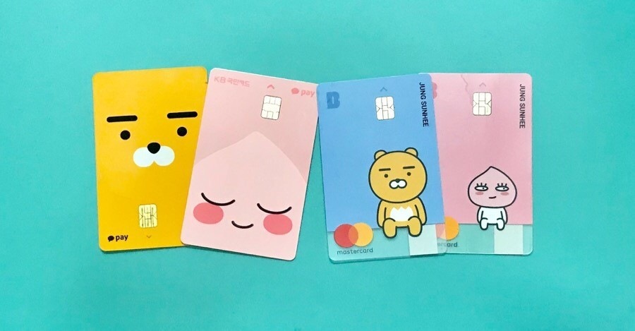
Korea’s main messenger, Kakao talk
Kakao Pay
Notes:
Kakaotalk is connected to something called kakako pay which you can use to buy stuff online, so it’s really really handy. You can send money through kakaotalk so there’s like a kakaopay which basically you take money out of your bank account and put it in this virtual wallet in kakaotalk and then you just send your friends money back and forth like instead of splitting the bill at a restaurant. So easy and basically.

Slide 8

Korea’s main messenger, Kakao talk
Emoticons in Kakao talk
Notes:
It’s something you need and also it’s something quite cute because they have a lot of cute emoticons that people use. and I’ve bought a few as well because they’re just fun to have they’re like a two dollars and I just use them all the time so to me it’s money well spent. But don’t worry, there’s a free emoticons in kakaotalk.
And The company created an system that users can design it themselves.

Slide 9
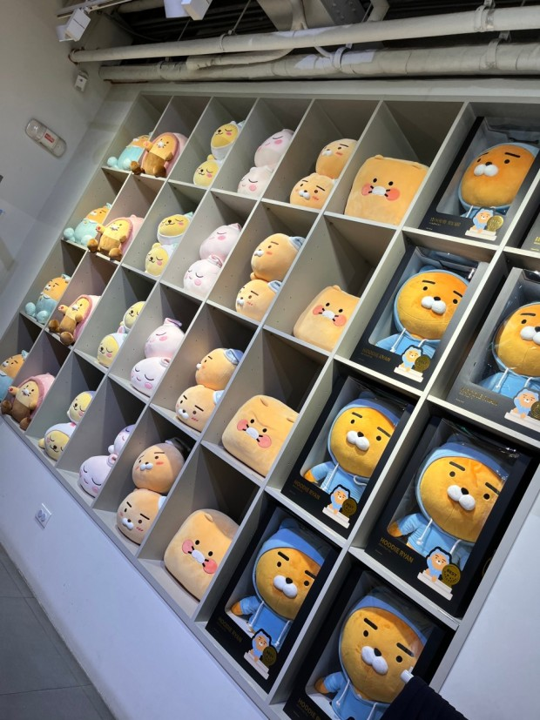
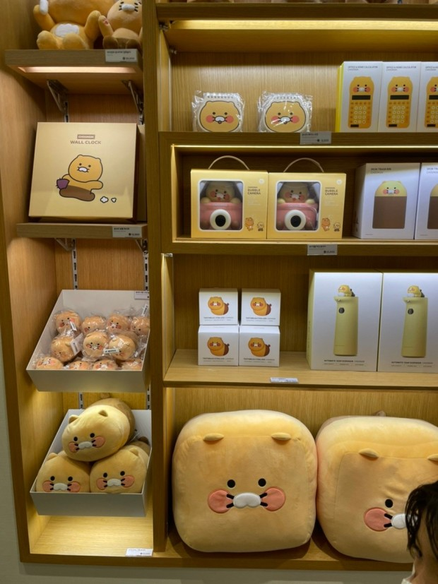

Korea’s main messenger, Kakao talk
Kakao friends shop
Notes:
And when you visit Korea, you can see a lot of kakao characters, in Kakao friends shop, there’s many goods about kakaotalk characters.

Slide 10
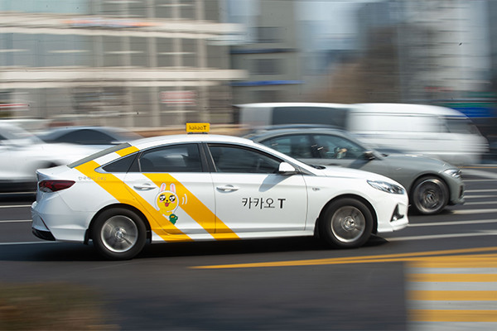
Korea’s main messenger, Kakao talk
Kakao Taxi
Notes:
An essential app for me is an app called kakaotaxi, kakaotaxi is basically how I call a car. we do have uber in Korea but I don’t know I just prefer kakao taxi. It’s just a lot easier and you can order your car no big deal and if you’re out like in the night time or whatever it’s just the best way to call a car.

Slide 11


Relationship between Koreans offline culture and Kakao talk
Forming relationships through introduction
an impromptu relationship
with an anonymous person
Koreans do not prefer to talk to strangers.
if they want to meet new people, Koreans usually prefer to meet people through introductions.
Notes:
Now, I will talk about Relationship between Koreans offline culture and Kakao talk
There are two case of forming relationships. Koreans do not prefer to talk to strangers. Koreans don't do small talk with strangers.
if they want to meet new people, Koreans usually prefer to meet people through introductions.

Slide 12
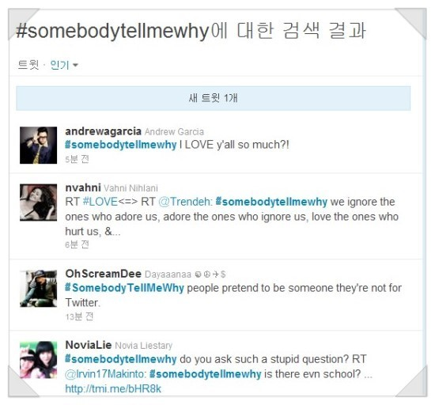

Relationship between Koreans offline culture and Kakao talk
Relationships are formed after having a conversation.
Notes:
So, for example, in the US, Twitter is very active. user can see who is talking about the field I am interested in, and if there is someone I want to talk to, I can reply to that person. Then they meet offline and become friends. I think that's the charm of American social media.

Slide 13
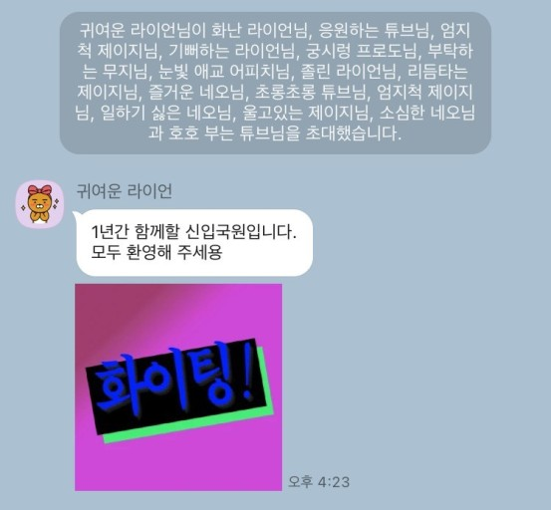
Relationship between Koreans offline culture and Kakao talk
Relationships are formed before having a conversation.
Notes:
In korea, when offline, Someone invites the person and gets close together. Kakao Talk group chat are also operated in that way. I think this fits well with the way Koreans used to manage their connections.

Slide 14
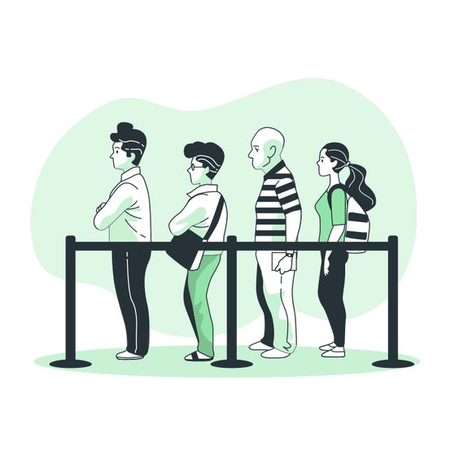

Relationship between Koreans offline culture and Kakao talk
Notes:
When many people eat together at a restuarnat, they pay separately. However, in Korea, one person completes all the payments and pays through Kakao Talk.

Slide 15
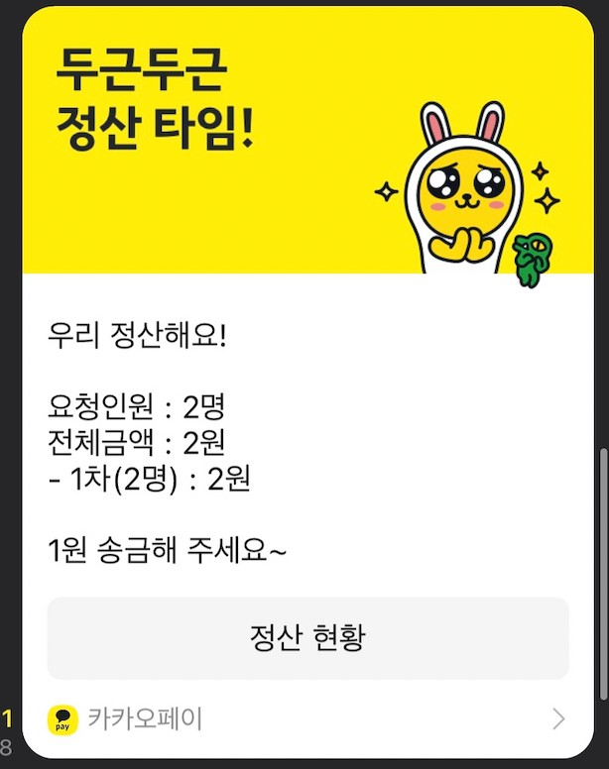
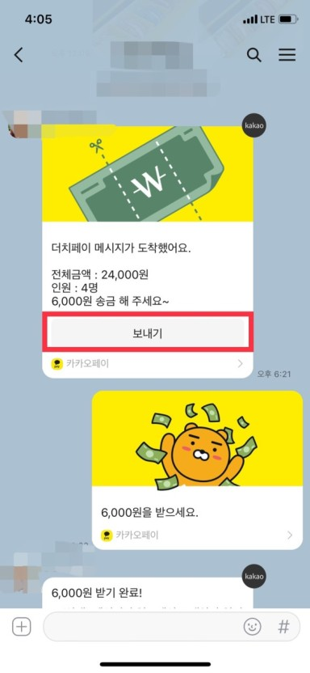

Relationship between Koreans offline culture and Kakao talk
Notes:
You can send money to your friends quickly on Kakao Talk. Kakao Talk automatically calculates how much money should be divided.
I Know that you guys use the revolute to send a money to your friends. but i think korean send a money more often than other country people.
Because there is a culture of sharing food So we don't just calculate our own food.

Slide 16
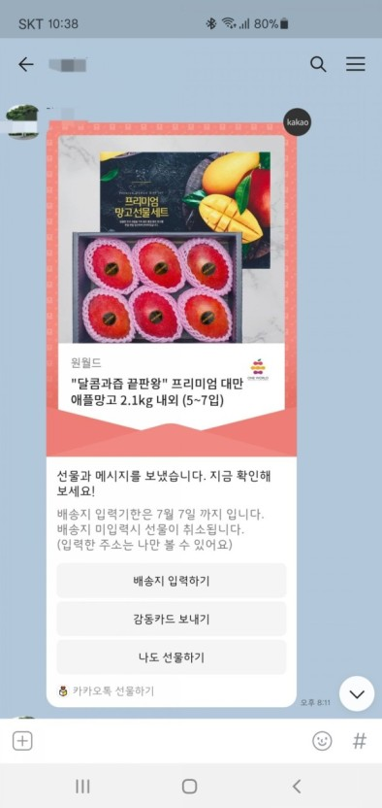
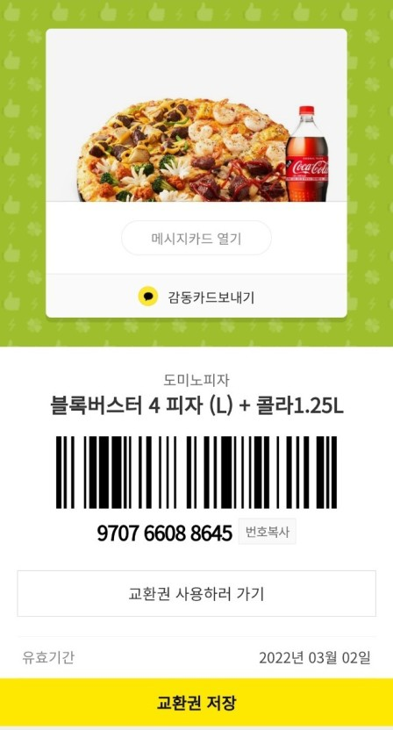

Relationship between Koreans offline culture and Kakao talk
Notes:
I heard that Americans don't feel awkward even if they meet friends after a long time. Koreans think it becomes awkward if they don't contact each other. So,When Koreans don't want to lose contact with their distant friends, they send gifts through Kakao Talk. They send gifts and continue the conversation on kakaotalk. And Koreans often send gifts through Kakao Talk on their friends' birthdays.

Slide 17

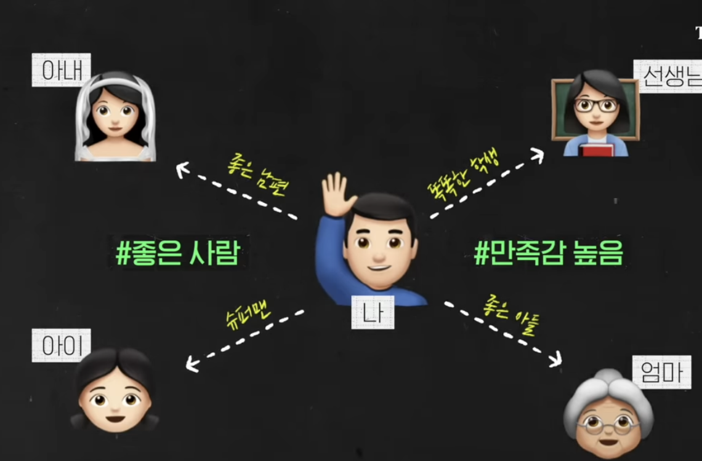
Relationship between Koreans offline culture and Kakao talk
MOM
Wife
Teacher
Teacher
ME
ME
Child
Friend
MOM
they should show themselves
the same in any social situation
the role should change well depending on the situation.
Notes:
Westerners thinks that they should show themselves the same in any social situation. When they feel that they are consistent people, their confidence and happiness increase. But Korean was not. A good son in front of his mother, a sweet husband in front of his wife, and a charismatic father to his children. In this way, the role should change well depending on the situation. That way, in Korea, they feel that I am living a good life.

Slide 18
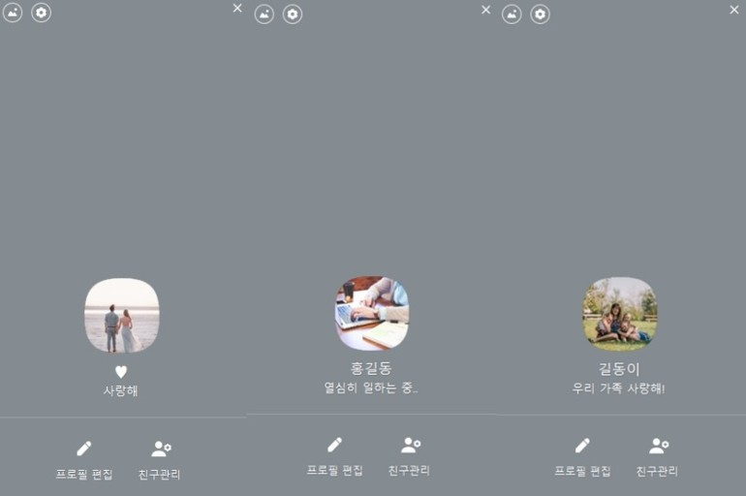
Relationship between Koreans offline culture and Kakao talk
Multi-profile
Notes:
I think multi-profile fits well with Korean culture.
you can make a profile based on the situation on Kakao Talk. .

Slide 19
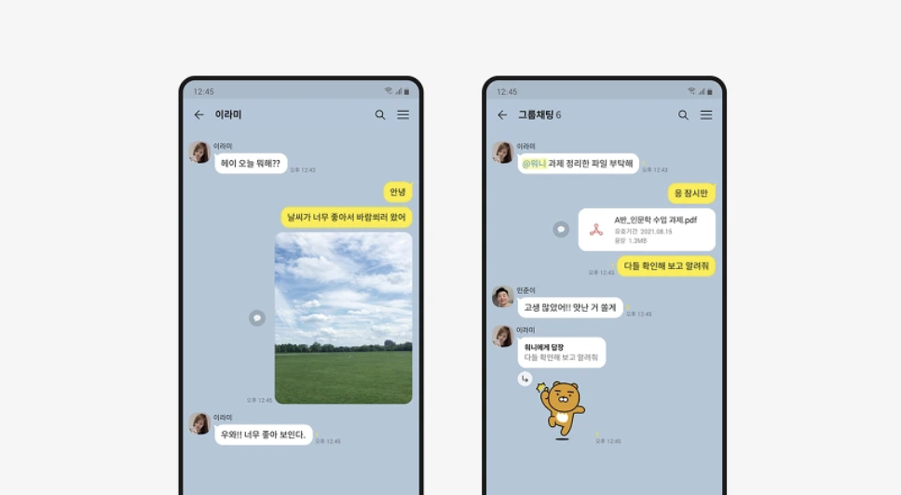
Notes:
Kakaotalk is a chatting service that suits the culture of Koreans. I think it has become a country where people of all ages can enjoy this Internet space because it has almost brought offline culture.

Slide 20
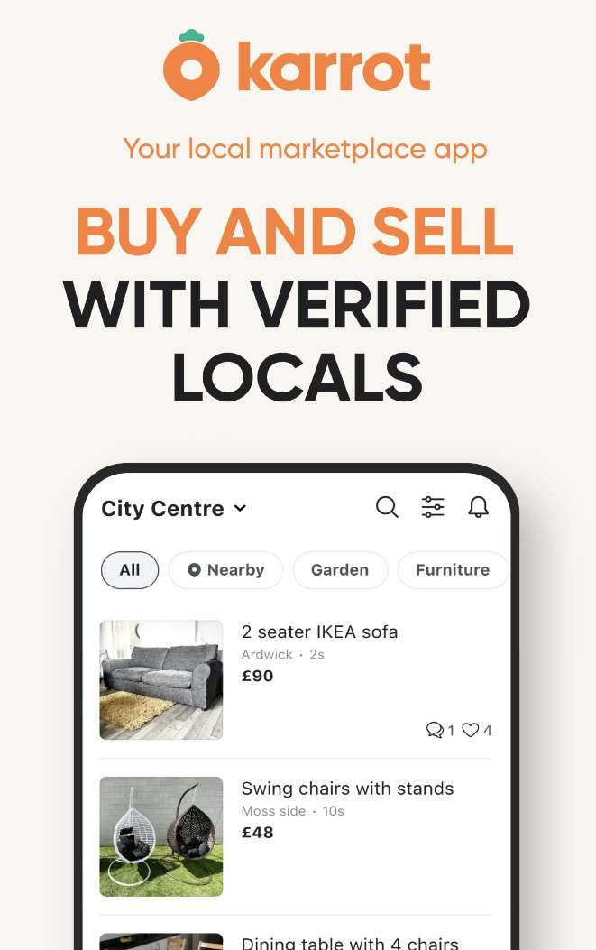

Second-hand trading app ‘Karrot’
Notes:
There’s an app that’s kind of been like widespread now in Korea it’s called 당근마켓 and it’s basically where you can buy and sell your used items.
It’s the out there it’s probably gonna help you when you’re moving out of Korea and when you’re moving into your apartment because you can treat a lot of stuff.
you can sell, you can buy ,second hand things (furniture, clothes, bike, smart phone even coffee like starbucks giftcard) everyting and everyone is on 당근마켓. It’s the app that it’s gonna save you a ton of money.

Slide 21
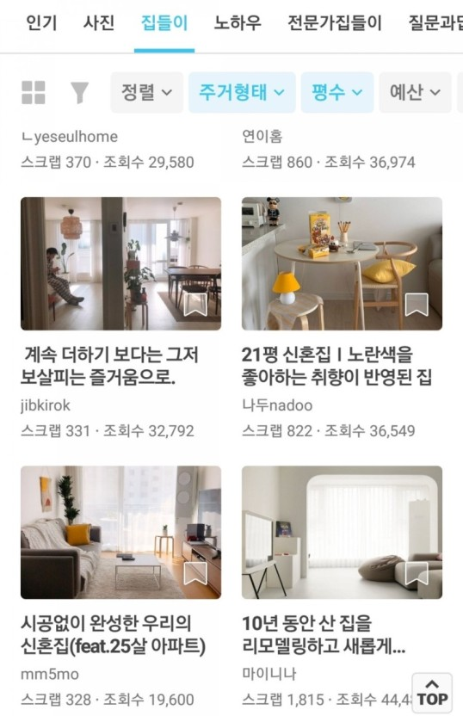

Interior application ‘오늘의 집’
Notes:
오늘의 집 is an interior application. It’s basically people who upload their room their home with the things they bought on 오늘의집 and you just get inspired so you can see the things around, you can buy big furniture like table chair mirrors or likes cutlery cups anything, and you can get it delivered.

Slide 22



Delivery apps
Notes:
If you need clothes for tomorrow right away, or if you need things or ingredients or food right away, you can order them through the delivery app.
Most young people in Korea buy clothes online, and delivery takes a day or two.
Coupang is like amazon so most likely if you find something on 오늘의집 for your house, check on coupang first. Because it might be cheaper. And when you buy it, you’re gonna get the items pretty soon.
The food delivery app called Baemin can receive food in 30 minutes to an hour, and it is also connected to the mart, so you can buy goods at home with the application and receive them in 20 minutes
In korea, delivery is very fast cause Korean land is so small.

Slide 23
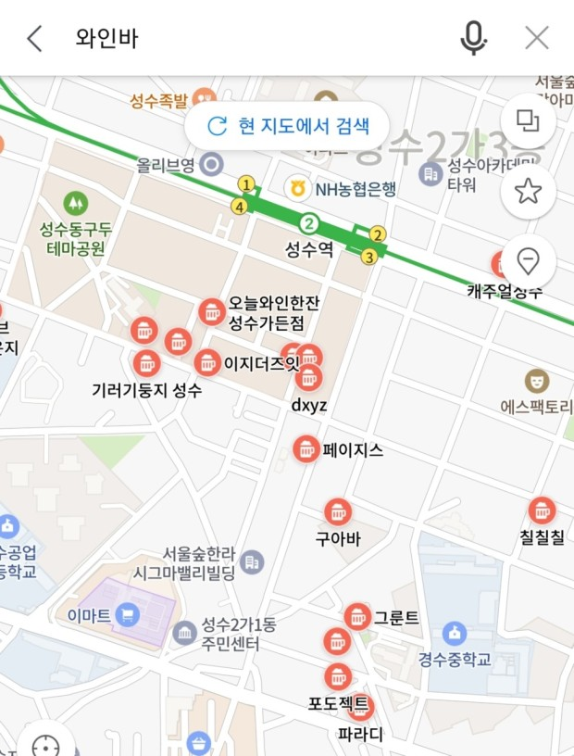
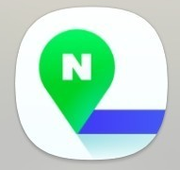
Naver Map
Notes:
Naver is so huge search engin company in Korea. They have a lot of branches of things.
Now, I will tell you about a Naver Map. It is like the only way you’re going to find your way around and it’s really great also for riding the subway it will let you know like what door like what train car you should go to have like the fastest transfer.
In Naver, you can make bookings on it and order food too actually. I will use naver to book things like my haircut.
And it’s all English on the app for the most part so it’s pretty easy to navigate.

Slide 24

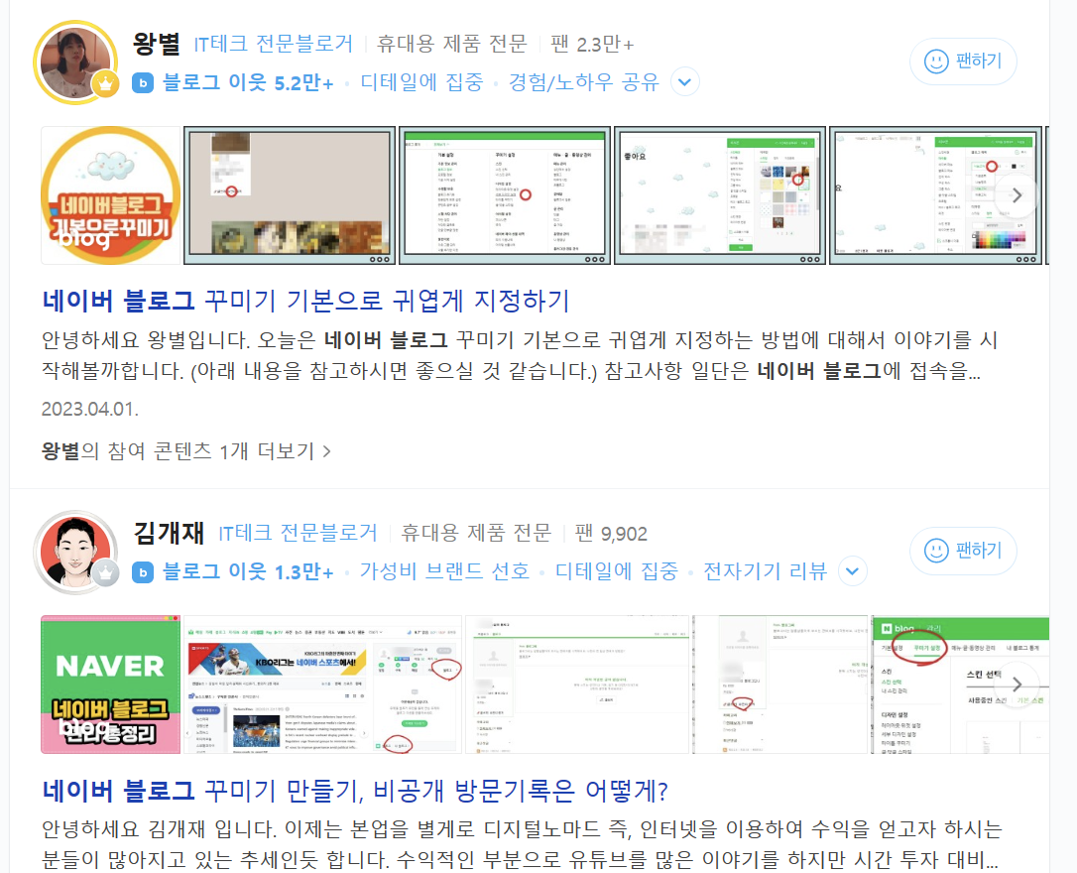
Naver blog
Notes:
Naver blogs are used by many people to keep diaries or share information. If you search for good restaurants on Naver, you can see posts on blogs. Use blogs to find good places or get new information in Korea

Slide 25
Thank you

