Slide 1
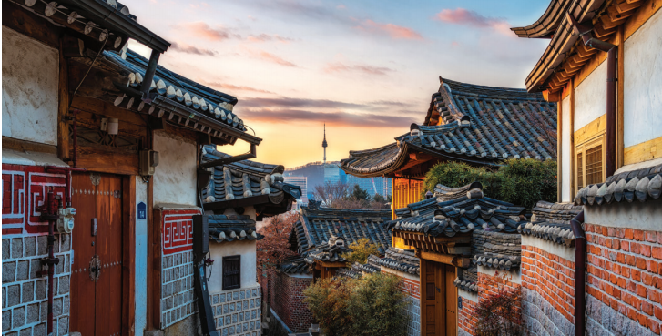
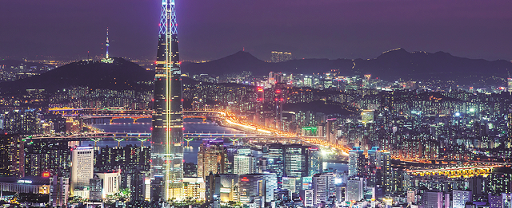
Korean culture class
Mail: goyuji4@gmail.com
Instagram: @yuvvnzzn
Yuji Koh

Slide 2


INDEX
1
korea geography
2
Korea city
3
Jeju

Slide 3
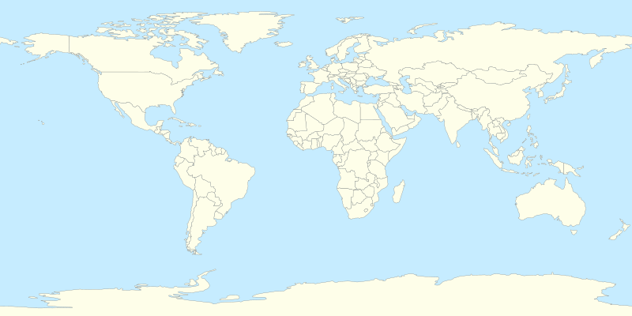

Where is Korea located?
-Located in Asia (East Asia)
-Divided into North and South Korea
-It is a peninsula type and 70% of the land is mountains

Slide 4
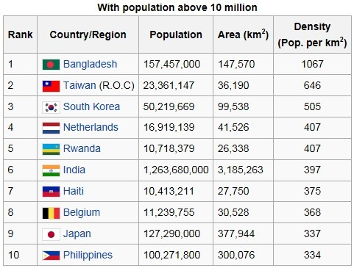
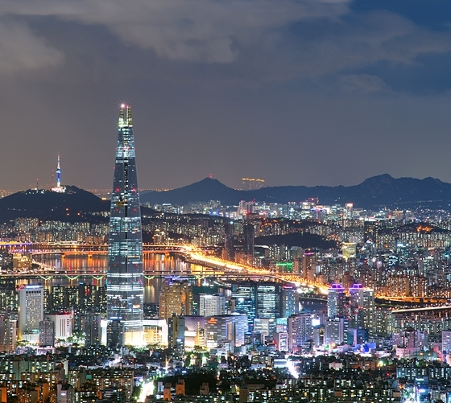
-High population density
-1/5 of the population lives in Seoul
https://youtu.be/viIhOorr11I

Slide 5
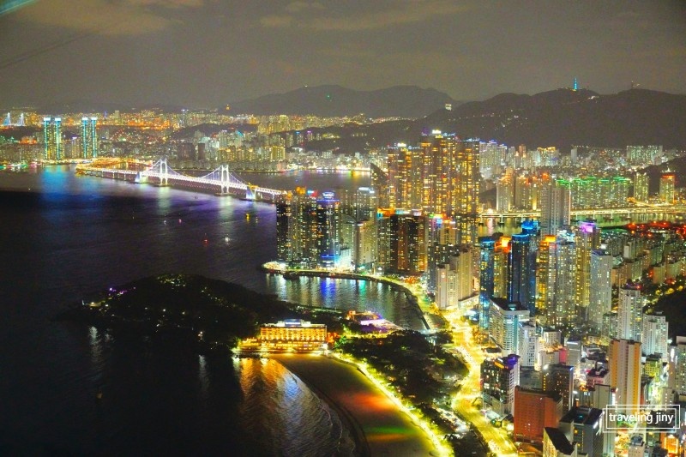
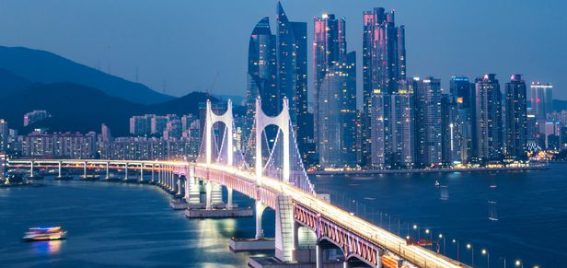
Busan
https://youtu.be/xLD8oWRmlAE
-2nd largest city
-Located on the sea, active trade area
-Famous for night view and bridge
-Efforts are being made to attract the 2030 Busan Expo

Slide 6
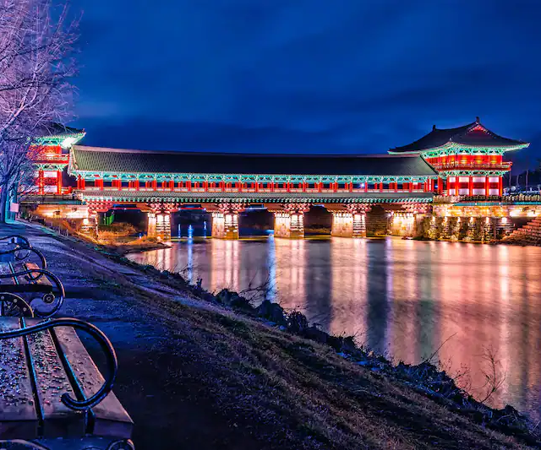
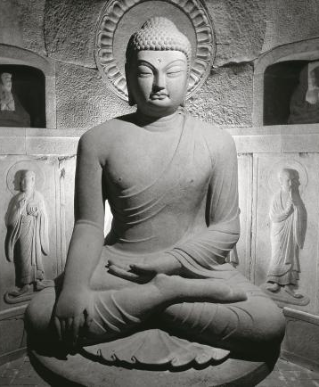
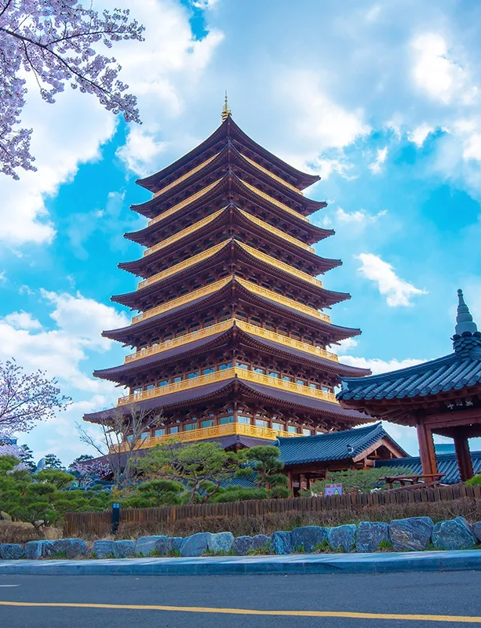
Gyeongju
https://youtu.be/dqkfpKJw348
-The ancient capital of Silla Dynasty in Korea
-Historical and traditional city

Slide 7
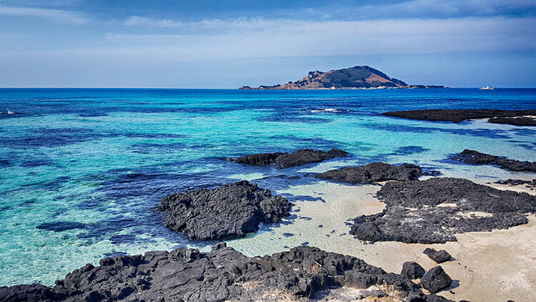
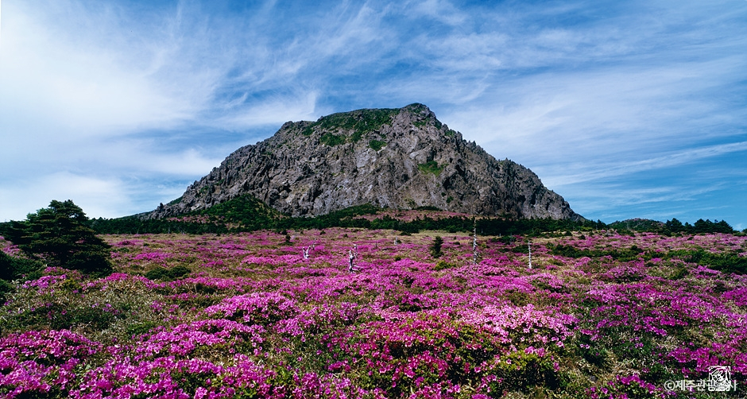
Jeju
https://youtu.be/gux_pyEIcUY
-An island located in the southernmost part of Korea
-It has the largest mountain in South Korea and is a volcanic island
-Selected as UNESCO World Natural Heritage

Slide 8
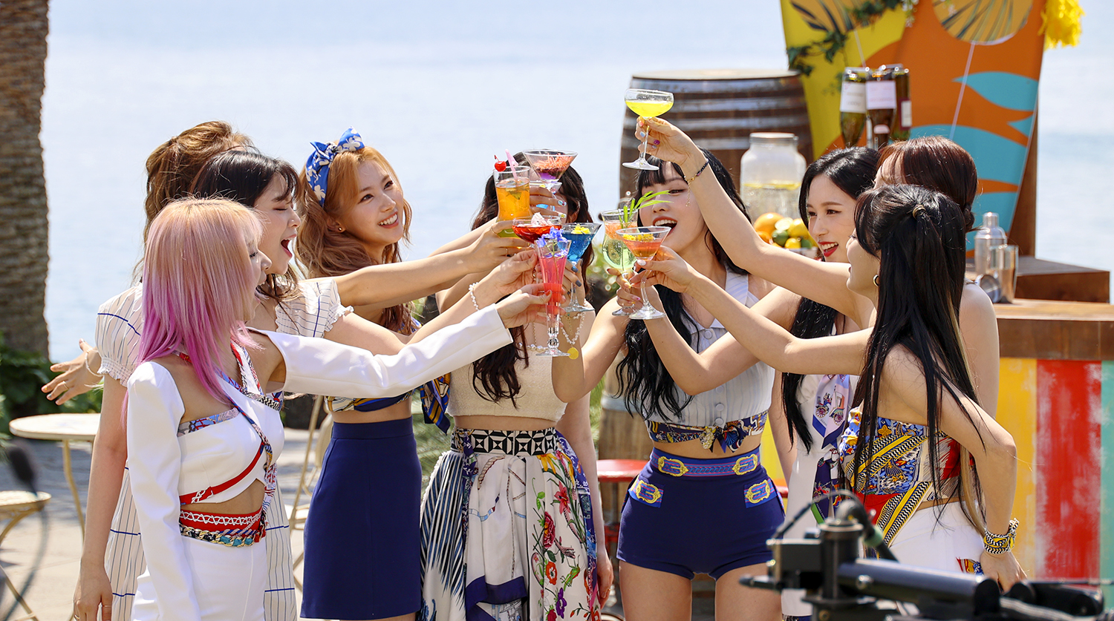
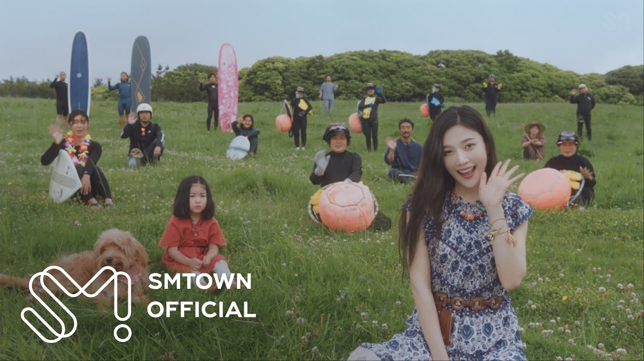
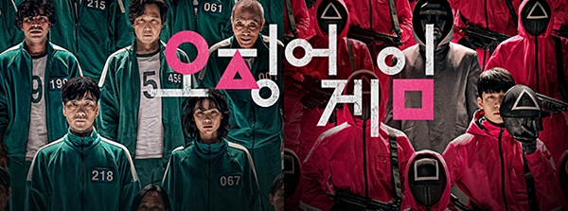
Twice - alcohol free
Red Velvet Joy - Hello
squid game
https://youtu.be/Qg0XyRXaB-Q

Slide 9
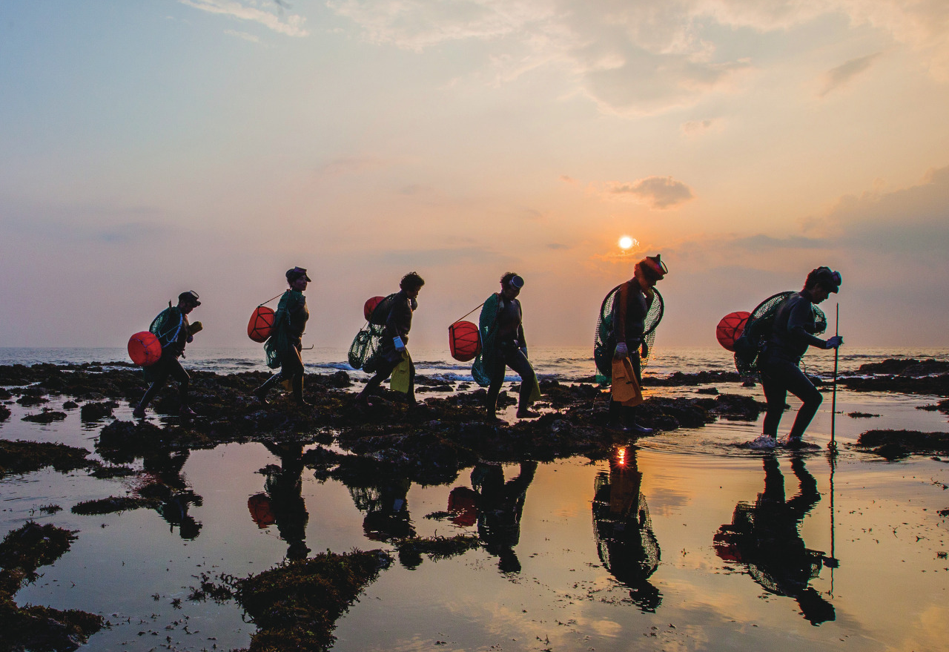
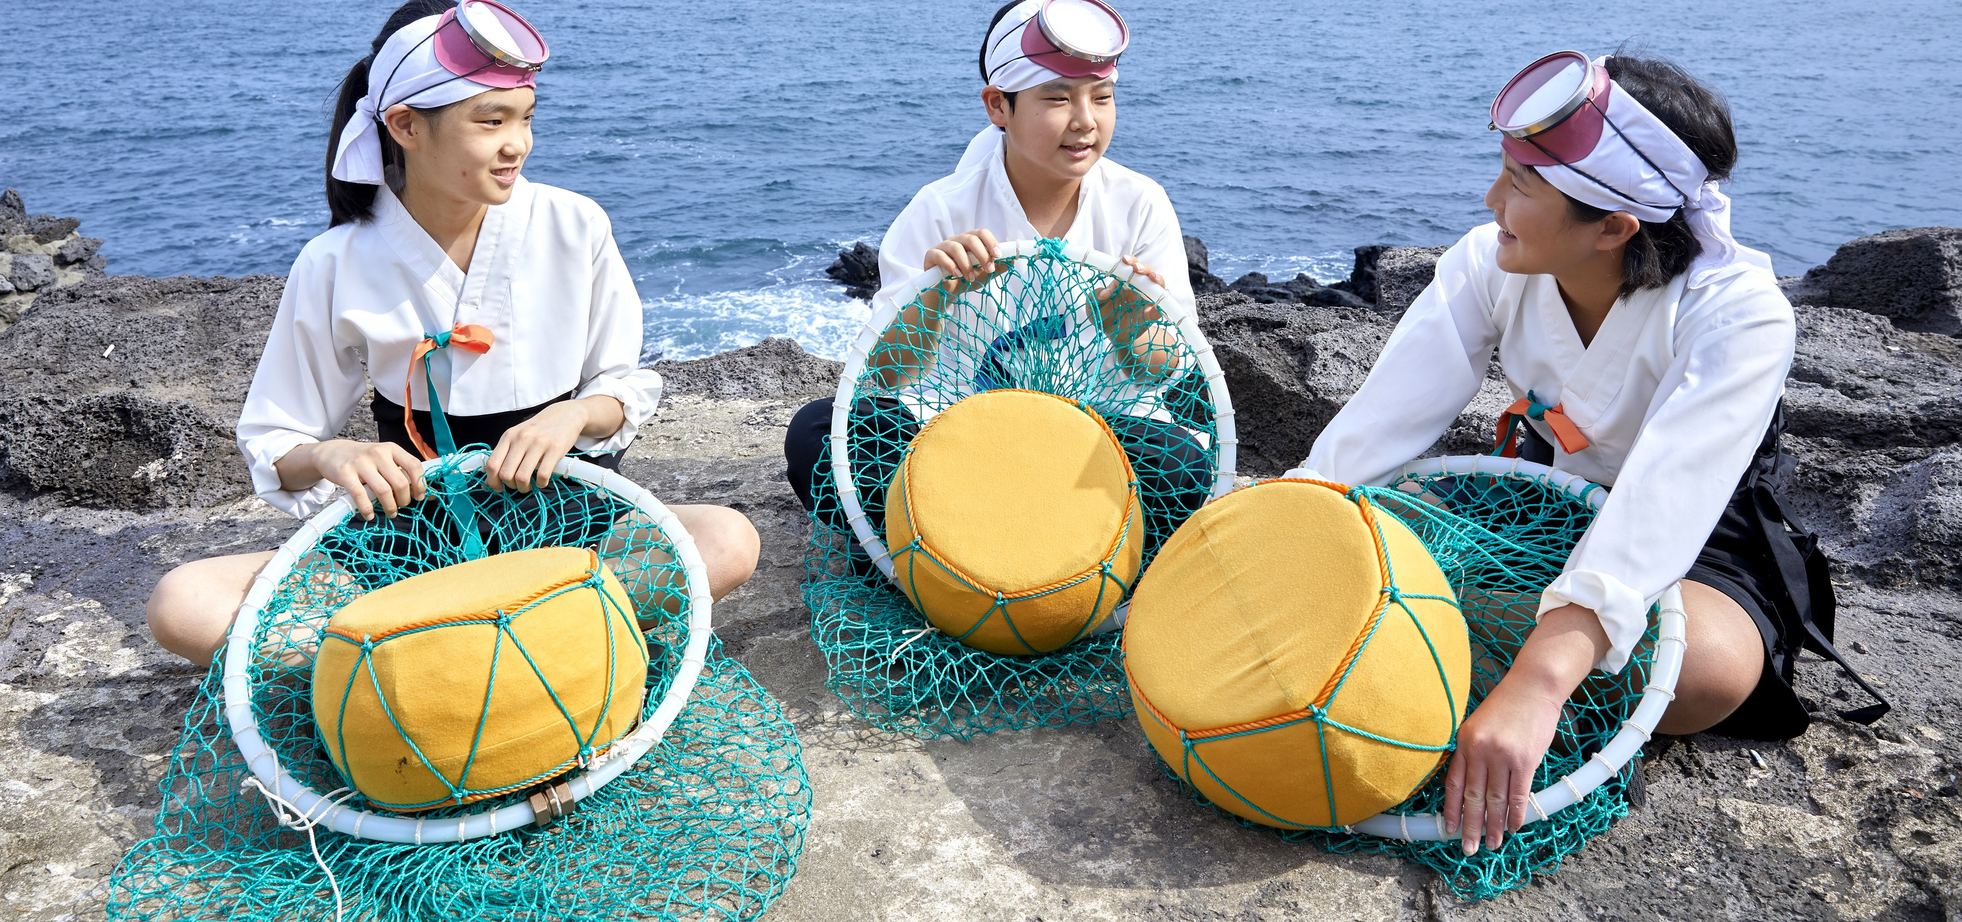
Jeju Haenyeo
-Diving in the sea to catch seafood
-made up of women
-Jeju's Social Tradition

Slide 10
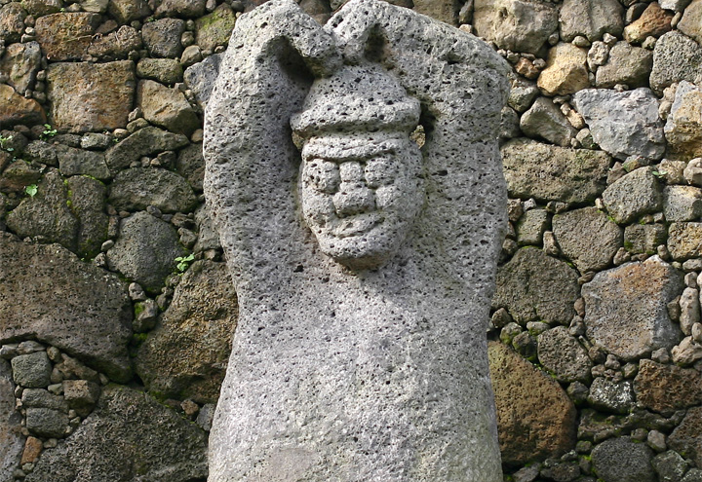
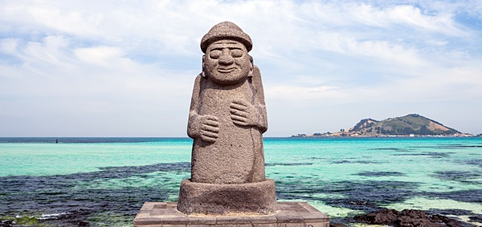
jeju Dol Hareubang
-Jeju is a volcanic island, so basalt is famous.
-made of basalt
-dol means stone Harubang is a Jeju dialect meaning grandfather.

