Slide 1
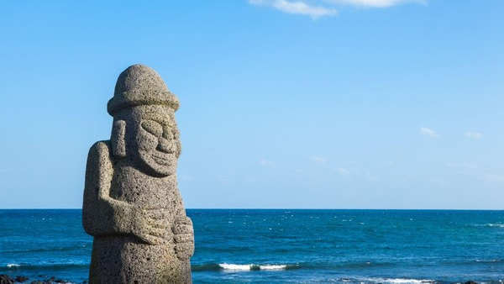
“ Welcome to
Jeju Island ”

Slide 2
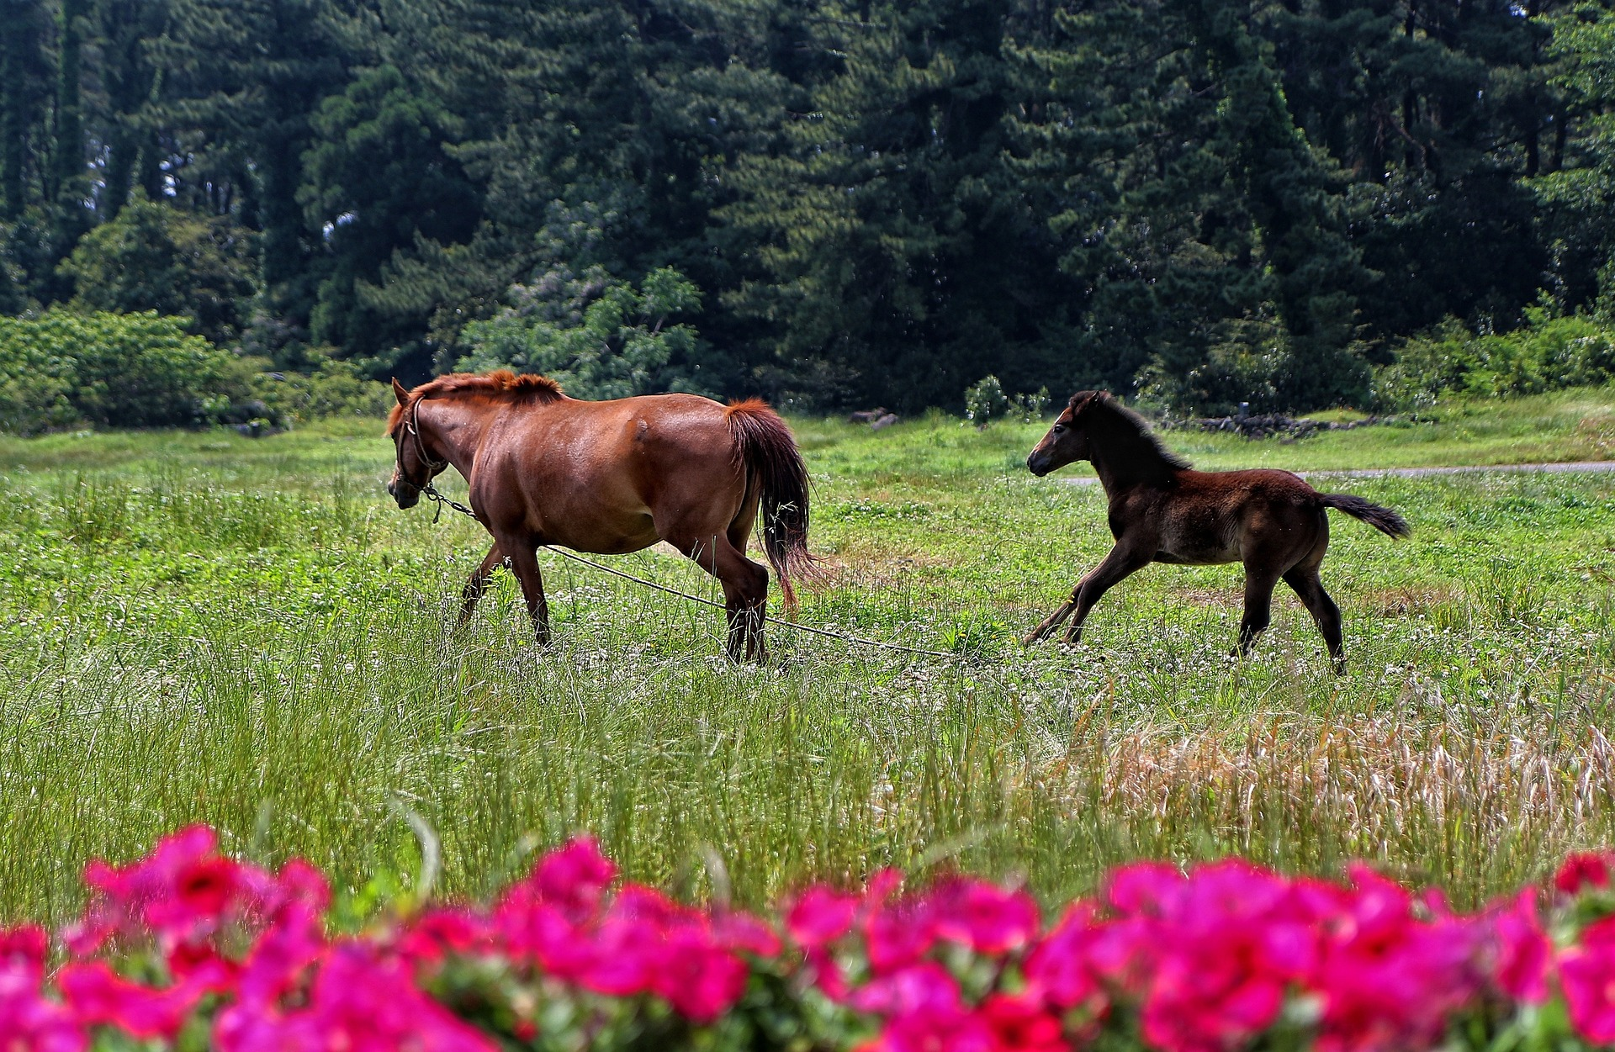
Contents
Jeju Island
Jeju in K-Drama
Local food of Jeju

Slide 3
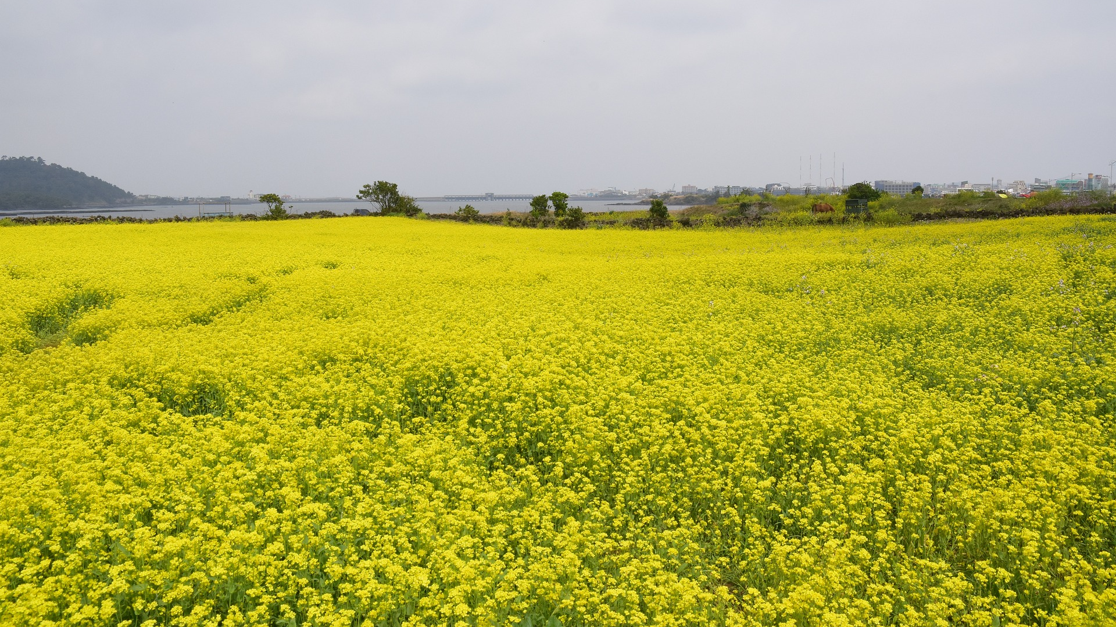
Jeju Island

Slide 4
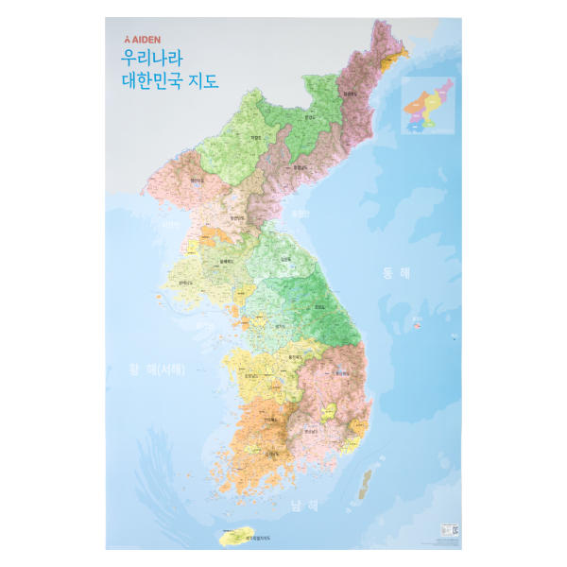
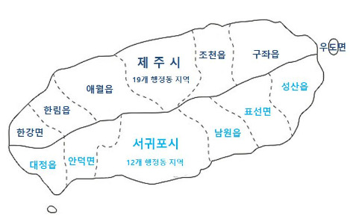
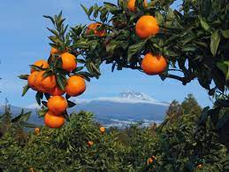
Jeju si
Seogwipo si
Location : South of Korea
Weather : Warm
Division area : Jeju si / Seogwipo si
Culticated crop ; Madarin orange

Slide 5
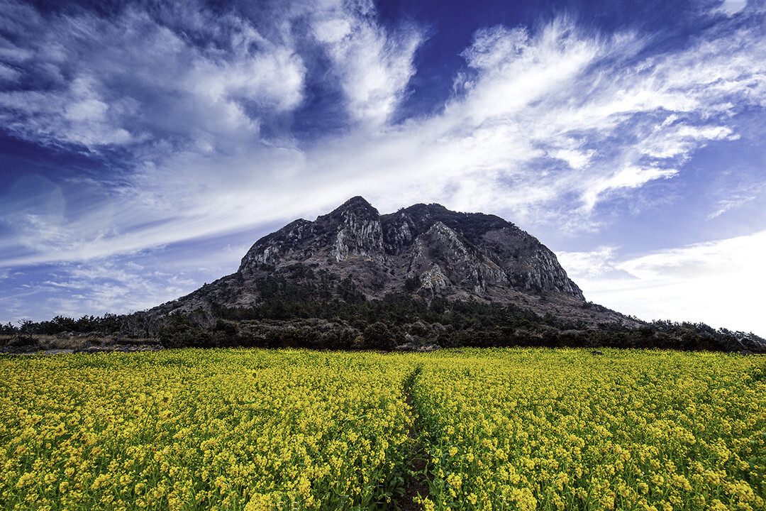
High : 1950m
-> The highest mountain in South Korea
In 1996 : designate as a natural reserve
In 2007: listed as a UNESCO World Natural Heritage Site
Mt. Hanlla

Slide 6
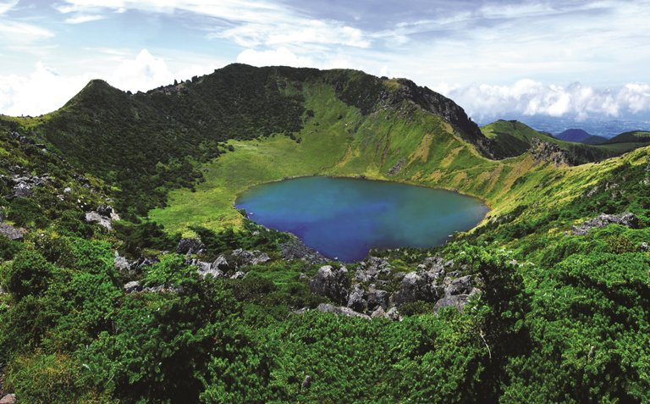
The snow has not melted and is piled up into the summer.
Name origin : many white deer played at the top of Mt. Hanlla
Baengnokdam

Slide 7
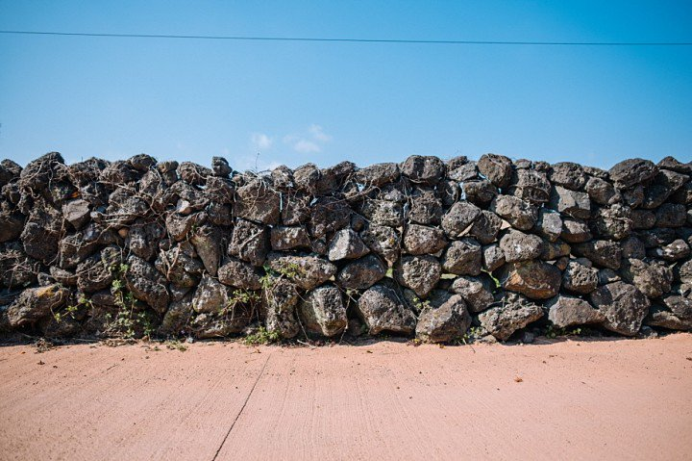
“ ”
삼 다 도

Slide 8
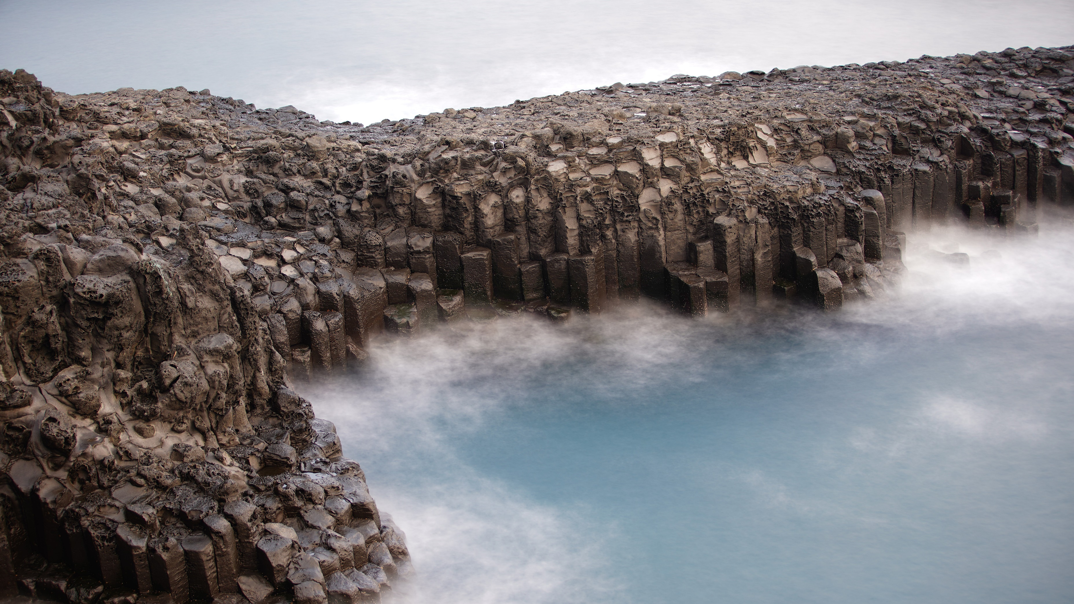
Jeju in the K-drama

Slide 9
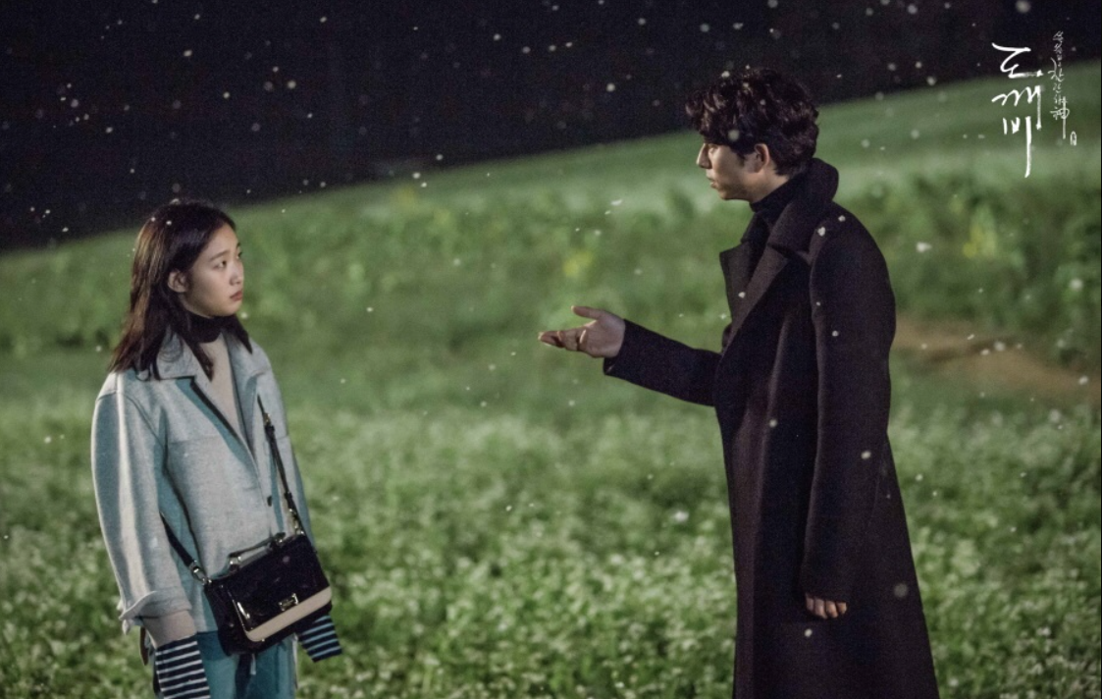
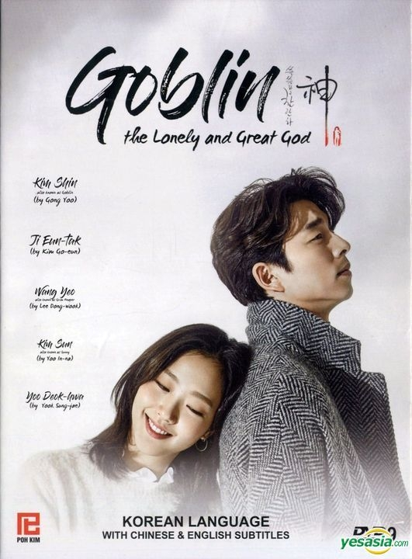
The goblin is cursed and lives forever. So, he wants to find a goblin bride and draw a knife from his chest for ending his life.

Slide 10
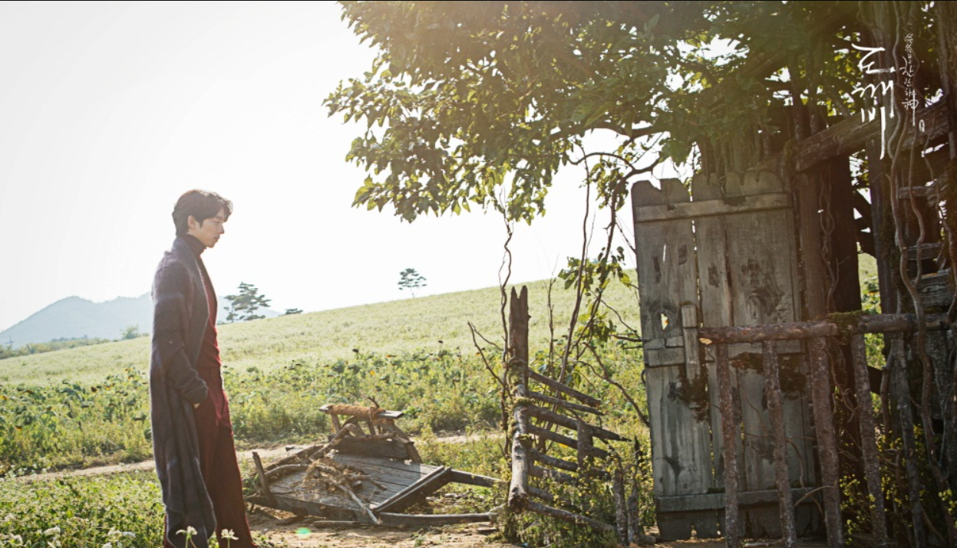
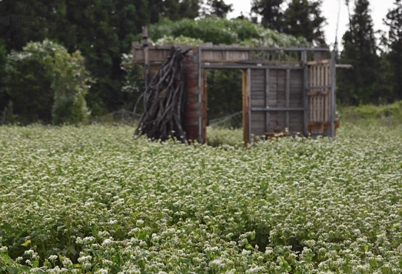
The picture on the left is a scene from a real drama. This door can go back and forth in the dimension of time. If you look at the picture on the right, you take pictures here. If anyone wants to go, go in May. Buckwheat flowers bloom only in May, so it is a good month to take pictures.

Slide 11
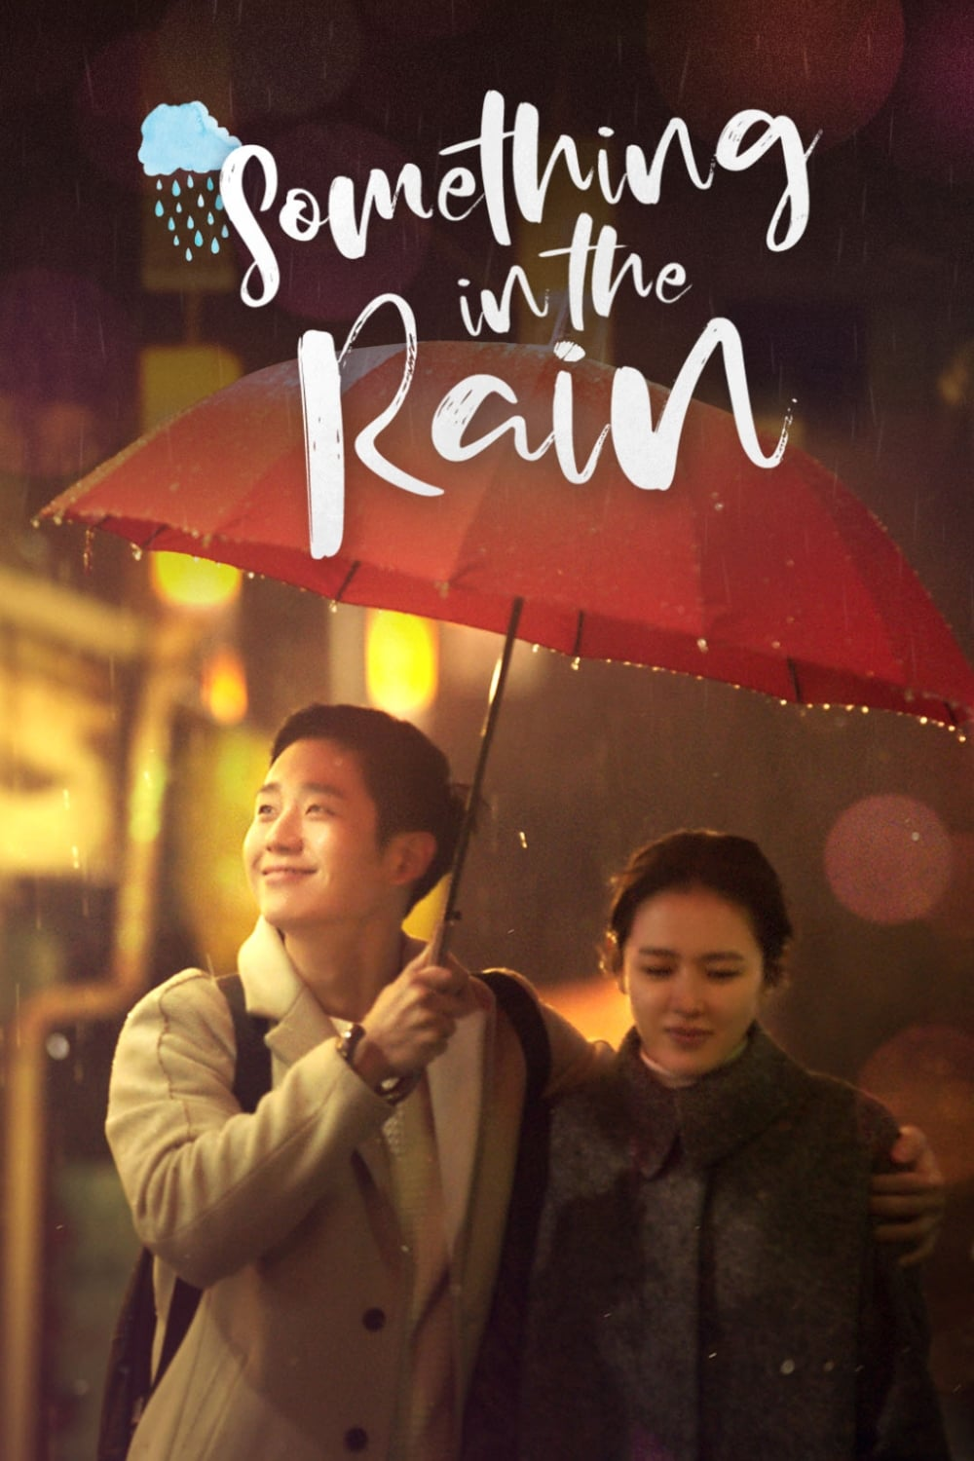
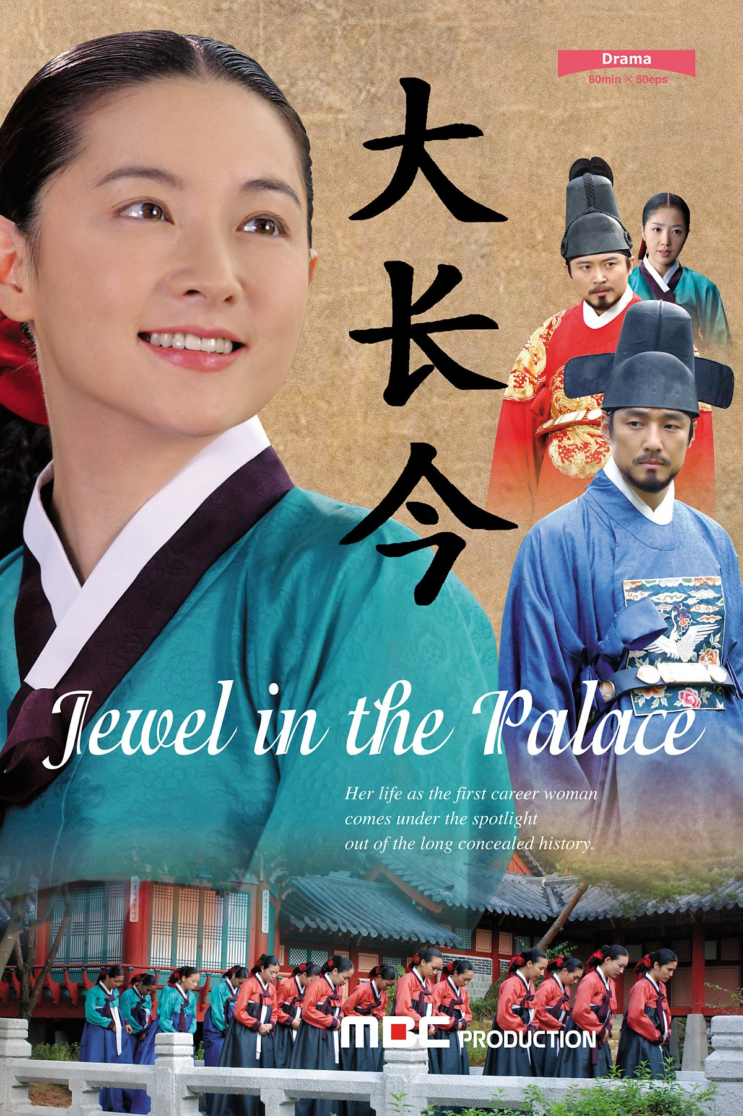

Slide 12
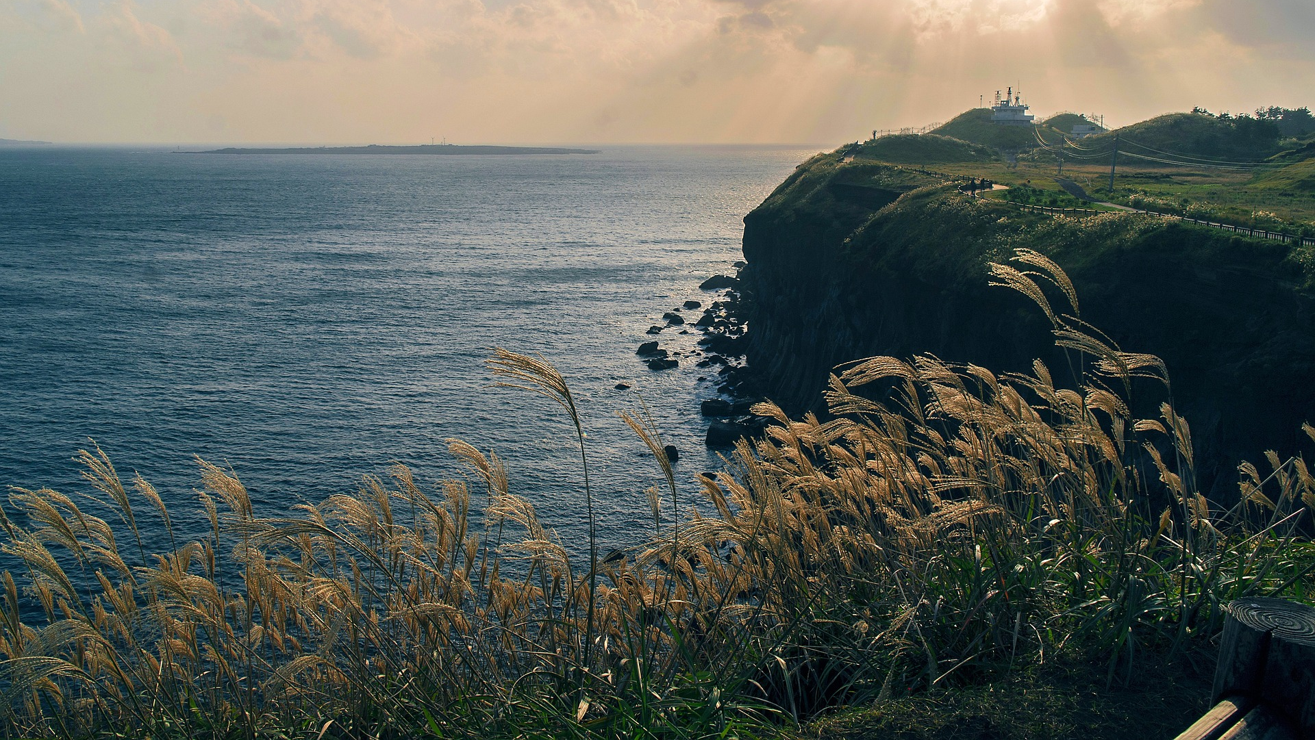
Local Foods of Jeju

Slide 13
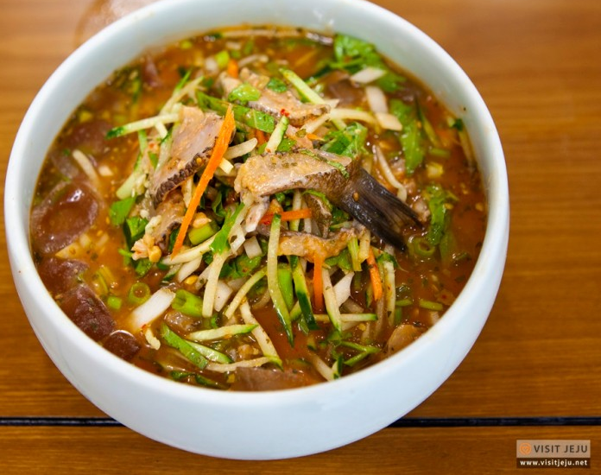
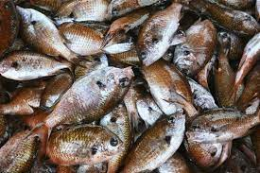
Jalidommulhoe (자리돔물회)
Live : in one area in the wide sea.
Compared to other fish species: smaller in size, goes around in groups
Best to eat : between June and July before spawning.

Slide 14
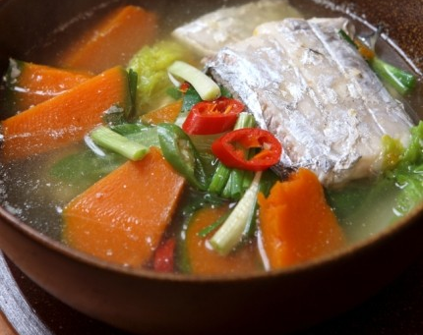
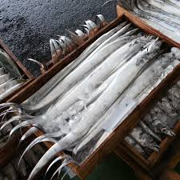
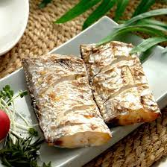
Hairtail Soup
Silver hairtail
Time : with ripe pumpkins in autumn
Point : only eat in Jeju
-> the fishy smell remains even if the hairtail scales are removed due to the fishy smell, but jeju is surrounded by the sea on there sides

Slide 15
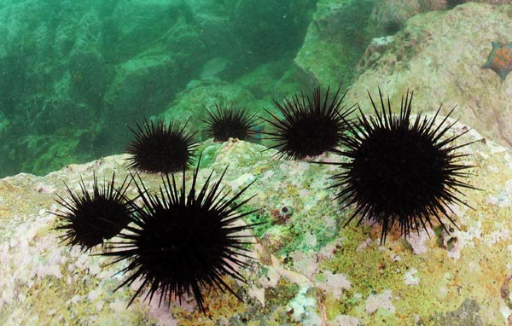
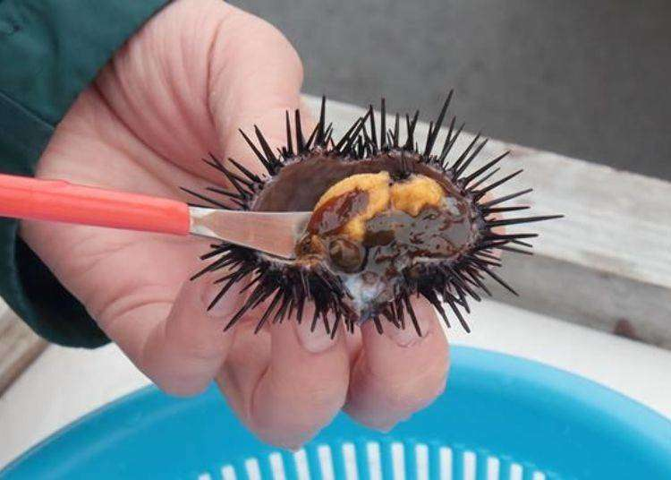
Sea Urchin
Sea urchins have thorns like hedgehogs. If you cut this thorn carefully, there are yellow eggs inside. This is the sea urchin roe. You scratch the eggs and collect them like this picture. However, it is also a precious food in jeju because it contains a small amount of eggs compared to its size.

Slide 16
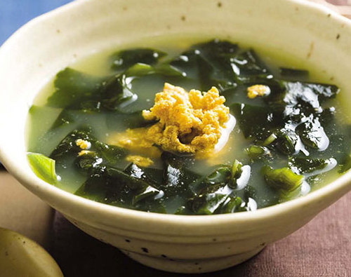
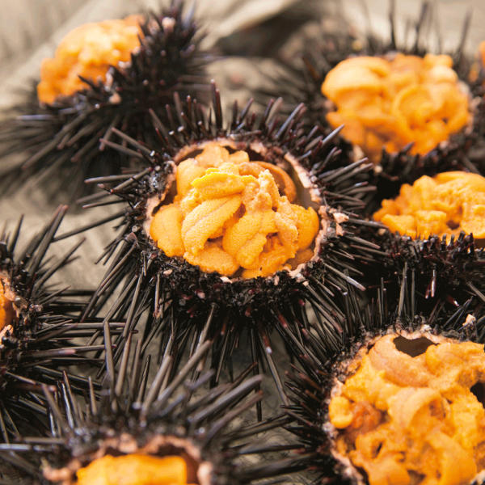
Sea Urchin
Eat : seaweed soup or raw
Best to eat : between May and July when barley ripens
-> at this time is called barley sea urchin

Slide 17
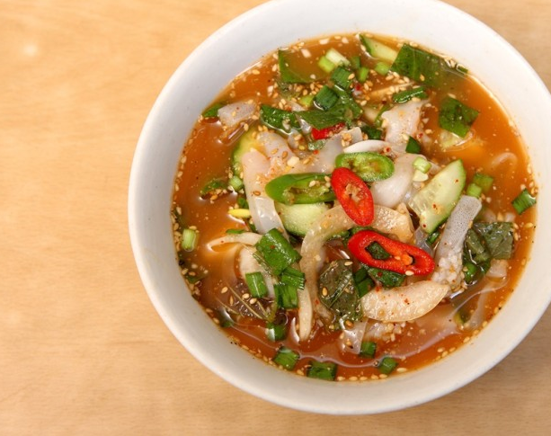
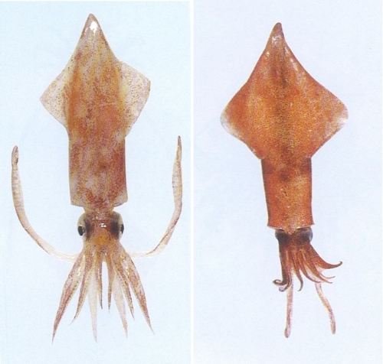
Hanchi
Shape : similar to squid, but they have short legs
How to cook : slice the hanchi thinly, mix it with vegetables and seasoning, and add water to make it
Squid
Hanchi

Slide 18
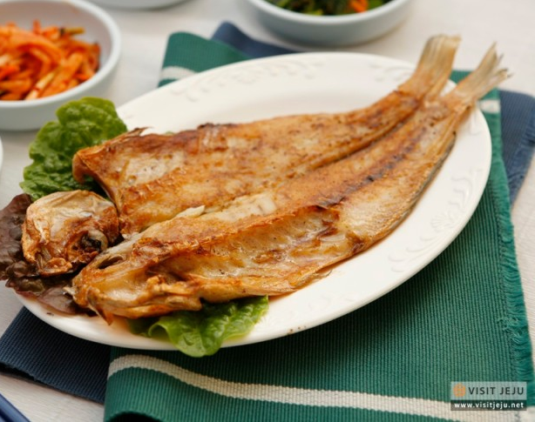
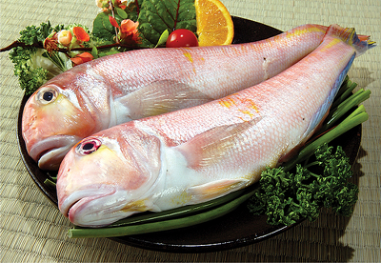
Ogdom(Jade dome)
Live area : rare fish in other areas But it is the most common fish in Jeju
How to cook : cut the belly of the Ogdom, sprinkle salt on it, and dry it and grill it to eat.

Slide 19
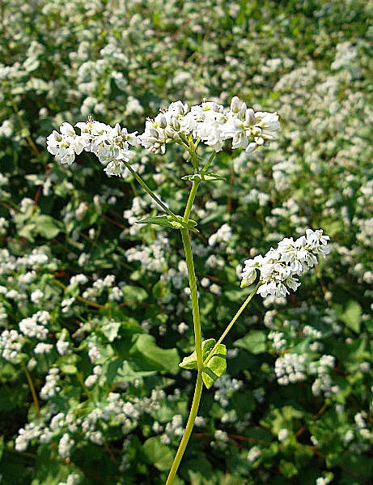
Bingtteok
Weather : Jeju has grown a lot of drought-resistant buck wehat due to its barren land
-> buckwheat developed
How to cook : made by frying thin pancakes with buckwheat flour, putting radish salad seasoned with salt and sesame seeds inside, and rolling it.

Slide 20
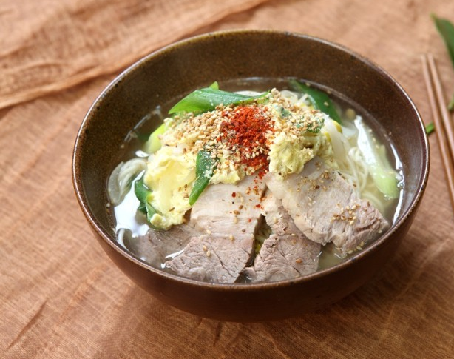
Meat Noodles
When : entertain guests, we boil pork and serve meat.
How to cook : made of pork bones with boiled noodles and pork pyeonyuk.

Slide 21
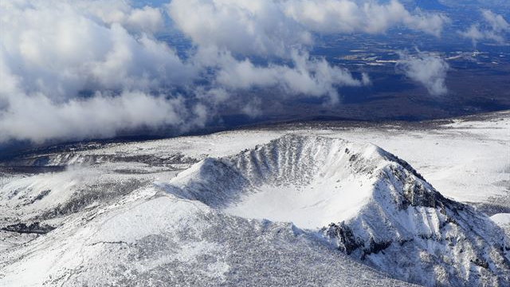
QUIZ

Slide 22
Q . Jeju Island has another name. It's Samdado (삼다도). Samdado means three things that are many on the island. What are the three things?

Slide 23
Q . This flower chosen as the filming location for the drama "Goblin" is a buckwheat flower. In Jeju, food using buckwheat flour developed because the land was barren. What kind of food is there?

Slide 24
“ Welcome to
Jeju Island ”

