Slide 1
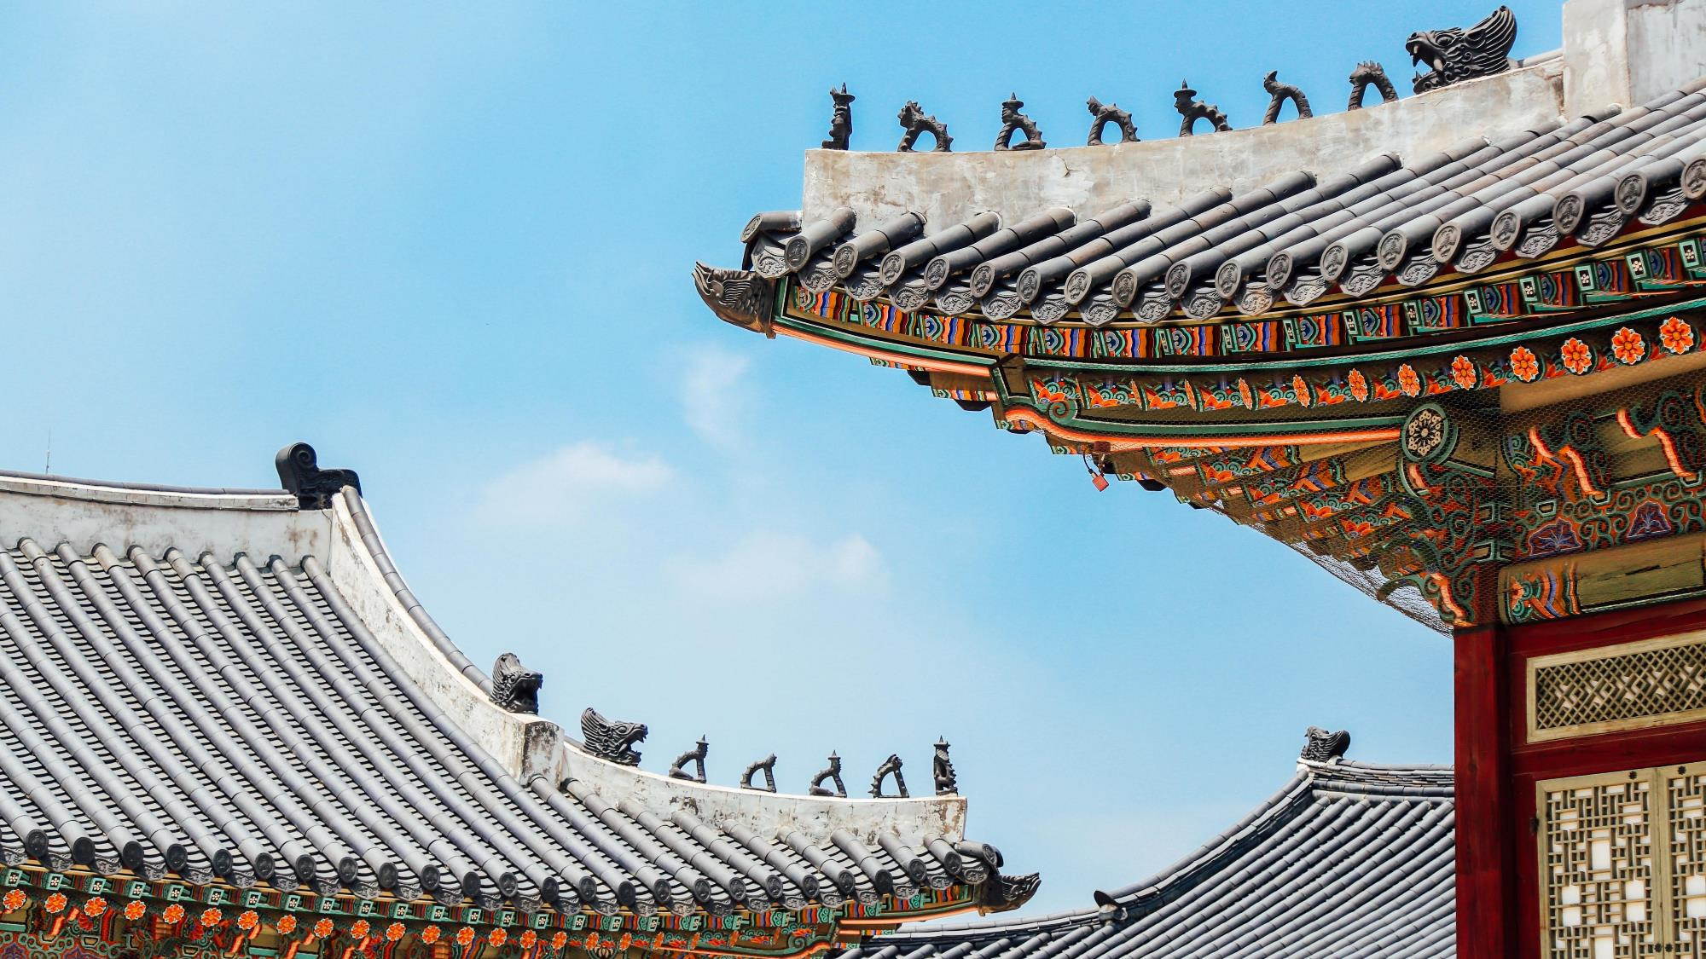
한
Introduce
국
Korea’s
Table
Setting
소
개
ⓒSaebyeol Yu. Saebyeol’s PowerPoint

Slide 2
CONTENTS
1
MAIN DISH
2
SIDE DISH
3
The table setting

Slide 3
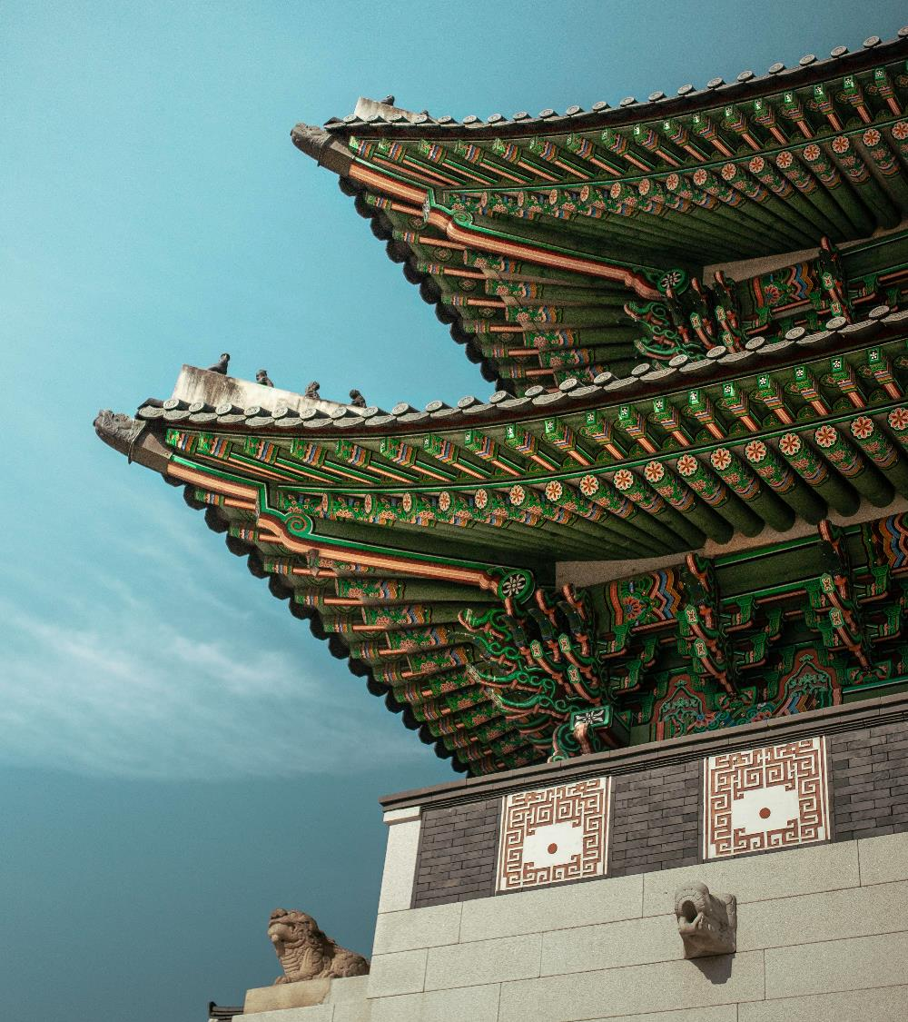
Part 1
MAIN DISH
ⓒSaebyeol Yu. Saebyeol’s PowerPoint

Slide 4
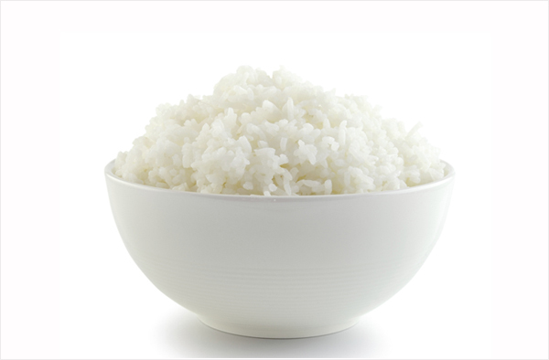
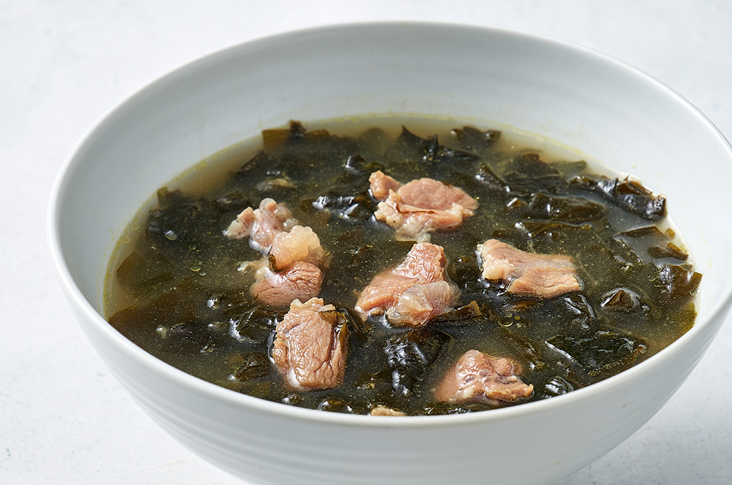
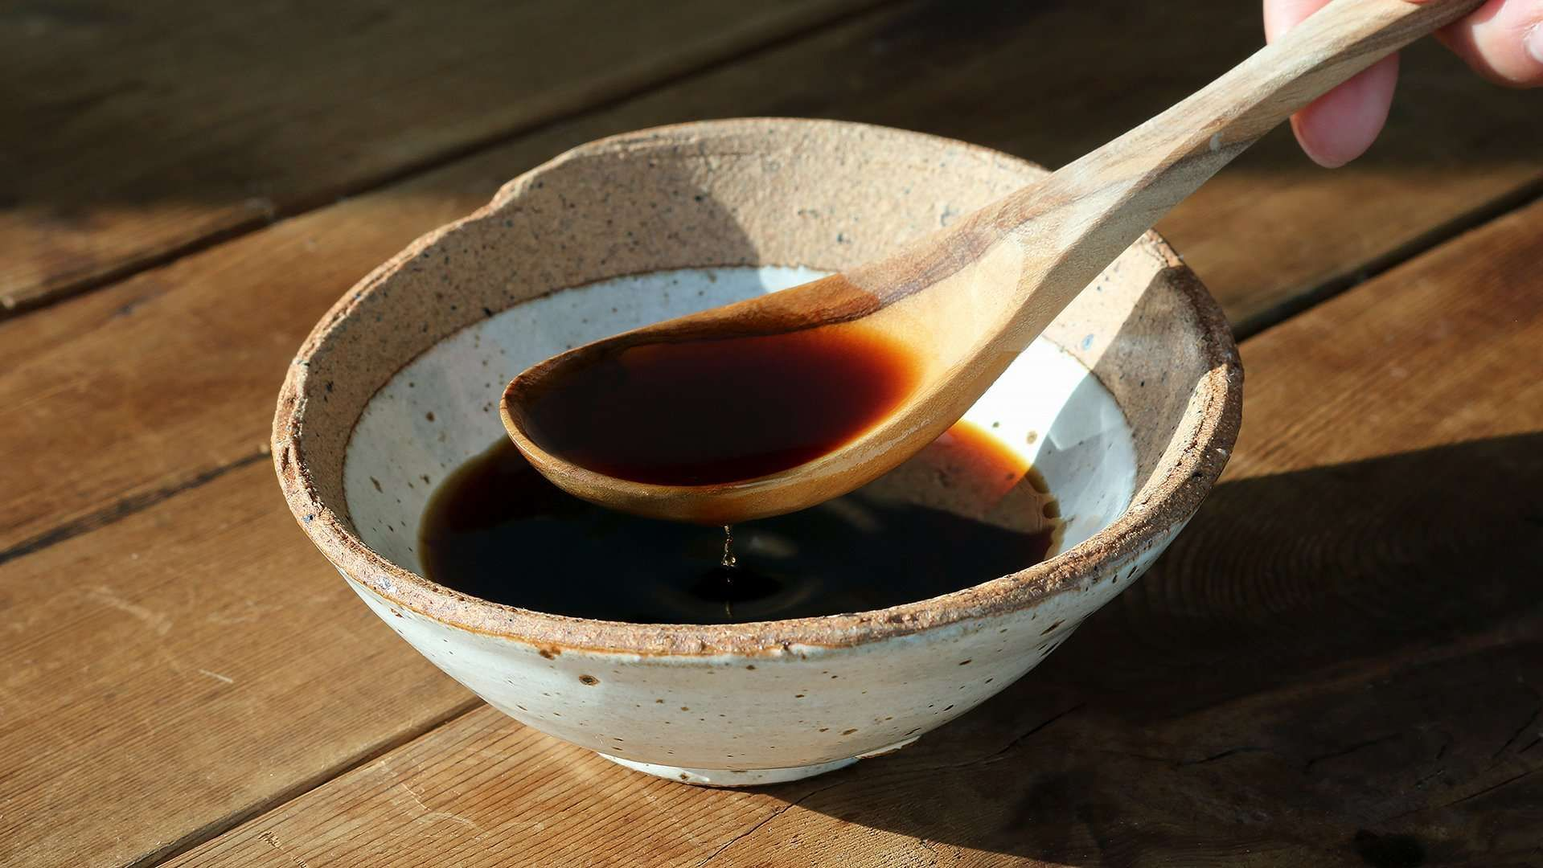
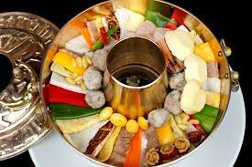
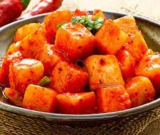
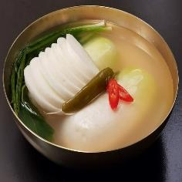
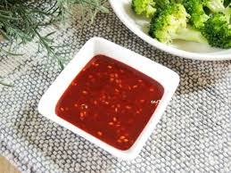
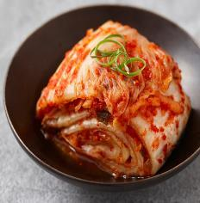
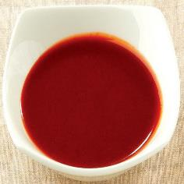
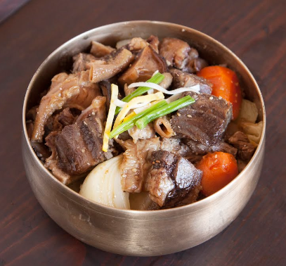
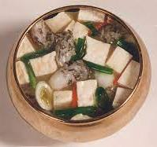
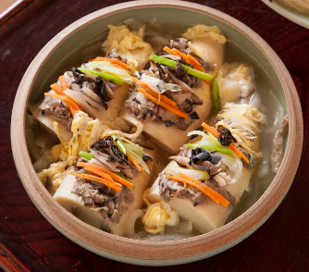
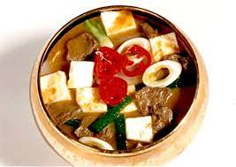
Part 1
The kind of main dish
Basic food
Rice
(밥)
Soup
(국)
Kimchi
(김치)
Sauce
(장)
Stew
(찌개)
Steamed dish
(찜)
Jeongol
(전골)

Slide 5
Part 1
The table setting of main dish
Table setting | Basic food
 | rice | soup | kimchi | sauce | stew | Steamed dish | jeongol
3 SIDE | 1 | 1 | 1 | 1 | X | X | X
5 SIDE | 1 | 1 | 2 | 2 | 1 | X | X
7 SIDE | 1 | 1 | 2 | 3 | 2 | choose | 1
9 SIDE | 1 | 1 | 3 | 3 | 2 | 1 | 1
12 SIDE | 1 | 1 | 3 | 3 | 2 | 1 | 1

Slide 6
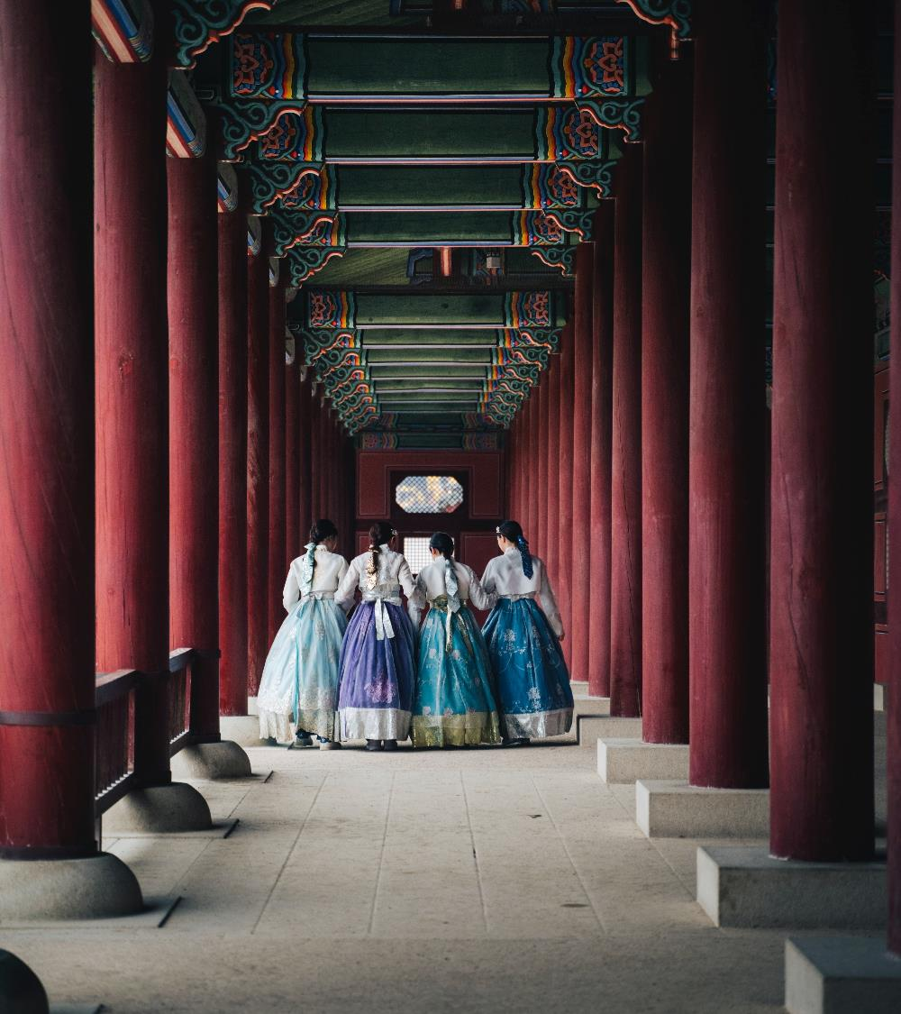
Part 2
SIDE DISH

Slide 7
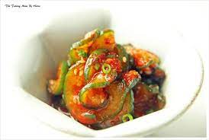
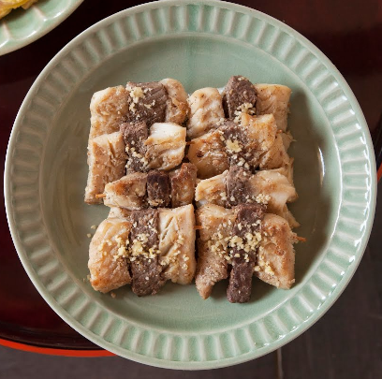
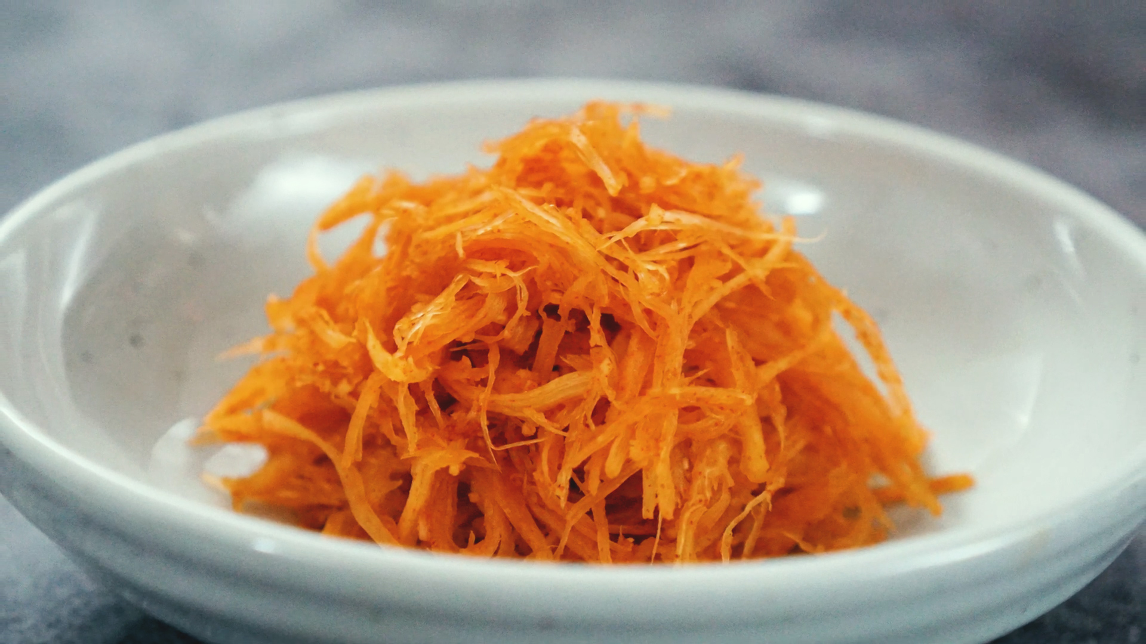
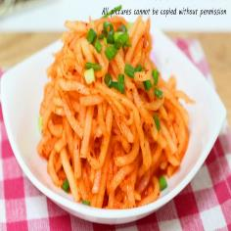
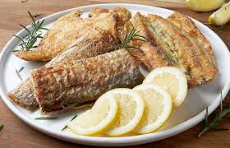
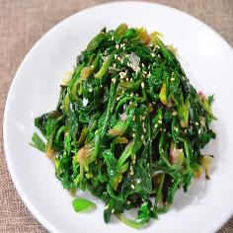
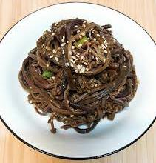
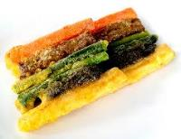
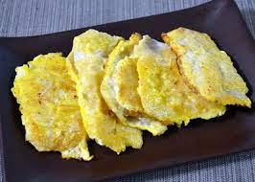
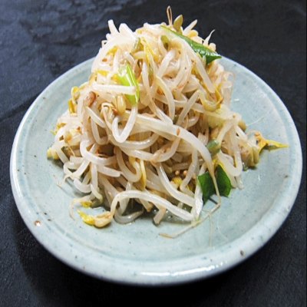
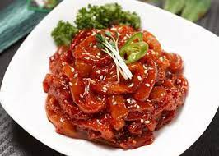
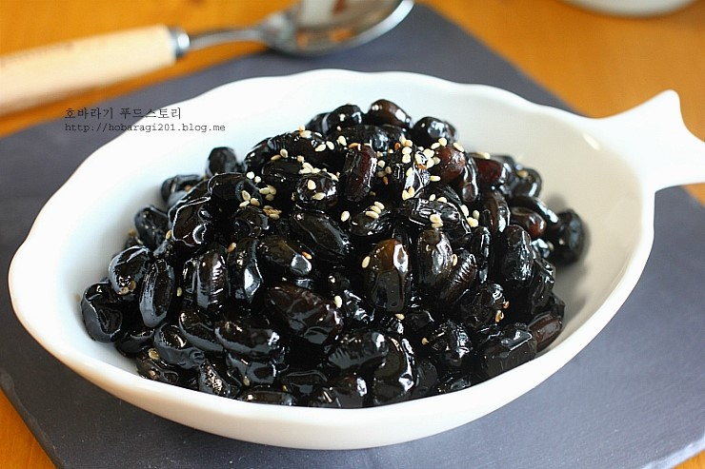
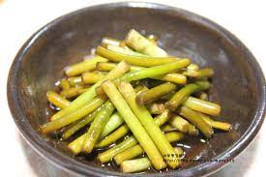
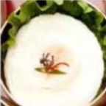
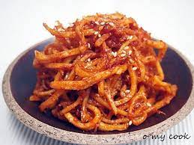
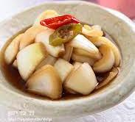
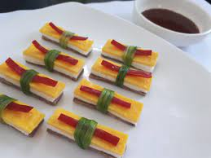
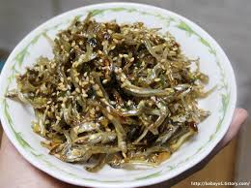
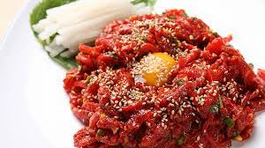
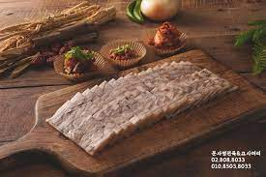
Part 1
The kind of side dish
Additional food
Vegetables (raw, blanch)
(나물 – 생채 / 숙채)
- Roasted
(구이)
Jeonyueo
(전유어)
- Dried
(마른 반찬)
- Jangajji (Korean pickled)
(장아찌)
- Salted sea food
(젓갈)
Parboiled fish
(회)
Pyeonyuk
(편육)
Peoached egg
(수란)

Slide 8
Part 1
The table setting of side dish
Table setting | Additional Food
 | Vegetables |  |  | Roasted / Boiled down food |  | Jeonyueo | Dried | Jangajji | Salted sea food | Parboiled fish | Pyeonyuk | Peoached egg
 | raw | blanch
3 SIDE | Choose |  |  | Choose |  | X | Choose |  |  | X | X | X
5 SIDE | Choose |  |  | 1 | 1 | 1 | Choose |  |  | X | X | X
7 SIDE | 1 |  | 1 | 1 | 1 | 1 | Choose |  |  | Choose |  | X
9 SIDE | 1 |  | 1 | 1 | 1 | 1 | 1 | 1 | 1 | Choose |  | 1
12 SIDE | 1 |  | 1 | 2 | 1 | 1 | 1 | 1 | 1 | 1 | 1 | 1

Slide 9
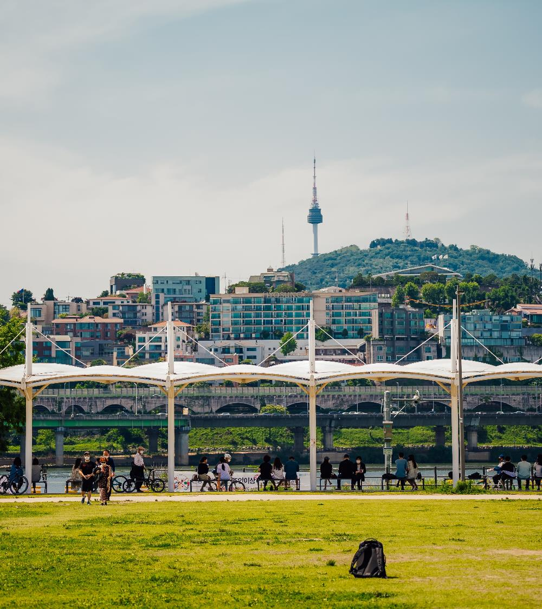
Part 3
The table setting

Slide 10
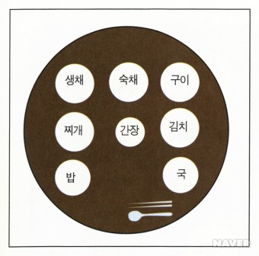
Part 1
The table setting of 3 dish

Slide 11
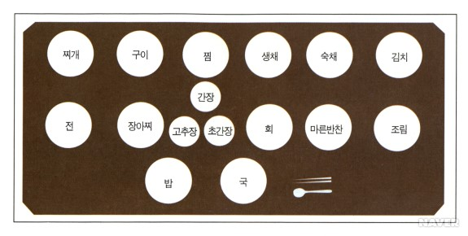
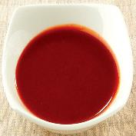
Part 2
The table setting of 5 dish

Slide 12
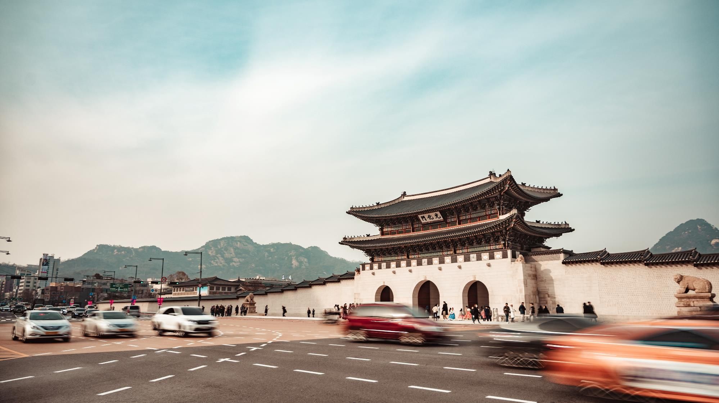
고
어
요
수
했

