Slide 1
Accents of Northern England
By Kristína Bošácka

Slide 2
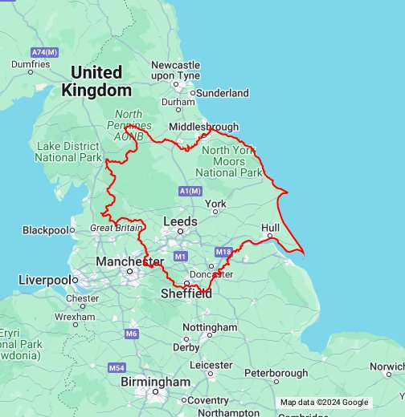
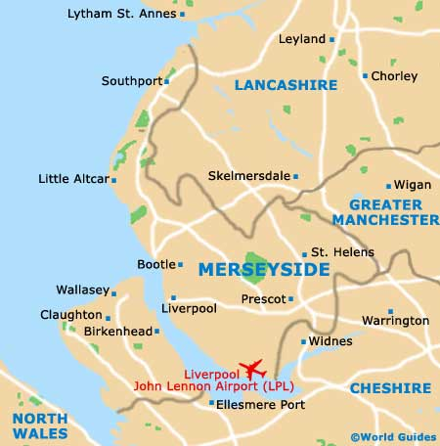
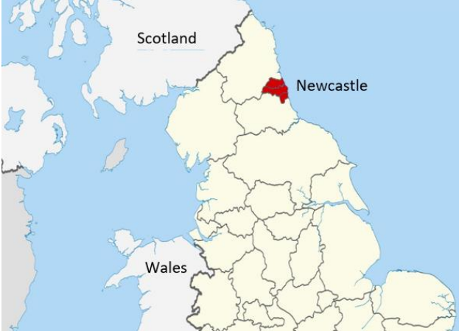
1.Yorkshire 2.Geordie 3.Scouse

Slide 3

https://www.youtube.com/watch?v=ZYGi1A-U_YE

Slide 4

https://www.youtube.com/watch?v=vnm0_-GvZZ8

Slide 5
Phonetic features
Yorkshire English is non-rhotic, which indicates that the 'r' is dropped in pronunciation, e.g., “hard” /hɑːd/, “four” /fɔː/.
The short vowel /ʌ/ as in words “love”, “some” changes to /ʊ/ in Yorkshire accent: /lʊv/ and /sʊm/.
The long vowel /ɑː/ becomes a short vowel /a/ or sometimes /æ/ in the Yorkshire accent. Example: “bath” /bɑːθ/ becomes /baθ/, or “chance” /tʃɑːns/ becomes /tʃans/.
The glottal stop [ʔ] , H is rarely sounded

Slide 6

https://www.youtube.com/watch?v=F2tBOO5qPOM

Slide 7

https://www.youtube.com/watch?v=k-g-EHptPYA

Slide 8
Phonetic features of Geordie
The Geordie accent is non-rhotic, although it might vary from person to person.
/ʌ/ changes to /ʊ/
words ending with -er, -or to be pronounced with the sound /a/. It is a stronger pronunciation of the shwa sound /ə/. Examples: “later” /ˈleɪta/, “over”/ˈəʊva/.
't ', 'k' and 'p’ glottalized
-ing -> “dancing”, “kissing” has an /n/ instead of /ŋ/
Geordie has a more musical quality to its intonation, with a lot of rising and falling intonation patterns.

Slide 9
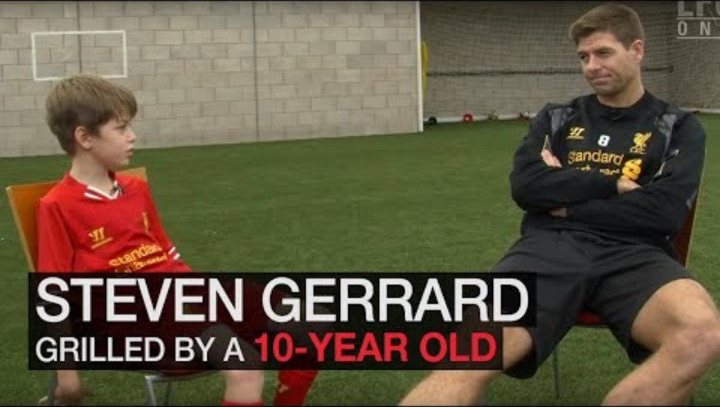
https://www.youtube.com/watch?v=Ifsu3SIC6kw

Slide 10
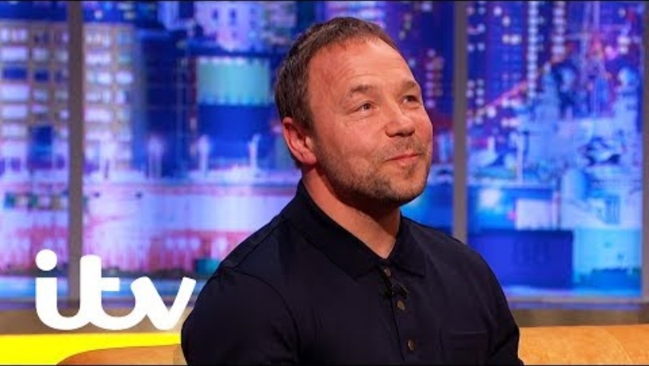
https://www.youtube.com/watch?v=zLpeAcwRshM

Slide 11
Phonetic features of Scouse:
The 'r' in Scouse is pronounced as a voiced tap 'ɾ' if followed by a vowel sound, e.g.,“very” /ˈveɾi/, “ring” /ɾɪŋ/. In other cases, Scouse is non-rhotic, e.g., “bird” /bɜːd/, “first” /ˈfɜːst/.
TH-stopping, replace /θ, ð/ with /t, d/, as in /diːz triː/ for “these three”.
In some short words ending with 't', the /t/ sound can become /h/, e.g., “not” /nɒh/, “it” /ɪh
In some words, the /ɜ/ and /ɜ:/ sound is replaced by /œː/, the tongue is more forward, as in “sir” /sœːr/, “bird” /bœːd/.
“back” /bɑːx/, “crime” /xraɪm/ - certain underlying plosive sounds are produced as affricates or fricatives

Slide 12
