Slide 1

Accents of Ireland:
Northern Irish Accent

Slide 2
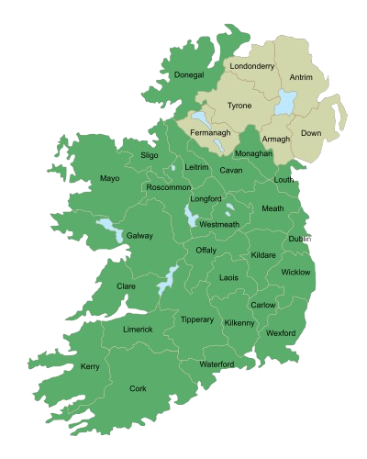
  Northern Irish
  Southern Irish
  Dublin
  West of Ireland
  etc.

Slide 3
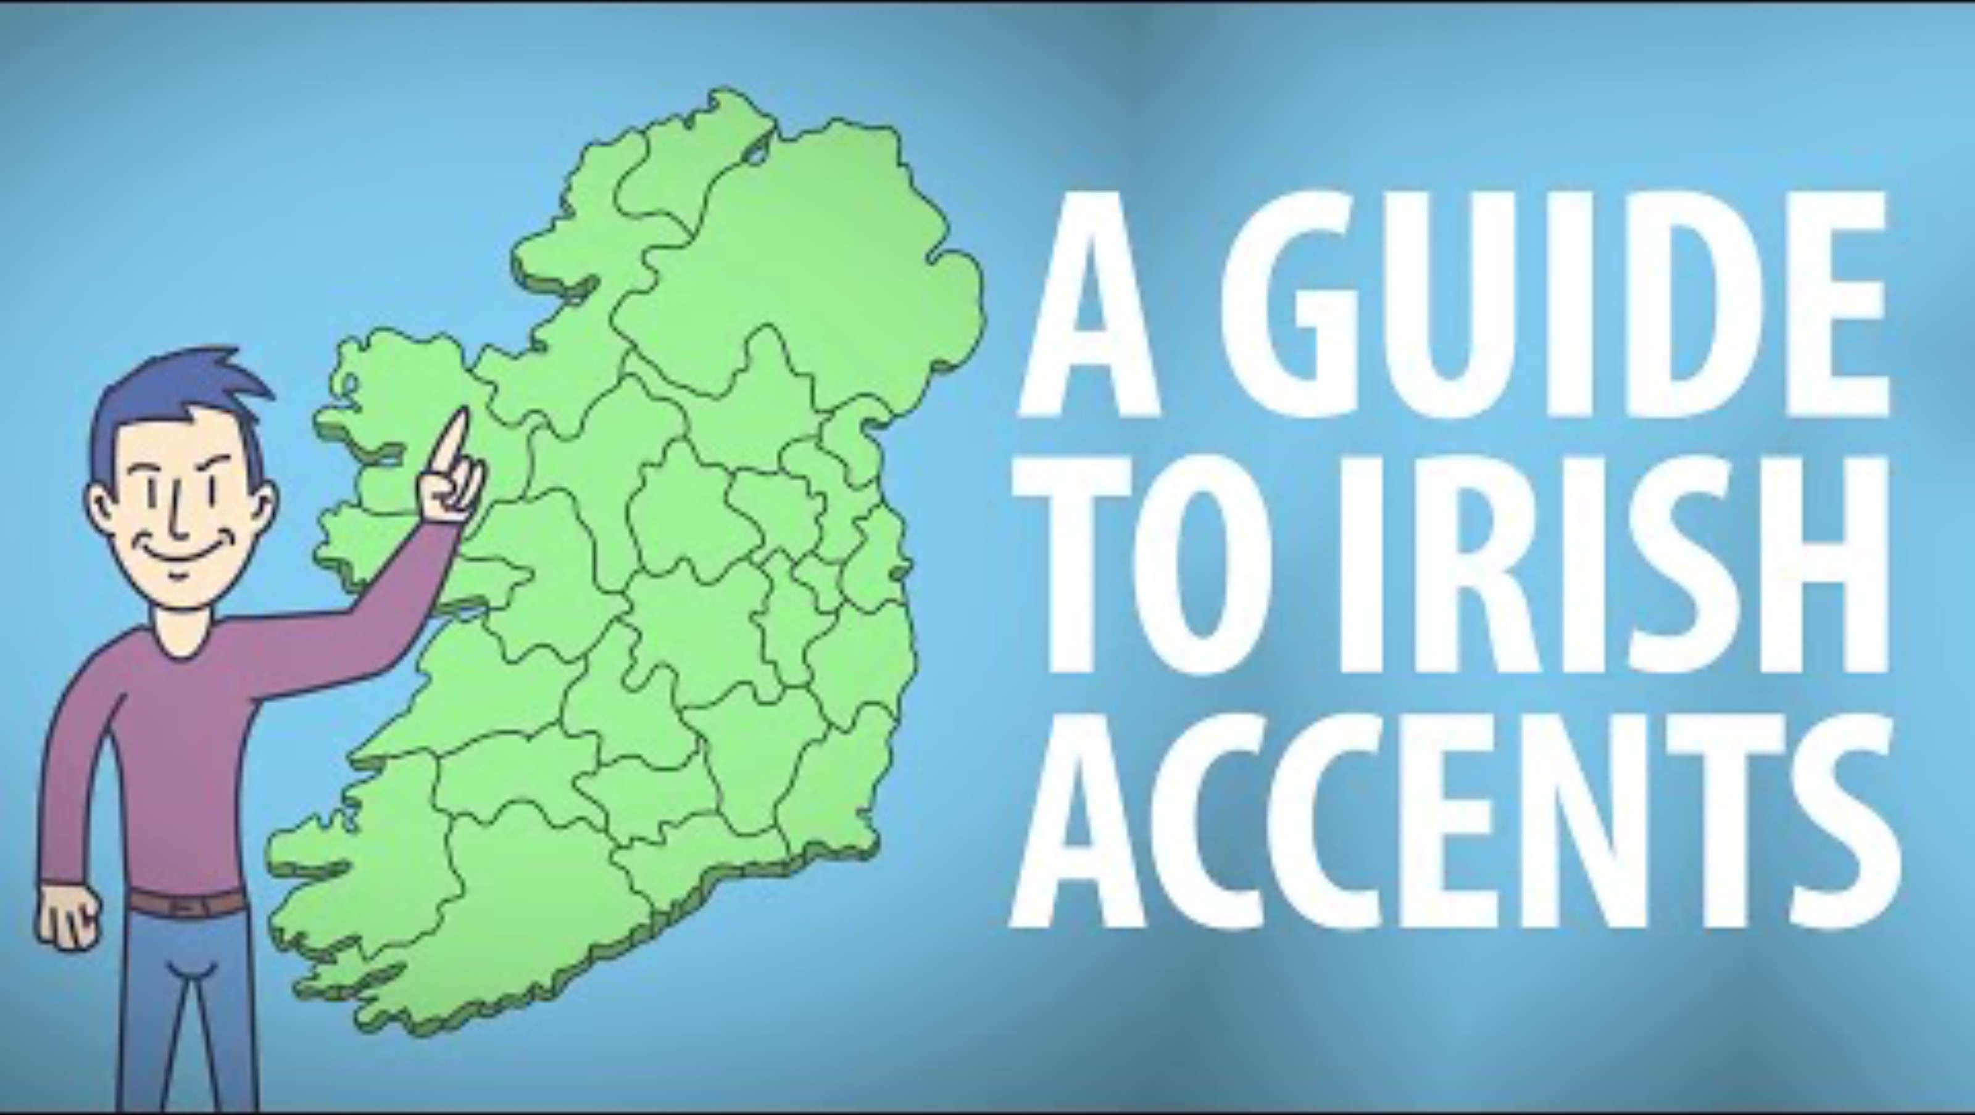

Slide 4

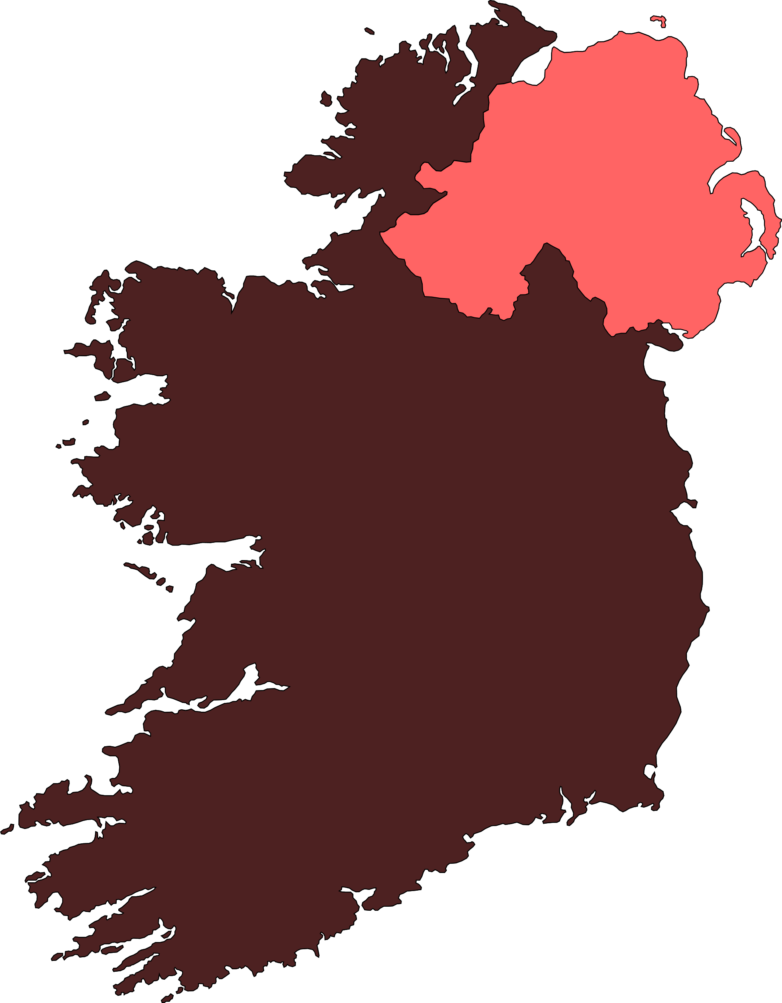
Northern Irish Accent
  Vowel features
  Consonant features
  Intonation and prosody

Slide 5
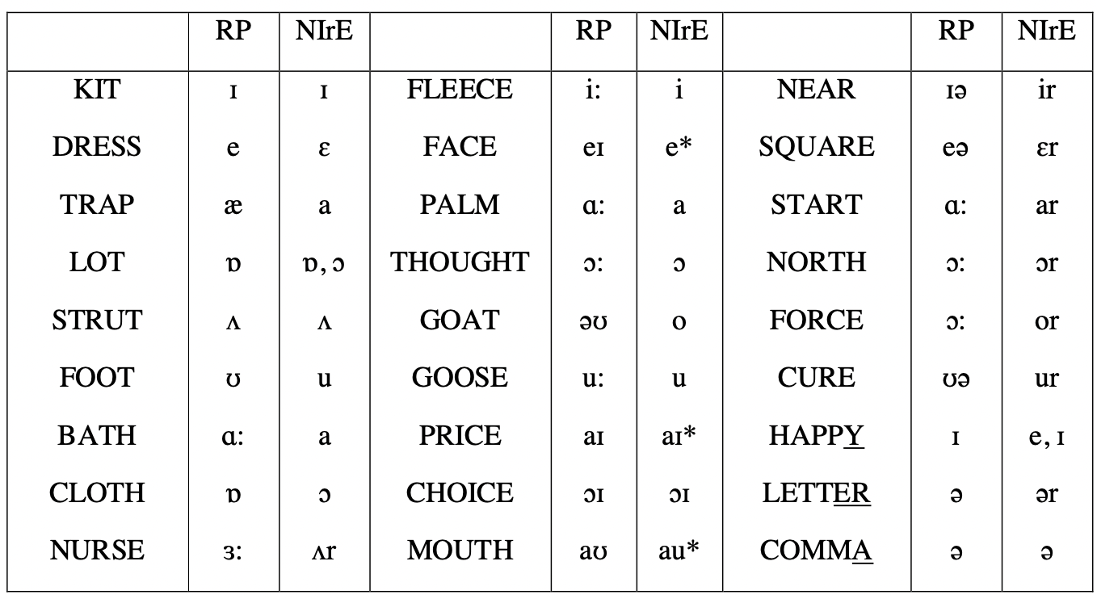
Vowel features: differences in pronunciation
(Julišová 2013 based on Wells, Accents 120 and 438)

Slide 6
Vowel features
Monophthongs:
  /e/ -> [ɛ]
  /ɒ/ -> [ɔ] or [o]
  /ɪ/ -> [i]
  /ʊ/ -> [u]
Diphthongs:
  /eɪ/ -> [ε:] in final position
  Pre-consonantally /eɪ/ -> [εə] or [iə]
  /aɪ/ -> [əi]
  realization of the /aʊ/ diphthog

Slide 7
Vowel features: vowel length
  diff. accents of En. language -> pronounce the same phoneme /ɪ/ slightly longer in kid than in kit
-> in NIr accent -> the contrast in vowel length is lost
  Ulster Lengthening = vowel length for /ɛ, a, ɔ/ if used word-finally or before any consonant than /p, t, ʧ, k/ -> longer allophones are used
-> /bed/ -> [bε:d]

Slide 8
Consonant features
  strong rhoticity -> “r” pronounced more prominently, esp. at the end of words and before consonants
-> eg. 'career'
  lack of dark /l/
  Elision: /mother/ -> [ma:ər] or [mɔ:ər]
/d/ -> lost completely in /hand/ or /old/
/l/ -> in the final position in /call/ or /full/
  Glottalization

Slide 9
Intonation
  rising / falling intonation patterns
  High rising terminal (HRT)
  the voice-pitch is continually rising and falling

Slide 10
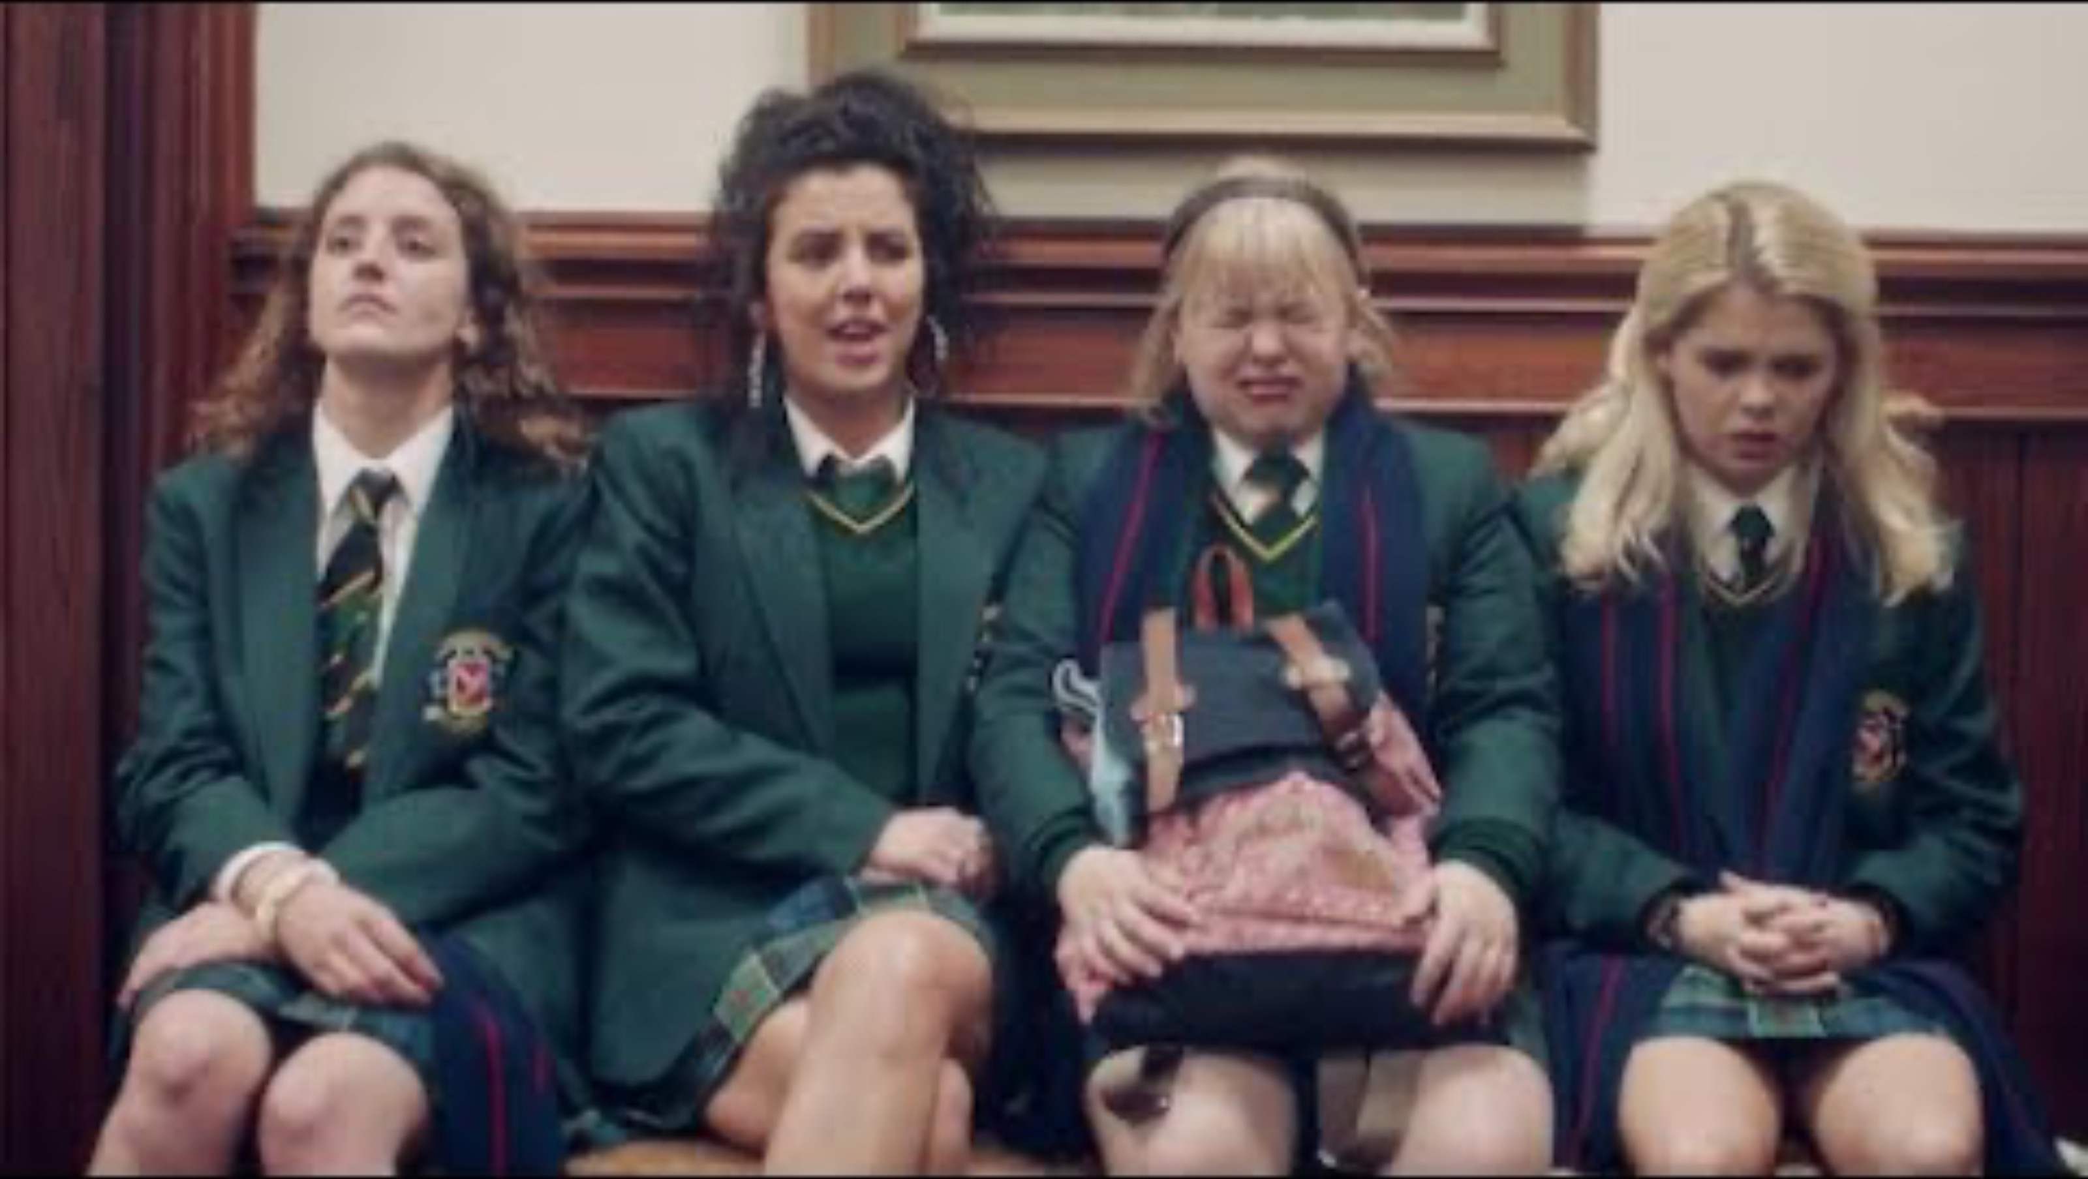
Derry Girls

Slide 11
Sources:
  Hickey, R. (2004). The phonology of Irish English. Handbook of varieties of English, 1, 68-97.
  McCafferty, K. (1998). Shared accents, divided speech community? Change in Northern Ireland English. Language Variation and Change, 10(2), 97-121.
  https://dspace.cuni.cz/bitstream/handle/20.500.11956/53716/DPTX_2013_1_11410_0_330031_0_95958.pdf?sequence=1&isAllowed=y
  https://www.voiceoverguy.co.uk/guide-to-a-northern-irish-accent

