Slide 1
regional colloquialisms
Regional slang that may come in handy

Slide 2
london

Slide 3
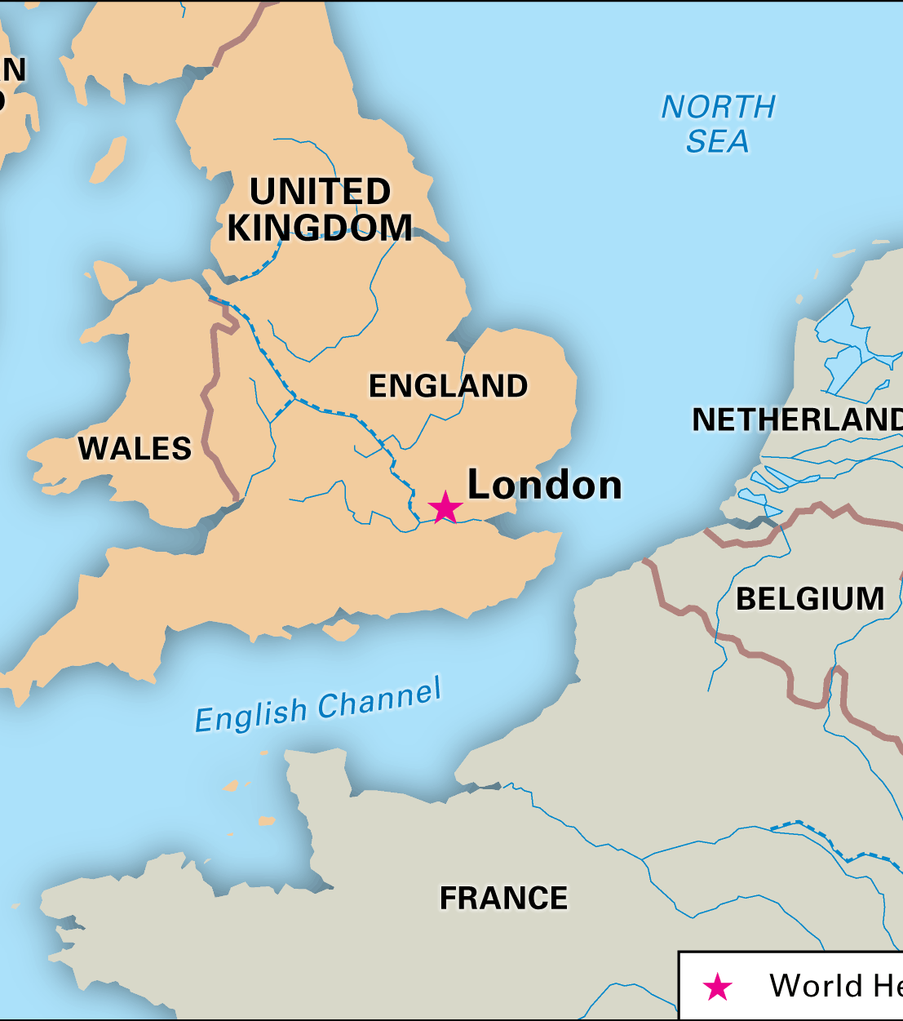
London
‘Bun that’ – ‘forget it.’ If you can’t be bothered to do something or it’s a lot of effort, you would use that phrase. Show of dissatisfaction: “Are you going to the party tonight?” “No, bun that.”;
Wasteman – this is basically a friendly insult to mean someone is lazy or not totally with it. Someone who parties too much? Wasteman. That person who never turns up to his lectures or study sessions? Wasteman.
Jokes –in London, it’s used as an adjective when something was fun: “That party was jokes.”

Slide 4
Bristol

Slide 5
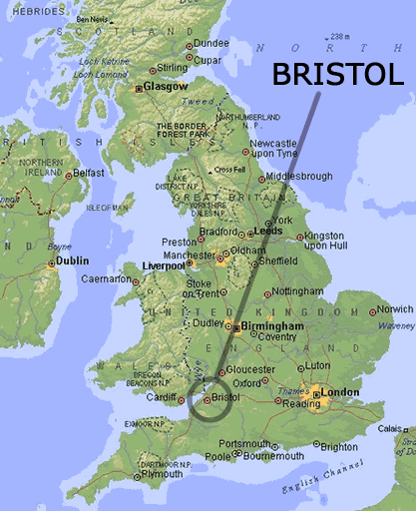
Bristol
Drive – this is probably the Bristol slang you’ll hear the most often as a student in Bristol, as the locals call their bus drivers ‘Drive’. Expect to hear ‘how much Drive?’ when people get on buses, and ‘cheers Drive’ as they depart.
Duck – this is another informal greeting used for everyone from your best friend to that stranger who held the door open for you. It’s the same as ‘man’ or ‘mate’ – but slightly more affectionate.

Slide 6
Manchester

Slide 7
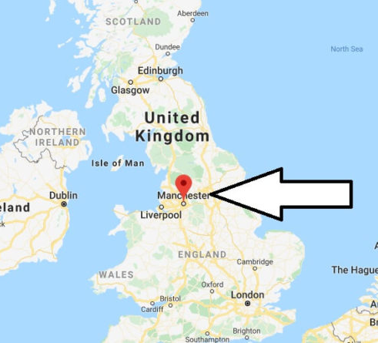
Manchester
Our kid – no this doesn’t mean you have suddenly given birth, it’s just the Manchester version of ‘duck’ or ‘mate’. It’s used to show alliance with someone else, meaning you’ve got a close bond with them. “Alright our kid, how’s it going?”
Tea – this one goes for all northern cities, but tea means much more than just the drink. Tea refers to your evening meal rather than dinner or supper.
Grim – this basically means disgusting. It can refer to the weather, food or just generally gross things. Be warned it rains a lot in Manchester, so you’re likely to hear this word being used a lot!

Slide 8
Quiz on regional phrases

Slide 9
NORTH EAST: Hoo's ya fettle?
Who's your father?
How's your father?
How are you?

Slide 10
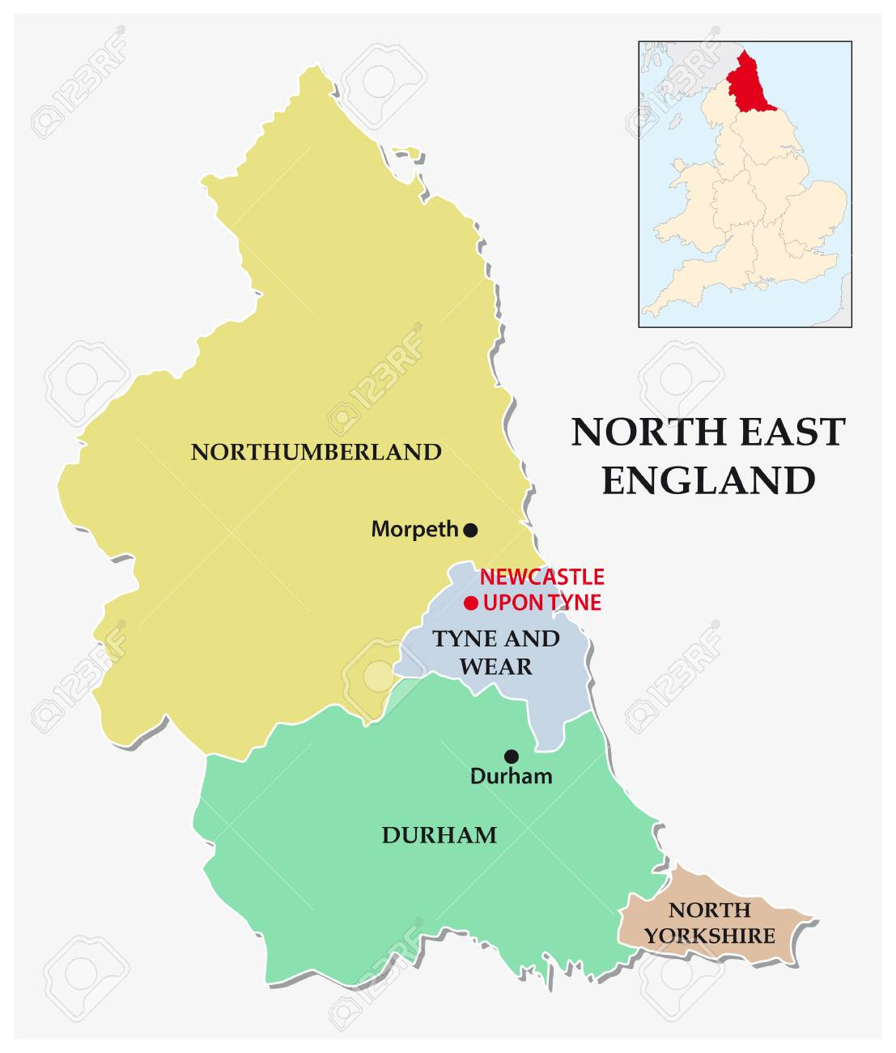
NORTH EAST: Hoo's ya fettle?
How are you?

Slide 11
NORTH EAST: Gan canny
Be careful
Be clever
This tastes metallic

Slide 12
NORTH EAST: Gan canny
Be careful

Slide 13
NORTH EAST: Pet
Animal friend
Stroking said animal friend
A term of endearment

Slide 14
NORTH EAST: Pet
A term of endearment

Slide 15
NORTH WEST: Owtelse?
Is there anything else?
Ouch, that hurts.
How can you tell?

Slide 16
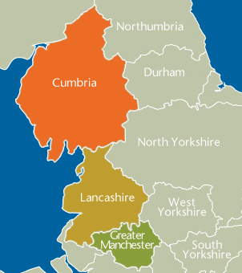
NORTH WEST: Owtelse?
Is there anything else?

Slide 17
NORTHERN IRELAND: Dead on
Deceased
Boring
Good, decent

Slide 18
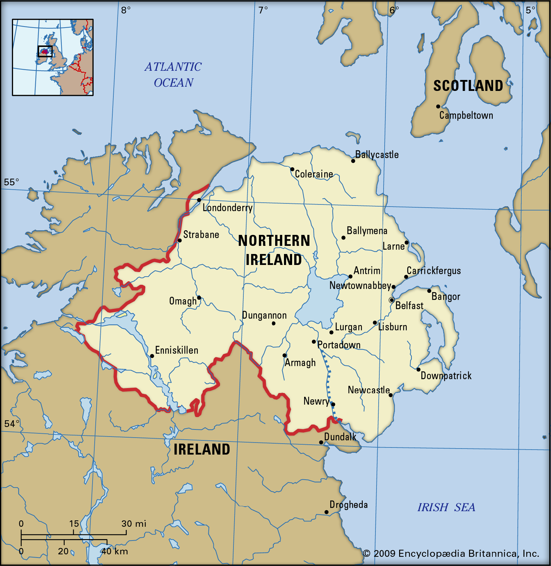
NORTHERN IRELAND: Dead on
Good, decent

Slide 19
NORTHERN IRELAND: Let's go for a dander
Let's go for a walk
1
Let's go for a dance
2
Let's hoover up all this dust
3

Slide 20
NORTHERN IRELAND: Let's go for a dander
Let's go for a walk

Slide 21
SOUTH WEST: Jonnick
Shortened form of Gin and Tonic
Nice, agreeable
Like supersonic, but a bit slower

Slide 22
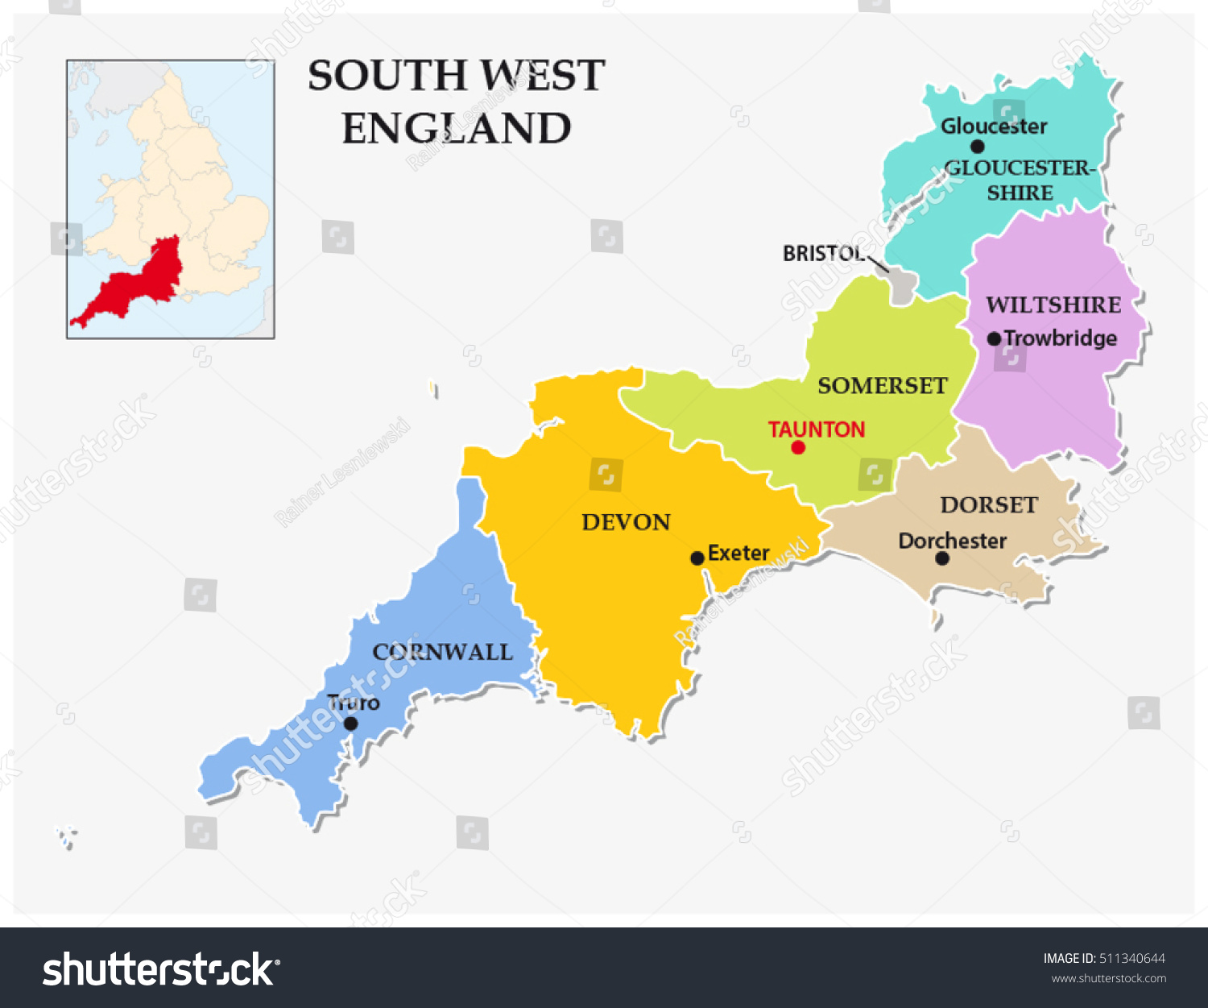
SOUTH WEST: Jonnick
Nice, agreeable

Slide 23
SCOTLAND: Lang may yer lum reek
May you live long and stay well
May your lower back smell fragrant
May your chimney never get blocked up

Slide 24
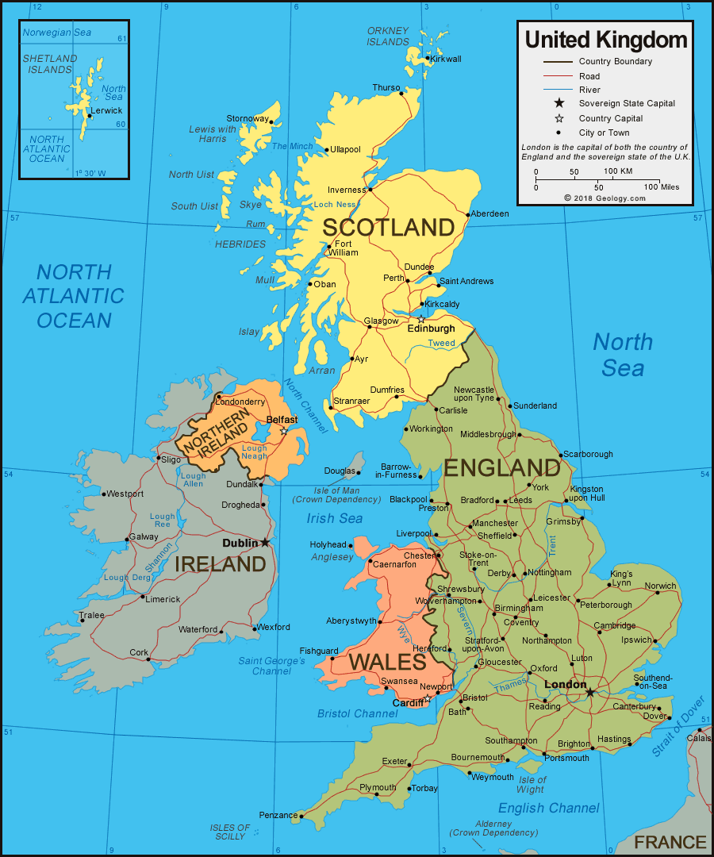
SCOTLAND: Lang may yer lum reek
May you live long and stay well

Slide 25
YORKSHIRE: Where there's muck there's brass
Hard work pays off
If there's mud on the ground, there's sure to be a band playing
It's pretty cold in the north

Slide 26
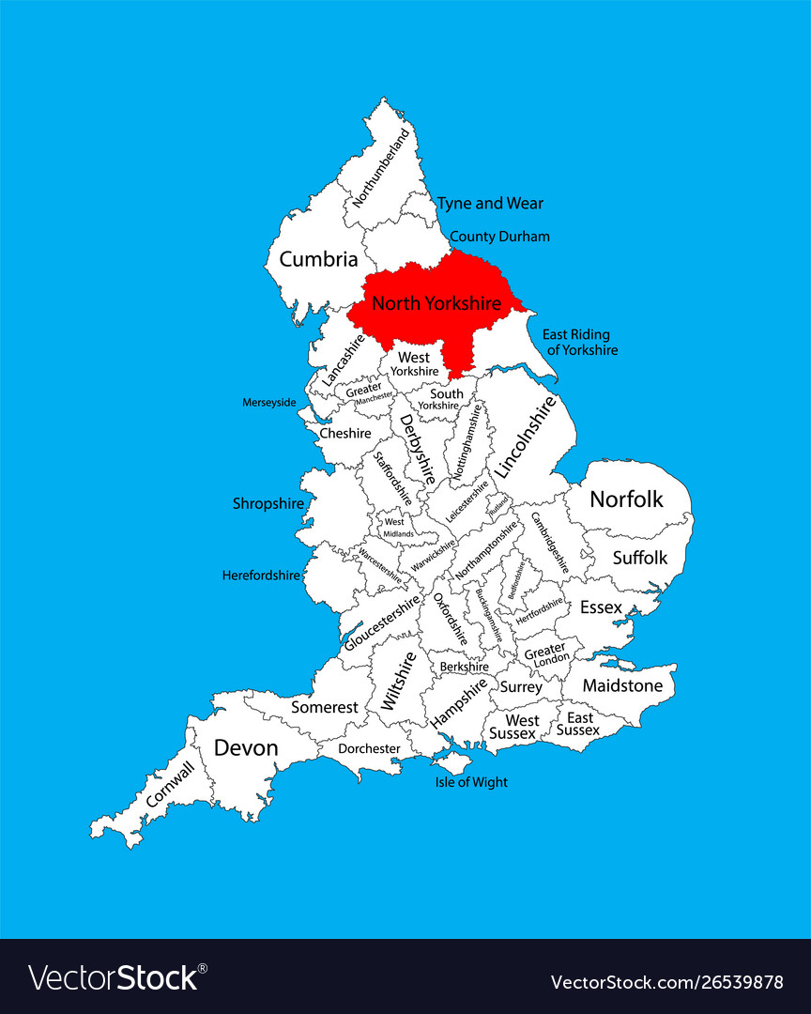
YORKSHIRE: Where there's muck there's brass
Hard work pays off

Slide 27
Sources
https://www.mirror.co.uk/news/uk-news/regional-phrases-quiz-how-well-3436836
https://www.studyinternational.com/news/english-regional-slang-you-need-to-know-before-you-study-here/

