Slide 1

ARTS023 (Chinese block)
Wei-lun Lu

Slide 2
Block overview
Overview of Chinese language:
Section of Mandarin and Chinese (languages): Define the difference between Mandarin and Chinese.
Section of pluricentricity: Find out where Mandarin is spoken.
Section of writing: Please define characters as a writing system.
Typological features of Chinese:
  - monosyllabicity
  - homophony
  - classifier language
  - tonal language
  - tenseless language
  - the Chinese TIME
Culture: the love of numbers

Slide 3
Check test (session 1)
Define the difference between Mandarin and Chinese.
Define characters as a writing system.
What is meant by monosyllabicity? More precisely, give examples of a monosyllabic word.
Define homophony in language and give a couple of examples.

Slide 4
Block overview session 1
Overview of Chinese language:
Section of Mandarin and Chinese (languages): Define the difference between Mandarin and Chinese.
Section of pluricentricity: Find out where Mandarin is spoken.
Section of writing: Please define characters as a writing system.
Typological features of Chinese:
  - monosyllabicity
  - homophony
  - classifier language
  - tonal language
  - tenseless language
  - the Chinese TIME
Culture: the love of numbers

Slide 5
Overview: linguistic facts
- Sinitic (Sino-Tibetan language family)
- Chinese and Mandarin?
Mandarin being a form of Chinese (a standard variety).
Other forms of Chinese (dialects)
Proportions of first-language speakers^{[24]}
Mandarin (65.7%)
Min (6.2%)
Wu (6.1%)
Yue (5.6%)
Jin (5.2%)
Gan (3.9%)
Hakka (3.5%)
Xiang (3.0%)
Huizhou (0.3%)
Pinghua, others (0.6%)

Slide 6

Lack(!) of mutual intelligibility
Lack of mutual intelligibility.
Example recordings
Mandarin
Yue/Cantonese
Mutual intelligibility: a relationship btw languages or dialects.
Factors:
  China’s size (9.6 mil km²); Europe’s size (10.5 mil km²)
  China’s imperial system (until the early 20th century)
Mandarin as the official language and the character system as a unifying force.

Slide 7


Characters and thought: Chinese Numbers
8
八 (as in 八字鬍 ‘(lit.) 8-character-mustache’)
Think of MUSTACHE in terms of EIGHT. Conceptual association motivated by imaginstic similarity (based on the writing system)
10
十 (as in 十字架 ‘(lit. 10-character-structure)’)
Think of CROSS in terms of TEN. Conceptual association motivated by imaginstic similarity (based on the writing system)
Writing system helps people understand the world!

Slide 8
Chinese characters
The Chinese script is a writing system that was developed to record the language spoken around the Yellow River around the 2nd millennium BC. Cr.
The oldest evidence of the use of Chinese writing around 1200 BC. Cr.
jiǎgǔwén 甲骨文 (oracle inscriptions on armor and bones)
Chinese is NOT the oldest script, but it is recorded as the longest continuous tradition of script use.
Syllable-based.
Question: character = word? (HINT: look up words in Chinese)

Slide 9
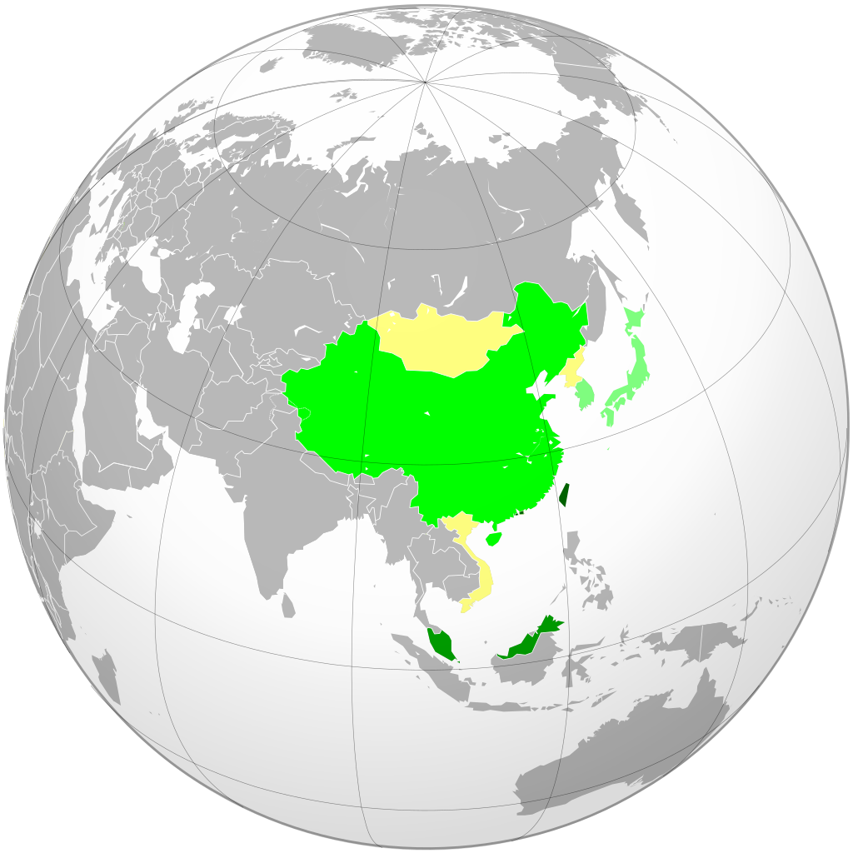
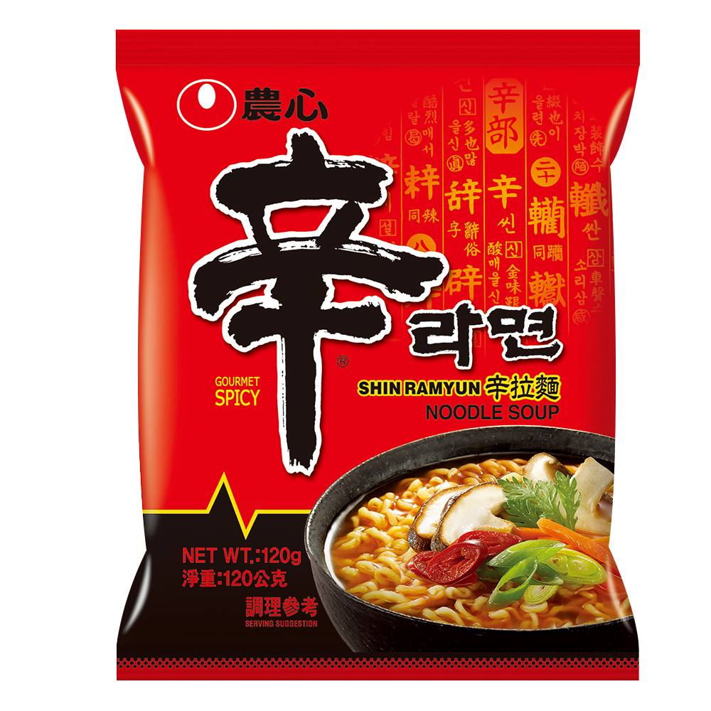
Sinosphere
Chinese characters (한자; 漢字; hanja) entered Korea (possible date: 300-100 BC), remained in use in the 20th century, has declined since the turn of century.
辛
Chinese characters (kanji; 漢字) entered Japan around 57 AD (earliest known date), remain in use as of today (along with hiragana and katakana).
Chinese characters (Chữ Hán; 𡨸漢 / Chữ Nôm; 𡨸喃) entered Vietnam around 111 BC, remained in use until early 20th century.

Slide 10
What is a Chinese character made of and how to write it?
Chinese is written with characters (汉字),
Character = basic carrier of lexical or grammatical meaning and also captures pronunciation to an extent (and only to an extent)
characters are a unifying element between different parts of the PRC
95% of characters have some internal structure
there are roughly 500 building blocks (components) of characters

Slide 11
Mono-syllabicity of Chinese
15% Chinese words are monosyllabic.
15% Chinese words are of one syllable/one character.
That means, a lot of words sound the same in Chinese! >> Homophony

Slide 12
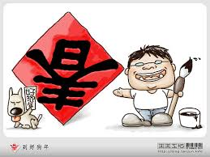

Homophony in New Year rituals (spring)
春
Homophony of 到 dào “arrive” and 倒 dào “reverse”
“Spring arrive”
Homophony of 魚 yú “fish” and 餘 yú “remain”
“Every year we have so much that remain.”
Linguistic basis of cultural convention and reasoning.

Slide 13


Homophony in traditional patterns
Bat 蝠 fú as auspicious animal, given its homophony with 福 fú “blessing”.

Slide 14
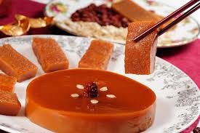
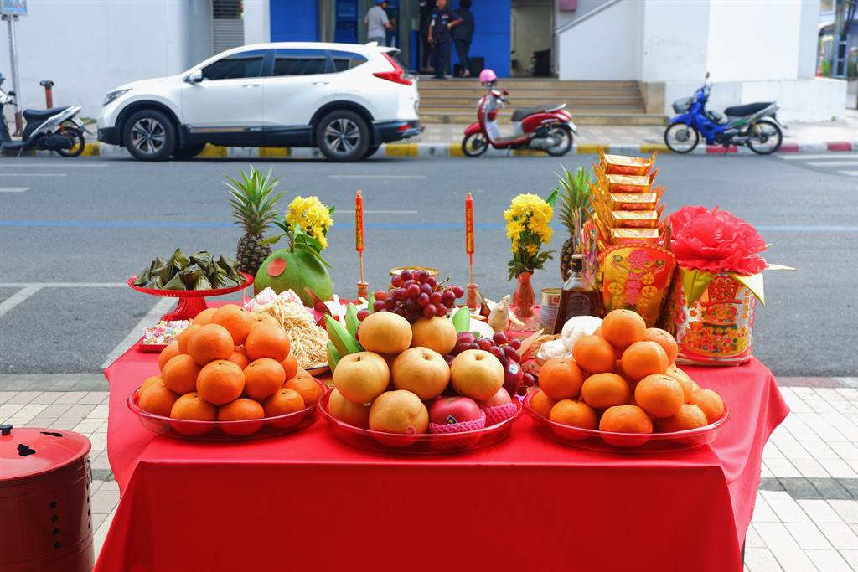
Homophony in New Year rituals (cake, orange, apple)
Homophony: 糕 gāo “cake” and 高 gāo “high”
“Every year we go up (in career)”
Homophony: 蘋 píng “apple” and 平píng “peace”
Near-homophony of 橘 jú “orange” 吉 jí “auspice”.
Linguistic influence of what people think about and do with food.

Slide 15
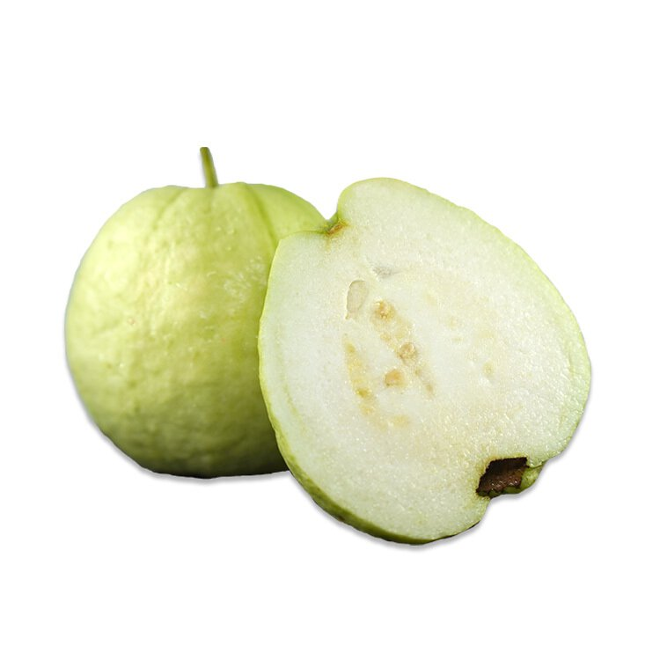
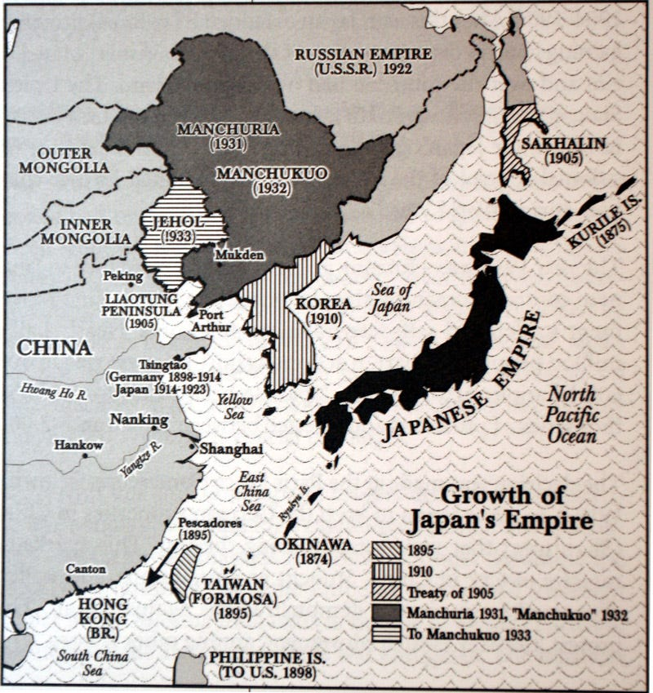


Food that brings a curse in a ritual…
Guava: 芭樂票 “(lit.) guava-cheque (dishonored cheque)”
Japanese fuwatari “dishonored”
Phon. borrowed into Taiwanese, finally into pa̍t-á “guava”
After Nationalist takeover of Taiwan (end of WWII), into Mandarin

Slide 16
Radicals (in characters)
Categorizes the characters
The radical as a semantic identifier of a character in the lexicon.
Show a dictionary
https://dict.revised.moe.edu.tw/searchR.jsp
Example: radical 女 ‘female’ contains 奶 ‘milk’, 奴 ‘slave’，妃 ‘second wives of emporor’, 妇 ‘housewife’, 奸 ‘manipulative’, 好 ‘good’, 妈 ‘mother’
Radical 人 contains 个 ‘general classifier’, 从 ‘to follow’, 会 ‘to meet’, 伞 ‘umbrella’ 傘 (traditional version)

Slide 17

Categorization: an issue of worldview
Radical (indexing component) as a semantic tag in Chinese.
女
Kinship terms:
with radical 女：妈、姥、姐、妹、姨、姑
with radical 男 ：舅、甥
爸、爷、兄、弟、叔、伯
Classnotes: Scan QR code.

Slide 18
Summary of session 1
Overview of Chinese language:
Section of Mandarin and Chinese (languages): Define the difference between Mandarin and Chinese.
Section of pluricentricity: Find out where Mandarin is spoken.
Section of writing: characters as a writing system.
Typological features of Chinese:
  - monosyllabicity
  - homophony
  - classifier language
  - tonal language
  - tenseless language
  - the Chinese TIME
Culture: the love of numbers

Slide 19
Preparation for session 2
Define the numerical classifier.
Define categorization as a human cognitive capacity.
Does your language have some numbers that its speakers prefer? Are there symbolic meanings in the numbers?

Slide 20
Check test for session 2
Define the numerical classifier.
Define categorization as a human cognitive capacity.
Does your language have some numbers that its speakers prefer? Are there symbolic meanings in the numbers?

Slide 21
Overview of session 2
Overview of Chinese language:
Section of Mandarin and Chinese (languages): Define the difference between Mandarin and Chinese.
Section of pluricentricity: Find out where Mandarin is spoken.
Section of writing: characters as a writing system.
Typological features of Chinese:
  - monosyllabicity
  - homophony
  - classifier language (categorization)
  - tonal language
  - tenseless language
  - the Chinese TIME
Culture: the love of numbers

Slide 22
Linguistic categorization
allow humans to organize things, objects, and ideas that exist around them and simplify their understanding of the world. For humans, both concrete objects and abstract ideas are recognized, differentiated, and understood through categorization. Objects are usually categorized for some adaptive or pragmatic purposes.

Slide 23
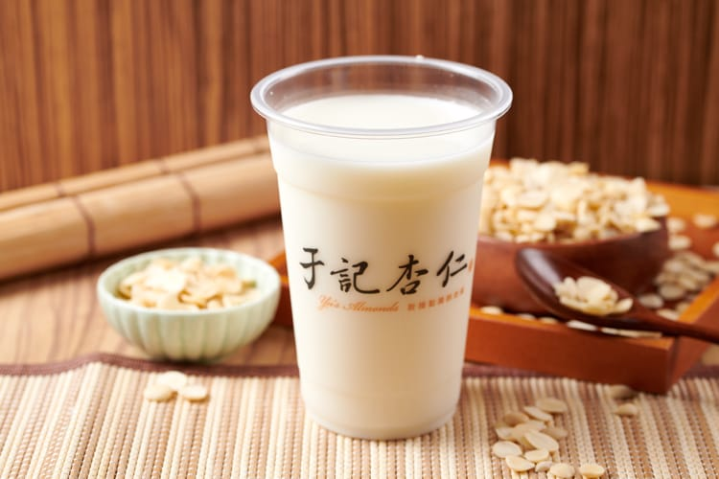
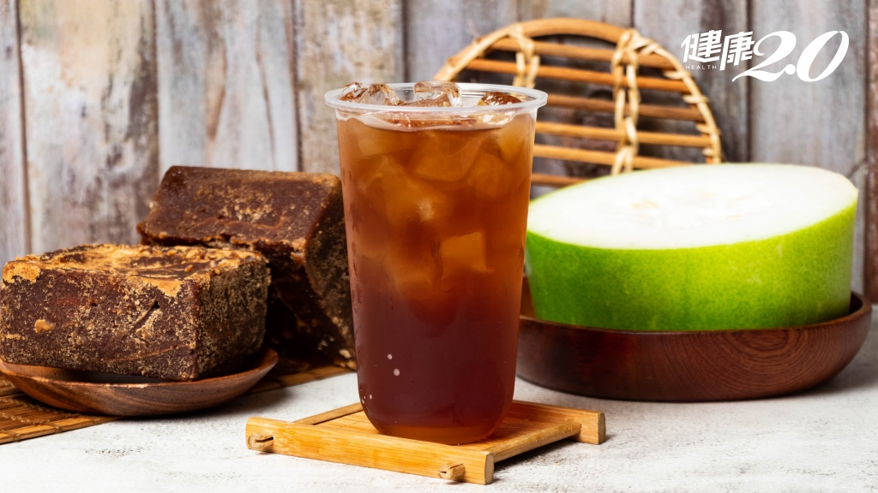
The example of TEA
What kind of TEA do we have in English?
- Category of TEA (in English): tea as the category identifier:
  Black tea, green tea, white tea, milk tea, fruit tea…
Category of 茶 ‘tea’ (in Chinese): 茶 as the category identifier:
  紅茶 ‘(lit.) red tea’、綠茶 ‘green tea’…
  But… 杏仁茶 ‘(lit.) almond tea’, 冬瓜茶 ‘(lit.) winter melon tea’

Slide 24
Numerical classifiers in Chinese
Numerical classifiers: used when counting, highlighting the inherent properties of the noun.
In a non-classifier lg:
one student, two students, three students
jeden student, dva studenti, tři studenti
In a classifier lg:
CH: [NUMERICAL] – [CLASSIFIER] – [NOUN]
一 个／位 学生
one-CL-student

Slide 25
Numerical classifiers
Another categorizing device in Chinese (in addition to radicals).
Highlights the inherent properties of the nouns.
Categories created are culture-specific.

Slide 26
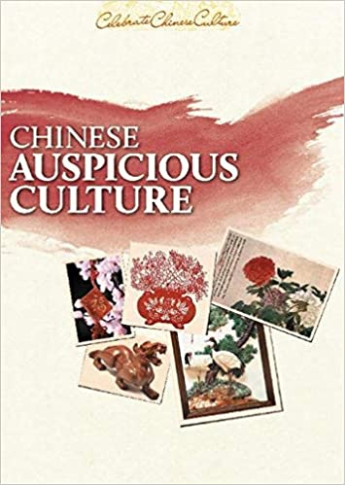
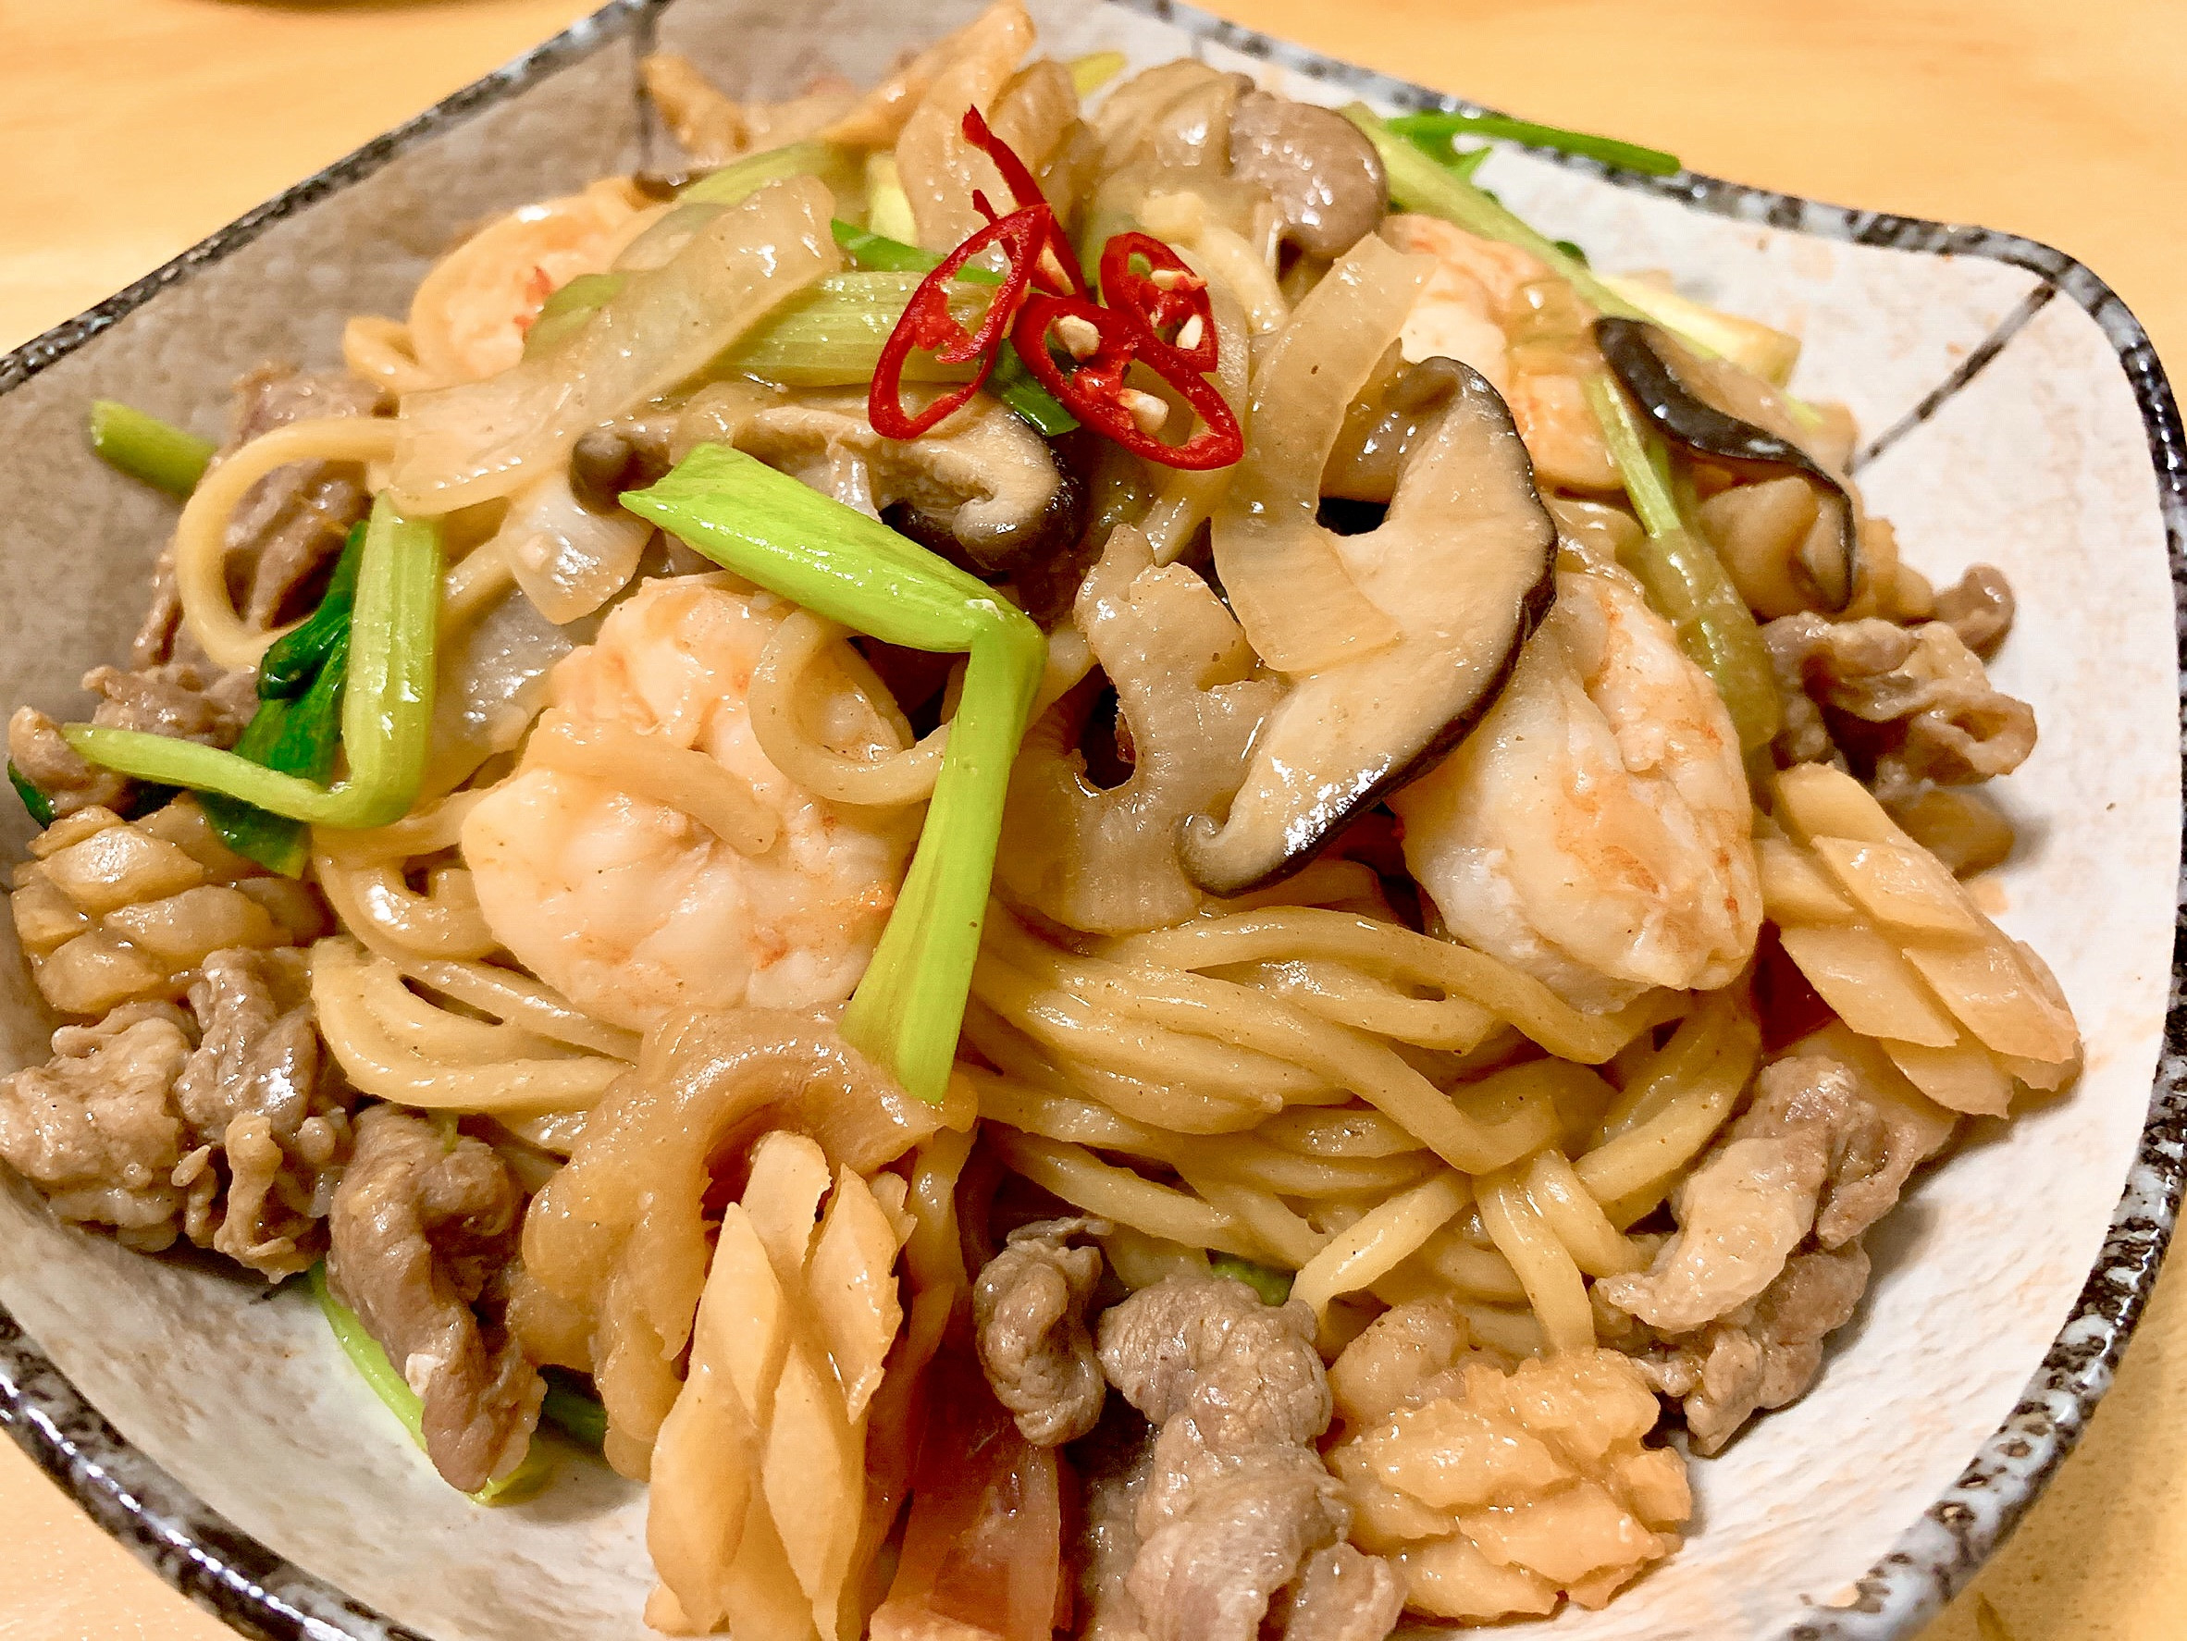
Numbers in Chinese dishes
Chinese lg love numbers (Chuah et. al, 2012)
In FOOD: sān-xiān 三鮮 ‘three-fresh’
No reference to ingredients (pork, squid, mushroom) is made.
Profiling the attribute of ingredients.
Ad-hoc category of FRESH (PORK; SQUID; MUSHROOM).
Also profiled: RESULT OF ENUMERATION (THREE)

Slide 27
Profiling (Langacker 2008: 66)
A linguistic expression selects a body of conceptual content (the so-called conceptual base).
A substructure of the base that receives the focus of attention (so-called conceptual profile).
In FOOD: sān-xiān 三鮮 ‘three-fresh’
Anything about the dish = conceptual base.
xiān 鮮 ‘fresh’ = profiled (attribute of ingredients).
Ad-hoc category of FRESH (PORK; SQUID; MUSHROOM).
Also profiled: RESULT OF ENUMERATION (THREE)

Slide 28
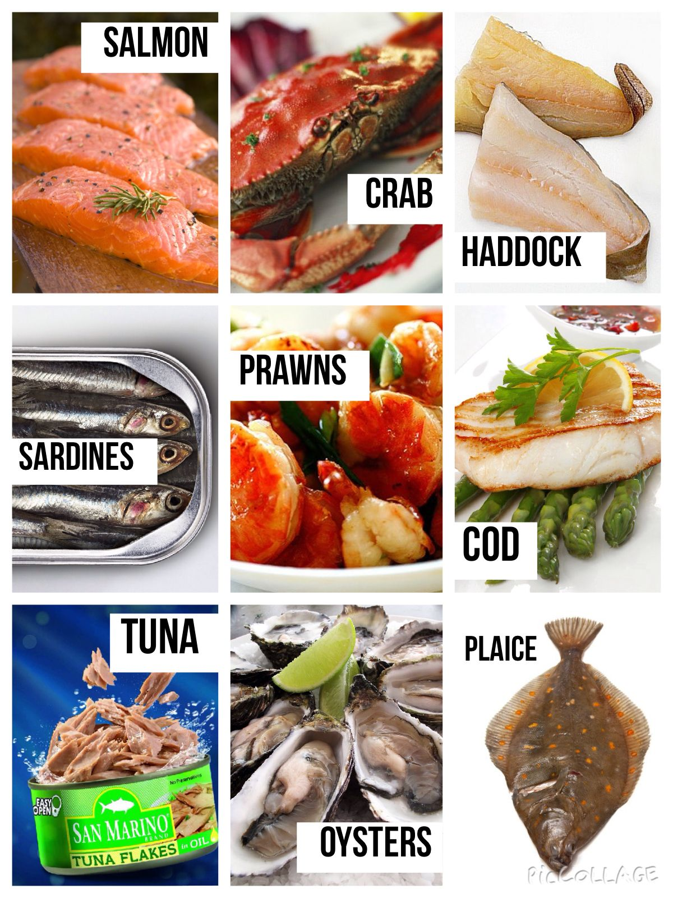
Categorization (Langacker 2008: 57)
A human mental capacity of capturing what is common to certain previous experiences.
What is a bird?
What is a fish/seafood?
PORK = FRESH; SQUID = FRESH; MUSHROOM = FRESH
Ad-hoc category of FRESH.
Also profiled: RESULT OF ENUMERATION (THREE)

Slide 29
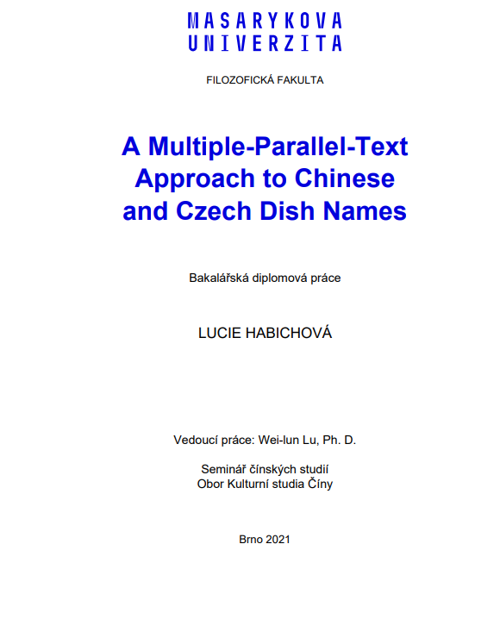
Linguistic sample
Only restaurants with a Chinese-Czech menu.
10 restaurants (7 in Prague; 3 in Brno).
Name in source lg
Name(s) in target lg
Simple frequency counts

Slide 30
Numbers in Chinese-Czech menus
TWO; THREE; FIVE; EIGHT
FIVE, EIGHT are cross-linguistically perfectly stable.
THREE not perfectly stable.
TWO not at all consistent.
TEN as an irregularity.

Slide 31
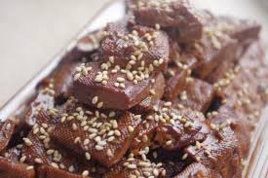
五香 wǔ-xiāng ‘five-fragrance’
Found in 6 menus.
Attribute of FRAGRANT profiled.
Ad hoc category: FRAGRANT.
RESULT OF ENUMERATION (profiled): FIVE
Rendered as pět vůní “five smells/fragrances” or pět chutí “five tastes”
Cognitive operation perfectly stable across lgs (6 out of 6).

Slide 32
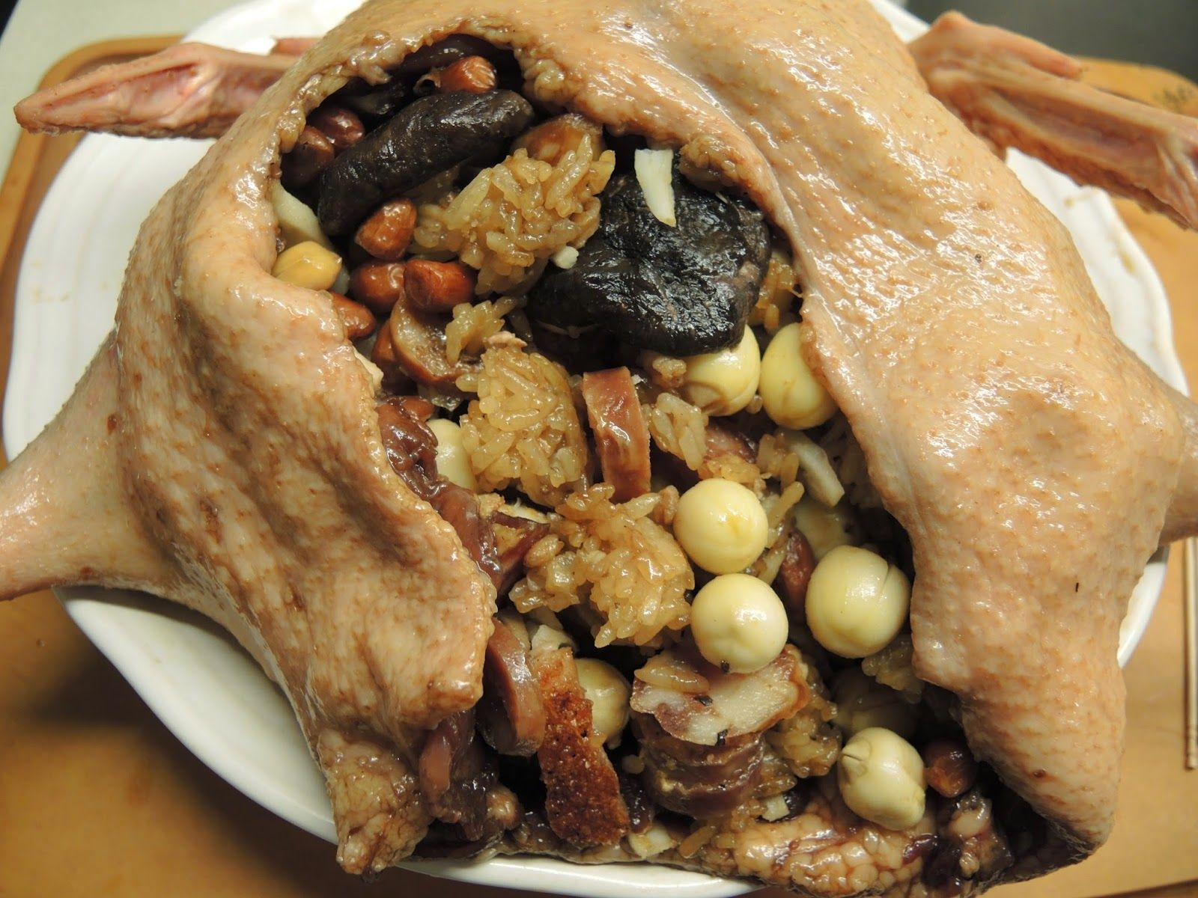
八宝 bā-bǎo ‘eight-delicacy’
Found in 8 menus.
Attribute of DELICATE profiled.
Ad hoc category of DELICACY.
RESULT OF ENUMERATION (profiled): EIGHT.
Rendered as osm pokladů “eight treasures” or osm pochoutek “eight delicacies”.
Cognitive operation perfectly stable across lgs (8 out of 8).

Slide 33
三鲜 sān-xiān ‘three-fresh’
Found in 10 Chinese menus.
Attribute of FRESH.
Ad hoc category of FRESH.
RESULT OF ENUMERATION (profiled): THREE.
Rendered as tři druhy masa “three kinds of meat” or (maso) tří chutí “(meat) of three flavours” (9 out of 10)
masový mix “meat mix” (1 out of 10)
Cognitive operation highly stable across lgs (9 out of 10)

Slide 34
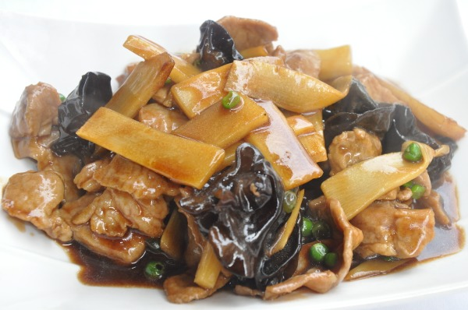
双冬 shuāng-dōng ‘pair-winter’
Found in 9 menus.
Bamboo shoots and mushrooms.
Use of dōng ‘winter’ as a metonymy.
SEASON ➔ FOOD.
Ad hoc category: WINTER (FOOD).
RESULT OF ENUMERATION (profiled): TWO.
Semantic complexity of shuāng: not a cardinal number but means “pair”.
Equal status btw BAMBOO SHOOT = MUSHROOM.
Cxs of TWO:
二 èr 、两 liǎng.

Slide 35
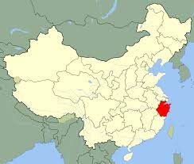
TWO-WINTER does not make sense in Czech menus!!
Cultural metonymy: WINTER ➔ MUSHROOM
Consistently rendered as bambus a houby “bamboo and mushrooms”.
Czech linguistic tool not receptive to the encoding strategy (0 out of 9).
Cognitive operation completely different.

Slide 36
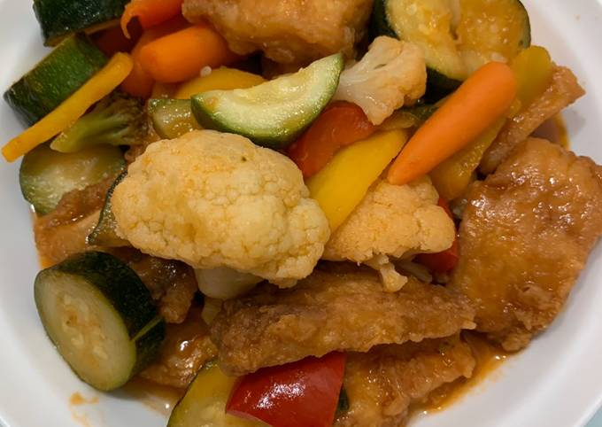
Czech invention: TEN
Not found in the Chinese sample
Found in 1 Czech menu (out of 10)
rybí plátky deseti barev “fish slices of ten colours”.
Chinese original: shíjǐn yú 什锦鱼 “assorted fish”. 拾
Found in 4 menus
Rendered as rybí směs “fish mixture” or ryba se zeleninou “fish with vegetables” (3 out of 4).
Czech invention (1 out of 4).

Slide 37
Multiple motivations of the Czech invention
Phonological level: Homophony between 什 shí and 十 shí (in SL).
Semantic level: TEN ➔ FULLNESS/AUSPICIOUSNESS (in SL).
TEN in TL (Czech) motivated by arbitrary phonological similarity and culture-specific cognitive association from SL (Chinese).

Slide 38
Summary of session 2
Overview of Chinese language:
Section of Mandarin and Chinese (languages): Define the difference between Mandarin and Chinese.
Section of pluricentricity: Find out where Mandarin is spoken.
Section of writing: characters as a writing system.
Typological features of Chinese:
  - monosyllabicity
  - homophony
  - classifier language (categorization)
  - tonal language
  - tenseless language
  - the Chinese TIME
Culture: the love of numbers (in menus)

Slide 39
Preparation for session 3
Define the lexical tone. How many tones are there in Mandarin?
Define an analytic language.
Find out (maybe through Google Translate) how to say “last week”, “this week”, and “next week” in Mandarin. What does each of the characters literally mean (again, you may use Google Translate or an online dictionary)?
Where is Mandarin used an official language? What scripts are used in these part of the world?

Slide 40
Check test
Define the lexical tone. How many tones are there in Mandarin?
Define an analytic language.
Find out (maybe through Google Translate) how to say “last week”, “this week”, and “next week” in Mandarin. What does each of the characters literally mean (again, you may use Google Translate or an online dictionary)?
Where is Mandarin used an official language? What scripts are used in these part of the world?

Slide 41
Overview of session 3
Overview of Chinese language:
Section of Mandarin and Chinese (languages): Define the difference between Mandarin and Chinese.
Section of pluricentricity: Find out where Mandarin is spoken.
Section of writing: characters as a writing system.
Typological features of Chinese:
  - monosyllabicity
  - homophony
  - classifier language (categorization)
  - tonal language
  - rare affixation (analytic language)
  - The Chinese TIME
Culture: the love of numbers (in menus)

Slide 42
Analyticity of Chinese
Chinese as an analytic language (very little inflection).
Inflection: word formation through modification of word form (tense, case, person, number, gender, etc.)
Vague language…

Slide 43
The Chinese TIME
Grammatical: (lack of) tense marking
Cultural: metaphorical understanding of TIME

Slide 44
Case 1: Tense and Narrative Viewpoint
Tense in narratives extensively studied in SAE languages.
Past as narrator’s and (historical) present as character’s consciousness (Fleischman 1990; Fludernik 2012).

Slide 45

STR in a glimpse
“From now on I will do the job myself!”
N: “Wei-lun: ‘From now on I will do the job myself!’”
  Narrator: distant, less involved in narration; little trace of narrator in narration.
  Direct discourse.
N: “Wei-lun shouted that from then on, he would do the job himself.”
  Narrator: distant, less involved in narration; little trace of narrator in narration.
  Indirect discourse.
N: “Wei-lun shouts that from now on, he will do the job himself.”
  Narrator: proximal (even embedded), more involved in narration.
  Free indirect discourse (FID).
Tense marking as an important tool in STR.

Slide 46
Research issue
Tense shifting (past/present) being a hallmark of FID (among other lexico-grammatical cues).
TIME being an important dimension in the encoding of narrative distance.
Chinese being a language without systematic tense marking.
Question: Does Chinese operate on narrative distance using TIME?

Slide 47
Sample FID feature (in SL): tense shifting
From Chapter 9 of David Copperfield by Charles Dickens and its 9 published Chinese renditions.
(1) If the funeral had been yesterday, I could not recollect it better. The very air of the best parlour, when I went in at the door, the bright condition of the fire, the shining of the wine in the decanters, the patterns of the glasses and plates, the faint sweet smell of cake, the odour of Miss Murdstone’s dress, and our black clothes. Mr. Chillip is in the room, and comes to speak to me.

Slide 48
Renditions in TL: Reduplications
Out of the 9 renditions, 9 use reduplication.
Reduplication has a function of intensifying the perceptual content (Liu 2012; Melloni and Basciano 2018), which creates narrator involvement.
In addition to simple full reduplications (AA), other types of reduplications are identified:
  AABB (e.g. 清清楚楚)
  ABAC (e.g. 各式各样 and 有声有色)

Slide 49
Implications for cross-linguistic FID research
FID: varying degrees of narrator involvement in discourse
Achieved via diff linguistic means in diff lgs (EN: tense; CN: reduplication)
Tense marking as obligatory; reduplication as optional
Vpt per sentence; less obvious demarcation of vpt
Switching/mixing of vpts; unspecified/context-dependent vpt
Language-specific vpt representation of the same(!) narrated content.

Slide 50
Case 2: Metaphorical understanding of TIME in CN
Phrases
Last week
This week
Next week

Slide 51
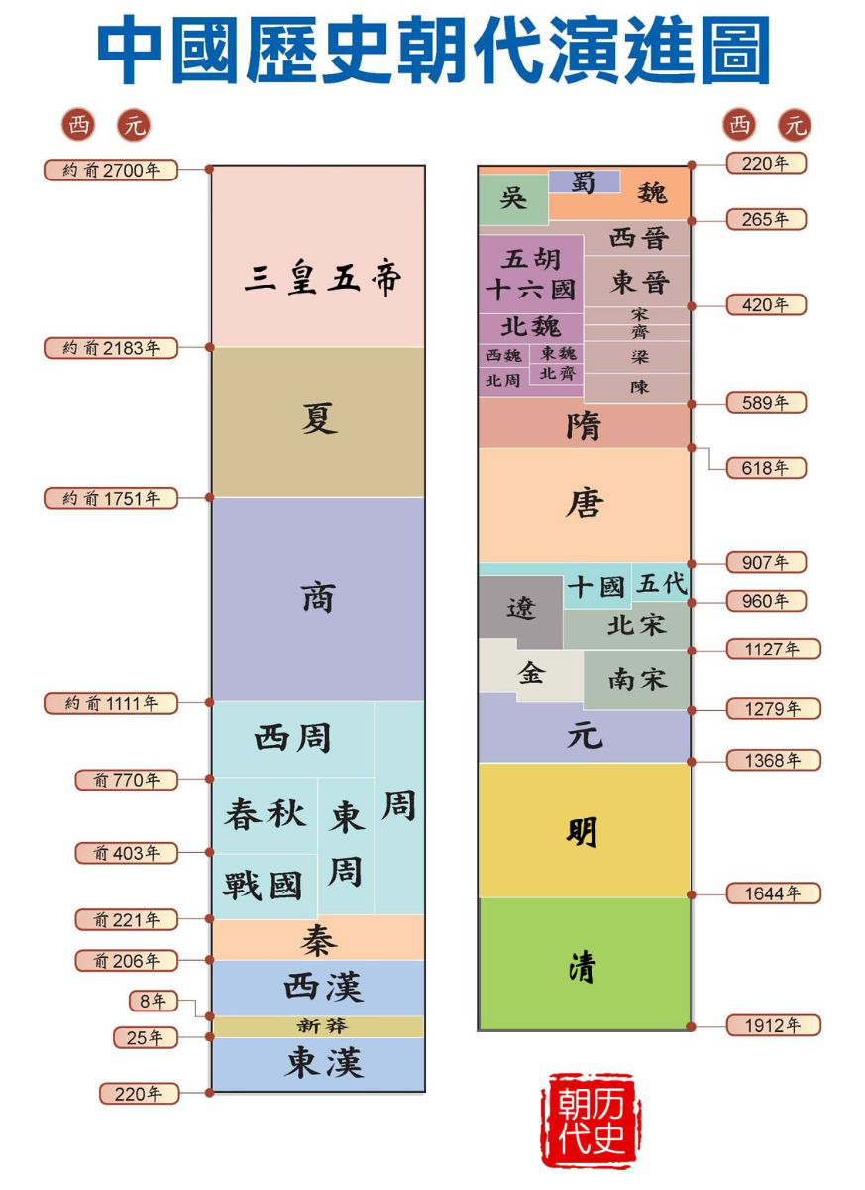
Understanding TIME using UP-DOWN
English: last month, next month
Chinese:
上個月 shàng-ge-yuè ‘up-CL-month’,
下個月 xià-ge-yuè ‘down-CL-month’,
Czech: minulý měsíc, příští měsíc
English: first half of the year, second half of the year
Chinese:
上半年 shàng-bàn-nián ‘up-half-year’,
下半年 xià-bàn-nián ‘down-half-year’
Czech: první polovina roku, druhá polovina roku

Slide 52
On reasoning about TIME
Fish race experiment (Boroditsky 2001):
Task: Below you will see a picture and a statement. Based on the picture, please decide whether the statement is true.

Slide 53
You will see a picture and a statement. Raise your left hand if the statement is true. Raise your right hand if the statement is false. Be as fast as you can.

Slide 54
You will see a picture and a statement. Raise your left hand if the statement is true. Raise your right hand if the statement is false. Be as fast as you can.

Slide 55
Mandarin-English bilinguals
Mandarin Chinese as L1, English as L2.
Strong vertical bias for CN-EN bilinguals who started English late.
Learning EN gives those CN speakers a “horizontal bias”.
Learning a different language does make one reason about TIME differently.
Lera Boroditsky’s TED talk (recommended!)

Slide 56
Summary of Chinese TIME
Tenseless
  Analytic
  Grammar-driven cognitive consequence (vagueness)
Metaphorical (SPACE > TIME)
Up-down temporal orientation

Slide 57
Tonal language
What is a lexical tone?
Tone is the use of pitch in language to distinguish lexical or meaning – that is, to distinguish words.
(East) Asian tonal languages: Chinese, Vietnamese, Thai, among others.
4 lexical tones in Chinese (marked by diacritics over vowel):
High tone (mā)
Rising tone (má)
Dipping/low tone (mǎ)
Falling tone (mà)

Slide 58
Tonal tongue twister
Tongue twister with tonal variation:
https://www.instagram.com/reel/CoJJz5VA6kt/?igshid=YmMyMTA2M2Y%3D
Māma qí mǎ
Mom ride horse
Mǎ màn
Horse slow
Māma mà mǎ
Mom scold horse
“”

Slide 59
Pluricentricity
Thailand | 9,392,792 (2012)^{[2]}
Indonesia | 8,010,720 (2011)^{[1]}
Malaysia | 6,712,200 (2021)^{[3]}
United States | 5,143,982 (2018)^{[4]}
Singapore | 2,675,521 (2020)^{[5]}
Myanmar | 1,725,794 (2011)^{[1]}
Canada | 1,715,770 (2021)^{[6]}
Australia | 1,390,639 (2021)^{[7]}
Philippines | 1,350,000 (2013)^{[8]}
South Korea | 1,070,566 (2018)^{[9]}
A pluricentric language: lg officially used in at least two countries and thus develop national varieties with specific linguistic and pragmatic features.
Mandarin as an official language in:
  China (incl. Hong Kong, Macau); Beijing
  Singapore; Singaporean
  Taiwan; Taiwanese
Also used in various parts of the world (lg of the diaspora).

Slide 60
Mandarin Chinese spoken and script used
Standard Chinese spoken as an official language in:
- China (incl. Hong Kong, Macau)
- Singapore
- Taiwan
Used by the United Nations as one of the official languages.
The simplified script.

Slide 61
Writing system
Evolution:
Traditional version used till end of WWII.
In 1950s, 1960s, the Chinese communist gov. started simplification process, resulted in the current system.
- Used also in Singapore and Malaysia.
Traditional version has remained:
- Taiwan
- Hong Kong (British colony until 1997)
- Macau (Portuguese colony until 1999)

Slide 62
Diaspora and varieties of CN in Western countries
United States | Chinese American, American-born Chinese | 5,025,817 | 1.5% | 2017^{[157]}
Canada | Chinese Canadian, Canadian-born Chinese | 1,769,195 | 5.1% | 2016^{[158][159]}
Cantonese (+trad. script) for earlier arrivals (1984, 1989)
1984: Sino-British Joint Declaration
1989:
Standard Chinese (+simp. script) for later arrivals
France | Chinese French | 600,000 | 1% | 2018^{[143]}
United Kingdom | British Chinese | 433,150 | <1% | 2011
Russia | Chinese people in Russia | 28,943 | <1% | 2010^{[144]}
Italy | Chinese people in Italy | 288,923 | <1% | 2020^{[145]}
Spain | Chinese people in Spain | 197,390 | <1% | 2020^{[146]}
Germany | Chinese people in Germany | 145,610 | <1% | 2020^{[147]}
Netherlands | Chinese people in the Netherlands | 94,000 | <1% | 2018^{[citation needed]}

Slide 63
Variation of Chinese characters
2 standard sets of Chinese characters:
1) Fántǐzì 繁体字 so-called traditional characters (Taiwan, Hong Kong, Macau)
2) Jiǎntǐzì 简体字 so-called simplified characters (PRC, Singapore) (they are the result of reforms from the 1950s)
Difference: number of strokes (types of simplification to be covered later)
Traditional/simplified: 馬／马; 國／国 (complicated characters simplified in 50s)
人／人; 月／月 (easier ones remain unchanged)

Slide 64
Summary of session 3
Overview of CN:
Section of Mandarin and Chinese (languages): Define the difference between Mandarin and Chinese.
Section of pluricentricity: Find out where Mandarin is spoken.
Section of writing: characters as a writing system.
Typological features of Chinese:
  - monosyllabicity
  - homophony
  - classifier language (categorization)
  - tonal language
  - rare affixation (analytic language)
  - The Chinese TIME
Culture: the love of numbers

Slide 65
Preparation for next week (JP block)
What words of Japanese origin can be seen in Czech/Slovak? Give at least 5 examples.
What toponyms (names of places) or names of companies, brands etc. of Japanese origin do you know? Give at least 10 examples.

