Slide 1
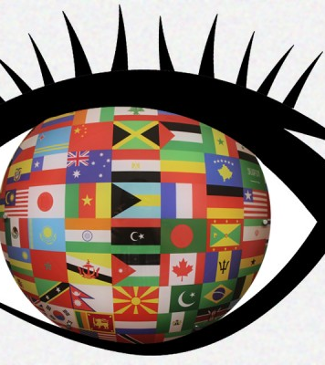
Cultural perspectives II

Slide 2
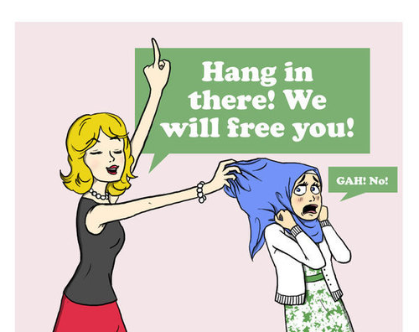
Ethnocentrism
Belief in the intrinsic superiority of own ś own culture, language, ethnic group
Involves emotions
Highly subjective, personal, emotional, usually subconscious
Tendency to judge (personal cultural standards)
Everyone

Slide 3
Languages (China: middle kingdom; Navajo/ Roma people = people; non-Diné, non-Roma: non-people, lesser status; USA: Americans
Reflected in maps

Slide 5
Stereotypes
Overgeneralized, exaggerated, oversiplified beliefs that people use to categorize a group of people
Psychological process, members of one group ascribe characteristics to another group (beliefs, expectations about people´s behavior, attitudes, views, demeanors)
Universal
Mental pictures

Slide 6
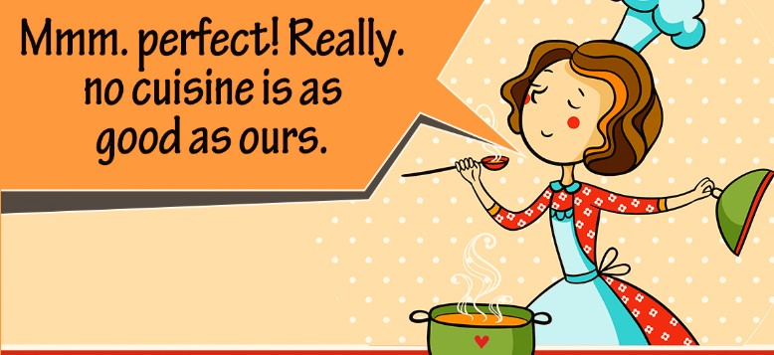
Stereotypes
Paul Bloom (Yale University): prejudice, bias, stereotypes: fundamental to human beings
+important skill in interaction (not to ask a toddler for directions/old man to help move a sofa)
-We vs. They; group in/out perspective
Cross-culture stereotypes: members of one group regard their way of doing things as the way to do things (cultures vaues harmony, respect x stereotype: loud, aggresive)

Slide 7
Stereotypes
Attitudes learned from parents and peers
Develop through contact with people who are „different“
Often created and perpetuated through media (Koreans: hard workers, French film Taxi)
Negative stereotypes may prevent or hinder effective communication (Japanese students and dean)

Slide 8
Attribution
Process by which people explain another person ´s behavior by referring to their own experiences, values and beliefs
Confronted with different or unknown, try to make sense of the world, to make it more predictable
Individuals attempt to „explain“ behaviors by attributing causes or reasons to their own behaviors
May result in misunderstanding, rejection, conflict, even hostility
E.g. Table manners (show pleasure by burping loudly, eye contact, paying…) Anecdote: Dieter and „person of color)

Slide 9
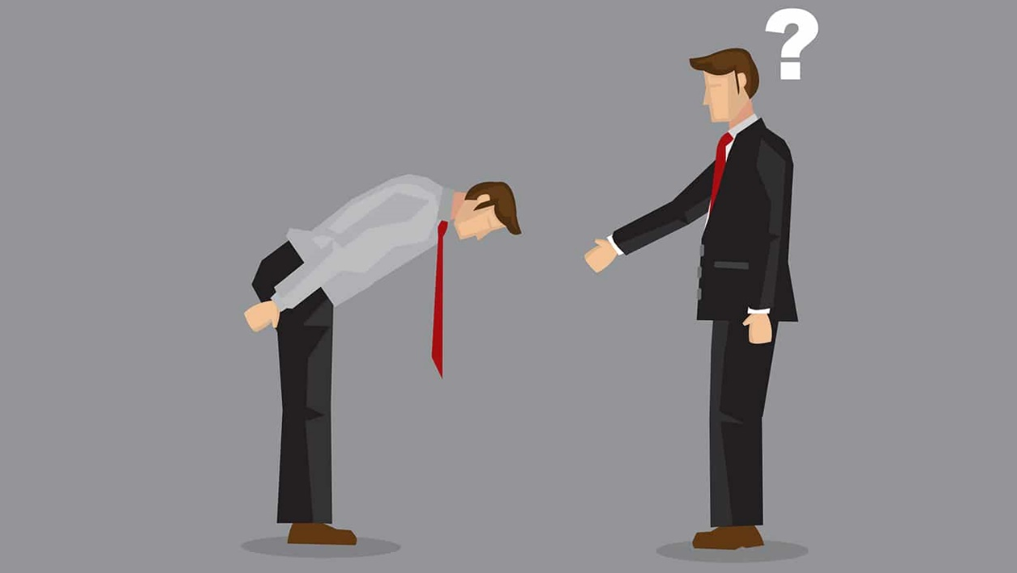
Culture shock
Occurs when a person´s expectactions do not coincide/conflict with a different culture reality
Confronted with unknown/different
Feel a loss of control

Slide 11
Pragmatics and Discourse
Language and communication are motre than words and grammar, also a reflection of the cultural and social context of the speakers
Language doesn´t occur in isolation (type of speech, choice of words, tone…
„It´s just about a lunchtime“???

Slide 12
Pragmatics
study how language is used in communication (functions, rulesof discourse, structure, appropriateness of c. interactions)
Pragmatic competence: ability of the interlocutors to participate effectively and appropriately in interactions (social context, social variables: status, gender, age, cultural knowledge: politeness codes, non-verbal cues)
Difficult
„See you later“ by Americans not intended as actual commitments to meeting, but solidarity with the speaker
Chinese: „Have you eaten?“

Slide 13
High/low context
High-context communication: in cultures that emphasise through the context of social interactions (speaker´s social roles, gender, age…) and the physical environment
Homogenous, collective cultures: China, Japan, Korea; long shared history
Low-context communication: culturess that stress communication via explicit verbal messages
Communication regarded as independent act performer between speakers and listeners
Speakers/listeners: seen as autonomous individuals

