Slide 1
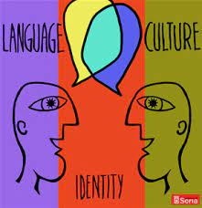
Culture, language and Culture

Slide 2
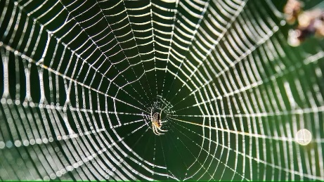
Culture
Very general concept
Set of fundamental ideas, practices and experiences shared by a group
Heterogenous (subcultures of subgroups); differences: regional, ethic backround, sex. orientation, work affiliation, religion, …
Spider story „How could anyone see this and not believe in natural selection/ in God!“
Changing: ongoing and continuous process
„collective mental programming of the people in the environment“
(Hofstede, 1980:42)

Slide 3
Enculturation
Culture: subconcious teacher of the beliefs, values, worldviews, patterns
Begins early:family, interactions: school, work, social media
We are unaware
Culture: lenses for seeing the world
„hidden codes“ of behavior
Pervades all areas: art, beliefs, behaviors, ceremonies, concept of self, customs, ideas, knowledge, laws, language, manners, morals, myths, religion, rituals, social institution, values

Slide 4
Describe, what do you see

Slide 5
Culture and culture
Culture: art, literature, drama, classical music, dance, cuisine
Objective culture, highbrow culture
The institutions that people have created
Institutional aspects: political, economic systems
culture: subjective culture, psychological in nature
People´s attitudes, beliefs, values
Larger society as a whole – cultural groups (college students, emplyees of a corporation, middle-class teenagers, family)

Slide 6
Elements of Culture
Beliefs: convinctions about the world, fundamental teachings about what reality is and expectations of how the world operates
Values: ideals or abstract standards, shared judgements, what is good, right and important (self-reliance, hard work, economic effrt x communal family goals x harmony)
Norms: fixed behavior patterns of doing things (example: two friends, same employer, 100 $: equally, family status, skills, reciprocity…)

Slide 7
Elements of Culture
Taboos: what is or is not permissible (universal prohibitions: murder, incest, and culture/religious specifics: left hand unclean; food taboos, eye contact)
Attitudes: emotional reactions to objects, ideas and people; e.g. Germans Gemütlichkeit (cafés, terrace gardens), North America: variety of religious houses x Latin America: one official religion; Japanese gift-giving; birthday gifts: open immediately x put away: Thai, Malaysian, Filipino)

Slide 8
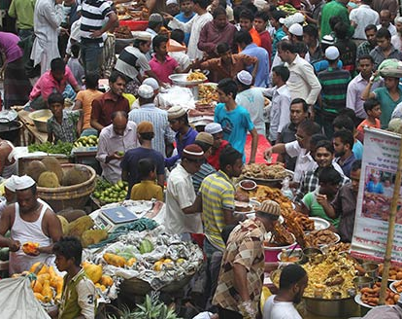
Emics (c. specifc) and etics (c. universal)

Slide 9
Language and Linguistic Relativity
Language and culture are linked
Linguistic relativity: chinese or Korean terminology that indicates person´s position
Categorization, e.g. Family members (older brother and younger b.), colours: English use 40 color terms x two: light and dark, as dark as the sky at noon; Russian: two words for blue)
Subculture: developing specialized vocabulary for necessary materials, conditions, situations
Language as a mirror

Slide 10
Language and culture
Language consists of symbols (vocabulary) and rules (grammar and syntax)
Language is a symbolic representation of a people
Lens through which reality is filtered
Language reflects the worldviews, thought processes, lifestyle
Language: primary medium for transmitting among it ś speakers and cultural beliefs, norms, worldview
Filipino: adressing: elder title Po, elder siblings kuya (eldest boy)/ ate (eldest girl)

Slide 11
Intercultural communication framework
1. Establish and maintain a relationship: develop and understand their classroom roles and expectations
Explicitely exchange cultural information
2. Identify and Accomodate Priorities
Teacher: recognize own educational priorities, clearly identify them, student and teacher two-ways communicatove relationship
3. Make Associations between Familiar and the Unfamiliar: building bridges (e.g. open praise)

