Slide 1
Global film festival circuit
Zemaityte, Karjus, Rohn, Schich, Ibrus, Quantifying the global film festival circuit: networks, diversity, and public value creation. Plos One, 2024

Slide 2


European Film festivals – history, politics, economy
Film Festival Search – FilmFreeway
Film Festival Research | The website for the Film Festival Research Network
Marijke de Valck (Utrecht University, Netherlands), Skadi Loist (Film University Babelsberg Konrad Wolf, Germany), Dina Iordanova (University of St. Andrews, Scotland)
Notes:
4158 festivalů – Evropa

Slide 3

history
three main phases
The first phase: from the establishment of the first reoccurring film festival in Venice in 1932 until 1968 (upheavals began to disrupt the festivals in Cannes and Venice) and early 1970s (when these upheavals were followed by a reorganization of the initial festival format: film festivals as showcases of national cinemas)
The second phase: independently organized festivals that operate both as protectors of the cinematic art and as facilitators of the film industries. This phase ends in the course of the 1980s
The third phase: since the 1980s; the festival phenomenon is professionalized and institutionalized
Marijke de Valck, Film Festival. From European Geopolitics to Global Cinephilia. Amsterdam University Press, 2007

Slide 4
Prehistory – film clubs; local festivals
From music festivals to film festivals
avant-garde’s cosmopolitan networks
Film clubs in Paris and elsewhere
Events: the gatherings of independent filmmakers in La Sarraz (1929) and Lausanne (1930),
“Film und Photo” Exhibition in Stuttgart in 1929
Notes:
The first festival was organized on New Year’s Day 1898 in Monaco
(! Ale první PRAVIDELNY až Benátky, 1932)
The first prize-winning festival was an Italian movie contest in 1907 organized by the Lumière brothers
The French-speaking cultural area seems to have had a pioneering role in adopting the festival concept from
music to film. There, a national film festival model emerged based on the gala music festival outlined above.
A reference to such an event can be found as early as 1908 in the November issue of the French newspaper
Le Figaro (1908:5). On the same page as the advertisement heralding a week of sensational music festivals
(see quotation above), the newspaper announced a “grand festival cinématographique” (great cinema festival)
to take place at the elegant Parisian Femina theatre on the Champs Elysées on November 14 and 15, 1908.
The event was organized by count Henri de la Vaulx, a famous French balloonist, and consisted of a series
of aviation films with live commentary. The ticket was sold for 3 francs. The event clearly mirrored the gala
music festival, both in terms of the program (a series of thematically related films rather than the usual mixed
program shown in movie theaters) and the choice of the venue (the Femina was a place of high culture, not a
nickelodeon-type movie theatre).
Over time, the organization of festivals seems to have become a regular practice in some movie theatres, both
commercial and cultural. One commercial movie theatre that embraced the concept was the Cinéma Palace
in Lausanne, in the French-speaking part of Switzerland. According to the local weekly film magazine L’écran
illustré (1925c: 3), the Palace was “known for its comic festivals“. In December 1925,
for example, it dedicated an event to the American comedian Harold Lloyd, “the best comic actor in the entire
world” (L’écran illustré 1925a: 4), screening three of his films twice each day for one week (December 11-17).

Slide 5
Notes:
https://de.wikipedia.org/wiki/Blutsbr%C3%BCderschaft_(1926)
Bayrische Landesfilmbühne
(Bavarian state film stage), a film association supported by the city of Munich and other Bavarian towns. Its
director and the main instigator of the event, Johannes Eckardt, later stated that he had hoped to establish a
large-scale annual festive event for film in Germany, akin to those that had long existed for other art forms
(Choy 2006: 94). The goal of the Bayrische Landesfilmbühne was the cultivation and promotion of so-called
“good films”, i.e., films that were morally sound, such as popular science documentaries called “Kulturfilme”
(cultural films), but also high-quality fiction films. The Bayrische Landesfilmbühne organized its first Film-
Festwochen in München (Munich Film Festival) in 1928 ( July 3 to August 23). The goal was to provide a “comparative
overview of the current artistic state of world cinema” by screening “42 top performances of European
and American film”

Slide 6
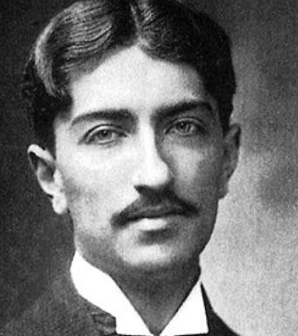
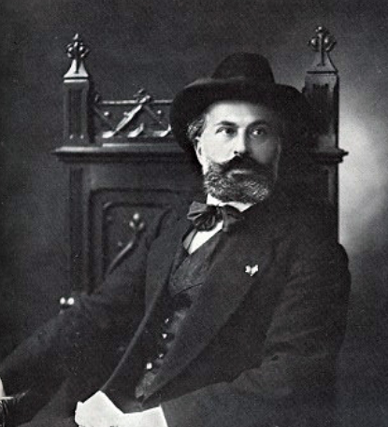
Film clubs
since 1920 – retrospective programmes organized by Louis Delluc
klub C.A.S.A. (Club des Amis du Septiéme Art): Ricciotto Canudo, commercial vs. elite cinemas
Jean Epstein: „this film anthology was very valuable because it drew attention to film style through fragments of films: it isolated style from narrative.“
Notes:
Vznik hnutí filmových klubů lze sledovat od r. 1920. Jejich zárodkem byla promítání v pařížském kině La Pépiniére, kde se promítaly např. filmy francouzského kreslíře Emile Cohla. S tímto modelem retrospektivních programů věnovaných jednomu filmaři přišel jako první Delluc.
Dellucovy aktivity – jeho texty a jím pořádané conférences – vycházely z pojetí filmu jako demokratického masového umění.
Poté vznikl klub Ricciotta Canuda C.A.S.A. (Club des Amis du Septiéme Art), kam chodili např. Germaine Dulacová, Marcel L´Herbier, Alberto Cavalcanti, Jean Epstein, Fernand Léger, Jean Cocteau ad. V manifestu C.A.S.A., zveřejněném v Cinéa, mj. Canudo uvádí jako cíl vytvoření hierarchie kin, rozlišení komerčních a elitních kin.
Canudův klub, který jako první fungoval pravidelně, byl více zaměřen elitářsky, na intelektuální kruhy. Promítaly se zde také ukázky z filmů – s cílem definovat film z hlediska národních stylů.
Epstein si to pochvaloval: „tato filmová antologie byla velmi cenná, protože skrze fragmenty filmů přitahovala pozornost k filmovému stylu: izolovala styl od narativu.“

Slide 7
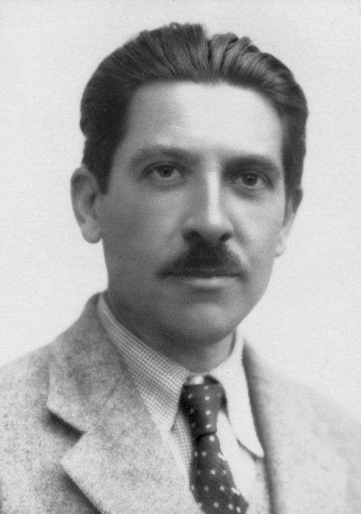
Léon Moussinac
Member of the Communist Party
1925: he presented films by Vertov and Eisenstein in France, including Potemkin in 1926, whose commercial release was banned in France
In 1922 he founded the Club français du Cinéma, which sponsored special screenings and debates
In 1927, after returning from a writers' conference in Moscow, he and other Communist Party members founded a network of film clubs, Les Amis de Spartacus, to spark a mass film movement
Membership grew rapidly to tens of thousands, and the club planned to expand to the Paris suburbs and beyond. But screenings of Soviet films became part of the political attacks against the French Communist Party
Notes:
V polovině 20. let se k filmovým klubům připojila kina zaměřená na avantgardu a filmové umění. Francouzská avantgarda tak vytvořila podpůrný systém filmových klubů, specializovaných kin, časopisů – všechny byly věnované propagaci filmu jako moderního umění.
tento intenzivní rozvoj nezávislých časopisů věnovaných filmu i intenzita teoretické a kritické diskuze na počátku 20. let byla ve Francii jedinečná a neměla obdoby nikde jinde v Evropě – snad s jistým zpožděním v Sovětském svazu v časopisech Kino-fot, Kino-Gazeta, LEF. Francouzské hnutí bylo ale více kulturní, než politické, a více zaměřené na film z hlediska diváctví, než tvorby.
Významným hybatelem těchto aktivit byl také levicový kritik Léon Moussinac, který se pod vlivem první sv. války přiklonil k levici a v r. 1923 vstoupil do francouzské komunistické strany.
V r. 1922 založil Club français du Cinéma, který sponzoroval speciální projekce a debaty; po smrti Canuda se tento klub spojil s C.A.S.A. (Club des Amis du Septiéme Art) do Ciné-Club de France.
Filmové kluby zaznamenaly velký úspěch a postupně se rozšiřovaly nejen v Paříži, ale ve druhé polovině 20. let vzniklo kolem deseti klubů i v dalších francouzských městech

Slide 8
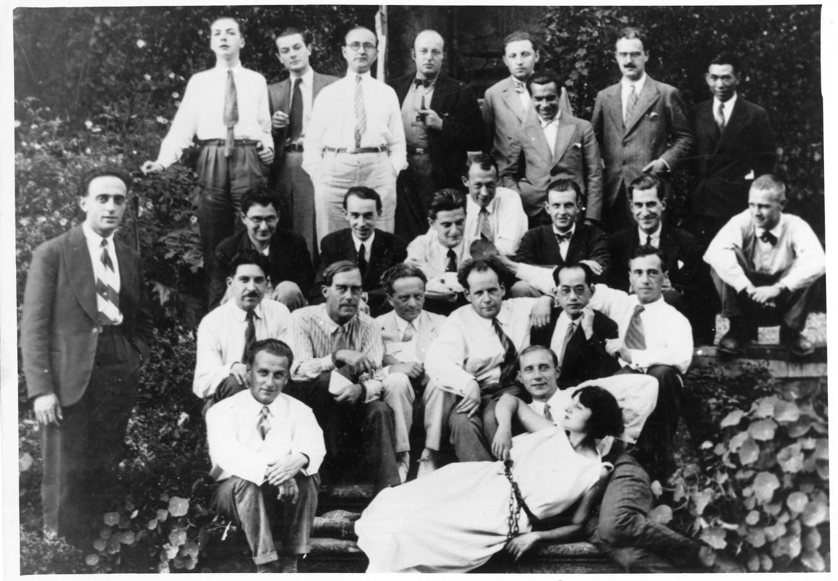
1929 - International Congress of Independent Film at La Sarraz Castle in Switzerland second row from the bottom - seated from the left
Léon Moussinac, Walter Ruttmann, Béla Balázs, Sergej Ejzenštejn, (?), Hans Richter
Notes:
Filmové kluby: začaly se objevovat i v dalších zemích: v roce 1925 v Londýně vznikla Film Society, v Lausanne a v Ženevě v roce 1926 Ciné d´Art, velmi aktivní klub se objevil v Bruselu, kde byly organizovány přednášky představitelů francouzské avantgardy.
Tento rozvoj vedl ke dvěma velkým mezinárodním událostem: v roce 1929 organizovali Robert Aron a Janine Bouissounouse desetidenní mezinárodní kongres nezávislého filmu na zámku La Sarraz ve Švýcarsku, kterého se účastnili např. Moussinac, Hans Richter, Walter Ruttman, Béla Balázs, Sergej Ejzenštejn, Grigorij Alexandrov, Eduard Tissé. Na konci téhož roku se konal v Paříži kongres filmových klubů, kde byla založena Fédération des Ciné-Clubs.

Slide 9
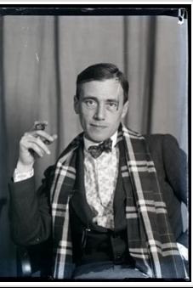

Hans Richter (1888-1976)
Richter curated the film part of the Film und Foto exhibition in Stuttgart
Notes:
Začínal původně jako malíř. Podílel se s Tristanem Tzarou a Hansem Arpem na formování dadaismu v Curychu.
Spolupráce se Švéde Vikingem Eggelingem; získali sponzora a snažili se pomocí filmu rozpohybovat své sériové kresby.
Richter připravil jako kurátor filmovou část výstavy Film und Foto ve Stuttgartu. Jeho kniha Filmgegner von Heute – Filmfreunde von Morgen, 1929 (Nepřátelé filmu dnes, fanoušci filmu zítra) připravená pro výstavu kladla důraz na ty aspekty viditelného světa, které obvykle unikají lidskému oku a nyní se staly dostupné pro umělecké prozkoumání. Film budoucnosti bude podřízen jen zákonům rytmu
Klíčové prvky filmového umění: radikální rozšíření percepce, překonání každodenní zkušenosti silami imaginace
Abstraktní studie Rhythmus 21, Rhythmus 23, Rhythmus 25 (1921–25) řadil Richter k dadaistické tvorbě; neodpovídá to obvyklému veřejnému obrazu dadaismu jako útoku na modernitu a umění, jako destruktivního hnutí, jehož nejčastějším příkladem ve filmu bývá Mezihra René Claira a Francise Picabii.
Dadaismus měl i konstruktivnější, tvůrčí podobu. Richter chápal své abstraktní filmy jako hledání „univerzálního jazyka“. Kritika racionality – ale ne racionality o sobě, ale její dominance, která vytlačuje to, co leží mimo ni: nevědomí, náhodu, spontaneitu. Nechápe tedy dadaismus jako kritiku racionality, ale jako kritiku její nadvlády.

Slide 10
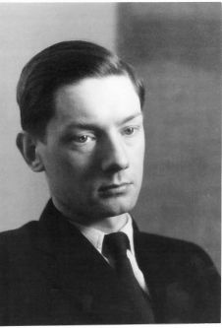
Avant-garde
Alexander Hackenschmied (1907-2004)
„Week of Avant-Garde Cinema“ in Prague in 1930 and 1931
Movies by Henri Chomette, Jean Vigo, René Clair, Alexander Hackeschmied, Otakar Vávra, František Pilát…
Notes:
listopad 1930 – Hackenschmied připravil týden avantgardního filmu – v kině Kotva, díky pochopení majitele – Miloše Havla.
Program: mj. Henri Chomette, Jean Vigo, René Clair; a Bezúčelná procházka.
V lednu 1931 druhý týden avant. filmu – Kříženecký, Ray, Fischinger, Dovženko.
Únor 1931: třetí – a poslední – týden avant. Filmu; film Otakara Vávry a Františka Piláta Světlo proniká tmou

Slide 11


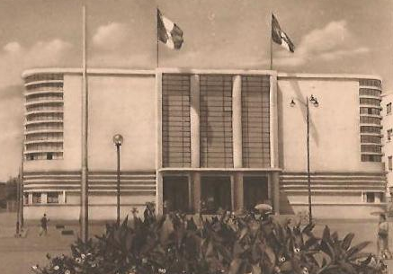
Venice, Cannes, and politics
first regularly organized film festival was established in Venice in 1932 (biannually, part of the Arts Biennale; since 1934, annually)
International combined with national dimension; working explicitly with the nationalistic sentiments that divided European nations
1936: Separated from the Arts Biennale
1938: Olympia (Leni Riefenstahl) + Pilot (Goffredo Allessandrini)
Cannes: planned for September 1-Sept. 20, 1939
Notes:
Politically, the Mostra’s foundation received strong support from Italy’s Fascist government.
During the first festival, Fascist influence was not yet evident. However, by the time Goebbels attended the festival in 1936 as an honored guest, the role of the Venice Film Festival as consolidator of the ideological and cultural position of the Fascist party was unmistakable. In 1938, the great prize, the Mussolini cup, was awarded ex aquo to Olympia (DE: Leni Riefenstahl 1938) and Luciano Serra, Pilota/Luciano Serra, Pilot (IT: Goffredo Allessandrini 1938), which had been produced by Mussolini’s son Vittorio.
https://it.wikipedia.org/wiki/Palazzo_del_Cinema_di_Venezia
Pro festival 1937 – palác filmu, s kinosálem pro tisíc diváků

Slide 12
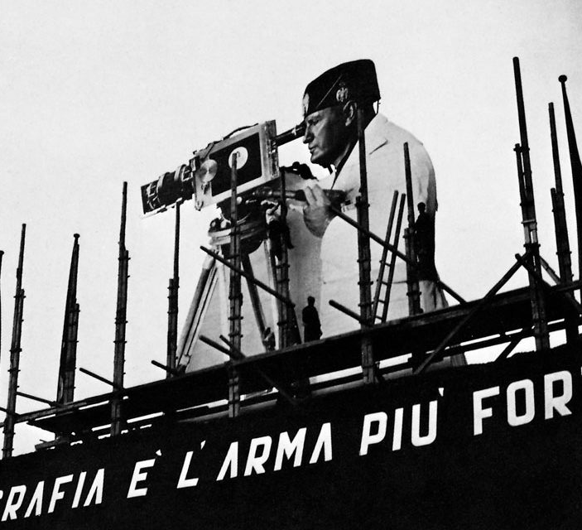
Venice, 1932-1942
In the late 1930s: film nomination by national film chambers (reaction to success of French films in 1937)
relaunched in the summer of 1946
Moscow International film festival (MIFF) was founded in 1935 (retrieved in 1959)
Notes:
International Film Chamber: prosazovala přes italského ministra lidové kultury Dino Alfieriho změny ve statutu festivalu v Benátkách (reakce mj. na úspěch francouzských filmů v r. 1937, mj. Velké iluze, Renoir).
Důsledek změna statutu festivalu – filmy nevybírala výběrová komise, ale národní filmové komory. To naznačuje, že nový inter-nacionalismus nenechával prostor pro nadnárodní pojem kvality. Posílení role filmu jako národní komodity, oslabení statutu festivalu jako místa nezávislého hodnocení uměleckých hodnot.
Ceny pro nejlepší zahraniční film na festivalu v Benátkách:
německé filmy v letech 1938 – Leni Riefenstahl: Olympia, 1940 - Gustav Ucicky – Der Postmeister, 1941 - Hans Steinhoff – Ohm Krüger, 1942 – Der grosse König.

Slide 13

cannes
After the 1938 Venice festival: the representative of the French government, Philippe Erlanger, started to think about creating an alternative festival
On 31 August 1939 The Hunchback of Notre Dame (William Dieterle) was shown in Cannes
Notes:
In „Festivals and the cultural public sphere“:
in September 1938, Hitler and Mussolini respectively overruled the jury’s decisions in favour of an Italian film produced under the
supervision of Mussolini’s son, and Leni Riefenstahl’s Fest der Völker/olympia, dealing with the 1936 Olympic Games in Berlin. These events deeply shocked American, British and French officials, and it was on the train journey back to Paris that the representative of the French government, Philippe Erlanger (1903–1987), started to think about creating an alternative festival (Erlanger 1974)
The American film industry was hugely overrepresented at the first Cannes
Film festival in 1939. Metro-Goldwyn-Mayer (MGM) rented a large transatlantic
liner to ship stars such as Tyrone Power, Gary Cooper, Douglas Fairbanks,
Jr, George Raft, Paul Muni, Norma Shearer and Mae West across the Atlantic.
Ten American productions were scheduled for screening, reflecting great
variety: fantasy represented by The Wizard of Oz but also a western, dramas,
comedies and adventure and historical films. France had a selection of eleven
films, mostly from the poetic realism movement but also showing the wealth
of the country: … The Soviet Union was equally well represented
with eight films, mostly adulating the working class and Lenin but also introducing
new cinematographic techniques, since they included the only film
of the festival in colour. But most of these films could not be screened.

Slide 14

Cannes 1946
The statute’ of the festival, 1946: ‘[the] objective [of the festival] is to encourage the development of cinematographic art in all of its forms and to create among all film-producing countries a spirit of cooperation.’
competition was not at the core of Cannes in 1946
The first Cannes festival: 20 September – 5 October, 1946, The French government and film industry had invited nineteen countries to participate
Almost every participating country received a prize of some kind
Notes:
Podobně rozdělování všem – v karlových varech, socialistická solidarita

Slide 15

cannes
Tourism
Competition with Venice and Locarno (1946)
State subsidy for the festival (70-80%)
Notes:
Foto: Cannes, 1947
Locarno International Film Festival was actually the first international
film festival held after the end of the Second World War, slightly before
Cannes.
Unlike the Berlin Film Festival, which is an open space attended by all strata
of the population, Cannes stands for something that is comparable with an
international conference of experts and government officials. Cannes is a closed
circle, which only highly select people have the right to join, at least for the
official selection. Cannes is ruled by strict dress codes and etiquette, and
Cannes’ paramount task is to assess films.

Slide 16

FiAPF and festival categories
Federation Internationale des Associations de Producteurs de Films (International Federation of Film Producers Associations), www.fiapf.org (founded in 1933)
43 International Film Festivals / 29 countries
Notes:
1951 that the boom in national and regional film festivals had to be channelled to prevent the festival
(award) inflation.
Cannes and Venice: being classified as a category “A” festival granted them the right to form an
international jury for their prestigious awards

Slide 17



“competitive feature film festivals”
Home | Fiapf | International Federation of Film Producers Associations
At the Berlin Film Festival, 1951: FIAPF provided accreditation for:
Venice (est. 1932; La Biennale di Venezia)
Cannes (est. 1946; Festival de Cannes - Festival de cinéma international depuis plus de 75 ans (festival-cannes.com)
1956: Berlin (established 1951) | Berlinale |
+ following festivals have the accreditation from FIAPF in 2024:
Karlovy Vary (Czech Republic, 1946) https://www.kviff.com/en/homepage
Locarno (Switzerland, 1946) | Locarno Film Festival (locarnofestival.ch)
Goa (India, 1952) 54th International Film Festival of India - IFFI Goa
San Sebastian (Spain, 1953) San Sebastian Film Festival :: (sansebastianfestival.com)
Mar Del Plata (Argentina; 1954) www.mardelplatafilmfest.com
Cairo (Egypt, 1976) Cairo International Film Festival (ciff.org.eg)
Tehran (Fajr International Film Festival, Iran; 1983) Home - Fajr International Film Festival (fajriff.com)
Tokyo (Japan, 1985) 37th Tokyo International Film Festival (2024) (tiff-jp.net)
Warsaw (Poland, 1985) WARSAW FILM FESTIWAL (wff.pl)
Tallin (Black Nights Film Festival, 1987) PÖFF : BNFF (poff.ee)
Shanghai (China, 1993) WARSAW FILM FESTIWAL (wff.pl)
FIAPF paused accreditation of the Moscow international film festival after the Russian invasion of Ukraine
Notes:
Tallin- Estonia
The Fajr International Film Festival replaced
Tehran in 1982(1983?) after the Iranian revolution of 1979. To reinforce the idea of a new
Iran, the Fajr (“sunrise” in Persian) festival is held in late January to commemorate
the anniversary of the revolution. Given the religious government of Iran,
the Fajr festival follows a clear party line based in a particular Shia Muslim worldview
and practices; however, the festival has allowed Iranians to see international
cinema, including works by Andrei Tarkovsky, Yasujiro Ozu, and Theo
Angelopoulos.

Slide 18
“competitive specialized feature film festivals” In Europe
European festivals:
(for the full list see Competitive Specialised Feature Film Festivals | Fiapf | International Federation of Film Producers Associations
Valencia (Spain) New directors’ films
Valencia (Spain) Films from Mediterranean countries
Gijon (Spain): Films for young people
Sitges (Spain): Fantasy films
Malaga (Spain): Spanish-speaking films
Turin (Italy): New directors’ films
Milan (Italy) Police and Mystery Films
Rome (Italy) Progressive Cinema – Visions for the World of Tomorrow
Skopje (North Macedonia) Cinedays
Cluj (Romania) First and second feature film
Sofia (Bulgaria) First and second feature film
Kitzbühel (Austria), Young directors’ films
Kyiv (Ukraine) Young directors’ films

Slide 19






I/ non-competitive feature film festivals in europe
II/ documentary and short films festivals in europe
I/ Vienna (Austria) Viennale
II/
Clermont-Ferrant (France)
Krakow (Poland)
Oberhausen (Germany)
Tampere (Finland)
Bilbao (Spain)

Slide 20

Berlinale i
6-18 June, 1951
Geopolitical reasons
American initiative
The festival organization was to collaborate with the Bonn government, American officials, and other allies in occupied Berlin
exclusion of movies from communist countries
1956: formed an international jury to award its Golden and Silver Bears
Notes:
the representation was limited to one or two movies per invited country. But there were two exceptions:
America and the UK, who could each submit three movies
The FIAPF banned the awarding of jury prizes at the festival, so between 1952 and 1955, the winners of the Golden Bear were determined by the audience members. In 1956, FIAPF formally accredited the festival and since then the Golden Bear has been awarded by an international jury

Slide 21
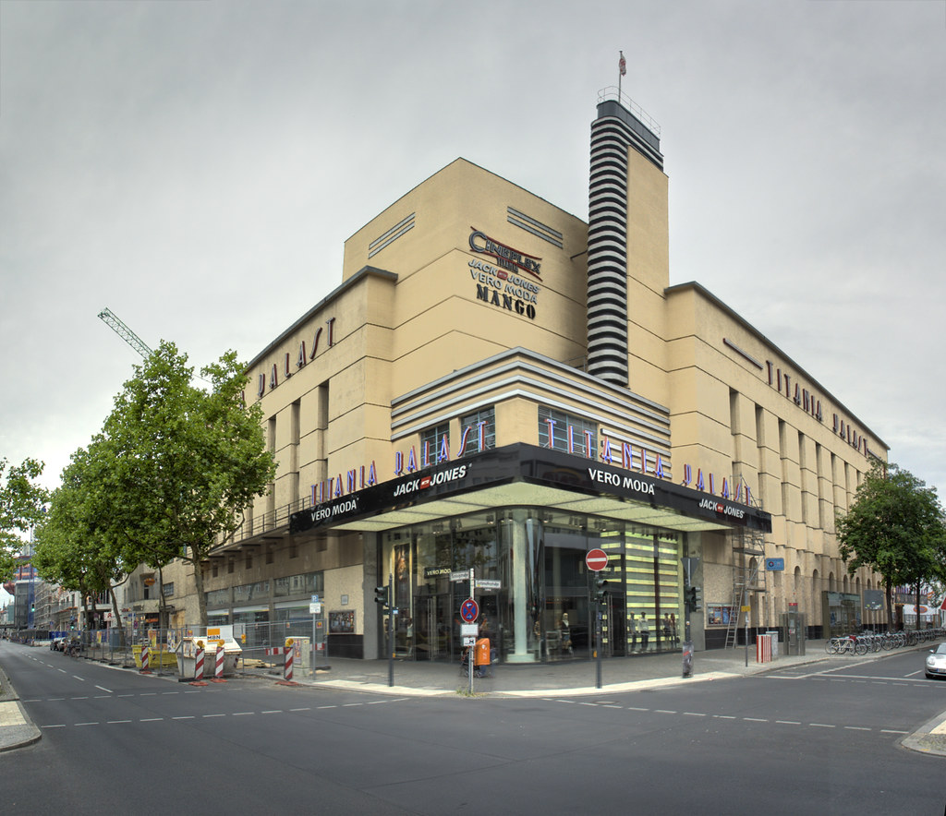
Berlin 1951
Titania Palast in Steglitz
Special screenings in twenty-one “Randkinos” along the border with East Berlin

Slide 22
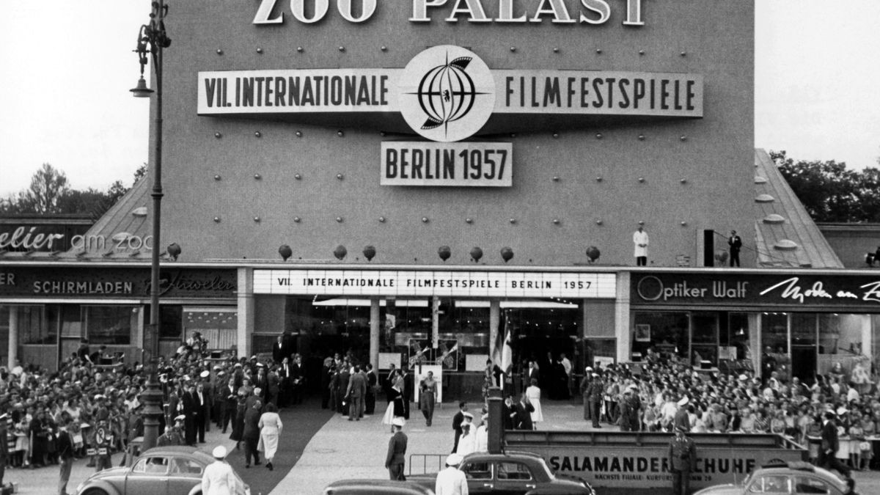
Zoo palast, 1957
Notes:
1957 wurde der neue eröffnete Zoo Palast zum neuen Zentrum des Festivals.

Slide 23
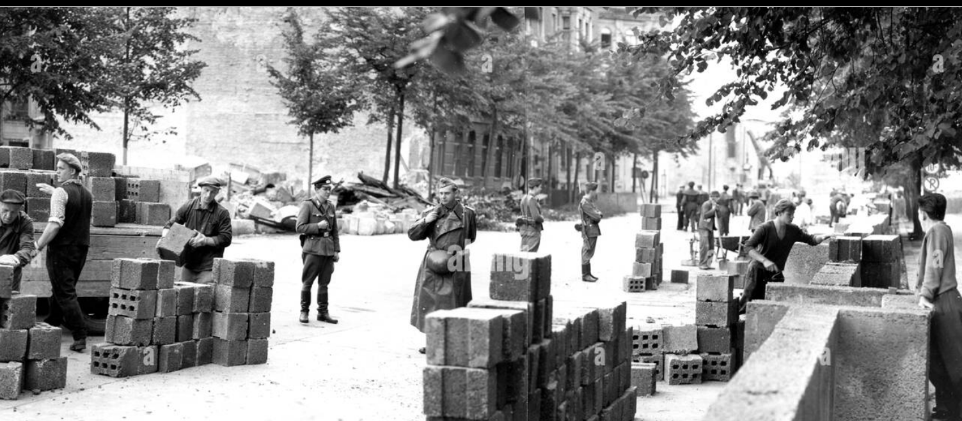
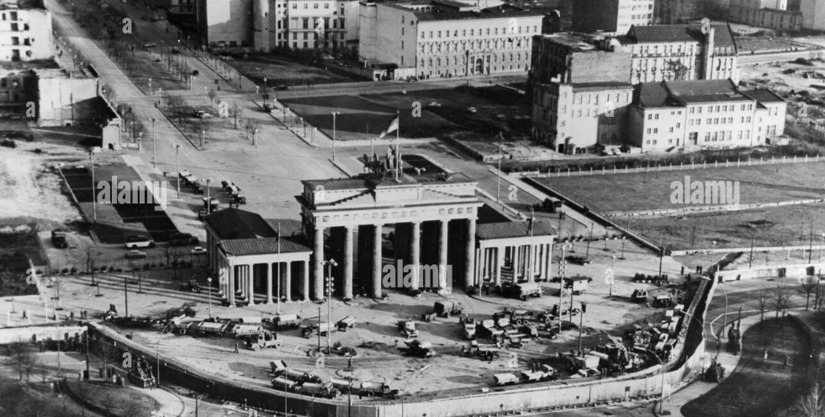
berlin
Inviting nations for participation in showcases and competitions, upon which the national committees would select their film entrees
construction of the Wall on 13 August 1961
Notes:
Twenty-one cinemas along the border with the Soviet sector and East Germany, were selected as extra locations
for festival screenings. Prices were low and the border areas were covered with posters advertising the festival

Slide 24

1970 Berlinale and politics
Michael Verhoeven’s film O.K.
based on the true story of Mao, the little Vietnamese girl who was raped and murdered by American soldiers in 1966
The festival’s program was abruptly stopped
FIAF was pressured to change its regulations
Like Cannes and Venice, the Berlinale developed from a showcase for national cinemas into an independent festival organization
Notes:
After it was screened in Berlin, the press reacted positively to the film, admiring
its political provocation but remained divided on the issue of artistic
choices. The political content, however, proved problematic. The jury, headed
by American director George Stevens, voted (six votes to three) “to neutralize
the German competition entry by Michael Verhoeven as long as the selection
committee has not re-confirmed that the film adheres to the rules of international
festivals.”
the jury obstructed artistic freedom with this act of censorship, it had also defended the festival’s original role as a geopolitical
instrument in the Cold War by concealing itself behind an FIAPF regulation passage that stated that international film festival entries should contribute to the rapprochement and friendship between nations. Moreover, Berlinale festival regulations prevented juries from interfering in the selection of festival entries.

Slide 25
Cannes, 1968
Protests against the dismissal of Cinémathèque director Henri Langlois and the subsequent disruption of the Cannes Film Festival
Dudley Andrew on 1968 revolt:
Cannes ’68: Cinema in Revolt - YouTube
May 1968
Paris Uprising May 1968 (youtube.com)
Jury: led by Roman Polanski; the festival was officially closed
global reconsideration of the role of film festivals
shift in the selection procedures: format of festivals as showcases of national cinemas had become antiquated
(Czech films in competiton: Capricious Summer (Jiří Menzel), Firemen´s Ball (Miloš Forman), The Party and the Guests (Jan Němec)
Notes:
competitions were no longer dependent on the submissions of national film bodies
Tehdejší události zpracoval Jan Němec v povídce Italská spojka, je součástí Němcovy vzpomínkové knihy Nepodávej ruku číšníkovi. Právě podle své předlohy napsal scénář ke snímku Vlk z Královských Vinohrad natáčenému v Cannes. Jeho životní příběhy na plátně prožije herec Jiří Mádl.
Menzel tu měl Rozmarné léto, Forman Hoří, má panenko a já O slavnosti a hostech. Bylo jasné, že neodjedeme s prázdnou. Jenže mezitím se François Truffaut, Jean Luc Godard, Carlos Saura a další zbláznili a hráli si na revoluci
! Srov. se soc . státy – zestátněná kinematografie, takže stát vysílá dál; viz příklad
když ČSF obdržel na konci roku 1952 pozvání na festival v Cannes, začal pátrat, zda uvažuje o účasti Sovětský svaz. Zástupce ČSF se i po negativní odpovědi odvážil vyptávat na velvyslanectví v Moskvě, zda by byly námitky proti účasti ČSR i za této situace, načež dostal od ministerstva zahraničí tvrdě za vyučenou a ambasáda vzkázala ministrovi informací Kopeckému: „Není pochopitelné, z jakých důvodů se Čs. státní film snaží zúčastnit se festivalu v Cannes 1953, když se tohoto festivalu nezúčastní SSSR […] Jednotný postup SSSR a lidových demokracií na mezinárodní aréně je přirozeným požadavkem a jeho nutnost byla jasně zdůrazněna celým průběhem XIX. sjezdu KSSS […].“

Slide 26
pesaro
1965; major platform for “both feature and documentary films of an experimental and invariably political nature”
festival showed “uncompromising solidarity with class struggles all over the world”
new festival format: discussion, lengthy publications and a productive combination of cinephile, political-activist and academics; Roland Barthes, Umberto Eco, Christian Metz, and Pier Paolo Pasolini were among the contributors to the famous Pesaro debates
Thanks to its alternative structure the festival was able to respond swiftly to the Cannes crisis, which had an effect on festivals worldwide; Pesaro immediately dedicated the 1969 festival to “Cinema and Politics.”
With “specialized” and “thematic” programming, festivals could participate in world politics and cinema culture
part of the traditional avant-garde project was absorbed into the film festival network

Slide 27
Berlinale II
general change in festival format:
emergence of “specialized” film festivals, which set out to intervene in cinema culture with thematic programs and debates, and to support political struggles around the world
interest in unfamiliar cinematic cultures
Berlinale 1974: the Soviet Union was allowed to participate (outside competition) in the Berlinale for the first time. A Soviet delegation visited the festival. The Berlinale debut of a film from the GDR followed in 1975

Slide 28
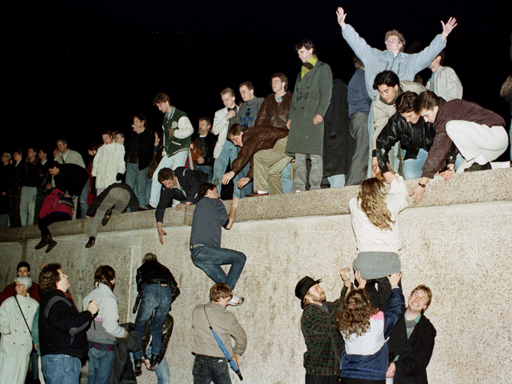
Post-Wende Berlinale
9 November 1989 (Günter Schabowski, SED member in TV on possibility to cross the border to West Berlin)
reunification of Germany on 3 October 1990
The national government ultimately moved from Bonn to the Reichstag in Berlin in 1999
Potsdamer Platz, which had once been the busiest intersection in the city before the erection of the Berlin Wall. The wall meant that the Potsdamer Platz space was neither bound to East or West German history. The location was reopened in the summer of 1990
audio-visual and entertainment center of Berlin

Slide 29
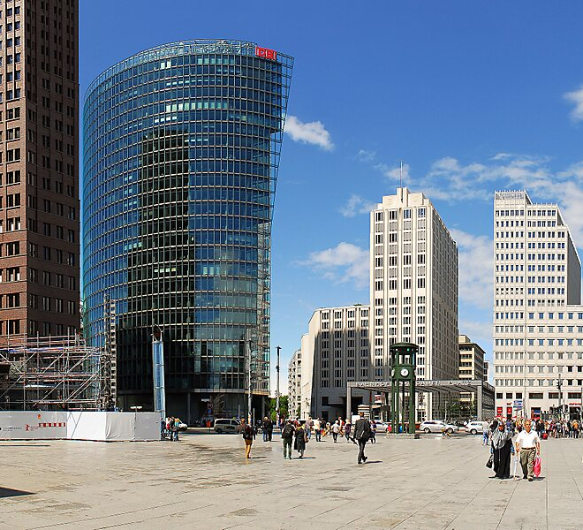
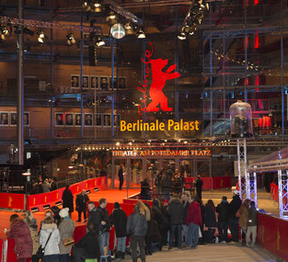
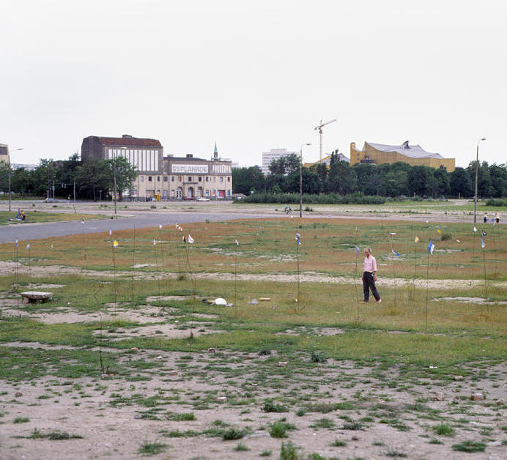
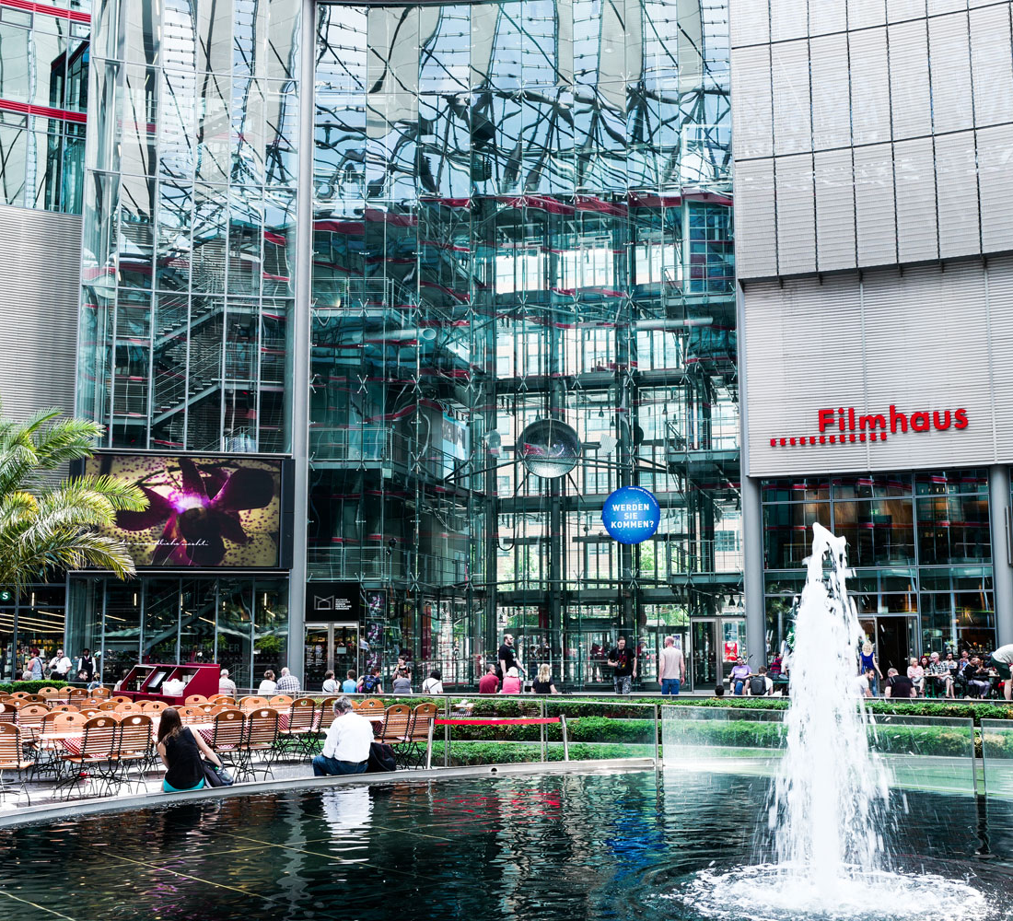
Potsdamer platz in 1990 and now
Notes:
most of the international corporations involved in the development of the Potsdamer Platz were not going to move their headquarters
there, a solution was necessary - festival
Picture: DB Tower, Sony Center

Slide 30
Festivals and film economics
In 1959, the Cannes Film Market – le Marché International du Cinéma – was founded
CineMart was founded in 1983 by the International Film Festival Rotterdam; since 1991: co-production projects
https://iffr.com/en/about-cinemart
More co-production markets followed, all modeled after the Rotterdam blueprint:
the Paris Project (belonging to the Paris Cinema International Festival, since 2003), Cinelink (Sarajevo International Film Festival, since 2003), Locarno (Open Doors, 2003), Cannes (Producers Network, 2004; Cinéfondation Atelier, 2005)
Berlinale Co-Production Market (since 2004)
Producer’s Network in Cannes (since 2004, part of the Marché du Film)
Festival circuit: some films can recoup their production costs by going around the festival circuit
Notes:
https://www.filmcenter.cz/cs/pro-filmove-profesionaly/pruvodce-koprodukcnimi-trhy/cinemart
Some festivals followed the example of the Cannes Film Market and established their own markets
The African filmmakers Ousmane Sembene (Senegal), Idrissa Ouedraogo (Burkina-Faso) and Souleymane Cissé (Mali) achieved international acclaim
in Cannes
Video – porn on the market (limited by French government in 1976)
Pre-sales of rights at the market for movies to be made
CINEMART: the first platform where independent filmmakers could present their projects to representatives of the international film industry to try and secure (additional) funding. CineMart differed from other existing markets at the time in important ways: the festival
played an active role, in selecting promising projects and introducing them to potential financiers.
since 2003, there has been a boom in international co-production markets.
Support for film projects in various stages of development
Rotterdam was the first to begin such a fund.
The Hubert Bals Fund (HBF) was founded in 1988 to support filmmakers from developing countries. Ten years later the International Documentary Film Festival Amsterdam initiated the Jan Vrijman Fund, limited to documentary projects fromemerging countries, and around the same time the Götenborg International Film Festival in Sweden launched the Film Fund. In 2004, the Berlinale started the influential World Cinema Fund. Since then, several new players were added (Source cjfs valck)

Slide 31

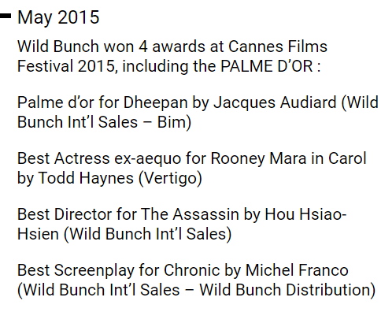
Sales agents
sales agents – Wild Bunch, Fortissimo, Celluloid Dreams (a.k.a. The Director’s Label’), Films Distribution, Pyramide, Bavaria-Film – control the art film market, often investing in the films at production stage.
They decide which festivals a film will play at, and often demand fees from festivals to cover ‘their costs’, costs that include participation at business festivals who generally aren’t required to pay these screening fees
„business festivals“ / „audience festivals“
Notes:
Mark Peranson, programmer for the Vancouver film festival: fim agents
Cincy Wonk: Non-“A” festivals may need to pay distributors $500 to $2,000 in rental fees for festival films. Only two
to three decades ago, distributors would send their films for free (charging only shipping, handling, and insurance), because they wanted exposure from festivals; here, they were also dealing with expensive prints rather than the disposable
videos and DVDs of contemporary film festival circulation.
Teslíková, festival jihlava: Na fyzickem festivalu se soutěžnim filmům neplati žadne fee. Pouze vyjimečně nastane
situace, že distribučni společnost ma interni pravidlo, že za každe uvedeni filmu musi festival
zaplatit screenign fee. Filmům, ktere jsou na festivalu mimo soutěž, festival plati fee dle typu
filmu a vlastnika prav. Programove odděleni rovněž často stanovuje ceny již ze zkušenosti a
předešle komunikace s danymi tvůrci. Co se tyče online festivalu, byla zde velka obava, že
častky za uvedeni filmů několikanasobně vzrostou. Velky cenovy rozdil se očekaval zejmena
u filmu z retrospektivni sekce. Programovy tym nepředpokladal, že cena bude stejna za jednu
projekci na fyzickem festivalu v porovnani se čtrnactidennim online uvaděnim. Podminky však
zůstaly přibližně stejne a častky pro filmy, ktere měly na festivalu prvni uvedeni, se pohybovaly
okolo 200–300 EUR. U filmů, ktere na festivalu neměly premieru, častka začinala na 100 EUR
za projekci.

Slide 32
Berlin-Cannes-venice 2007

Slide 33
Film, awards, and audiences
Nominations for major prizes
1996-2005
Audience size in 25 European countries
Notes:
Descriptive statistics
In/dependent variables; dependent variable -for each prize won, the number of people that see a film increases by attenance in 25 European countries
about 60 per cent more than the increase that comes with a US partner
and almost twice as much as merely being nominated at Cannes, the
most prestigious of the festivals. There is also significant evidence that
these festivals contribute to a status ordering among films. The results
indicated that films which are nominated at Cannes receive a much
greater increase in audience interest than films that are nominated at
Berlin or Venice. In addition, a status ordering among nominated films
is created by various competitions. It is clear from our results that films
that win a prize receive a significantly greater boost in audience than
films that do not win one. A further status ordering is created even
among the elite films that win prizes by differences in the prestige of the
competitions. Our results show that films that win one of the best
picture prizes experience a significantly greater increase in audience
than films that win other prizes.

Slide 34
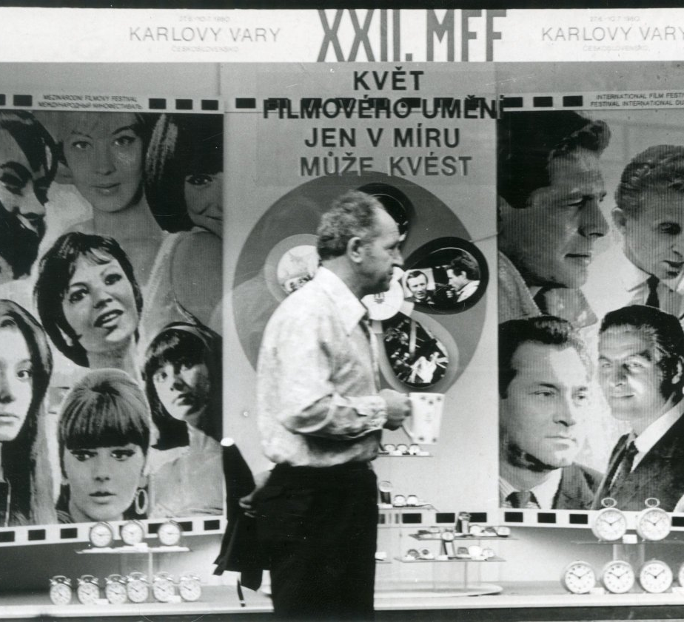
Karlovy vary international film festival
1959, an international film festival was established in Moscow - granted “A” category status by the FIAPF
political decision to offer only one “A” festival annually in the communist countries
Karlovy Vary and the Moscow IFF became biannual events, and they took turns in organizing a film festival between 1959 and 1993
Mezinárodní filmový festival Karlovy Vary 1990. Magazín o filmu 39/90 (youtube.com)
Notes:
window decoration in 1980, "the flower of film art can only bloom in peace“
1990 – coping with ideology; aversion to political topics; dimenion of programme is missiing, in cotranst toJihlava festival.
Organization denied continuity with former showcase of the cinema of easter Europe and global South
Video: scaffolding – lešení
Forman a pištěk na kole z paříže
Rozhovor s Bernardem Šafaříkem – emigrant

Slide 35
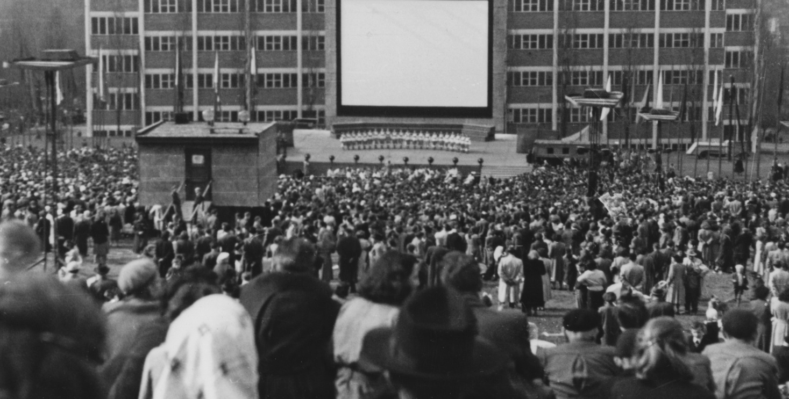
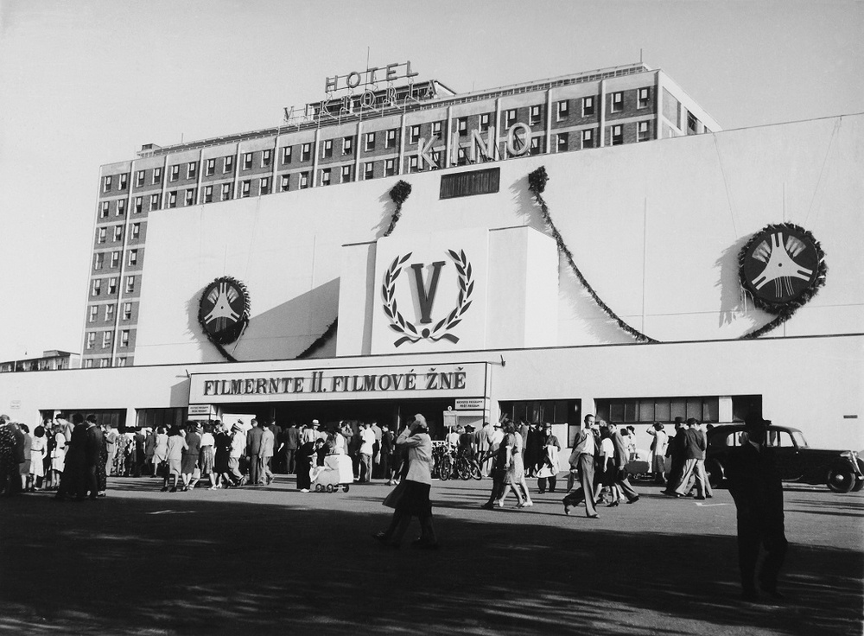
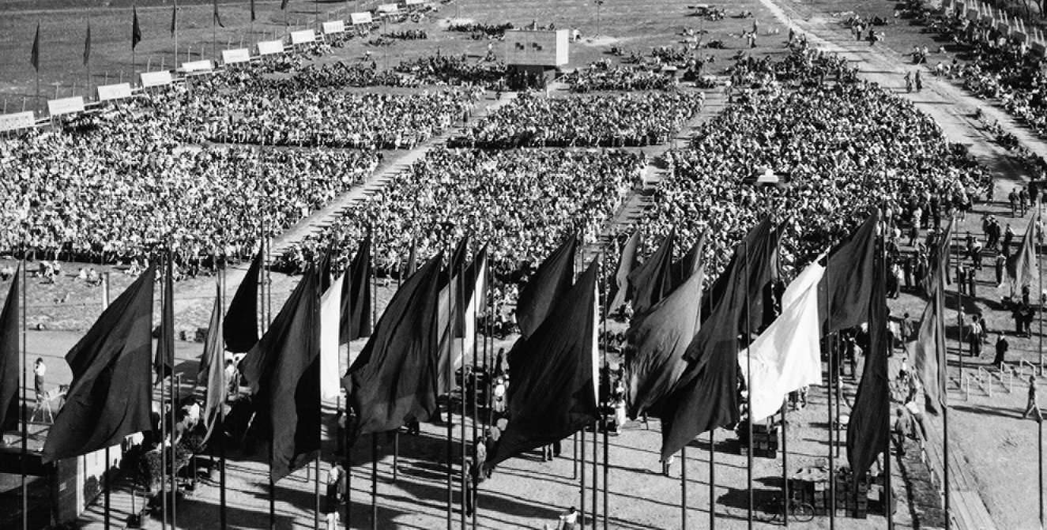
„Film Harvest“, 1940-1941 festival of working people, 1948-1990

Slide 36
Festivals in Czech republic
12 general film festivals and showcases (IFF KV, Summer Film School, Febiofest, Slavonice Fest, Marienbad Film Festival, etc.)
4 festivals of animation (Animefest Brno, Anifilm Liberec..)
3 festivals for children films (Zlín Film Fest, Ota Hofman Festival in Ostrov, Juniorfest in Plzeň)
4 documentary film festivals (Academia Film Olomouc, IFF Jihlava, One World, Elbe Dock Ústí nad Labem)
3 festivals of student films (FAMUfeest, Film festival of the Faculty of Informatics, Masaryk University; Opava)
21 other festivals (Brněnská 16; Ekofilm; Mezipatra; Outdoor film festival; Filmasia; Krrr!; Noir film festival, etc.)
Notes:
Dobrovolnictví v kultuře se zaměřením na filmové festivaly v České republice (muni.cz)

Slide 37

Zlín film festival
Zlínský film | Ústav filmu a audiovizuální kultury (muni.cz)
zlinfest.cz

Slide 38

Documentary film festival jihlava
Ji.hlava IDFF (ji-hlava.com)
Notes:
Poslední předcovidový ročník, 2019: 5 330 akreditovaných návštěvníků a hostů, 8 screening places, 277 movies, 11 sections.

Slide 39

Summer film school in uherské hradiště
Letní filmová škola Uherské Hradiště (lfs.cz)
1964-1993: event for Film clubs members

Slide 40

Serial killer
Serial Killer – International Series Festival | Sept. 24–⁠29, 2024 Brno, CZE

Slide 41
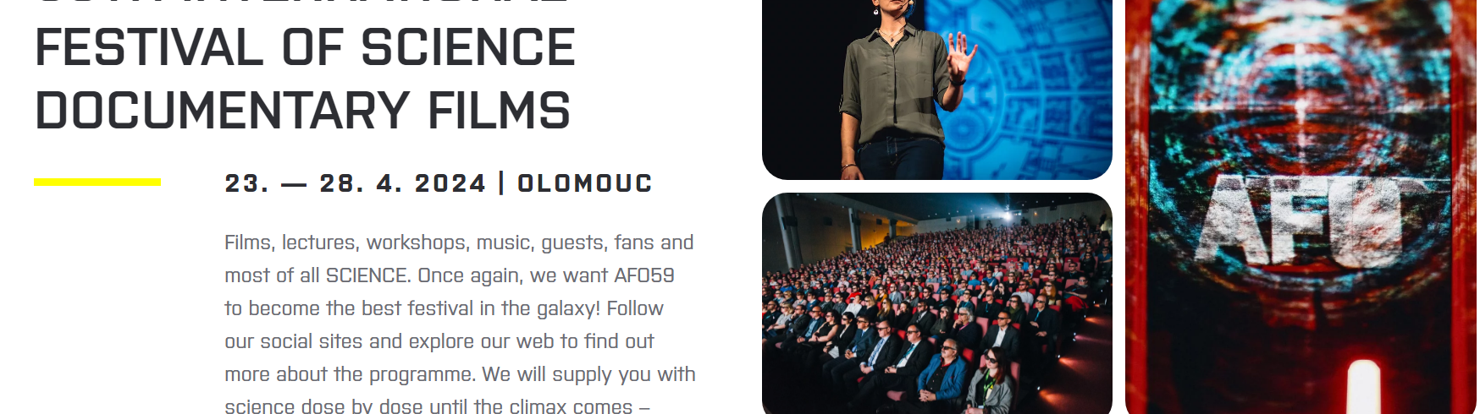
Academia film olomouc
Home – AFO

Slide 42

mezipatra
Mezipatra queer filmový festival - Home

Slide 43

Jeden svět/one World
One World 2024

Slide 44
The Wolf from Royal Vineyard Street
(Jan němec – tomáš klein, 2016)
KVIFF.TV • The Wolf from Royal Vineyard Street • Film on-line

