Slide 1
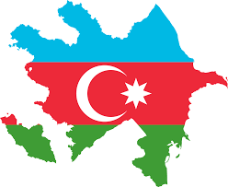
AZERBAIJAN
Politics vs. Human Rights

Slide 2
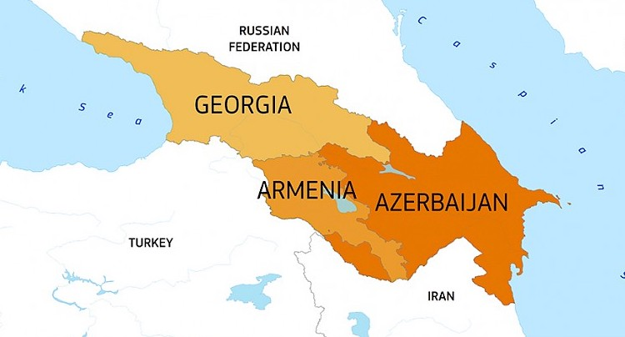
Quick facts
Azerbaijan is located in the South Caucasus region, between Russia and Iran
Azerbaijan is a Muslim-majority yet politically secular country
Main military & political ally: Turkey
Rich in natural resources of gas and oil
Universal suffrage introduced in 1919
Currently in peace process with Armenia

Slide 3
Quick Facts on fundamental freedoms
151st on the last World Press Freedom Index – 29th worst in the world (between Bahrain and Egypt)
Rated „not free” in the annual Freedom in the World Index by Freedom House
37 out of 100 points in Freedom of the Net Index (unfree)
No free election since early nineties

Slide 4
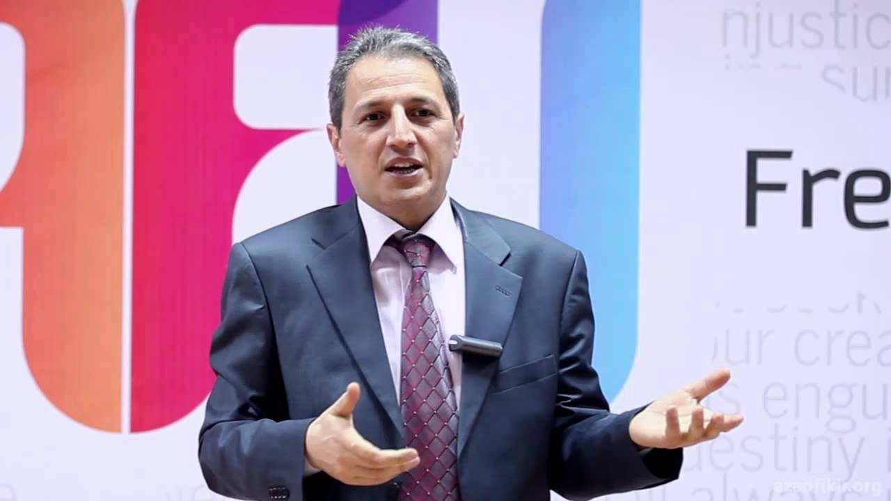
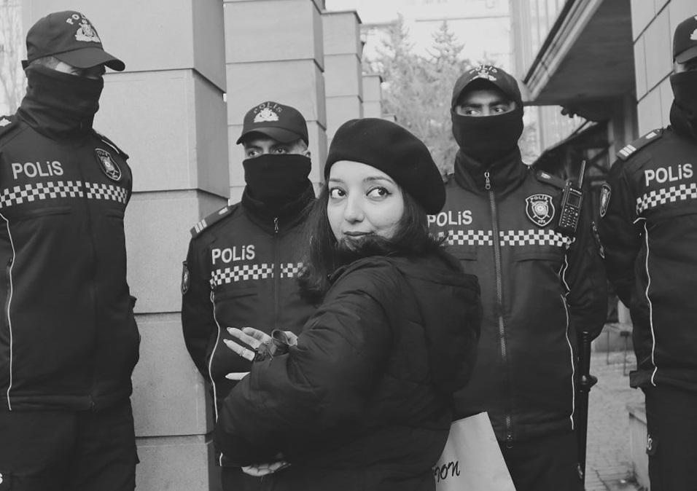
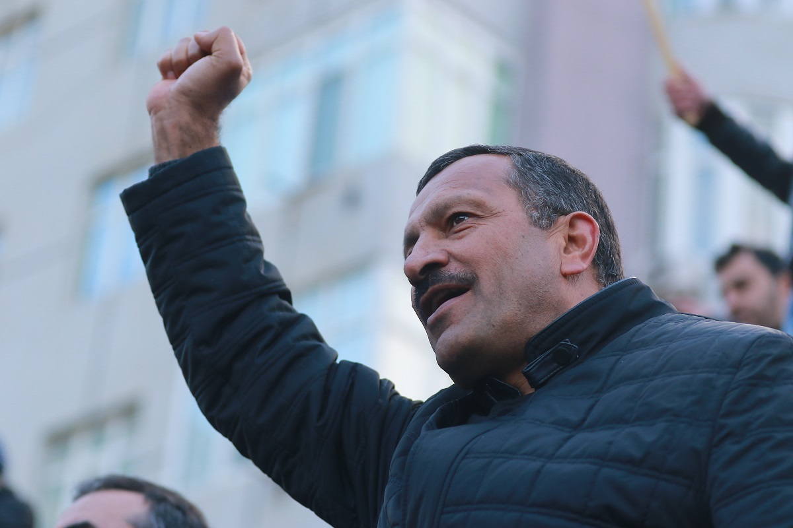
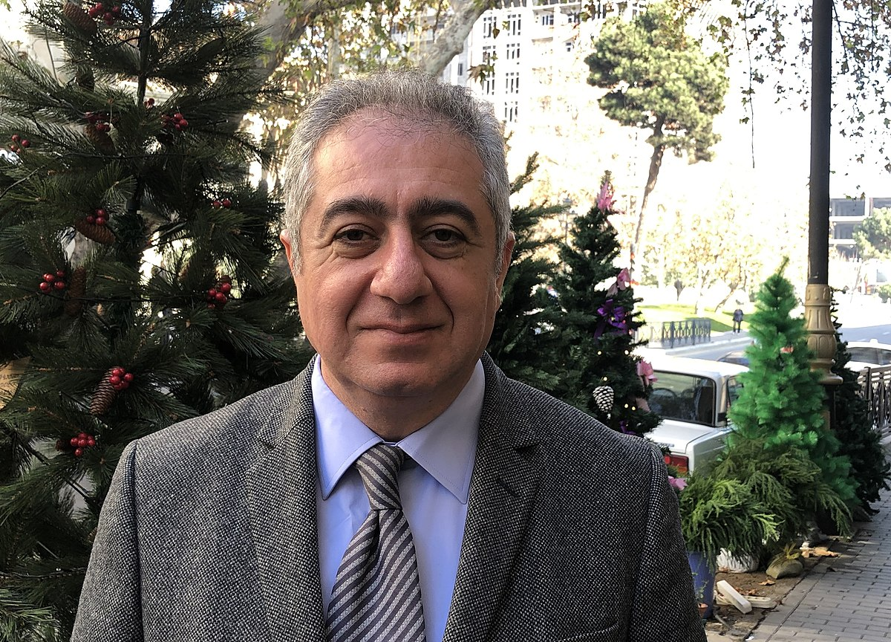
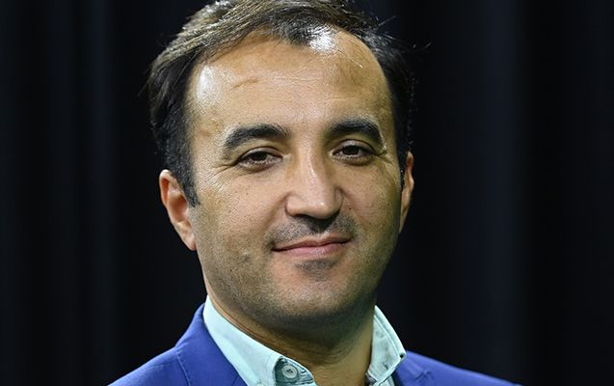
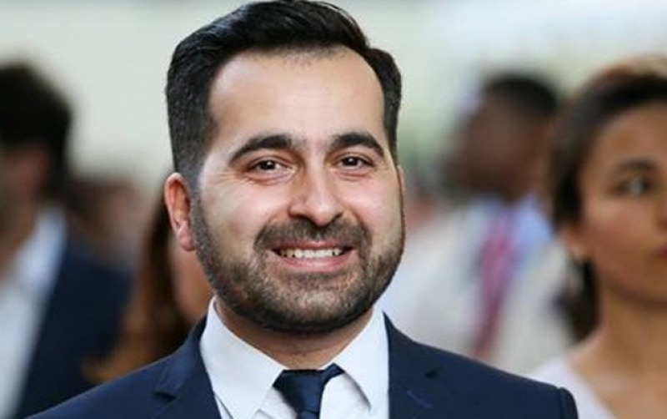
Political prisoners 288 people

Slide 5
Eastern Partnership (AZ, AR, BEL,
Azerbaijan is the only country among EaP states (excluding Belarus) where the situation of civil society has dramatically worsened since the launch of the program in 2009.
Unlike all other EaP states, Azerbaijan has not updated the main agreement with the EU since 1999

Slide 6
Azerbaijan as organizer of major events
2015 Baku European Games
Since 2017, Grand Prix Azerbaijan in Formula 1

Slide 7
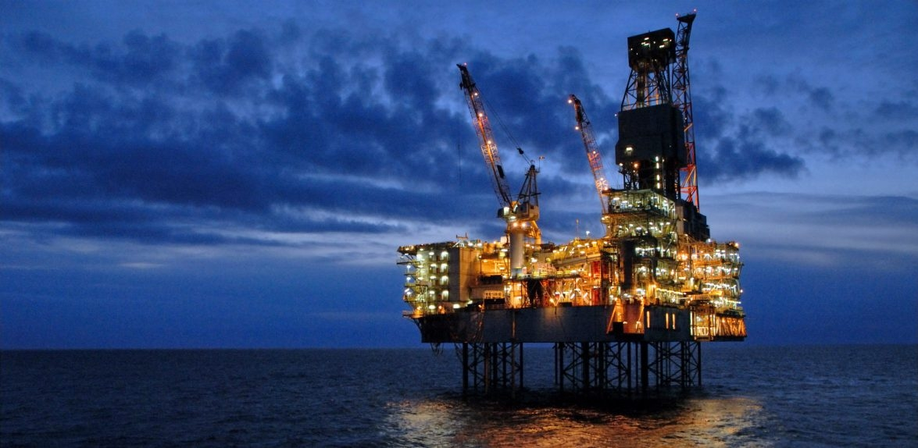
Azerbaijan in Europe: Energy partnership vs. values
Ursula von der Leyen, President of the European Commission (2022)
„Azerbaijan is a key partner in our efforts to move away from Russian fossil fuels.”
„Azerbaijan is a reliable partner..”
Peace as a priority for Brussels

Slide 8
Council of Europe
→ Azerbaijan joined CoE in 2001
→ In the years 2012-2016 it caused a caviar diplomacy scandal
→ 2012 Strasser report on political prisoners rejected in PACE vote
The Caviar Connection trailer

Slide 9
Council of Europe
Azerbaijani delegation has been suspended from PACE in January 2024

Slide 10
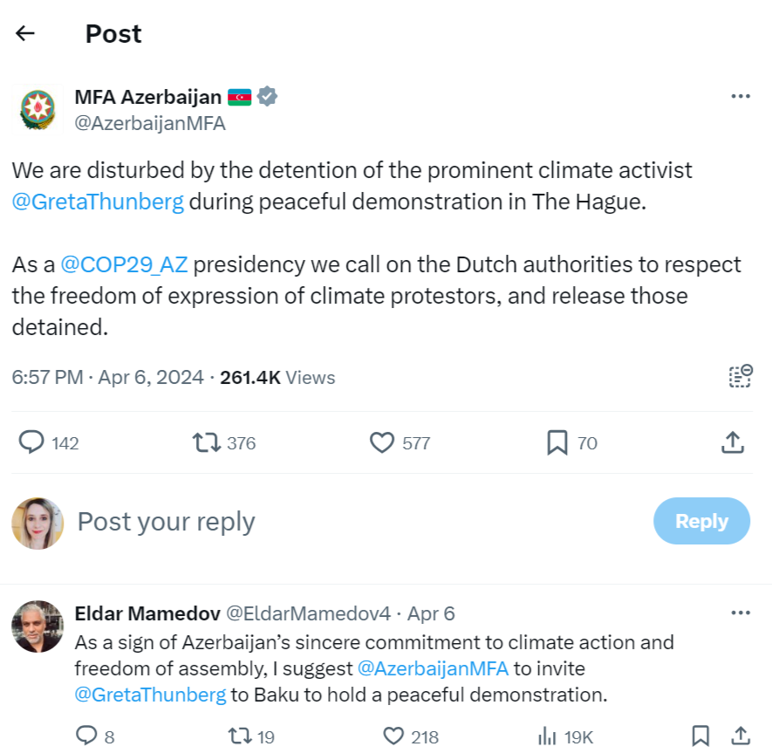
COP 29 Nov 2024 Baku, AZ

Slide 11
Questions? Thanks for listening!

