Slide 1
Belarus
Quiz

Slide 2
https://www.menti.com/alh6xkw4eugi
Reflection of the homework

Slide 3
Which are all the countries Belarus borders on?
a) Estonia, Latvia, Lithuania, Poland, Russia, Ukraine
b) Latvia, Lithuania, Poland, Russia, Ukraine
c) Latvia, Lithuania, Moldova, Poland, Russia, Ukraine
d) Latvia, Poland, Russia, Ukraine

Slide 4
Which are all the countries Belarus borders on?
a) Estonia, Latvia, Lithuania, Poland, Russia, Ukraine
b) Latvia, Lithuania, Poland, Russia, Ukraine
c) Latvia, Lithuania, Moldova, Poland, Russia, Ukraine
d) Latvia, Poland, Russia, Ukraine
https://bit.ly/3I27hdR

Slide 5
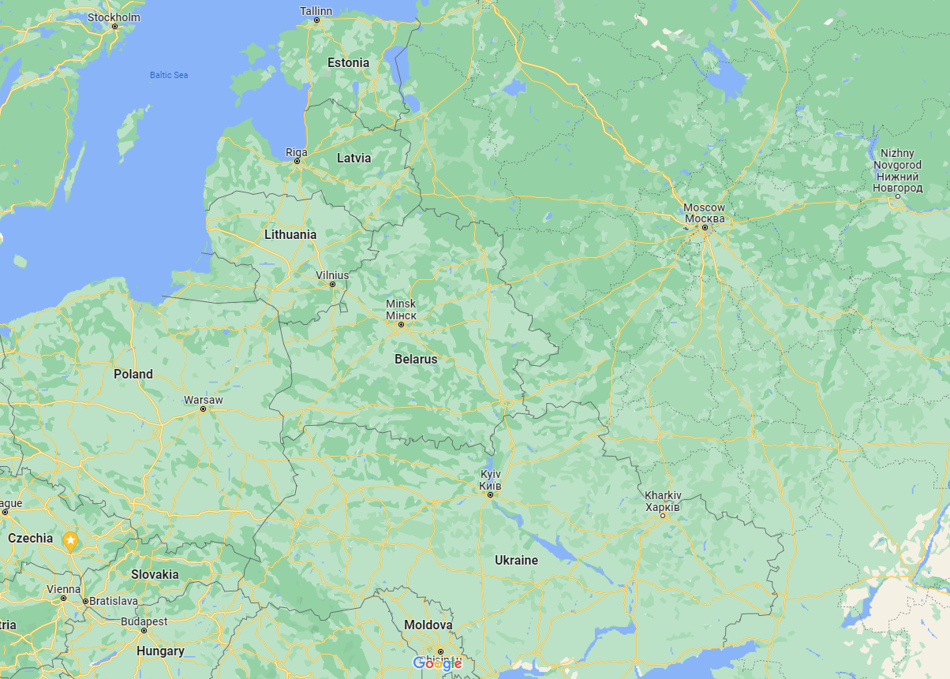

Slide 6
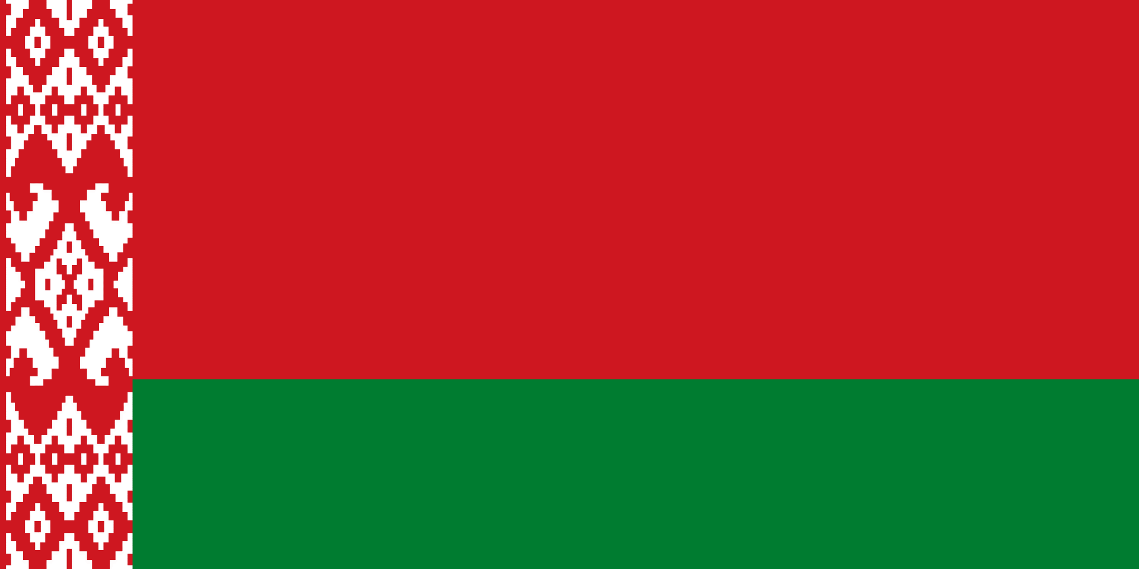
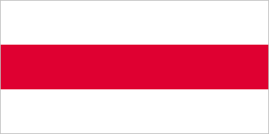
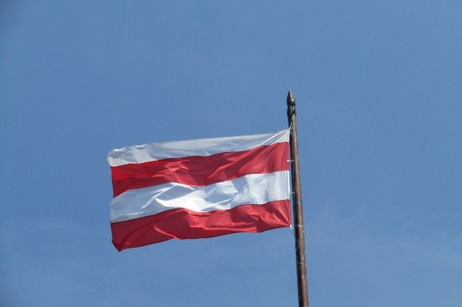
Which is the flag used in the pro-democratic protests in Belarus?
A)
B)
C)

Slide 7
Which is the flag used in the pro-democratic protests in Belarus?
A) official flag of Belarus, similar
to the flag of Soviet Belarus,
used by Lukashenko
B)
C) flag of Brno

Slide 8
How long has Lukashenka, called the last dictator in Europe, been the president of Belarus?
24 years
30 years
33 years
40 years

Slide 9
How long has Lukashenka, called the last dictator in Europe, been the president of Belarus?
24 years
30 years
33 years
40 years

Slide 10
Most Belarusians speak Russian at home. However, how many Belarusians do you think said in the 2009 census that they normally speak Belarusian at home?
10%
26%
45%

Slide 11
Most Belarusians speak Russian at home. However, how many Belarusians do you think said in the 2009 census that they normally speak Belarusian at home?
10%
26% and rising
45%
https://belsat.eu/en/news/belarusian-language-facts-and-figures

Slide 12
Reflection
What emotions did the presentation bring up?
What was new or the most interesting information for you?
Can you relate the information to anything in your country or another country you are interested in?

