Slide 1
Svetlana Savitskaya, Governance & Anti-Corruption Expert
21 March 2024, Masaryk University, Faculty of Arts
Notes:
It is remarkably resilient
1

Slide 2
CIVIL SOCIETY
AND
ANTI-CORRUPTION
IN
EASTERN EUROPE

Slide 3
C-Word
Taboo in policy and research circles until the mid-1990s
1993 - Transparency International
1995 - Corruption Perceptions Idex
1990s & 2000s – international legal framework
2000s & 2010s – Leaks and Papers, rise of investigative journalism
New anticorr and good governance oganizations, global and national
Research on corruption, its cause and consequences
Limited evidence on what works in anticorr
Citizens engagement remains a challenge
Notes:
3

Slide 4
Corruption is
the abuse
of entrusted power
for private gain
Notes:
4

Slide 5
Corruption as an umbrella concept
Kleptocracy; privatization of public funds; stealing
Treason; subversion; illegal foreign transactions; smuggling
Misapproptiation; forgery and embezzlement; padding of accounts; skimming; misuse of funds
Abuse of power; intimidation; torture; undeserved pardons and remissions;
Deceit and fraud; misrepresentation; cheating and swindling; blackmail; perversion of justice; criminal behaviour; false evidence; unlawful detention
Non-performance of duties; desertion; parasitism
Bribery and graft; extortion; illegal levies; kickbacks
Election tampering; vote-rigging; gerrymandering
Misuse of inside knowledge and confidential information; falsification of records
Unathorized sale of public offices; public property and public licences
*Source: The Elements of National Integrity System. TI, Jeremy Pope, 2000.
Notes:
5

Slide 6
Corruption as an umbrella concept
Manipulation of regulations, purchases and supplies, contracts and loans
Tax evasion; excessive profiteering
Influence peddling; favour brokering
Conflict of interest
Acceptance of improper gifts, fees, speed money and entertainments
Links with organized crime; black market operations
Cronyism; cover-ups
Illegal survelilance; misuse of telecommunications and mails
Misuse of official seals, stationery, residence
*Source: The Elements of National Integrity System. TI, Jeremy Pope, 2000
Notes:
Transformation of state capture to kleptocapture (Kaufman)
6

Slide 7
Corruption as an umbrella concept – new forms and types
Grand corruption
Political corruption
Petty corruption
Nepotism
Revolving doors
Money laundering
State capture
Kleptocapture
Notes:
7

Slide 8
Corruption as Governance Regime
Governance is a government‘s ability to make and enforce rules, and to deliver services, regardless of whether that government is democratic or not. (Fukuyama)
Worldwide Governance Indicators (WGI) Six Dimensions:
Voice and Accountability
Political Stability and Absence of Violence/Terrorism
Government Effectiveness
Regulatory Quality
Rule of Law
Control of Corruption
Notes:
8

Slide 9
Corruption as governance regime
The governance mode under which public goods are distributed on the basis of ethical unversalism. (Mungiu-Pippidi)
Particularism - a social practice rampant in developing societies, where standards for the way a person is treated (including by the state) depend on the group a person belongs to and not on merit/entitlement = Corruption is the rule
Ethical universalism - the practice of individualistic societies, in which everyone is treated equally regardless the group they belong to = Corruption is the exception
Notes:
9

Slide 10
Civil Society as a Driver of Anti-Corruption Reforms Preconditions for Civil Society Engagement in Anticorruption:
Access to information and transparency
Free media
Civil society space
Safety of media, civil society, activists
Political regime does matter: electoral democracies vs autocracies
+ Armenia, Georgia, Moldova, Ukraine
Azerbaijan, Belarus, Russia
EU Candidate Status: Georgia, Moldova, Ukraine
Armenia may apply
Notes:
10

Slide 11
Charateristics of Good Anti-corruption Initiatives and Approaches
Evidence based: political settlement analysis, network analysis, et al.
Locally designed, ideas can be borrowed
Strong local ownership
Getting the objectives right: understand C and anticorr
Aim high: change of behaviour, not only laws and policies
Impact oriented (e.g. resignations of the corrupt after investigation), less output focused (e.g. number of journalists trained)
Theory of change: how change is assumed to come about through intervention in a given situation? Validating assumptions
Coalitions, locally set up and coordinated: citizens, business, media, etc.

Slide 12
Anti-corruption Initiatives and Approaches
Experts + Activists + Journalists
Policy and legal: drafting and monitoring laws, policies, regulations
Monitoring and evaluating performance of anticorr institutions
Investigations: national, crossborder
Public sector integrity: conflict of interest, income and assets declarations
Procurement monitoring
Elections: political parties and campaign financing; abuse of administrative resources
Parliamentary oversight → reporting to citizens
PEP Database; asset tracing and asset recovery
! Private sector work
! Sectors: education, health, police, energy, land, water, etc.

Slide 13
Anti-corruption Investigations
Anticorr investigations on the rise: Leaks, Papers, Files, Secrets
Transformation from „lonely ranger“ model to transnational collaborative networks built on mutual trust
Institution of global governance
Exposing wrongdoing, bringing it to light (OSINT)
Post-factum corruption investigations, very few prosecutions
Mostly crossborder and national level, not much local level
Full cycle: investigations, analysis of legal and policy gaps, coalition building, advocacy, monitoring of implementation

Slide 14
Anti-corruption Advocacy
Evidence based; seeks to generate political change, better policies and practices
Analyse problems, find solutions, identify stakeholders, build coalitions
Develop advocacy strategy: decision makers as a target audience
It is not activism, awareness raising, campaigning or communication. But they can be part of advocacy strategy
Better results in coalition
Resource and labour intensive, long time span required
Regress on previously achieved advocacy goals
Notes:
14

Slide 15
The Challenge of
Measuring Corruption

Slide 16
Why Measure Corruption?
What can be measured, can be managed
C measurement is a solid foundation for designing reforms
Track progress over time (but challenging)
Notes:
16

Slide 17
Challenges in Measuring Corruption
Diversity of definitions
Some forms of corruption are more visible (and easier to measure) than others
Creating unbiased corruption measurements
Capturing change
Notes:
17

Slide 18
CPI A global (180 countries/territories)
aggregate index (13 different data sources)
capturing perceptions (experts/business people)
of corruption (abuse of power for private gain)
in the public sector (public officials and institutions)
CPI Captures:
Bribery
Diversion of public funds
Red tape & excessive bureaucratic burden
Meritocratic vs nepotistic civil service
Conflict of interest & financial disclosure of public officials
Access of civil society to information on public affairs
CPI does NOT Capture:
Citizens perception & experience of C
Tax fraud
Illicit financial flaws
Enablers of C
Money laundering
Private sector C
Informal economies and markets

Slide 19
CPI Sources
African Development Bank Country Policy and Institutional Assessment
Bertelsmann Stiftung Sustainable Governance Indicators
Bertelsmann Stiftung Transformation Index
Economist Intelligence Unit Country Risk Service
Freedom House Nations in Transit
Global Insights Business Conditions and Risk Indicators
IMD World Competitiveness Yearbook
Political and Economic Risk Consultancy
The PRS Group International Country Risk Guide
World Bank Country Policy and Institutional Assessment
World Economic Forum Executive Opinion Survey
World Justice Project Rule of Law Index
Varieties of Democracy Project

Slide 20
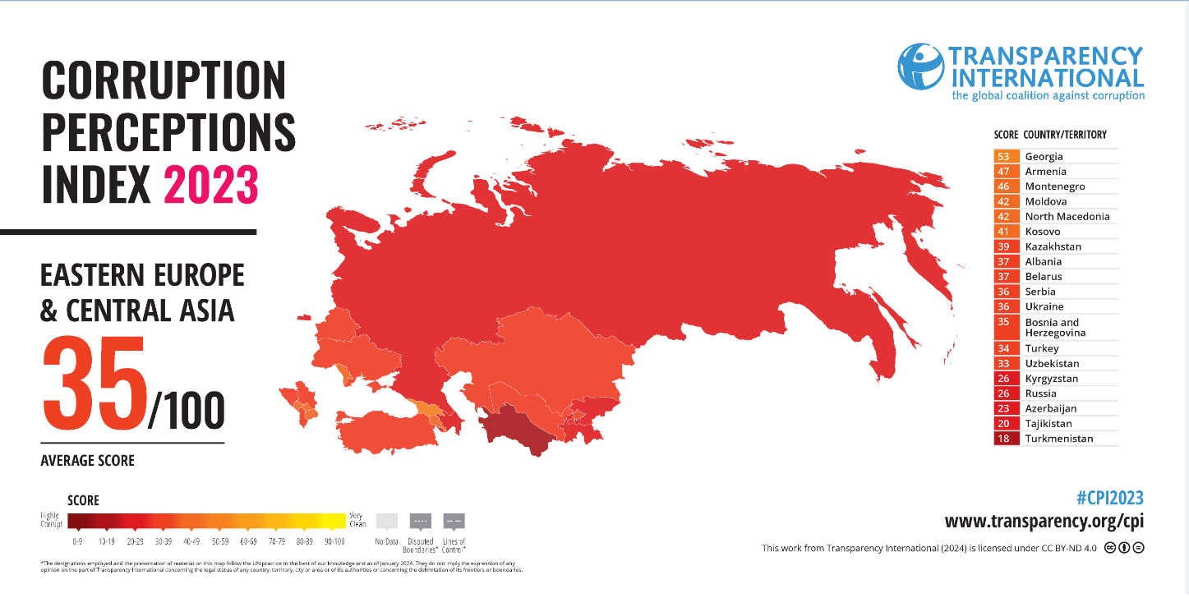

Slide 21
“Anticorruption is like a bicycle, which manages to stand as long as it runs: but its separate pieces are worthless if they do not amount to a full-running bike” (Alina Mungiu-Pippidi)
“Anti-corruption should focus on citizens and wellbeing of citizens” (Bo Rothstein)
“Corruption is effectively a form of injustice. People are getting things they are not supposed to get. …Start thinking how to manage the problem. Not how to solve it, because C is a constant” (Paul Heywood)

Slide 22
THANK YOU!

