Slide 1
INTRODUCTORY CLASS
course
teacher
students
region
human rights
civil society

Slide 2
Main question of the course
How does civil society contribute
to the promotion and protection
of basic human rights and freedoms
in Eastern Europe?
https://miro.com/app/board/uXjVN3OievA=/

Slide 3
EASTERN EUROPE ?
ARMENIA, AZERBAIJAN AND GEORGIA ARE CONSIDERED TO BE EASTERN EUROPEAN COUNTRIES BOTH BY
- THE UN (CAN BE ELECTED TO UN HUMAN RIGHTS COUNCIL FOR EASTERN EUROPEAN REGION) AND
- THE EU (MEMBER OF EASTERN PARTNERSHIP INITIATIVE).

Slide 4
GOALS of the course
reflect on HR and CS
basic HR, HR documents and institutions
civil society activities
examples from the our region and from history
players promoting HR in Eastern Europe
threats to human rights defenders
your own potential for civic engagement
interpret the readings
ask questions

Slide 5
Format of the course
Preparation at home
https://is.muni.cz/auth/predmet/phil/jaro2024/CORE099 - Study materials - Interactive Syllabus
Quiz in class every week (not graded)
Discussion with a guest
Reflection

Slide 6
aSSESSMENT
ENGAGEMENT WITH A MINIMUM OF 9 TOPICS
  (either presence in class or a short written reflection on home preparation materials – to be sent to the teacher by email by May 9, max. 350 words)
SHORT WRITTEN ANALYSIS – during reading week, on human rights and/or civil society in our region or elsewhere in the world, show us what you‘re interested in
OPEN-BOOK TEST – at home May 10-May 16
QOLLOQUIUM - TIMOTHY SNYDER: ON TYRANNY (the university library has limited copies, so it is recommended to purchase the book or make copies in advance. You can order it for example from this great Brno bookstore - Book Therapy. There is also an illustrated version.)

Slide 7
WORKLOAD
3 CREDITS
1 CREDIT = 30 HOURS OF WORK PER SEMESTER
1 CREDIT – LECTURES AND/OR WRITTEN REFLECTION OF HOME ASSIGNMENTS
1 CREDIT – AT-HOME PREPARATION – 3 HRS WEEKLY
1 CREDIT – SHORT WRITTEN ANALYSIS, OPEN-BOOK TEST, COLLOQUIM

Slide 8
INTRODUCTION OF THE TEACHER
English and Russian Studies, Faculty of arts, muni
Work for human rights organizations
- People in Need – covered Ukraine and Belarus
- Civic Belarus
- Human Rights House Foundation – a Norwegian organization – lived in Tbilisi, Georgia and covered mainly Azerbaijan and Armenia
Teaching English to human rights defenders from eastern europe and central asia

Slide 9
introduction of students
1. Where are you from and/or what do you study?
2. Why are you interested in Eastern Europe and/or human rights and civil society?

Slide 10
OUR REGION
(individually)

Slide 11
When did the Soviet Union dissolve?
a) 1989
b) 1991
c) 1993

Slide 12
When did the Soviet Union dissolve?
a) 1989 – fall of communism in Czechoslovakia, Eastern Germany, Hungary, Poland…
b) 1991 – Sovied Union dissolves
c) 1993 – Czechoslovakia splits into Czechia and Slovakia

Slide 13
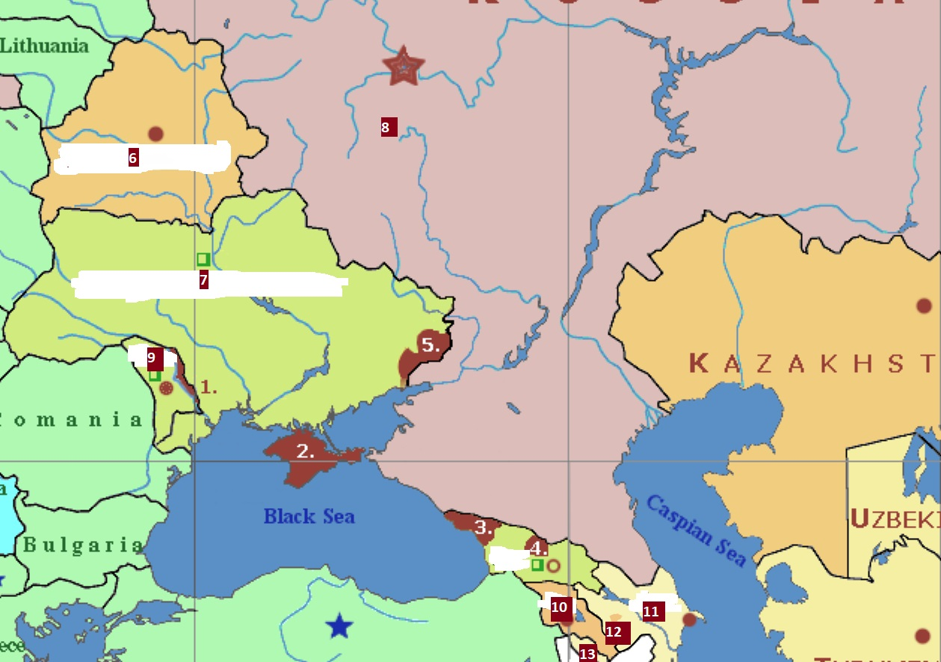
Connect the numbers with the names of countries and territories
Abkhazia, Armenia, Azerbaijan, Belarus,
Crimea, parts of Donetsk and Luhansk Regions
occupied since 2014, Moldova, Nakhichevan,
Nagorno Karabakh, Russia, South Ossetia,
Transnistria, Ukraine
Map of current situation in Ukraine:
https://liveuamap.com/

Slide 14
Connect the numbers with the names of countries and territories
3 Abkhazia, 10 Armenia, 11 Azerbaijan, 6 Belarus,
2 Crimea, 5 parts of Donetsk and Luhansk Regions
occupied since 2014, 9 Moldova, 13 Nakhichevan,
12 Nagorno Karabakh, 8 Russia, 4 South Ossetia,
1 Transnistria, 7 Ukraine
Map of current situation in Ukraine:
https://liveuamap.com/

Slide 15
HUMAN RIGHTS

Slide 16
Definition
fundamental rights and freedoms inherent to all human beings

Slide 17
PURPOSE
To protect
dignity, equality, and justice
globally

Slide 18
Questions for you:
What is the main international document?
When was it adopted?
Who adopted it?
Is it binding?

Slide 19
1. Universal Declaration of Human Rights (UDHR)
2. Adopted by the United Nations General Assembly
(48 member states voted in favor, eight abstained, none opposed)
3. 1948
4. Non-binding

Slide 20
Which of our countries/territories are not members of the United nations?

Slide 21
Which of our countries/territories are not members of the United nations?
Abkhazia
South Ossetia
Transnistria
Nagorno Karabakh until recently

Slide 22
Categories of rights

Slide 23
Categories of rights
Civil and Political Rights
(e.g., freedom of speech, right to a fair trial)
Economic, Social, and Cultural Rights
(e.g., right to education, work, and healthcare)

Slide 24
Two international covenants
Legally Binding if ratified
on Civil and Political Rights (ICCPR)
on Economic, Social and Cultural Rights (ICESCR)

Slide 25
We are going to mention
Right to Life (Article 3 of the UDHR)
Freedom from Torture (Article 5)
Freedom from Arbitrary Arrest and Detention (Article 9)
Right to a Fair Trial (Article 10)
Right to Freedom of Expression (Article 19)
Freedom of Peaceful Assembly (Article 20)
Freedom of Association (Article 20)
Rights to participate in government (Article 21)

Slide 26
UN HR mechanisms https://www.ohchr.org/en/instruments-and-mechanisms

Slide 27
UN HR mechanisms https://www.ohchr.org/en/instruments-and-mechanisms
Decisions by the UN HR Committee
https://www.ohchr.org/en/countries - by country
Universal periodic review – UN HR Council
https://www.ohchr.org/en/hr-bodies/upr/documentation - by country
Special Rapporteur on the situation of human rights in Belarus – since 2012
UN HR Monitoring Mission in Ukraine – since 2014
Universal Human Rights Index (UHRI) – database
https://uhri.ohchr.org/en/

Slide 28
Role of civil society

Slide 29
Role of civil society
Contributing information
  national or shadow reports
  meetings with UN experts and member states
  side-events
  submit allegations of human rights violations
Advocacy and awareness
Monitoring implementation

Slide 30
Also relevant (not for belarus and russia)
Council of Europe
European Covenant on Human Rights
European Court of Human Rights

Slide 31
Civil society

Slide 32
Definition
organized groups and institutions
outside of the family, market and state
represent or advance particular interests, values or causes of people
some definitions: promote the public good

Slide 33
Václav Havel and civil society
https://www.vaclavhavel.cz/elearning/en/course/9

Slide 34
The rise of illiberal civil society in the former Soviet Union

Slide 35
The rise of illiberal civil society in the former Soviet Union
2018
covers: Georgia, Armenia, Ukraine, Kyrgyzstan and Moldova
illiberal, anti-Western and socially conservative civil society, anti-civil rights
Particularly regarding LGBTI rights, women‘s role in society, abortion, the attitudes toward ethnic and religious minorities
linked to the dominant religious organisations, or political factions with influence over state resources
while some groups have direct or indirect contact with Russia, many do not and the primary drivers of such activity are to be found in the local societies
https://fpc.org.uk/publications/the-rise-of-illiberal-civil-society-in-the-former-soviet-union/

Slide 36
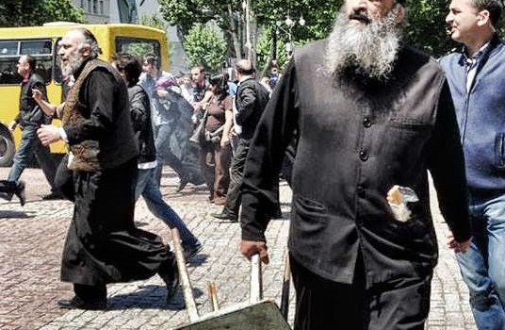
2013 – Georgia – 17 IDAHO (today IDAHOBIT) activists x thousands of violent anti-gay activists and Orthodox Church representatives

Slide 37
Civil society consists of citizens who voluntarily participate in the governance of public affairs. ARE YOU active?
Are you a member of a party, trade/labor union, business/professional organization, rights advocacy organization, church/religious organization, sports/leisure club, cultural association, another voluntary association, or an online group related to your interests?
Have you taken part in a protest/demonstration/strike or social movement?
Have you ever volunteered?
Have you organized others around a common interest?
Have you signed a petition?
Have you donated money to a non-governmental organization or a social cause?
Have you shared information about a public issue on social media?
Have you contacted a politician or civil servant in respect to an issue you are concerned about?

Slide 38
NGO vs CSO

Slide 39
NGO vs CSO
NGO – non-governmental organization
CSO - include NGOs, but also professional associations, foundations, independent research institutes, community-based organizations, faith-based organizations, social movements, and labor unions.

Slide 40
SITUATION IN YOUR COUNTRY
Can you tell us about one interesting fact concerning civil society or human rights in your country?
  Important or interesting non-governmental organizations?
  Reasons for protests?
  Topics the civil society mobilizes itself around?
  Human rights issues?

Slide 41
Final reflection
Do you have any questions on your mind right now?
How do you feel after today‘s class? One word

