Slide 1
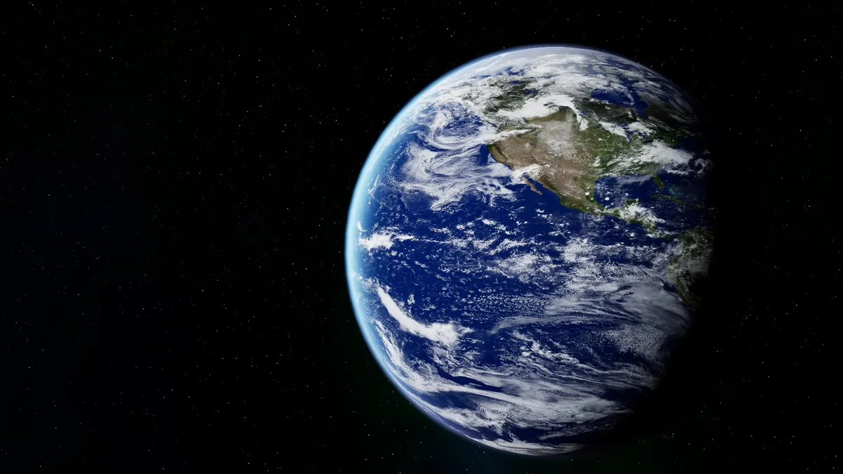
Journalism &
civic society
Vojtěch Boháč, MUNI, 2024

Slide 2
What is Voxpot

Slide 3
Path towards journalism
Writing and reading
Traveling and curiosity
Kind of luck

Slide 4
Why has it started
I hate being manipulated
No media for 21. century in the Czech Republic
No media to put events in broad context

Slide 5
Basics for a good journalism
Trying to understand all sides – people are not dumb
Traveling to the source no matter what
Cleaning reality from bullshit

Slide 6
Power is always the adversary
Power corrupts and has to be contained
Power wants to define narratives and control it (War in Ukraine)
We are here to shed light and challenge those narratives

Slide 7
Why free media matters
Well informed people are hard to manipulate
It enables free civil society to exist
Free media means free people

Slide 8
Time for discussion

