Slide 1
Eastern Partnership and Human Rights. War in Ukraine

Slide 2
Where we work?
Eastern Europe and Central Asia
Latin America
Northern Africa
Vietnam

Slide 3
What We Do?
Activities:
Capacity Development
Protection
Advocacy
Target Groups:
Activists and HRDs
Journalists
Lawyers

Slide 4
Protection
Financial assistance to the political prisoners and their families, activists under threat
Relocations, sustainable work with exiled civil society
Mental Health and Psychosocial Support (MHPSS)

Slide 5
Capacity Development
Trainings
Internships
Fellowships
Financial Support to Third Parties

Slide 6
Advocacy
International advocacy
Awareness-raising in the Czech Republic and target countries

Slide 7
Why support human rights abroad?

Slide 8
Human Rights and War in Ukraine

Slide 9
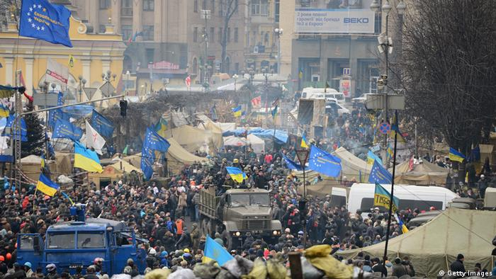
Independent Ukraine in Russia’s focus
Referendum for Independence on December 1st 1991
Relationship with Russia
Orange Revolution 2004
Naval Base in Crimea and Russian gas
Revolution of Dignity

Slide 10
Human Rights in Ukraine before 2014
Freedom of speech – censorship, journalists’ deaths
Freedom of Assembly – Ukraine without Kuchma, revolutions
Discrimination of minorities
Electoral rights

Slide 11
War in Ukraine and Civil Society
Protests in Crimea and Donbas
Participation in the Reforms
Volunteering
Assistance to IDPs
Monitoring of human rights situation on occupied territories

Slide 12
After 24.2.2022
Staying in the country
Partisanship
Draft
Documentation of human rights violations and war crimes
War coverage in independent media
Need of psychosocial support
Humanitarian aid in the communities

Slide 13
Thank you for your attention
Nadiia Ivanova
nadiia.ivanova@peopleinneed.net www.peopleinneed.net

