Slide 1
Unrecognized territories
South Caucasus:
Abkhazia (Georgia)
South Ossetia (Georgia)
Until recently: Nagorno Karabakh (Armenia – Azerbaijan)
Transnistria (Moldova)
Russia annexed the following regions of Ukraine:
Donetsk, Luhansk, Kherson, Zaporizhzhia, Crimea

Slide 2
Connect the translation of the sentence „Hello, welcome to the class today!“ with the corresponding language:
Armenian
Azerbaijani
Georgian
Moldovan/Romanian
Salam, bu gün dərsə xoş gəlmisiniz!
გამარჯობა, მოგესალმებით დღეს კლასში! (gamarjoba, mogesalmebit dghes k’lasshi!)
Բարև, բարի գալուստ դասի այսօր: (Barev, bari galust dasi aysor)
Buna ziua, bine ai venit in clasa de astazi!

Slide 3
„Hello, welcome to class today!“
Azerbaijani (Turkish)
Salam, bu gün dərsə xoş gəlmisiniz! (Merhaba, bugün sınıfa hoş geldiniz!)
Georgian
გამარჯობა, მოგესალმებით დღეს კლასში!
gamarjoba, mogesalmebit dghes k’lasshi!
Moldovan/Romanian
Buna ziua, bine ai venit in clasa de astazi!
Armenian
Բարև, բարի գալուստ դասի այսօր:
Barev, bari galust dasi aysor

Slide 4
Which language families do the languages belong to?
Armenian
Azerbaijani
Georgian
Moldovan/Romanian

Slide 5
Which language families do the languages belong to?
Armenian - an Indo-European language and the sole member of an independent branch within that language family.
Azerbaijani. also known as Azeri – is a Turkic language – related to Turkish, Turkmen, Gagauz , Crimean Tatar.
Georgian - part of the Kartvelian language family, which includes other related languages like Megrelian and Laz (mostly in eastern Turkey). There are no claimed genetic links between Kartvelian languages and any other language family in the world.
Moldovan/Romanian – shares its Latin roots with other Romance languages such as French, Spanish, Italian, and Portuguese.

Slide 6
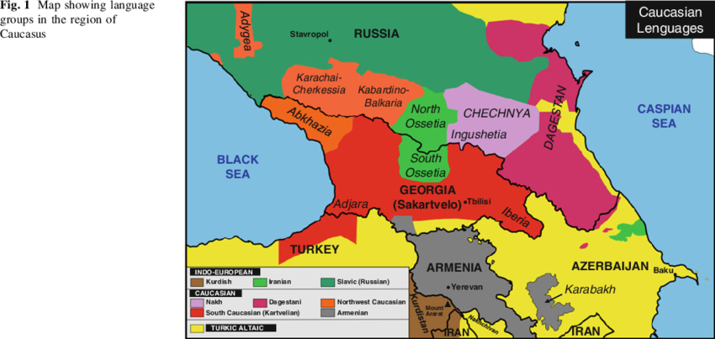

Slide 7
Do you have an update
– article from JAMnews?

Slide 8
Role play?
An Abkhaz young person who wants to study in the EU
The Abkhaz president
A Georgian elderly man who used to have a house in Abkhazia and whose ancestors are buried in Abkhazia
The Georgian prime-minister
EU representative on the issues of EU enlargement
Russian minister of foreign affairs
A representative of a peace-building organization

Slide 9
Final discussion in groups
What activities does NESEHNUTI engage in regarding the regions we mentioned today?
What are the activities of the local civil society in the regions?
Which of these activities do you think you could or would like to take part in?

Slide 10
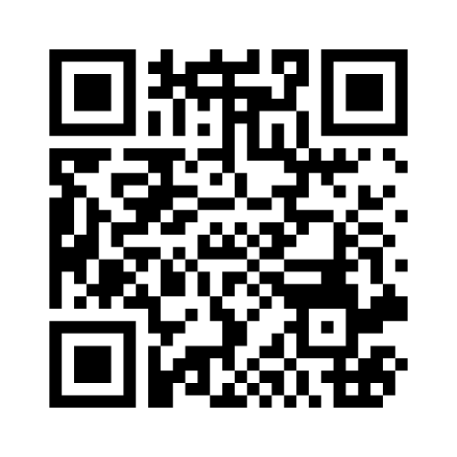
Reflexion of the class
Write your answers in mentimeter.
Read the responses of your fellow students.
Join at menti.com.
Code: 2354 6100
https://www.menti.com/al4r2t2fhnf8

