Slide 1
POLITICAL AND CIVIL RIGHTS
IN OUR REGION and your countries
2023

Slide 2
Freedom in the World 2024
A report published annually by Freedom House.
Freedom House
  an independent watchdog organization
  founded in 1941 in the US
  nonpartisan
  leads a consortium: The Lifeline Embattled CSO Assistance Fund https://www.csolifeline.org/

Slide 3
Freedom in the World 2024
Evaluates the state of freedom in 195 countries and 15 territories during calendar year 2023.
Each country and territory is assigned up to 100 points.
At the top of the list, there is Finland, New Zealand, and Sweden.
At the bottom there is Nagorno Karabakh, Tibet, Syria, South Sudan, Turkmenistan, Crimea and Eastern Donbas (all worse than North Korea).

Slide 4
Freedom in the World 2024
The methodology is derived from the Universal Declaration of Human Rights.
Freedom in the World analyzes
electoral process
political pluralism and participation
the functioning of the government
freedom of expression and of belief
associational and organizational rights
the rule of law
personal autonomy and individual rights.

Slide 5
Can you group countries that have a similar situation as to civil and political freedoms? Free – Partly Free – Not Free
Abkhazia
Armenia
Azerbaijan
Belarus
Bosnia and Herzegovina
Bulgaria
Crimea
Czech Republic
Eastern Donbas
France
Georgia
Hungary
Nagorno Karabakh
Norway
Philippines
Russia
Serbia
Slovakia
South Ossetia
Transnistria
Turkey
Ukraine
United Kingdom
United States

Slide 6
countries by the level of civil and political rights (max. 100 points)
FREE
Norway 98
Czech Republic 94
United Kingdom 91
Slovakia 90
United States 83
France 89
Bulgaria 78
For more information: https://freedomhouse.org/countries/freedom-world/scores
PARTLY FREE
Hungary 65
Moldova 61
Georgia/Philippines 58
Serbia 57
Armenia 54
Bosnia and Hercegovina 54
Ukraine 49
Abkhazia 39
e.g. https://freedomhouse.org/country/azerbaijan/freedom-world/2024
NOT FREE:
Turkey 33
Transnistria 17
Russia 13
South Ossetia 12
Belarus 8
Azerbaijan 7
Eastern Donbas/Crimea 2
Nagorno Karabakh -3

Slide 7
Discussion On HW
Human Rights Watch 2024 Report on the human rights situation in Azerbaijan: what were three most surprising facts for you?

Slide 8
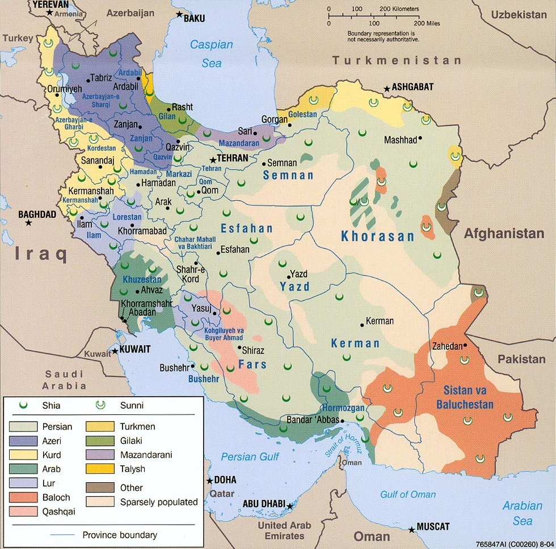
Azerbaijani language is spoken by
- around 10 mln speakers in Azerbaijan
- around 20 mln speakers in Iran
- around half a million speakers in turkey

Slide 9
azerbaijan - Recommended book of fiction and a film based on it
Kurban Said: Ali and Nino
https://www.imdb.com/title/tt4072326/ -

