Slide 1
Periodisation and time
21st March 2024

Slide 2
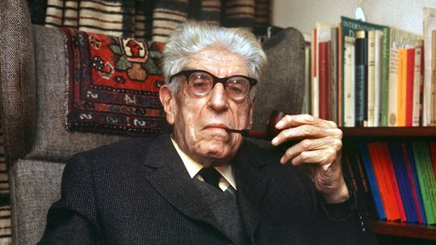
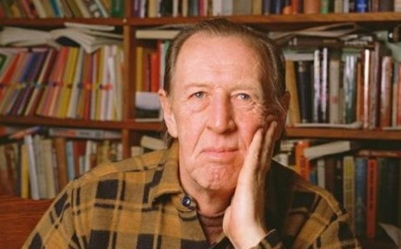
‘the residual … has been effectively formed in the past, but it is still active in the culture process … Thus, certain experiences, meanings and values which cannot be expressed or substantially verified in terms of the dominant culture, are nevertheless lived and practised on the basis of the residue – cultural as well as social – of some previous social and cultural institution or formation.’
Raymond Williams, Marxism and Literature (Oxford, 1977) p. 122
‘Not all people exist in the same “Now. “They do so only externally, by virtue of the fact that they may all be seen today. But that does not mean that they are living at the same time with others.’
Ernst, Bloch, Heritage of our Times (1935) (Cambridge, 1991) p. 97 .

Slide 3
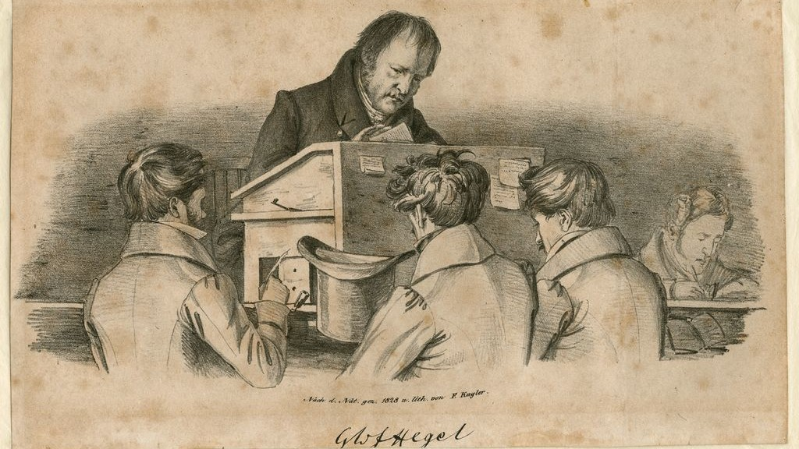
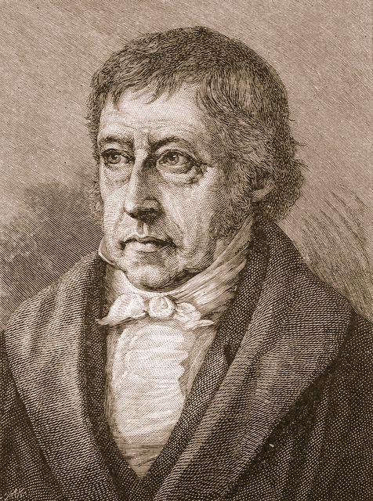
Georg Hegel (1770-1831): The ‘Father of Art History
Lectures on Fine Art (“Hegel’s Aesthetics”)
First delivered in Berlin, 1818, 1820/21, 1823, 1826 and 1828/29.
Published in 1835

Slide 4
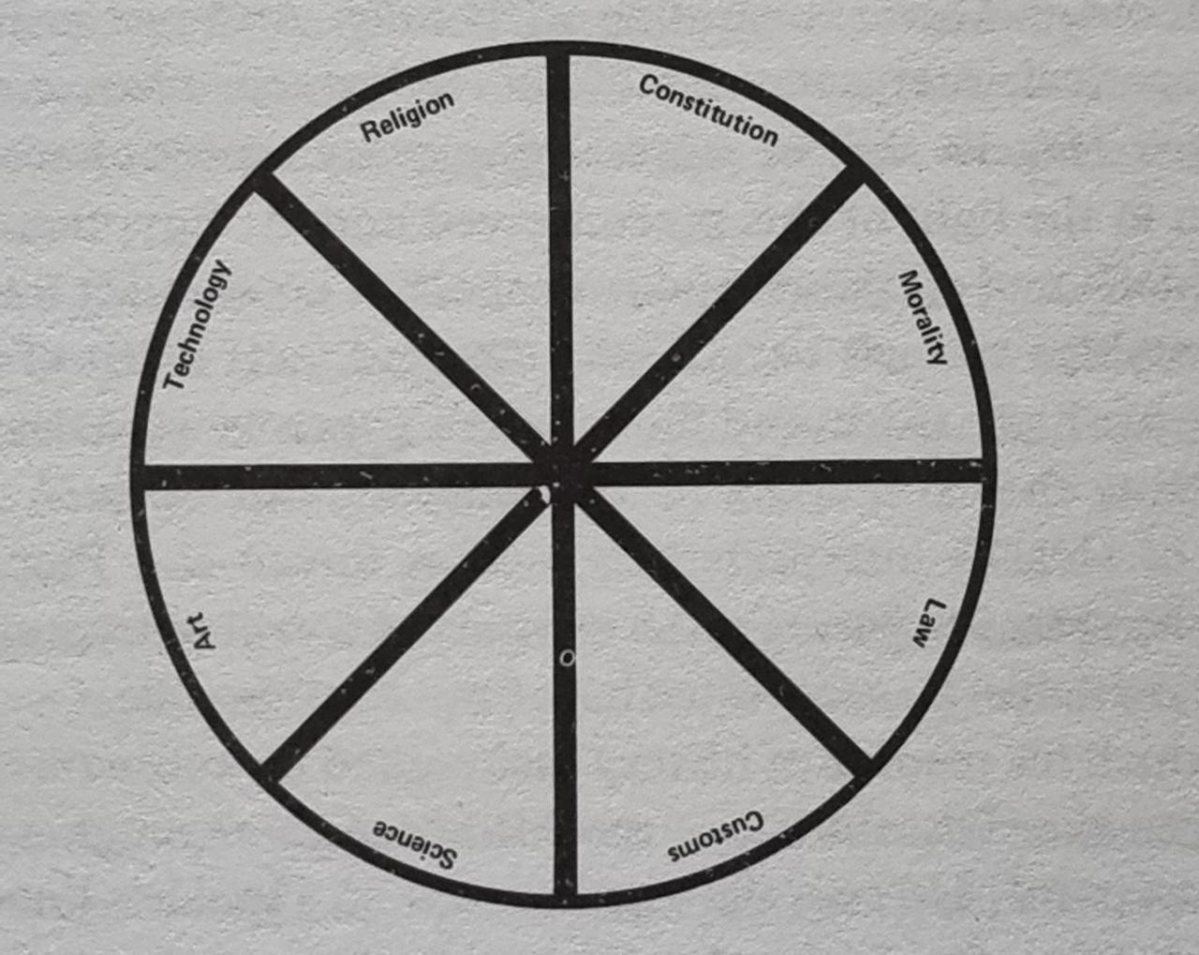
Hegel’s model of the history of culture.
Diagram from Ernst Gombrich, In Search of Cultural History (Oxford, 1969)
‘Every cultural epoch which presents itself as a complete and articulate whole, expresses itself not only in the life of the state, in religion, art and science, but also imparts its individual character to social life as such.’
Jakob Burckhardt, The Civilization of the Renaissance in Italy (1860) quoted in Gombrich, p. 20.

Slide 5
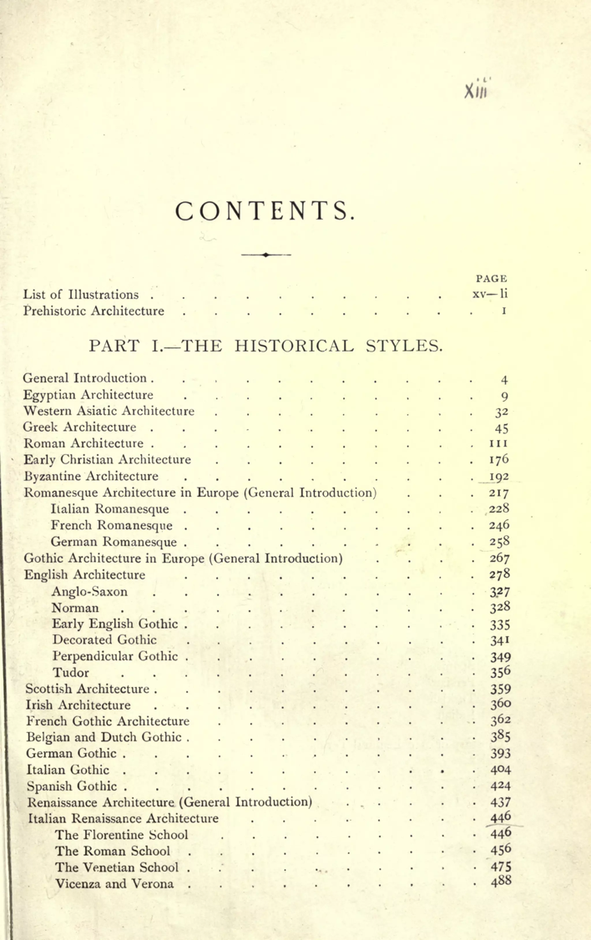
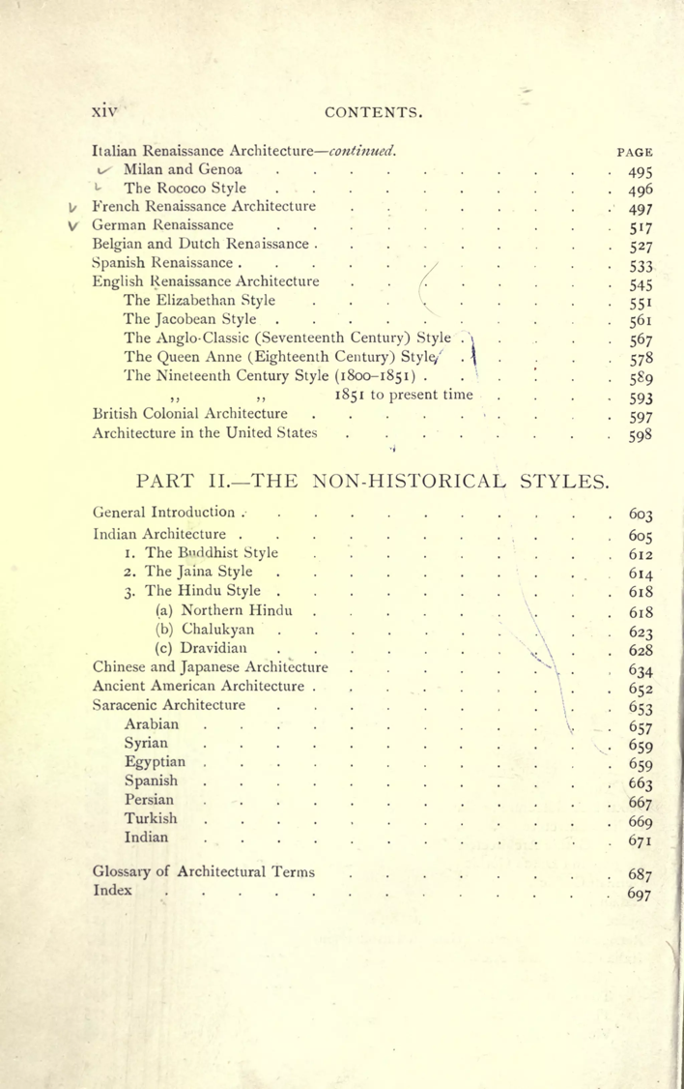
Table of contents from: Sir Bannister Fletcher, A History of Architecture (London, 1905)

Slide 6
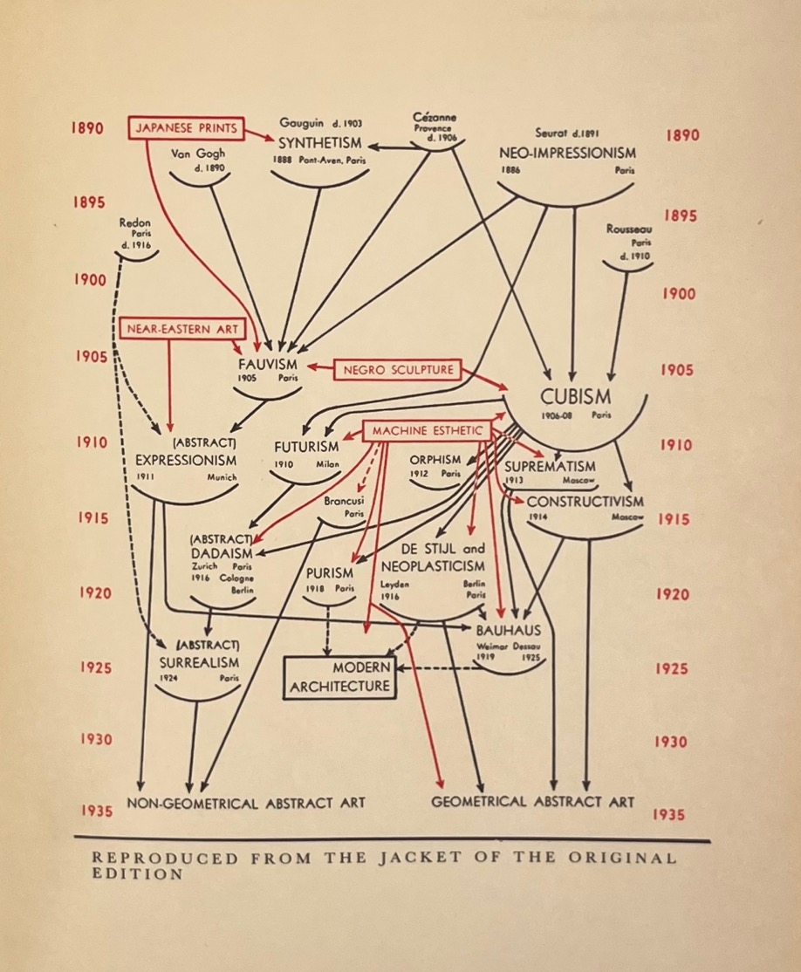
The Succession of Modern Art Styles
From: Alfred Barr, Cubism and Abstract Art (New York, 1936)

Slide 7
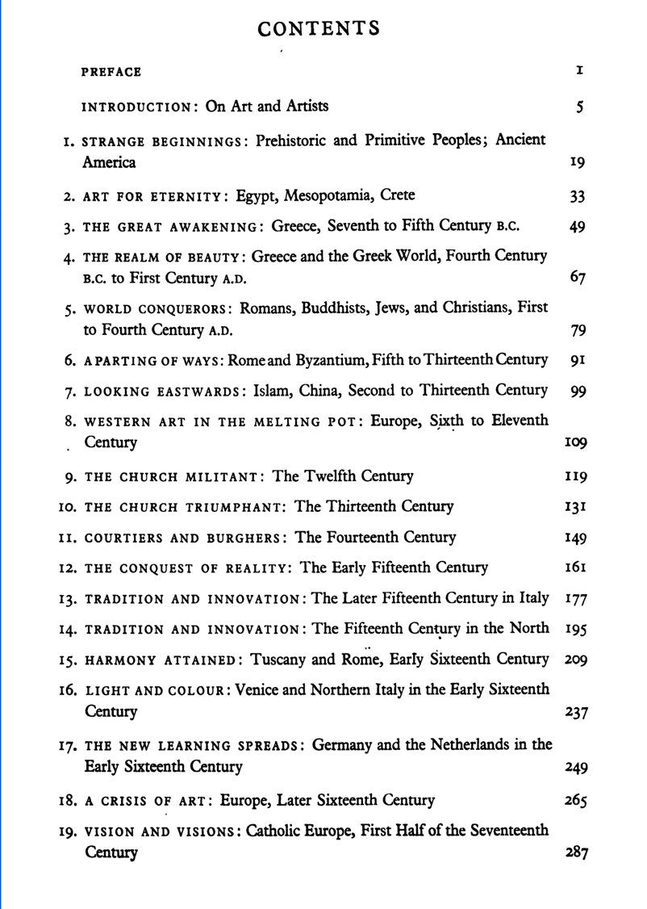
Table of Contents from Ernst Gombrich, The Story of Art (London, 1951)

Slide 8
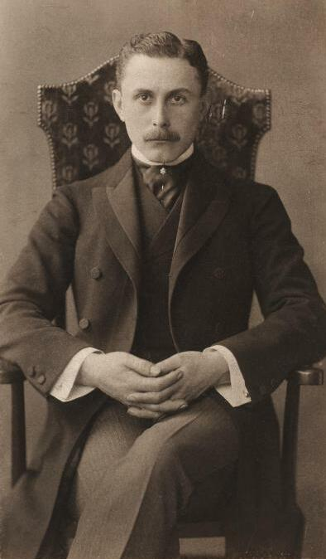
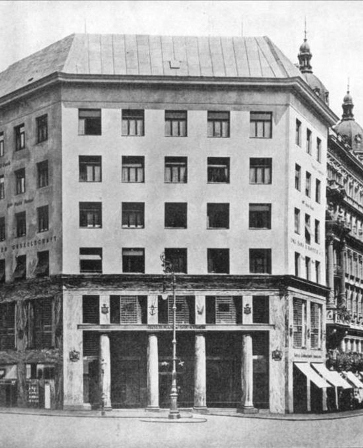
‘I perhaps am living in 1908, but my neighbour is living in 1900 and the man across the way in 1880 … The peasants of Kals [in the Tyrol] are living in the twelfth century. And there were people taking part in the Jubilee Parade [of Emperor Franz Joseph in 1908] who would have been considered backward even during the period of the migrations.’
Adolf Loos, ‘Ornament and Crime’ (1908) Programs and Manifestoes on 20th-century Architecture, edited by Ulrich Conrads. Cambridge, MA, MIT Press pp. 19-24, here p. 21.
Adolf Loos, The Loos House, Vienna, 1910
Adolf Loos (1870-1933)

Slide 9
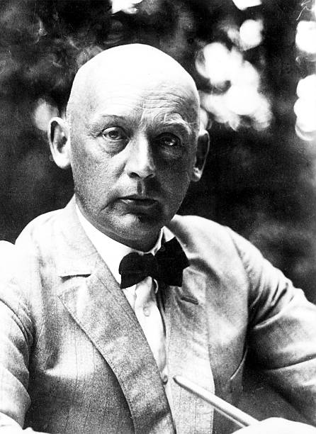
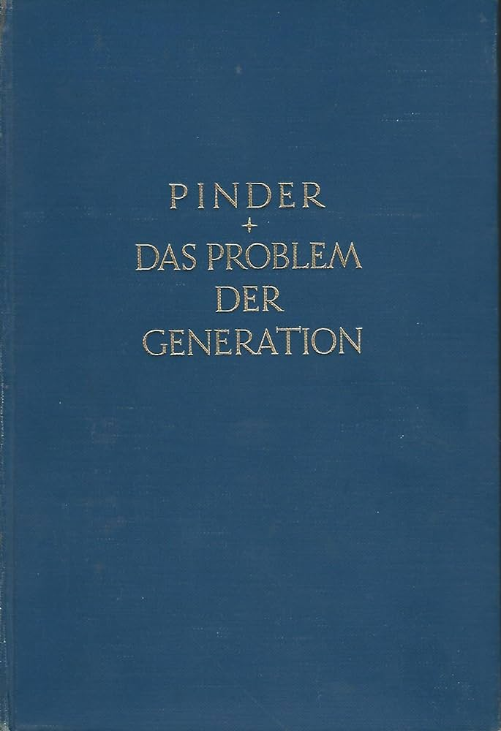
L: Wilhelm Pinder (1878-1947)
R: The Problem of Generation in the Art History of Europe (1926)

Slide 10
Pinder: the contemporaneity of the non-contemporaneous (Gleichzeitigkeit des Ungleichzeitigen)
‘ … every person lives amidst a host of contemporaneous possibilities alongside others who are the same age or a different age. For every person the same moment in time is a different one, in other words, a different era, which he shares only with others of the same sage. For every person, each moment in time thus has a different meaning, not only because, obviously, it is experienced differently by every individual, but also – as a real moment in time that stands apart from everything to do with the individual person – because the same year is a different point in the life of a 50-year old than of a 20-year old etc, in countless variations.’
Pinder, Das Problem der Generation, p. 11

Slide 11
‘A scholarly pursuit (Wissenschaft) that seeks to resurrect past forms of life, as they have been deposited in works of art, a creative history that is a struggle against death and for life, should replace the cold notion of an objective stretch of time with a nuanced one of subjectively varied times, marked by the warmth of life, in order to view the moment as a whole (synthetically) as what, in history, it really is: not one-dimensional, but multi-dimensional. We can thus speak of the hidden “contemporaneity of the non-contemporaneous”.’
Pinder, Das Problem der Generation, pp. 10-11.

Slide 12
‘the mere presence of phenomena alongside each other is always chaos. The succession of generations hidden within them, however, produces rhythm, even polyphony.’
[ … ]
‘the fact that today older layers are still present, that they still constitute the present, signifies nothing other than the normal run of things. In other words: if we explain the apparent chaos of our “today” through the historical distinction between generations … we ought to attend to every “today” of the past in the non-anonymous history art in the same way …’
Pinder, Das Problem der Generation, p. 27.

Slide 13
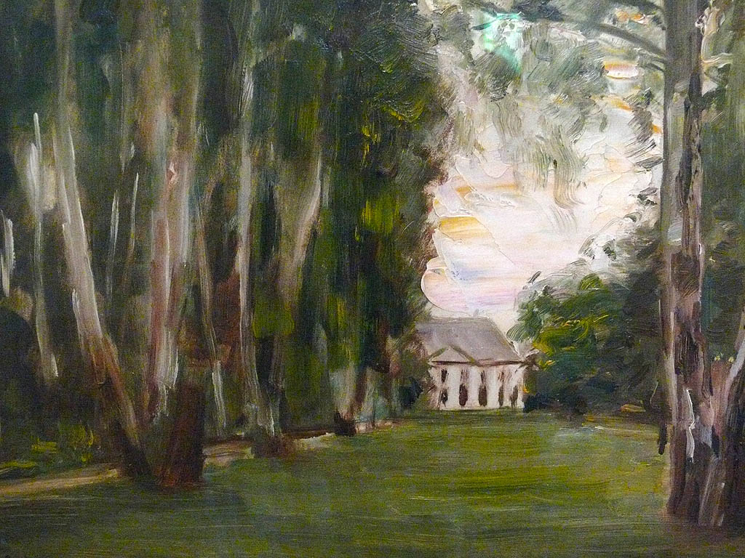
Max Liebermann, Birchtrees in Wannsee (1926)

Slide 14
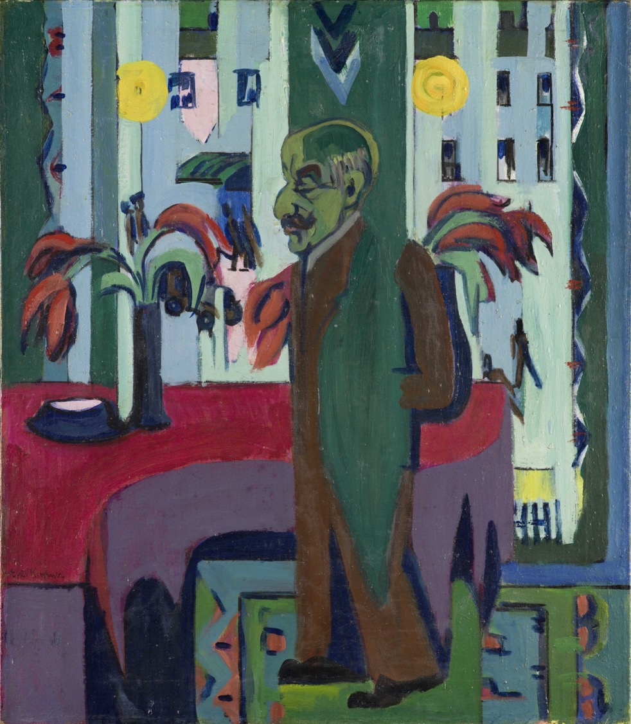
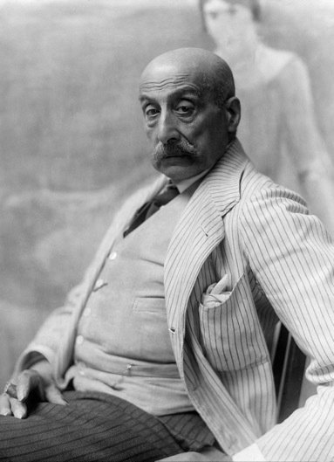
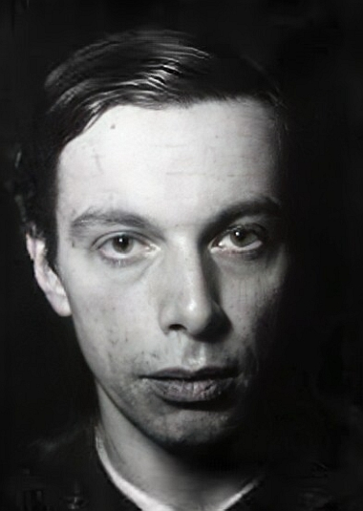
Ernst Ludwig Kirchner
Max Liebermann in his Studio (1926)
Max Liebermann (1847-1935)
Ernst Ludwig Kirchner (1880 – 1938)

Slide 15
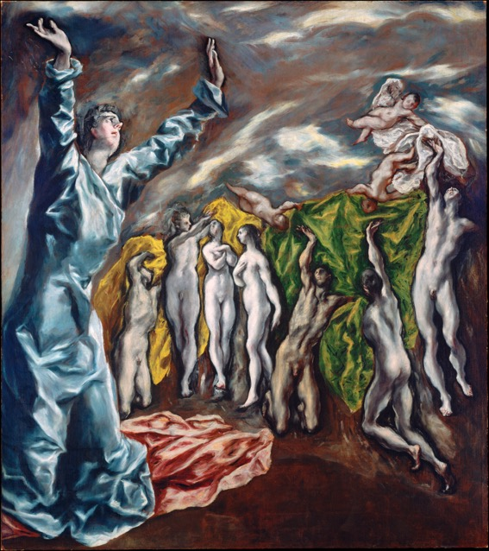
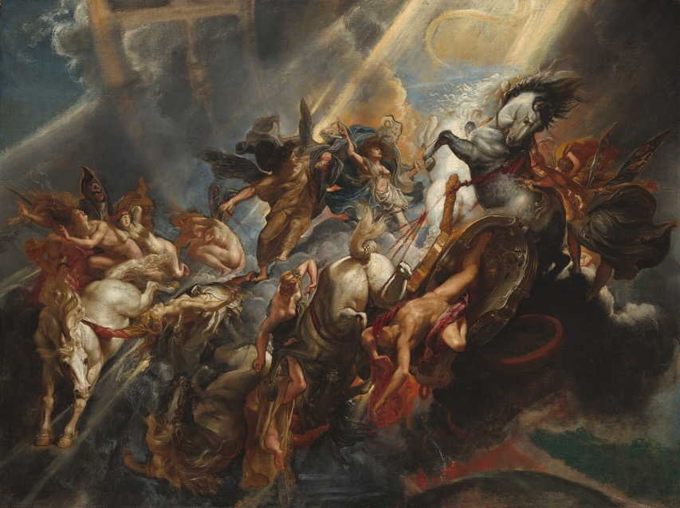
1608-14
1604
‘We know that styles, too, do not have sharp chronological boundaries, they do not have any simple times allocated to them. They do not follow each other, marching in step. Rather, they rub up against and on top of each other, styles as a whole, as well as personal styles … Today, we see in [El] Greco and Rubens, for example, representatives of two collective styles: late (expressive) Mannerism and early high Baroque. Yet works by both of them exist at the same time.’
Pinder, Das Problem der Generation, p. 14

Slide 16
‘Contemporaries felt that the fragmentation of the age was reflected in the lack of unified formal principles in art, architecture … they witnessed what they considered the mechanical imitation of earlier, dead styles, a situation the architect Hermann Muthesius described, like Simmel, with the metaphor of language: he wrote of the fall from the “artistic paradise of style” to a state he likens to the “Tower of Babel.” Around the same time, in 1902, Wölfflin too felt this commonplace deeply enough to confide it to his diary, writing that the modem age lacked a style.
Thus, the art historian's notion of style … represents to a certain extent a longing for an idealized past.’
Frederic Schwartz, ‘Cathedrals and Shoes: Concepts of Style in Wölfflin and Adorno,’ New German Critique 76 (1999) p. 14.

Slide 17
‘Truly, I am not demanding chaos and arbitrary whim; rather I am asking for the sense of a new engagement. Art history by generations does not offer some comfortable scheme, instead, it demands ever greater elasticity … A necessary working hypothesis for the history of art – that, at least, is what I believe I am giving.’
Pinder, Das Problem der Generation, p. xvi
‘Polyphony is not chaos; you just have to learn how to listen to it.’
Pinder, Das Problem der Generation, p. 2
‘The pure presence of phenomena alongside each other is always chaos. The succession of generations hidden within them, however, produces rhythm, even polyphony.’
Pinder, Das Problem der Generation, p. 17

Slide 18
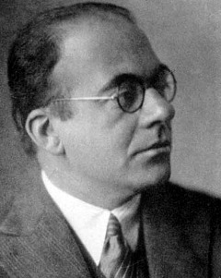
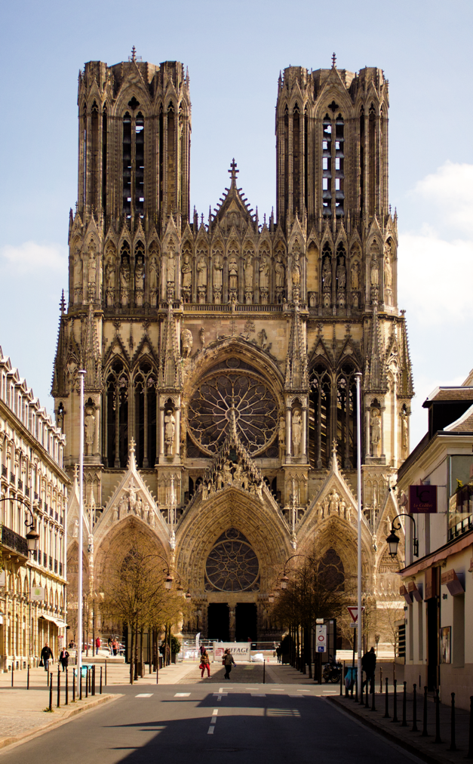
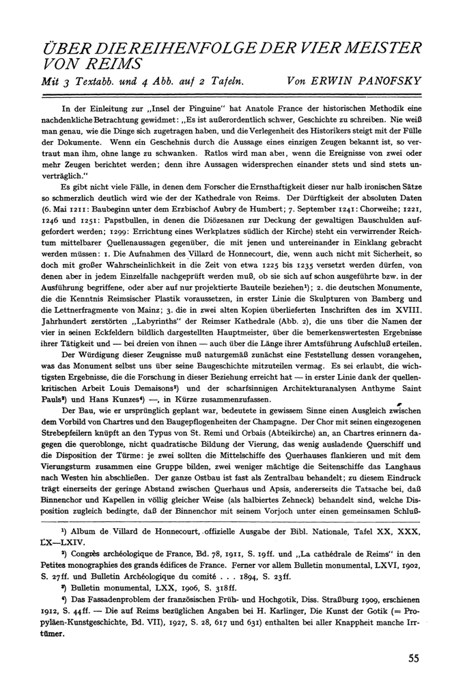
Erwin Panofsky (1892 – 1968
Reims Cathedral (13th century)
‘On the Sequence of the 4 Masters of Reims’ (1927)

Slide 19
Historical vs. Natural Time – Frames of Reference and the Problem of Relativity
‘ … it must be conceded, as the art historian will instinctively and readily admit, that historical (cultural) time is not the same thing as astronomical (natural) time. When a historian says “around 1500,” he does not mean a point in time at which, according to a conventionally determined starting point, the earth has made 1500 rotations around the sun. Rather, he means a point in time that is indicated not only by concrete events but also by specific and concrete cultural characteristics.’
Panofsky, ‘Reflections on Historical Time’ (1927) in Critical Inquiry (2004) p. 695
The world of the art historian represents above all an unending variety of individual frames of reference within which space and time determine and even bring one another into being. The gothic basilica, the Swabian wood sculpture of the fifteenth century, the Byzantine illuminations of the post-iconoclastic period, the sculpture of the Parthenon, the art of Albrecht Dürer all constitute such frames of reference in which a particular segment of historical space is observed and analyzed within a particular span of historical time’
Panofsky, ‘Reflections on Historical Time’ (1927) in Critical Inquiry (2004) p. 696

Slide 20
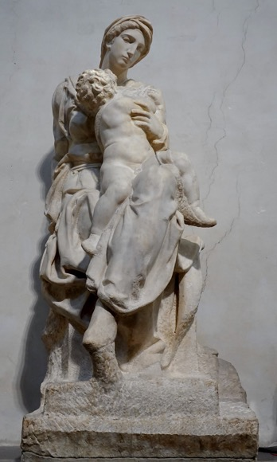
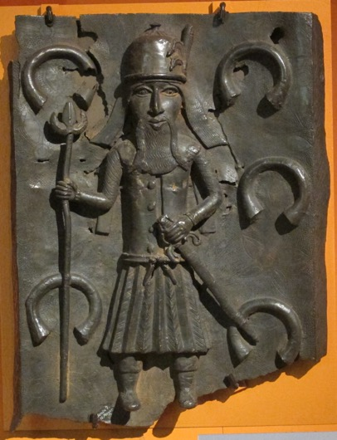
‘this endless multiplicity of frames of reference, which seems to primarily constitute the world of the art historian, amounts to a confusing and unformalizable chaos. ‘
Panofsky, ‘Reflections on Historical Time’ (1927) in Critical Inquiry (2004) p. 697
‘This inherent problem of the historical discipline, which, as it were, employs two very different conceptions of time and space but which, at the same time, must always be related to one another.’
Panofsky, ‘Reflections on Historical Time’ (1927) in Critical Inquiry (2004) p. 699
‘ … two conceivably unconnected works, such as an African sculpture made in 1530 and Michelangelo’s Medici Madonna, in light of which the difference is so great that the connecting natural simultaneity is historically irrelevant.’
Panofsky, ‘Reflections on Historical Time’ (1927) in Critical Inquiry (2004) p. 699
T: Michelangelo, Madonna and Child (1521)
B: Benin bronze of a Portuguese Soldier (mid-16th century)

Slide 21
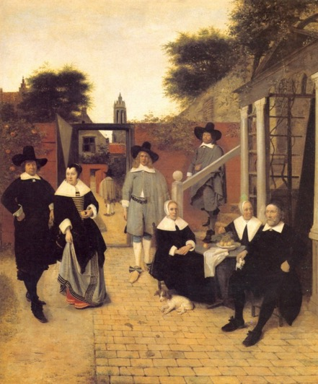
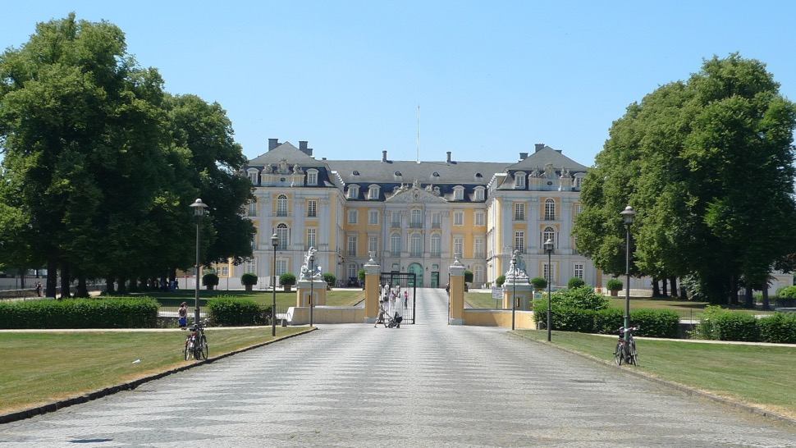
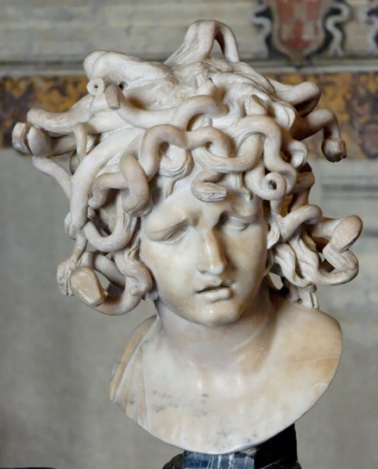
‘ … since the selection of a style as the object of study inevitably involves a presumption of cohesiveness, it should follow and not precede the hypothesis that a certain group of works is closely integrated and clearly distinguished from other groups. If we assume the existence of a style at the start (a danger with pat concepts such as "Classic" and "Romantic" periods, etc.), we shall delude ourselves into crowding into it what does not belong.’
James S. Ackerman, ‘A Theory of Style,’ The Journal of Aesthetics and Art Criticism 20.3 (1962) p. 237

Slide 22
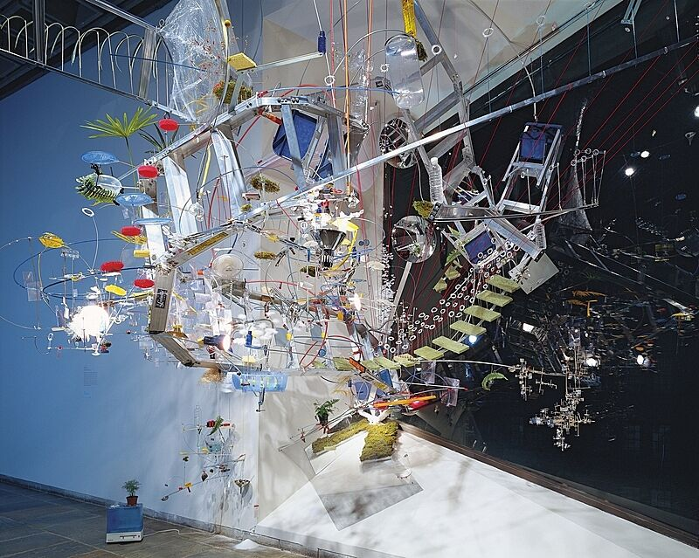
The problem of contemporary art
‘[The lack of an identifiable style] in fact is the mark of the visual arts since the end of modernism, that as a period it is defined by the lack of a stylistic unity, or at least the kind of stylistic unity which can be elevated into a criterion and used as a basis for developing a recognitional capacity, and there is in consequence no possibility of a narrative direction.’
Arthur Danto, ‘Introduction: Modern, Postmodern, and Contemporary,’ in After the End of Art: Contemporary Art and the Pale of History (Princeton, 1997) p. 12
Sarah Sze, Strange Attractor (2000)
Chris Ofili
Blossom (1997)

Slide 23
‘[Time’ is not a tidy sequence of partitioned units but a profusion of whirlpools and rapids, eddies and flows, as objects, ideas and images and texts from different moments swirl, tumble and collide in ever-changing combinations and constellations. New actors jostle, alongside those with thousand-year histories; inventions and innovations feed off the very traditions they excoriate.”
Rita Felski, The Limits of Critique (2015) p. 33

Slide 24
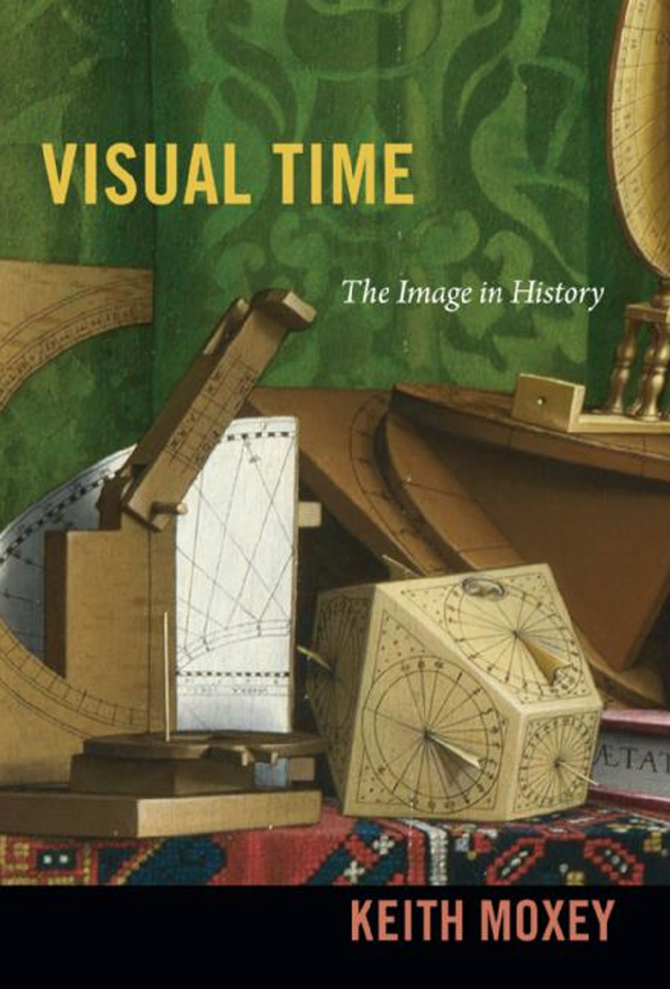
‘Periodization involves negotiating the non-synchronous nature of temporality—the need to relate multiple streams of time to one another in a narrative that does not do them undue violence. The compromising process of translating multiple forms of time into a singular narrative in order to ascribe them meaning will always be subject to revision. While it seems imperative to distinguish different moments in order to construct the idea of a period, be it in the past or the present, it is also necessary to admit that these distinctions are never permanent and that their differences depend on the interests of the now.’
Moxey, p. 45

Slide 25
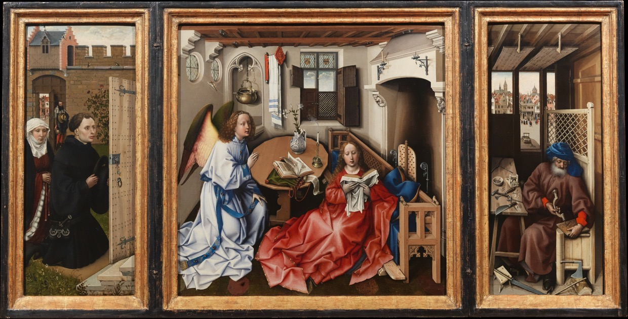
Robert Campin,
Mérode Altarpiece
(1427-32)
‘Why is it, for example, that Flemish artists are so much more concerned with the depiction of the “skin” of objects than are the Italian? Rather than extolling surface textures, linear perspective is the yardstick used to evaluate Flemish painting. The requirement to relate historical developments to one another and to attribute them a common source obscures the particularity of the local for the sake of the universal. Despite the brilliance of its surfaces and textures, a painting such as Robert Campin’s Merode Altarpiece is implied to be somehow wanting because it flouts the principles of geometric perspective.’
Moxey, Visual Time, pp. 26-27.

Slide 26
Time and globalisation

Slide 27
Table of contents from: Sir Bannister Fletcher, A History of Architecture (London, 1905)

Slide 28
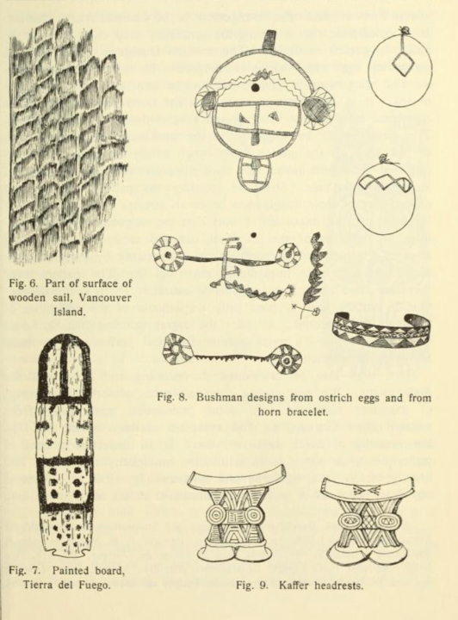
‘Systematic study of “primitive” tribes began first in the hope of utilizing them as a kind of time-machine, as a peer into our own historic past, as providing closer evidence about the early links in the great Series.’
Ernst Gellner, Thought and Change (Chicago, 1968) p. 18
From Franz Boas, Primitive Art (New York, 1927)

Slide 29
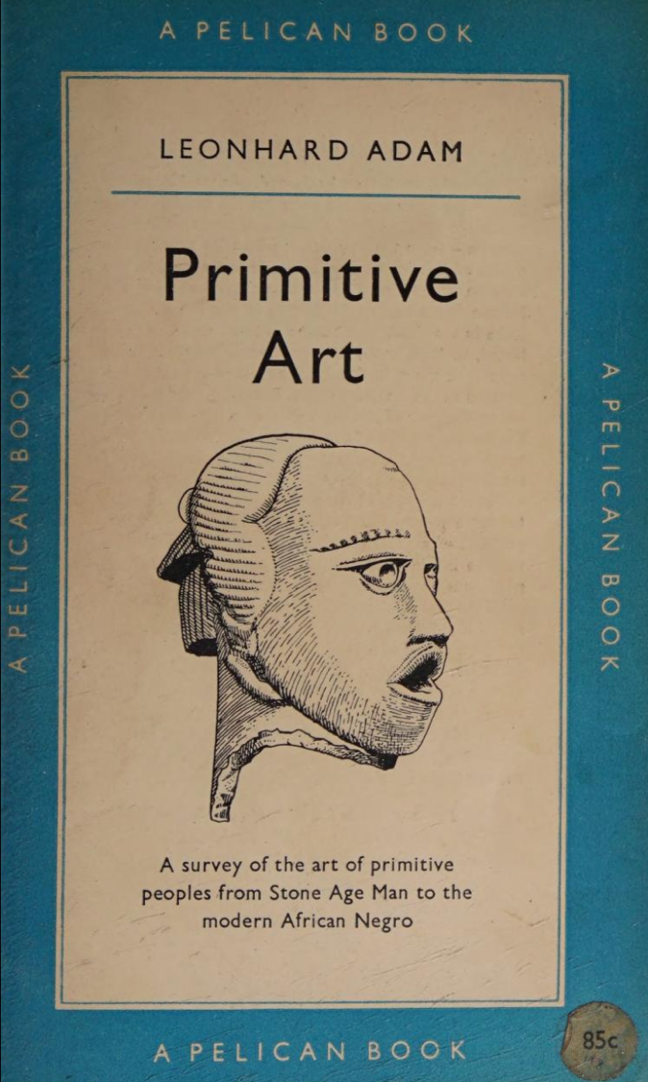
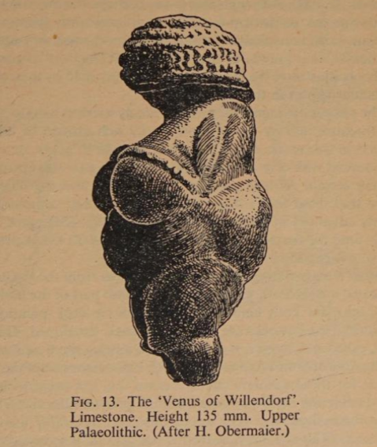
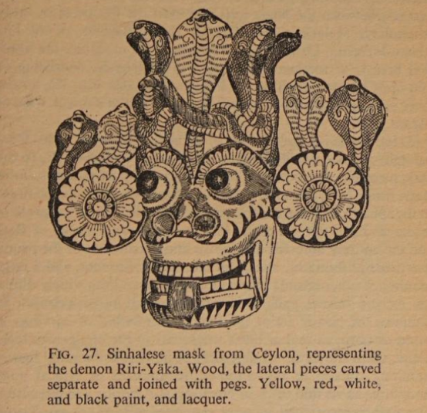

Slide 30
Art on a Global Scale:
‘ … historical time is not universal but heterochronic, that time does not move at the same speed in different places. The history of art faces the disconcerting possibility that the time it imagines, history’s very architecture, is neither uniform nor linear but rather multivalent and discontinuous.’
Moxey, Visual Time, p. 1

Slide 31
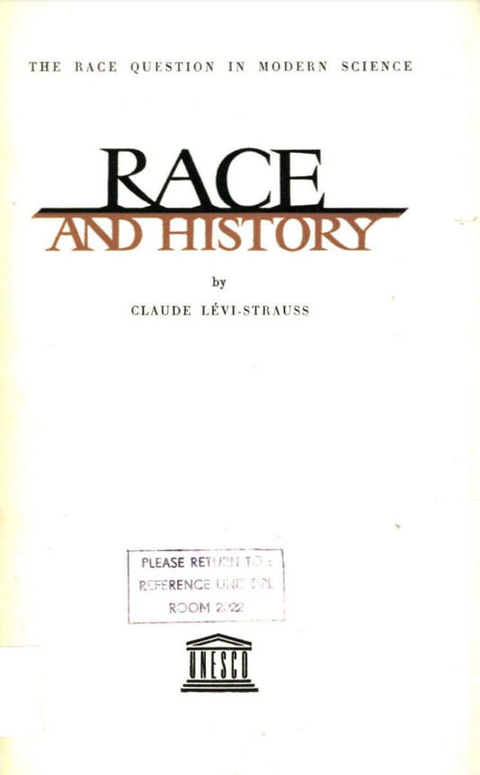
‘ … we are inclined to talk of “peoples with no history” (sometimes implying that they are the happiest). This ellipsis simply means that their history is and will always be unknown to us, not that they actually have no history.
‘We might, of course, say that human societies have made a varying use of their past time and that some have even wasted it; that some were dashing on while others were loitering along the road. This would suggest a distinction between two types of history: a progressive, acquisitive type, in which discoveries and inventions are accumulated to build up great civilizations; and another type, possibly equally active and calling for the utilization of as much talent, but lacking the gift of synthesis which is the hall-mark of the first. All innovations, instead of being added to previous innovations tending in the same direction, would be absorbed into a sort of undulating tide which, once in motion, could never be canalized in a permanent direction.’
Claude Lévi-Strauss, Race and History (Paris, 1952) p. 19

Slide 32
‘What would be the observer's attitude towards a civilization which had concentrated on developing values of its own, none of which was likely to affect his civilization? Would he not be inclined to describe that civilization as “stationary”?
[ … ]
Other cultures, on the contrary, would seem to us to be “stationary”, not necessarily because they are so in fact, but because the line of their development has no meaning for us, and cannot be measured in terms of the criteria we employ.’
Claude Lévi-Strauss, Race and History, p. 24

Slide 33
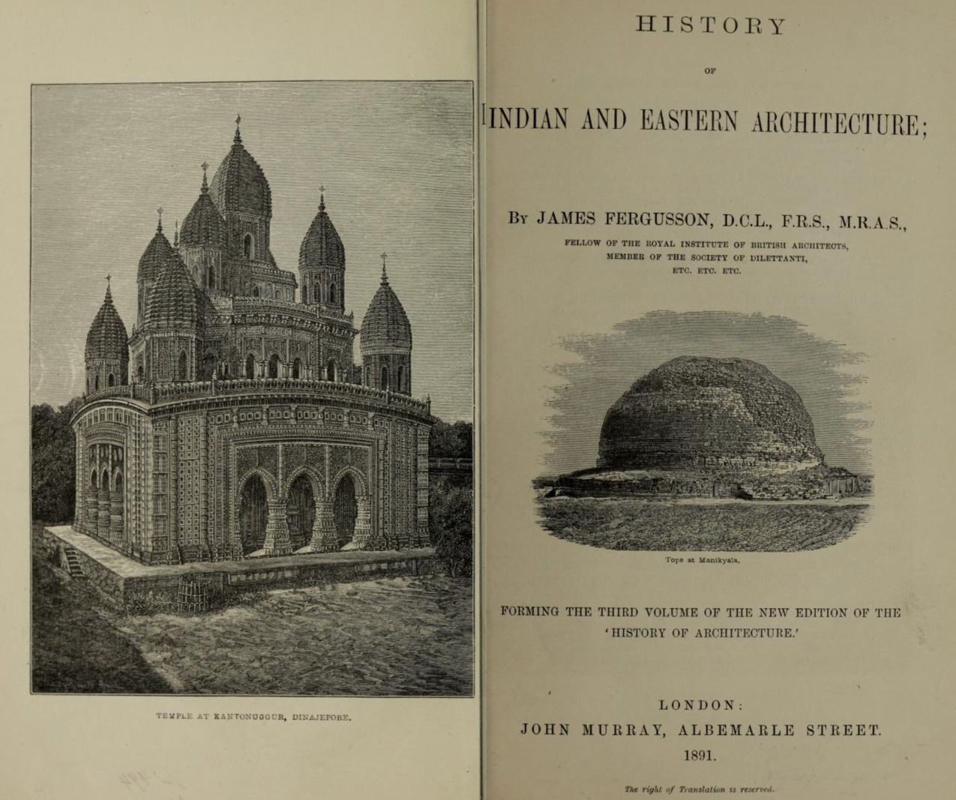

Slide 34
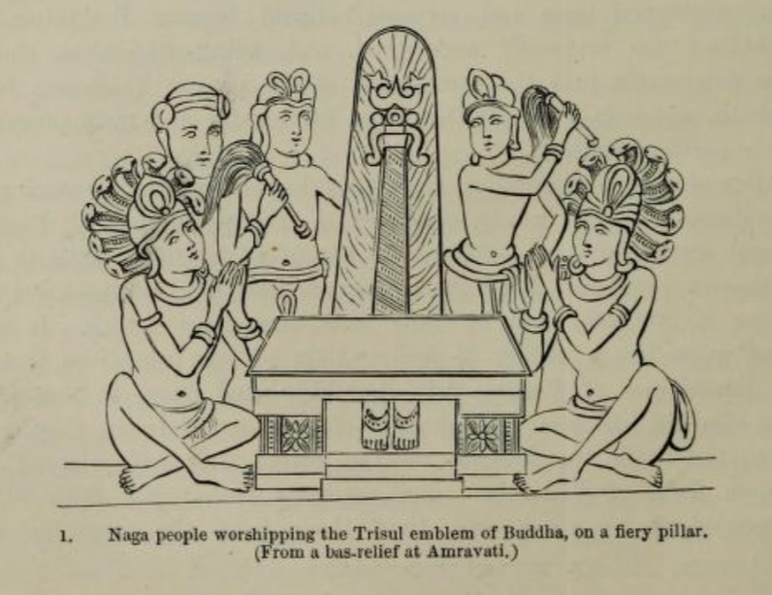
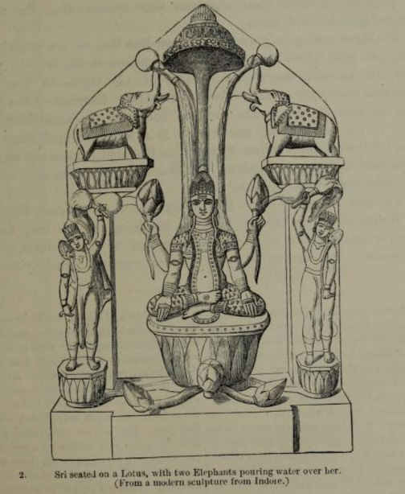
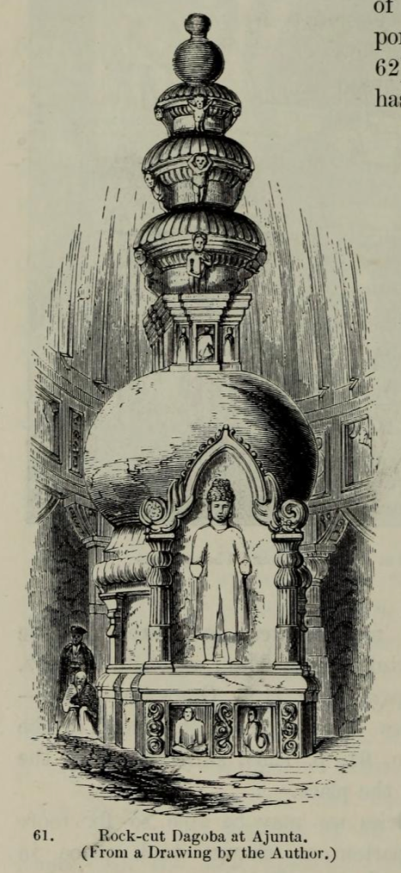
‘Sculpture in India may fairly claim to rank, in power of expression, with mediaeval sculpture in Europe, and tell its tale of rise and decay with equal distinctness, but it is also interesting as having that Indian peculiarity of being written decay. The story that [Leonardo] Cicognara tells [of medieval European art] is one of steady forward progress towards higher aims and better execution. The Indian story is that of backward decline from the sculptures of Bharhut and Amaravati topes, to the illustrations of Coleman’s “Hindu mythology.”
Ferguson, History of Indian and Eastern Architecture (London, 1891) p. 33. First published, 1876.

Slide 35
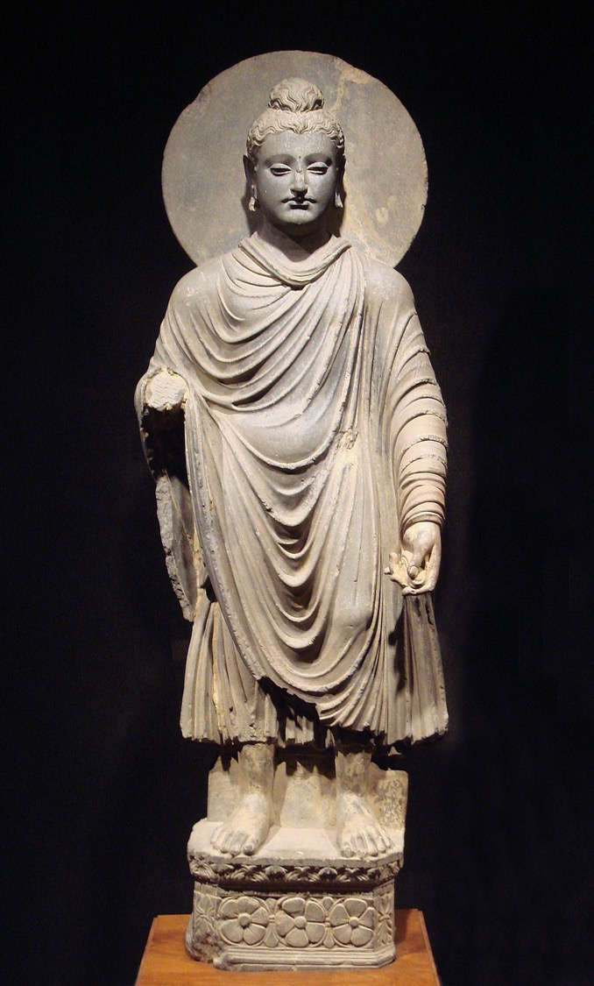
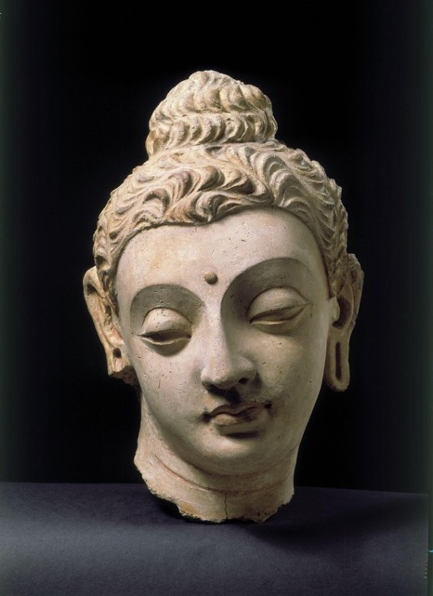
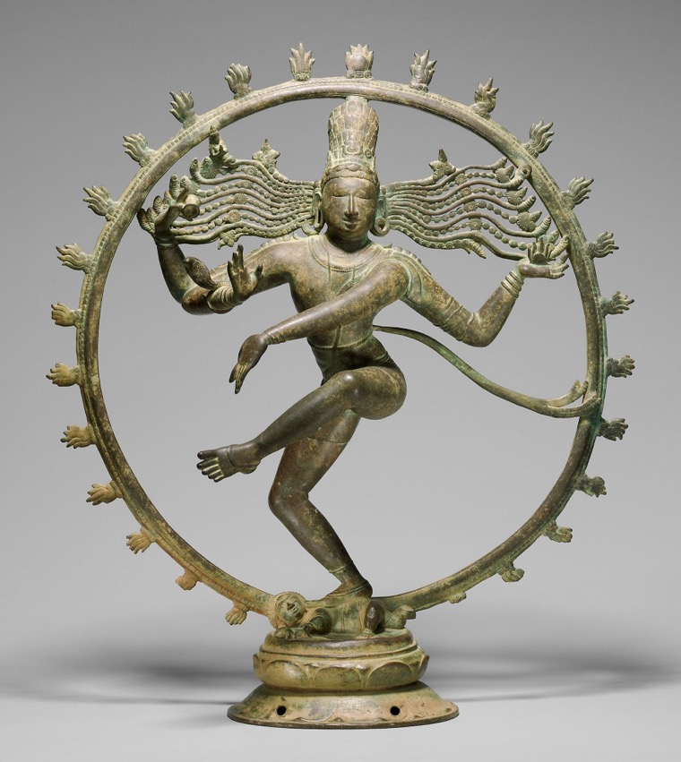
L: Greco-Buddhist Representation of the Buddha, Gandhara (1st century CE)
C: Head of Buddha (3rd -5th century CE)
R: Bronze sculpture of Shiva, Tamil Nadu (10th -11th century CE)

Slide 36
’ … the object of our argument is not to deny the fact of human progress but to suggest that we might be more cautious in our conception of it. As our prehistoric and archaeological knowledge grows, we tend to make increasing use of a spatial scheme of distribution instead of a time scale scheme. The implications are two: firstly, that “progress” (if this term may still be used to describe something very different from its first connotation) is neither continuous nor inevitable; its course consists in a series of leaps and bounds, or, as the biologists would say, mutations. These leaps and bounds are not always in the same direction.’
Claude Lévi-Strauss, Race and History (Paris, 1952) pp. 21-22

Slide 37
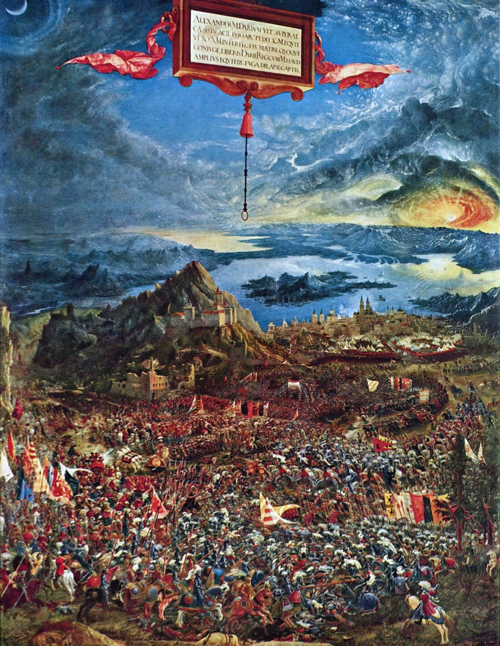
Albrecht Altdorfer
Battle of Issus (1529)
The battle of Issue took place in 333 BCE between Alexander the Great and the Persian Emperor Darius III

Slide 38
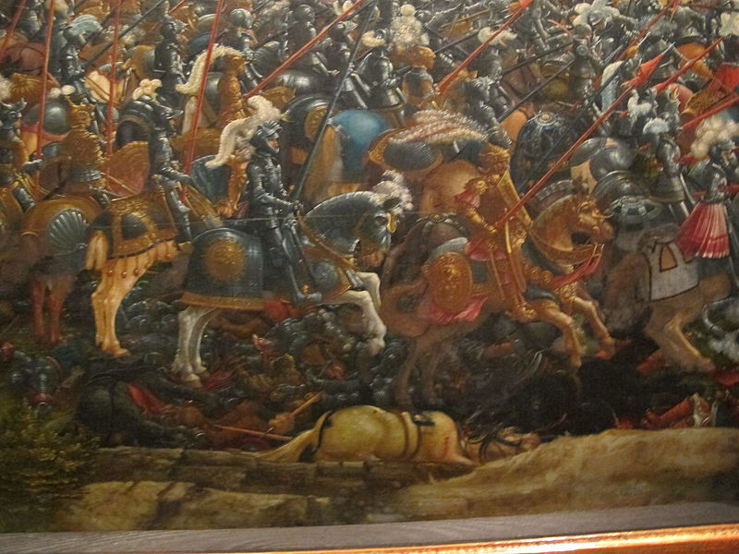

Slide 39
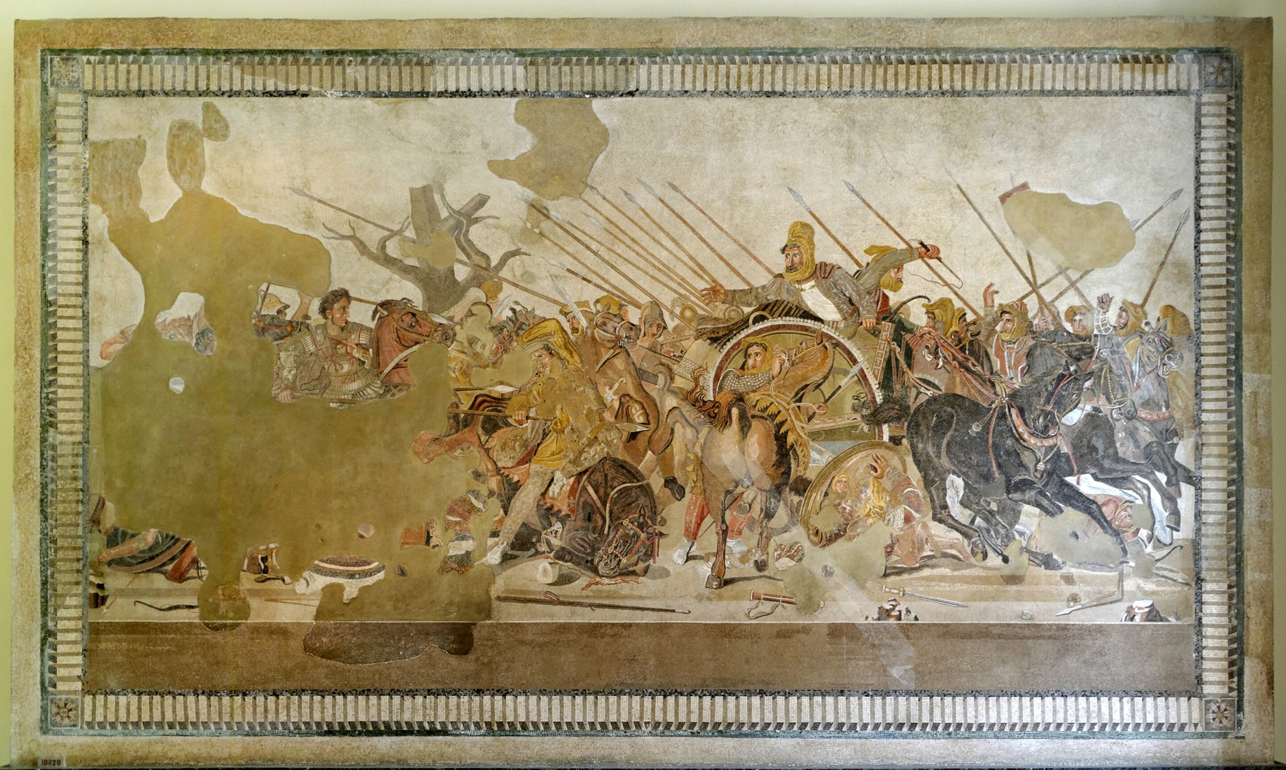
The ‘Alexander Mosaic’ showing the Battle of Issus, Pompei (ca. 100-120 BCE

Slide 40
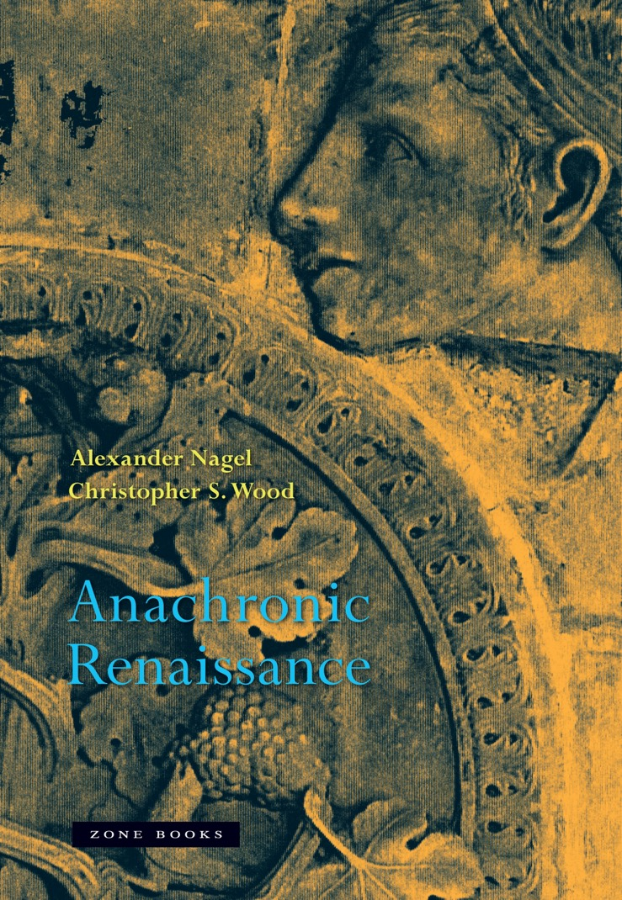
‘No device more effectively generates the effect of a doubling of bending of time than the work of art, a strange kind of event whose relation to time is plural. The artwork is made or designed by an individual or by a group of individuals at some moment, but it also points away from that moment, backward to a remote ancestral origin, perhaps, or to a prior artefact, or to an origin outside of time, in divinity. At the same time, it points forward to all its future reicipients who will activate it as a meaningful event. The work of art is a message whose sender and destination are constently shifting.’
Alexander Nagel & Christopher Wood, Anachronic Renaissance (New York, 2020) p. 9

Slide 41
‘The historian who interprets the work of art as a token within a system of symbolic exchanges opens up a window onto the hidden mechanisms of social power in a remote, vanished society. But such an interpretation tends not to want to take up the possibility of the work’s symbolic rearch beyond the historical life-world that created it – its abilities to symbolize realities unknown to its own makers.’
Nagel & Christopher Wood, Anachronic Renaissance, p. 17
‘To describe a work of art as an “anachronism” is to say that the work is best grasped not as art, but rather as a witness to its times … To describe the work of art as ”anachronic” is to say what the artwork does qua art.’
Nagel & Wood, Anachronic Renaissance, p. 14

Slide 42
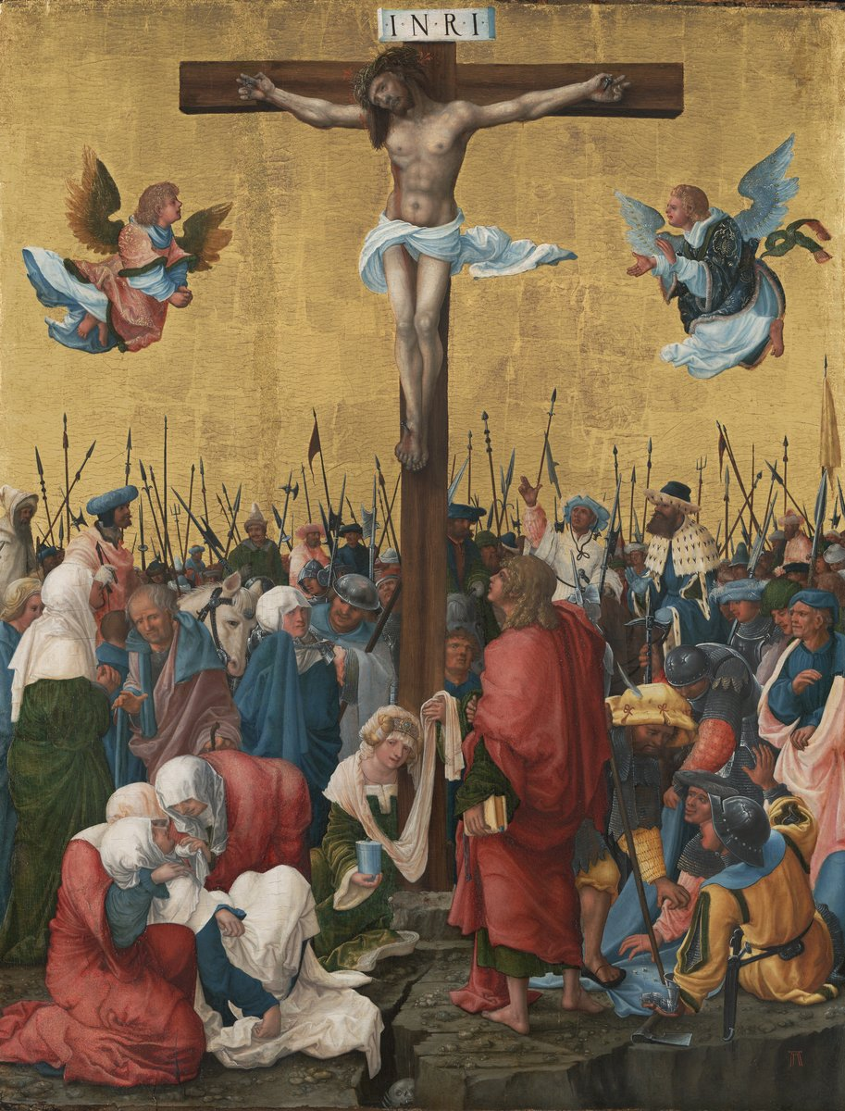
An anachronistic work …..
Albrecht Altdorfer, Crucifixion (1520)

Slide 43
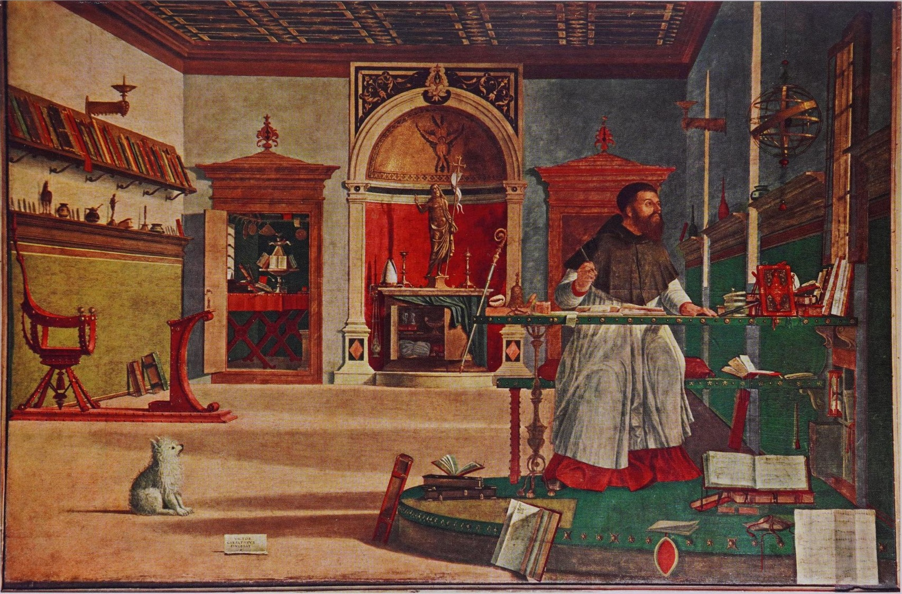
And an ‘anachronic’ work of art ….
Vittore Carpaccio, St. Augustine in his Study (1503)

Slide 44
And an ‘anachronic’ work of art ….
Mosaic
Astrolobe
Christ statuette
Venus
Bessarion?
Bishop’s crozier etc
Renaissance chair
Vittore Carpaccio, St. Augustine in his Study (1503)

Slide 45
The argument of Nagel & Wood
The interior of the studio, the future, is 16th century, not 5th century
Maybe this is not really St. Augustine, but a portrait of Cardinal Bessarion (1403-1472)
On the left is a figure of Venus (Augustine hated pagan statues, but Renaissance scholars collected them)
The crozier and other items by the niche at the back are those of a Renaissance bishop
The bronze Venus is based on a statuette by Pier Jacopo Alari Bonacolsi (1460-1528)
The statue of Christ is based on a statuette from the 1490s (based on a model by Antonio Lombardo)
The mosaic behind the statue is a 13th-century mosaic in San Mark’s basilica in Venice

