Slide 1
Art Historical Canons and the Idea of Canonicity
11 April 2024

Slide 2
What is a canon?

Slide 3
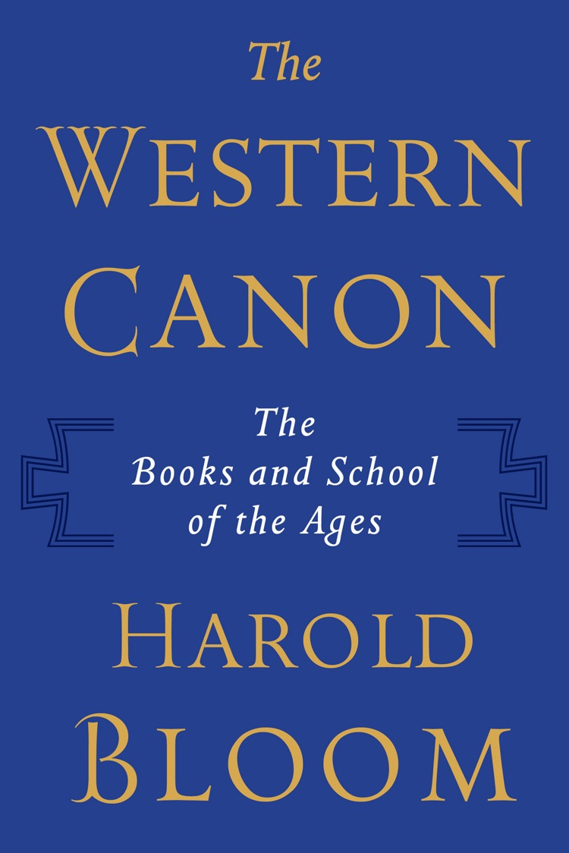
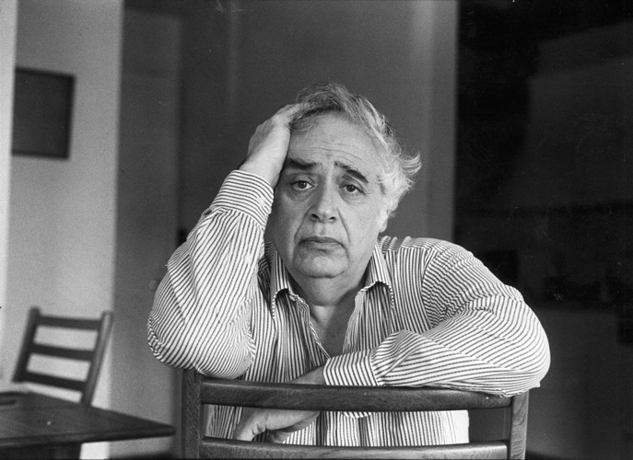
Harold Bloom
The Western Canon (New York, 1994) p. 527

Slide 5
Bloom’s aims:
To provide a basic framework of great works of art and literature as a means of setting shared universal standards
To affirm the intrinsic aesthetic value of great works of art and literature (note the criticism of scholars who see works of art and canons as the product of ‘race, class, gender and national interests.’
To affirm the self-evident nature of artistic and literary value
‘Greatness in the West’s literature centers upon Shakespeare, who has become a touchstone for all who come before and after him, whether they are dramatists, lyric poets or storytellers.’
Bloom, The Western Canon, p. 521.

Slide 6
What is a Canon?
From the Greek term κανών / kanon = straight rod, rule or standard
‘ … an obligatory syllabus of knowledge to be learned by heart and to be referred to as authoritative in critical discussions and situations’ (Jan Assmann, p. 121)
Legitimating power of a canon
    Best and normative
    Most representative and significant
    Must be studied as exemplary
  Creates the notion of the ‘classic’ text / work of art
    Jan Assmann, ‘Tradition, Writing and Canonisation’ p. 121

Slide 7
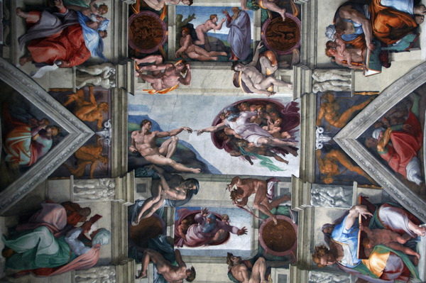
Michelangelo – The Creation of Adam,
from the Sistine Chapel Ceiling (1512)

Slide 8
The Canon:
‘The canon is emblematic not merely of authority but of the authoritative weight of the past. Infused by tradition, the canon often shapes norms and so becomes the vehicle for shared culture. In its more prominent manifestations, the canon does merely inspire culture. Rather, it comes to command where attention is directed.’
Anita Silvers, ‘The Canon in Aesthetics’ in Oxford Art Online (2013)
‘The humanist, then, rejects authority, but he respects tradition. Not only does he respect it, he looks upon it as something real and objective which has to be studied and, if necessary, reinstated: nos vetera instauramus, nova non prodimus [we conserve the old, we do not bring forth the new] as Erasmus puts it.’
Erwin Panofsky, ‘The History of Art as a Humanistic Discipline’ in Eric Fernie, ed, Art History and its Methods (London, 1995) 85.

Slide 9
‘Canon formation is concerned with the formation and confirmation of individual and group identity. The individual finds her- or himself addressed and represented in the canon. Its function is to give orientation, which can only be achieved if the reference system is relatively stable.’
Hubert Locher, ‘The Idea of the Canon’ in M. Rampley et al, eds,
Art History and Visual Studies in Europe (Leiden, 2012) p. 33.
‘A canon constitutes a nexus between the identity of the ego and collective identity. It represents the society as a whole and at the same time a system of values and interpretations, to which the single person avows and to which he or she builds his or her identity as a member of the society.’
Jan Assmann, Das kulturelle Gedächtnis (Munich, 2007) p. 127

Slide 10
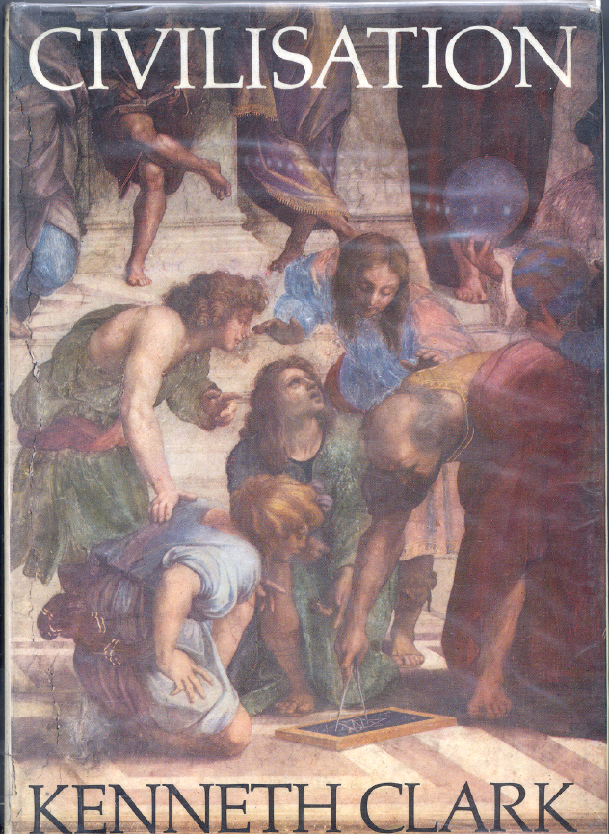
Kenneth Clark Civilisation (London, 1969). This was a hugely popular television series broadcast in 1970.
‘This series has been filled with great works of genius, in architecture, sculpture and painting, in philosophy, poetry and music, in science and engineering. There they are; you can't dismiss them. And they are only a fraction of what western man has achieved in the last thousand years, often after setbacks and deviations at least as destructive as those of our own time. Western civilisation has been a series of rebirths. Surely this should give us confidence in ourselves.’
Civilisation p. 347.

Slide 11
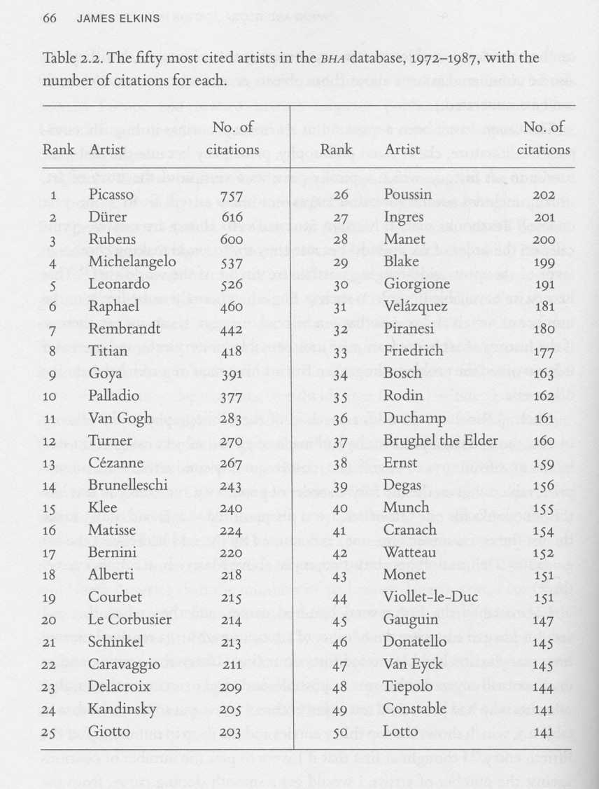
Source: James Elkins, ‘Canon and Globalization in Art History’ in A Brzyski, ed., Partisan Canons (Durham, Duke University Press, 2007) p. 66

Slide 12
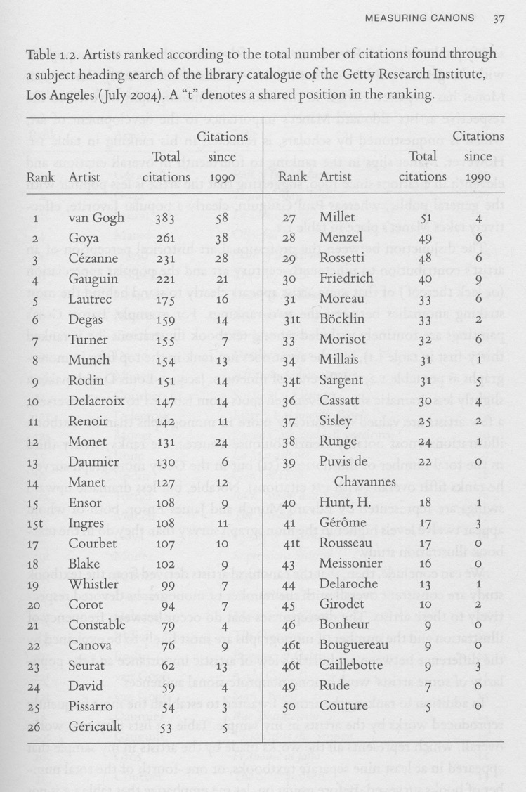
Source: Robert Jensen, ‘Measuring Canons’ in A Brzyski, ed., Partisan Canons (Durham, Duke University Press, 2007) p. 37

Slide 13
Critiquing the canon

Slide 14
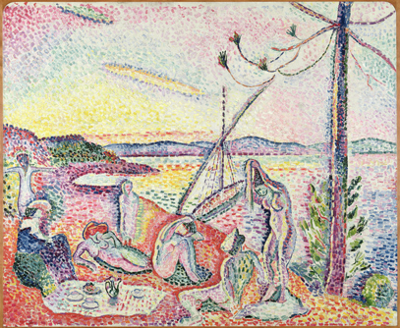
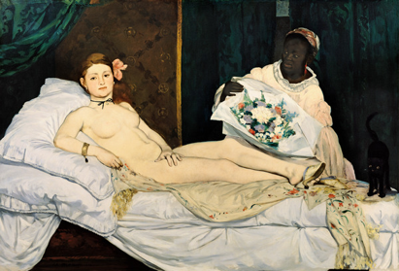
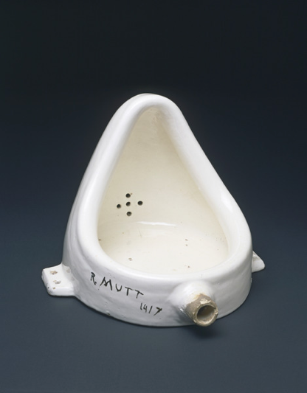
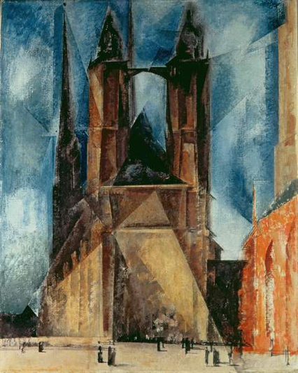
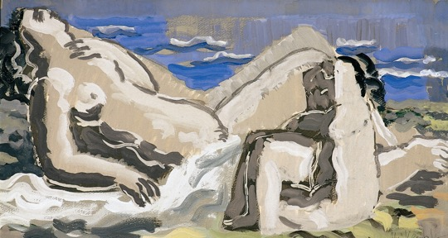
‘Status as a classic is not an either/or matter, but a matter of degree. At any given time, the canon is represented by a series of concentric circles. At the center are texts with the highest degree of canonicity, while at the periphery are those whose classical status is most tenuous. This means that historical changes in the canon are not simply matter of inclusion and exclusion, but also matters of location between the center and the periphery.’
Merold Westphal, ‘The canon as flexible , normative fact,’ The Monist, 76 (1993) p. 436

Slide 15
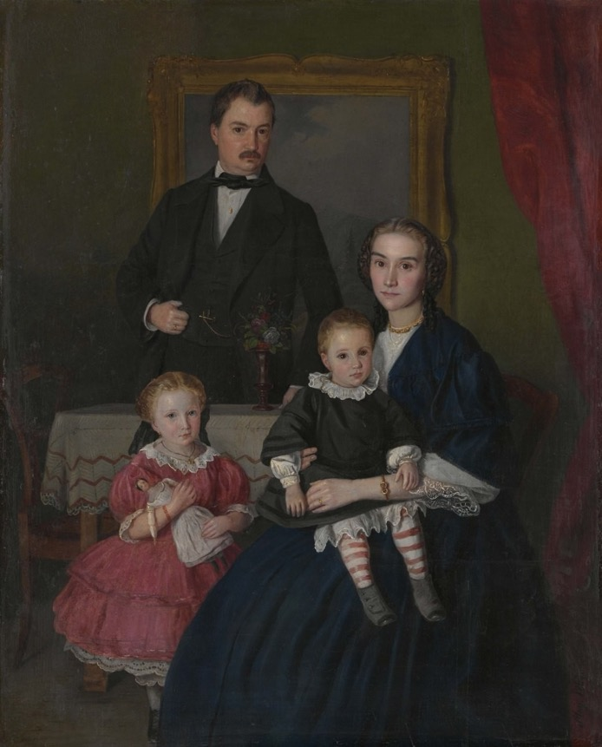
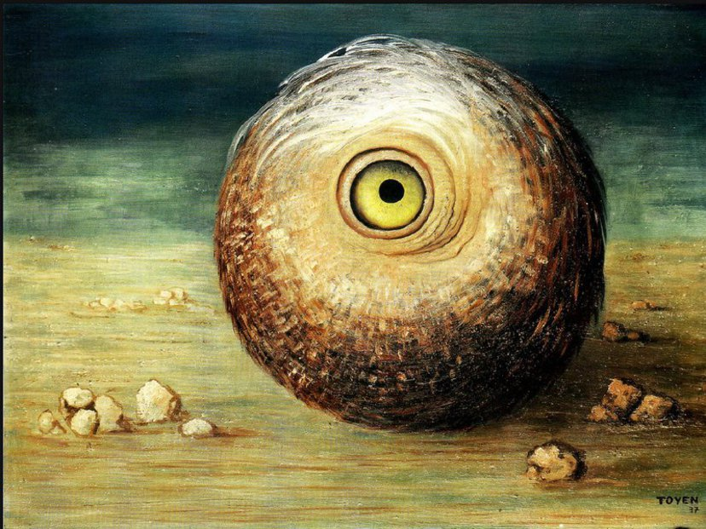
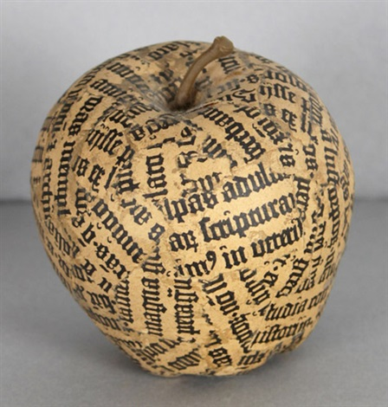
L: Josef Mánes, Family Portrait (1859)
UR: Toyen, Object Phantom (1937)
LR: Jiří Kolář, Apple (1965-70)

Slide 16
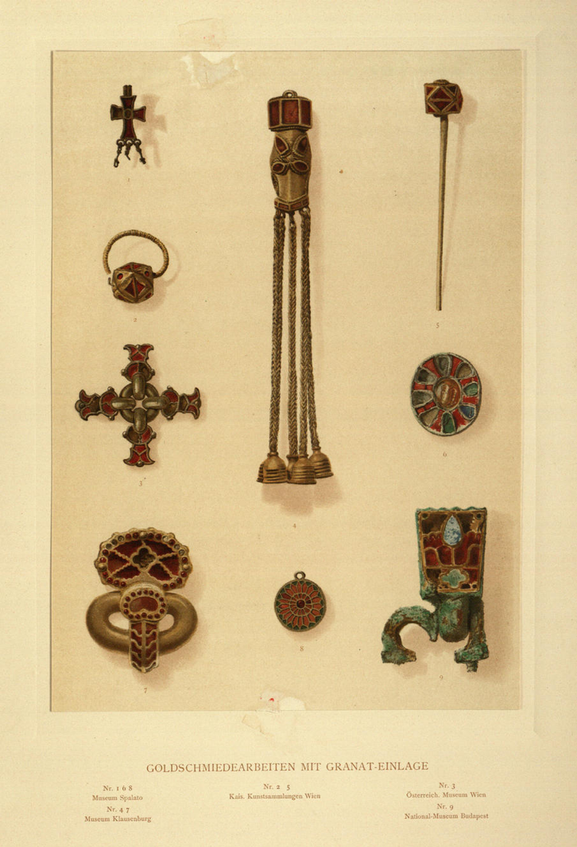
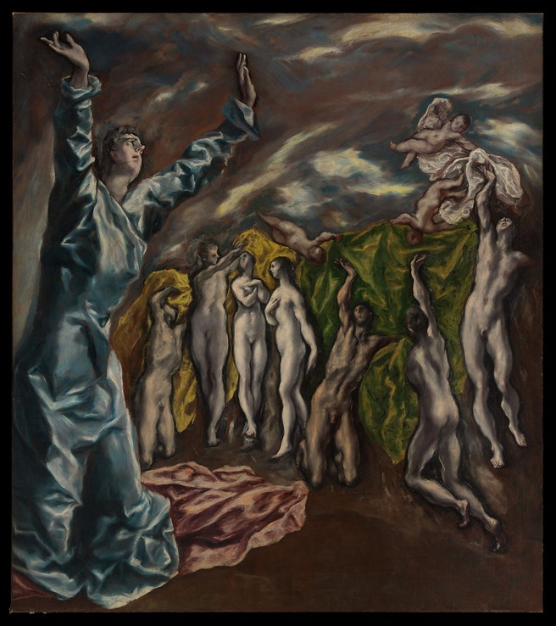
L: Plate of gold jewellery from Alois Riegl, Late Roman Art Industry (1901)
R: El Greco, The Vision of St. John (1608-14). See Max Dvořák, Art History as the History of Spirit (1924)

Slide 17
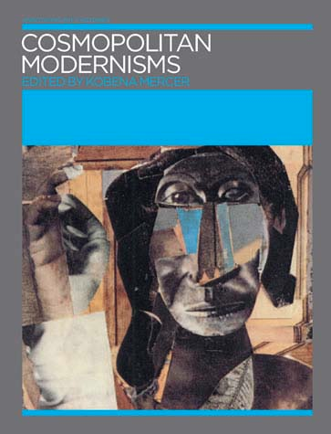
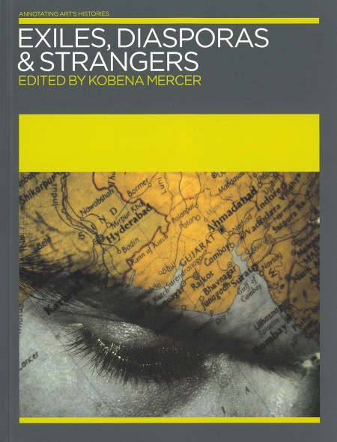
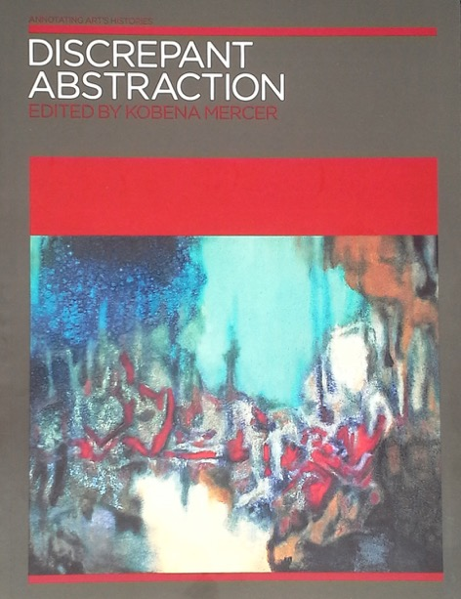
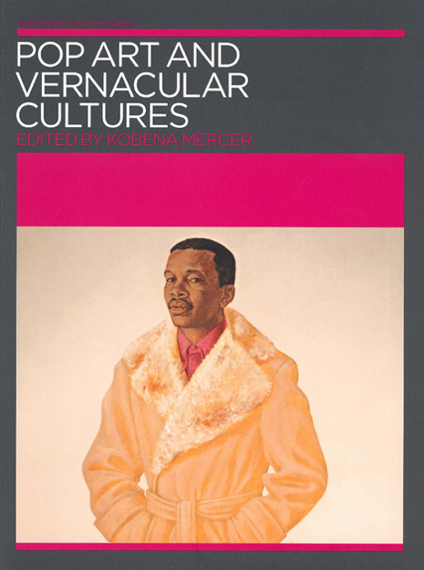
Kobena Mercer, Annotating Art’s Histories (2005-2008)

Slide 18
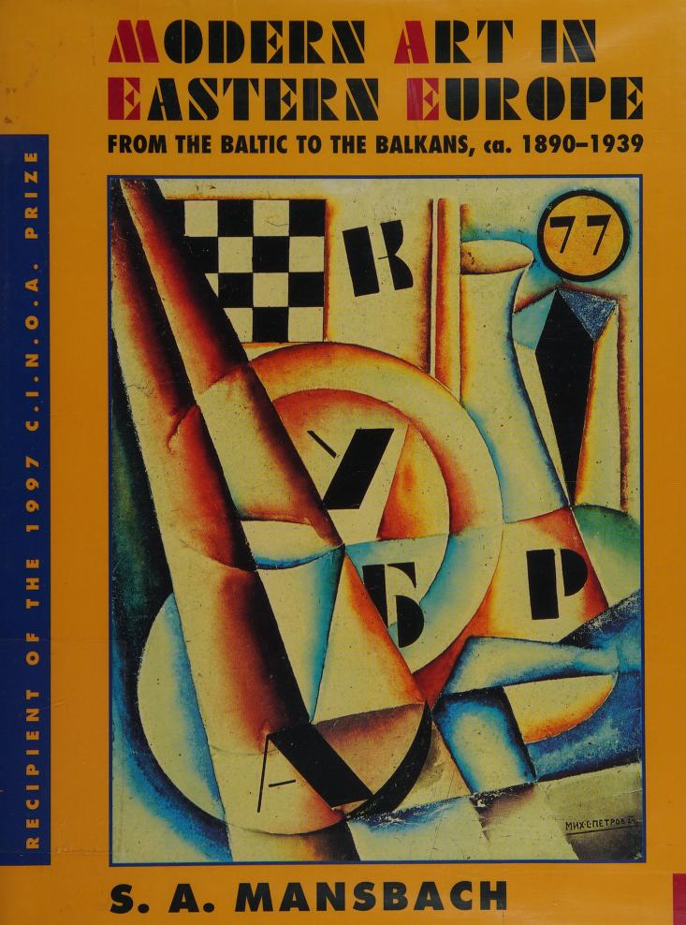
Steven Mansbach, Modern Art in Eastern Europe (Cambridge, 1999)

Slide 19
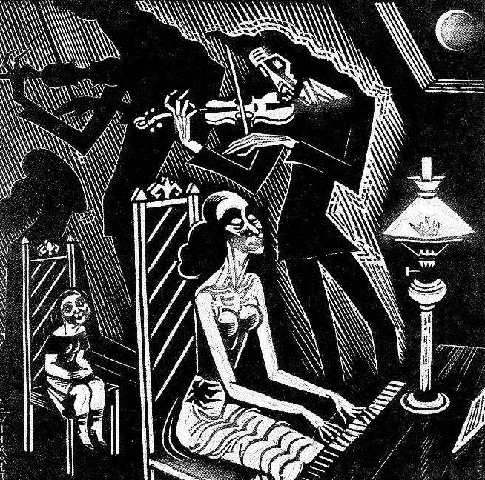
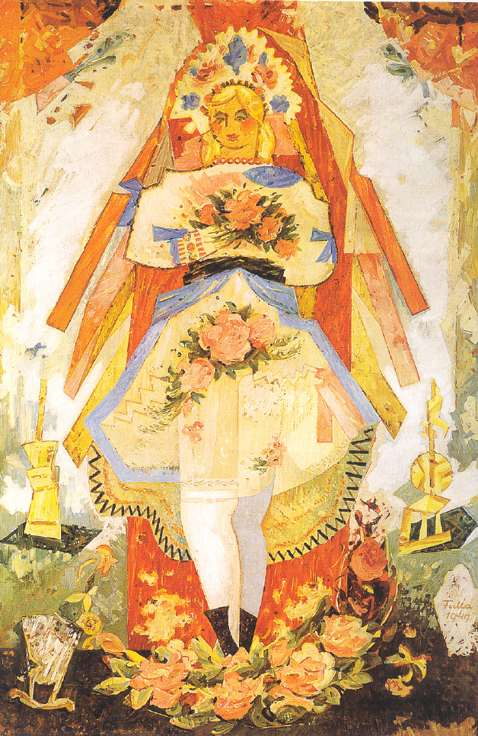
L: Eduard Wiiralt, Music (1925)
R: Ludovít Fulla, Slovak Bride (1949)

Slide 20
‘The history and sociology of art have completely fulfilled their purely empirical task when they have made plain the material, technical, social and psychological conditions of the new style. In so doing they do not “evaluate” the Gothic style in relation, say, to the Romanesque or Renaissance style … Rather, the interest of the works of art and their aesthetically relevant individual properties … is something given from outside… it is given by the aesthetic value of the work of art, which cannot be established by the empirical disciplines.’
Max Weber, ‘The Meaning of Ethical Neutrality in Sociology and Economics’ (1917) in Weber The Methodology of Social Sciences (Atlantic Highlands, 2011) 30

Slide 21
The Fact / Value Dichotomy
‘An empirical science cannot tell anyone what he should do - but rather what he can do — and under certain circumstances — what he wishes to do. It is true that in our sciences, personal value-judgments have tended to influence scientific arguments without being explicitly admitted.
[ … ]
... we regard as objectively valuable those innermost elements of the "personality," those highest and most ultimate value-judgments which determine our conduct and give meaning and significance, to our life … Only on the assumption of
belief in the validity of values is the attempt to espouse value-judgments
meaningful. However, to judge the validity of such values is a matter of faith.’
Max Weber, ‘ “Objectivity in Social Science”.’ pp. 54-55.

Slide 22
Hence:
If canonization is based on a faith in the validity of certain values, what are those values?
Two examples:
‘texts are classics because we find in them an inexhaustible (or at least not yet exhausted) source of meaning. They speak to us, they address claims to us, they put us in question.’
(Westphal, ‘The canon as flexible, normative, fact,’ p. 439)
‘The enigma of Shakespeare is his universalism: Kurosawa’s film versions of Macbeth and King Lear are thoroughly Kurosawa and thoroughly Shakespeare … The miracle of Shakespeare’s universalism is that … the great characters and plays accept being embedded in history and in society while refusing every mode of reduction.’
(Bloom, The Western Canon, p. 524)

Slide 23
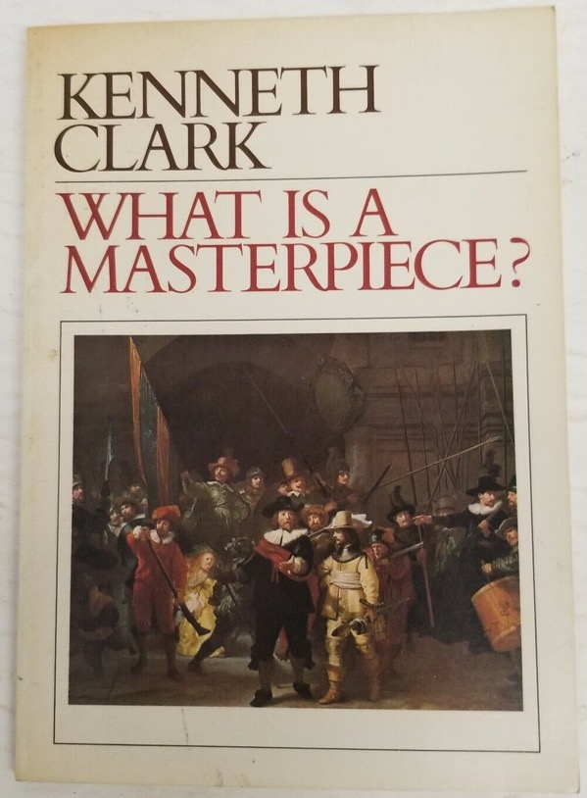
However:
Are these values valid? Where does the belief in the value of inexhaustible meaning come from? How is it justified?
When Bloom et al. talk about universal values as the grounds of the canon, who are they speaking for? Do Shakespeare / Michelangelo etc speak universal values?
‘Although many meanings cluster around the word masterpiece it is above all the work of an artist of genius who has been absorbed by the spirit of the time in a way that his made his individual experiences universal.’
Kenneth Clark, ‘What is a Masterpiece?’ Portfolio (1980) p. 53

Slide 24
And:
What about the value placed on originality, for example?
And can a canon reflect the values of ‘society as a whole’ (Assmann)?
And if canons aid ‘the formation and confirmation of individual and group identity’ (Locher) are groups / cultures / societies comprised of single, coherent sets of values? What happens in modern societies with different groups with opposing values?

Slide 25
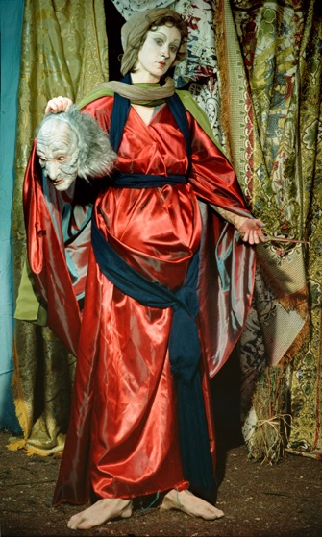
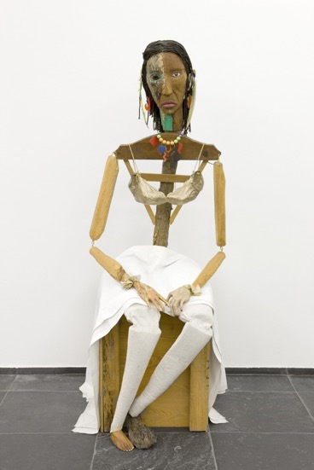
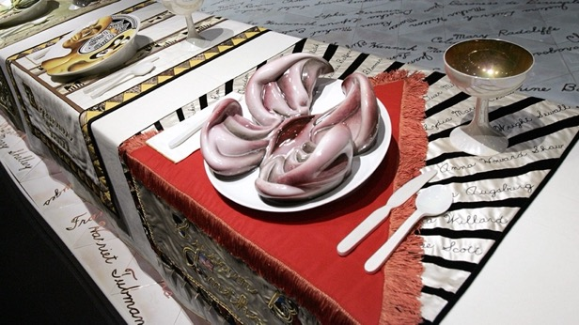
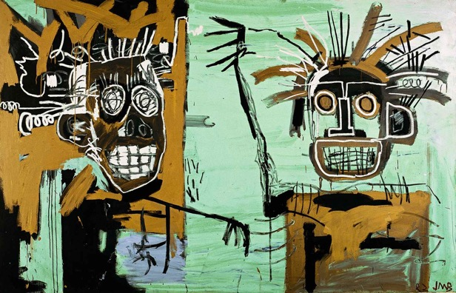
Perhaps it is no accident that it was in the USA that the idea of the canon was first challenged …..
Clockwise from left:
Cindy Sherman, Jimmie Durham, Robert Judy Chicago, Jean-Michel Basquiat

Slide 26
Pollock, Differencing the Canon (London, 1999) pp. 12 and 13

Slide 27
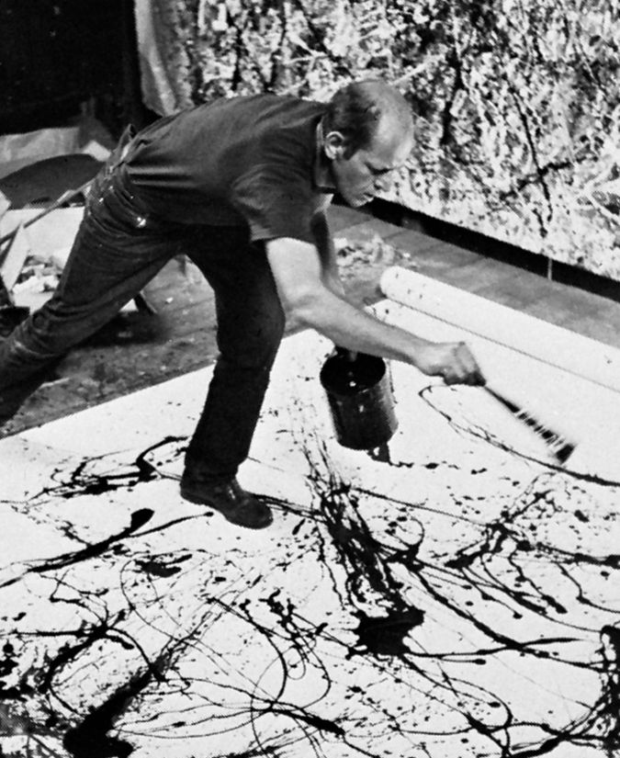
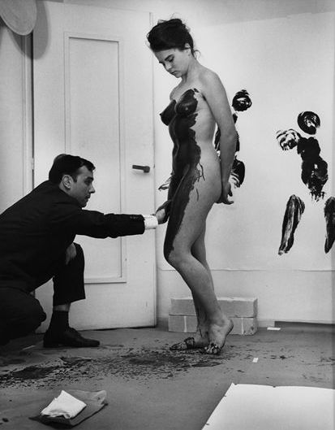
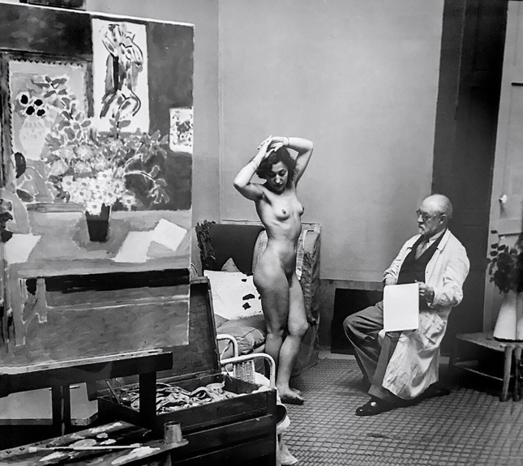

Slide 28
The logic of the canon

Slide 29
So, if the character of the canon is to be criticized because:
…. it is not as universal as its proponents believe
… is it based on a set of values that are a matter of fait
… its values involve exclusions ....
Is the solution merely to expand it to be less exclusive / more inclusive ?

Slide 30
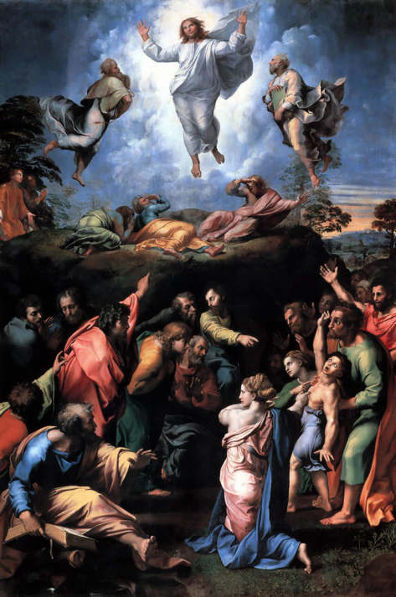
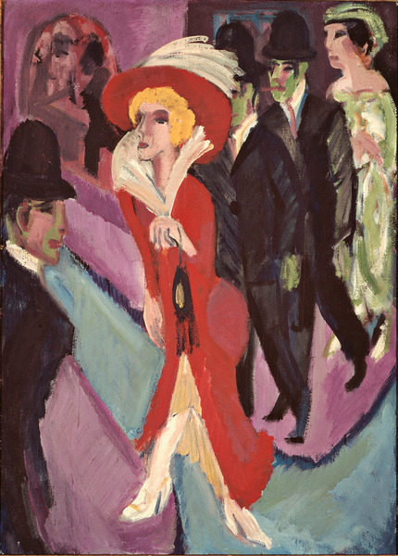
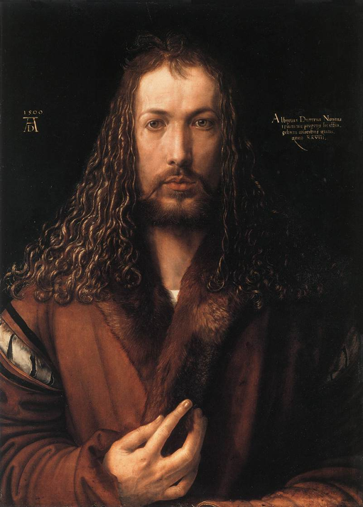
Raphael
Transfiguration (1516-20)
Ernst Ludwig Kirchner
Berlin Street Scene (1914)
Albrecht Dürer,
Self Portrait (1500)

Slide 31
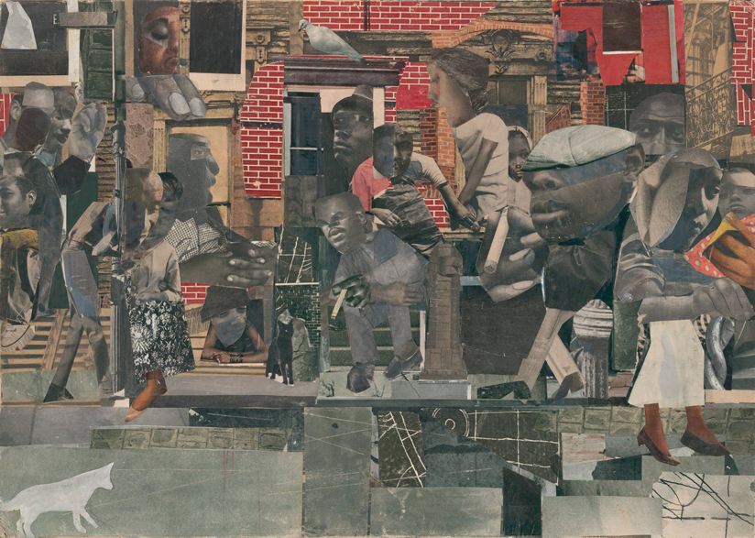
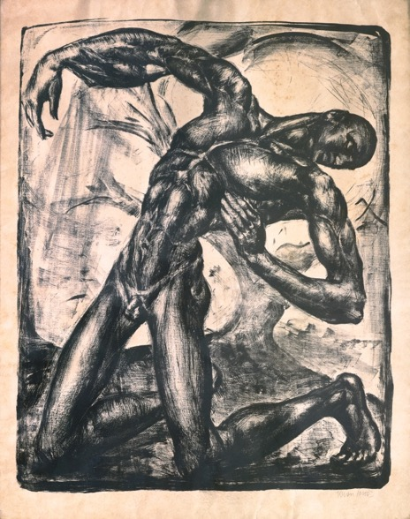
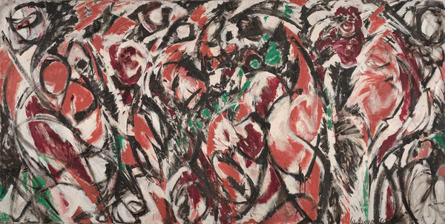
L: Romare Bearden, The Dove (1964)
UR: Jenő Krón, The Wounded (1919-20)
LR: Lee Krasner – Celebration (1960)

Slide 32
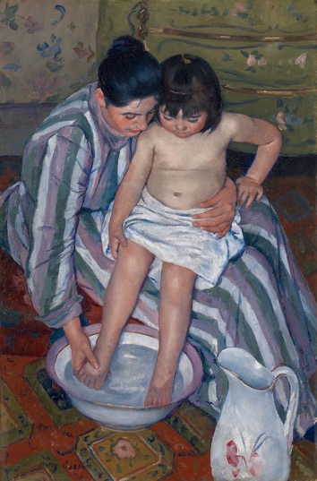
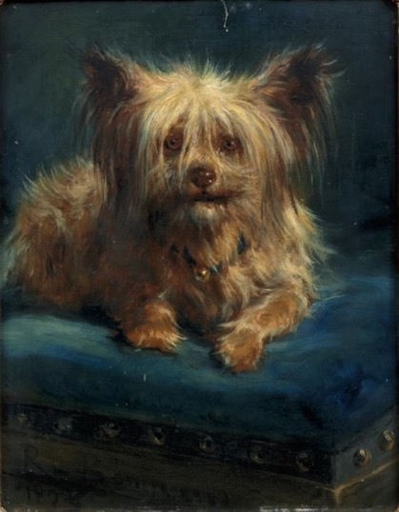
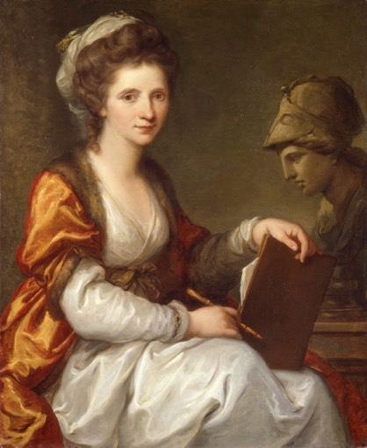
Answer …. Not necessarily, if we take Griselda Pollock’s criticisms seriously
Pollock, Differencing the Canon (London, 1999) p. 9

Slide 33
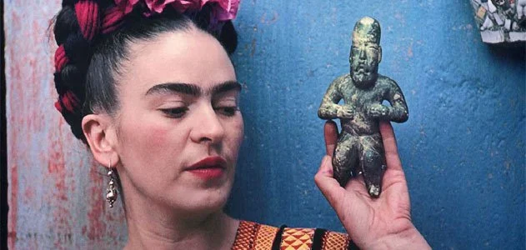
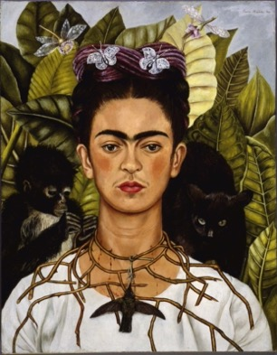
Pollock, Differencing the Canon (London, 1999) p. 14

Slide 34
But what happened if we abolished the canon I ?
Is the proposal: (a) to abolish a particular kind of canon based on mythic ideas of the artist or the masterpiece, or (b) to abolish the idea of canonicity (i.e. the idea of certain works having a normative status, or of there being a hierarchy amongst works of art)
Ad (a): this seems to be the most straightforward, but ….
Is it possible to privilege certain artists and artworks above others without being vulnerable to the criticism that they are still mythification?
What would it look like to privilege certain artworks in a non-hierarchical way?
Radical art historians may challenge the canon, but they mostly replace it with another canon of works / artists selected for other reasons

Slide 35
But what happened if we abolished the canon II ?
Ad (b): if we have no norms or frame of reference, if we abolish hierarchy, how do you decide what is worth studying?
Is it possible to study works of art without having an opinion as to whether they are worth studying?
Is a value-free history of art possible?

Slide 36
But what happened if we abolished the canon III ?
If we have no norms or shared frame of reference, what stops the selection of artworks being arbitrary and random?
If the canon serves to shape a shared frame of reference or ‘cultural literacy’ (Assmann) on what basis can debates take place if there is no common knowledge ?
So can the idea of the canon be defended - even if not Bloom’s vision of the canon?

